Slide 1
FUTURE DIRECTIONS FOR EDUCAUSE RESEARCH
Susan Grajek, PhD | October 19, 2011
EDUCAUSE Vice President of Data, Research, and Analytics

Slide 2
What will you need next?
The increasing need for rigorous data and knowledge:
Maturation of IT management
Accountability demands from leadership
Government regulations
End users are more sophisticated… about IT and about data

Slide 3
What do you need research to do for you?
Analytics is upon us
Understand and manage costs and outcomes
Make sense of complexity and make decisions based on the new understanding that emerges
Applying analytics is a differentiator
Analytics makes demands on data:
The right data
Standardized across all environments

Slide 4
Evolving to increase value
Consolidate and organize EDUCAUSE data and research activities:
Research focus and agenda
Data gathering
Research methodology
Research products
Research volume and sources

Slide 5
RESEARCH FOCUS AND AGENDA
from
to
Descriptive and exploratory
Objectives-based and actionable
Transparent and responsive agenda

Slide 6
ECAR RESEARCH AGENDA 2011-12
Undergraduate students’ use of technology
Mobile IT
Cross institutional collaborations and shared services
Analytics readiness and needs assessment
Service catalogs
Benchmarking user satisfaction
Research computing: Key performance indicators and maturity index

Slide 7
Ecar research agenda 2011-12
Benchmarking and Analytics Research
Research Projects
Alignment KPIs and success factors
Client satisfaction benchmarks
Information Technology service management
Align
Core activities
Plan
3. Service catalog frameworks
Manage
4. Service-based cost frameworks
KPIs and maturity indices for:
5. IT Support
6. Research computing
Operate

Slide 8
A Data ARCHIPELAGO

Slide 9
DATA GATHERING
from
to
Long, time-consuming surveys
A data archipelago
Shorter, more focused surveys
Integration of data sources

Slide 10
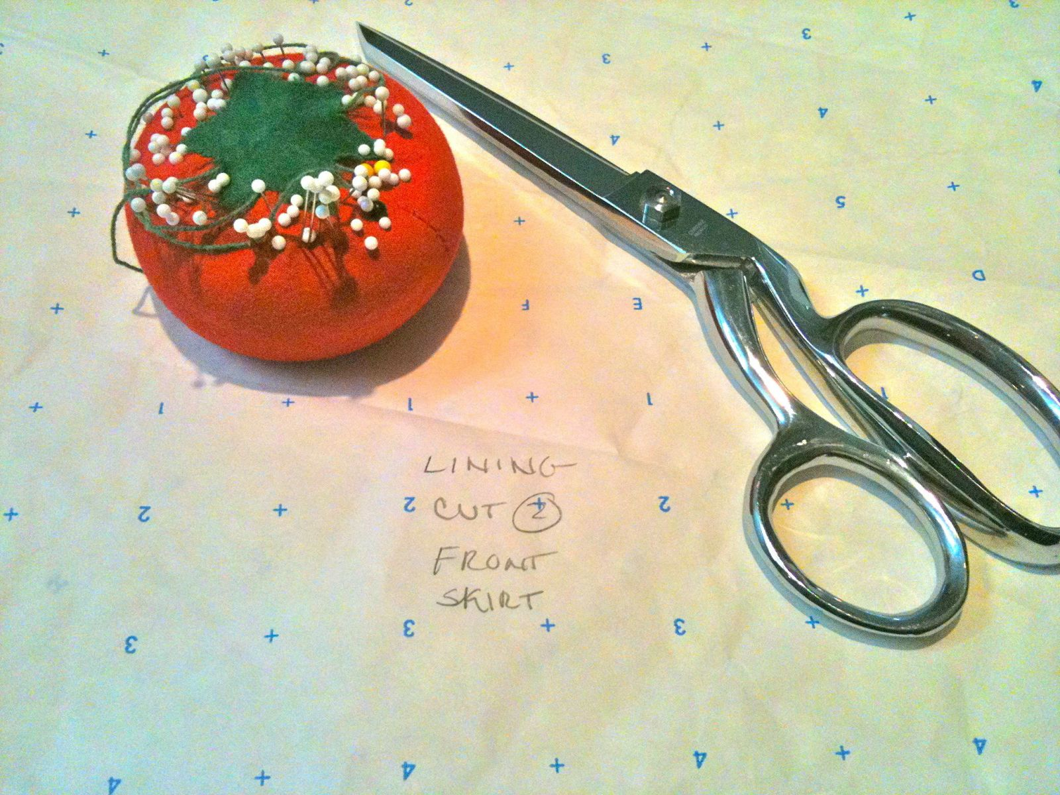
A Data ARCHIPELAGO
Achieving the right fit
with our research methodology

Slide 11
RESEARCH METHODOLOGY
from
to
Consistent method applied to all issues
Opportunistic sampling
Method is tailored to the issue
Random, stratified panels

Slide 12
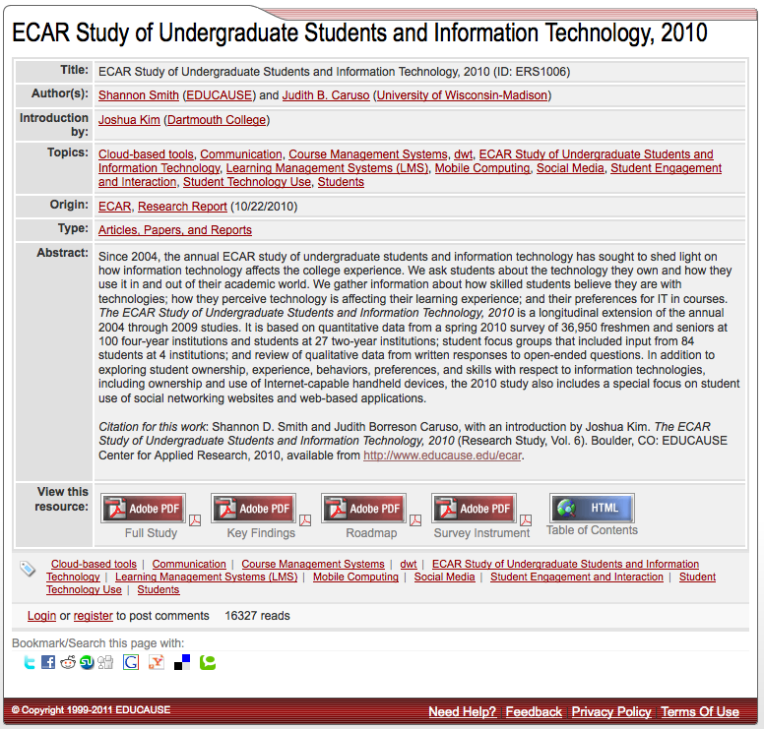
MAKING THE MOST OF YOUR TIME

Slide 13
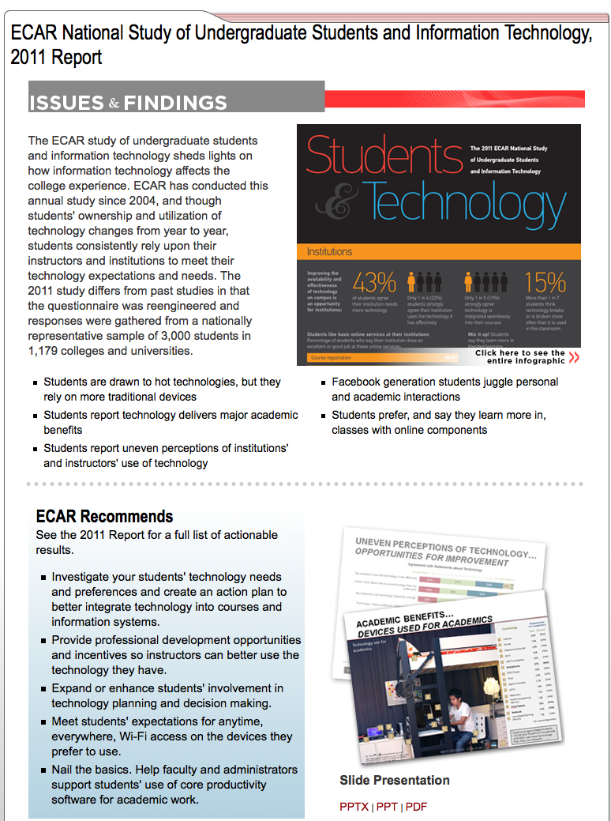
MAKING THE MOST OF YOUR TIME

Slide 14
RESEARCH PRODUCTS
from
to
Dissertation model
Long report, summary report, case studies
Plan-to-publish: 1-1 ½ years
HBR model
Research hub
Plan-to-publish: 4-6 months

Slide 15
RESEARCH VOLUME
from
to
Four original studies
Member-submitted Research Bulletins
Four Burton studies
Six original studies (and growing)
Core Data “Observation of the Month”
Member-submitted Research Bulletins
Gartner research

Slide 16
Integrating data and research and adding analytics

Slide 17
Data
Improving our data
Evaluate CDS data
Integrate with ECAR
Shorter
Benchmarks you need to plan and manage IT: KPIs, maturity indices, costs
Standard definitions
Baseline definition that can be extended
benchmarking data

Slide 18
Data
Improving our data
Evaluate CDS data
Integrate with ECAR
Shorter
Benchmarks you need to plan and manage IT: KPIs, maturity indices, costs
Standard definitions
Baseline definition that can be extended
research and benchmarking data
Add additional data
Data from ECAR studies
More IPEDS
Additional sources (CUPA-HR, etc)

Slide 19
Research
Research contributes to data
Integrate research data with CDS data
Data from ECAR studies
Timely topics data from just-in-time research suggested by new IT Issues panel
Add the “Top 10” survey questions from this year’s ECAR research to next year’s CDS
research and benchmarking data
research
Data contributes to research
Mine existing data to
Answer timely questions
Seed and shorten new research studies

Slide 20
Analytics: We will build the capability in coming years
Analytics mines data
Analytics explores interrelationships among various data sources and slices
An analytics interface faciliates data queries and explorations, provides dashboards and reporting templates
analytics
research and benchmarking data
research
Analytics interacts with Research
Research generates data
Analytics is a form of research

Slide 21
Professional development
Professional development
Collecting and using metrics
Focus on your data and your organization
How to start a metrics program
How to manage with metrics
analytics
research and benchmarking data
research
How to use benchmarks
Focus on comparing your organization with others
How to pick peers
How to make your case

Slide 22
THANK YOU
“Not everything that can be counted counts, and not everything that counts can be counted.” Albert Einstein

