Slide 1
Malcolm Brown Veronica Diaz ….. EDUCAUSE Learning Initiative ….. October 19, 2011

Slide 2
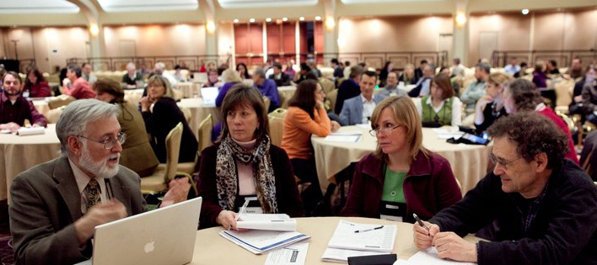
+ ELI

Slide 3
Membership: up 21% since 8/2009
AM proposals: up 70% since 2010 AM
The Community
Type | Percentage
AA | 5%
BA | 13%
DR | 39%
MA | 23%
Professional | 3%
System Offices | 3%
International | 7%
Corp & Others | 4%

Slide 4
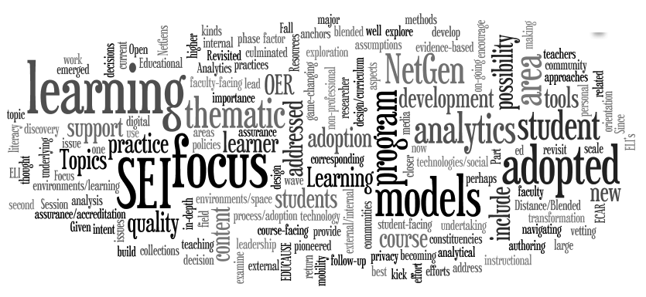
Content anchors
Major directions
Major Themes

Slide 5
Major directions
Learners
ELI
triad
Learning
technology
Learning
principles

Slide 6
Focus Session (April 2012)
Major directions
White
papers
Learning
Analytics
OL
seminars
Webinars

Slide 7
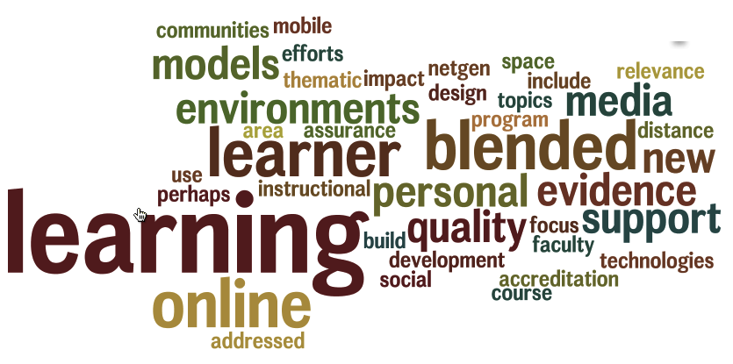
Online and blended
learning environments
Major directions

Slide 8
Austin, TX
Face to Face and Online
February 13-15, 2012
www.educause.edu/ELI2012

Slide 9
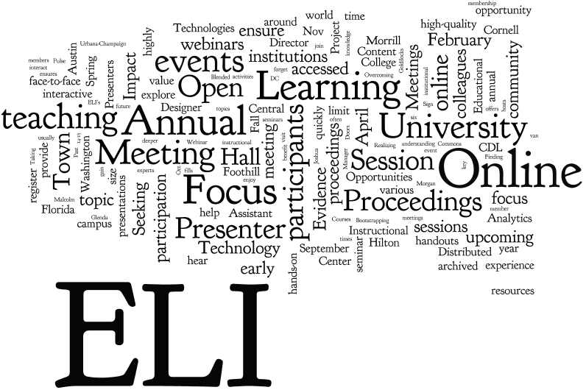
Annual Meeting
Focus Session
Webinars
Online Seminars
……………
http://www.educause.edu/eli/events

Slide 10
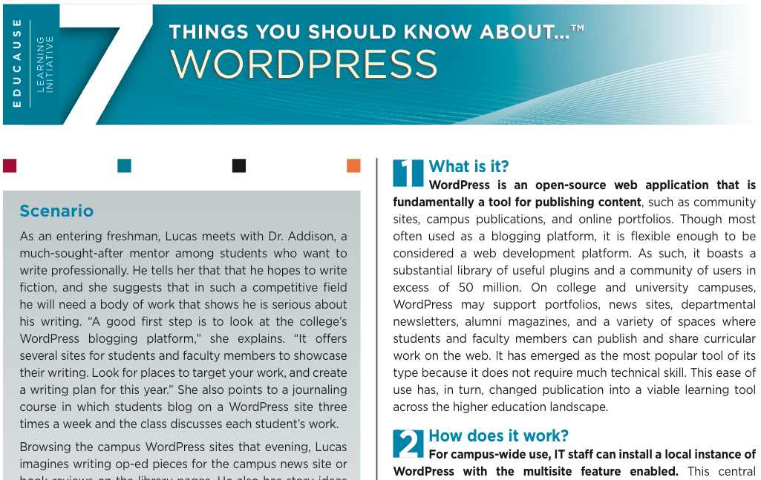
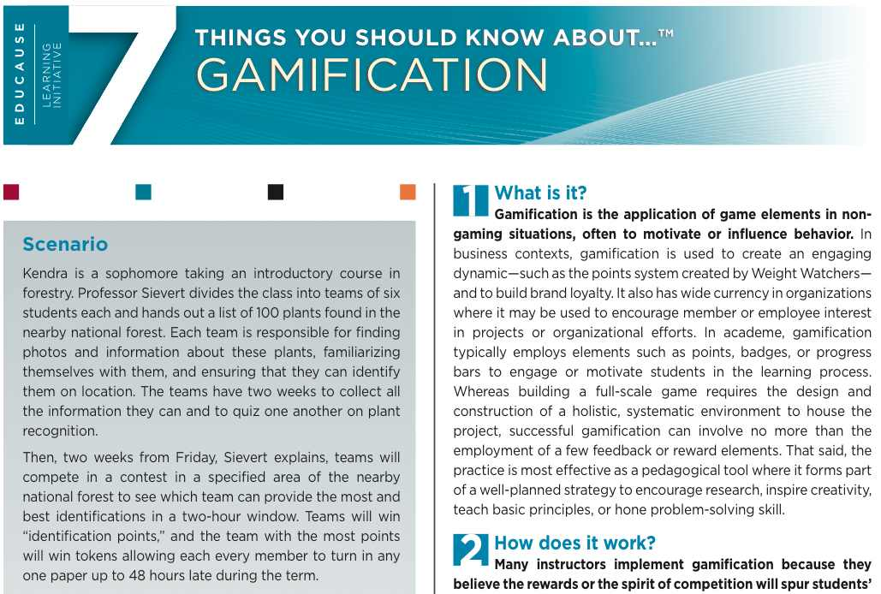
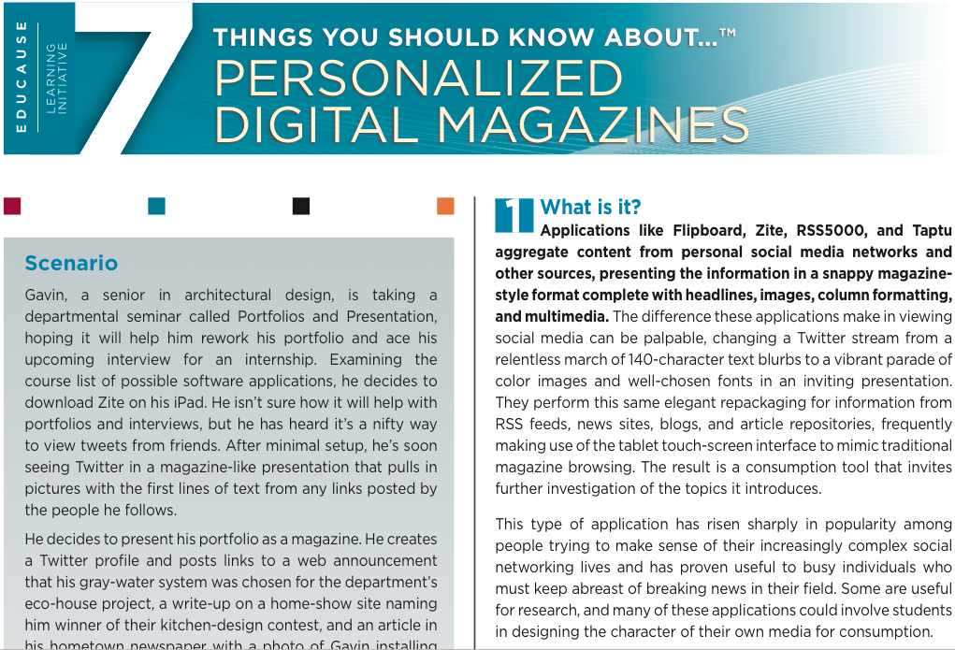
ELI’s 7 Things You Should Know About… http://www.educause.edu/7Things
Learning technology briefs offering quick snapshots of emerging technologies with jargon-free answers to questions like:
What is it?
How does it work?
Where is it going?
Why does it matter to teaching and learning?

Slide 11
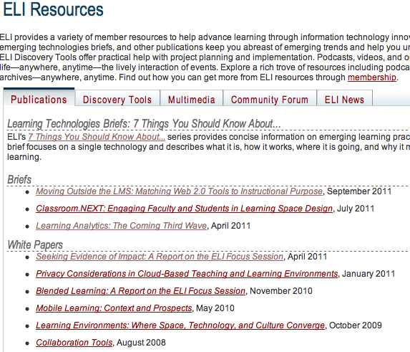
http://www.educause.edu/ELI/Resources

Slide 12
http://www.educause.edu/ELI/Resources

Slide 13
Download at
http://www.educause.edu/eli
ELI 2012 Horizon Report
available at the
ELI Annual Meeting
…
February 2012

Slide 14
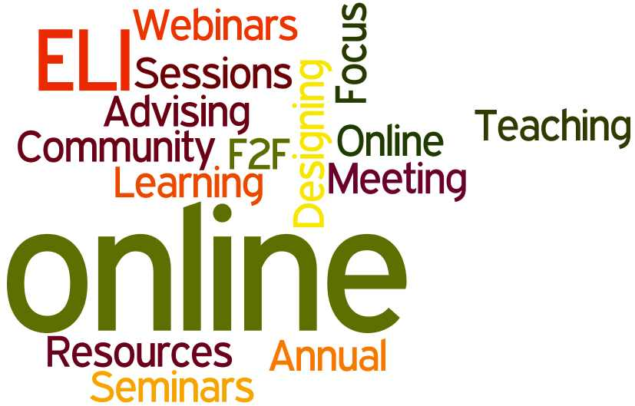

Slide 15
The EDUCAUSE Institute Learning Technology Leadership Program
June 25-29, 2012, Atlanta, Georgia
http://net.educause.edu/TheEDUCAUSEInstituteLearningTechnologyLeadershipProgram/6273
10% off for
ELI members

Slide 16
Tell Us What You Think http://tinyurl.com/comminput

Slide 17
http://www.educause.edu/ELI2012

Slide 18
Leadership Roundtable
…..
http://www.educause.edu/ELI2012

Slide 19
Jan 30
Online Orientation
Feb 13
Opening session
Feb 14
Initiating and leading learning analytics projects
Feb 15
VIP reception
Luncheon
Closing session
ELI Annual Meeting
Leadership Roundtable: Learning Analytics

Slide 20
Join ELI as we Seek Evidence of Impact
Catalyze new collaborations to advance evidence-based applications of learning innovation
Encourage the teaching and learning community to explore new ways of gathering evidence
Inaugurate ongoing dialogues, projects, and collaborations to enable institutions to effectively gather and share evidence of impact

Slide 21
Case study candidate? Contact us!
Malcolm Brown, Director, ELI mbrown@educause.edu
Veronica Diaz, Associate Director, ELI vdiaz@educause.edu

Slide 22
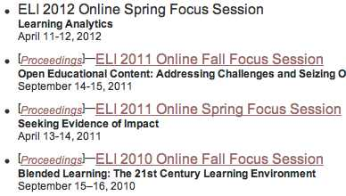
Upcoming Focus Sessions: http://www.educause.edu/eli/events
Previous Focus Sessions: http://www.educause.edu/eli/archive

Slide 23
Focus Session Format
Activities
Topics

Slide 24
What topics would you like to see covered?

Slide 25
Publications
What topics would you like to see covered?
Focus Sessions
Webinars
Online seminars

Slide 26
Open Mike

Slide 27
Questions/Thoughts?
Malcolm Brown, Director, ELI mbrown@educause.edu
Veronica Diaz, Associate Director, ELI vdiaz@educause.edu

