Slide 1
RESOURCES AND NEXT STEPS
Terrill Thompson, University of Washington

Slide 2
Help to Create a Market for Accessible Products
Ask vendors specific questions about accessibility
Include accessibility requirements in RFPs
Participate in any of several multi-institutional collaborations with vendors to help them understand our accessibility needs http://collaborate.athenpro.org

Slide 3
Attend “Accessing Higher Ground”
14th annual accessible media, web, and technology conference
Hosted by University of Colorado – Boulder
November 14-18, 2011
http://colorado.edu/ATconference/

Slide 4
Join the IT Accessibility Constituent Group

Slide 5
Help us help the EDUCAUSE community to…
Identify resources and initiatives
Develop best practices on IT accessibility, policy, assistive program and service development
Strategize pathways to approach campus-wide universal access to information available via technology

Slide 6
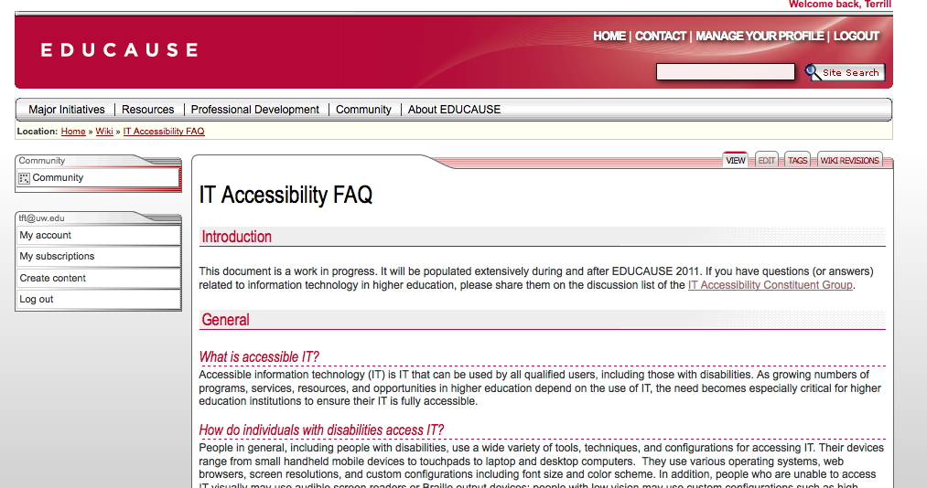
Consult the IT Accessibility FAQ http://bit.ly/itaccessfaq

Slide 7
THANK YOU

