Slide 1
Recognizing Exemplary Leaders in our Community
Meet the 2011 EDUCAUSE Awards Winners
Marilyn A. McMillan | Leadership Award Recipient
Keith W. McIntosh | Rising Star Award Recipient
Shannon D. Smith | Moderator

Slide 2
EDUCAUSE Awards Program www.educause.edu/awards
Guided by the Recognition Committee
Brings peer endorsement and distinction to professional accomplishments in higher education IT
Recognizes exceptional leadership in both individual and institutional accomplishments

Slide 3
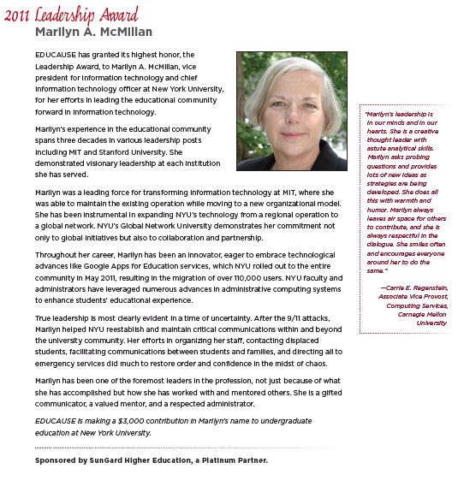
EDUCAUSE Awards Program www.educause.edu/awards
Leadership Award
Marilyn A. McMillan
Highest individual recognition
Recognizes prominent professionals
“Summa Cum Laudes” in our field
Vice President for IT and CIO at New York University
3 decades in various leadership posts including at MIT and Stanford
Leading force for transforming information technology at MIT
Instrumental in expanding NYU’s technology from a regional operation to a global network

Slide 4
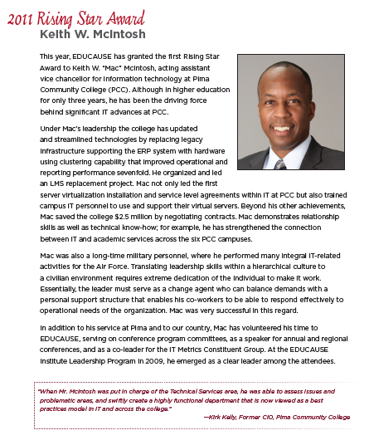
EDUCAUSE Awards Program www.educause.edu/awards
Rising Star Award
Keith W. McIntosh
Earlier in Higher Ed IT career
Demonstrates exceptional leadership and accomplishment
In Higher Ed for only 3 years
Driving force behind significant IT advances at Pima Community College
Planned, organized, and lded an LMS replacement project
Led first server virtualization installation and SLA within PCC IT saving $2.5 million by negotiating contracts
24.5 years in U.S. Air Force

Slide 5
Questions?

Slide 6
THANK YOU

