Slide 1
FUTURE DIRECTIONS FOR EDUCAUSE RESEARCH
Susan Grajek | October 19, 2011
EDUCAUSE Vice President of Data, Research, and Analytics

Slide 2
Evolving to increase value
Consolidate and organize EDUCAUSE data and research activities:
Research focus and agenda
Data gathering
Research methodology
Research products
Research volume and sources

Slide 3
RESEARCH FOCUS AND AGENDA
from
to
Descriptive and exploratory
Objectives-based and actionable
Transparent and responsive agenda

Slide 4
DATA GATHERING
from
to
Long, time-consuming surveys
A data archipelago
Shorter, more focused surveys
Integration of data sources

Slide 5
RESEARCH METHODOLOGY
from
to
Consistent method applied to all issues
Opportunistic sampling
Method is tailored to the issue
Random, stratified panels

Slide 6
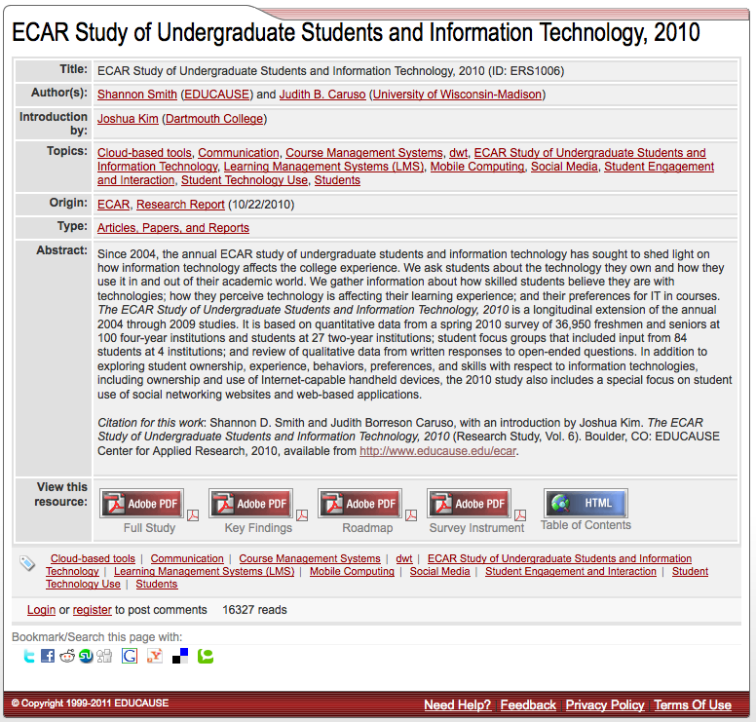
MAKING THE MOST OF YOUR TIME

Slide 7
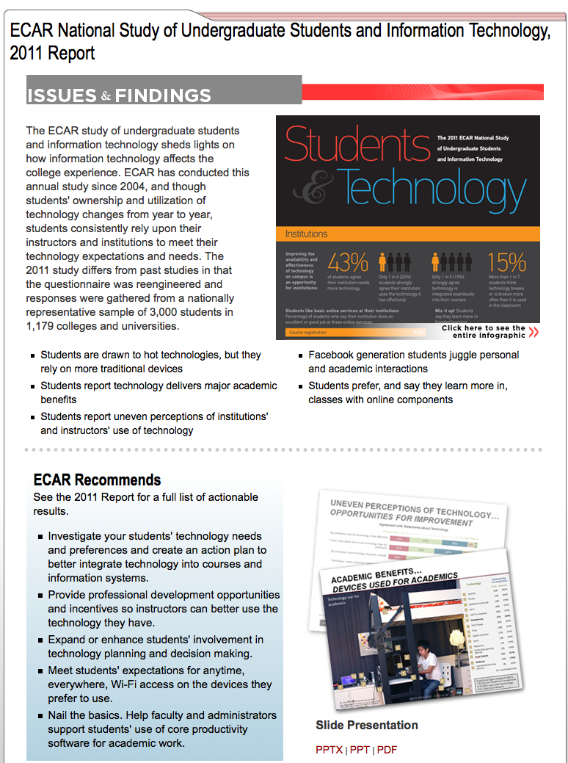
MAKING THE MOST OF YOUR TIME

Slide 8
RESEARCH PRODUCTS
from
to
Dissertation model
Long report, summary report, case studies
Plan-to-publish: 1-1 ½ years
HBR model
Research hub
Plan-to-publish: 4-6 months

Slide 9
RESEARCH VOLUME
from
to
Four original studies
Member-submitted Research Bulletins
Four Burton studies
Six original studies (and growing)
Core Data “Observation of the Month”
Member-submitted Research Bulletins
Gartner research

Slide 10
ECAR RESEARCH AGENDA 2011-12
Undergraduate students’ use of technology
Mobile IT
Cross institutional collaborations and shared services
Analytics readiness and needs assessment
Service catalogs
Benchmarking user satisfaction
Research computing: Key performance indicators and maturity index

Slide 11
Ecar research agenda 2011-12
Benchmarking and Analytics Research
Research Projects
Alignment KPIs and success factors
Client satisfaction benchmarks
Information Technology service management
Align
Core activities
Plan
3. Service catalog frameworks
Manage
4. Service-based cost frameworks
KPIs and maturity indices for:
5. IT Support
6. Research computing
Operate

Slide 12
THANK YOU

