Slide 1
November 8, 2012

Slide 2
The Quest for a Digital Repository
University - Wide Content Management Solution

Slide 3
Quest for a Digital Repository From Concept to Implementation
Patricia Bassett, Ed.D. – Director of Online Learning
Rick Hubbard, M.Ed. – Media Instructional Design Assistant
Jonathan Epps, B.S. – Content Management Administrator

Slide 4
Palm Beach Atlantic University

Slide 5
The Challenge
Increased creation of digital assets for online and blended course delivery
Increased need to centralize university data involving faculty profiles/credentials
Increased demand for reporting faculty accomplishments from a single data base
Change in administrative leadership
Technology Services Infrastructure

Slide 6
The Process
2008 – Task force formed
Analysis and Comparison of Vendors
Presentations by Selected Vendors
Design of Proposal; Budget Creation
Content Administrator Qualifications
Presentation to Cabinet
System Installation

Slide 7
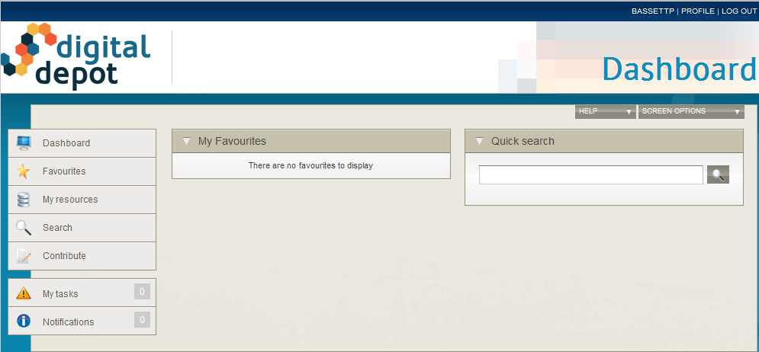
The Solution
PBA’s instance of Equella

Slide 8
Equella as eLearning Support
Benefits for
Learning Management Systems

Slide 9
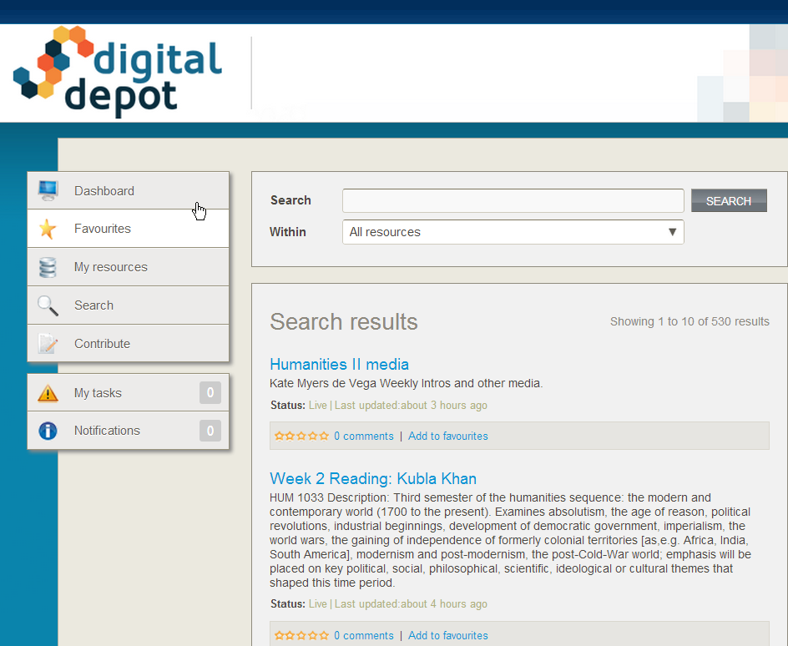
Benefits for LMS
Centralized management
LMS integration
Keyword searches
Learning object delivery
Asset integrity

Slide 10
Benefits for LMS
Centralized management
LMS integration
Keyword searches
Learning object delivery
Asset integrity

Slide 11
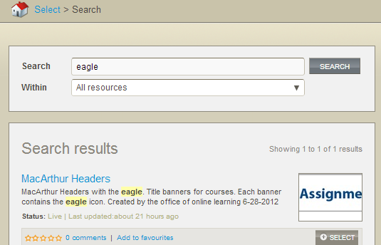
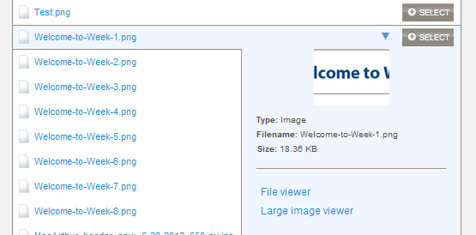
Benefits for LMS
Centralized management
LMS integration
Keyword searches
Learning object delivery
Version control

Slide 12
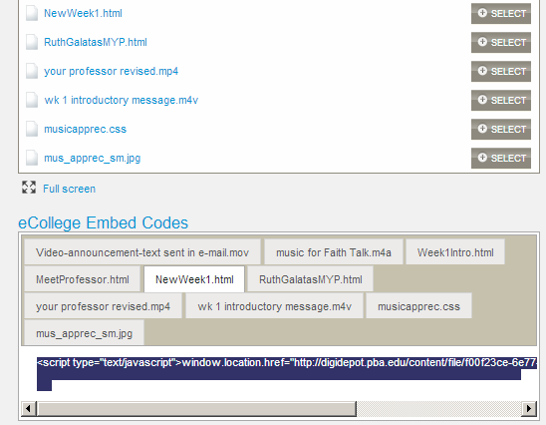
Benefits for LMS
Centralized management
LMS integration
Keyword searches
Learning object delivery
Asset integrity

Slide 13
Benefits for LMS
Centralized management
LMS integration
Keyword searches
Learning object delivery
Asset integrity
Utilize: iframes, href, javascripts, and css to deliver and format Captivate, SoftChalk, Presenter, flash, videos, and podcasts.

Slide 14
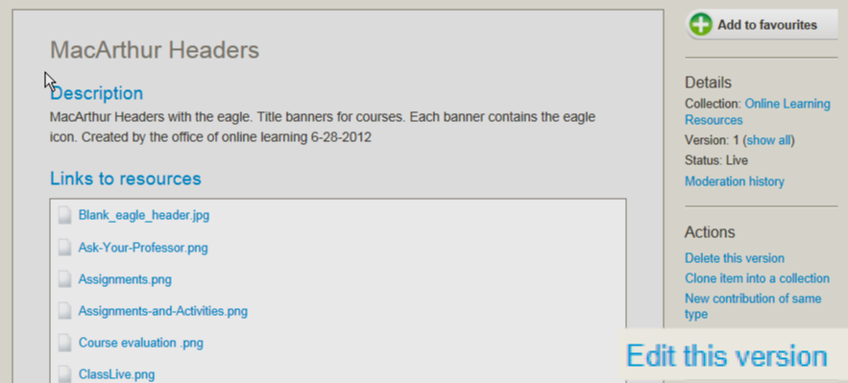
Benefits for LMS
Centralized management
LMS integration
Federated search
Learning object delivery
Asset integrity

Slide 15
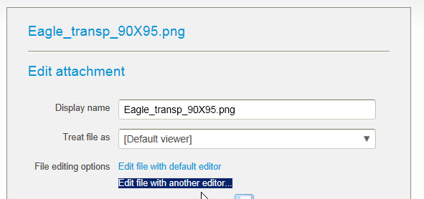
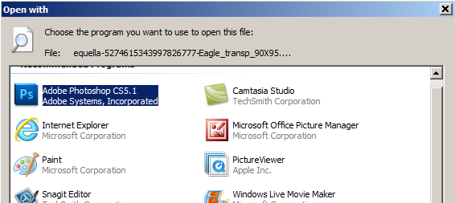
Benefits for LMS
Centralized management
LMS integration
Federated search
Learning object delivery
Asset integrity

Slide 16
The man behind the curtain
EQUELLA from the Perspective of its Administrator

Slide 17
Administrator’s Perspective
Schemas
Collections
Security
Institutions
Other Projects

Slide 18
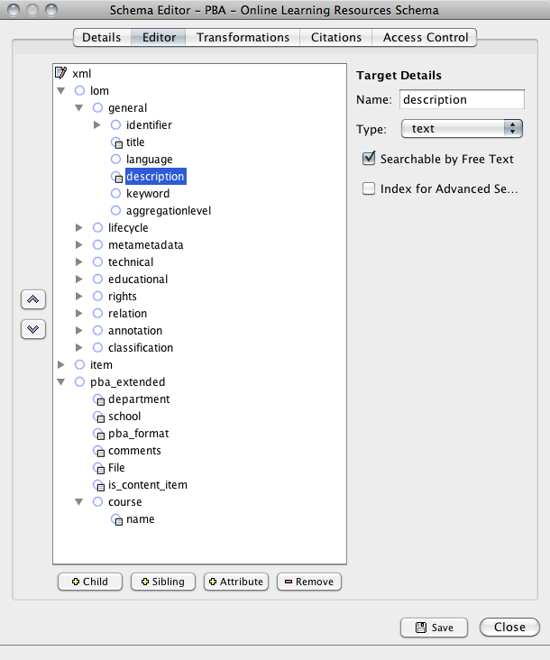
Administrator’s Perspective
Schemas
Collections
Security
Institutions
Other Projects

Slide 19
Administrator’s Perspective
Schemas
Collections
Security
Institutions
Other Projects

Slide 20
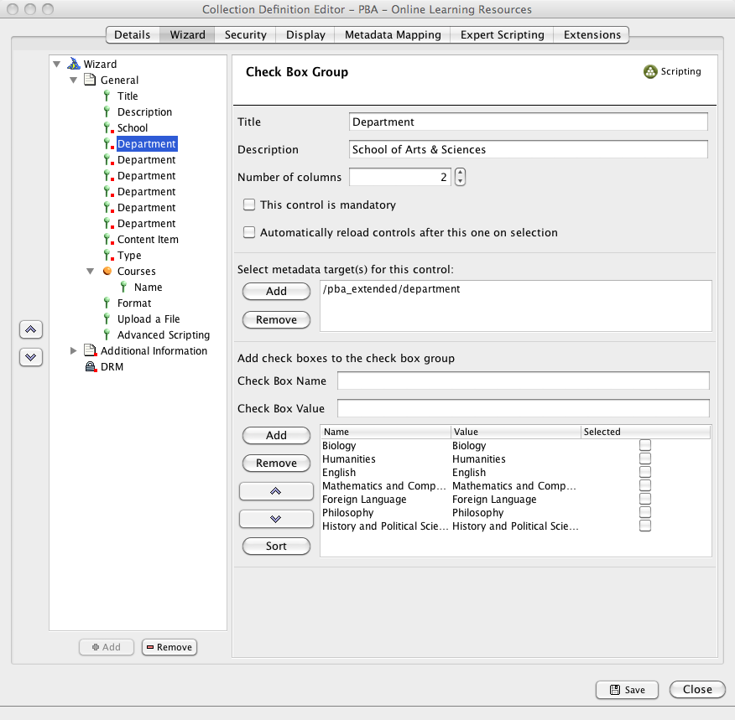
Administrator’s Perspective
Schemas
Collections
Security
Institutions
Other Projects

Slide 21
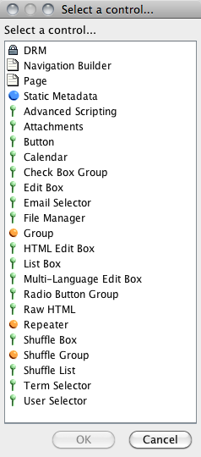
Administrator’s Perspective
Schemas
Collections
Security
Institutions
Other Projects

Slide 22
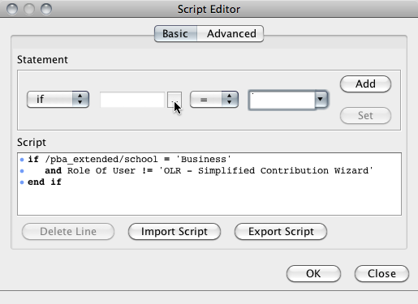
Administrator’s Perspective
Schemas
Collections
Security
Institutions
Other Projects

Slide 23
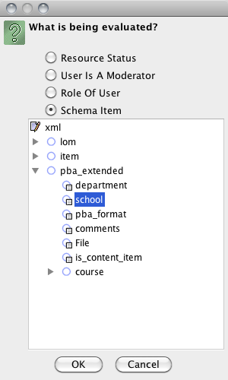
Administrator’s Perspective
Schemas
Collections
Security
Institutions
Other Projects

Slide 24
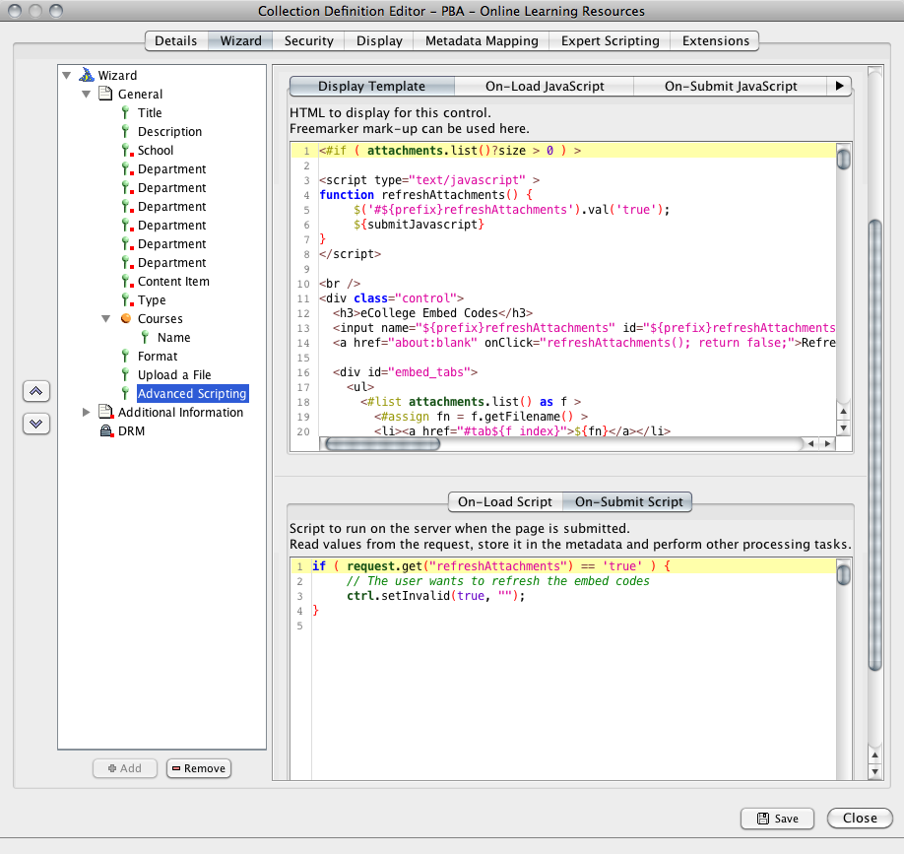
Administrator’s Perspective
Schemas
Collections
Security
Institutions
Other Projects

Slide 25
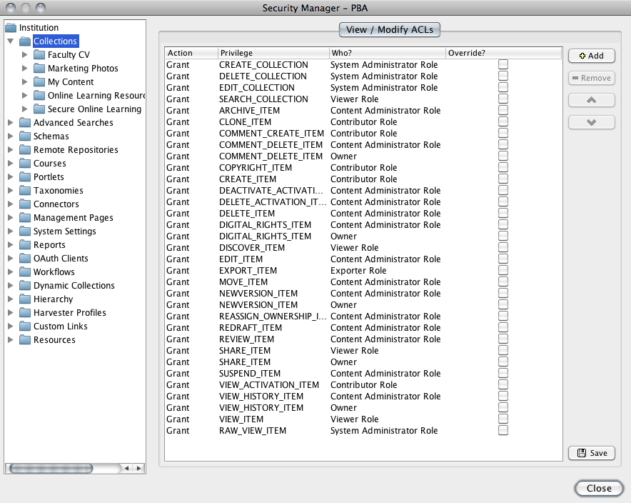
Administrator’s Perspective
Schemas
Collections
Security
Institutions
Other Projects

Slide 26
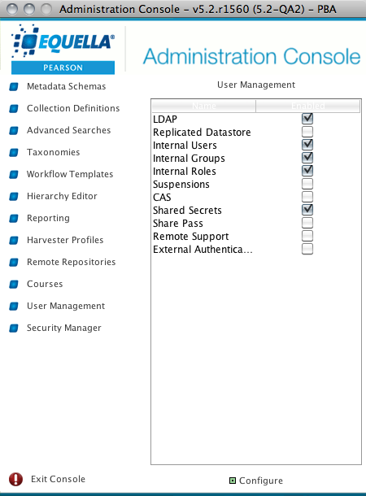
Administrator’s Perspective
Schemas
Collections
Security
Institutions
Other Projects

Slide 27
Administrator’s Perspective
Schemas
Collections
Security
Institutions
Other Projects

Slide 28
Administrator’s Perspective
Schemas
Collections
Security
Institutions
Other Projects

Slide 29
Thank You
The Office of Online Learning

