Slide 1
BYOD
Past, present & future at Pepperdine University
Notes:
BYOD a new acronym for a long time issue

Slide 2
Pepperdine University
Notes:
“Obligatory campus slide,” as Educause speakers like to say.

Slide 3
Background
Undergraduate
4 Graduate Schools
Law
Public Policy
Business
Education & Psychology
Several thousand visitors yearly
Notes:
Educational context with implications for BYOD

Slide 4
Who is bringing devices?
Undergrad students
Grad students
Professional practitioners among faculty
Business, Education and Psychology
Adjunct and Full-time
Visitors
Conferences
Camps
Notes:
Significant populations with large BYOD impact.

Slide 5
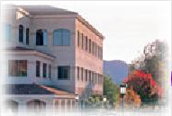
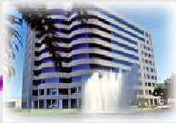
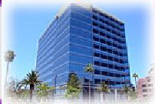
4 Graduate Campuses
Notes:
You think anyone in these office towers is interested in using our WLAN and Internet? They’d like BYOD.

Slide 6
Rough BMOD Timeline
1992 LANs – hobbyist PC
1996 WLANs & Dorm LANs, Student PCs
Brought my PC to the dorm.
1999 first personal PowerBooks and Portables – Classroom LANs
Who is on our networks? Novell>MS transition & Internet vs. LAN users
2000-2003 Wireless revolution in full swing
When we get a firewall, people can war drive behind it!
2007 first iPhones (led by CIO)
2008 WLAN & LAN access control – registration
2009 influx of mobiles, led by students
Notes:
The point is BYOD is not a 2011 or 2012 issue at Pepperdine, nor unless I miss my guess, is it on your campuses!

Slide 7
Current BYOD Goals
Ease of connection
What is our standard in 2012?
Provide appropriate access
What do visitors need?
Guidance
Common Services
Prevent inappropriate access
Limit visitors
Hold campus users accountable for insecurity
Notes:
See our use policy at https://community.pepperdine.edu/it/security/policies – brief and to the point! Each BYOD user must subscribe.

Slide 8
Facilitating BYOD
2003 WLAN access control – session timeout
Pros: Domain Integrated, Guest Access
Cons: reauthentication, in-band, closed
2008 WLAN/LAN access control – registration
Pros:
Out of band, wide network & device support
Enterprise authentication, IP network standards
Settable user and device registration timeout
Configurable user & device roles; remediation
Minable information
Cons: needs agent to tie NICs
Notes:
Systems facilitating BYOD

Slide 9
Agreement!
Brief, readable use policy must be accepted

Slide 10
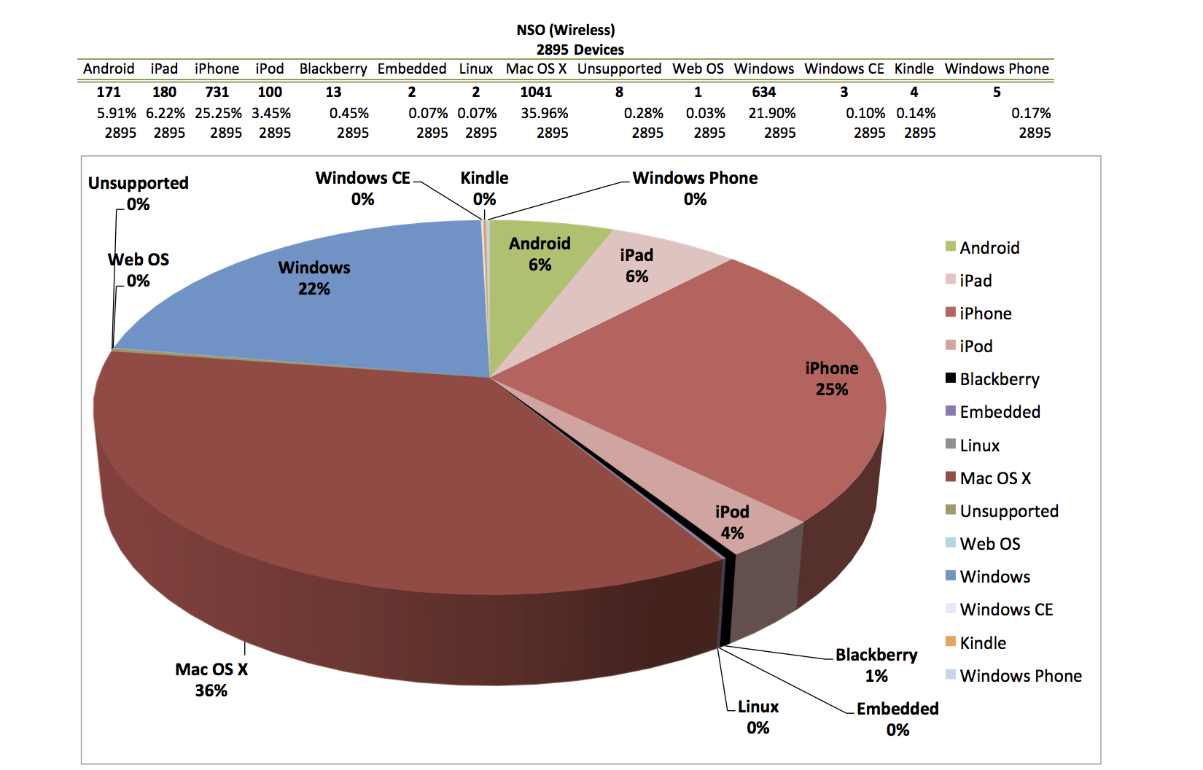
Data!
Notes:
Your system should be able to inform your decision making about IT services.

Slide 11
What’s next?
Device security posture. Who manages it?
Users: need helpers, helpers want monoculture
System: do it for the user, across platforms
Now: WSUS (Apr 2008) for domain connected systems
New Rollout: Device Management Agent
December > March this academic year
University devices only (not BYOD)
Web plug-in patches first
Apple system patches, other
Notes:
Our users are most willing! However, they are have proven to be unable to consistently manage device security and updates. Successes in this area, both in usability and in compliance, have been when a system performs the necessary configurations and updates for the user.

Slide 12
What is our future?
Access based on role > role+security?
Done wrong & you’re done.
Done right, you’re in the last mile.
Now:
Visitor – limited
Student, FacStaff, Guest – full
Maybe:
Visitor – limited
Student, FacStaff, Guest – no LAN, no ActiveSync
Student, FacStaff + managed – full
Notes:
This is speculative and we can’t commit to this til we see the effectiveness of our new management system on University devices, WRT user experiences & compliance.

Slide 13
Questions!
How do you… ?
Why don’t you… ?
Dr. Kim Cary CISO – Pepperdine University kim.cary@pepperdine.edu (310) 506-6655

