Slide 1
WELCOME! 2012 CIO Constituent Group Meeting
Theresa Rowe, Oakland University CIO & CG Leader
November 6, 2012

Slide 2
WELCOME Colleagues Participating Online in our first hybrid meeting!
Thanks to our online facilitator, Robert Renaud, Vice President & CIO, Dickinson College

Slide 3
Watch This Space!
Online meeting space projected in Denver
Chat
Google doc with discussion notes
Online participants will only hear speakers using mics
Online group will have their own discussions

Slide 4
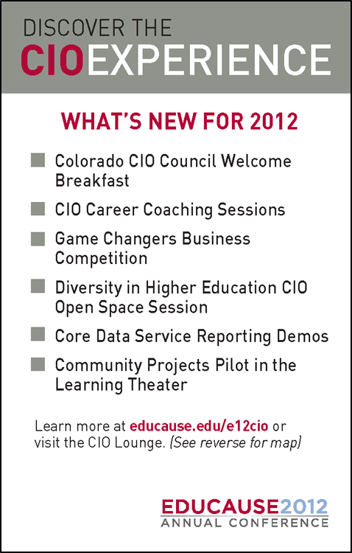
Welcome to the CIO Experience!
Nearly 900 CIOs and senior IT leaders in Denver
New program offerings for 2012 →
educause.edu/e12cio

Slide 5
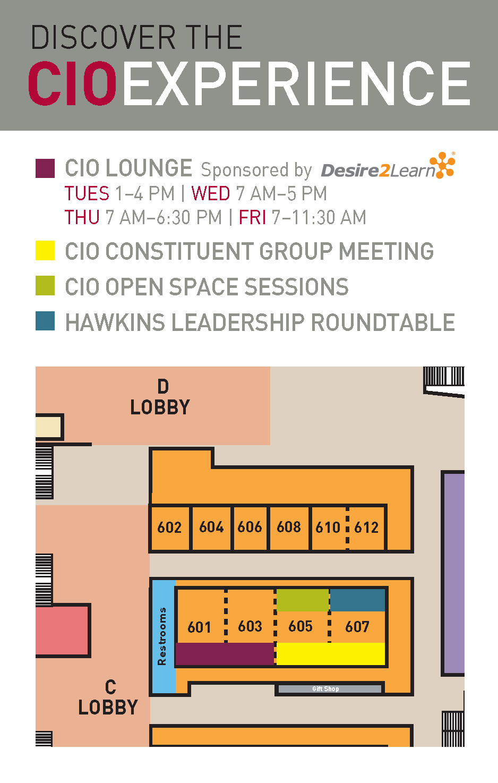
Centrally Located Activities
CIO Lounge
CIO Open Space Sessions
CIO Meetings

Slide 6
What to Know
Daily “CIO-only” e-mails from EDUCAUSE with next day’s program highlights
Still Available:
CIO Coaching Sessions
CIO Open Space Sessions
See EDUCAUSE staff after the meeting to sign up – Lisa Gesner, Ashlan Sarff
Notes:
In person or online for coaching session

Slide 7
Agenda
Core Data Service update, Susan Grajek
Discussion #1
Discussion #2
Wrap-up and takeaways

Slide 8
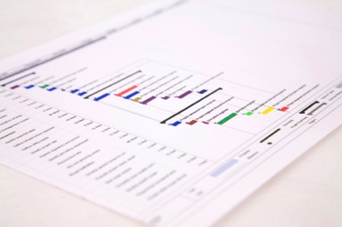
Core Data Service Update
Susan Grajek
Vice President for Data, Research and Analytics
EDUCAUSE

Slide 9
Plan for the Afternoon
Two discussion rotations; topics on tables
Select table, facilitator (if not pre-defined)
Table facilitator will add major take-aways from each session to Google doc
http://tinyurl.com/E12CIOCG

Slide 10
Discussion #1

Slide 11
Discussion #2

Slide 12
Closing Comments

Slide 13
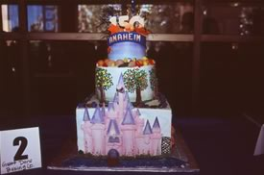
See You Next Year
EDUCAUSE 2013 October 15–18, 2013. Anaheim, California

