Slide 1
Data Administration SIG
Mike Fary
Enterprise Data Architect
University of Chicago
November 8, 2012

Slide 2
Big Data
Data Management Challenges Abound
-or-
We thought we had problems before ...

Slide 3
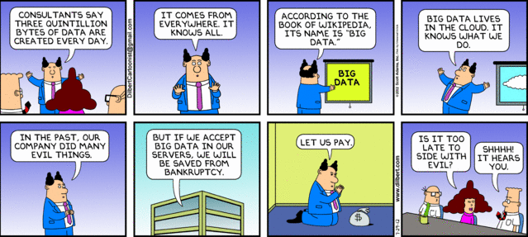

Slide 4
Big Data is not new
Late 19th century
1890 census
US population reached 63 million
How to deal with all that data
Machine readable punched cards, invented by Herman Hollerith

Slide 5
“Big data is really about new uses and new insights, not so much the data itself”
Rod Smith, IBM technical fellow and VP for Emerging Internet Technologies

Slide 6
OBAMA ADMINISTRATION UNVEILS “BIG DATA” INITIATIVE: ANNOUNCES $200 MILLION IN NEW R&D INVESTMENTS March 29, 2012
Aiming to make the most of the fast-growing volume of digital data, the Obama Administration today announced a “Big Data Research and Development Initiative.” By improving our ability to extract knowledge and insights from large and complex collections of digital data, the initiative promises to help solve some the Nation’s most pressing challenges.
To launch the initiative, six Federal departments and agencies today announced more than $200 million in new commitments that, together, promise to greatly improve the tools and techniques needed to access, organize, and glean discoveries from huge volumes of digital data.

Slide 7
To make the most of this opportunity, the White House Office of Science and Technology Policy (OSTP)—in concert with several Federal departments and agencies—created the Big Data Research and Development Initiative to:
Advance state-of-the-art core technologies needed to collect, store, preserve, manage, analyze, and share huge quantities of data.
Harness these technologies to accelerate the pace of discovery in science and engineering, strengthen our national security, and transform teaching and learning; and
Expand the workforce needed to develop and use Big Data technologies.

Slide 8
McKinsey
If US healthcare were to use Big Data creatively and effectively to drive efficiency and quality the sector could create more than $300 Billion in value every year.

Slide 9
McKinsey
In the developed economies of Europe, government administrators could save more than $149 Billion in operational efficiency improvements alone by using Big Data (not including using Big Data to reduce fraud and errors and boost the collection of tax revenues).

Slide 10
McKinsey
Users of services enabled by personal location data could capture $600 Billion in consumer surplus.
“Big data: The next frontier for innovation, competition, and productivity”
McKinsey Global Institute, May 2011

Slide 11
Big Data
WalMart – 1 million customer transactions every hour; into a 2.5 petabyte database
Facebook – 40 billion photos
Large Synoptic Survey Telescope – due in 2016, 140 terabytes every 5 days

Slide 12
More Big Data
Equifax – 800 billion records, 26 petabytes of data
500 million consumers and 81 million businesses worldwide
“We know more about you than you would care for us to know”
Equifax CIO Dave Webb

Slide 13
With all that data ….
How do we manage it ?

Slide 14
Ok, so we’re going to do this …
how do we access the data ?
what data do we access ?
in what format ?
is it free ?
what do I use to get at it ?
if it’s that big, how do I deal with it ?

Slide 15
How do we think about data classification when dealing with Big Data ?
public ?
confidential ?
somewhere in the middle …..

Slide 16
Implications
personal privacy
legal/liability
FERPA
HIPAA
national security

Slide 17
Data is now available for analysis in raw form
Not confined by structured environments like DBMSs
Data.gov
City of Chicago data portal
Chicago restaurant inspection data
Others – thousands

Slide 18
Open Government Directive
Dec. 8, 2009
required agencies to register at least three new high-value datasets on Data.gov by January 22, 2010
continuing submissions in accordance with Open Government Directive provisions
as of 10/9/2012 378,529 data sets

Slide 19
Data.gov
How were the datasets in Data.gov selected?
data.gov was initially launched in May 2009 with a limited number of Federal datasets and tools.
datasets that already enjoy a high degree of consensus around definitions
some agencies offered data extraction and mining tools, and widgets

Slide 20
Analytics
understanding the problem vs.
“Free Wheeling”
knowing the data
knowing the value of the data

Slide 21
What effect will Big Data have on research at your institution ?
pre research analysis
analysis of research output
post analysis in combination with other research
integration with other data – How ?

Slide 22
Effects on Higher Ed
University of Kentucky example (SAP HANA)
Queries executed 350 times faster
Get out of ETL business
Reallocating IT staff to assist business users with modeling needs
Notes:
Develop breakthrough business applications and run real-time analytics with SAP HANA. This powerful, in-memory computing platform delivers a next-generation technology stack – all in one package.
SAP HANA transforms business by streamlining applications, analytics, planning, predictive analysis, and sentiment analysis on a single platform so business can operate in real-time. SAP and partner solutions powered by SAP HANA have everything you need to build a personalized customer experience and to reach your business goals.

Slide 23
Implications ?
Data warehousing vs. analytics ?
Exist side by side ?
Existing staff skill sets vs. new skills

Slide 24
ECAR Report
“Analytics in Higher Education”
Jacqueline Bichsel, August 2012

Slide 25
Who uses the data ?
Institutional Research group
Executive staff
Deans/Faculty
What does that say about
level of detail
quality of the data
“freshness” of the data

Slide 26
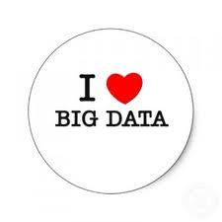

Slide 27
Questions ?

