Slide 1
ITIL in Higher Education
David McGuire, UNM Assoc Dir. IT Proj & Svc Mgt
Rita Barrantes, UH Assoc. to CIO & Mgr. IT Svcs
- November 2012 -
Notes:
One of the most common questions: How do you get started in ITIL?
Many paths: We want to find out today what has worked for people in the room

Slide 2
A
G
E
N
D
A
ITIL Constituent Group
Intro: Quick ITIL overview [5 min]
Poll: ITIL journey: Just starting, or on the road? [5 min]
Group Discussion: Focused questions [15 min]
Groups share: Summarize answers [20 min]
Topics for the ITIL CG List? [5 min]

Slide 3
A
B
O
U
T
I
T
I
L
ITIL: Globally recognized best practice
v1 – Late 80’s: Manage infrastructure (mainframes, tape libraries, etc.)
v2 - ~2000: Design & improve processes (Incident Mgmt, Change Mgmt, etc.)
v3 – 2007-11: Manage full service lifecycle (Service Strategy, Service Design, Service Operations, etc.)

Slide 4
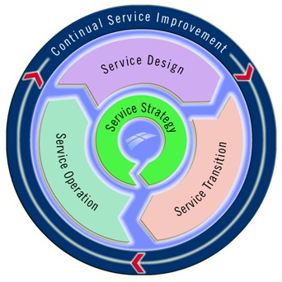
A
B
O
U
T
I
T
I
L
ITIL: Framework for Managing IT
as a Service Organization

Slide 5
A
B
O
U
T
I
T
I
L
ITIL: Moves IT Up the Value Chain
Strategic Partner
Service Provider
Technology Provider
Value To Institution

Slide 6
A
B
O
U
T
I
T
I
L
Who Uses ITIL?
HP
Microsoft
Disney
Toyota
Walmart
Staples
Boeing
Sony
Pfizer
Bank of America
Target
IBM
Fujitsu
Barclay’s Bank
Eli Lilly
Notes:
Higher Ed is NOT the early adopter. Widespread use in industry, healthcare; Europe, Asia.

Slide 7
A
B
O
U
T
I
T
I
L
ITIL in Higher Ed: (not a comprehensive list)
Boston U
Brigham Young U
Clemson
Cornell
CSU-Sacramento
Deakin (Australia)
Duke
Emory
Fresno State
George Washington
Georgia State
Georgia Tech
Harvard FAS IT
Marquette
Miami U (Ohio)
Michigan State
New York U
Notre Dame
Ohio State
Purdue
St Louis U
U of Alaska
U of Canterbury, NZ
U of Chicago
U of Kansas
U of Maryland
U of Minnesota
U of Pennsylvania
U of Sydney
U of Virginia
U of Wisconsin System
UC Santa Barbara
UC Santa Cruz
UNC Chapel Hill
Vanderbilt
Wake Forest
Yale
Notes:
Probably schools represented in this room today who have been walking the ITIL path but who are not on this list.

Slide 8
Group Discussion
G
R
O
U
P
S
Focused questions [15 min]
Notes:
WHERE do you start?
Sense of urgency
Training
Management support
Assess pain points
Identify resources
Roadmap, including low-hanging fruit

Slide 9
Groups Share
G
R
O
U
P
S
Summarize Answers (20 min)
Notes:
WHERE do you start?
Sense of urgency
Training
Management support
Assess pain points
Identify resources
Roadmap, including low-hanging fruit

Slide 10
Topics for the ITIL CG?
W
R
A
P
U
P
Notes:
WHERE do you start?
Sense of urgency
Training
Management support
Assess pain points
Identify resources
Roadmap, including low-hanging fruit

Slide 11
Stay Connected
W
R
A
P
U
P
Rita Barrantes – rbarrant@central.uh.edu
David McGuire – dmcguire@unm.edu
ITIL Resources:
www.itil-officialsite.com
www.educause.edu/discuss/constituent-groups-about-information-technology-management-and-leadership/itil-higher-education (or just search Educause for “ITIL”)

