Slide 1
Disrupting College: How Disruptive Innovation Can Deliver Quality and Affordability to Postsecondary Education
Michael B. Horn
mhorn@innosightinstitute.org
Twitter: @innosightinstit

Slide 2
N
M
OVEMBER
http://mobro.co/michaelbhorn

Slide 3
Questioning higher education’s quality
Study of 2,300 undergraduates at two dozen universities who took the Collegiate Learning Assessment
45 percent “demonstrated no significant gains in critical thinking, analytical reasoning, and written communications during the first two years of college”
32 percent of the students whom they followed did not, in a typical semester, take “any courses with more than 40 pages of reading per week
50 percent “did not take a single course in which they wrote more than 20 pages over the course of the semester”

Slide 4
America’s college degree edge is slipping
% of Citizens with Postsecondary Degrees Among OECD Countries, by Age Group (2007)
 | 55-64 | 45-54 | 35-44 | 25-34 | ALL (25-64)
1 | U.S. (39%) | Canada (45%) | Canada (53%) | Canada (56%) | Canada (48%)
2 | Canada (39%) | Japan (41%) | Japan (46%) | Korea (56%) | Japan (41%)
3 | N.Z. (35%) | U.S. (40%) | Finland (43%) | Japan (54%) | N.Z. (41%)
4 | Finland (28%) | N.Z. (39%) | U.S. (42%) | N.Z. (47%) | U.S. (40%)
5 | Australia (27%) | Finland (36%) | N.Z. (41%) | Ireland (44%) | Finland (36%)
6 | Norway (26%) | Australia (32%) | Korea (40%) | Norway (43%) | Korea (35%)
7 | Sweden (26%) | Norway (31%) | Norway (36%) | France (41%) | Norway (34%)
8 | Neth. (26%) | U.K. (31%) | Belgium (36%) | Belgium (41%) | Australia (34%)
9 | Switz. (26%) | Denmark (30%) | Iceland (35%) | Australia (41%) | Ireland (312)
10 | U.K. (25%) | Neth. (30%) | Ireland (34%) | U.S. (40%) | Denmark (32%)
11 | Denmark (24%) | Switz. (30%) | Denmark (34%) | Denmark (40%) | Belgium (32%)
12 | Japan (24%) | Sweden (29%) | Australia (34%) | Sweden (40%) | U.K. (32%)
13 | Germany (23%) | Belgium (28%) | Switz. (34%) | Finland (39%) | Switz. (31%)
14 | Iceland (23%) | Iceland (28%) | U.K. (32%) | Spain (39%) | Sweden (31%)
15 | Belgium (22%) | Germany (25%) | Spain (32%) | U.K. (37%) | Neth. (31%)
Source: OECD, “Education at a Glance 2009” (All rates are self-reported)

Slide 5
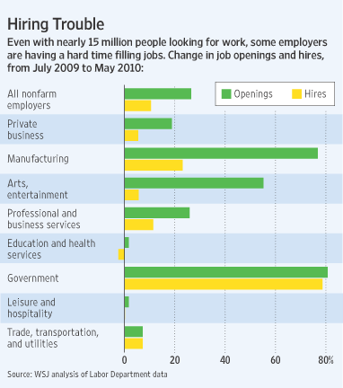
Job mismatch paradox

Slide 6
College’s broken business model

Slide 7
Sustaining vs. disruptive innovation
Incumbents dominate sustaining battles
Pace of performance improvement
Sustaining innovations
Ability to use improvements
Performance
Time
Disruptive Innovations
Entrants typically win at disruption
Time

Slide 8
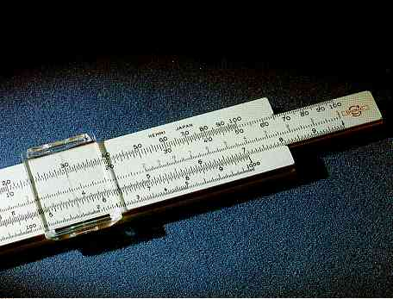
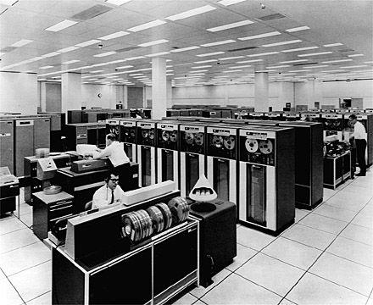
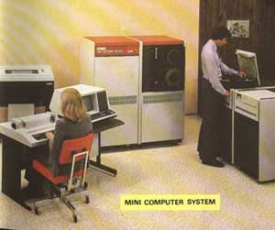
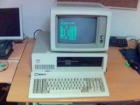
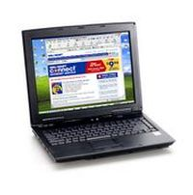
Disruptive innovation in computing
7

Slide 9
Disruption = affordability, accessibility
Yesterday
GM
Dept. Stores
Digital Eqpt.
Delta
JP Morgan
Xerox
IBM
Cullinet
AT&T
Sony DiskMan
Today
Toyota
Wal-Mart
Dell
Southwest Airlines
Fidelity
Canon
Microsoft
Oracle
Cingular
Apple iPod

Slide 10
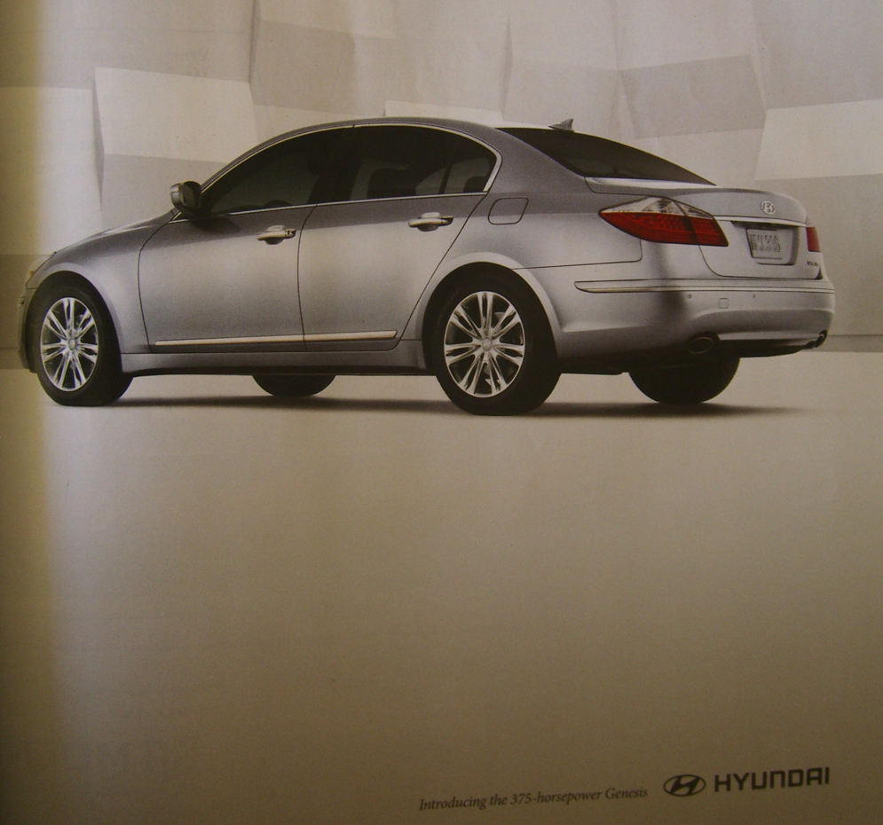
Disruption of Toyota

Slide 11
Disruption = affordability, accessibility
Yesterday
GM
Dept. Stores
Digital Eqpt.
Delta
JP Morgan
Xerox
IBM
Cullinet
AT&T
Sony DiskMan
Today
Toyota
Wal-Mart
Dell
Southwest Airlines
Fidelity
Canon
Microsoft
Oracle
Cingular
Apple iPod
Tomorrow
Chery
Internet retail
Smartphones
Air taxis
ETFs
Zink
Linux
Salesforce.com
Skype
Cell Phones

Slide 12
Higher ed decentralization is just beginning

Slide 13
Substitution follows S-curve pattern
% new
% old
% new
10.0
1.0
0.1
.01
.001
.0001
03
05
07
09
11
13
15

Slide 14
Online learning gaining adoption
Percentage of college students taking at least one online course, divided by students who did not take an online course
Notes:
5.6M students took at least one online course in Fall 2009
Grew 21% from year prior, to 29% of all postsecondary students

Slide 15
Different learning needs @ different times
Multiple intelligences
Learning Styles
Talents
Motivations/interests
Aptitude
Depends on subject/domain
Different paces
Ongoing neuroscience research

Slide 16
Online learning inherently modular
Image courtesy of Khan Academy

Slide 17
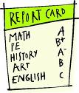
Fixed time, variable learning
Deliver content to students
Testing & assessment
Progress to next grade, subject,
or body of material
Receive results

Slide 18
Competency-based learning
Offer learning experiences for students
Testing & assessment
Receive real-time interactive feedback
Progress to next body of material

Slide 19
It’s not a technology problem
Tabletop Radios, Floor-standing TVs
Performance
Path taken by
vacuum tube manufacturers
Different measure
Of Performance
Time
Portable TVs
Pocket radios
Hearing aids
Non-consumers or Non-consuming
occasions
Time

Slide 20
What is a business model?
RESOURCES:
People, technology, products, facilities, equipment, brands, and cash that are required to deliver this value proposition to the targeted customers
THE VALUE PROPOSITION:
A product that helps customers do more effectively, conveniently & affordably a job they’ve been trying to do
PROCESSES:
Ways of working together to address recurrent tasks in a consistent way: training, development, manufacturing, budgeting, planning, etc.
PROFIT/REVENUE FORMULA:
Assets & fixed cost structure, and the margins & velocity required to cover them

Slide 21
RESOURCES:
People, technology, products, facilities, equipment, brands, and cash that are required to deliver this value proposition to the targeted customers
THE VALUE PROPOSITION:
A product that helps customers do more effectively, conveniently & affordably a job they’ve been trying to do
Business units don’t evolve.
Corporations do.
PROCESSES:
Ways of working together to address recurrent tasks in a consistent way: training, development, manufacturing, budgeting, planning, etc.
PROFIT FORMULA:
Assets & fixed cost structure, and the margins & velocity required to cover them

Slide 22
3 different kinds of business models
Solution Shops
Value-Adding Process Businesses
Facilitated User Network
Diagnose and solve unstructured problems
Add value to something that is incomplete or broken
Enable exchange among participants
Fee for service
Fee for outcome
Fee for transaction or membership; ad-supported

Slide 23
The right product architecture? It depends…
IBM Mainframes, Microsoft Windows
Compete by improving
functionality &
reliability
Performance
Proprietary, interdependent architectures
Modular open architectures
Compete by improving
speed, responsiveness and customization
Dell PCs, Linux
Time

Slide 24
Integration shifts impact on computer industry
1960 - 1980
1980 - 1990
1990 - 2000
Equipment
Teradyne, Nikon, Canon, Applied Materials, Millipore, etc.
Materials
Monsanto, Sumitomo Metals, Shipley, etc.
Components
Intel, Micron, Quantum, Komag, etc.
Product design
Compaq, Dell, Gateway, Packard Bell
Assembly
Compaq
Contract assemblers
Apple Computer
IBM
Operating system
Microsoft
Control Data
Microsoft
Digital Equipment
Applications software
Word Perfect, Lotus, Borland, etc.
Sales & distribution
Micro-
Center
CompUSA
Dell
Field service
Independent contractors

Slide 25
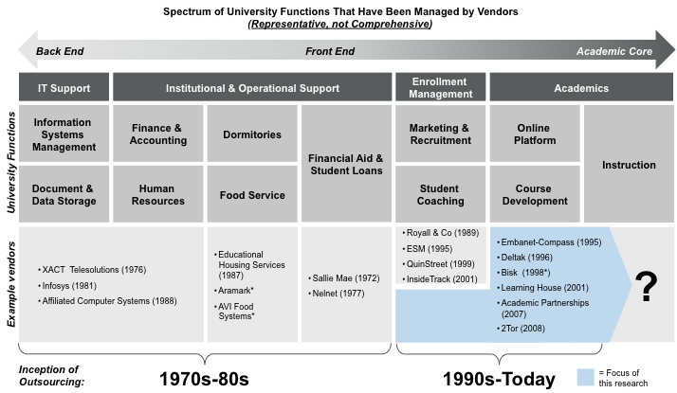
Modularization of the university

Slide 26
Recommendations for existing institutions
Apply correct business model for the task
Frame online learning as a sustaining innovation, disrupting class
Drive the disruptive innovation where possible in autonomous model
Develop strategy of focus

Slide 27
Disrupting College: How Disruptive Innovation Can Deliver Quality and Affordability to Postsecondary Education
Michael B. Horn
mhorn@innosightinstitute.org
Twitter: @innosightinstit

Slide 28
Turning machines
Polishing Dept.
Hobbing department
Tapping equipment
Path taken by product A
A starts here
Annealing furnace
Storage
Shipping Department
Boring machines
Cut-off
saws
Path taken by product B
Office area
De-burring machines
B starts here
Stamping machines

Slide 29
The Maysville plant

Slide 30
Understanding how users experience life
“The customer rarely buys what the company thinks it is selling him” - Peter Drucker
Notes:
How does one successfully innovate? First, need to nail “the job” and integrate properly
SatComs – reliable, secure, dependable 1s and 0s…not that they want a satellite not a copper wire…
Robotics – segment in terms of military activities –
DUALITIES POINT – Job of Lockheed Martin (mission of the future) vs. segmenting by Army, Navy, etc. or by Gov’t versus Commercial

Slide 31
Three levels in the architecture of a job
What and how to integrate?
What experiences in purchase & use must we provide to do the job perfectly?
What’s the job-to-be-done?
(Each job has functional, emotional & social dimensions)

Slide 32
Different learning needs @ different times
Multiple intelligences
Learning Styles
Talents
Motivations/interests
Aptitude
Depends on subject/domain
Different paces
Ongoing neuroscience research

Slide 33
The right product architecture? It depends…
IBM Mainframes, Microsoft Windows
Compete by improving
functionality &
reliability
Performance
Proprietary, interdependent architectures
Modular open architectures
Compete by improving
speed, responsiveness and customization
Dell PCs, Linux
Time

Slide 34
Integration shifts impact on computer industry
1960 - 1980
1980 - 1990
1990 - 2000
Equipment
Teradyne, Nikon, Canon, Applied Materials, Millipore, etc.
Materials
Monsanto, Sumitomo Metals, Shipley, etc.
Components
Intel, Micron, Quantum, Komag, etc.
Product design
Compaq, Dell, Gateway, Packard Bell
Assembly
Compaq
Contract assemblers
Apple Computer
IBM
Operating system
Microsoft
Control Data
Microsoft
Digital Equipment
Applications software
Word Perfect, Lotus, Borland, etc.
Sales & distribution
Micro-
Center
CompUSA
Dell
Field service
Independent contractors

Slide 35
Modularization of the university

Slide 36
General-purpose products disrupted on job-by-job basis
Pace of performance improvement
Major Metropolitan Newspapers Help me:
Unload this stuff
Find the right car
Sell or buy a home
Find the right job, or the right employees
Kill commuting time productively
Become well-informed
Unwind at the end of the day
Performance
Sustaining innovations
Different measure
Of Performance
Time
Craig’s List
AutoTrader.com
Realtor.com
Monster.com
Metro; Blackberry
CNN.com
Unwind at the end of the day
Disruptive Innovations: Competing against
non-consumption
Non-consumers or Non-consuming
occasions
Time

Slide 37
The Harvard Business School is being disrupted
Incumbents nearly always win
$150,000 !!
Performance
2-year MBA
Part-time MBA
On-line “Garbage”
Different measure
Of Performance
Help me solve this problem
Teach me what I need to know to become a great manager
Give me the credentials I need to get the next, more lucrative job
Help me switch careers
Help me join a prestigious network
Brand
Connections
Time
Corporate Universities: Competing against
non-consumption
Non-consumers or Non-consuming
occasions
Time

Slide 38
Policy recommendations
Eliminate barriers blocking disruptive innovations
Remove barriers that judge based on inputs, such as seat time, credit hours, student-faculty ratios
Don’t focus on degree attainment as sole measure of success; real outcomes & mastery are more important
Fund higher education with aim of increasing quality, decreasing cost
QV Index = 90-Day hire rate + Δ salary/Total rev per conferral + Retrospective student satisfaction + Cohort repayment rate (adj.)
Recognize continued importance of research institutions, but don’t pit against teaching institutions

Slide 39
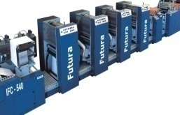
Content production historically integrated

Slide 40
Disintermediation of content production
Data Platform

Slide 42
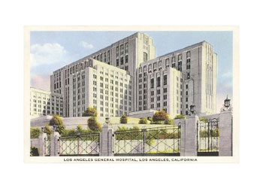
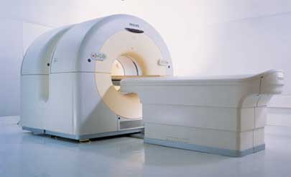
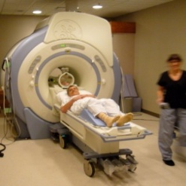
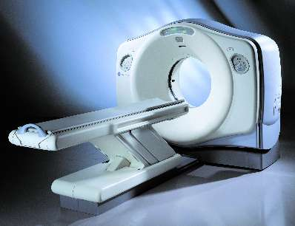
Sustaining competition often adds cost

Slide 43
The right product architecture? It depends…
IBM Mainframes, Microsoft Windows
Compete by improving
functionality &
reliability
Performance
Proprietary, interdependent architectures
Modular open architectures
Compete by improving
speed, responsiveness and customization
Dell PCs, Linux
Time

Slide 44
Integration: Rise of the corporate university

Slide 45
Modularity and targeted partnerships

Slide 46
Hiring on competency, not a brand

Slide 47
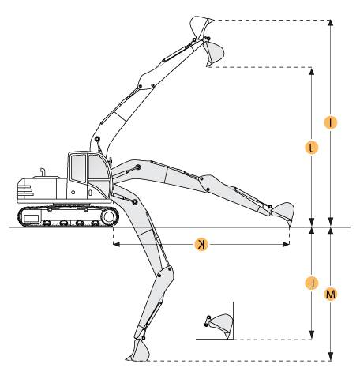
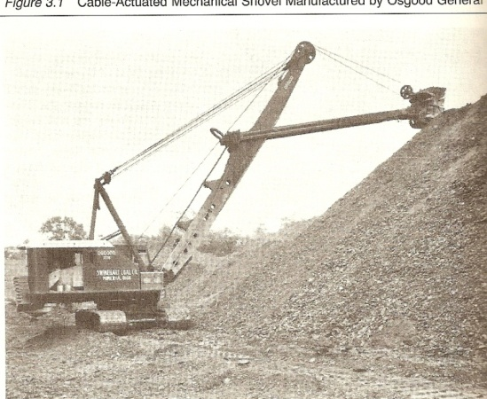
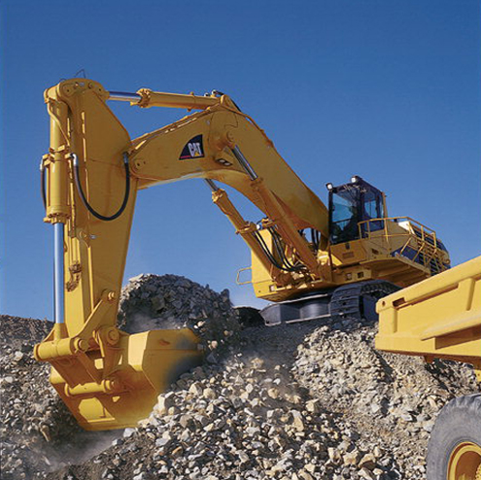
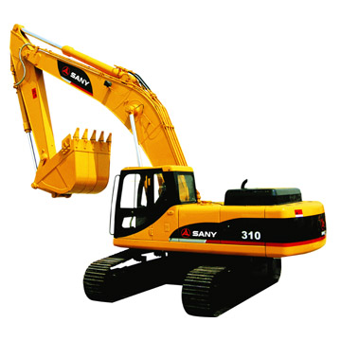
Expensive failure almost always results when disruption is crammed into direct competition with established technology
Tabletop Radios, Floor-standing TVs
Performance
Different measure
Of Performance
Time
Portable TVs
Pocket radios
Hearing Aids
Non-consumers or Non-consuming
occasions
Time

Slide 48
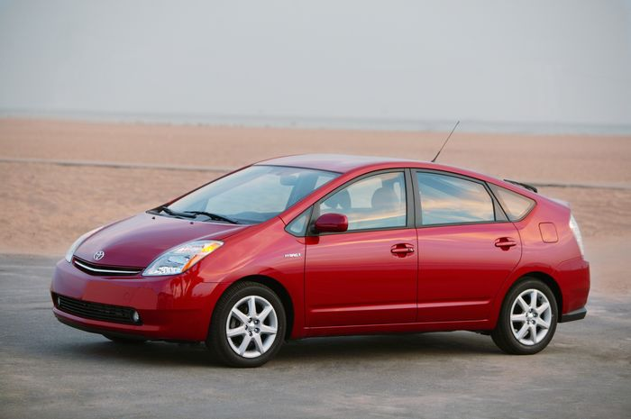
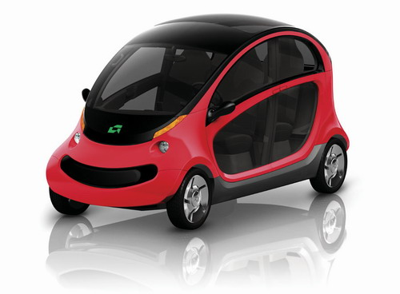
A Theory of Hybrids
Competing on cost, design, reliability, and performance on the California Freeway
Tesla $100,000
Prius Hybrid
Performance
Sustaining innovations
Time
Disruptive Innovations
Peapod: Are there customers that would love a car that won’t go far, and won’t go fast?
Time

Slide 49
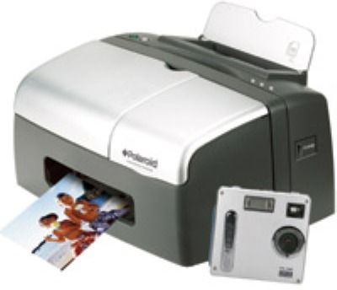
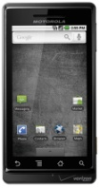
A Theory of Hybrids
The metric of performance changes
Performance
Sustaining innovations
Time
The disruptive
technology doesn’t
invade and reform the
existing system. Rather, new measures of performance entice customers into the new system.
Disruptive Innovations
Time
Smartphones

Slide 50
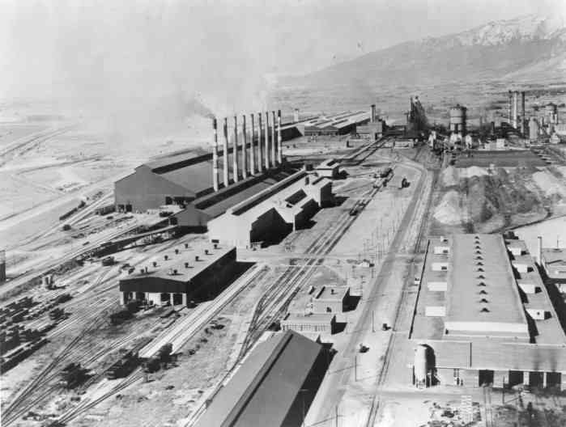
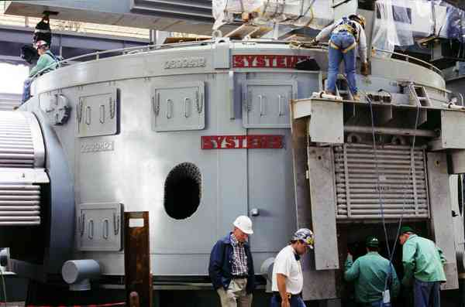
Technology enabler allows for disruption
25–30%
% of tons
55%
Steel Quality
Sheet steel
18%
22%
Quality of integrated mills’ steel
Structural Steel
8%
Angle iron; bars & rods
12%
Quality of minimill-produced steel
4%
Rebar
7%
1975
1980
1985
1990

Slide 51
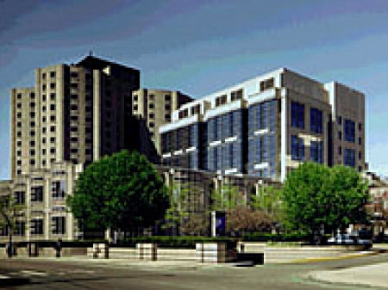
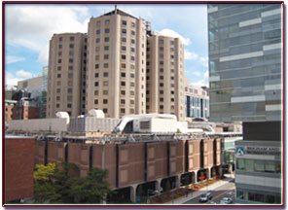
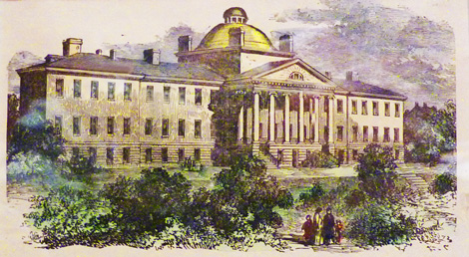
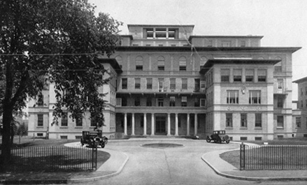
Creating a price floor
Performance
Employer insurance
Medicare
Employer insurance
Medicare
Time

Slide 52
Creating a price floor
Performance
Student Loans
Pell Grants
Student loans
Pell Grants
Time

Slide 53
How future universities may be built
Unit of accreditation: the course
Standards:
thru course acceptance
A different type of university
Unit of accreditation: The institution

Slide 54
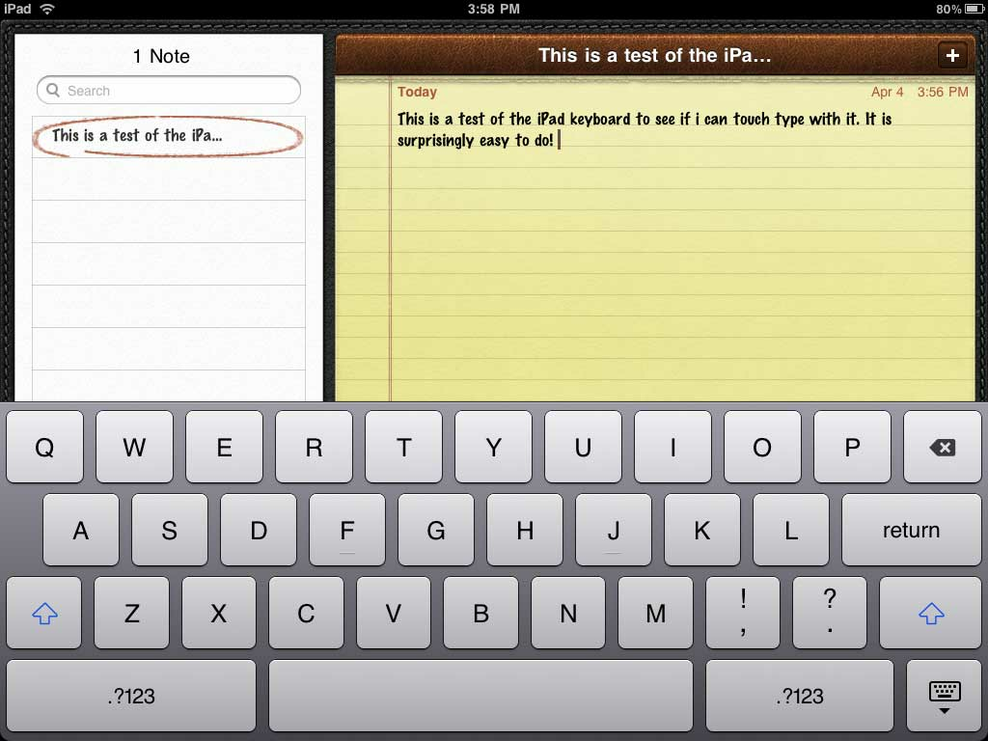
WGU models a competency-based system
Front End:
Student Control
Students use an online portal to view and manage their individual degree plans
Back End:
Assessment System
WGU stores over 800 assessments that students can take to demonstrate mastery
Objective Assessments
Performance Assessments
Notes:
WGU enrolled its first 30 students in 1999. Today it has over 30,000 students and an annual growth rate of roughly 30 percent for the past 5 years.
It’s data system is designed for competency-based learning. The two pillars:
A student portal on the front end that gives students total ownership of their learning. Through one access point, students connect to their courses of study, link to outside learning resources, and track their progress toward passing the assessments required for graduation. They even have a tool to calculate when they will graduate given different scenarios for how quickly they pace through the competencies.
A robust assessment system that uses performance and objective assessments to precisely measure each competency required to earn a given degree.

Slide 55
WGU system architecture

Slide 56
Online learning inherently modular
Image courtesy of Khan Academy

Slide 57
Student motivation, student learning
Student achievement in online courses when administered by focused online faculty
5.7
Student achievement in traditional classes taught by faculty in core
Student achievement in online courses when administered by faculty in core
4.6
5.6

Slide 58
Disruption targets nonconsumption; changes performance metric
Tabletop Radios, Floor-standing TVs
The metric of performance changes
Ability to use improvements
Performance
Path taken for transistors by vacuum tube manufacturers
Different measure
Of Performance
Time
Portable TVs
Pocket radios
Hearing Aids
The customers are enticed into the new system, not vice versa.
Non-consumers or
Non-consuming
occasions
Time

Slide 59
Beat competitors with asymmetry of motivation
25–30%
% of tons
55%
Steel Quality
Sheet steel
18%
22%
Quality of integrated mills’ steel
Structural Steel
8%
Angle iron; bars & rods
12%
Quality of minimill-produced steel
4%
Rebar
7%
1975
1980
1985
1990

