Slide 1
On Campus and Off: A Conversation about Today’s Modern Music Marketplace Cary Sherman EDUCAUSE November 8, 2012

Slide 2
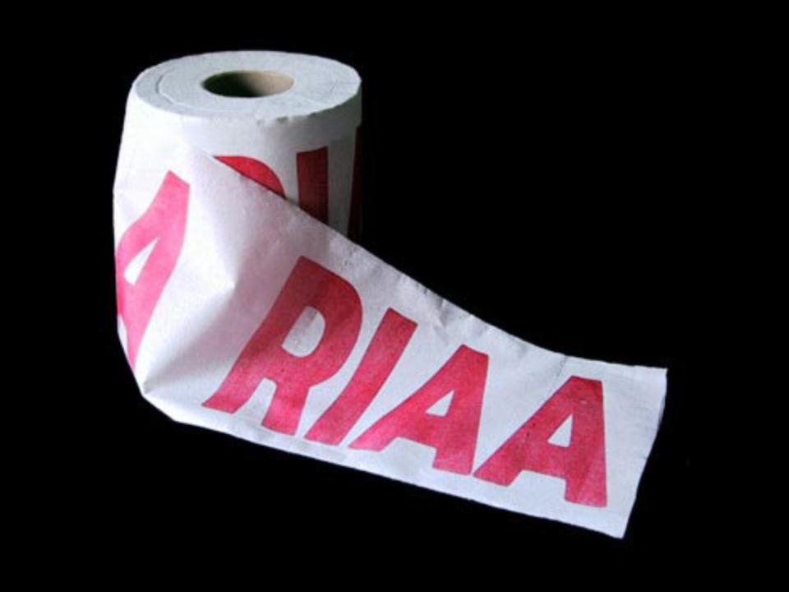

Slide 3
David Letterman
Top 10 Questions Asked By Saddam Hussein When He Was Captured
10. "Be honest...have you ever seen a nicer spider hole than this?"
9. "Who's got a coat hanger -- this beard itches like a son of a bitch!"
8. "Anyone have a mint?"
7. "Is this about the illegal music downloads?"
6. "Am I going to be on 'Cops'?"
5. "Which describes me better right now -- 'haggard' or 'grizzled'?"
4. "How did you get past my impenetrable styrofoam brick?"
3. "Do I get the 25-million-dollar reward?"
2. "How's the war going?"
1. "Will you go easy on me if I tell you where Martha Stewart is hiding?"

Slide 5
Top 5 Courses for 2013 (as presented by the RIAA)
1. Vinyl: The bright horizon
2. Megaupload: An unbiased look at why it was evil
3. How to win friends and influence people: case study of RIAA's litigation strategy
BitTorrent: Why World of Warcraft updates are essential in today’s Higher Education Environment
5. RIAA Master class on the art of advocacy: an insider's look at the campaign for SOPA/PIPA

Slide 6
The Music Industry Is Now Primarily Digital
①

Slide 7
2011
Physical
50%
Digital Downloads
38%
Performance Rights
4%
Mobile
4%
Subscription
4%

Slide 8
U.S. Digital Music Sales
$ Billion
Source: RIAA Music Industry Shipment Database

Slide 9
Percent of Market Digitally Distributed
(United States 2011)
Source: RIAA [for music industry]; RIAA analysis of PWC data [for other industries]

Slide 10
Get a new business model?
②
We have.

Slide 11
DRM Free Digital Downloads

Slide 12
Subscriptions: All You Can “Eat” on Your Computer or Device

Slide 13
Free On Demand Audio and Video Streaming

Slide 14
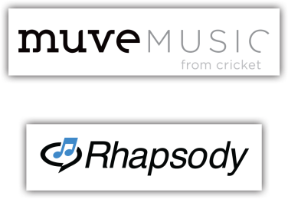
Music Bundled with Mobile Phones

Slide 15
Access Your Collection From the Cloud
and more coming

Slide 16
Specialized Digital Radio
and …

Slide 17
Online Simulcasts of AM/FM Radio Stations
…altogether totaling 2,000 options

Slide 18
ALL types of digital business models are now embraced and licensed by the major music labels 26 million tracks licensed worldwide 500 digital services licensed worldwide

Slide 19
A Major RIAA Priority: Making it simpler and easier to license music and develop new business models.

Slide 20
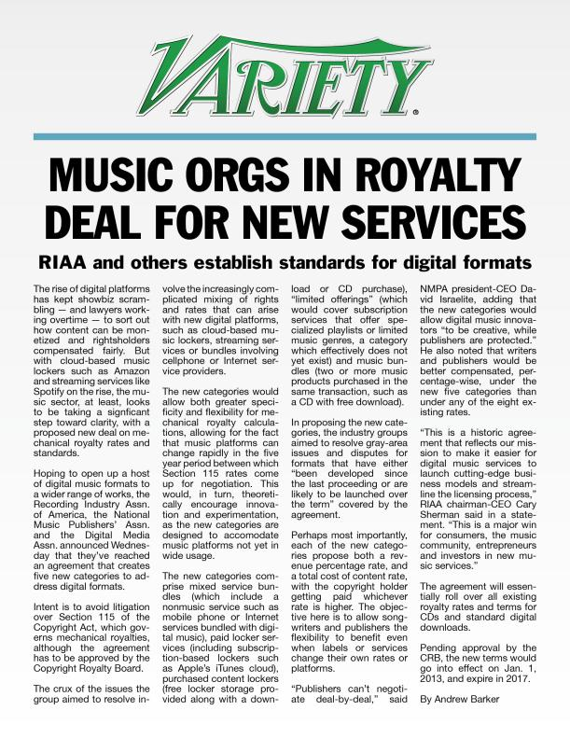
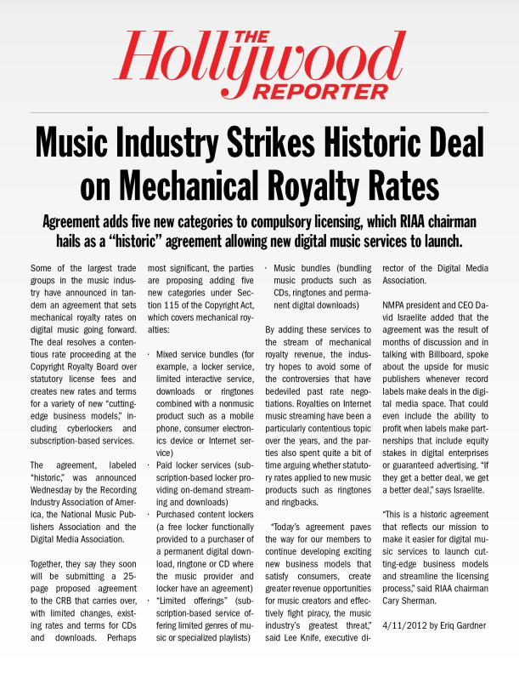
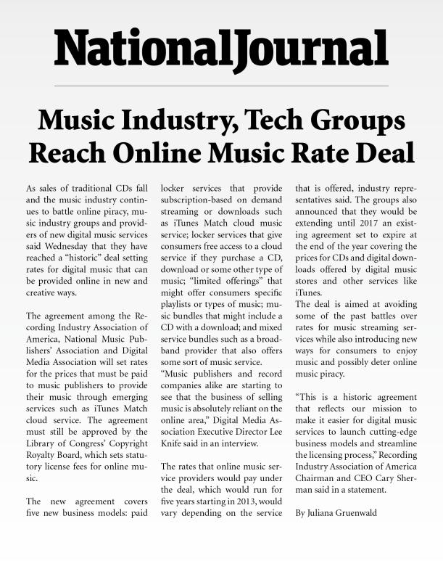

Slide 21
The Long Tail?
③
Not so much.

Slide 22
80% of newly released albums sold fewer than 100 copies.
94% of newly released albums sold fewer than 1000 copies.
Source: Nielsen Soundscan 2011

Slide 23
The top 2% of albums = 89% of total new album sales.
Source: Nielsen Soundscan 2011

Slide 24
Illegal Downloading Hurts. Strategic Enforcement Helps.
④

Slide 25
Virtually every academic study confirms…
Blackburn, D. (2004) “Online piracy and recorded music sales.” Working Paper, Department of Economics, Harvard University.
Zentner, A. (2009). “Ten Years of File Sharing and its Effect on International Sales of Copyrighted Music: An Empirical Analysis Using a Panel of Countries”
Rob, Rafael, and Joel Waldfogel. (2006). “Piracy on the High C’s: Music Downloading, Sales Displacement, and Social Welfare in a Sample of College Students.” Journal of Law and Economics 49(1) p 29-62.
“The Impact of Free Music Downloads on the Purchase of Music CDs in Canada”, Barker & Maloney, Aug ’12
All of our regression results… show a negative association between P2P downloading and CD demand. We consistently find a negative and statistically significant partial correlation between CD purchases and P2P downloads.”
Peitz, Martin, and Patrick Waelbroeck (2004). “The Effect of Internet Piracy on Music Sales: Cross-Section Evidence.” Review of Economic Research on Copy right Issues 1:71-79.
Hong, S. H. (forthcoming) “Measuring the Effect of Napster on Recorded Music Sales: Difference-in-differences Estimates under Compositional Changes” Journal of Applied Econometrics.
Zentner, Alejandro (2006). “Measuring the effect of music downloads on music purchases” Journal of Law and Economics 49(1): 63-90.
“Assessing The Academic Literature Regarding the Impact of Media Piracy on Sales”, Smith & Telang, Aug ‘12
“…the vast majority of the literature (particularly the literature published in top peer reviewed journals) finds evidence that piracy harms media sales”
Zentner, Alejandro (2005). “File Sharing and International Sales of Copyrighted Music: An Empirical Analysis with a Panel of Countries.” Topics in Economic Analysis and Policy 5, art. 21, pp. 1-15.
Hong, S. H. (2007) “The recent growth of the internet and changes in household-level demand for entertainment,” Information Economics and Policy.
“The Metric is the Message: How much of the Decline in Sound Recording Sales is due to File-Sharing?”, Liebowitz, Dec ’11
“The results indicate that the majority of all studies support a conclusion that the entire decline in sound recording sales can be explained by file-sharing. Even those studies that do not find that file-sharing caused the complete decline usually find that it was responsible for a large share of the decline.”
Liebowitz, Stan J. (2006) “File-Sharing: Creative Destruction or just Plain Destruction?” Journal of Law and Economics 49 April, 2006, p1-28.
Liebowitz, Stan j. (2008). “Testing File-Sharing’s Impact on Music Album Sales in Cities” Management Science, April (4) Vol. 54, pp. 852-859.

Slide 26
Yes, file sharing can be used for legal purposes, but the overwhelming majority of users engage in illegal activity…

Slide 27
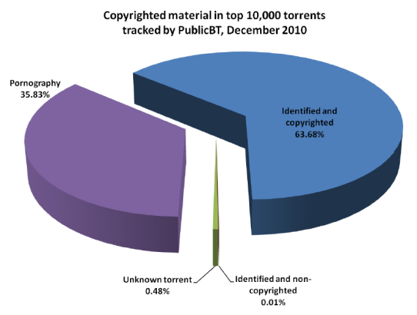
Copyrighted material makes up
largest portion of torrents
Technical report:
An Estimate of Infringing Use of the Internet
January 2011

Slide 28
Only 1% of BitTorrent files
are“likely noninfringing”
According to Professor ED FELTEN in Freedom To Tinker:
“Census of Files Available via BitTorrent” (Jan 2010)
Of 1021 files sampled:
“…all of the 476 movies or TV shows in the sample were found to be likely infringing”
“All of the 98 music torrents were likely infringing”
“Overall, we classified ten of the 1021 files, or approximately 1%, as likely noninfringing”

Slide 29
Recorded Music Shipments
1999–2011
Source: RIAA

Slide 30
Recorded Music Shipments and Employment of Musicians and Artists
1999–2011
Source: RIAA and Bureau of Labor Statistics

Slide 31
LILY ALLEN “We need people to know that [illegal file-sharing] is destroying people’s livelihoods and suffocating emerging new British artists.”
ELTON JOHN “The unchecked proliferation of illegal downloading…will have a seriously detrimental effect on musicians, and particularly young musicians and those composers who are not performing artists.”
TAIO CRUZ “File-sharing has had a very, very negative effect on my career, as it has on many others.”
RANDY BACHMAN “Digital online piracy is making it nearly impossible for Canada’s emerging artists to make it.”
DAVID DRAIMAN/DISTURBED “This mentality has created an environment where it is more and more difficult for artists, particularly up-and-coming ones, to survive and sustain themselves.”
BONO “Music has become tap water, a utility, where for me it’s a sacred thing, so I’m a little offended.”
LL COOL J “My first question is this: Do people in the entertainment industry have the same rights as other Americans to fair pay for fair work?”
PATRICK CARNEY/ THE BLACK KEYS “The guy [Sean Parker] has $2.5 billion he made from figuring out ways to steal royalties from artists, and that’s the bottom line.”
JOHN MCCREA/CAKE “I do think that if music is going to be free, then sandwiches should also be free. There should be some consistency and we should learn to cooperate better.”
EMINEM “I think that shit is fucking bullshit. Whoever put my shit on the Internet, I want to meet that motherf***er and beat the shit out of him, because I picture this scrawny little dickhead going ‘I got Eminem’s new CD!’”
ZACH HEMSEY “…if they are making money by commandeering and exploiting my work, and not even sharing any of those earnings with me to boot, then it shouldn’t be controversial to suggest their actions are less than admirable.”
PRINCE “Nobody’s making money now except phone companies, Apple and Google… It’s like the gold rush out there. Or a carjacking. There’s no boundaries.”
DAVID LOWERY “I feel that what we artists were promised has not really panned out… The music business never transformed into the vibrant marketplace where small stakeholders could compete with multinational conglomerates on an even playing field.”
DON HENLEY “…they’re not just stealing movies and music; they are stealing America’s jobs and future.”
TRENT REZNOR “Just because technology exists where you can duplicate something, that doesn’t give you the right to do it.”
THE GRATEFUL DEAD “No commercial gain may be sought by websites offering digital files of our music, whether through advertising, exploiting databases compiled from their traffic, or any other means.”
LOGAN LYNN “What pisses me off is having over 91 percent of my personal intellectual property stolen, often before it even has the chance to be finished and released to the world… As an independent musician, that money comes directly out of my own pocket.”
LUPE FIASCO “Who are you to have the right to tell me that I shouldn’t demand payment or feel a certain way for seeing people put my music out there like that? If I chose to do that, that’s one thing. But I didn’t choose to do that. That music was stolen.”
Most quotes compiled by David Lowery on thetrichordist.wordpress.com

Slide 32
Protecting Rights Can STIMULATE Sales

Slide 33
About 2/3 of file sharers used Limewire 2007–2010
Source: NPD’s Music Acquisition Monitor

Slide 34
Year-Over-Year Changes in Digital Music Sales and Limewire Users
Source: RIAA Analysis of RIAA Music Industry Shipment Database and Nielsen Company Data

Slide 35
Big Drop In Limewire Users, More Than Half Go Legit NPD “Industry efforts to combat illegal file sharing, and increased options for listening and downloading legally, have resulted in a sharp reduction in the number of P2P music downloaders.” Nielsen Of the 13 million LimeWire users, 9.7 million stopped using LimeWire and 51% of them stopped using file sharing services altogether.

Slide 36
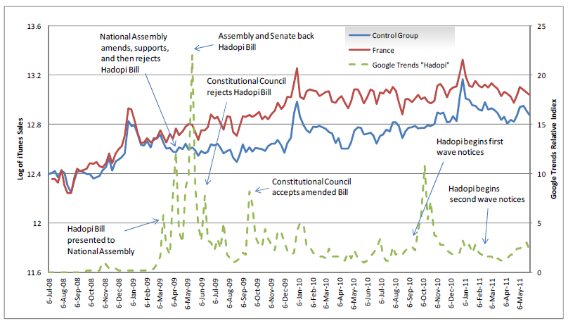
Study of HADOPI
The Effect of Graduated Response Anti-Piracy Laws on Music Sales:
Evidence from an Event Study in France
“Our results suggest that increased consumer awareness of HADOPI caused iTunes song and album sales to increase by 22.5% and 25% respectively relative to changes in the control group.”
Danaher, Smith, Telang, & Chin
(Carnegie Mellon Univ & Wellesley College)

Slide 37
Megaupload Indictment Impacted
Most Rogue Locker Services
Locker Site | % of Infringing URLs in 2011 | Status in 2012
Filesonic.com | 41.2% | Closed Down
Wupload.com | 17.4% | Closed Down
4shared.com | 14.1% | 22% of 2012 Infringements
Fileserve.com | 6.8% | Disabled All Sharing
Hulkshare.com | 2.8% | Audible Magic Filtering
Mediafire.com | 2.7% | Audible Magic Filtering
Wupload.uk | 2.6% | Closed Down
MegaUpload.com | 2.5% | Closed Down

Slide 38
What next?
⑤
Voluntary marketplace agreements with partners in the Internet ecosystem can make a difference.

Slide 39
ISPs
Tech Community
Payment Processors
MUSIC
Government
Advertisers
Civil Society Groups
Registries/ Registrars
Search Engines

Slide 40
Commercial ISP Deal
Voluntary deal ready to launch
Five participating ISPs
AT&T, Comcast, TWC, Verizon & Cablevision
Includes a 3 step copyright alert process:
1 or 2 educational notices
2 acknowledgement notices
1 or 2 mitigation measure notices
Provides for validation of technologies
Provides independent review process
Creation of Center for Copyright Information (CCI)

Slide 41
Why are we so optimistic about this approach? Because you have proven that it works.

Slide 42
Universities: The Original Intermediary

Slide 43
Universities – and EDUCAUSE – have been good partners
THANKS!

Slide 44
Schools have taken action…
Educational campaigns
Technological tools
Enforcement and consequences for repeat offenders
These have often been implemented into escalating tiered responses including:
Educational moments, requiring student acknowledgment and learning.
Repeated and escalating fines.
Escalating community service requirements.
Referral to disciplinary authorities.
Disabling users’ access for escalating periods of time, potentially resulting in a permanent block from the network.
Notation on student records.

Slide 45
University | 2008-09 | 2011-12 | Notice Change ‘08 to ‘12
Eastern Illinois University | 2291 | 388 | -1903
Texas A&M University | 2371 | 707 | -1664
Bridgewater State College | 1649 | 3 | -1646
George Mason University | 1815 | 401 | -1414
Montclair State University | 2824 | 1452 | -1372
California State University | 1548 | 238 | -1310
University Of Nevada | 1296 | 0 | -1296
University of Northern Colorado | 1233 | 23 | -1210
University of Arizona | 1852 | 665 | -1187
Georgetown University | 1932 | 746 | -1186

Slide 46
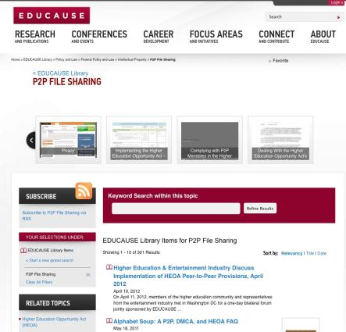
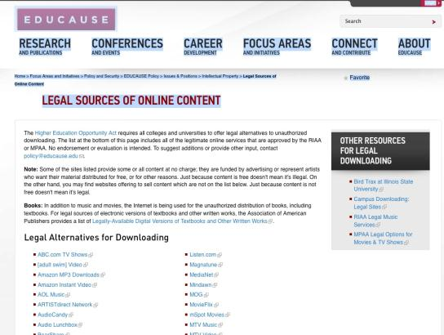
EDUCAUSE resources

Slide 47
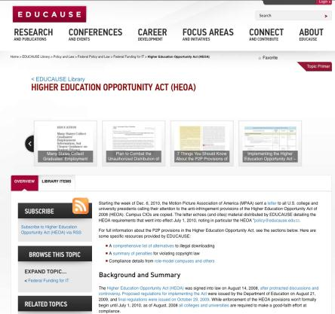
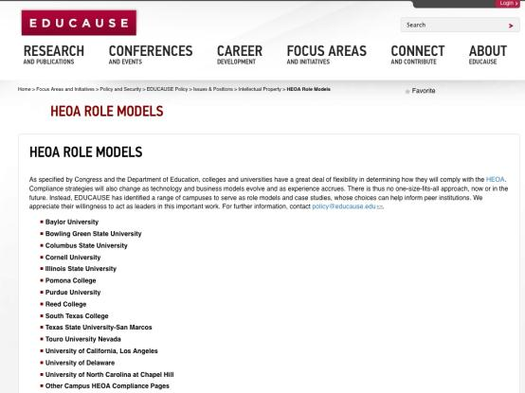
EDUCAUSE resources

Slide 48
Schools See Benefits Too
“If someone is repeatedly doing this, that’s not a culture we want to promote here.” – Marist
“Since the workshops started, repeat offenders have virtually disappeared.” – UCLA
“The university has received fewer complaints from copyright holders about alleged copyright violations since it updated its policy to meet the piracy provision in January 2009.” – Wichita State
“We want to educate people not to do things illegally. This is becoming a bigger issue and it needs to stop.” – Columbia

Slide 49
Who best to advise us on messaging?
It’s All About Education…
Duh. College students.

Slide 50
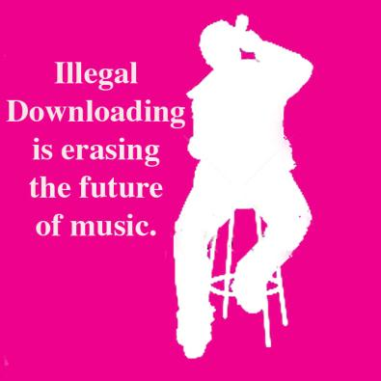
On-campus anti-piracy ad campaigns
EdVenture
Worked with classes at 5 Universities to develop anti-piracy messaging
Colorado University - Boulder
Georgia State

Slide 51
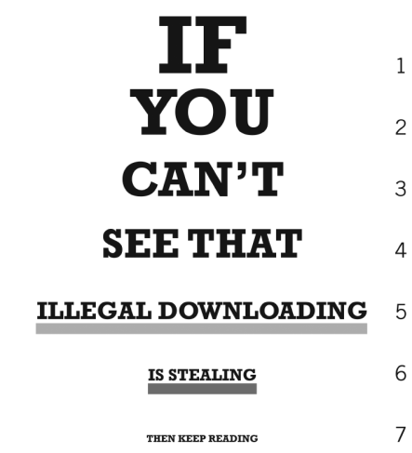

Slide 52
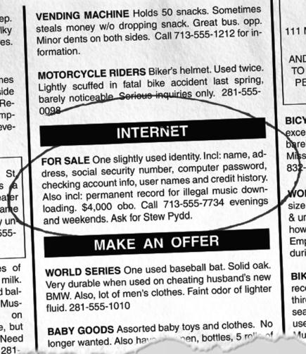

Slide 53
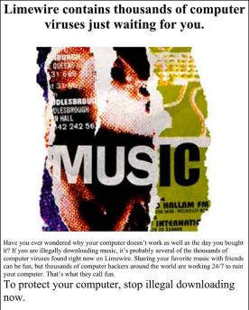
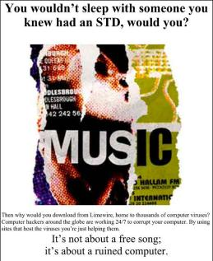
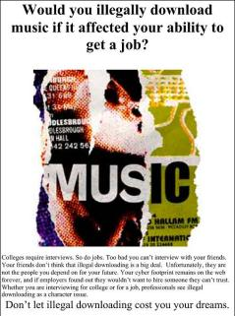
On-campus anti-piracy ad campaigns
Syracuse University
Newhouse School of Public Communications Professor Brian Sheehan

Slide 54
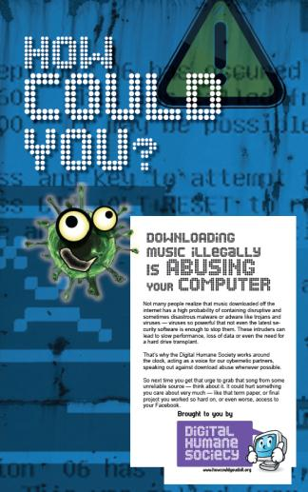
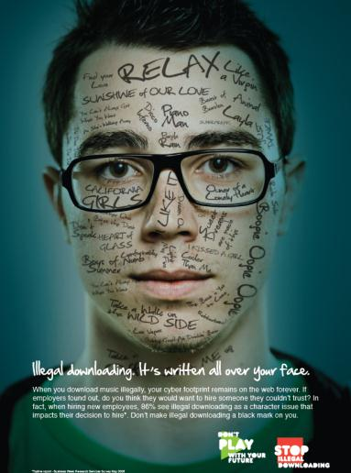
Syracuse: Results

Slide 55
Music Matters

Slide 56
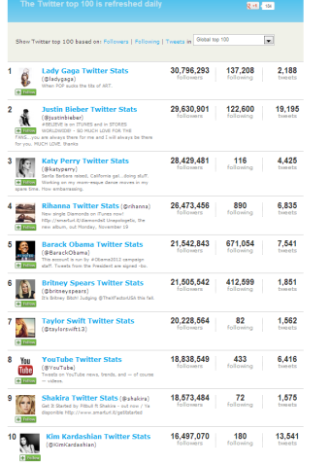
Seven of the 10 most followed Twitter users are musicians
Lady Gaga (@ladygaga)
Justin Bieber (@justinbieber)
Katy Perry (@katyperry)
Rihanna (@rihanna)
Britney Spears (@britneyspears)
Shakira (@shakira)
Barack Obama (@BarackObama)
Kim Kardashian (@KimKardashian)
Taylor Swift (@taylorswift13)
YouTube (@YouTube)

Slide 57
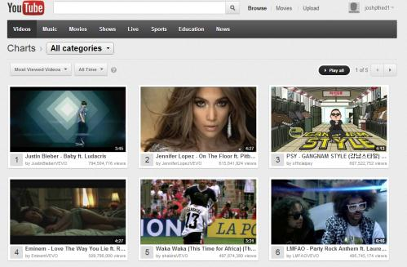
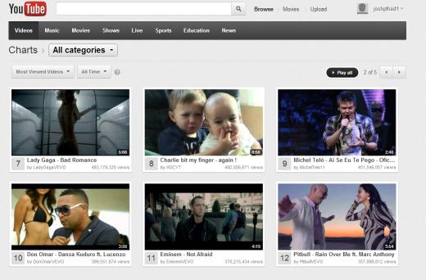
Music videos make up 11 of the top 12 most watched YouTube videos of all time.

Slide 58
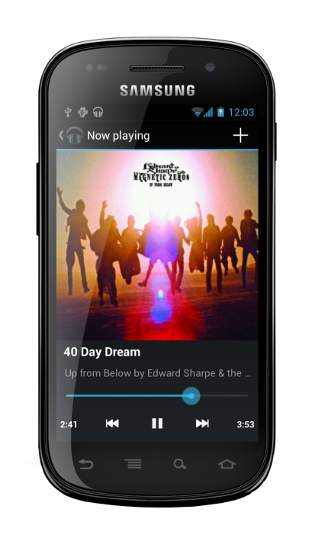
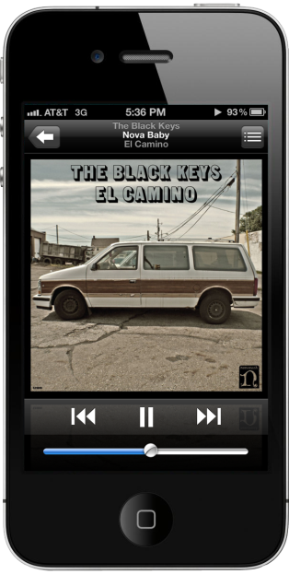

Slide 59
Music: Worth Creating Worth Protecting

