Slide 1
November 2012

Slide 2
Capturing the attention of Generation Y
Steffne Hughes, University of Cape Town
November 7, 2012

Slide 3
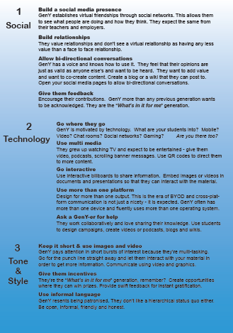
Posters session at EDUCAUSE

Slide 4
Golden rule: Know your audience
Born between1981-2000
Digital natives
Short attention span
Supreme multi-taskers
Social and participative
Constantly connected
Informal communication style
Audio-visually stimulated

Slide 5
Campaigns aimed primarily at Gen Y students over the last 3 years

Slide 6
Campaigns aimed primarily at GenY
2010 UCT respects copyright
2011 Email migration to myUCT
2011 Student laptop initiative
2012 Cyber security month

Slide 7
Launch of ICTS social media
April 2011 - @ICTS_Feedback Twitter acct
2010 UCT respects copyright
2011 Email migration to myUCT
2011 Student laptop initiative
2012 Cyber security month
Sept 2012 - ICTS Facebook acct

Slide 8
UCT respects copyright
Students (and staff) unaware of copyright, downloading and using copyrighted content
University-wide campaign to educate, inform and persuade
Ran for 3 months
Encouraged debate
Hugely successful albeit strongly challenged

Slide 9
Channels used
Web (ICTS site and corporate site)
Campus newspapers (student and staff)
UCT Radio (campus radio station)
Online quiz with fantastic sponsored prizes
Posters (printed and digital)
Adverts in Varsity student newspaper
Links on campaign web page to videos hosted on South African Federation against Copyright Theft (SAFACT) website

Slide 10
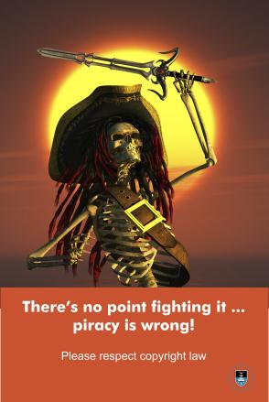
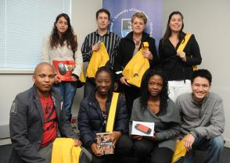
Sample images: UCT respects copyright

Slide 11
Email migration to myUCT
Ran from Aug 2011 to March 2012
Undergrad students moved to Live@edu mailboxes
Students had to choose to move when it suited them best within the migration window
First time that
Large scale comms directed specifically at students
Twitter was used for support (@gomyuct and @icts_feedback)

Slide 12
Sample images: myUCT

Slide 13
Student Laptop Initiative (SLI)
Launched Nov 2011 and on-going
National scheme amongst participating universities
Harnesses united purchasing power of HEIs
Two vendors selected to provide a range of laptops to students at hugely reduced prices
All finance and support provided by vendors & not institutions

Slide 14
Channels used
Campus newspapers(Monday Paper and Varsity newspaper)
Websites (ICTS and corporate)
Desktop backgrounds in student labs
Digital poster on student LMS (Vula)

Slide 15
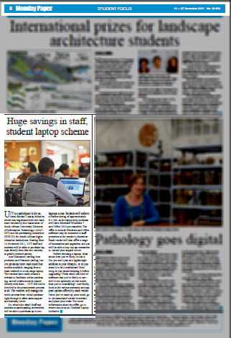
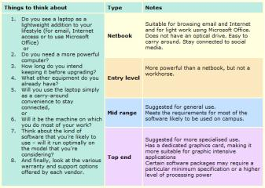
Sample images: Student Laptop Initiative

Slide 16
October: Cyber security month
Run for the first time at UCT in Oct 2012
Four themes across four weeks:
Social media safety
Personal cyber safety
Banking and buying safety
Portable and public computing safety
Used as a vehicle to gain following for our social media (Twitter and Facebook)
Multi-media campaign

Slide 17
Channels used
Web (ICTS site and corporate site)
Campus newspapers (student and staff)
UCT Radio (campus radio station)
Twitter & Facebook
Videos produced each week & uploaded to UCT’s YouTube channel
Posters (printed and digital)
QR codes direct to web articles & social media
Cartoons commissioned and used on social media

Slide 18
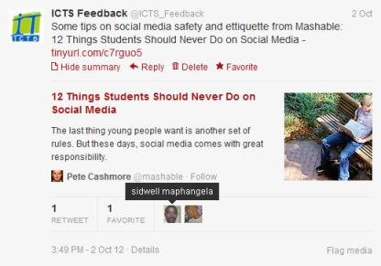
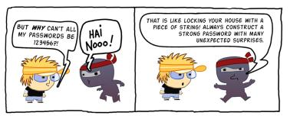
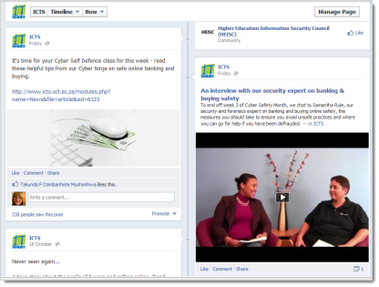
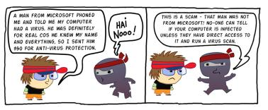
Sample images: Cyber security month

Slide 19
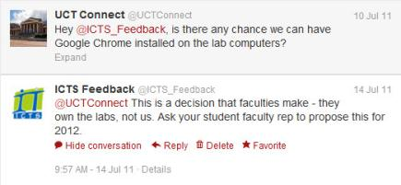
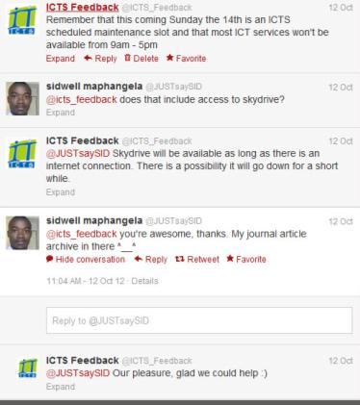
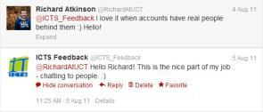
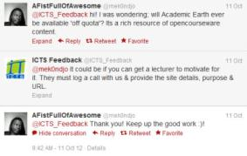
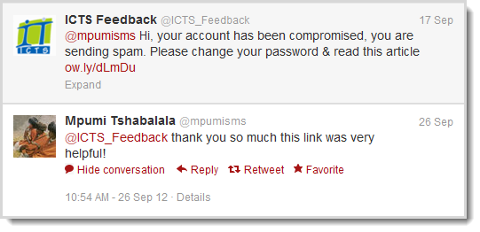
Twitter account: @icts_feedback

Slide 20
Summary
We are expanding our communication into the student population and creating a community of users
Our Twitter feed shows more bi-directional communication and is being used for information sharing and basic support
Our new Facebook page is steadily growing
The challenge is to keep the content fresh and engaging – especially when there is no campaign to sustain interest
We’re still learning… watch this space!

