Slide 1

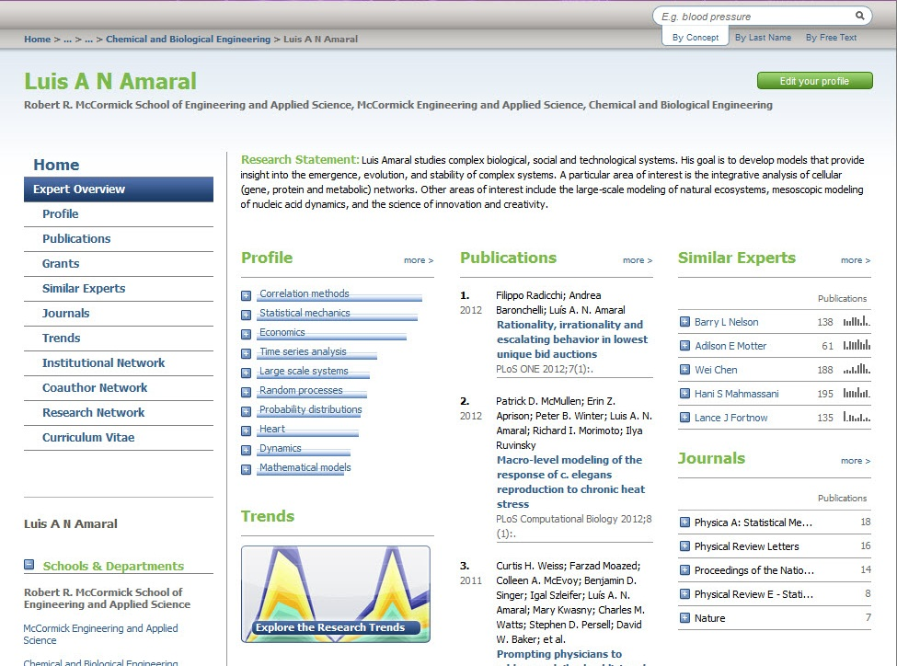
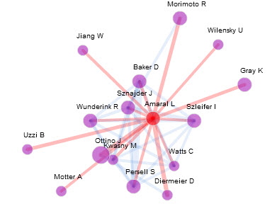
Sh
Enhance the Faculty and Staff Information System for 3000 Faculty
Northwestern Scholars
Value for Faculty
    Challenge:
        Showcase the faculty
        Help them collaborate
        Facilitate their funding searches
        (But don’t impose on their time)
Northwestern Scholars is a research networking tool, a searchable database of publications, grants, research interests, patents, and activities showing collaborations and links to publications.
SciVal Experts (Elsevier) + VIVO (open-source) => Northwestern Scholars
Unique among RN Tool implementations
  Crosses all disciplines
  Collaborative effort across all Schools and Business Units, managed by the Office of Human Resources and the Office of the Provost
  Adds a Semantic Web Portal to a proprietary system
  http://www.scholars.northwestern.edu
  Maintain a single copy of CV content
  Showcase expertise to a wide audience
  Most publications are automatically updated (weekly)
  Identify existing and potential collaborations
  Find funding opportunities and potential co-PIs
  Export the data for other uses (Biosketch, CV, etc.)
Wow, this thing is totally amazing! I’m excited for it to get fully up to speed (capturing more journals, etc.). It’s a remarkable piece of software…
Eli Finkel, Associate Professor, Psychology, Northwestern University
A bit of background on me: I am a PhD researcher in the Cell and Molecular Biology department at the medical school and one of the two new Associate Directors for Northwestern's MSTP program, in charge of directing graduate studies for MSTP students.
I can already see that the Scholars tool is incredibly valuable. I have used it twice in the last 2 days to search for colleagues with specific expertise: once for an experiment that my lab would like to do, and once while advising an MSTP student on rotation labs. For both my research and advising responsibilities, this database is wonderful. It is easily searchable and gives excellent, relevant information that is easy to follow up on. WOW!
Sarah Rice, Assistant Professor, Cell & Molecular Biology, Northwestern University Feinberg School of Medicine
Given I provided no direct input and you used secondary sources, this information was surprisingly accurate! Thanks!
David Cella, Professor and Chair, Department of Medical Social Sciences, Northwestern University Feinberg School of Medicine
Profile, Publications, Collaborations, Grants, CV…
Solution: Use a Research Networking Tool and Make it open-source compatible
Sophisticated Analytics
Automatically gather publication data, whenever possible
Use proven, excellent methods to match faculty members to their publications
Provide fingerprinting, using semantic web ontology
  text + context + controlled vocabularies => fingerprint
Extend existing tools across all disciplines
Use linked open data standards; create a semantic web portal
Find Similar Experts
See Trends Across an Individual’s Career
See the Institutional Network, Coauthor Network, and Research Network at the individual or aggregate level
Find Funding Opportunities based on previous and/or current interests/publications/grants
At left:
An example of a researcher network: connections are revealed by hovering over individual points in the network.
Chicago and Illinois Research Networks
ISTC to build Statewide Research Networking Portal across Illinois
Building on the model of Northwestern Scholars, the Illinois Science & Technology Coalition (ISTC) has committed to create an overarching network to connect researcher expertise and unique facility and equipment databases from research institutions throughout the state of Illinois - the Illinois Open Innovation Network (OIN). The OIN will serve as a portal to Illinois' research talent and facility assets. Through keyword, semantic, and conceptual searches, visitors to the site will provide solutions for their research needs. Such a network promises to ease collaborations for grants and core facilities and facilitate the understanding and planning for joint or collaborative projects and mentoring.
Great tool for Administrators
Northwestern Scholars will have a profound impact on the work of students, faculty and staff. By creating scholarly 'fingerprints' of each faculty member, this new tool takes a comprehensive picture of scholarly activity on campus and off. We expect it will create new opportunities for collaboration across schools, disciplines and institutions.
Daniel Linzer, Provost, Northwestern University
Northwestern Scholars fills a huge gap for our undergraduate population. As coordinator of university-wide grant programs, I am approached by students getting involved in research. Two key stumbling blocks exist. First, they don’t know who deals with their topic, and second, they don’t know the relevant literature. Northwestern Scholars has solved both issues. Now, I can meet with students and identify the core faculty they need to contact and send them off with a big pile of articles from the site. Previously they had to search web sites and/or do Google searches (each one coming up with 200,000+hits). Students are fascinated by the ability to learn about their professors not just as teachers, but as researchers as well. Northwestern Scholars is a remarkable tool that has directly impacted my work in an incredibly positive way in a very short period of time.
Peter J. Civetta, Assistant to the Associate Provost for Undergraduate Education, Northwestern University
Acknowledgements and Contact
Ruth Reingold
Faculty and Staff Information Systems, Northwestern University
1800 Sherman Avenue, Suite 600
Evanston, IL 60208 reingold@northwestern.edu
This project is supported in part by NIH NCRR Grant 3UL1RR025741-04S3 awarded to the NUCATS Institute at Northwestern University.

