Slide 1
Using ITIL to become a Baldrige Quality Organization
Jane McGuire University of New Mexico

Slide 2
University of New Mexico
Research Extensive University – New Mexico’s Flagship Institution
30,000 Albuquerque Main campus Students
Branches: Taos, Los Alamos, Valencia, Gallup
Medicine, Nursing, Pharmacy Schools
Rural telemedicine, midwifery, family & community medicine,
Cancer Center, Mind Research Center
Teaching Hospital
Law School
Anderson School of Management
School of Engineering ECE, CS, Mechanical
Center for Advanced Research Computing
Architecture, Anthropology, Art & Photography, Dance
Collaborations with Los Alamos and Sandia National Labs

Slide 3
Today’s IT World
SPAM
No Raises
Obsolescence planning
Bigger
Faster
Cheaper
Bandwidth

Slide 4
Today’s University
Funding
Threatened or declining
State Formula changes from enrollment to retention & graduation
Granting agencies changing from inputs to outcomes
From counting books or patrons or computers to measuring competencies, meeting SLAs, compliance
University
Data Driven Research
Mobile, multi-media instruction
Quality academics & extensive research
User Needs
Authenticated & authorized – independent of place
Self-configured, on-demand, elastic, bundled pricing

Slide 5
IT Objective
Validation of IT service management and organizational performance approaches and deployment as measured against an objective, non-institutional, non-IT criteria

Slide 6
Strategy without tactics is the slowest route to victory. Tactics without strategy is the noise before Defeat (Failure)
Sun Tsu

Slide 7
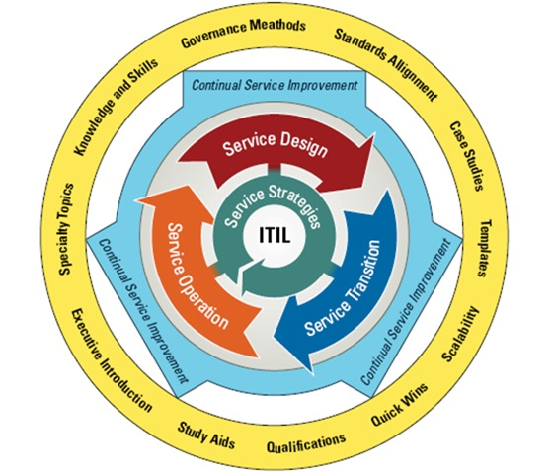
Why itil?
IT Industry Standard Service Management Framework
Effective and Efficient Processes
Growth Paths / Maturity Models
Objective Criteria Assessments
Improve IT Services
Reduce Costs
Improve Customer Satisfaction
Improve Productivity
Improve Skill Use
Improve Delivery of 3rd Party Service

Slide 8
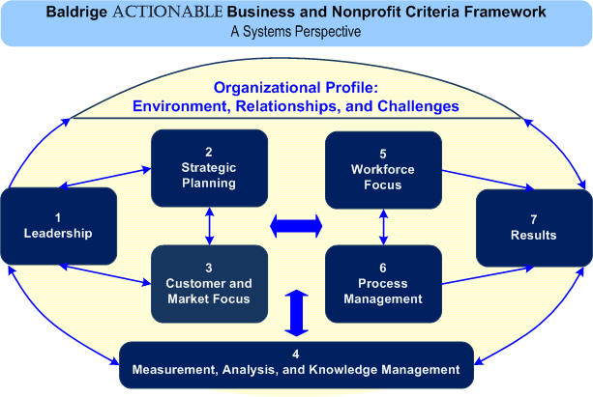
Why Baldrige?
External National Quality Standard
Improve Competitiveness & Performance of US Organizations
Criteria for Business & Non-Profits, Education & Health Care
Beyond IT: Addresses Workforce Management, Strategy and Outcomes
Synthesis in Approach & Deployment
Alignment
Integration
Organizational Learning

Slide 9
ITIL quality Journey
2007 through Tomorrow

Slide 10
ITIL TIMELINE
2007
Tech Staff Groundswell
Management Commitment
2008
Incident Management
Training Requirement
2009
Change Management
Tool RFP
Assessment on Incident
2010
HSC Collaboration
2011
Service Management Tool Implementation
2012
Config Management
Service Level Agreements
Continuous Improvement
Service Design
V3 Training

Slide 11
Quality Journey
2010
Write Application for mid-level recognition in State Baldrige Quality Program
2011
Pinon Recognition of Management Commitment
2012
Readdress processes
Redevelop Profile
Feedback Report
2013
Reapply?

Slide 13
Jane Mcguire
IT Strategic Planner
Office of the CIO, University of New Mexico
jmcguire@unm.edu 505 277-3378

