Slide 1
Using Games to Effect Organizational Change
Approachable Project Management

Slide 2
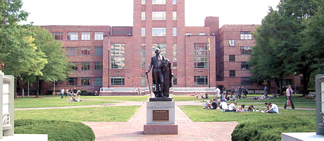
Introduction
Who are we?
Our University
Our Roles
Who you are
Adam Donaldson
Program Manager
Business Management & Analysis Group
Christina Griffin
Director
Project Management Office
Bill Koffenberger
Director
Service Level Management

Slide 3
Agenda
Introduction
Bridge Exercise
Using games to effect change
Requirements Gathering
Knowing what we want
Project Management Process Overview
GW’s Project Management Life Cycle
Wrap Up

Slide 4
Bridge Exercise
Using Games to Effect Organizational Change

Slide 5
Initiating / Idea Phase
Usage of Bridge Exercise at GW
Let’s build a bridge
Your company is bidding for the construction - your group will be the project team
The facilitators consist of:
Client – Contracting your company to build the bridge
Company Official – Works for your company and represents various departments (HR, Sr. Mgt., etc.)
Supplier – 3rd party equipment supplier

Slide 6
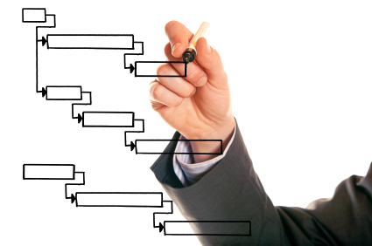
Initiating / Proposal Phase
HINTS
Analytical estimates are a good start, but usually provide only ‘best case’.
Make sure consideration is given for potential delays.
‘80% Rule’ – Team members usually can’t give 100%.
Reliance on 3rd parties can add uncertainty to a project.

Slide 7
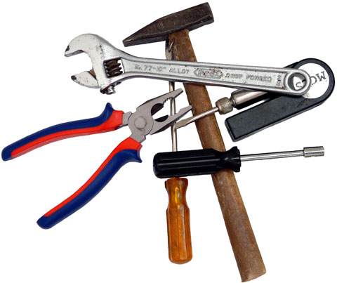
Planning Phase
HINTS
?
Planning is the time to ask clarifying questions.
Role definition and clarification is important.
Do you have everything you need to get started?
Are all of the requirements completely understood?

Slide 8
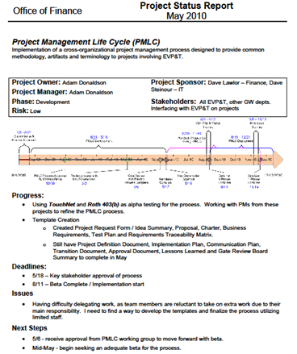
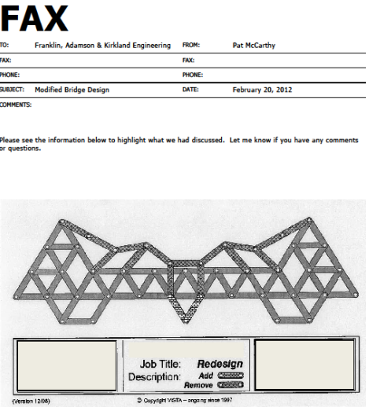
Execution / Development Phase
HINTS
Is everyone performing their role? Does each role have backup?
Ensure the team is communicating status accurately.
Protect scope – clarify any departure from requirements

Slide 9
Execution / Testing Phase
HINTS
Ask for preliminary check-point reviews to resolve issues early.
Verify that EACH of the requirements has been met.
Is someone responsible for overseeing quality?

Slide 10
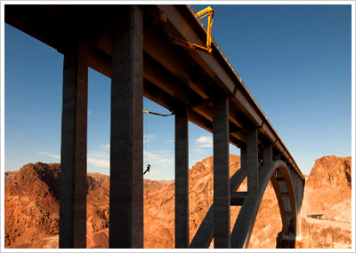
Closing / Review Phase
Final Inspections
Transition to Operations
Lessons Learned

Slide 11
Agenda
Introduction
Bridge Exercise
Using games to effect change
Requirements Gathering
Knowing what we want
Project Management Process Overview
GW’s Project Management Life Cycle
Wrap Up

Slide 12
Requirements Gathering
Knowing What You Want … What You Really Really Want

Slide 13
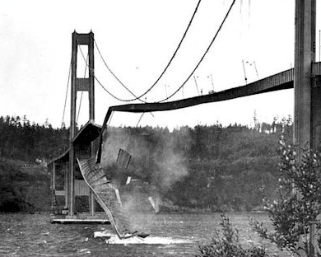
Requirements Gathering
What You Really Really DON’T Want
Tacoma Narrows Bridge Circa 1940

Slide 14
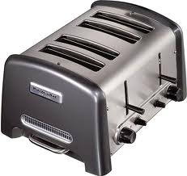
Requirements Gathering
Lets develop some requirements…
Scope =
Develop a high-capacity electric bread & bagel toaster with a low to moderate price point.

Slide 15
Requirements Gathering
About Requirements – What’s not How’s
Specific, Clear and Concise – deconstruct into single requirement, easily read and understood, objective
Traceable / Verifiable – if you cannot measure or observe it you cannot test or evaluate the outcome
Relevant & Necessary - must be within / related to the scope of the project or request, critical to operation of the solution

Slide 16
Agenda
Introduction
Bridge Exercise
Using games to effect change
Requirements Gathering
Knowing what we want
Project Management Process Overview
GW’s Project Management Life Cycle
Wrap Up

Slide 17
Project Management Process
Implementation of the
Project Management Life Cycle at GW

Slide 18
Purpose of the PMLC
Employ a Project Management Life Cycle (PMLC) intended to enable standardization of methodology, documentation, terminology and approval across organizations, while ensuring clear ownership and empowerment of project leadership.

Slide 19
Basic Project Life Cycle
Initiating
Planning
Monitoring & Controlling
Executing
Closing

Slide 20
PMLC Process
PMI Best Practice
Initiating
Planning
Executing
Closing
GO LIVE!
The
PMLC
Idea
Proposal
Planning
Analysis,
Design & Development
Testing & Readiness
Cutover/
Post Go Live
Closing
Monitoring & Controlling

Slide 21
PMLC Process
Initiating
Idea
Proposal
Quick summary and review of an idea
Determine if worth expending resources
Begin gathering requirements
Provide detailed proposal of solution
Upon agreement, charter the project

Slide 22
PMLC Process
Planning
Planning
Develop schedule, plans and requirements for implementation
Acquire resources and engage the project team

Slide 23
PMLC Process
Executing
Analysis
Design &
Development
Testing &
Readiness
Cutover
Post-Go
Live
Transform business requirements / specifications into actionable items
Design and develop the planned solution
Validate the solution against the business requirements / specifications
Verify deployment readiness
Implementation (deployment) of the solution, including training
Prepare to transition project to operations

Slide 24
PMLC Process
Monitoring & Controlling
Idea
Proposal
Planning
Analysis,
Design & Development
Testing & Readiness
Cutover/
Post Go Live
Closing
Schedule / Resource Management Change Management | Risk Management Stakeholder Management

Slide 25
PMLC Process
Closing
Closing
Receive approval to close the project
Transition project items to the operational owner
Perform Lessons Learned

Slide 26
PMLC Process
Phase Gate Reviews
Idea
Proposal
Planning
Analysis,
Design & Development
Testing & Readiness
Cutover/
Post Go Live
Closing
Reviewers are the Executive Sponsors of the project
Receive approval to proceed to the next phase
Serves as point to monitor the health of a project
Clarify project attributes such as roles, milestones, and schedules
Make major decisions about the direction for upcoming phases

Slide 27
PMLC Process
PMLC Flexibility
Idea
Proposal
Planning
Analysis,
Design & Development
Testing & Readiness
Closing
Analysis,
Design & Development
Cutover/
Post Go Live
Minimize bureaucracy while maintaining controls
Artifacts for phases can be modified by Gate Review approval
Phases can be combined by Gate Review approval
Key is that modifications must be approved by Gate Review

Slide 28
Wrap Up
Developing a New Approach to Projects
Emphasizing Requirements to Increase Success
Using Games to Support Implementation of Change
Questions?

Slide 29
Thank You
Continuing the Discussion
Adam Donaldson
Program Manager
Business Management & Analysis Group
adonald@gwu.edu
Christina Griffin
Director
Project Management Office
cgriffin@gwu.edu
Bill Koffenberger
Director
Service Level Management
billkoff@gwu.edu

