Slide 1
Maximize Efficiency
Duane Schau
Director Client Services and Emerging Technologies – Indiana University
Pete Bucklin
Manager Leveraged Services – Indiana University
November 6, 2012

Slide 2
Maximize Your Efficiency:
The New Leveraged Services Model
Indiana University
Strategic Vision
New Era
Computing History
Emerging Technologies
Live Demo
Establishing the Value Proposition
Interactive Session

Slide 3
What Are Your Summary Tiles?

Slide 4
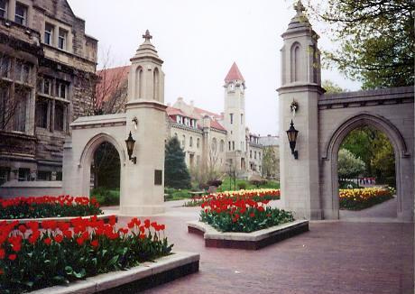
Indiana University
Founded in 1820
Over 110,000 students
Over 25,000 FTE faculty and staff
7 Campuses
Notes:
Duane

Slide 5
Engine for Economic Growth
Fast Facts
Economic Impact
$11.5 B
Jobs
100,031
State Appropriations
$24.91 return
per State Dollar
Tax Revenues
$1.11 for every $1.00 State Revenue
Alumni
570,000
Notes:
Indiana University and IU Health provide
$11.5 billion in total economic impact to the state
100,031 jobs for Indiana citizens
$24.91 to the state for every $1.00 it invests in IU
$1.11 in tax revenue for each $1.00 the university receives in state funding
$843.9 million in impact and support for over 6,500 jobs through research spending
$328.2 million in community benefits
One out of every 30 jobs in Indiana
19,000 graduates every year who are essential to the state’s human capital and workforce needs
More than 50% of Indiana’s physicians, 35% of its teachers, 75% of its attorneys, and 90% of its dentists
XX Number IT Professionals
30,000 PC’s
200,000 student devices

Slide 6

Economic Impact: Jobs
Fast Facts
Graduate Workforce
19,000 yearly
Indiana Graduates
1 out of 30
Physicians
50%
Teachers
35%
Dentists
90%
Attorneys
75%
Notes:
Pete Centralized --- Decentralized

Slide 7
Decentralized
(Pete)
Centralized
(Duane)

Slide 8
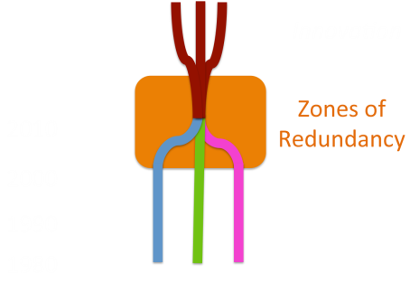
IU History of Personal Computing
Period of Decentralization
Zones of Redundancy
Period of Convergence
Workplace Services Arrives
Notes:
Timeline of University Computing
Period of Decentralization (1980)
1980 – 200X: Unique (“Wild West” of .edu IT)
Period of Decentralization (1980)
Separate unique IT Shops
Period of Convergence → Resulting in Zones of Redundancy
(2000 – 2008)
Common tools emerge and are replicated
Staff working
Symantec Ghost, virus, Windows file servers, Server Administration, Printer, Active Directory (OU Administration)
New Era (2012-2020)
Collaboration, Leveraging, Innovation, Emerging Technologies, Efficiencies, Repurposing financial and human resources
Workplace Services Arrives
Enterprise focus for maximizing efficiency to return dollars for research and innovation – Giving IU competitive advantage (Elsewhere???)
Development of services for the common good
Leaving socialism of .edu and working toward new business model
This isn’t the end-all be-all answer, a vision we’re trying to move forward
Don’t have complete buy-in yet, working toward that consensus
But we HAVE to increase efforts; repurpose people and money into teaching and research
(POSSIBLE BREAK AFTER TIMELINE – 10 MINUTES)
Verify 2012 – 2020 concepts
What are we missing?

Slide 9
Evolution of Cultural Standards
Zones of Redundancy
30 Years?

Slide 10
Evolution of Cultural Standards
2020
Innovation
Zones of Redundancy
2010
2000
1990
1980

Slide 11
Evolution of Cultural Standards
2020
Innovation
Zones of Redundancy
2010
2000
1990
1980

Slide 12
?
Zones of Redundancy

Slide 13
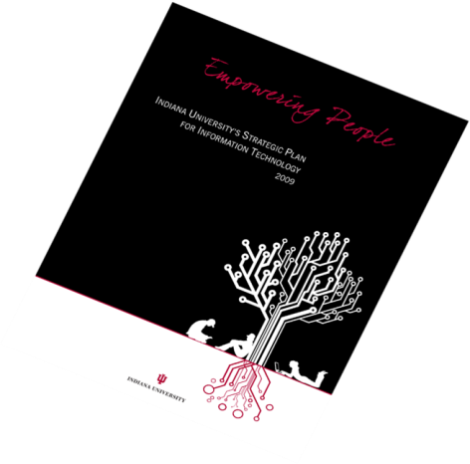
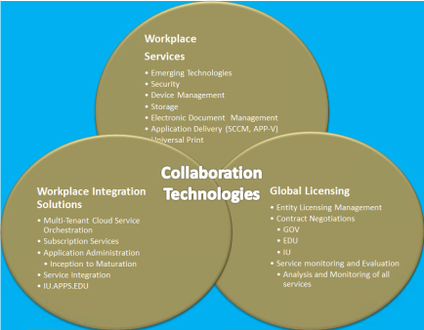

Edge, Leverage, and Trust:
Strategic Vision for the New Era
Financial
Research
Teaching
Notes:
IU’s second strategic plan – Empowering People
EP.IU.EDU
IU Strategic Plan II <5-7 min>
1IUIT (Sue) <5-7 min>
Work close with AVP, need coordinated vision – first place to start
Action 29: Human Engagement
UITS should expand its formal and informal engagements with the IU community to ensure continuous, timely dialogue, and flow of information
Collaborative Workplace Solutions <25 min>
Action 22B: Collaborative Workplace Solutions – Turn-key Solutions
Technologies such as desktop virtualization should be explored to help reduce the costs and extend the lifecycles of personal computing devices.
Virtual, Doc, Automation, Database, Server Administration, Web Solutions – creating an environment of abundance
Partnerships – Action 6: Leveraging Partnerships (External)
IU should continue its highly successful program of relationships with hardware, software, and services vendors, and seek additional partnerships and creative exchanges that provide mutual benefits.
Developing partnerships with vendors (MS, Citrix, Pharos, etc.)
Research <3 min>
Teaching (Staci Marrone) <5-7 min>
Mobile Computer Lab (100k students)
Anytime, anywhere accessibility
Financial <10 min>
Action 1 & 2: Life Cycle Funding Review & Expansion
IU should continue a lifecycle replacement model similar to the one established in ITSP1 to provide baseline support for computing devices and the maintenance of university-provisioned student computing labs.
The lifecycle-funding model should be expanded to cover school, academic and administrative department, and discipline-specific needs and variations to more fully support the diversity of research and creative activity across the university.

Slide 14
BREAK

Slide 15
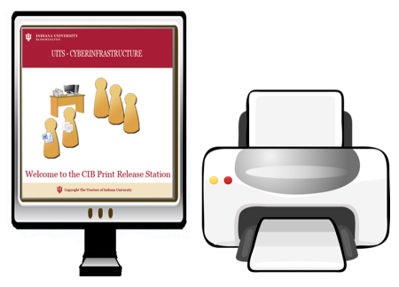
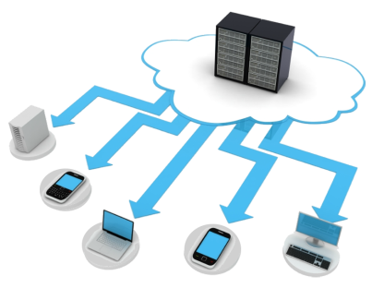

Collaborative Workplace Solutions
Storage Solutions
Deployment and Device Management
Automation and Document Management
Notes:
Collaborative Workplace Solutions provides the Roadmap for Indiana University to eliminate Zones of Redundancy
Print Solutions
Storage Solutions
Virtualization
Deployment and device management
Server Solutions
Automation & document management
Vender Partnerships
================
Some of these are Horizontally and Some of these are Vertically Integrated
Otherwise Knonw As:
Common Good Services
“Department in a Box”

Slide 16
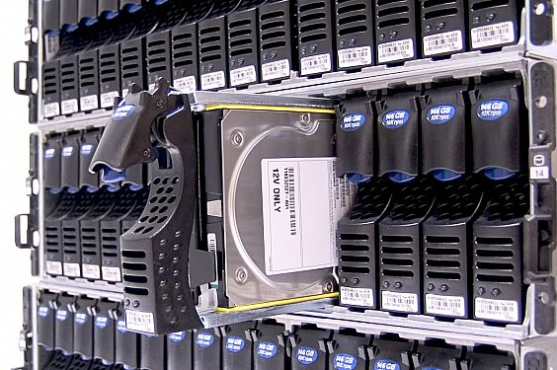

Collaborative Workplace Solutions
Print Solutions
Server Solutions
Virtualization Solutions
Automation and Document Management
Profile Management, AD Policies
MSI
APP-V
XenAPP
SCCM
AD Integration, Patch Management, User Interface, Reporting, Packaging
Hypervisor (vSphere, Hyper-V, XenServer)
Notes:
Graphical Representation of Collaborative Workplace Solutions

Slide 17
Project Development Lifecycle
Phase 1: Project Kickoff
Phase 2: Exploration
Phase 3: Design
Phase 4: Build
Phase 5: Testing
Phase 6: Pilot Rollout
Phase 7: Fine-tune Rollout Plan
Phase 8: Production Rollout
Phase 9: Ongoing Support
Notes:
Given the new model that Duane eluded to earlier, the only way we can be successful is to develop a common standard for project management that everyone can related to and understand

Slide 18
Server Solutions
Administration
SQL
Hypervisors (vSphere, Hyper-V, XenServer)
Intelligent Infrastructure

Slide 19

Storage Solutions
RFS
SharePoint
IU Storage
Alfresco
(ePHI)
Notes:
Research File System
The Research File System is a spinning disk system with currently 30TB of total capacity. RFS can be mounted on the desktop or accessed over the web or SFTP protocol. RFS supports active editing of files and documents unlike the SDA. Files are backed up on a nightly basis from RFS. RFS has robust support for project work as well. IU is first in implementing a geographically distributed HPSS in production and is one of the largest HPSS sites in the world.
System configuration Aggregate information
Machine type Research filesystem
Operating system Red Hat Enterprise Linux 5
Nodes 4 file servers
4 gateway nodes
Storage information Aggregate information
Netwrk filesytm protocols OpenAFS, CIFS (Samba), SFTP/SCP, HTTPS
Total disk space 50 TB
Availability scope Access to RFS is available to IU graduate students, faculty, and staff. Undergraduates and non-IU collaborators must have IU faculty sponsors.
Quotas 100 GB (default) per user, 100 GB (default) per project; increases as needed
Backup and purge policies The system is backed up nightly. Data recoveries are possible within 30 days of deletion. The system is never purged.
Aggregate I/O 4 gbs (currently limited by network connection)
Departmental File Storage
Box
50 GB of File storage for faculty staff and students
Sharepoint Storage
Unlimited file storage for faculty, staff

Slide 20

Print Solutions
Pharos vs. GoPrint
Software
Hardware
Project Development Life Cycle

Slide 21
Universal Printing Roadmap
Internal Security Review
Web Jetadmin Management Tool
BL Swipe Card & Touchscreen
Print Cost
Q4 2012
SOP Framework
Reporting
Mobile Printing
Pharos Upgrade from xx => xy
(BL, IN)
The Universal Printing Roadmap provides a mechanism to help forecast, plan and coordinate technology developments.

Slide 22
Universal Printing Roadmap
Steering Comittee
Design Architecture
Development Testing
(Early Adopters)
Implementation Strategy
Q4 2012
Q1 2013
Q1 2013
Q2 2013
Determine Vendor
Build Out Infrastructure
Production/
“Go Live”
The Universal Printing Roadmap provides a mechanism to help forecast, plan and coordinate technology developments.

Slide 23
Deployment and Device Management
SCCM
InTune
Hyper-V
Project Development Life Cycle
App-V
MSI
Notes:
Show Example after talking points

Slide 24
SCCM Roadmap
Microsoft InTune TAP Acceptance
POC – Phase VII
Fine Tune Rollout Plan
Phase II
Exploration
POC – All New Builds
Deploy from 2012
POC - Stabalization
POC – R/S Migration
Q4 2012
POC – AIT Full Migration
2007 → 2012
Identify Team SCCM
Phase I
Project Kickoff
Phase III
Design
POC – Athletics Migration
2007 → 2012
The SCCM Roadmap provides a mechanism to help forecast, plan and coordinate technology developments.

Slide 25
SCCM Roadmap
POC – Phase VIII
Production Rollout
IU ADS CA
PCI/DSS Merger
2007 environments
Phase VI
Pilot Rollout
DR Submission
Q2 2013
Q1 2013
Q2 2013
IU ADS Schema Extension
Phase V
Testing
Security Review
Phase VII
Improve Master Rollout
Phase IV
Build
The SCCM Roadmap provides a mechanism to help forecast, plan and coordinate technology developments.

Slide 26
Virtualization
IUanyWare
CloudStorage
Applications
Architecture
On-Demand
Anytime
Anywhere
Any Device
Notes:
Cloudstorage.iu.edu
IUanyWare.iu.edu
Citrix Receiver

Slide 27
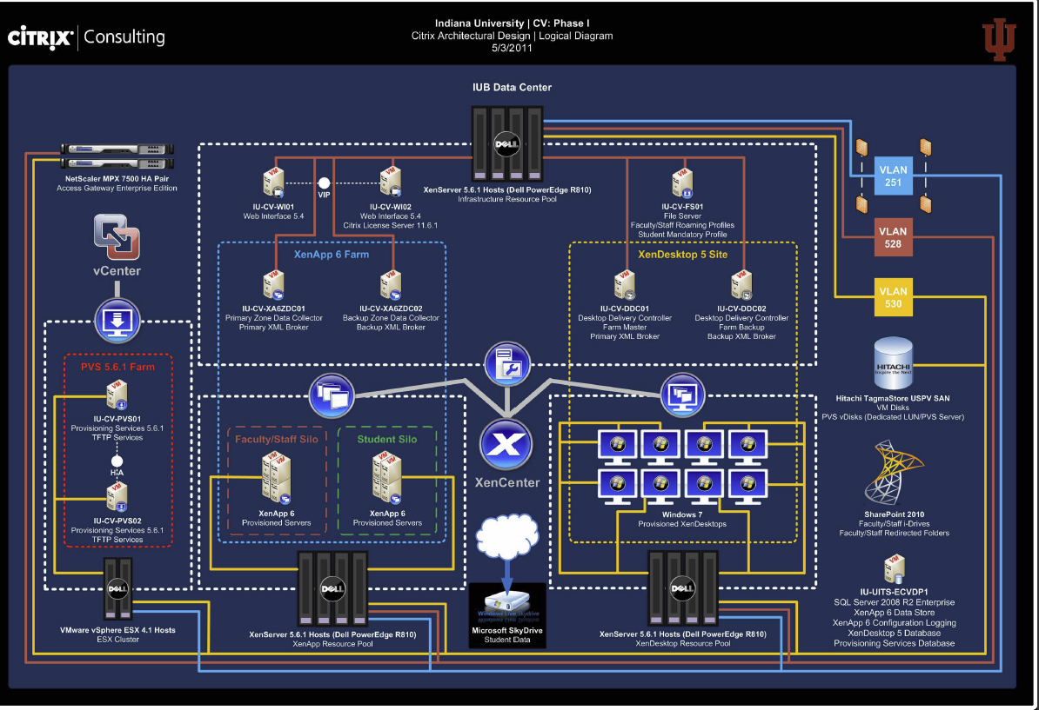
Schematic Design (IU-Citrix)
Notes:
Duane

Slide 28
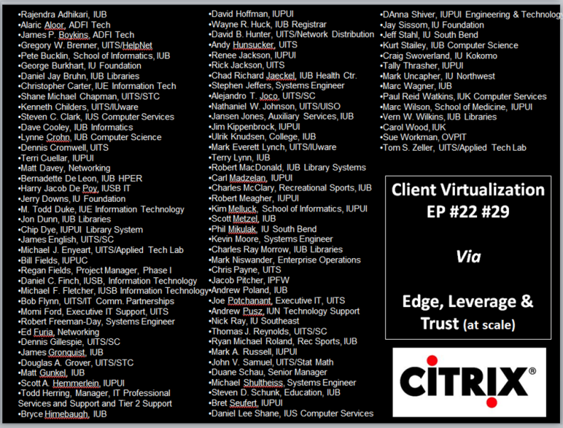

Slide 29
IUanyWare Roadmap
Storage Configurator
IUanyWare releases a cloud configuration tool for data storage of your choice
Stat/Math Software
IUanyWare releases Stat/Math Software, pending license approval
University Technology KIOSKS
IUanyWare begins to replace technology KIOSKS – available University-wide
Beta → Production
IUanyWare moves from Beta to Production.
Q3 2012
Fall Classes Begin
August 20th
Campus Technology Innovators Presentation
IUanyWare presents at campus technology innovators conference
Adobe CS6
IUanyWare releases Adobe CS6
IU Recreational Sports Pilot
IUanyWare integrates into Recreational Sports
Statewide IT Presentation
IUanyWare presents mobile lab at Statewide IT Conference
The IUanyWare Roadmap provides a mechanism to help forecast, plan and coordinate technology developments.

Slide 30
IUanyWare Roadmap
IU School of Dentistry Pilot
IUanyWare provides applicatons for mobile devices at the IU Dental School
Café
IUanyWare augments labs and collaboration spaces across all Indiana University Campuses
EDUCAUSE
IUanyWare presents at Educause national conference
Q4 2012
ACUTA Presentation
IUanyWare presents at ACUTA national conference
Office 2013
IUanyWare releases
Microsoft Office 13
IUPUI Finance/Administration Pilot
IUanyWare moves into the worklife of administration on the IUPUI campus
XenApp 6.5
IUanyWare upgrade to XenApp version 6.5
The IUanyWare Roadmap provides a mechanism to help forecast, plan and coordinate technology developments.

Slide 31
IUanyWare Roadmap
IUanyWare Partnerships
IUanyWare looks for new ways to integrate with Academic Units and Departments
STOREFRONT
IUanyWare overhauls interface to application management
Citrix Synergy
IUanyWare presents at Citrix national conference
Q1 2013
Q2 2013
Q1 2013
XenDesktop 6.5 Upgrade
IUanyWare steps into the future with XenDesktop 6.5
CloudStack
IUanyWare looks at ways to leverage cloud hypervisors
The IUanyWare Roadmap provides a mechanism to help forecast, plan and coordinate technology developments.

Slide 32
Automation and Document Management
Knowledgelake
OnBase
SharePoint
Project Development Life Cycle
Nintex Workflow
Notes:
https://iupress.sharepoint.iu.edu/sites/eds-dev/Project/SitePages/Home.aspx

Slide 33
Adapting to Personal Ecosystems
Device & OS Independence
Apple Ecosystem
Windows Ecosystem
Google Ecosystem
Linux Ecosystem
Ubuntu 12.X
Windows 8
Android 4.0
iOS
Windows 7
Mac OS
SCCM, XenApp & App-V Application Collections
Indiana University
Workplace Services
Notes:
Student Video

Slide 34
What Are You Doing to Integrate Ecosystems?
Apple Ecosystem
Windows Ecosystem
Google Ecosystem
Linux Ecosystem
Ubuntu 12.X
Windows 8
Android 4.0
iOS
Windows 7
Mac OS
Student
Faculty
Staff

Slide 35
Teaching Mission
Online Courses
Anytime Anywhere Accessibility
Anytime Anywhere Student Labs
Pedagogy Advancement
Notes:
Identifying core components representing our zones of frequency.
Innovation occurs at the edge represented in the following innovation examples.
Administrative Video

Slide 36
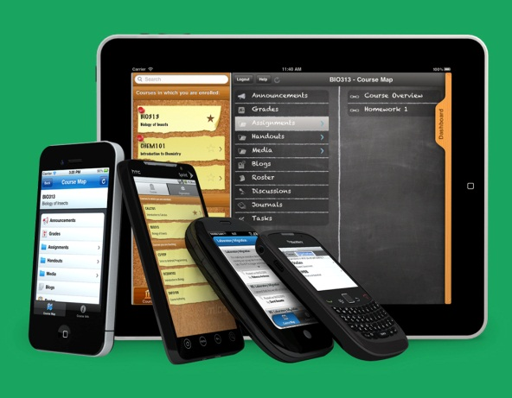
Academic Year 2012-2013
Today’s Mobile Student Computing Lab
BYOD
Printing
Storage
Collaboration Centers
Notes:
Complete on-the-go lab for all students
BYOD
BYOA
BYON
Printing
Storage
Collaboration Centers

Slide 37
Research
Security
Privacy
Compliance

Slide 38

Financial
Energy
Data Center
Student Labs
SSI
Space

Slide 39
Virtual Datacenter Costs
IUanyWare
Notes:
Duane
FY 10-11 OS and Application Service
Hardware and Infrastructure
Intelligent Infrastructure
$10,072
Development Machines
$4,000
Student Software Licenses
$287,495
Personnel
FTE Salary and Benefits (%s of 7 FTE)
$427,932
Total Cost
$729,499
IU Bloomington Students
42464
Cost Per Student
$17.18
Devices Supported
3,272
Cost Per Device
$222.95Client Virtualization (Citrix) VirtApp VirtOS
DataCenter Cost Model
Cost per Server (CPU) $10,241 $10,241
Cost per Server (RAM) $3,840 $7,680
Cost per GB - Server Stor $10.40 $10.40
Cost per GB - User Stor $2.08 $2.08
Cost per Server (XenServer) $0 $0
Cost per Server (Switch+) $2,381 $2,381
Netscaler & PVS Overhead $2,035 $2,218
SAV & OPER Staff $6,048 $6,048
Data Center Cost (power,etc) $1,400 $1,400
Cost per GB of Backup $6.24 $6.24
Users_per_Core 16 4
Cores_per_System 16 16
Users_per_System 256 64
Users_per_GB of RAM 2.00 0.25
GB of RAM per System 128 256
GB of STOR per User 1 4
GB of STOR per System 200 800
CPU $40.00 $160.02
RAM $15.00 $120.00
Storage $10.21 $138.32
XenServer $0.00 $0.00
TOR Switch+ $9.30 $37.20
NetScaler & PVS $7.95 $34.66
SAV & OPER Staff $23.63 $94.50
Data Center $5.47 $21.88
Backups $6.24 $24.96
------------- -------------
Cost per User $117.79 $631.53
Yearly Cost per User $29.45 $157.88

Slide 40
A
L
U
V
E

Slide 41
Student Lab Scenarios
Scenario 1 | BL/IN combined cost | Comparison to standard desktop, $800, 4yr lifecycle | Savings
FY13 | $ 99,400 | $ 497,000.00 | $ 397,600.00
FY14 | $ 95,928 | $ 479,640.00 | $ 383,712.00
FY15 | $ 86,335 | $ 431,676.00 | $ 345,340.80
Scenario 2
FY13 | $ 191,290 | $ 497,000.00 | $ 305,710.00
FY14 | $ 236,975 | $ 479,640.00 | $ 242,665.00
FY15 | $ 213,278 | $ 431,676.00 | $ 218,398.50
Scenario 3
FY13 | $ 148,240 | $ 497,000.00 | $ 348,760.00
FY14 | $ 131,940 | $ 479,640.00 | $ 347,700.00
FY15 | $ 118,746 | $ 431,676.00 | $ 312,930.00

Slide 42
Do we have something to take back to make a difference in our institutions?
Notes:
Breakdown
Tasks
Identify solutions to reduce or eliminate zones of redundancy
Ideas integrate ecosystems
Opportunities for Innovation
How can you incorporate all these ideas to take back and make a difference in your institution.

Slide 43
ROI
Workplace Solutions
Emerging Technologies
Thin Clients
Under $300
PC Minis
Under $400
Mini PC-Sticks
Under $ 70

Slide 44
Q & A
+ Delta
DEMO

