Slide 1
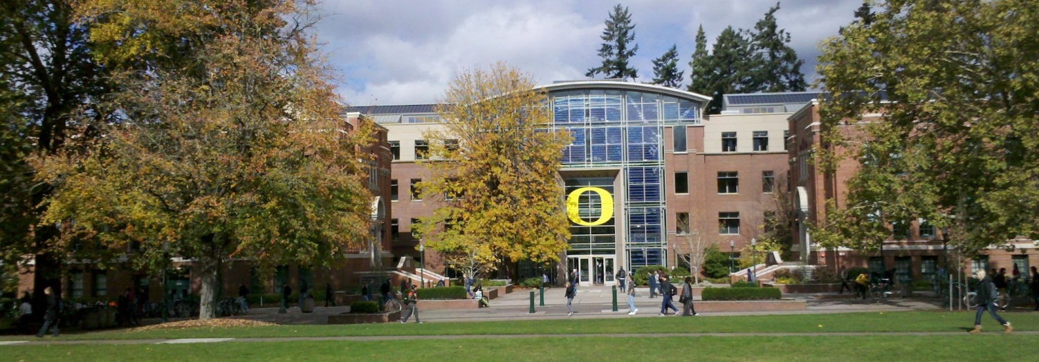
The Importance of Mentors on the Journey to a First CIO Position
Melissa Woo, University of Oregon
Notes:
Session abstract
Mentoring has evolved beyond the traditional long-term, one-on-one style. There are many different mentoring styles, and each can be leveraged effectively to assist in one's professional development. This session will cover different mentoring styles that can be used during the different steps in the journey towards that first CIO position.

Slide 2
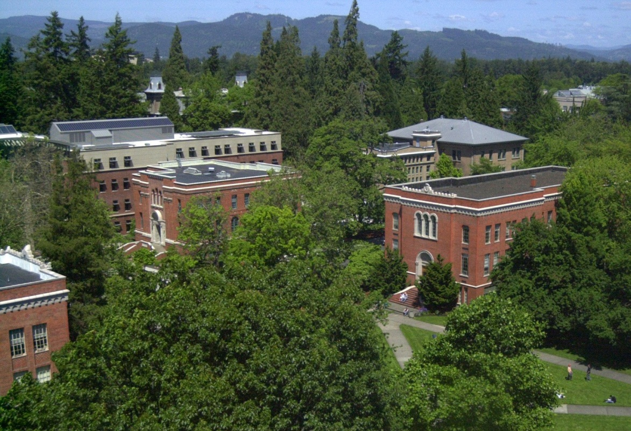
Photo credit: Erik R. Bishoff
Notes:
University of Oregon
Located in Eugene, OR
Flagship of the Oregon University System
Full-time enrollment ~24,500 students
Carnegie classification RU/VH
Member of the AAU

Slide 3
Administrivia
The Twitter hashtag for this session is #E12_SESS017
Yes, I’ll be uploading the slide deck to the E12 web site: http://www.educause.edu/events/E12/SESS_017

Slide 4
How many mentors do you currently have?
1? 2? 3? >3?
Take the poll at:
http://polls.tw/jt2/p
Notes:
http://polls.tw

Slide 5
We are each a mosaic
CC BY-SA 2.0 by robynejay
Notes:
I like to think of each of us as a mosaic, made up of many different tiles that in the aggregate makes each of us unique. Tiles that represent people who have touched our lives are included in each of our mosaics.

Slide 6
Mentors are tiles in your mosaic. They are…
Notes:
I like to think of mentors in my life as being brightly colored tiles in the mosaic that is me.

Slide 7
Managers and leaders, but also…
CC BY-SA 2.0 by robynejay

Slide 8
Colleagues at all levels
CC BY-SA 2.0 by robynejay

Slide 9
Friends
CC BY-SA 2.0 by robynejay

Slide 10
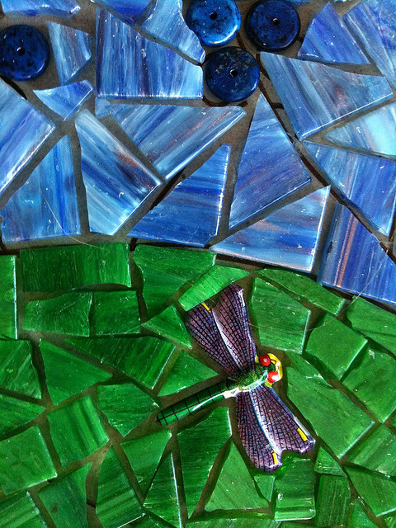
… and sometimes people you’ve not yet met
CC BY-SA 2.0 by robynejay

Slide 11
Mentoring Functions & Styles

Slide 12
Relevant mentoring functions
Career:
Sponsorship
Visibility
Coaching
Psychosocial:
Role modeling
Counseling
Notes:
When considering whether you should be involved in a mentoring relationship, think about the functions that mentoring serves and determine which are of primary importance to you.
Mentoring functions fall under two general categories: career and psychosocial. Sponsorship, visibility, and coaching are career mentoring functions. Role modeling and counseling are psychosocial mentoring functions.
These are just a subset of mentoring functions. For additional information, see the
EDUCAUSE table of mentoring functions:
http://www.educause.edu/careers/special-topic-programs/mentoring/about-mentoring/types-mentoring-functions

Slide 13
Sponsorship
Nominates mentee for lateral moves / promotions
Mentee advantages
Mentor advantages / risks
Builds reputation
Provides job opportunities
Gain reputation for finding / developing talent
Can enhance or damage mentor’s reputation

Slide 14
Visibility
Gives mentee opportunities that allow relationships w / key figures
Mentee advantages
Mentor advantages / risks
Learn organization at higher level
Increases visibility
Gain knowledge about future opportunities
Can enhance or damage mentor’s reputation depending on mentee’s performance

Slide 15
Coaching
Outlines strategies for accomplishing objectives; shares understanding
Mentee advantages
Mentor advantages / risks
Gain informal knowledge of organization
Broadens perspective
Navigate organization
Confirms value of experience
Gain feeling of effectiveness
Personal view carried on

Slide 16
Role modeling
Gives attitudes, values, behavior for mentee to emulate
Mentee advantages
Mentor advantages / risks
Learns mentor’s approaches, attitudes, values
Helps redefine professional image
Confirms value of experience

Slide 17
Counseling
Explore concerns that may interfere with self / career accomplishment
Mentee advantages
Mentor advantages / risks
Derive comfort from sharing doubts / concerns confidentially
Review earlier career stage decisions
Provides basis for feeling valued

Slide 18
Which mentoring function is currently most important to you?
Sponsorship?
Visibility?
Coaching?
Role Modeling?
Counseling?
None / not seeking mentor
Take the poll at:
http://polls.tw/jt4/p

Slide 19
Mentoring styles for aspiring CIOs
CC BY-NC 2.0 by Virginia Mosaics
Traditional
Network
Circle
Invisible
Notes:
When most people think of mentoring, they generally think of the traditional, one-on-one mentoring style that involves a more experienced, usually older, individual acting as a mentor to a younger individual.
The increased communications media, specialization, and individual time commitments has led to wider adoption of many different mentoring styles. Different mentoring styles suit different goals, and should be chosen with goals and individuals in mind.
These four styles - traditional, network, circle, and invisible – are a subset of mentoring styles, but are probably the most useful to technology leaders aspiring to the CIO position.
For a more complete treatment of mentoring styles:
http://www.educause.edu/careers/special-topic-programs/mentoring/about-mentoring/mentoring-styles

Slide 20
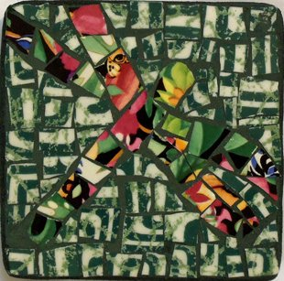
Traditional
One-on-one
Expert passing on knowledge
Hierarchical
Long-term time commitment
CC BY-NC 2.0 by Virginia Mosaics
Notes:
An example of a slight modification to the traditional mentoring style is one in which an individual passes along knowledge to more than one mentee, but responds to each separately.
An example I’m currently using is what I call the “Sausage-making series.” ☺
I bcc a group of people email about what I’m doing in my first year as a new CIO. These emails are usually forwarded messages that I’ve sent to our staff and leadership team, to which I’ve added extra context. The list of people I email is a bcc list, as a couple don’t want it widely known that they are actively looking for CIO positions. I invite the recipients to contact me if they have questions and/or comments about what I’ve sent.

Slide 21
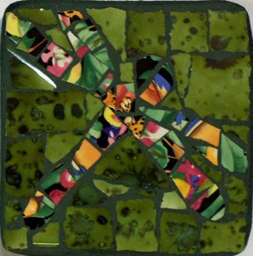
Network
Group mentoring
Share knowledge
Hierarchical and/or peer
Variable time commitment
Social networks
CC BY-NC 2.0 by Virginia Mosaics
Notes:
Network mentors are a small group of people to whom you turn for mentoring.
Generally, you’ll want to incorporate individuals outside your own organization into your group of network mentors.
The network style of mentoring is based on a high degree of mutual learning and trust.
Some examples of Network Mentoring that have helped me:
Emailing CIOs that I admired (and only knew on very scant acquaintance) for advice on how to interview for a first CIO position
Reading and responding to others in higher ed on social networks, such as Twitter and Google+

Slide 22
Circle
Group mentoring
Share knowledge
Peers - develop a cohort
Medium/long-term time commitment
CC BY-NC 2.0 by Virginia Mosaics
Notes:
Circle mentoring is a peer mentoring support network of friends and / or colleagues.
Relationship in circle mentoring are reciprocal in nature.
Members of the circle support each others’ professional and personal growth.
Examples of Circle Mentoring that I’ve used:
Bi-weekly Google+ Hangout with colleagues in similar cohort
Social networks, particularly Google+
Get-togethers at conferences / meetings

Slide 23
Invisible
Non-interactive mentoring
Observe mentor at a distance
Variable time commitment
CC BY-NC 2.0 by Virginia Mosaics
Notes:
Invisible mentors are leaders from whom you can learn by observing from a distance.
Learning is through extensive research into the mentor’s life, including what has been written about him/her, speeches/presentations, etc., and what the mentor has produced, such as articles, blog posts.

Slide 24
Which mentoring style are you most likely to try?
Traditional?
Network?
Circle?
Invisible?
None
Take the poll at:
http://polls.tw/jt5/p

Slide 25
Creating a professional development plan
CC BY-SA 2.0 by patti haskins
Reflecting
Gaining self-awareness
Seeking outside input
Developing action steps
Setting longer term goals
Notes:
An important step you should take before embarking on a mentoring program is to develop a professional development plan. It can help you determine what mentoring functions are styles are most appropriate for achieving your goals.
A good reference is the document, “Creating a Professional Development Plan,” which has been used in the EDUCAUSE Management Institute.
http://net.educause.edu/section_params/mentoring/M06_%20PDP.pdf

Slide 26
Find a mentor
Conferences
Social networks
EDUCAUSE Affinity Finder
Ask! What’s the worst that could happen?
CC BY-NC 2.0 by Virginia Mosaics

Slide 27
The worst anyone can say is “no”
CC BY 2.0 by M0les
Notes:
A former colleague of mine said that she was hesitant to ask me to be her formal mentor. She waited a year before she had the courage to ask me.
What’s the worst I could have said to her? The worst I could’ve said was no, and it would’ve been for a reason completely unrelated to her as a person.
Weigh the potential benefits against the very small potential downside… ask! How bad will it really be if the potential mentor says no?

Slide 28
To thine own self be true
CC BY-NC 2.0 by Virginia Mosaics
Notes:
Be realistic about your current knowledge, skills, and abilities. A mentor can help you significantly, but isn’t a miracle worker. Ultimately you’re responsible for your own professional development and advancement. A mentor can’t fill in gaps in your experience for you – only you can do that.

Slide 29
Finally, remember…

Slide 30
Pay it forward
CC BY-SA 2.0 by patti haskins
Notes:
This is a personal opinion, but I feel a moral obligation to “pay it forward.” That is, I’ve been the fortunate beneficiary of the generosity of many, many mentors throughout my life (and continue to benefit). Therefore, in order to pay those individuals back, I contribute my time and knowledge to assist others who are in the leadership pipeline in the hopes that they can similarly benefit.
Remember… you can be a brightly colored tile in a mentee’s mosaic!

Slide 31
Resources
EDUCAUSE Mentoring Resources www.educause.edu/mentoring
Creating a Professional Development Plan net.educause.edu/section_params/mentoring/M06_%20PDP.pdf
EDUCAUSE Affinity Finder www.educause.edu/members

Slide 32
Take this moment to thank the mentors in your life
CC BY-NC 2.0 by Virginia Mosaics

Slide 33
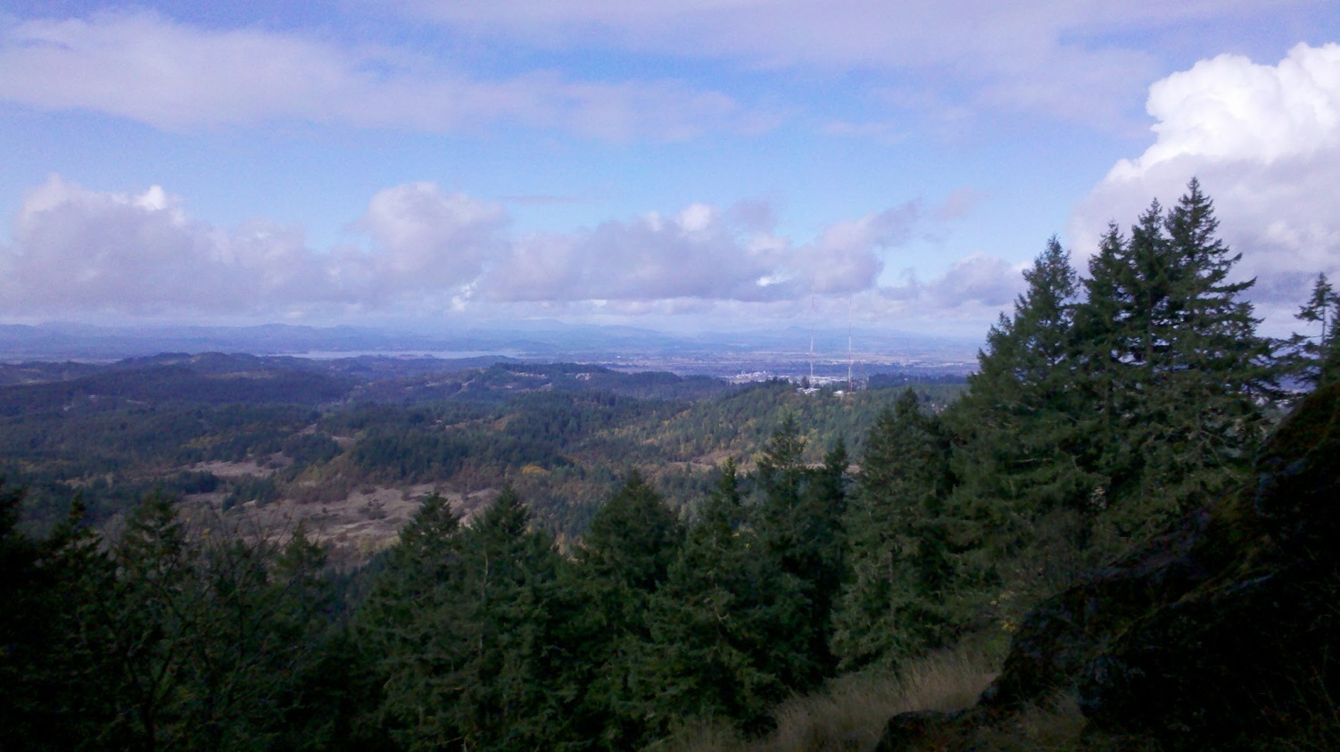
Questions?
Melissa Woo
Vice Provost for Information Services & CIO
University of Oregon
cio@uoregon.edu
Notes:
(This is a view from the top of Spencer Butte, overlooking the area around Eugene.)

