Slide 1
Sue Cullen
Program Manager, CSUN Universal Design Center
Accessible Product Testing Coordinator, California State University Accessible Technology Network

Slide 2
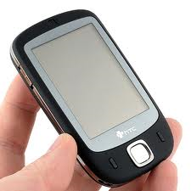
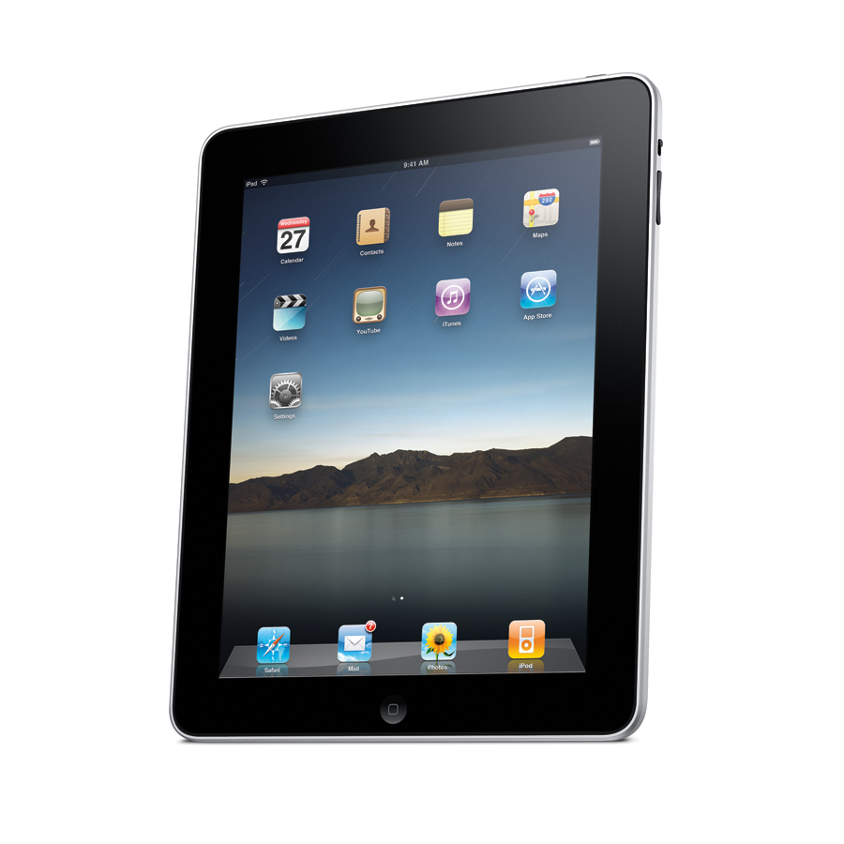
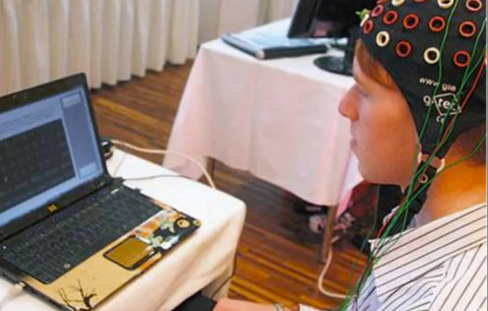
Good Structured Allows For Flexible Use
Smart Phones
Laptops
Ipads
Voice Command
Text to Speech
Mind Control

Slide 3
UDC Services
Usability and Accessibility consultation and training
Evaluation of web sites and applications for compliance and usability
Web Designer/Developer professional development
Campus ADA/504/508 compliance
Compliance testing for California State University Accessible Technology Network

Slide 4
Visual Perception:
Color Contrast, Visual Confusion
Interface
Navigation:
Table Structure, Headers, Form fields etc
Usability:
Layout Design based on content
Functional Need::
Site accomplishes intended goals
Categories of Interface
Notes:
Large circle surrounded by smaller circles orbiting around it. Each small circle has even smaller circles orbiting around it. Concept: Each of the elements of universal design has many components.
8 Great Questions
Navigation:
Table Structure, Headers, Form fields etc.
Visual Perception:
Color Contrast, Visual Confusion etc.
Usability:
Plugins, Layout Design, Understandable content etc.
Functional Need:
Does the site do what is is supposed to do without too much difficulty for the user?

Slide 5
Utilizing the CSU Goals and Success Indicators – CSUN
Help to focus campus collaborations
Provide clarity of expectations
Campus Organization
Executive Support
Department and Divisional ATI Coordinators
Utilize Campus Governance Committees

Slide 6
Operationalize Goals
Developed training for Web Designers and Developers
Universal Design Toolkit
Blend compliance standards into coding standards
Page scans: Provide the right tool for the right need: WAVE, Juicy Studios etc
Campus scans: Compliance Sheriff
Inventory
Tractable over time

Slide 7
CSUN Cultural Outreach
ATI Regional Conference
“Just One Thing” Challenge
Accessibility Camp LA
Campus Faculty, Staff and Students

