Slide 1
Cheryl Pruitt
Director, Accessible Technology Initiative

Slide 2
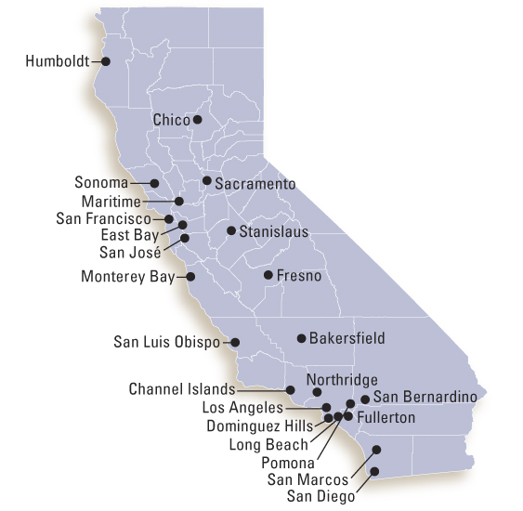
Context: about the CSU
California State University (CSU)
Largest public baccalaureate degree-granting institution in the United States
23 campuses; with more than 400,000 students
About 11,800 students with disabilities are registered with our campus disability services offices

Slide 3
CSU People: Our Most Important Resource
The CSU’s Accessible Technology Initiative (ATI) is all about empowering everyone on campus to make choices in doing their work that enables the CSU education to be accessible to all.
An “Empowering” Strategy requires:
People know what to do, know how to do it, know why they are doing it, and know the consequences of their choices.
Goals of maturing capabilities and continuous process improvement leading to sustainable organizational change

Slide 4
Executive Leadership & Support
In 2004, CSU Chancellor Reed signed an Executive Order affirming the CSU’s commitment to ensuring equal access for persons with disabilities.
Recognized that accessibility was an institution-wide responsibility that must be managed by all campus units—not just disability services programs.
Outlined responsibilities of stakeholder groups and required an Executive Sponsor be appointed on each campus to coordinate campus ATI activities.
In 2006, CSU funded the Accessible Technology Initiative (ATI) and hired staff at the Chancellor’s Office to support the ATI implementation across the 23 campuses.
Notes:
Strong Executive leadership and support are essential for a successful ATI implementation

Slide 5
Developing ATI Implementation Policy
Based on lessons learned the ATI implementation policy has been revised several times over the years.
Our current policy focuses on a year-long cycle of planning, working the plan by utilizing systemwide and campus capacity, and reporting on progress. Accessibility is integrated into campus business processes by accomplishing goals supported by a set of success indicators. We have limited resources so we base our implementation efforts on a prioritization framework that considers impact, probability, risk, and capacity.

Slide 6
Empowering People: Knowing what we need to do
The ATI Goals and Success Indicators articulate the processes, practices, and procedures that need to be in place for the sustainable removal of accessibility barriers.
Collectively there are 22 Goals and 142 Success Indicators spread across three priority areas Web, Procurement, and Instructional Materials
They were developed through our shared governance process that included diverse groups of CSU stakeholders coming together to share their accessibility expertise and knowledge
Progress is measured by a set of status levels.
Notes:
Our current policy empowers people by stating what needs to be done to integrate accessibility into our institutional processes

Slide 7
Goal and Success Indicators
Web Accessibility Evaluation Process Area
Goal 1.0 Identify and repair or replace inaccessible websites, web applications, and digital content.
Success Indicator | Status Level
1.1 Assigned responsibility for the evaluation process to a body (person(s) or business entity). | Established
1.2 Inventoried all campus websites and web applications | Established
1.3 Established a process to perform regularly scheduled accessibility audits using established criteria to identify websites that need remediation. | Defined
Notes:
Here is an example of one of our Goals and a few of success indicators that support the goal and status levels that measure progress.
The success indicators describe what needs to be done. Our campuses decide how they will do it.

Slide 8
Measuring Progress – Status Levels
Notes:
Status levels range from Not Started to Optimizing and they are measured by a description of the maturity of the procedure, the level of documentation, a whether or not resources have been allocated. For example, on the last slide we had a success indicator that is at the status level of defined. Establishing a regularly scheduled audit process – in this case defined may mean that Sally in the IT department has been designated to do audit scans every 6 months but the task is not part of her regular job description. So to move this success indicator to Established the tasks would need to part of her job description which would require more complete documentation and resource allocation.

Slide 9
ATI Implementation Process
Planning – Each campus establishes a yearly plan based on priorities such as impact and capacity to guide their work on the Success Indicators.
Working the Plan - the ATI System team organizes projects to address specific high impact Success Indicators. These projects are collaborative efforts across our campuses that produce deliverables that can be adopted and adapted by each individual campus. Each campus works on their own projects and adopts systemwide deliverables as needed.
Measuring Progress - ATI Annual Reports that cover all the goals and success Indictors measured by status level are submitted by each campus. Systemwide Aggregate reports are compiled from the individual campus reports.
Notes:
We accomplish the Goals and Success Indicators using our implementation process that consists of
We are concluding the third year of measuring systemwide progress. We have seen improvement each year and we have been able to determine where campuses are experiencing difficulties.

Slide 10
Building Capacity
Automatic Sync systemwide contract that provides cost effective timely video captioning services
Systemwide contract for a Web Accessibility Evaluation tool including standardized accessibility requirements and extensive training and support so campuses will able to use the tool to its full capacity.
CSU Accessible Technology Network CSU ATN - leverages accessibility expertise across the system. Campus personnel at a variety of campuses contract with the Network to provide services and produce deliverables that can be shared throughout the system. The CSU ATN is starting to work collaboratively across campuses to provide accessible product documentation review, product accessibility testing, and collaboration with vendors to improve the accessibility of products. These services will reduce redundancy of effort and deliver cost savings to the system.
Notes:
Our annual reporting has also helped us identify areas where systemwide projects can help campuses build capacity. Some examples of these projects are

Slide 11
Empowering others: What we can do together
The CSU has learned many valuable lessons over the years
We are happy to share what we have learned
We welcome opportunities to collaborate with others
We hope that vendors of educational technology are receiving a clear and consistent message about accessibility from all postsecondary institutions ☺
We welcome your inquiries ati@calstate.edu

