Slide 1
Moving Your Library To The Cloud: OCLC Worldshare at Bucknell University
Carrie Rampp, Director of Library Services and Instructional Technology
Jason Snyder, Librarian for Online Services
8 November 2012

Slide 2
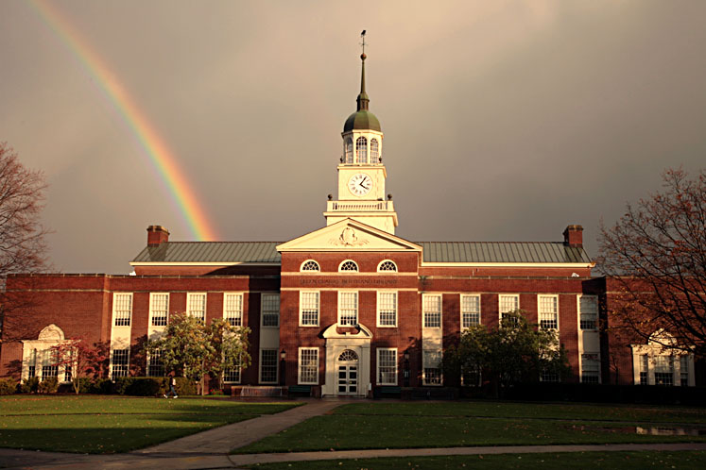
Quick overview of Bucknell
Bucknell University
Located in rural Lewisburg, PA
Largest liberal arts university in U.S., founded 1846
3400 undergraduates, 150 graduate students
350 faculty, 50 majors
Organization – Library & IT
Merged with approximately 80 staff, nearly 25 directly related to the library
One University library, approximately 810,000 physical volumes
Approximately $3m materials budget
Receive more than 85-90% of materials shelf-ready
Notes:
Carrie

Slide 3
There’s so much cloud hype, what are we talking about?
What is WorldShare?
More and more cloud offerings, how is this one different?
When we say we “are in the cloud,” what do we mean?
What happened to your library system?
Not just hosting, rack space, etc.
Notes:
Carrie

Slide 4
How did we get here?
3 most commonly asked questions
How did you make this decision?
What is the cloud?
Why not open source?
Positively received by the community
More on costs, legal, user impact and the like in a moment…
Notes:
Carrie

Slide 5
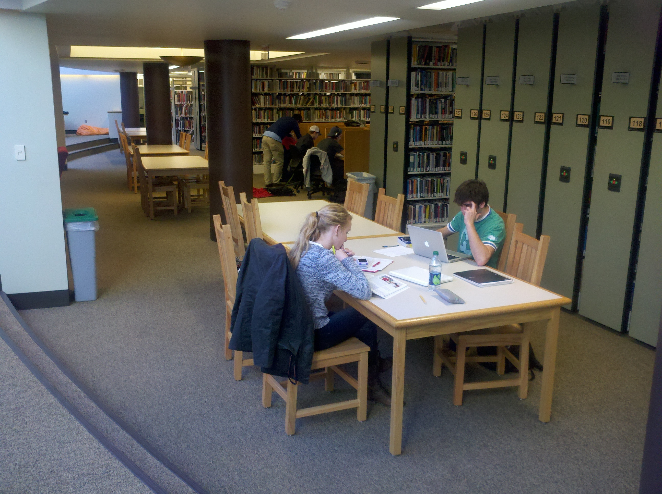
What’s the value?
Savings
A LOT of $$
Staff time (approaching 2 FTEs to date)
Far less duplicated work/effort
MOST IMPORTANT:
Even closer to our goal of one-stop discovery
One stream for patron-driven acquisitions/inter-library loan
What will we cover?
Our path to implementation
Bucknell perspective, a little insight into each major system module
User perspectives
What comes next
Notes:
Carrie

Slide 6
Getting over the mental cloud hurdle
Gmail, Facebook, Amazon Cloud have prepared us for resources living off campus
These services have made users *a bit more* comfortable with change we don’t control
Cloud vendors have specialized in their business, and we know our system is a priority (especially in the case of disaster)
Letting go of update schedule
Less concerned with specifics of technical environment—i.e. we don’t know or care what kind of servers OCLC has deployed
Notes:
Carrie

Slide 7
Issues with the cloud
When things go down, there’s nothing you can do but call the vendor
When they introduce new features that you don’t like, all you can do is submit a request
You can’t customize very many things
Your data is somewhat out of your hands, since it’s not in a local system
Notes:
Carrie

Slide 8
Introduction to Worldshare
WMS backend
WorldCAT front end
Other components (ILL, Knowledgebase)
Notes:
Carrie

Slide 9
WMS Back end
Modules:
Circulation
Acquisitions
Cataloging
Serials (we don’t use)
Knowledgebase
Authentication
CAS
Data feeds from Banner for personal data
Notes:
Carrie

Slide 10
In the beginning…
July 2010 – Invited by OCLC to participate in the early-adopter program for WMS
Internal discussions focused on…
Privacy and data security
Business plan
Cost/Benefit analysis
What’s the back-up plan?
SLA
Notes:
Carrie

Slide 11
Then, there’s the contract…
Show Stoppers
University counsel and OCLC counsel negotiation
CAS implementation for authentication
Support for Summon feed
Go Live date – prior to June 30th, 2011
Bertrand Library
Notes:
Carrie

Slide 12
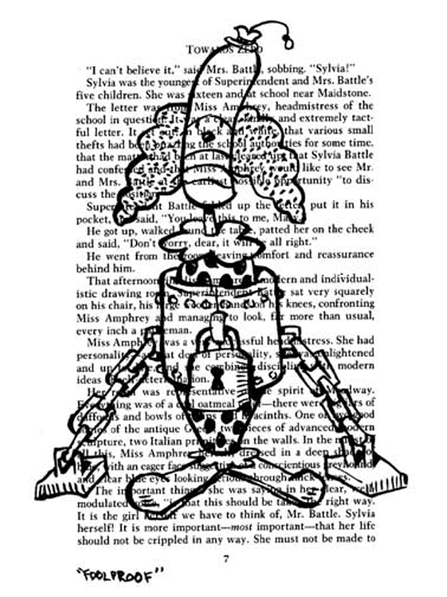
Getting started…
Cohort Group (8 other University libraries)
Weekly online meetings
Assignments
Presentations
Local task-force
weekly meetings
Filled out many, many forms…
Artist John Kovaleski, panel from “Unbound”
Notes:
Carrie

Slide 13
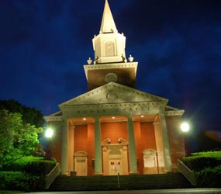
Challenges to work through
Not all Bucknell records had OCLC number
How to preserve our local subject headings
Lack of a reporting module, short term
Notes:
Carrie

Slide 14
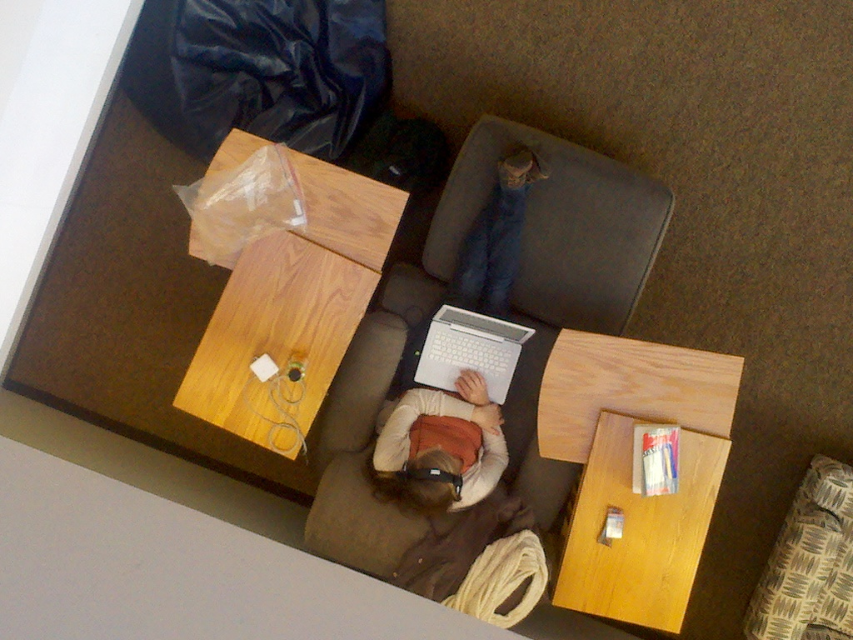
Timeline
March 2011 -- Bibliographic Data
8 files of 90,000 records each
Ceased shipments of all new materials, except for RUSH (created a backlog of several thousand titles)
May 2011 -- Patron Data
Ceased adding new patrons
June 2011 -- Circulation Transaction Data
Manual circulations for a couple of weeks
June 13, 2011 – WENT LIVE!!!
Loaded manual circs from spreadsheet
Notes:
Carrie

Slide 15
Immediately after go-live
Cataloging and Circulation had exception reports and other migration issues to clean-up – which were mostly done by the middle of August
Verify…
Bib records, patron records, circulation transactions, holdings
CAS Authentication (Single-sign on)-Available in July 2011
Notes:
Carrie

Slide 16
Collection Development
Implementation of Worldshare/WMS has impacted our collection development model
Patron Driven Acquisitions
Get-It button in WorldCat allows us to make buy/borrow decisions immediately
Knowledge Base
Allows to easily configure and enable collections (ebooks, databases, etc) for patron use
Notes:
Carrie

Slide 17
Request Submitted
GIST Workflow
ILL – Awaiting Request Processing
Awaiting Acquisitions Processing
Borrow
Cancel
Cancel
Email patron/
librarian
Purchase through GOBI /
Notify user
No
Yes
Receive item / catalog in Connexion
Place hold for patron

Slide 18
View into OCLC Knowledgebase
Notes:
Carrie

Slide 19
On to module by module….
The Library Unbound, our giant yearly orientation event!

Slide 20
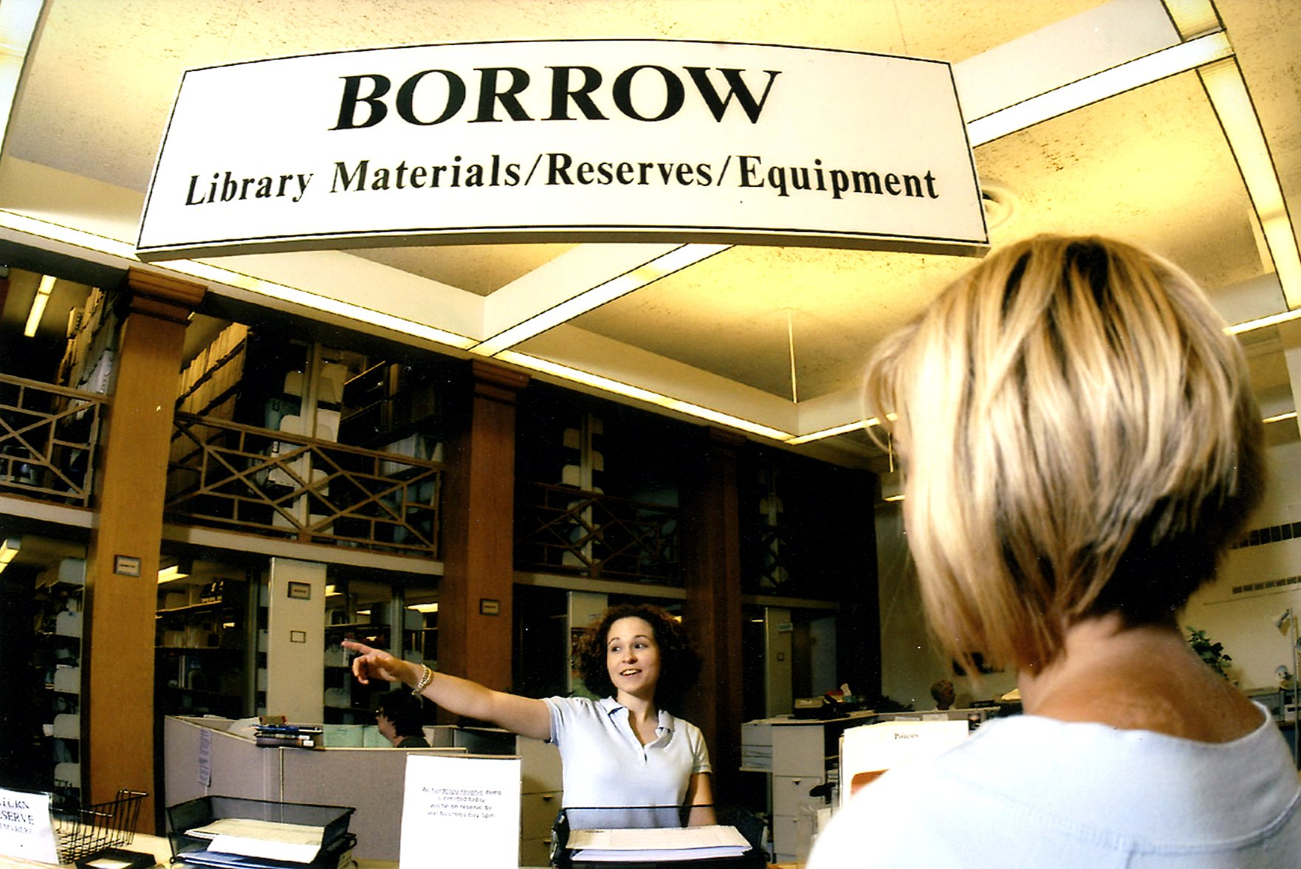
Circulation
Module fairly basic, but evolving
Good reserves module
Limited reports
Basic statistical reports
Items added
Items checked out
No collection analysis, or more complex reports
Notes:
Jason

Slide 21
User Experience: Circulation
Circulation map drastically whittled down
Fewer than ten user types
Circulation staff quotes:
"the circulation module is the least well developed part of WMS”
Patrons like Reserves. Easy to access the courses for which we have course reserves
Routine check functions work okay -- checking out, checking in, placing a hold request
Notes:
Jason

Slide 22
User experience – Circulation (cont.)
Shortcomings of WMS:
Cannot search items by call number!
Cannot delete users
Reporting not yet sufficient for inventory, patron accounts, collection management
No date of last check-in (helpful for finding lost items)
Notes:
Jason

Slide 23
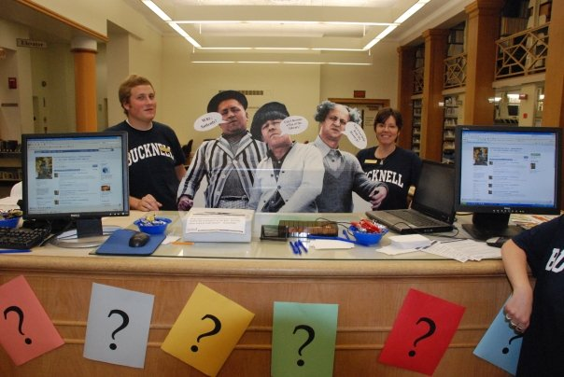
Acquisitions
We use WorldShare acquisitions only for rush orders or items we can’t get from YBP. Most items requested through Get-It/YBP interface.
Catalogers need not do anything with items ordered through acquisition module or YBP, as OCLC local holding record is automatically created.
Notes:
Jason

Slide 24
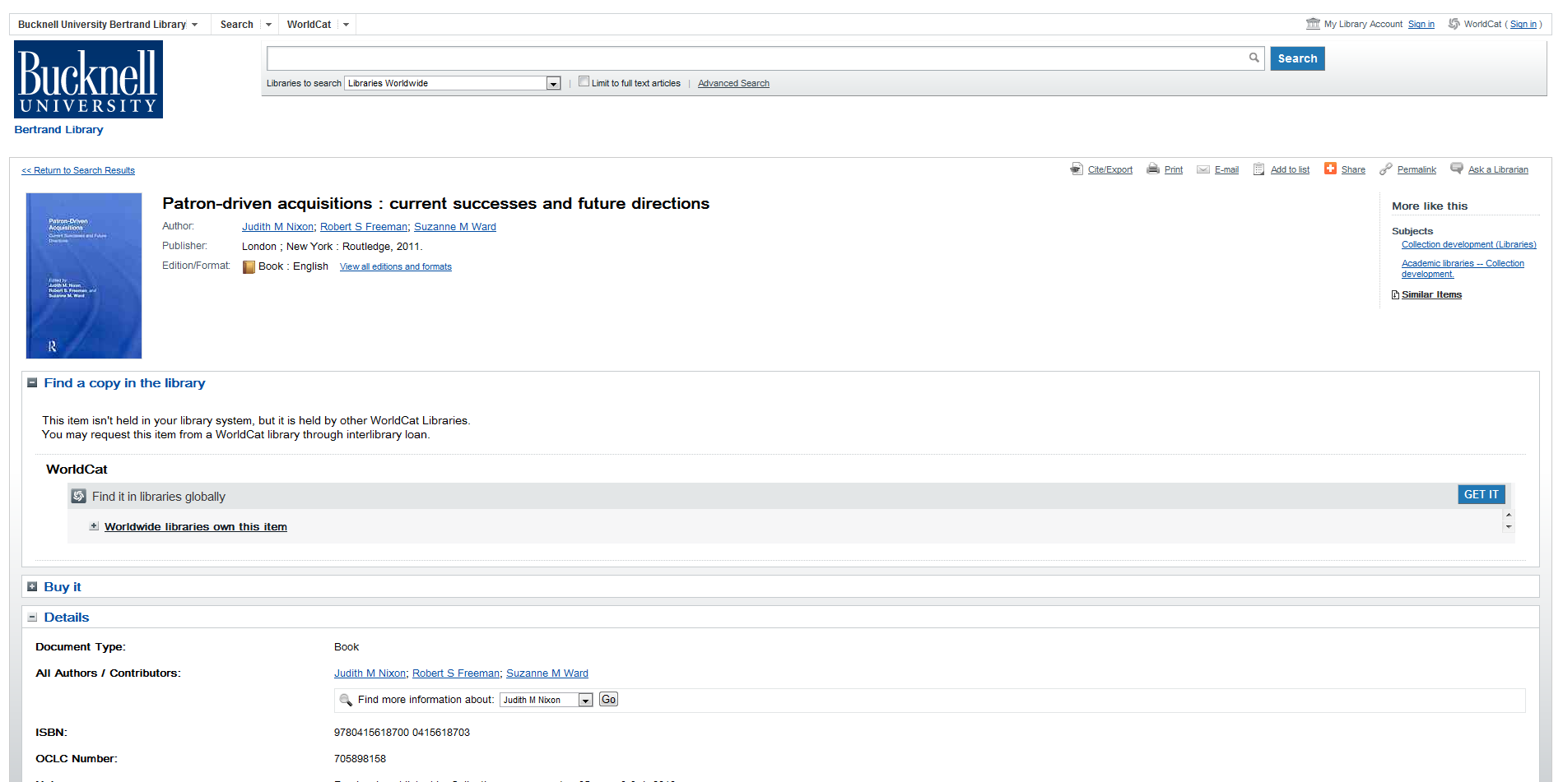
Patron Driven Acquisitions…the path
Notes:
Jason

Slide 25
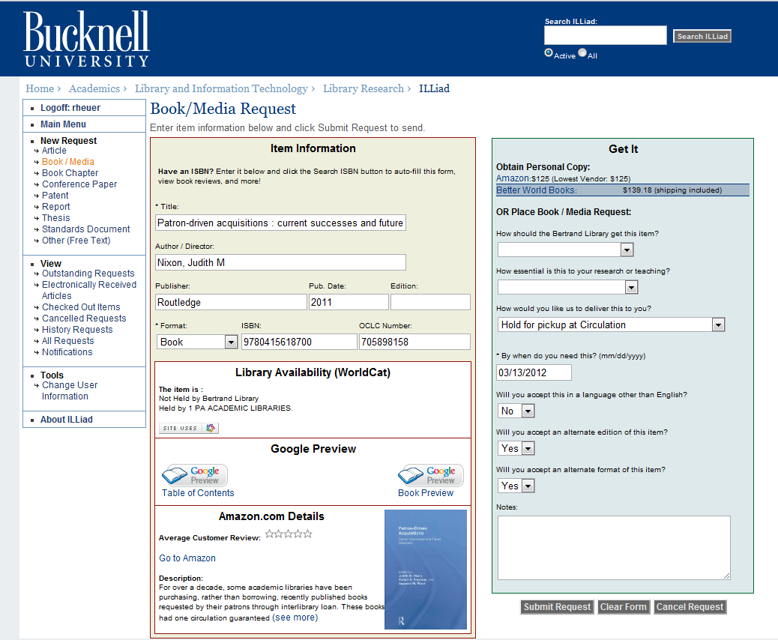
Notes:
Jason

Slide 26
Request Submitted
GIST Workflow
ILL – Awaiting Request Processing
Awaiting Acquisitions Processing
Borrow
Cancel
Cancel
Email patron/
librarian
Purchase through GOBI /
Notify user
No
Yes
Receive item / catalog in Connexion
Place hold for patron

Slide 27
Pushed to ILLiad
Notes:
Jason

Slide 28
User experience: Acquisitions
“In the acquisitions module of WMS, the ease of having all of the functions available in one service is a great time saver. I can now order an item, receive it, bar code it, and even invoice the item all in one continuous workflow.”
“Local holding records are automatically created during receiving”
Notes:
Jason

Slide 29
More acquisitions
Get IT impacts approval plan
Approval plan cancelled
Faculty reps still selecting, but now all faculty are empowered to add to collection, not just reps
Monies formerly used for approval plan now being used to solve budget deficit in serials
Notes:
Jason

Slide 30
Cataloging
Changed from YBP to OCLC WorldCat Cataloging partners
Receive 85-90% of materials shelf-ready
Bucknell symbol and OCLC local holdings record created by WorldCat Cataloging partners—Means most of what we get goes straight to the shelves upon arriving.
Huge savings -- $$$$
License fees, server maintenance, staffing
Since June, 600 fewer books for original cataloging/cataloging review
Accepting additional levels of cataloging
No more redundant work – no more creating separate Bucknell records in OCLC…however, we can’t slack with brief records any more
We can add local notes to existing items: Bucknell Authors’ Series, Alumni Authors, etc.
No need to maintain local authority work
Cataloging DVDs is a little more cumbersome—short term
DVDs come from multiple vendors, not YBP
Notes:
Jason

Slide 31
User experience: Cataloging
No need to tediously maintain a local authority file: it’s all in the cloud now!
Incoming material is virtually cataloged during the receiving process in acquisitions
It no longer makes sense to maintain an extract of OCLC in our local catalog (because we no longer have a local catalog!)
“Letting go of control of local data!”
We now more fully participate as cooperative catalogers in OCLC/WorldCat
Enhancing existing records, cataloging rare materials
“It’s hard to imagine the way we used to do things!”
Notes:
Jason

Slide 32
Worldcat library catalog front end
Familiar user interface – Worldcat has existed for years
Worldwide searching
More of a discovery tool
Search first, limit on results list
Includes multiple formats as well as full text article listings and links to e-books
Notes:
Jason

Slide 35
Lists, saved search functionality

Slide 36
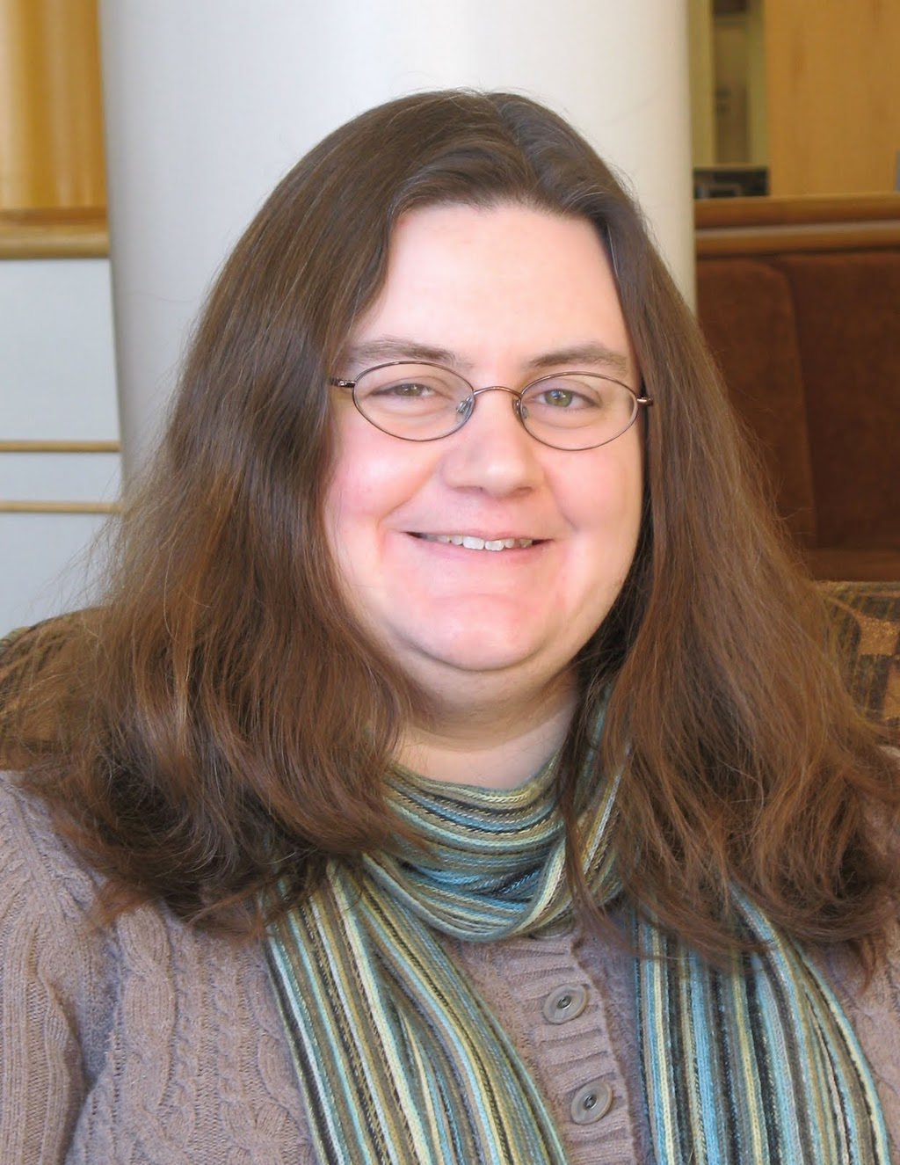
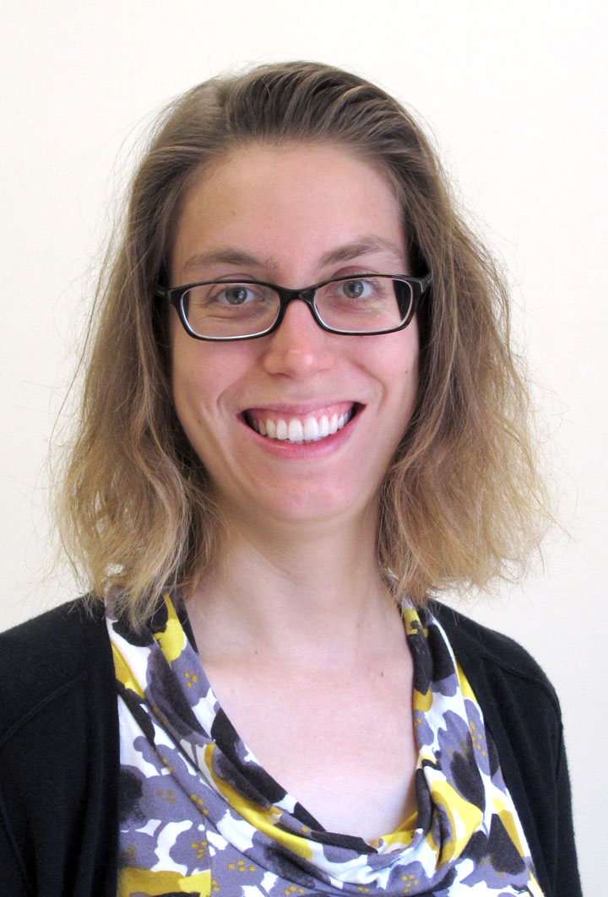
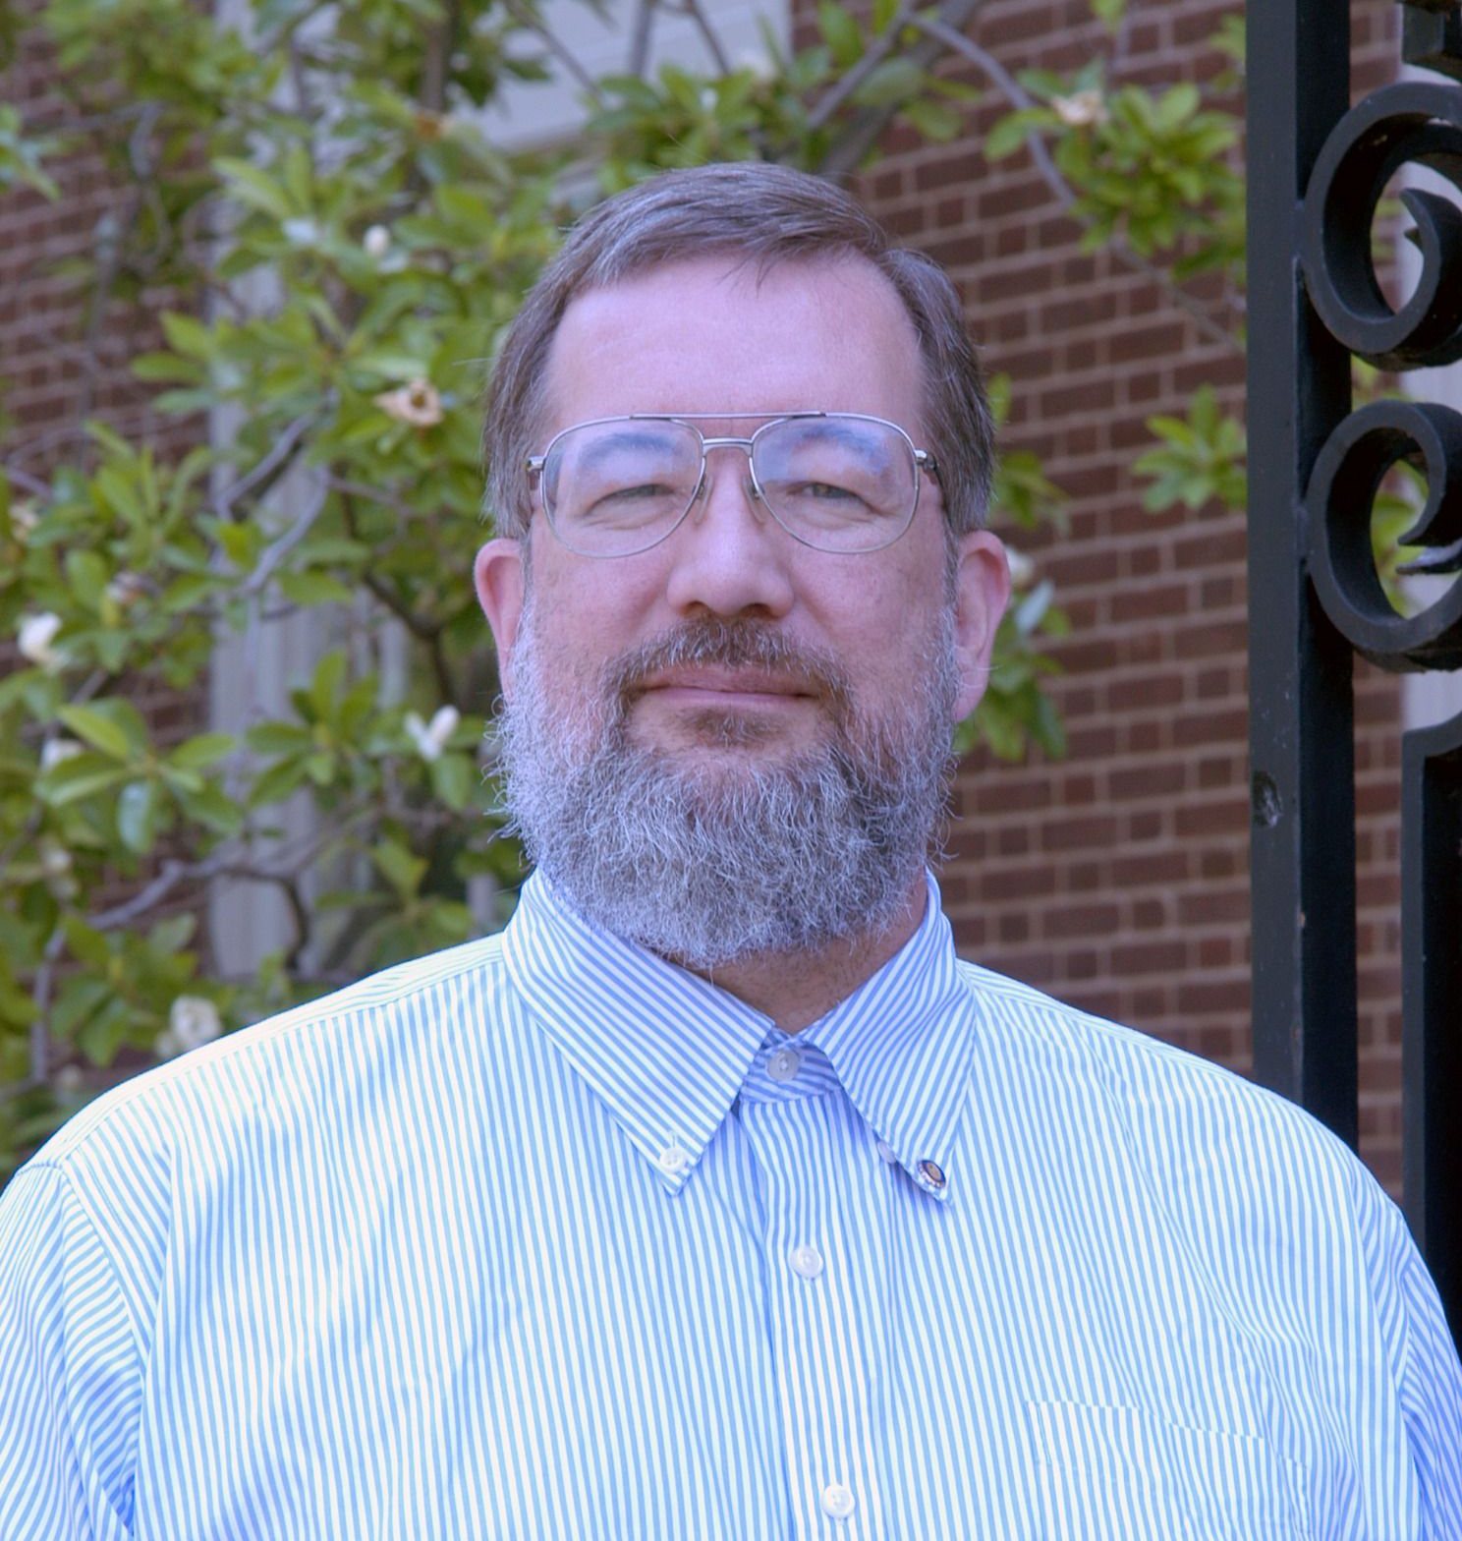
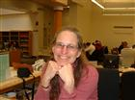
User Experience: Teaching and Reference
“Using WorldCat as a teaching tool helps me highlight the value of curiosity, exploration, and discovery.”
“Providing students with a wide angle view of the global search landscape, and then showing available limits (e.g. format, date, subject area) to focus on individual materials, fosters the development of evaluation skills as well.”
“Using WorldCat’s citation and sharing tools reinforces the importance of source attribution and collaboration”
Research Services Librarians
Notes:
Jason

Slide 37
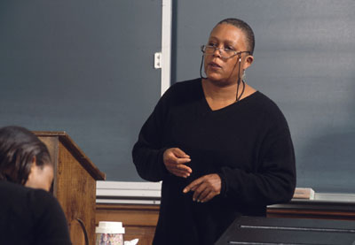
User Experience: Faculty
“I love the Reserves search, how you can limit by course or subject!”
“The ability to make lists and share them with students is great!”
“I miss the ‘nearby items on shelf’ function we had in the old catalog”
“Interlibrary loan is so much easier!”
“In instances when the book I wanted wasn’t in our collection, I simply clicked…“get it” …and within a week… the book was waiting for me at the front desk.”
Notes:
Jason

Slide 38
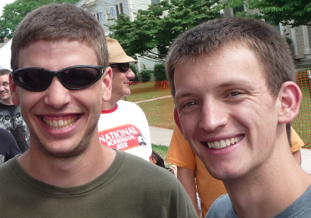
User experience: Students
Students love the “Get It” button/links
For more specialized/esoteric topics, or areas outside Bucknell’s curriculum, worldwide search has really broadened access
Easier to find full text scholarly articles, since they’re included with the search results, along with physical items
Students are very appreciative when librarians make lists of materials and share with them
Notes:
Jason

Slide 39
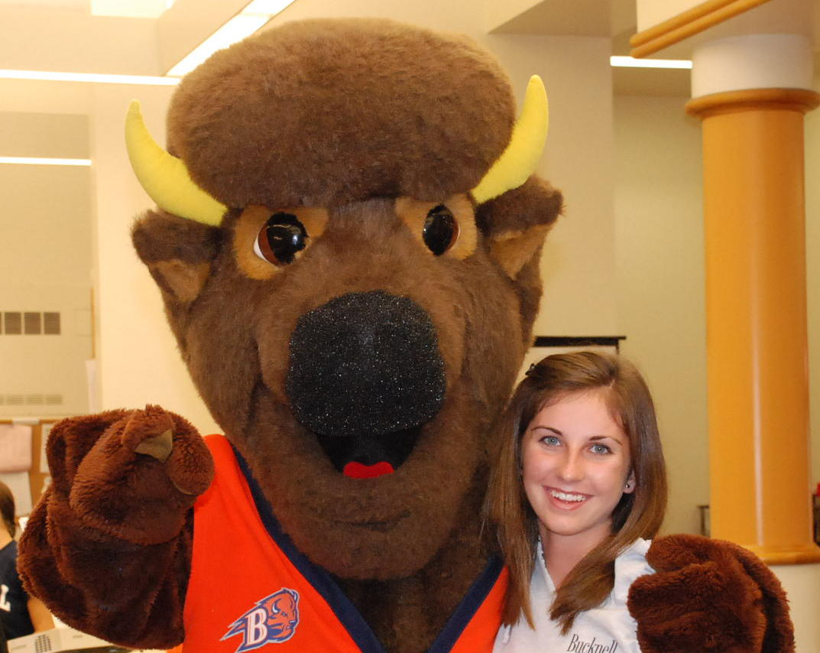
Looking forward to…
Call numbers on user generated lists (coming soon)
Self-checkout machine functionality (coming soon)
More robust reports (still waiting)
Already eliminated:
Serials Solutions, A-Z list
Summon Discovery Tool
Possibly on the chopping block:
ILLIAD
Notes:
Jason

Slide 40
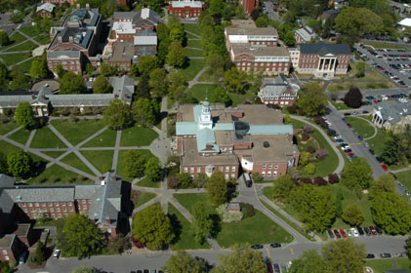
Thank you!
Questions?
Carrie Rampp, Director of Library Services & Instructional Technology
cer013@bucknell.edu
Jason Snyder, Librarian for Online Services
jcsnyder@bucknell.edu

Slide 41
Thank you for attending! Please remember to fill out this session’s evaluation by going to the appropriate listing in the conference program on the EDUCAUSE website. Your feedback directly affects future planning.

Slide 42
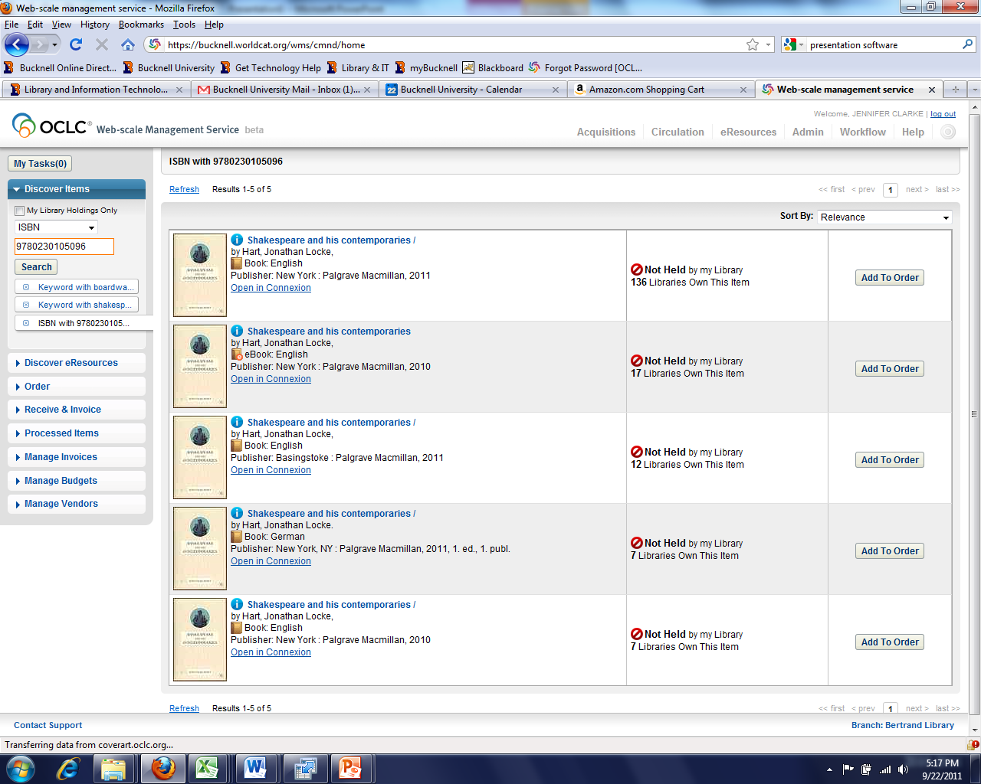
Find the item in WC

Slide 43
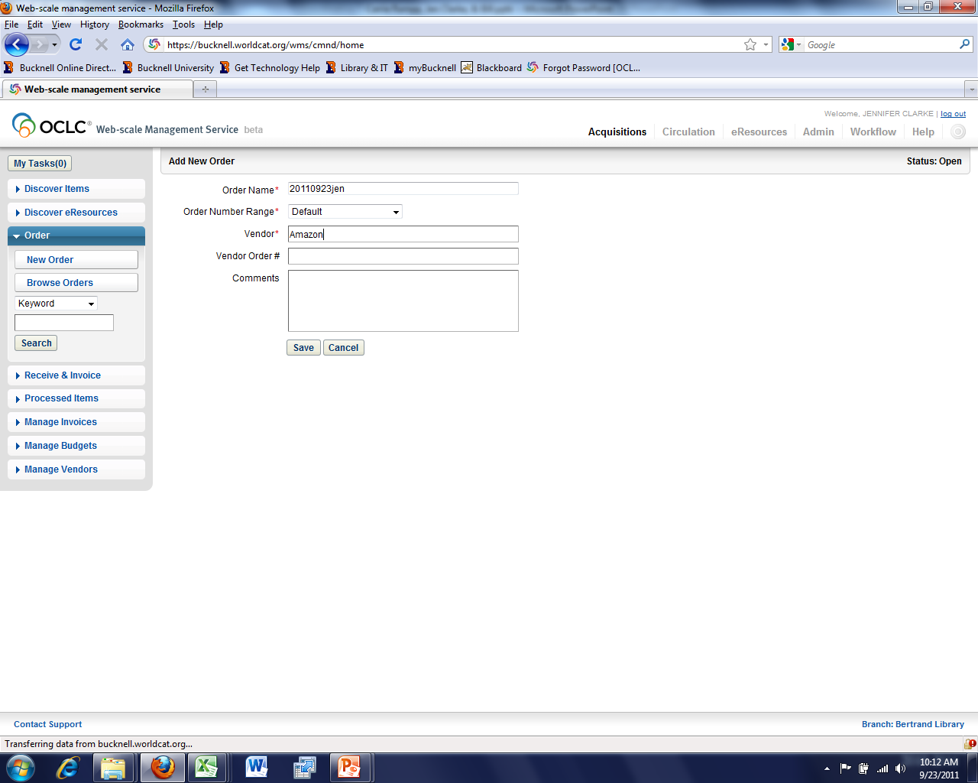
Would like auto-generated po numbers

Slide 44
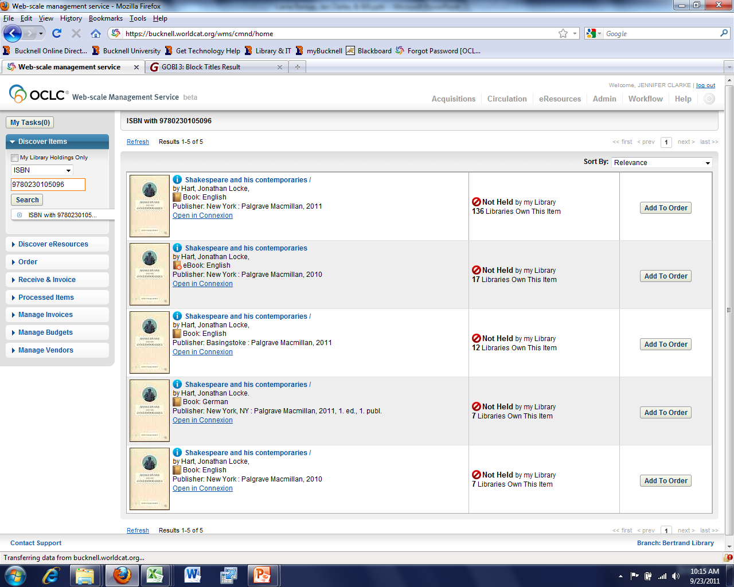
Discover the item
Create a New Order

Slide 45
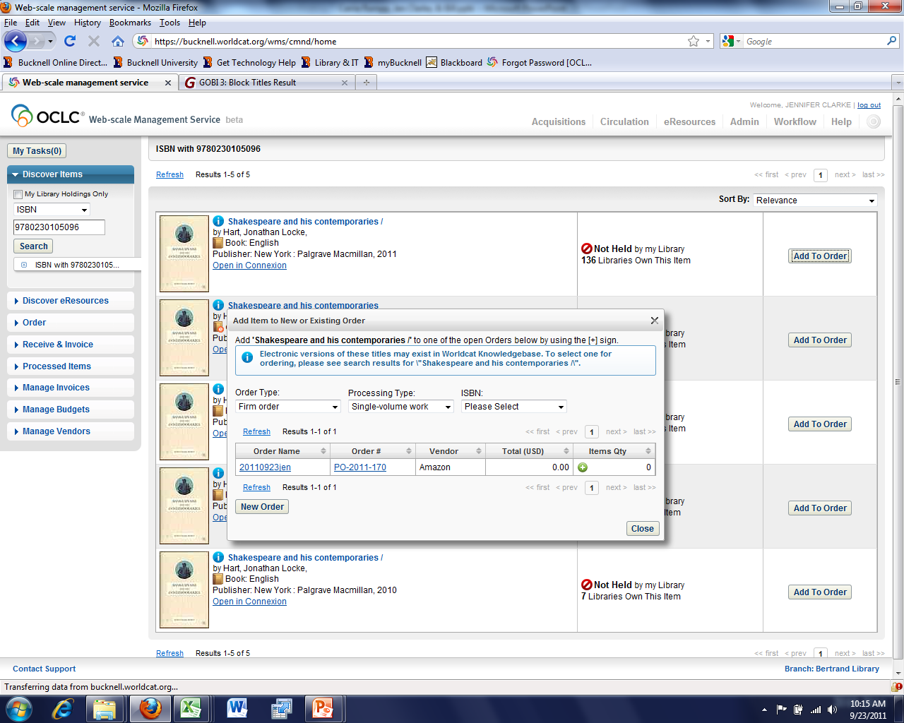
Add the title to the order

Slide 47
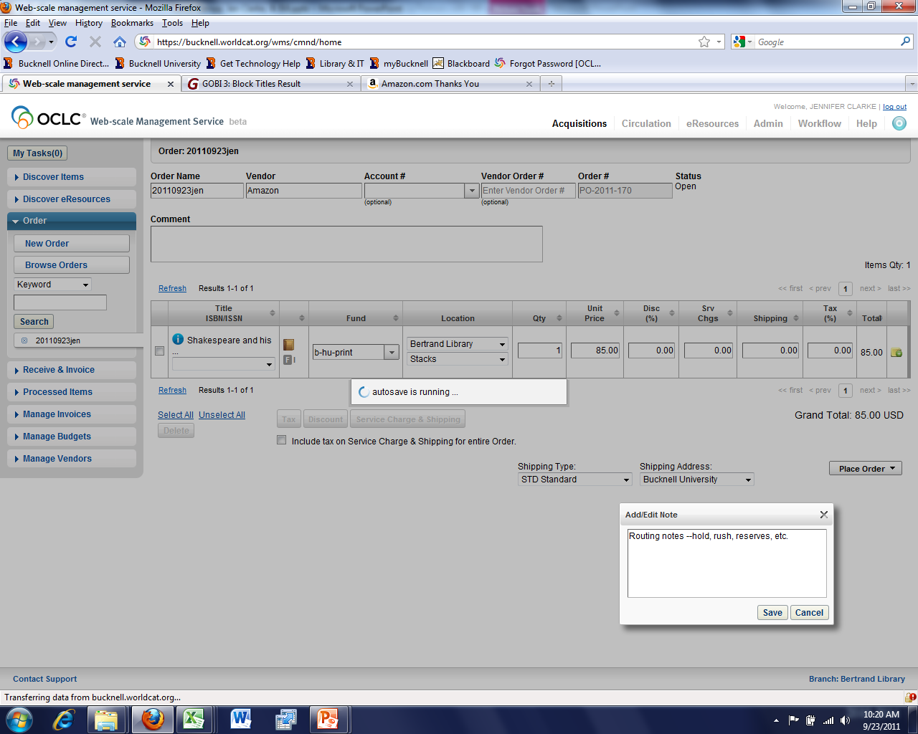
Enter fund, location, price, and notes

Slide 48
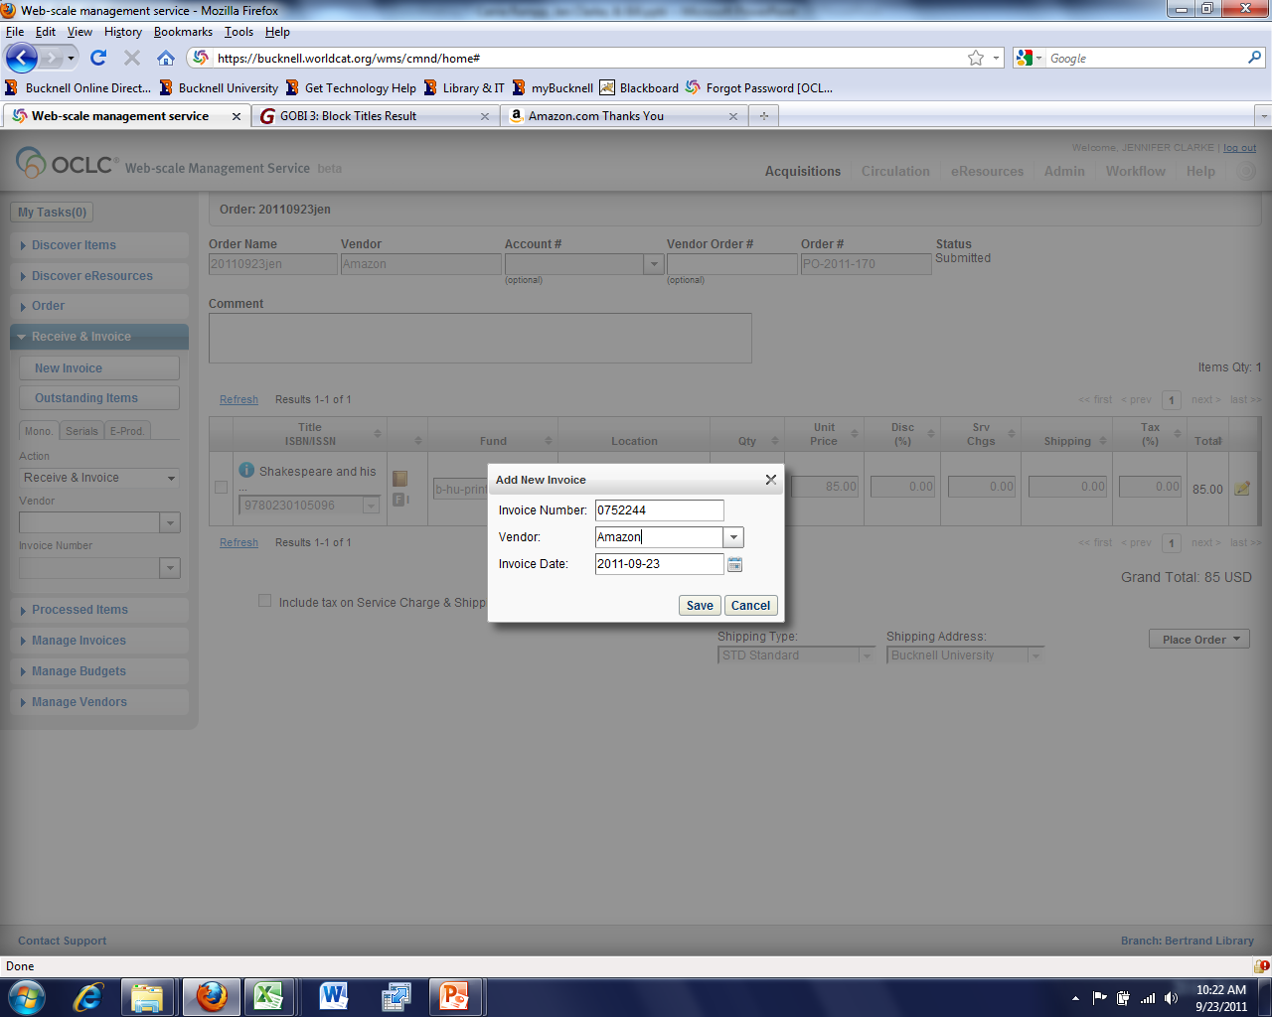
Receive and Invoice

Slide 49
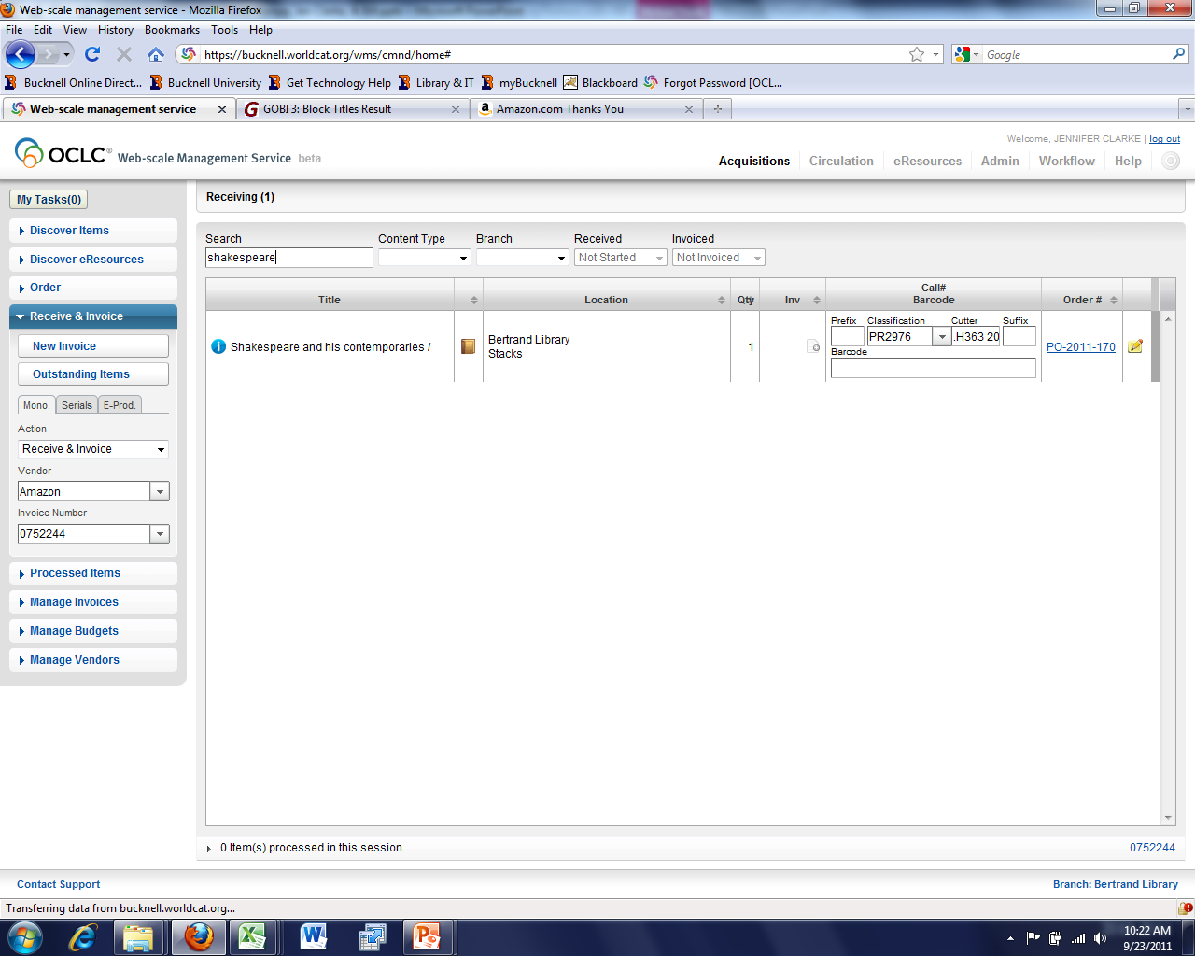

Slide 50
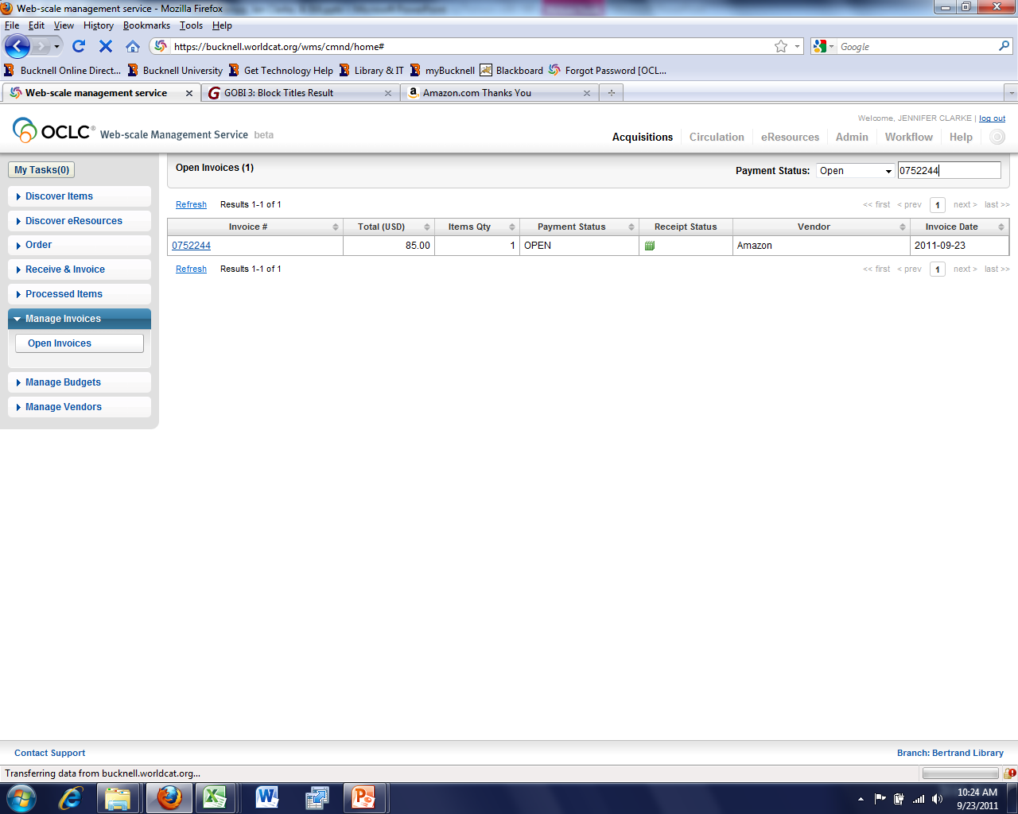
Manage Invoice (pay)

Slide 51
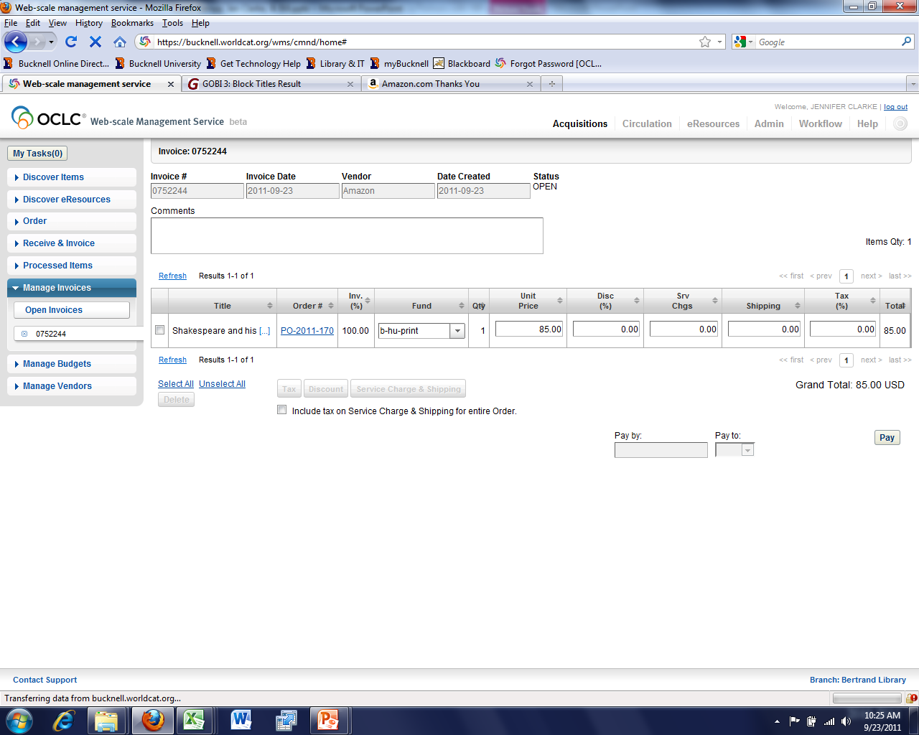
Pay

Slide 52
