Slide 1
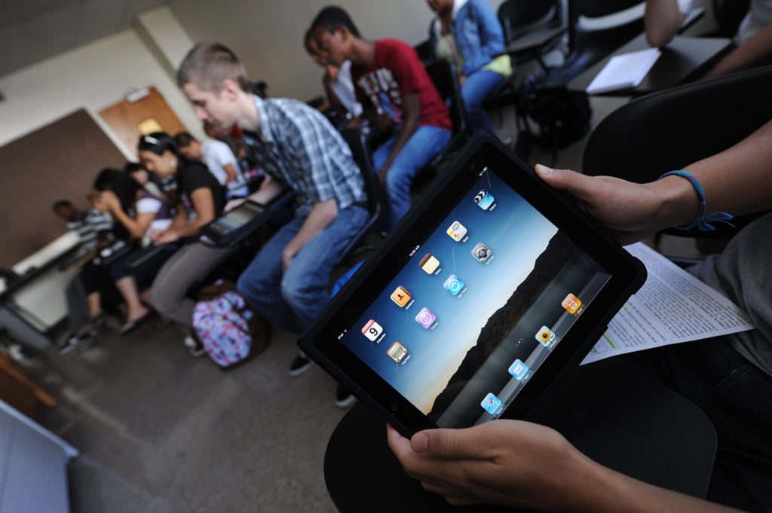
You can get there from here!
Strategies for Planning Academic Mobile Initiatives

Slide 2
Share with Others!
#E12_SESS047

Slide 3
About Us…
Joe Horne
Manager, Instructional Design Services
Julian Allen
Director, Professional Services

Slide 4
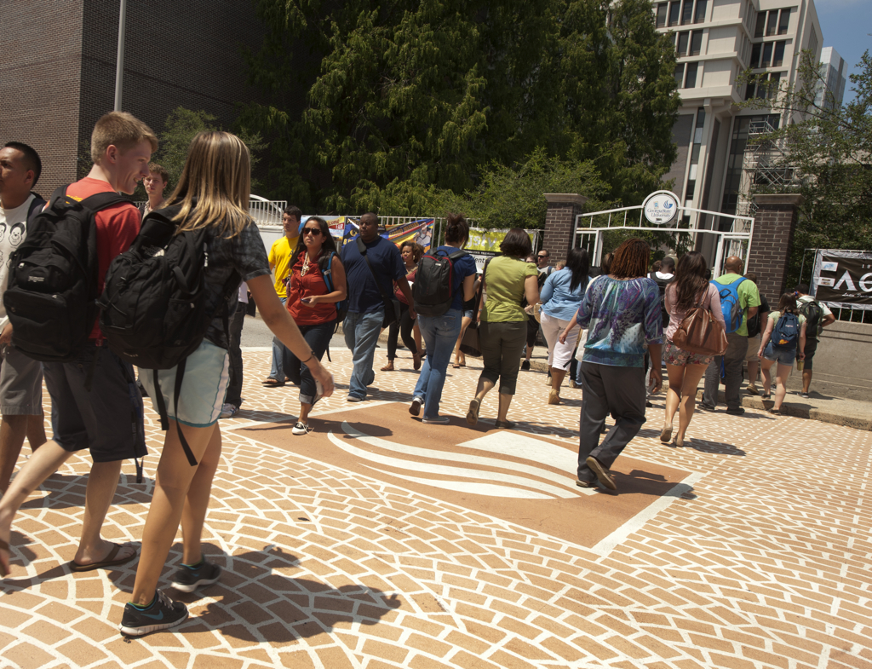
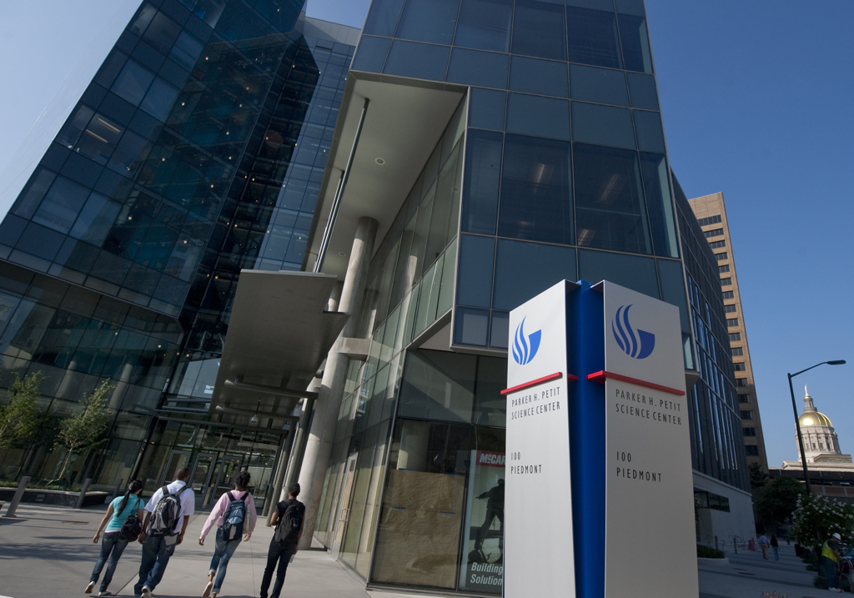
About Georgia State University
Founded in 1913 (we’re counting down to 100!)
32,000 students (graduate and undergraduate)
1150 faculty
250 degree programs across 8 colleges
Located in the heart of Downtown Atlanta

Slide 5
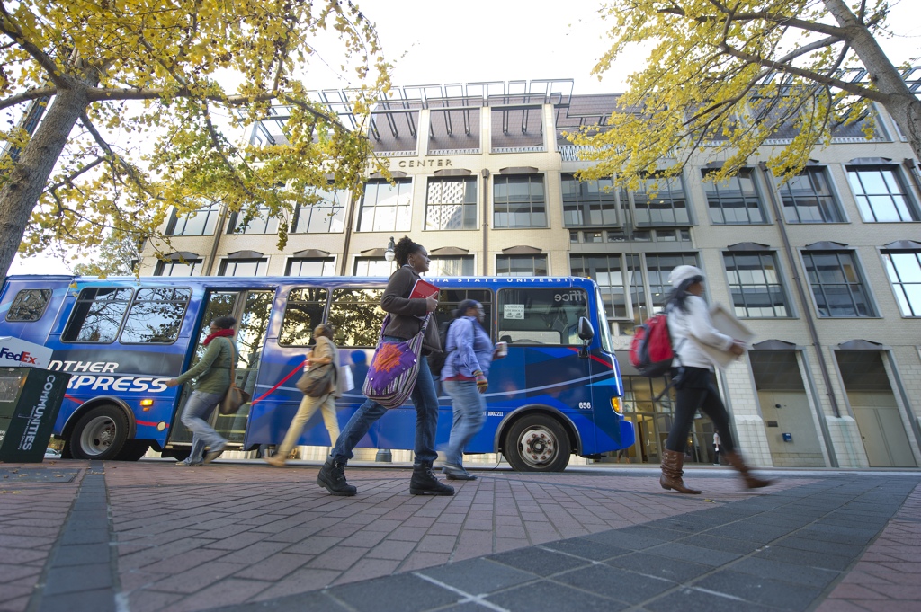
Mobile Learning
How do we define Mobile Learning at GSU?
Notes:
Joe: Ask question about IT arrangement… do you have a mobile initiatives group

Slide 6
Group Activity
Are you engaging students in mobile learning?
If so, what challenges are you facing?

Slide 7
What is readiness?
Are you ready for mobile?
readiness [ˈrɛdɪnɪs] n
the state of being ready or prepared, as for use or action
Collins English Dictionary

Slide 8
Are we ready?
Devices
Centers
Faculty
Students
Readiness

Slide 9
Devices: Ready to Deploy
Inspected • Inventoried • Imaged
Managed?

Slide 10
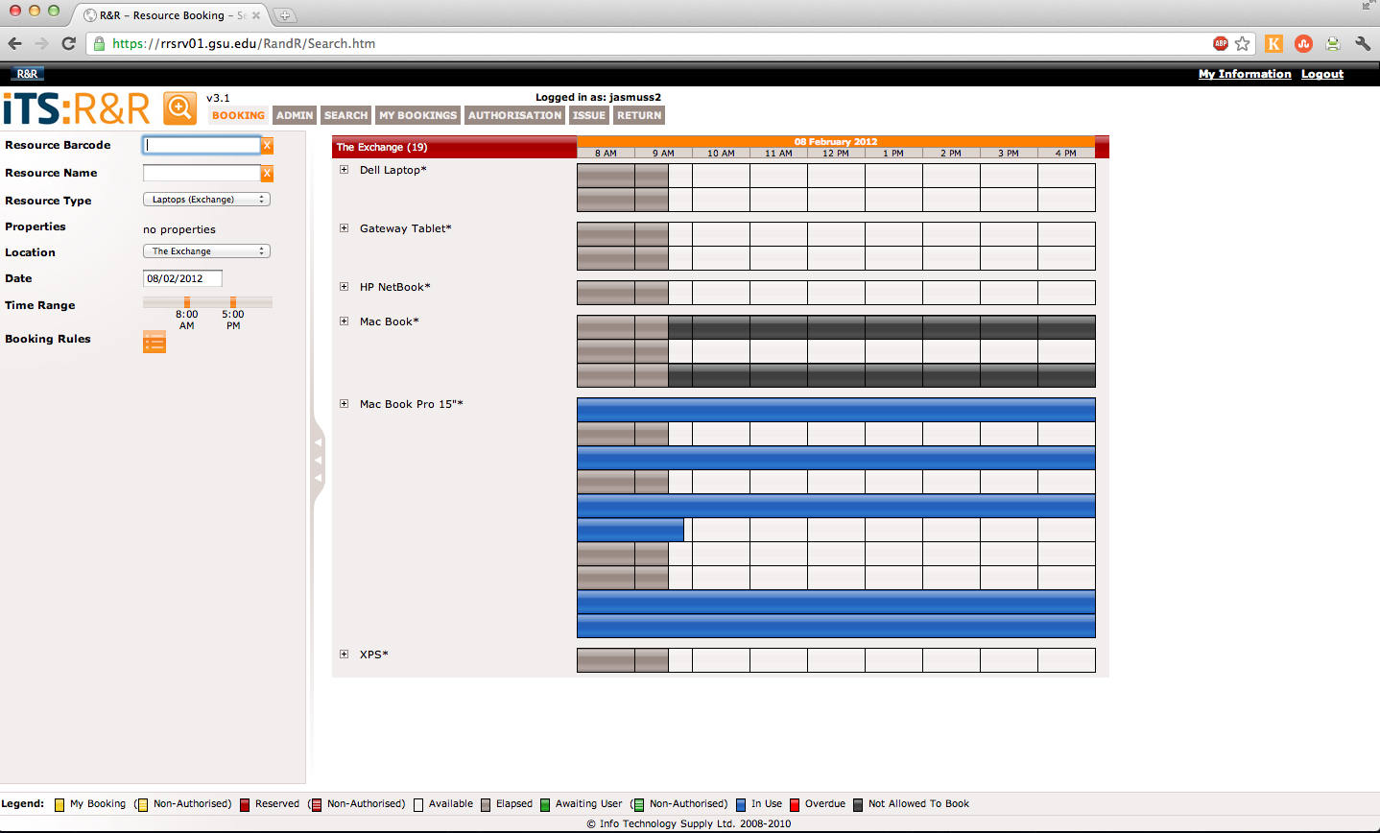
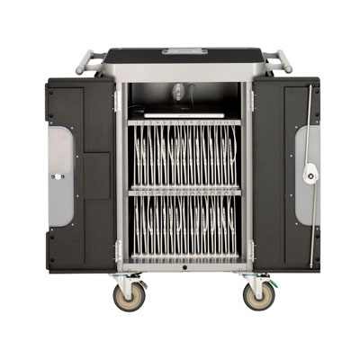
Devices: Ready to Deploy
Carts: Great for recharging and re-imaging
R&R: Our checkout system

Slide 11
Devices: Ready to Deploy
Wireless Network

Slide 12
Devices: Ready to Deploy
What about the apps?
University Owned:
Apple Volume Licensing
Gifting
Managed Devices
Student Owned:
These are personal devices

Slide 13
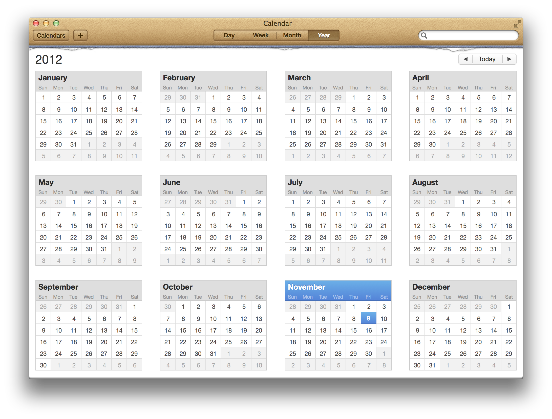
Devices: Ready to Deploy
What happens when your mobile devices aren’t in use?

Slide 14
Centers: Ready to Support
Have a Walk-up Center Ready
Trained in support
Tested on procedures
Equipped for success

Slide 15
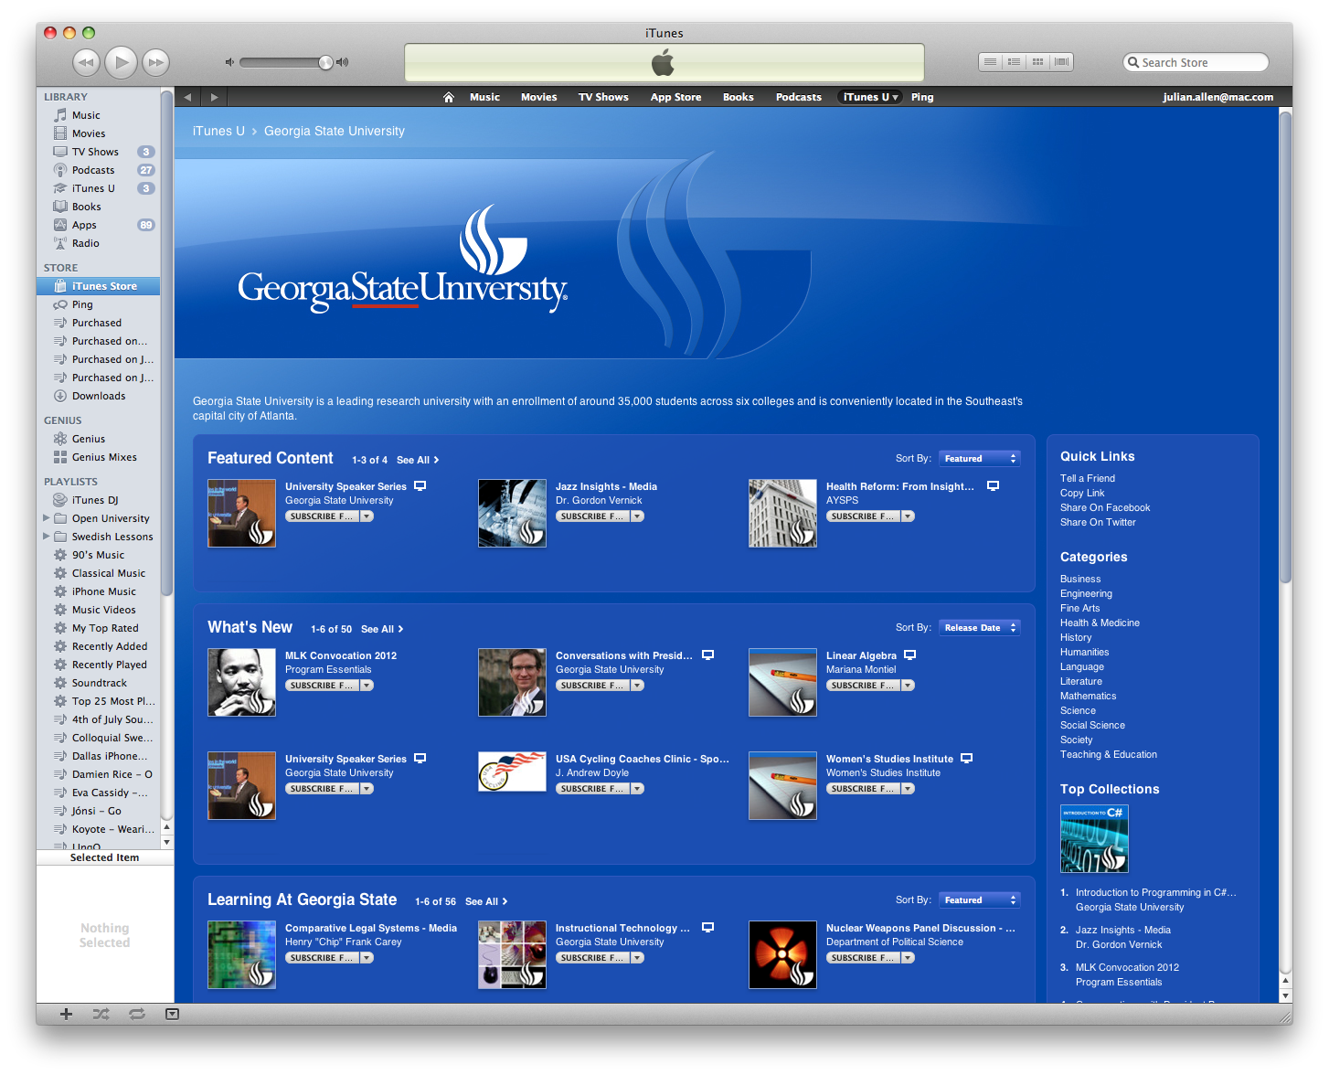
Centers: Ready to Support
iTunes U
Difficulty in uploading content
Inconsistent interface
Why not YouTube or Vimeo?

Slide 16
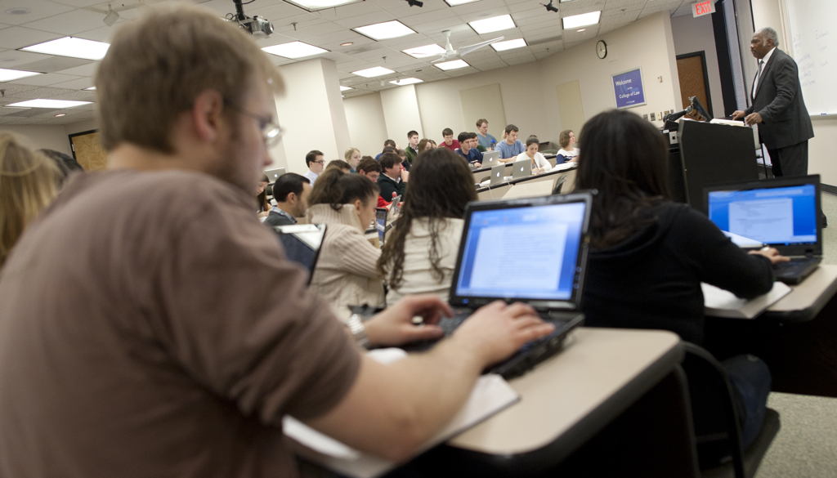
Faculty: Ready to Engage
Buy-in is Key!
Comfortable with the device
Understanding of the limitations and benefits
Curriculum adaptations

Slide 17
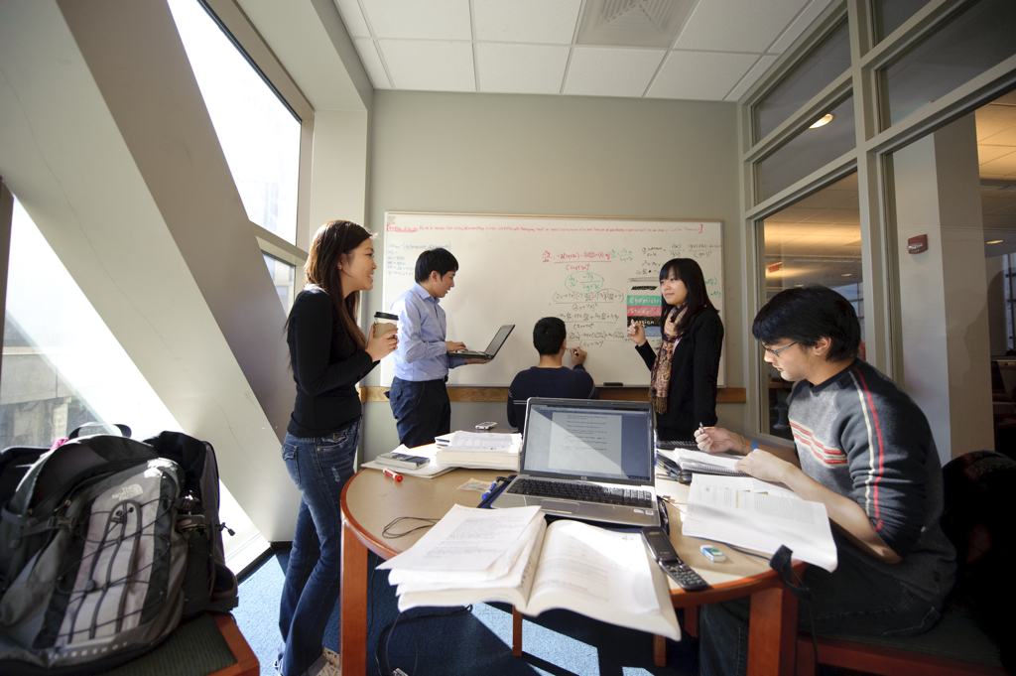
Faculty: Ready to Engage
Training + Time
Trials
Teamwork

Slide 18
Students: Ready to Learn
Comfortable with the device
Committed to its use
Cognizant of the purpose
Know how to find help

Slide 19
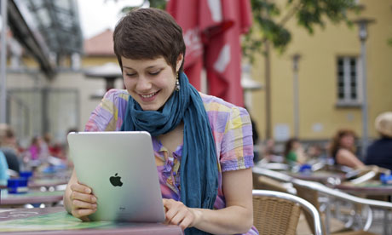
So what’s next?
BYOD?
Will we continue to buy devices for students?
Consider your students!

Slide 20
Like a well-oiled machine?
Faculty
Centers
Students
Devices

Slide 21
Group Activity
Pick one of the following:
Devices Centers
Faculty Students
Brainstorm your ideas and create a list creative solutions to readiness challenges for your respective group.

Slide 22
Any Questions?

Slide 23
Contact Us!
jphorne@gsu.edu
joallen@gsu.edu

