Slide 1
Perceptions of Progress:
Learning Analytics and Social Learning Behaviors

Slide 2
Our multi-disciplinary perspectives
Deborah Everhart, Adjunct Assistant Professor, Georgetown University
Director of Integration Strategy, Blackboard
http://www.georgetown.edu/everhart
John Fritz, Asst. VP, Instructional Technology & New Media,
University of Maryland Baltimore County
http://userpages.umbc.edu/~fritz/
Erin Knight, Sr. Director of Learning, Mozilla Foundation
http://erinknight.com/
Jeanine Turner, Associate Professor, Georgetown University
http://explore.georgetown.edu/people/turnerjw/
Notes:
A few comments about the multi-disciplinary nature of the material

Slide 3
Questions for consideration
Does student activity in learning environments correlate to student success?
How can analytics be used to identify and promote effective learning behaviors?
What types of alerts and dashboards for insights into analytics data are most useful, and who should be using them?
How do students make decisions about how to spend their limited time and attention?
What types of social frameworks promote learning?
Notes:
The questions we have in front of us today are just a sampling of the many important questions surrounding learning analytics. Our goals today are to help you visualize what’s possible, stimulate discussion and idea sharing, and leave with practical advice for how you can begin to take advantage of learning analytics.
So what do we mean by “learning analytics”? In brief, it’s “the use of data and models to predict student progress and performance, and the ability to act on that information,” as defined in the Educause Next Generation Learning Challenges. Learning analytics overlaps with the somewhat broader phrase “academic analytics,” which encompasses other institutional bodies of data such as program enrollments, costs per credit hour, retention rates, and institutional outcomes tracking.
Our work also falls into the category of “social learning analytics,” which focuses on the aspects of learning analytics that are related to the way learners interact with each other, compare behaviors, and form social learning groups.
There are extensive opportunities in this arena that are coming to fruition very quickly. As Mark Milliron, formerly of the Gates Foundation has put it, let’s “put our technology on purpose” and anchor our work in analytics.

Slide 4
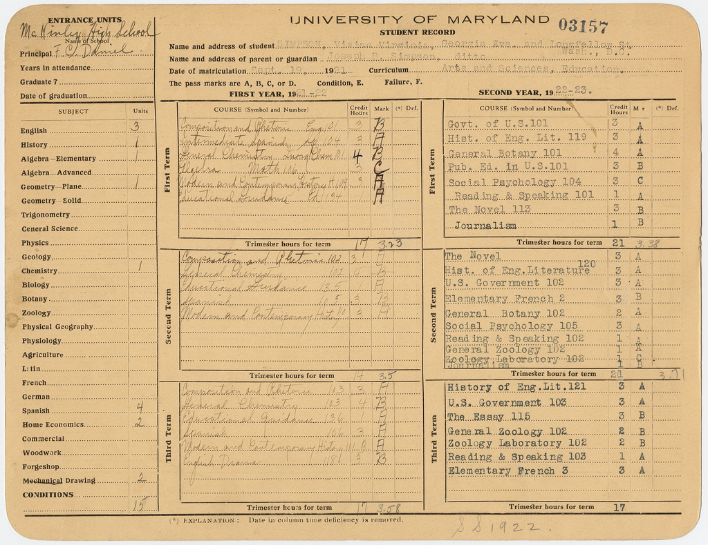

Perceptions of progress: old school
Digital Collections at the University of Maryland
Amboo who?
Notes:
http://www.flickr.com/photos/digitalcollectionsum/7135737441/
http://www.flickr.com/photos/amboo213/4020584983/

Slide 5
Perceptions of progress: old school
“Compared with the new open badge systems, the standard college transcript looks like a sad and archaic thing. Its considerable value is not based on the information it provides, which is paltry. What does a letter grade in a course often described only by the combination of a generic department label and an arbitrary number (e.g. Econ 302) really mean? Nobody knows….”
-Kevin Carey, The Chronicle of Higher Education (April 2012)
“Im gonna have a bad report card and im scared…I feel worthless and like a failure and I know my dad is going to beat me and im going to be grounded this summer …even though I tried my best my good is not good enough ... Please help im in tears right now!”
-anonymous
Notes:
“A Future Full of Badges - Commentary - The Chronicle of Higher Education.” Web. 24 Apr. 2012. http://chronicle.com/article/A-Future-Full-of-Badges/131455/

Slide 6
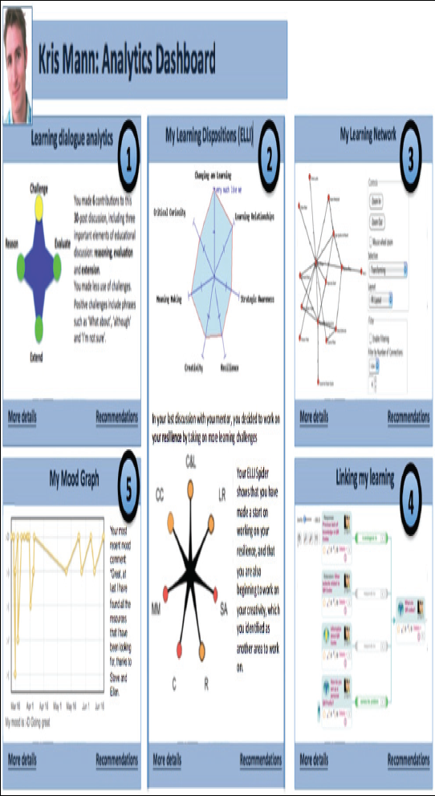
Perceptions of progress: new school
Society for Learning Analytics Research (SOLAR)
Notes:
how to visualize possibilities
Later in the presentation, we’ll talk through some examples of how learning analytics is being used today
“Society for Learning Analytics Research (SOLAR).” Web. 15 Feb. 2012. http://www.solaresearch.org/
solaresearch.org/OpenLearningAnalytics.pdf
Open framework for learning analytics visualizations

Slide 7
Perceptions of progress: examples from other arenas
Personal productivity
Health
Athletics
Applications of “big data” are becoming increasingly mainstream…
Notes:
Quick examples – show how analytics are already being used in other fields, demonstrating opportunities for applications in education
These examples have in common with learning analytics the same basics:
Collected data
Visualizations
Leading to behavior modification
*social* motivations
Help, feedback, friendly competition

Slide 8
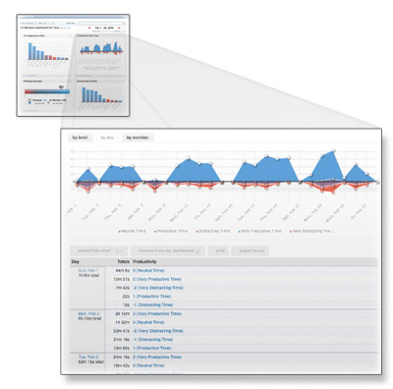
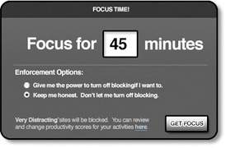
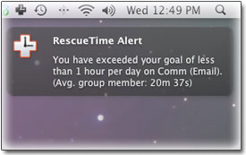
Perceptions of progress: productivity
RescueTime- Reports and analytics on how you spend your time and attention, time management tools, and nudges when you get too distracted
Notes:
http://rescuetime.com/tour

Slide 9
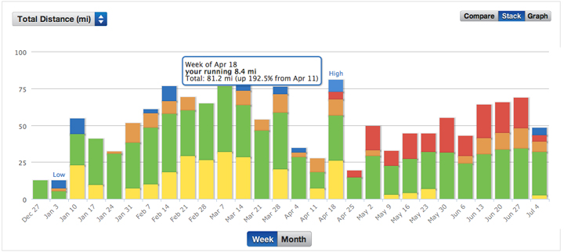
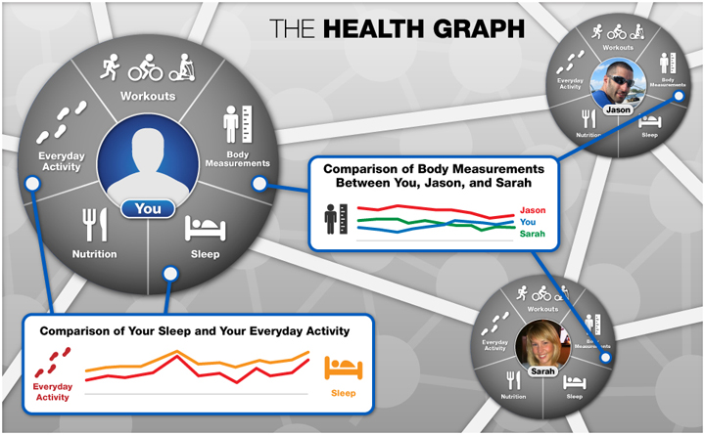
Perceptions of progress: running
RunKeeper:
set goals
track progress
visualize accomplishments
compare with friends and virtual teammates
Notes:
http://developer.runkeeper.com/healthgraph/introducing-the-health-graph
*social motivations and engagement with activities toward goal achievement*

Slide 10
Why do students take a class?
Motivations shape student engagement expectations
To fulfill the requirements for a degree
To acquire knowledge in a specific area
To share in knowledge creation within a specific area
Notes:
Key points on why combining learning analytics with social motivations and environments is a powerful combination
Learning analytics helps each student who comes to a course with a way to monitor the way they are engaging the material
The way course work currently happens, students may pretend to be participating at a level where they are contributing to knowledge creation-- when they are actually just checking off the box, doing what they need to do for degree requirements. Learning analytics visualizations can make these motivations and levels of engagement more transparent, to the students themselves, to their peers, and to faculty.
Are students just investing the minimum amount of time and effort to get a grade? Do they see the value of investment in collaborative learning?
Helping students understand why they are in a class and what they should expect to get out of it– realistic expectations

Slide 11
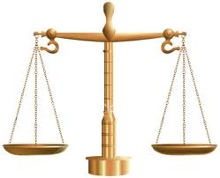
Social exchange perspective
Human beings make decisions based on costs and rewards
Students make similar costs and rewards decisions when investing time in a class
Goals that underlie the motivation to succeed in a course will drive a student’s cost/benefit analysis of levels of participation in a course
Notes:
Studies in social exchange theory applied to learning environments
Social exchange perspective is based on one of the most popular ideas in socio-psychological tradition – that human beings make decisions based on costs and rewards. Michael O’Leary and Jeanine Turner at Georgetown are using this perspective to understand how individuals approach business meetings and why they will bring technology into the meeting and attend to multiple meetings at once and why they might focus on one meeting at a time. The research is exploring multi-communicating decisions.
We can take the same approach to the learning environment. A student makes decisions about how much time to invest in a class based on the cost benefit analysis of those activities over others. Because the process has not been transparent in the past, we have created a situation where as long as students were able to pass the test at the end of the semester or to hand in a reasonable paper, the way that they got to that point was the decision of the student…so the student could weight the cost and benefits of attending class, reading the material, pushing the material further to look at outside material based on the value given to that…since teachers often did not have ways to evaluate students other than physical attendance and possibly interaction in class (but only in class sizes that allow that type of monitoring), students could “fake” their presence in the same way that business people “fake” their presence.
Learning analytics changes the playing field by making learning and decisions about learning within a specific class much more transparent…which means the time spent in a class in every respect will be much more “countable”…great for students who are doing the work and want to contribute to knowledge (third motivation level)..not good for students trying to check off the box (first level)

Slide 12
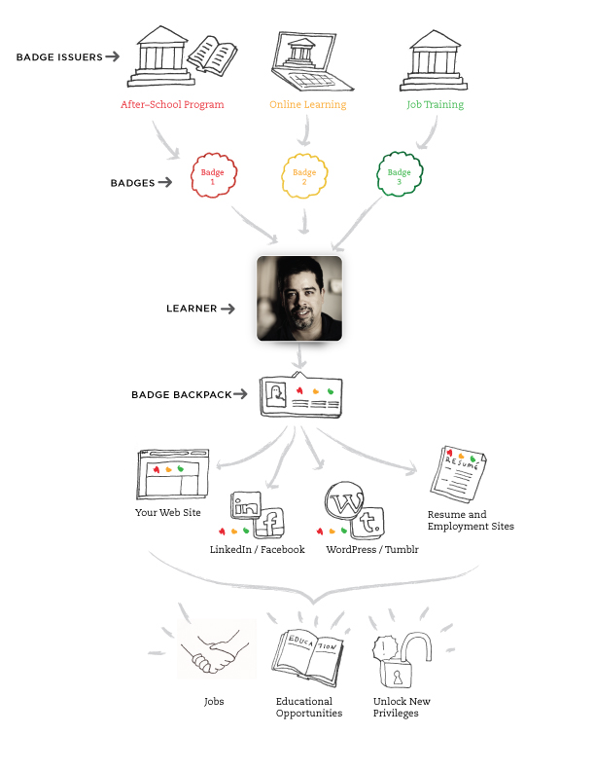
Badge frameworks
Badges: achievements, skills, affiliations, interests
More granular and comprehensive credentialing system
Evidence-based
Badge ecosystem: Badge issuers, learners, and badge display sites
Experts and authorities endorse badges
End-to-end value chain
Openbadges.org
Notes:
Define reputation frameworks and why they are important in learning environments
Define badge frameworks and provide brief introduction to Mozilla badge framework
Collaborative learning structure
Provide ways of visualizing competencies and the reputation frameworks that verify them
The Mozilla Foundation; The MacArthur Foundation (2012). Open Badges for Lifelong Learning, https://wiki.mozilla.org/File:OpenBadges-Working-Paper_012312.pdf
Image from http://openbadges.org/en-US/about.html

Slide 13
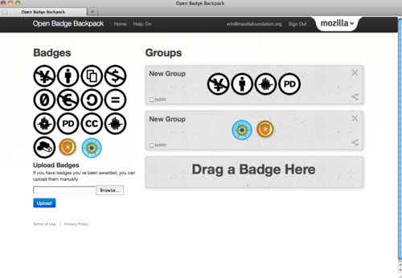
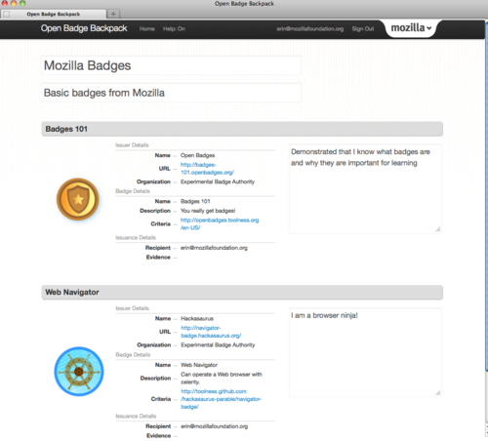
Perceptions of progress: badge frameworks
Openbadges.org
Notes:
http://erinknight.com/

Slide 14








Badges in the Wild

Slide 15
Check My Activity,
University of Maryland, Baltimore College
5 years of data clearly correlating student LMS activity and grades.
Students earning a D or F at UMBC tend to use Blackboard on average 39 percent less than students earning higher grades
“Check My Activity” tool lets students see their LMS activity and grades in comparison with other students in the course– in real time
New research:
  Spring 2011: Students using CMA were 1.9 times more likely to earn a C or higher, after controlling for other variables (OR=1.92, p<.006).
  Since 2010: Students with more activity in an introductory prerequisite course achieved higher grades in the next level course.
Notes:
Learning analytics, examples with proven results
Evidence of real-time benefits and longer term impacts– UMBC President Hrabowski's definition of student success -- "not only passing one course but also passing the next one that requires it“
Impact on course design- courses designed to encourage or require active engagement throughout the course lead to students who are not only more likely to pass that course, but also earn on average ½ letter grade higher in the subsequent course that requires the prior course

Slide 16
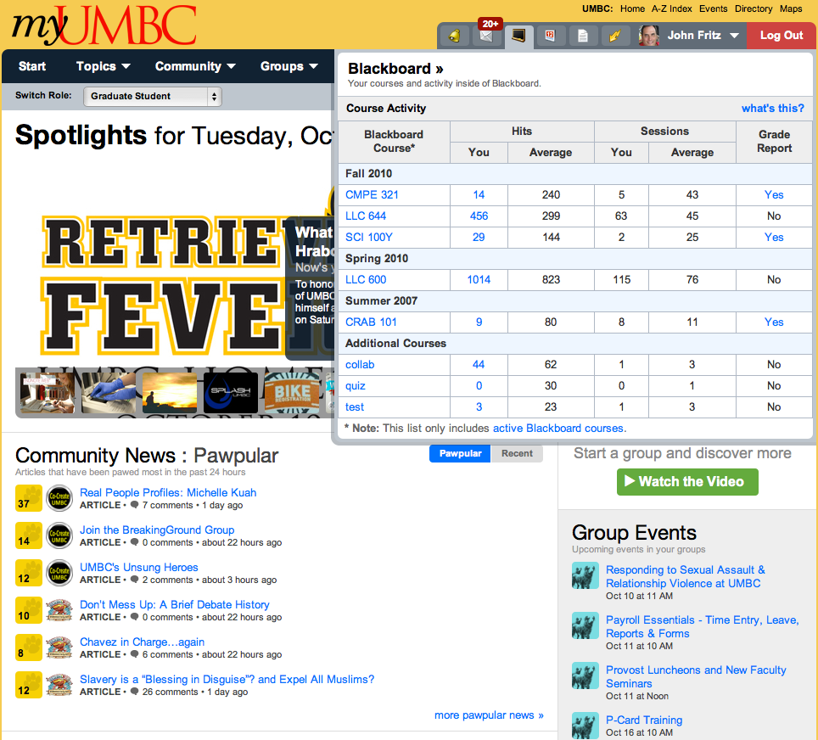

Slide 17
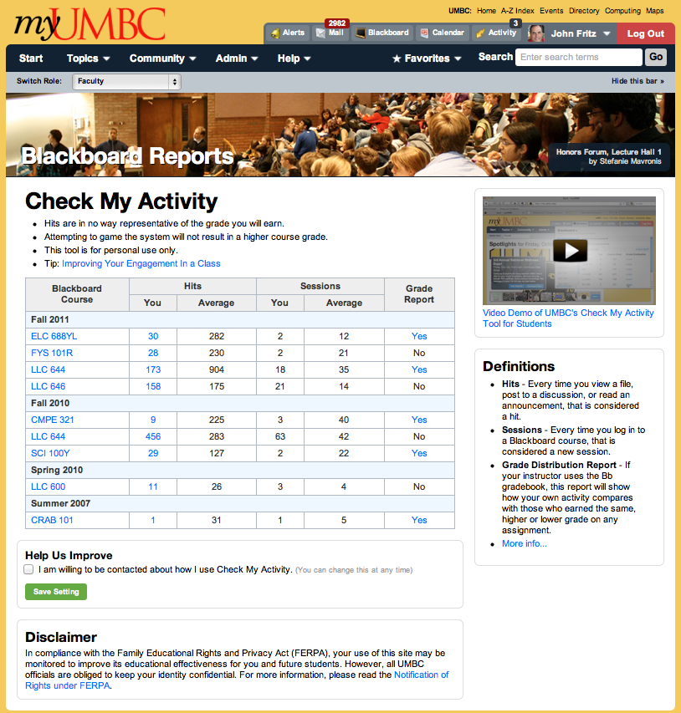

Slide 20
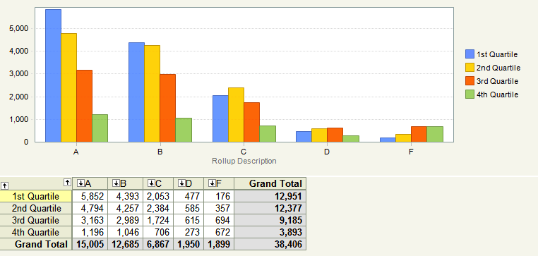
Accesses by Grade (SP2012)

Slide 21
Evolving LMS Use by Faculty
User & Document Management (Pull)
  Password-protected class & group space
  Attach or Copy/Paste Documents (expiration)
Communications (Push)
  Announcements
  Email, Messages
  Discussion & Chat
Assessments (Push & Pull)
  Electronic assignment delivery & collection
  Quizzing, Surveys, Course Usage
  Adaptive release of content based on prior student action.

Slide 22
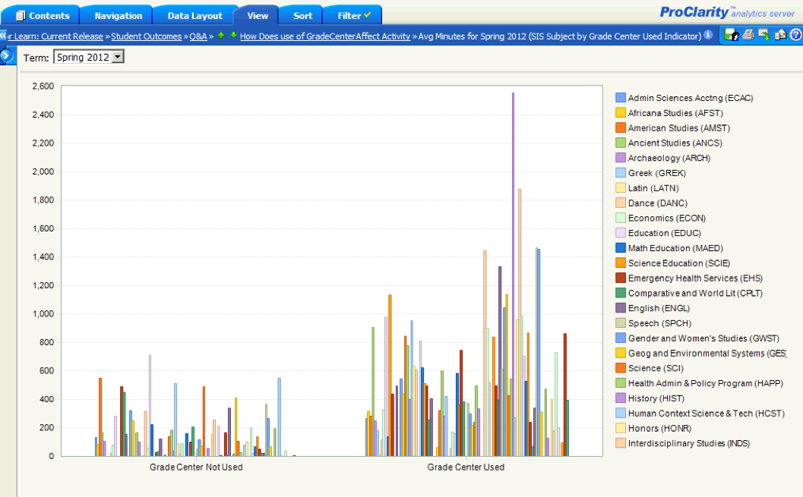
Grade Center Impact on Activity
Notes:
We’ve also used student activity to identify and promote effective practices. For example, we’ve seen that courses using the grade center tend to generate more student activity than courses that don’t.
Research by Educause confirms that students value checking grades and access to practice quizzes more than any other function. But this can’t simply mean that faculty should assign and grade more student work. So, how do we scale up the feedback function?

Slide 23
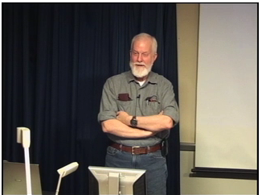
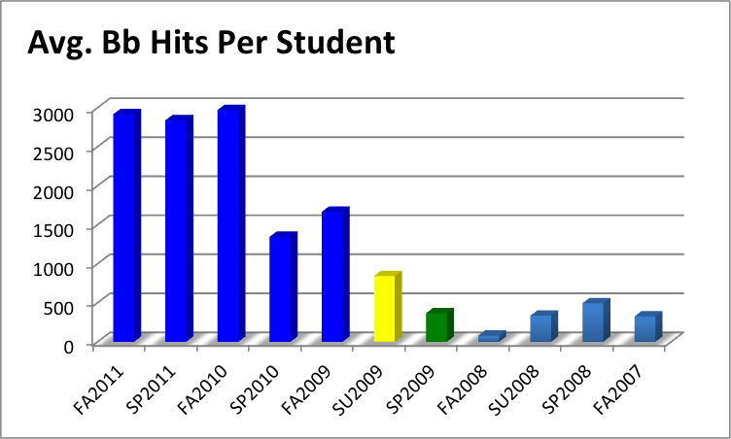
Tim Hardy & ECON 122
Tim attends hybrid course design workshop
Notes:
One of six faculty funded by the Provost’s FA2009 pilot to deliver a 50/50 hybrid course.
· Joined the SU2009 cohort of the Alternate Delivery Program (ADP)
· Attended the January 2009 Hybrid Course Redesign Workshop.
· His UMBC Blackboard ranking for student-only activity has increased dramatically:
FA2010 (1st overall, 2,970 average hits per student) * See note below *
SP2010 (1st overall, 1,345 average hits per student)
FA2009 (1st overall, 1,666 average hits per student)
SU2009 (4th overall, 842 average hits per student)
SP2009 (36th overall, 366 average hits per student)
FA2008 (532nd overall, 78 average hits per student)
SU2008 (38th overall, 334 average hits per student)
SP2008 (76th overall, 494 average hits per student)
FA2007 (151st overall, 326 average hits per student)
Note: His ECAC329 “Cost Accounting” course registered 5,536 avg. hits per student, 1st among all UMBC Bb courses (not just undergrad) for FA2010.
SP2011 (53.7%)
FA2010 (49.4%)
SP2010 (47.7%)
FA2009 (46%)

Slide 24
ECON 122 Students in Next Course

Slide 25
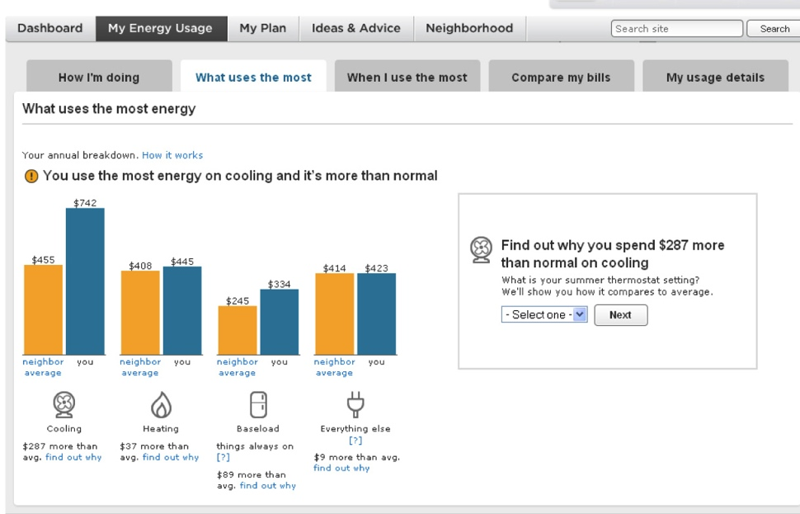
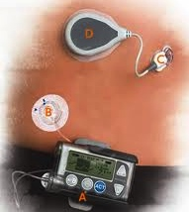
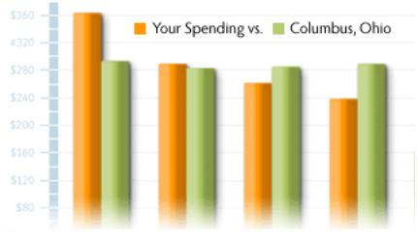
Personal Analytics in Action

Slide 26

Can IT Architect User Choices?
Notes:
A good book on how "choice architecture" creates default choices that are anything but neutral.
RECAP
Record
Evaluate
Compare
Alternative
Prices – or Performance

Slide 27
Open Learning Initiative,
Carnegie Mellon University
Open educational resources (OER) project initiated in 2002, providing learning environments that have been developed through learning science research
Designed to facilitate the progress of individual learners, with adaptive resources that respond to the learner’s progress
Student learning data is used in real time to give the learner suggestions and cues during their problem-solving processes
Accelerated learning (successful outcomes in less than half the time), contributing to higher rates of course completion
Notes:
http://oli.web.cmu.edu/openlearning/index.php
Pittsburgh Science of Learning Center (PSLC)
http://www.changemag.org/Archives/Back Issues/2011/March-April 2011/cold-rolled-steel-full.html

Slide 28
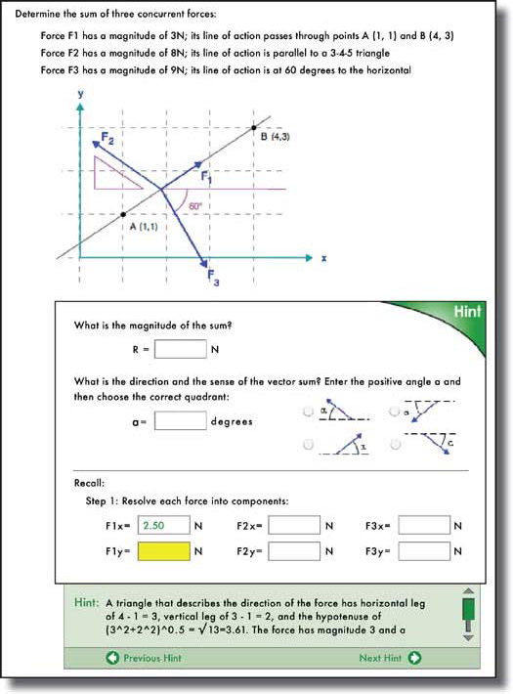
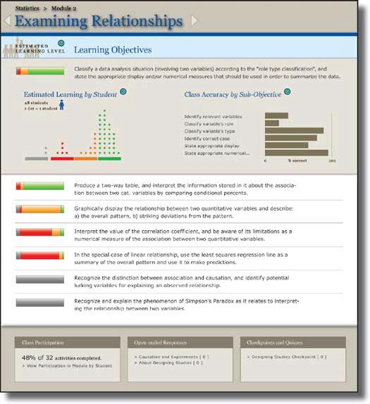
Perceptions of progress: OLI
Notes:
Hints
“mini-tutors” built into the learning materials that provide corrective comments, answer questions about next steps, guide the learner through the material
The mini-tutors adapt to the learner’s behavior, and all this activity goes into the data that leads to research to continuously improve the materials
Data collected (with permission) from hundreds of thousands of learners
Contributing to predictive analysis of learners’ performance

Slide 29
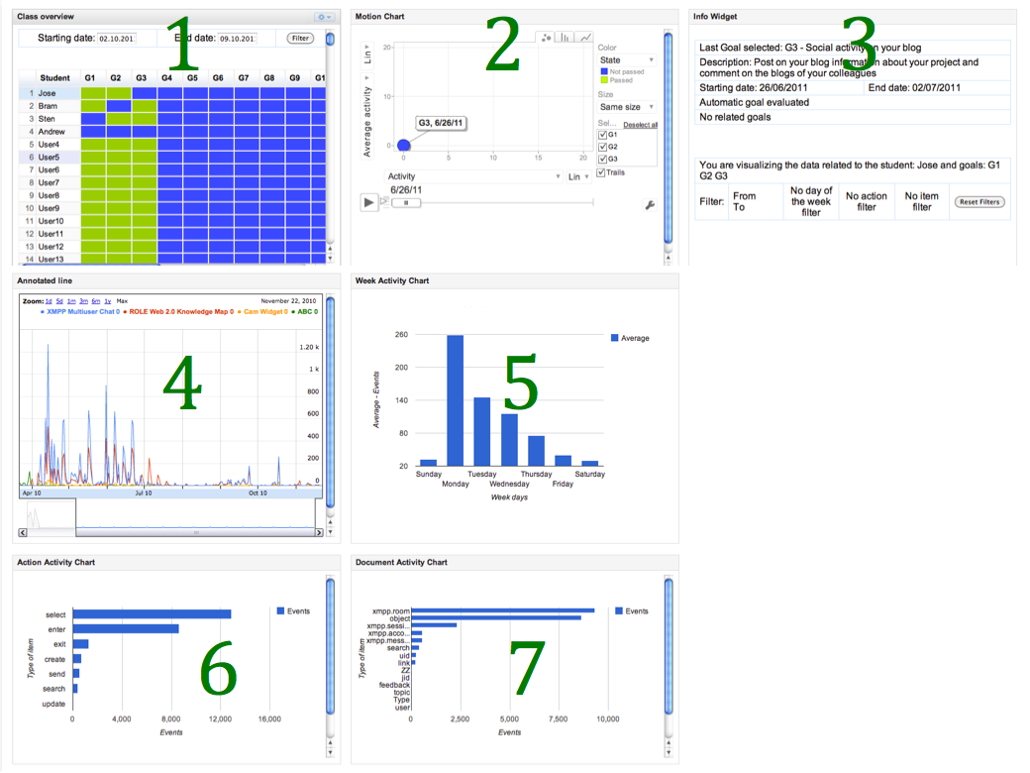
Goal-oriented visualizations
Notes:
Erik Duval, KU Lueven, Belgium
Learning analytics, new opportunities: cutting edge, new, currently evolving examples- research, exploratory
Goal-oriented visualizations of activity tracking: a case study with engineering students http://projects.arts.ubc.ca/lak12/Full%20Papers/Paper%2033-Full.pdf
Charts showing
goal achievement for all students in the class
Motion chart showing the student’s activity compared to class average and goals achieved
Time per day spent on activities based on RescueTime
Comparison across students of time spent on activities
http://www.slideshare.net/erik.duval/learning-analytics-tracking-learning
http://erikduval.wordpress.com/

Slide 30
Perceptions of progress: new school
Society for Learning Analytics Research (SOLAR)
Notes:
“Society for Learning Analytics Research (SOLAR).” Web. 15 Feb. 2012. http://www.solaresearch.org/
solaresearch.org/OpenLearningAnalytics.pdf
Open source framework
Incorporating research projects from multiple sources
Beyond statistics on activities and grades to visual mirrors of learning progress. Suggestions, nudges, comparisons, social frameworks for becoming a more effective, strategic learner.
Discourse analysis
Effective lifelong learning inventory
Social network of learners and interactions
Knowledge map- relationships between ideas
Emotions about learning

Slide 31
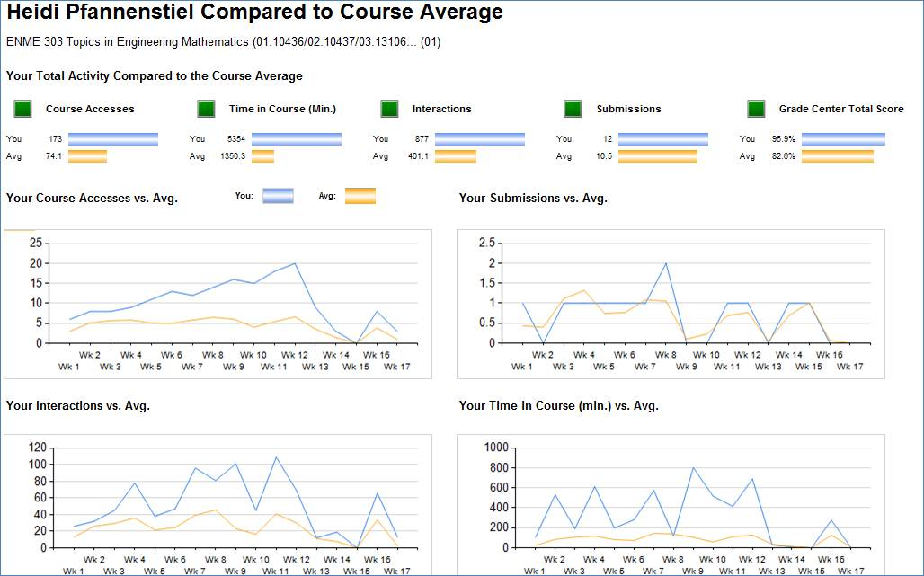
Blackboard Analytics for Learn: Student View
Notes:
Comparing activity and grades to other students in the same course. Student view is based on collaboration w/ UMBC
Analytics for Learn provides analytics features for evaluating
Activity at multiple levels
Course design
Performance against objectives
Institutional
Program
Course
Individual

Slide 32
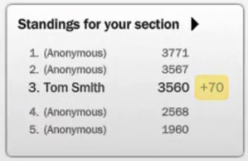
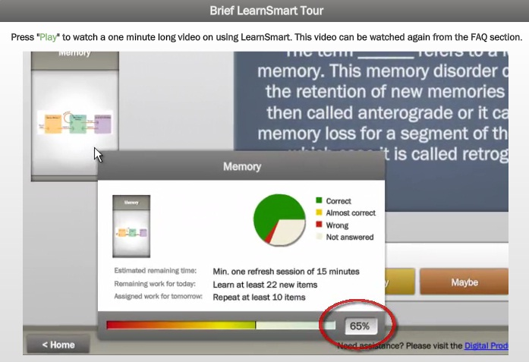

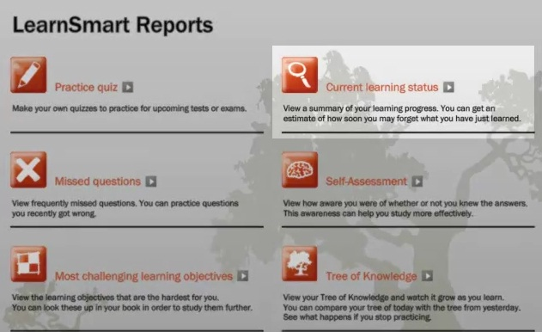
McGraw-Hill LearnSmart
Notes:
Call out “standings”– provides a social framework that influences behavior even when the others on the list are anonymous. Brings out competitive attitude in learners, gives them a context for defining strong behavior, and plays to the appeal of gaming.
http://www.mhhe.com/learnsmart/tryit.html

Slide 33

Learning analytics: the future is now!
Notes:
Call to action- opportunities to apply the power of learning analytics today

Slide 34
Thank you!
Deborah Everhart, Adjunct Assistant Professor, Georgetown University
Director of Integration Strategy, Blackboard
http://www.georgetown.edu/everhart
John Fritz, Asst. VP, Instructional Technology & New Media,
University of Maryland Baltimore County
http://userpages.umbc.edu/~fritz/
Erin Knight, Sr. Director of Learning, Mozilla Foundation
http://erinknight.com/
Jeanine Turner, Associate Professor, Georgetown University
http://explore.georgetown.edu/people/turnerjw/

