Slide 1
How Accessible Are Google Apps?
EDUCAUSE 2012

Slide 2
Presenters
Terrill Thompson
  Technology Accessibility Specialist
  University of Washington
Greg Kraus
  University IT Accessibility Coordinator
  NC State University

Slide 3
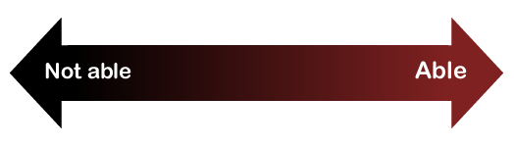
Ability on a continuum
See
Hear
Walk
Read print
Write with pen or pencil
Communicate verbally
Tune out distraction
etc.

Slide 4
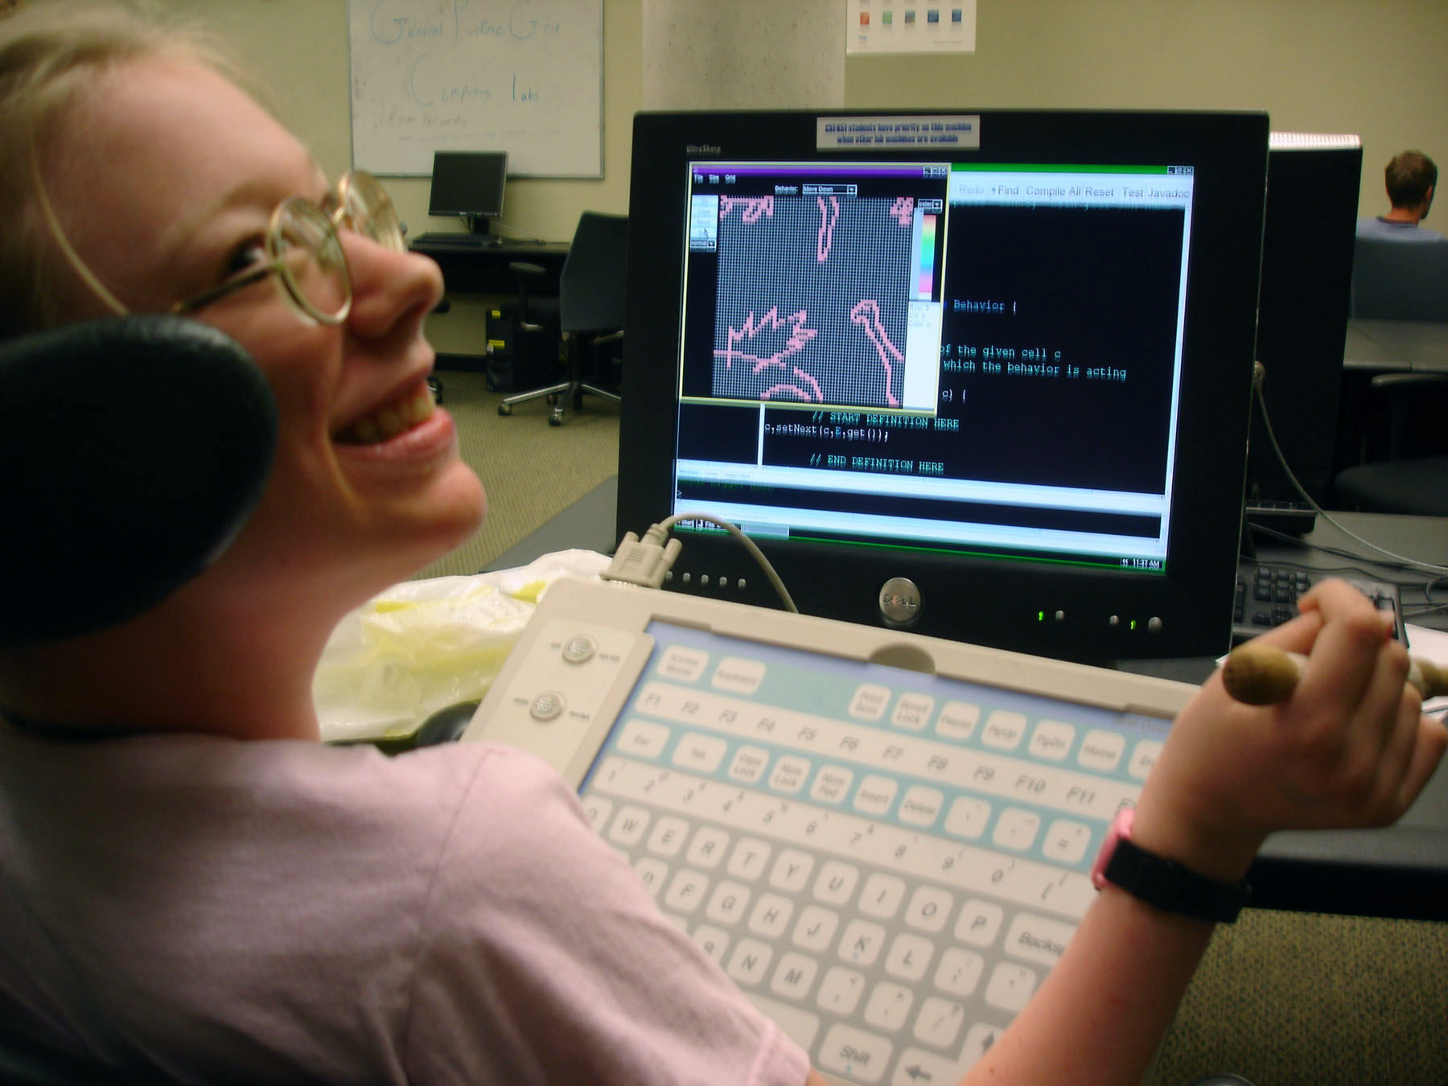
Student Photo #1
Notes:
Jennifer Bishop
National Honor Society in high school
Received scholarships to attend college, working toward a degree in public relations.

Slide 5
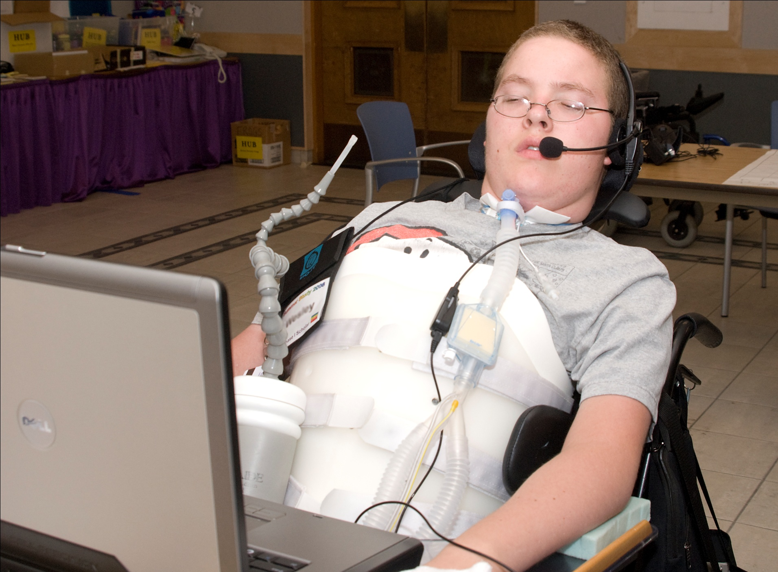
Student Photo #2
Notes:
Wesley Strong
Plans to study psychology.

Slide 6
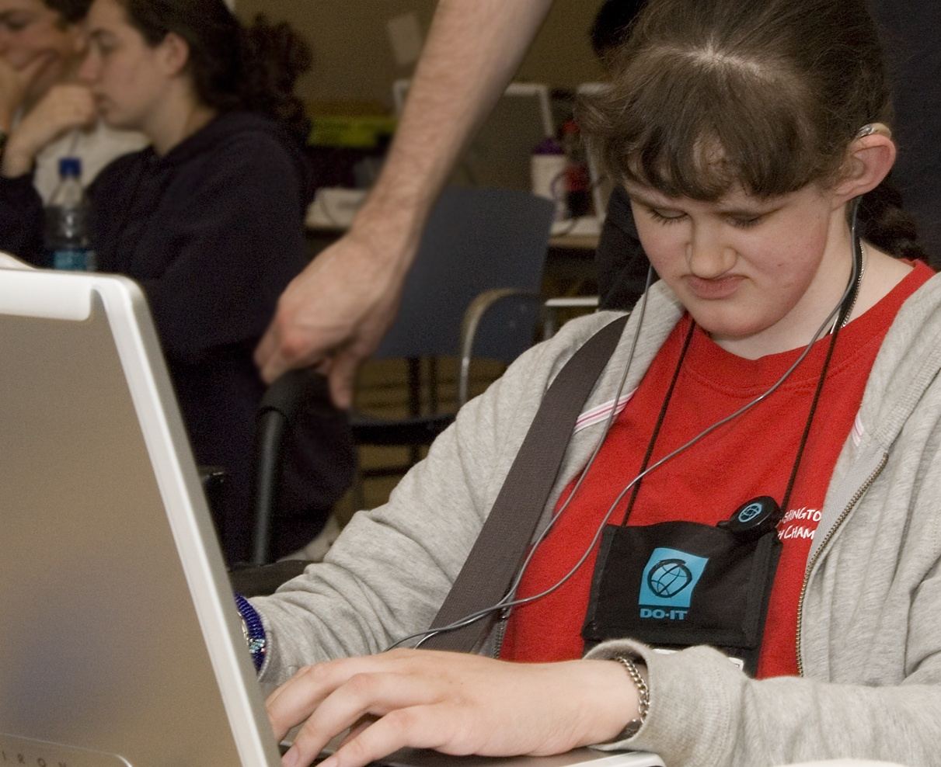
Student Photo #3
Notes:
Nicole Torcolini
Attended Stanford
Majored in computer science with focus on human and computer interaction.
Interned at Microsoft 2x, UW Mobile Accessiblity team and Yahoo!
Now works at Google

Slide 7
How is Accessibility Measured?
W3C Web Content Accessibility Guidelines (WCAG) 1.0 published in 1999
  14 guidelines, 65 checkpoints
Federal Electronic and Information Technology Accessibility Standards
  Written to support Section 508 of the Rehabilitation Act as Amended, 1998
  Standards published in 2001

Slide 8
Updates to Standards
WCAG 2.0 published in 2008
  Level A, AA, and AAA conformance
Accessible Rich Internet Applications (ARIA)
  W3C Candidate Recommendation, Jan 2011
Updates to Section 508 Standards
  Public comment period ended in June 2010
  Draft harmonized with WCAG 2.0 at Level AA

Slide 9
What are the Legal Requirements?
Section 504 of the Rehabilitation Act of 1973
  programs and services of recipients of federal money must be accessible
Americans with Disabilities Act of 1990
  Prohibits disability discrimination in employment, public entities, and places of public accommodations
Some state laws have adopted Section 508
There is no law that requires web-based software applications to be accessible

Slide 10
National Federation of the Blind (NFB)
March 2011 – Filed complaints with the U.S. Department of Justice against Northwestern University and New York University (plus four school districts in Oregon) for violating Section 504 and the ADA by adopting Google Apps
January 2012– NFB informally declared that Google Apps are "not there yet"

Slide 11
ATHEN Reports on Google Apps
ATHEN = Access Technology Higher Education Network
Report on Accessibility of Google Documents
  October 2011
  http://athenpro.org/google-docs-accessibility
Report on Accessibility of Gmail and Google Calendar
  February 2012
  http://athenpro.org/google-gmail-calendar-accessibility

Slide 12
Functional Evaluations
We asked, “Can I accomplish particular tasks?”
  Can I compose an email?
  Can I add a guest to a meeting?
  Can I read a document?

Slide 13
Which Disabilities Did We Test For?
Visual
  Screen readers (JAWS, ChromeVox, VoiceOver)
  Screen magnification (Zoom Text)
  High Contrast Mode
Mobility
  Keyboard-only access
  Speech Recognition Software (Dragon Naturally Speaking)
Cognitive
  Literacy software (Read&Write Gold)

Slide 14
The Grading Scale
A = a user can fully use all functions of the application
B = a user can perform most functions using the prescribed methods of interacting with the application
C = a user can perform many functions, but must rely on non-prescribed methods of interacting with the application
D = a user can perform some basic functions, but most functions are unavailable or there are other significant problems
F = a user cannot use even basic functions of the application

Slide 15
Google Docs (October 2011)
Assistive Technology | Grade
High Contrast - OS X | C
High Contrast - Windows | D
JAWS | D
ChromeVox | D
Keyboard Only | C
Sticky Keys | A
Read and Write Gold | D
ZoomText | A-
Dragon Naturally Speaking | F

Slide 16
General Problems with Docs
Keyboard focus is not always visible
Modal windows allow users to interact with “locked” portions of the application
Users need to “explore” the user interface outside the standard interaction methods
Over dependency on shortcut keys
Inconsistent implementation across browsers
No ability to apply established Web accessibility standards (alt text, table headers, MathML)
Saving user preferences for assistive technology
Not utilizing best practices in how assistive technologies interact with applications

Slide 17
Gmail and Calendar (Jan-Feb 2012)
Assistive Technology | GMail | Calendar
High Contrast - OS X | A- | A
High Contrast - Windows | C | D+
JAWS | D | D-
ChromeVox | C | C
VoiceOver | D | D
Keyboard Only | B | B
Sticky Keys | B | B
Read and Write Gold | A | A
ZoomText | B | B
Dragon Naturally Speaking | D | D-

Slide 18
General Problems in GMail
Standard View vs. Basic HTML?
  Basic HTML has some fundamental accessibility errors that cannot make it an accessible alternative
Tab order is illogical
Rich text editing tools often aren’t available

Slide 19
General Problems in Calendar
The Agenda View generally works well for most assistive technology, but not all
The accessibility features don’t carry down to the meeting creation/edit screen
Often can’t schedule a joint meeting based on available times

Slide 20
Notable Improvements
High Contrast (Chrome Extension)
ChromeVox
Keyboard Only
Read & Write Gold (vendor solution)
Dragon Naturally Speaking (vendor solution)

Slide 21
Demonstrations
High Contrast Mode
Keyboard Only
ChromeVox
VoiceOver

Slide 22
Why do Chrome Solutions Work Better?
Marketing vs. Technical Limitations

Slide 23
The Accessibility Telephone Game
Which browser?
Which OS?
Web Application
Which version?
Browser
Operating System
Assistive Technology
Use ARIA
How does it
support ARIA?
Which version?
How does it
support ARIA?

Slide 24
Google’s Solution
Google’s
Ecosystem
Web Application
Browser
Browser
Operating System
Browser
Operating System
Assistive Technology

Slide 25
Accessibility Direction at Google
Chrome Browser/Chrome OS is what Google Apps are designed to run on
Solutions are primarily delivered via extensions
  ChromeVox (from Google)
  High Contrast (from Google)
  Read&Write Gold (from vendor)

Slide 26
Accessibility News from Google
Administrator Guide to Accessibility
  http://www.google.com/support/enterprise/static/gapps/docs/admin/en/gapps_accessibility/gapps_accessibility.pdf
"An update on Apps accessibility in the last year”
  https://groups.google.com/forum/#!topic/accessible/BVvL293pWJ0/discussion

Slide 27
How to Deal with Google Accessibility on Campus
NC State University’s Google Apps Accessibility Usage Guidelines
  http://google.ncsu.edu/accessibility/google-apps-accessibility

Slide 28
Are We There Yet?
No, but we are making progress
The ongoing battle in the accessibility community
  Chrome-only solutions vs. other assistive technologies

Slide 29
Next Steps
Let Google know that you require full accessibility!
  File accessibility bugs using your support system
  Accessibility Feedback Form:
  https://services.google.com/fb/forms/accessibilityfeedback/
  Accessibility Group @ Google Groups
  https://groups.google.com/group/accessible
  On Twitter: @googleaccess

Slide 30
This Isn't Just About Google
270+ Exhibitors at EDUCAUSE
How many of them are accessible?
Be sure to ask!

Slide 31
Eight Great Questions to Ask Vendors
Can the application be used with only the keyboard?
Do images have appropriate text descriptions?
Do pages have a consistent look-and-feel?
Does text content have enough color contrast?
Does the content include headings and landmarks
Do form controls and web widgets have labels?
When styling and layout is removed, is the document understandable?
Does audio content have transcripts and do videos have captions?

Slide 32
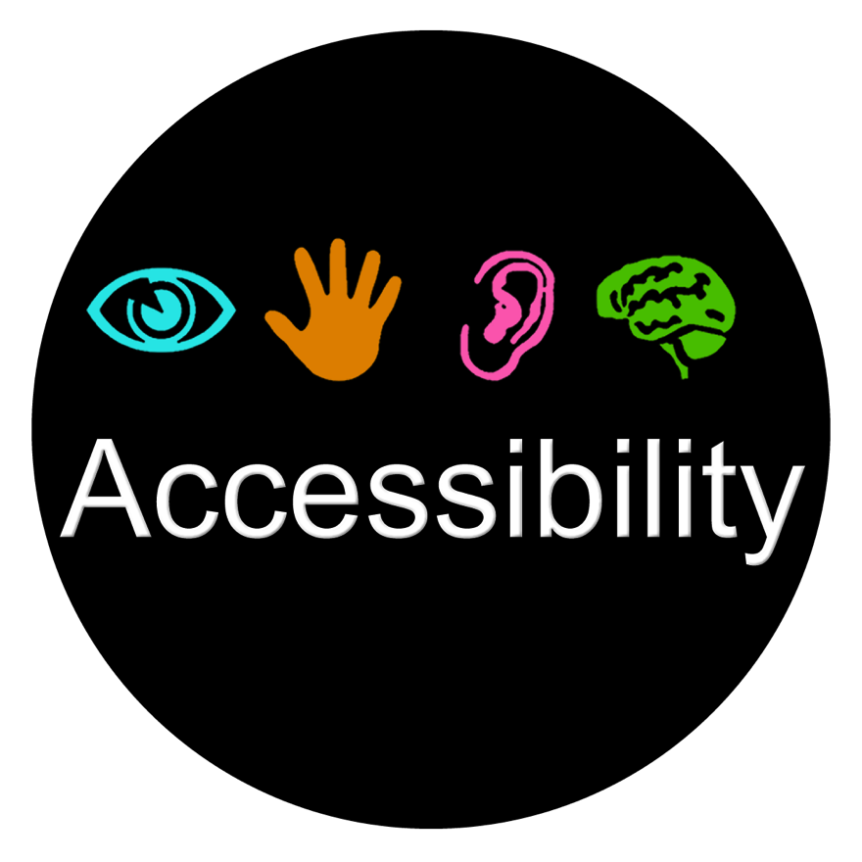
Get Your Accessibility Sticker!

