Slide 1

NVCC Copes and Competes using IT Infrastructure
Allen Sinner
NVCC Chief Technology Officer
November 2012

Slide 2
Coping with Size and Growth
NVCC belongs to VCCS
  VCCS has 23 community colleges
  40 campuses across the state
    8% growth 2009-2011
    13% growth 2008-2010
  VCCS often used as a cost effective launch platform into VA’s excellent university system
NVCC Campuses
  NVCC is the nation’s 2nd largest community college after
  Miami-Dade
  Six campuses in NoVA
  75,000+ students from 150 countries
  160 associate degrees
While IT is essential to increase enrollment, IT resources are challenged
  Power, cooling, space, and technical people in short supply
  Extended service hours to accommodate students
Campuses expanding while IT infrastructure is consolidating
  Each campus has its specialty and culture
  IT infra is application agnostic
  Distributed services moving to private cloud
  Virtualization
    Servers
    Classroom and lab desktops
Notes:
NVCC is part of Virginia Community College System (VCCS). The VCCS has 23 schools, 40 campuses, and have had enrollment growth in most of the economic downturn.
NOVA is the 2nd largest community college in the country with 75,000 students from 150 countries and 160 Associate degrees
IT is a necessary aspect to increase enrollment but that comes with problems – Not enough power, space, cooling, qualified technical staff to run the systems all while campuses are expanding their IT environment and we are reducing the infrastructure by moving to private could for IT and Virtualization

Slide 3
VCCS Competitively Priced
Economics
  The cost of a Virginia Community College education is about 20% of a public 4-Year Virginia college as a percentage of per capita disposable income
Demographics
  In reaction to economic uncertainty, increasingly wealthy middle class families choose a lower price point than 4-Year schools
  11% international students
As the cost of a 4-Year college rises, the average tuition at Virginia 2-Year colleges was about 2/3 that of 4-Yr schools in 2000
and slightly more than half in 2010
Notes:
Throughout the economic crisis more and more families have turned to a more cost effective learning solution. NVCC and the VCCS provide a savings of at least 20% over traditional state 4 year school alone.

Slide 4
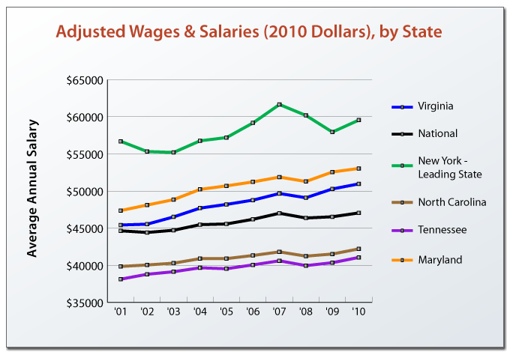
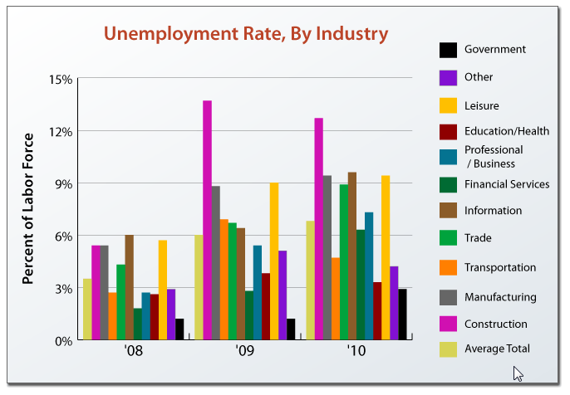
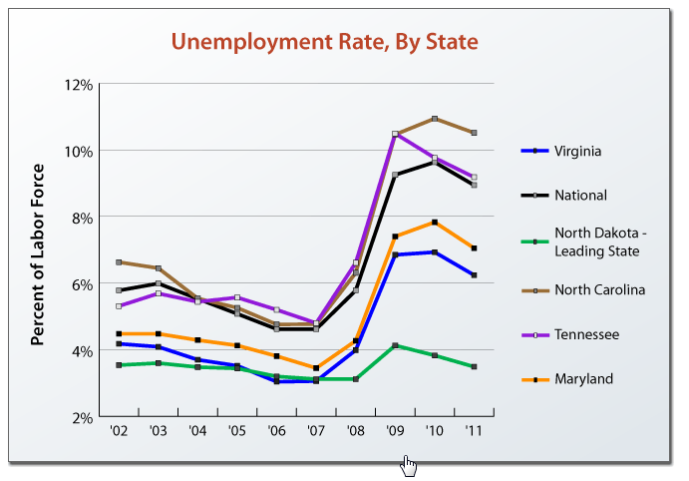
Northern VA Really Is Different
Employment and economy drive parents’ and students’ educational choices
While NY thrives on financials, ND on energy, NoVA and MD thrive on Government
Government employment almost steady
Notes:
Northern Virginia really is different from the rest of the nation. We have some of the lowest unemployment in the nation.
While NY relies on the financial markets and ND relies on the energy industry to help their economy, the Washington area are relies on government and their related contractor support

Slide 5
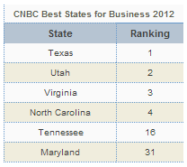
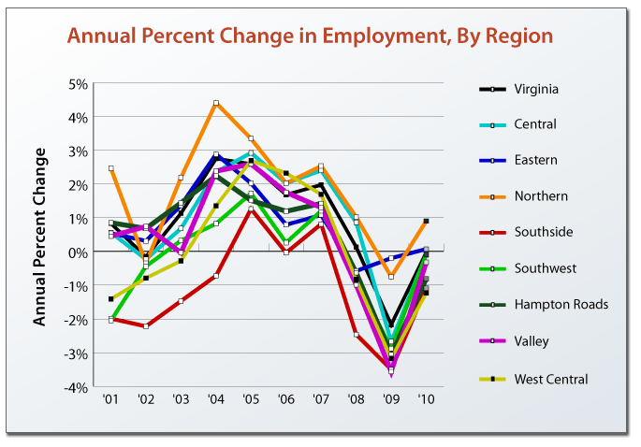
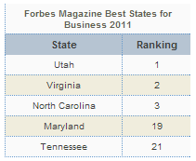
Private Business Thrives in VA
VA educated work force, competitive climate contribute to being amongst the top three states for private business. But the traffic… !
NoVA private economy more vibrant than all other VA regions.
Notes:
VA Ranked amount the best in the nation for business and Northern VA is leading the entire state as the best. As a result of this pro business environment we do have one down side, the traffic really is bad (also ranked as one of the worst)

Slide 6
NVCC Reacted to Demand
Admission growth rate doubled in 2009 when families and students reacted to the recession
  Total students 4.1% to 8%
  FTES 5.2% to 11.6%
IT made capital improvement plans in response to ‘09 influx
Notes:
While our student growth has slowed some from the high point to 8% in for total students and 11.6% for FTES in 2009/2010. We knew we need to make some changes to keep up.
We made a major capital investment in IT to meet the needs of the college

Slide 7
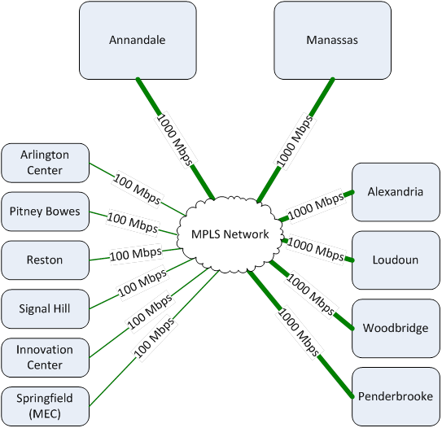
Campus Network
Annandale main computing site
Manassas disaster recovery site
Thick routes enable distributed computing and storage
Notes:
Our Campus Network is comprised of 6 campus & 8 centers/sites
Annandale is the Main campus and houses the Data center, Manassas houses our DR site and the other major campus all have gig connection. Our Distance Learning environment is the 3rd largest campus we have.
Smaller sites all have 100 mb connections and all sites have redundant connections

Slide 8
Must-Have I.T.
Like commercial enterprises, educational institutions compete using flexible, ubiquitous and safe computing
“Corporate” solutions offer suitable educational economics but with increasing density and complexity
How do community colleges cope with IT complexity to meet their customer’s expectations?
The Cloud ! (of course)
Notes:
Education institutions must compete using flexible, creative and safe computing solutions to deal with the increasing density and complexity of IT
So how do we cope - we move to the Cloud of course

Slide 9
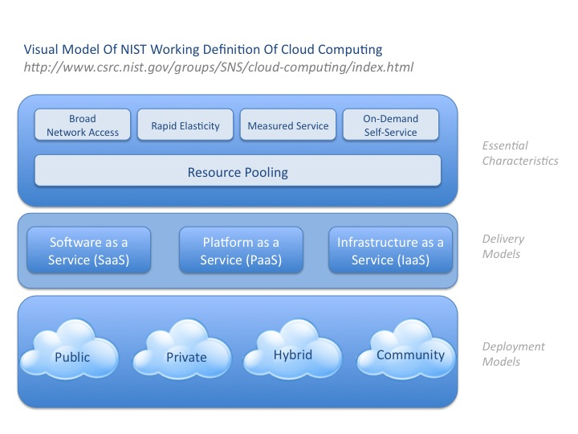

So What is “The Cloud” Anyway?
NVCC is building a private cloud
Essential Characteristics
Delivery Models
Deployment Models
“Cloud computing is a model for enabling ubiquitous, convenient, on-demand network access to a shared pool of configurable computing resources (e.g., networks, servers, storage, applications, and services) that can be rapidly provisioned and released with minimal management effort or service provider interaction.”
Notes:
We are building our own private cloud and participate in the VCCS cloud for shared resources
Clouds offer access to servers, virtual workstations, applications, networks, storage in a ubiquitous, safe, convenient and on demand environment

Slide 10
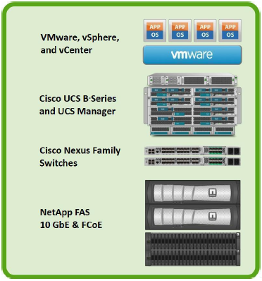
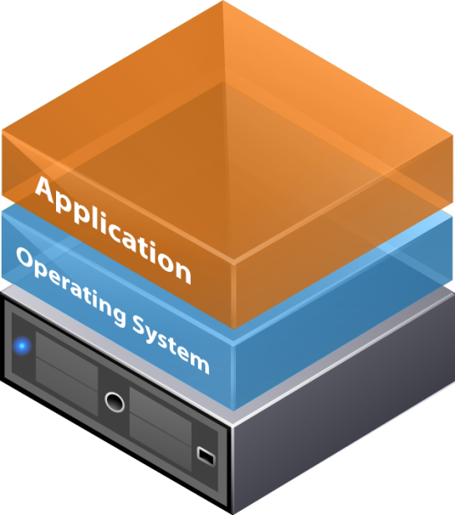
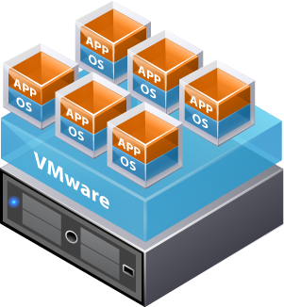
Cloud Building Blocks
FlexPod
computing, storage, and switching
Hypervisor abstracts traditional physical machine resources and runs workloads as virtual machines (VMs)
Each virtual machine runs guest operating system and applications
Source: VMware
Notes:
The cloud building blocks allows the Hypervisor to remove the physical server requirements - Allows virtual machines to run unique guest operating systems
We have Built our cloud using the basic building blocks = NETApp Storage, Cisco nexus switches, Cisco UCS B series server platform, and using both VMware and Citrix for the hypervisors, Then placing Windows and Linux on top.

Slide 11

Server Software Stack
Faculty / corporate network
Student network
Windows7 & XP, Mac OS, Android, …
Campus faculty
Faculty remote
Classrooms and labs
Centralized management of
lab boot image
Windows Server 2008
Xen Provisioning Services
XenApp Server 6.0
Xen Provisioning Services
Xen used for labs, VMware for enterprise servers
VMware
XenServer
CISCO UCS Server Hardware
Both hypervisors run on UCS
For cost and flexibility considerations, we chose to run all Windows servers on VMware, major site (MA & AN) XenApp Servers on XenServer, and PVS on VMware or XenServer at campuses
Notes:
Server software stack
By selecting the Cisco UCS platform we have centralized the Management of all server environments - Data Center and Labs
We have provided a stable and flexible platform Windows server run on either VMware or Citrix XenServer. We use XenApp servers on XenServer and PVS on either Vmware or XenServer

Slide 12









Traditional Server Management
LAN
SAN
Storage
SME
Server
SME
Network
SME
QoS settings
Border port assignment
per vNIC
NIC Transmit/Receive
Rate Limiting
FC Fabric assignments for HBAs
  Subject matter experts consumed by manual configuration chores
  Serial processes and multiple touches inhibit provisioning speed
  Configuration drift and maintenance challenges
VLAN assignments for NICs
VLAN tagging config for NICs
Number of vHBAs
HBA WWN
assignments
FC Boot Parameters
HBA firmware
Number of vNICs
PXE settings\
NIC firmware
Advanced feature settings
Remote KVM IP settings
Call Home behavior
Remote KVM firmware
Server UUID
Serial over LAN settings
Boot order
IPMI settings
BIOS scrub actions
BIOS firmware
BIOS Settings
RAID settings
Disk scrub actions
Source: CISCO
Lots of stuff to manage separately with three SMEs to grow IT capacity.
Does this look like “minimal management effort or service provider interaction” to you?
Notes:
Traditional Server Management - multiple resources working together to integrate each and every server
Server team. – RAID, partitions, bios updates, OS install & Configuration
SAN team – storage, LUNS,
Networking team - vlans, speed, # NICs, QOS
Security over sees all changes and configurations

Slide 13

Unified, Embedded Management
Unified
Management
Server Name
UUID, MAC, WWN
Boot Information
LAN, SAN Config
Firmware Policy
Subject Matter Experts
Define Policies
Server Name
UUID, MAC, WWN
Boot Information
LAN, SAN Config
Firmware Policy
1
Storage
SME
Server
SME
Network
SME
Server Name
UUID, MAC, WWN
Boot Information
LAN, SAN Config
Firmware Policy
2
Policies Used
to Create
Service Profile Templates
Server Name
UUID, MAC, WWN
Boot Information
LAN, SAN Config
Firmware Policy
Server Policy…
Storage Policy…
Network Policy…
Server Name
UUID, MAC, WWN
Boot Information
LAN, SAN Config
Firmware Policy
3
4
Virtualization Policy…
Service Profile
Templates
Create Service Profiles
Associating Service
Profiles with Hardware
Configures Servers
Automatically
Application Profiles…
Source: CISCO
Same stuff is now systematized in a Unified Management layer using automated policies that prompt consistency, quality and cooperation
Notes:
Policy based mgmt approach
Define the environment once with all 3 parties in the data center, create the policies that control the definition
Create a template based on the policies that provide a consistent configuration
Implement the profiles (virtual abstraction of hardware) to scale out the solution
Associate the profiles with the hardware.

Slide 14
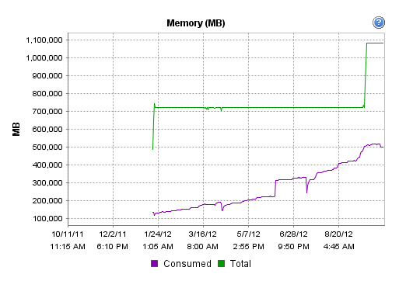

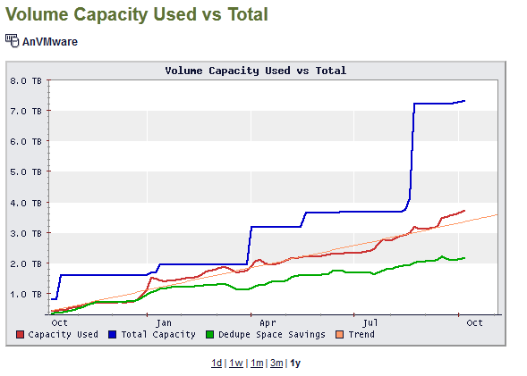

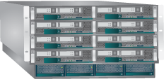


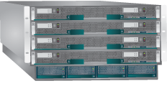

Modular Expansion
Recently added third B-series chassis of servers to meet rising VMware and Citrix VDI demand
Cisco UCS
Fabric Interconnect
Brains over brawn
Cisco
Fabric Extender
C-Series Rack Optimized Servers
B-Series Blade Servers
Source: CISCO
Notes:
Ease of usage and growth using modular expansion
Simply add additional servers and chassis to grow. Flexibility to increase cluster sizes, fail over groups and blades to span multiple blades and chassis. Can add rack servers is requirement are needed

Slide 15
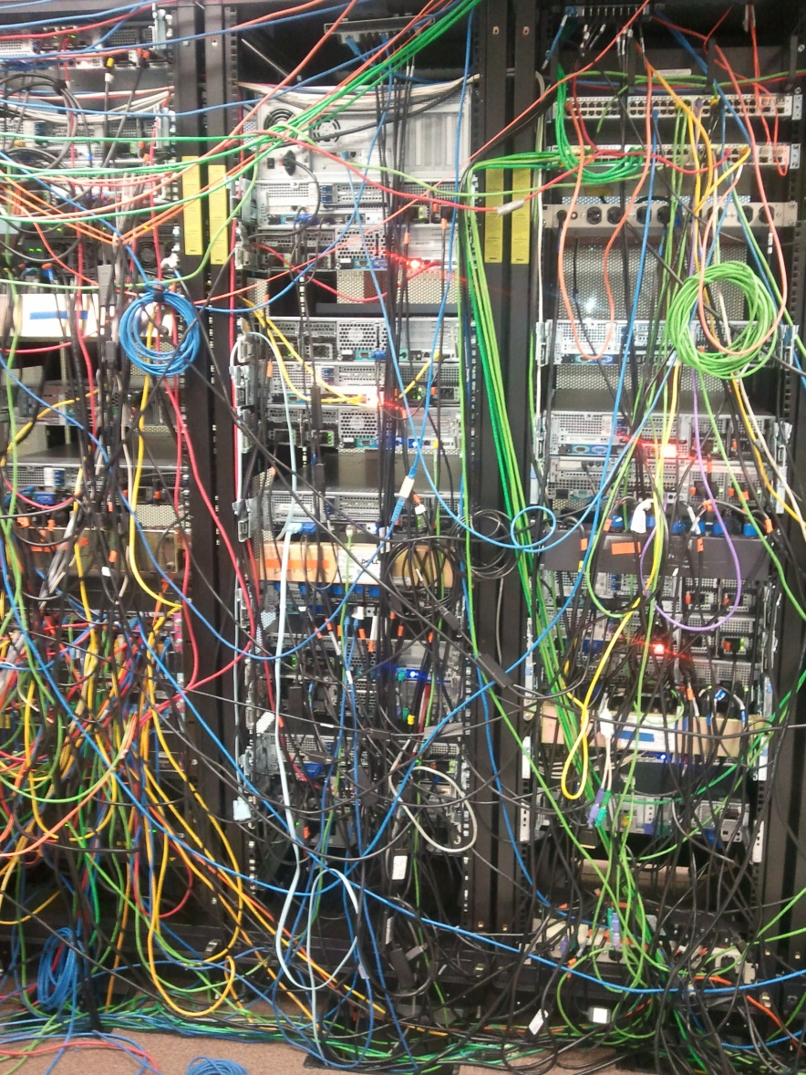
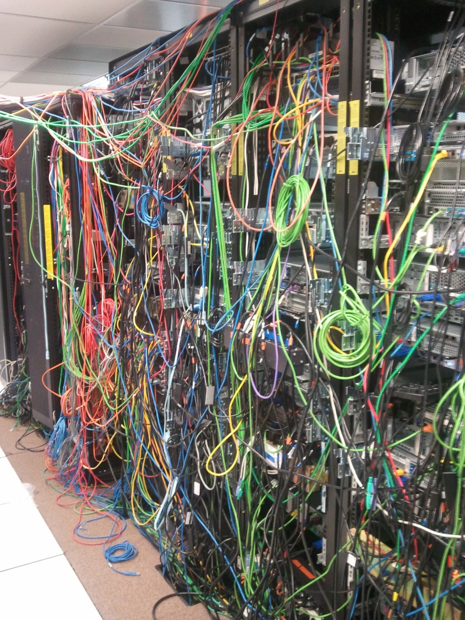
Moving From This…
Notes:
The real ugly truth of a data center that grew out if control and had multiple groups doing their own stuff.

Slide 16
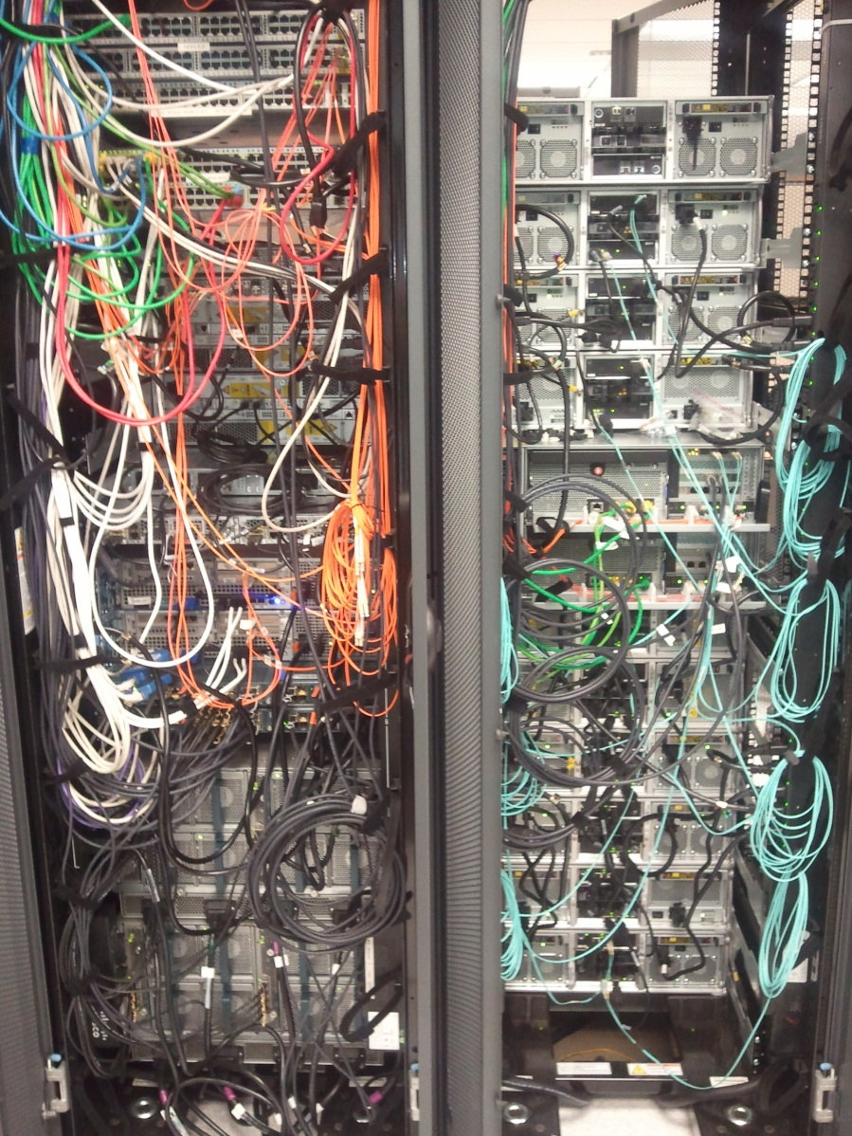
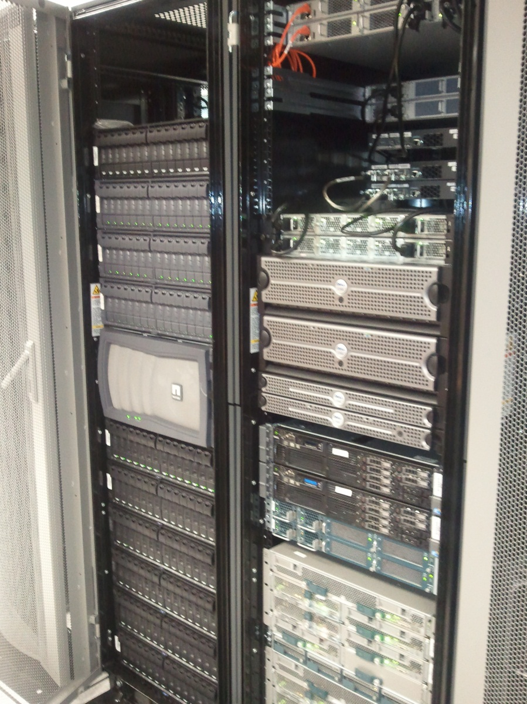
To This
CISCO Fabric Interconnect
CISCO Nexus 5000 Switch
CISCO UCS
NetApp SAN
Notes:
A new clean consolidated environment. Reducing the cable nightmare into a simple manageable environment.
This is still a small mess due to the cables being too long to start with.
By deploying a top of rack solution it cleans things up and reduces the mess.

Slide 17
Outcomes
Data Center
  Power reduced 48%
  HVAC reduced 40%
  Space reduced 68%
  Savings as old equipment is not replaced but virtualized
  Some old servers cannot be virtualized
    Old and forgotten application technical details
    Some hardware not offered in UCS
      Graphics accelerators
      Modems
  SQL machines are being bundled into a separate effort
VDI
  Three class rooms at each campuses in production pilot
    Make campus-specific choices
    Shake the bugs out
    Campus IT people are trained and become proficient in the new methods
  2013 Target:
    Double or triple VDI sessions for labs and classroom usage
    100 VDI sessions for faculty and Staff usage (Secure Remote work/ Continuity of Operations)
  Can accommodate future Distance Learning
Notes:
Reduced - power by 48%
HVAC by 40%
Space 68%
All while increasing the number of servers by 40%
VDI will allow the labs to redeploy systems faster. No more re-imaging an entire lab each semester

Slide 18

Managing Desktops in Education
Information and data is our most important asset. Security is a priority and we need to ensure that this data and IP is safeguarded
How do I maintain or improve desktop management when I’m required to do more with less? Less budget, less power consumption, less resources..
I need to support a growing portfolio of diverse applications and some of them are from the 1800s!
I need to provide students and teachers with the best possible experience on campus, off campus, on multiple devices.
Source: Citrix
Using cloud building blocks, Desktop and Application Virtualization became feasible. Again, what was once very manual can be automatic.
Notes:
With almost 10,000 College owed computers and 5,000 to 10,000 BYOD on the network at any time we need a way to manage them.
Provide the applications needed, provide access when and where they need it, reduce IT headache and Secure the data

Slide 19
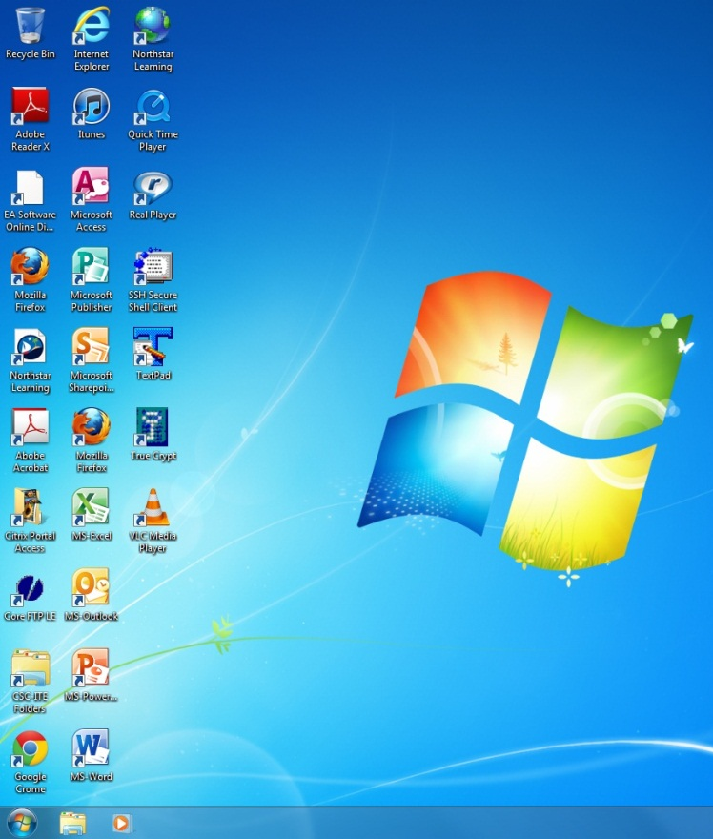


Virtual Desktop Infrastructure (VDI)
Network-based Boot and Applications
Provisioning Server
XenApp Server
All applications run on the centralized XenApp Servers and no longer reside on the PC hard drive.
Click on these shortcuts to run an app.
App Screen I/O
(server-based applications)
Bootable Base Image
Save student files
to external drive
Notes:
VDI
Running everything from central servers, provides better Management of environment, faster repair/replacement of down PC's, faster re-configuration of the lab environment
Encourage students to save data on external drive or web based storage such and Dropbox

Slide 20



Culture Clash
Campus IT control OS but who controls the classroom and lab applications?
Server-based Apps
All-in-One Boot Image
XenApp Server
Centralized Citrix app farm
PVS Server
Local provisioning server
All Apps on all campuses from server results in faster boot time but some loss of control
Thin Client
Fat Client
Campus puts Apps in boot image results in slower boot time
Answer: Depends on who needs control, and speed considerations. Each campus makes their own decisions rather than forcing one-size-fits-all.
Notes:
One flavor does not fit everyone or every campus
We need a mix of both thin and thick client to meet the demands of the campus and lab IT staff and the faculty. What is the most important for the site. Everything available at one time (fat client) or selecting the desired apps that are needed. Slow boot up or faster startup.
Each site make the choice after meeting with the faculty and IT

Slide 21
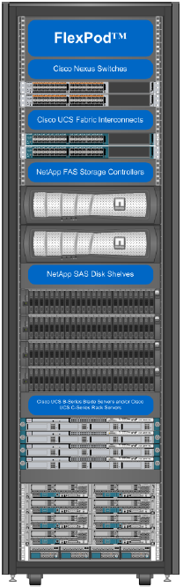
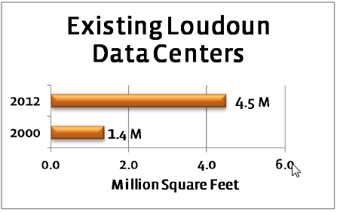
NVCC Teaches Virtualization
IT has installed a FlexPod for a new virtualization class
Loudon County Jobs, Many in IT
  Amongst fastest growing counties in the nation
  Job growth (2000-2011): 83.6%
  Amazing complement of data centers and good paying jobs
Notes:
In order to meet the need of the area we are teaching Virtualization & VDI on a FlexPod in the class room. This allows us to not only teach, VMware, Citrix but also Cisco UCS hardware and UCS Manager and Netapp's hardware and OnTap
Loudoun is amongst the fastest growing county in the nation and the fact that NOVA has 4.5 million sq feet of data centers and continuing to grow.

Slide 22
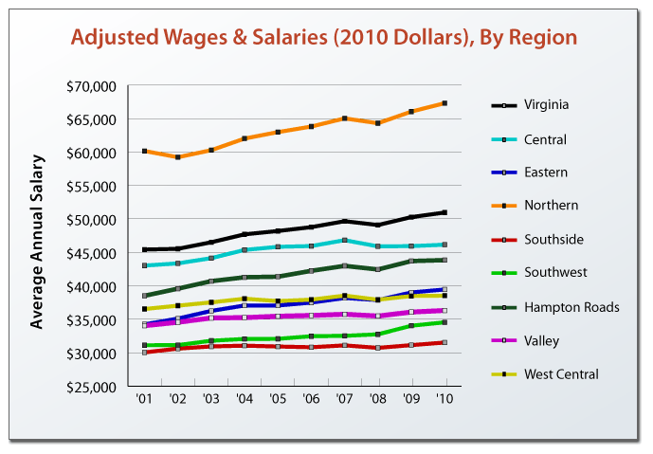
Continued Prosperity
NVCC helping to prepare students for high paying jobs and further education
Using and teaching IT infrastructure to cope with complexity and uncertainty
"It's no accident that such a business-friendly [Loudon] county with the highest household income in the U.S. would attract employers who want to hire smart and successful people.“
Loudoun County Chairman Scott York, R-At large
Notes:
We are dedicated in helping our student focus on the technology and education that will allow them to get high paying jobs.

Slide 23

Questions?
A copy of this presentation will be posted at www.nvcc.edu/home/asinner

Slide 24
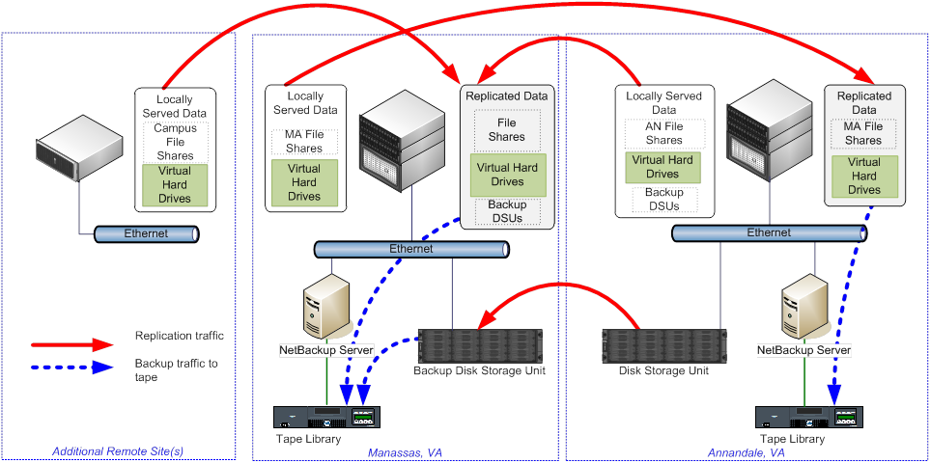
Upgraded Data Protection
Distributed computing requires hypervisor and user data replication
Longer term archiving to tape

Slide 25
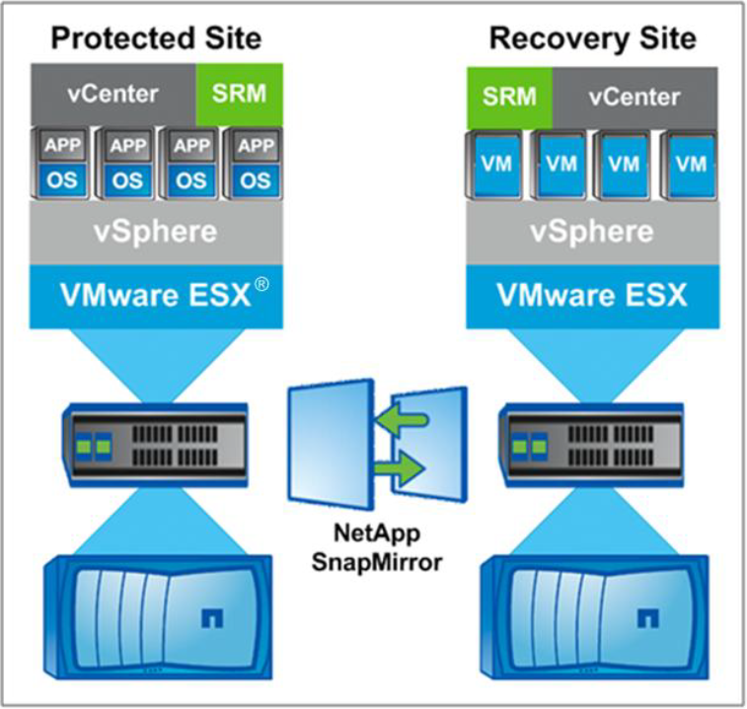
Disaster Recovery Path
Site Recovery Manager (SRM) used to switch VMs from the dead to the live site

Slide 26
Reason for UCS
Reasons for change
  Space
  Power
  Cooling
Superior economics
  Increased compute capacity in the same footprint as others
  Exceptional bandwidth capacity with 40gig connections
  Ease of Network management
  Increased processor and memory per blade and chassis
  Comparative costs to other vendors
Easier to manage through standardization
  Fewer technical people necessitates fewer platforms
  Cross training ongoing
Cost reduction

