Slide 1
Reading, Writing, & Robots: Using remote controlled video conferencing for instructional enrichment
Tim Logan
Associate Vice President, Electronic Library,
Baylor University
Pattie Orr
Vice President for IT & Dean of Libraries,
Baylor University
Nils Holgersson
Academic Consultant,
Electronic Library,
Baylor University

Slide 2
Copyright Baylor University,
2012
This work is licensed under a
Creative Commons Attribution-NonCommercial-ShareAlike 3.0 Unported License.
BALDO (c) 2012 Baldo Partnership. Used by permission of Universal Uclick. All rights reserved.
Permission includes not only permission for the use of the cartoons in the presentation, but for the file to be posted for public review. All other rights reserved.

Slide 3

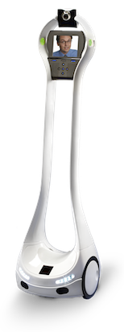
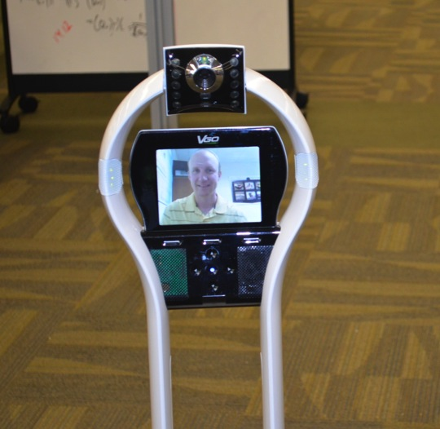

Slide 4
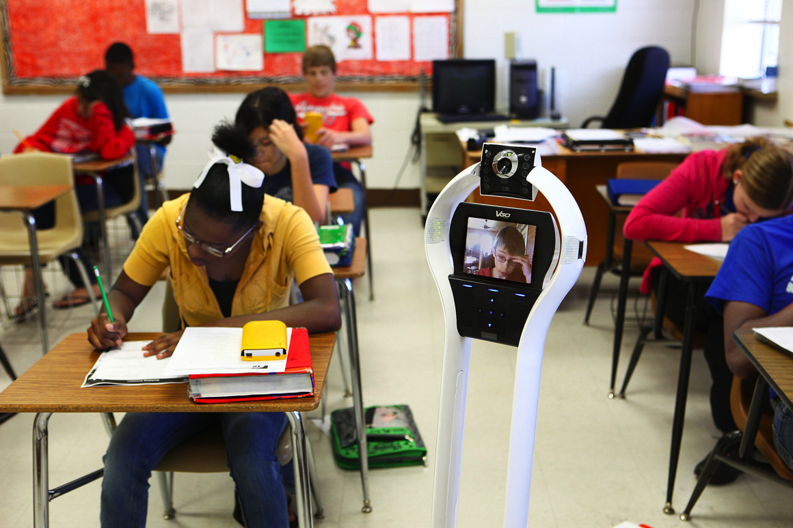

Slide 5
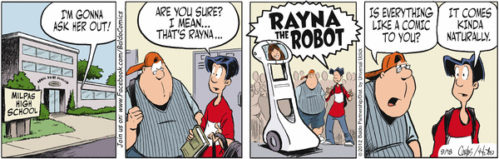
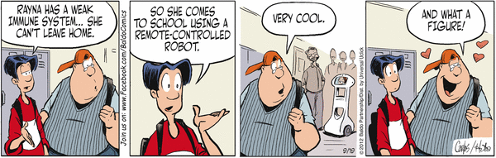
BALDO (c) 2012 Baldo Partnership. Used by permission of Universal Uclick. All rights reserved.

Slide 6

Field Trips

Slide 7
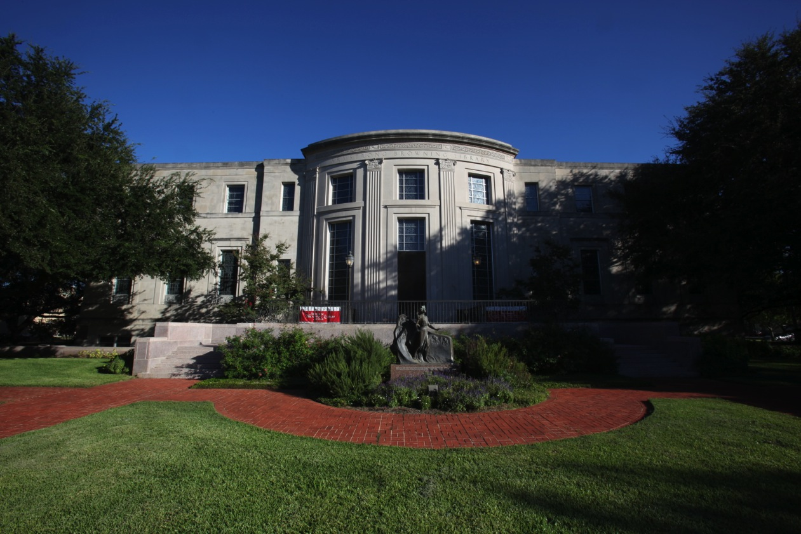

Slide 8
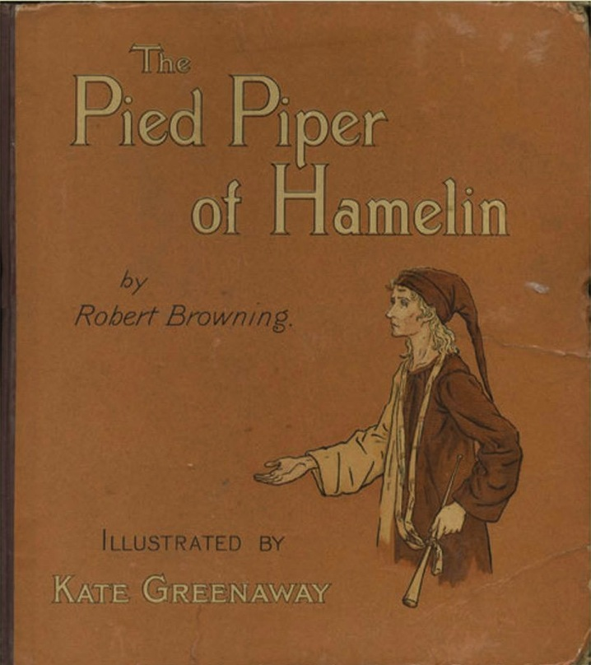

Slide 9
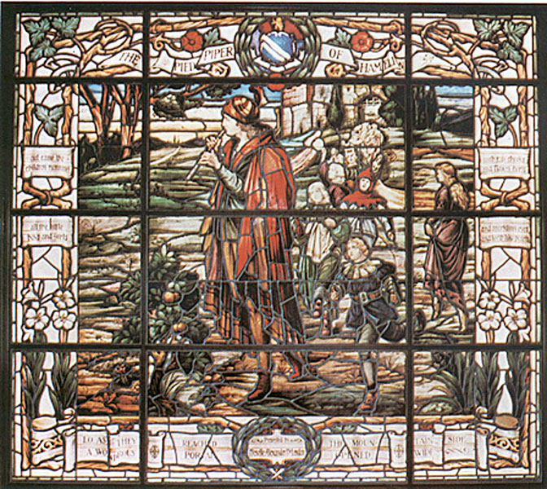

Slide 10


Slide 11
TETN Consortium
TETN is a cooperative of the Texas Education Agency and the 20 Texas Education Service Centers(ESCs).
The mission of the Texas Education Telecommunications Network (TETN) is to facilitate communications among educational entities throughout Texas to improve student performance and to increase efficiency of educational operations via an effective telecommunications network.
Notes:
The Texas Education Telecommunications Network was created in 1996 as a recommendation in the TEA Long-Range Plan for Technology. The network originally provided video conferencing services until it was upgraded in 2006 to a gigabit backbone, utilizing capacity mainly from the LEARN network. Today TETN provides network and content services such as internet access, Internet2 access, access to the Texas education intranet, backhauling, and disaster recovery transport.

Slide 12



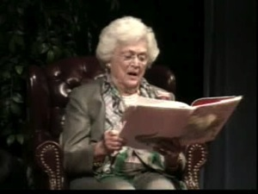

Other Organizations
Connected to ESCs
Hospitals
Universities/Colleges
Consortiums
Museums
Libraries
Notes:
TETN is a gigabit, middle-mile network connecting the 20 ESC regional networks. Besides providing network connectivity to their schools, the ESCs also connect content providers in their region to provide content to students and professional development to educators.

Slide 13
Types of Projects/Collaborations
High School Courses
Dual-Credit College Courses
Graduate Courses
Staff Development
Electronic Field Trips
Access to Experts
Professional Development
These are all delivered using interactive videoconferencing technology
Notes:
Through TETN and the Distance Learning Workgroup, the ESCs provide a wide variety of content programs that are shared among schools in the regions across the State and across the nation utilizing I2 access.

Slide 14
Types of Projects/Collaborations
High School Courses
Dual-Credit College Courses
Graduate Courses
Staff Development
Electronic Field Trips
Access to Experts
Professional Development
These are all delivered using interactive videoconferencing technology
Notes:
Through TETN and the Distance Learning Workgroup, the ESCs provide a wide variety of content programs that are shared among schools in the regions across the State and across the nation utilizing I2 access.

Slide 15
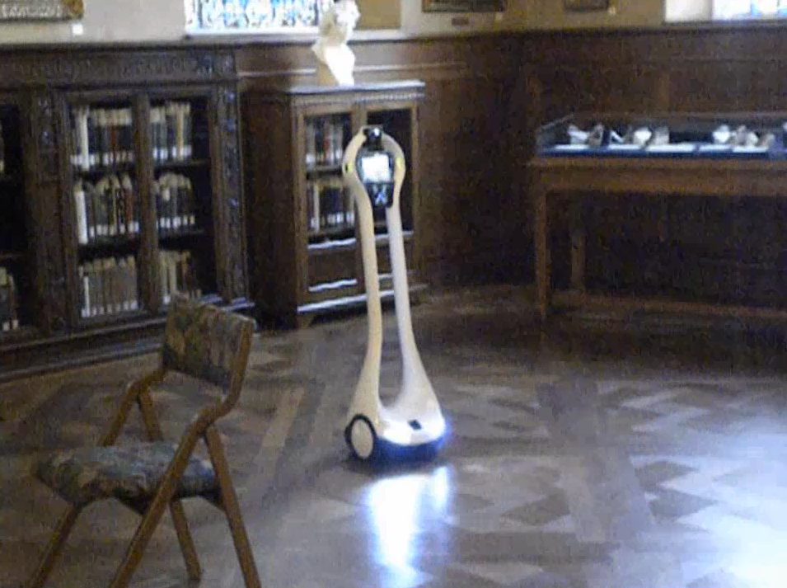

Slide 16
Demonstration

Slide 17
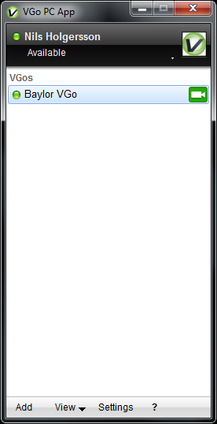
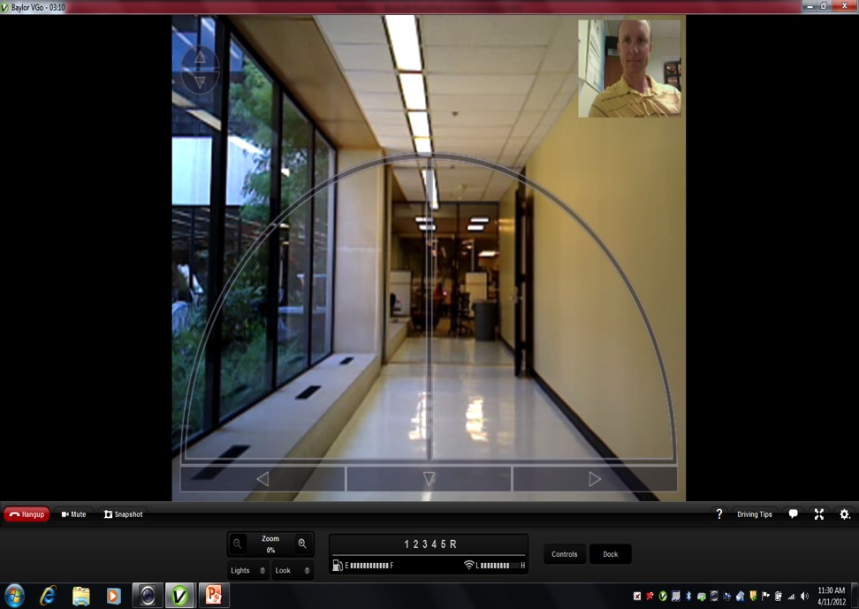
Remote Computer Requirements (PC/Mac)

Slide 18
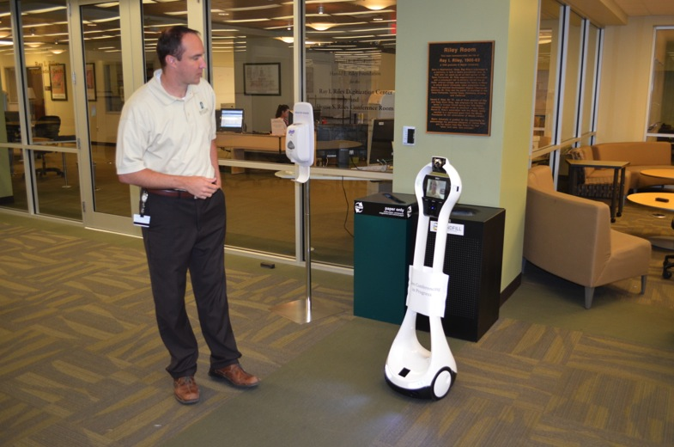
VGo Physical Features
4 ft Tall
18 lbs
Can travel up to 3 ft/sec
38 LED lights

Slide 19
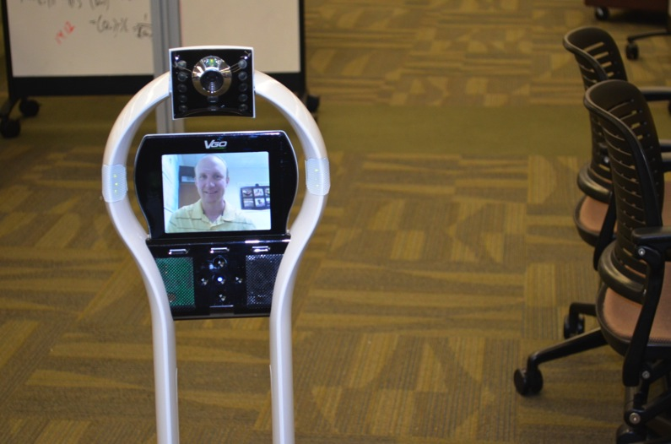
A/V Highlights
H.264 30 fps video
8khz Hi fidelity audio
360 degree 4 microphone array
6” LCD display
2MP motorized camera w/ flash

Slide 20
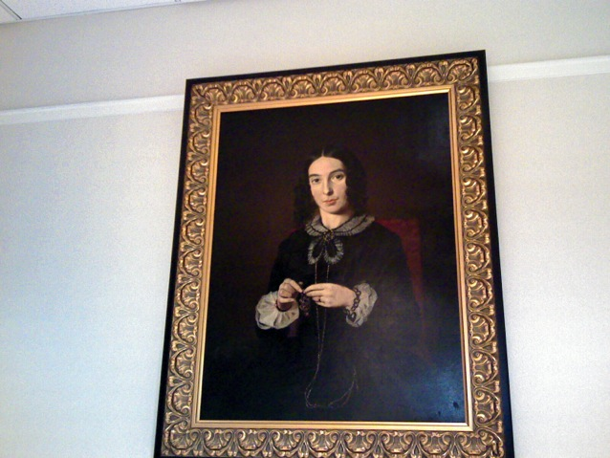
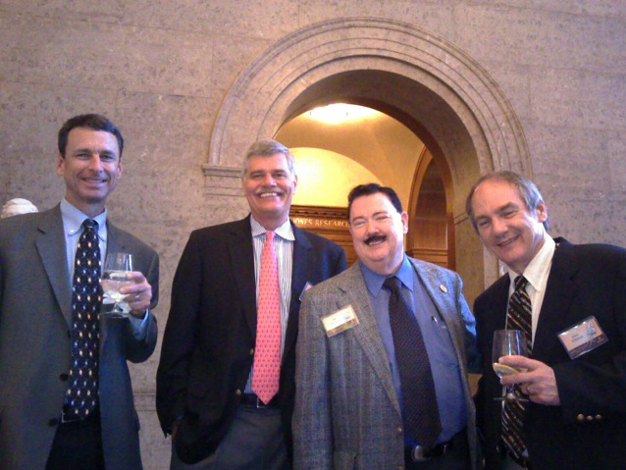
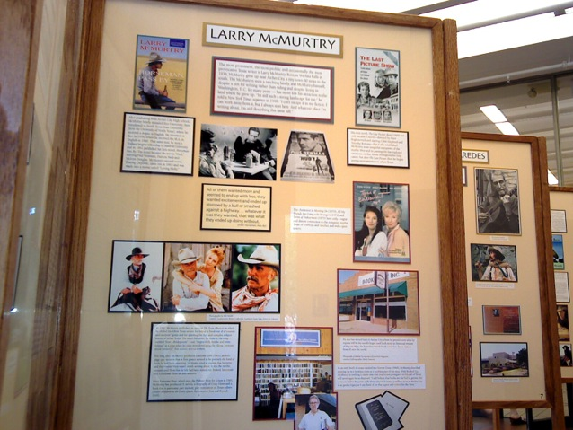
VGo Snapshots

Slide 21
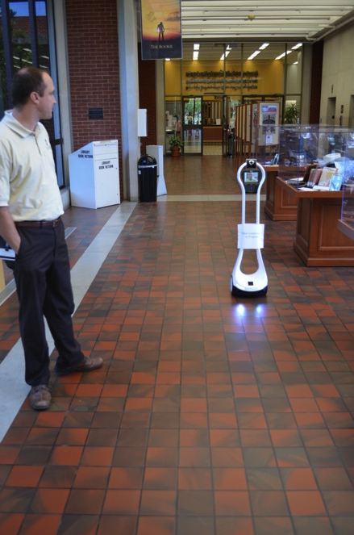
System Feature Highlights
WiFi and Battery Status indicators
Comprehensive web management tools
Obstacle & Cliff Sensors
Text to Speech

Slide 22
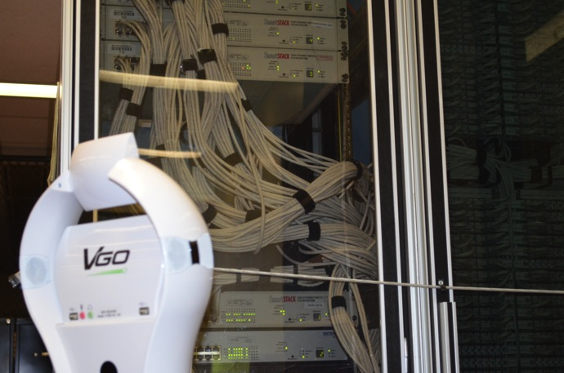
Networking Highlights
802.11 b/g/n wireless coverage for the VGo with WEP, WPA, WPA2 or unsecured
4G wireless interface card
768 Kbps internet up/down speed
Outbound ports will need to be opened on the firewall
  5222 (XMPP, TCP)
  3478 (STUN, UDP)
  80 (HTTP Non-Proxy, TCP)
  443 (HTTPS, TCP)

Slide 23
Testing & Findings
VGo Robot on Baylor campus
VGo was very easy to setup on Baylor WPA2 Enterprise network
  VGo found the campus wireless network with no issues
  We use 802.1x authentication with EAP method
  We created our own AD credentials for the robot to authenticate
VGo traversed access points with about a 5-10 second delay
Traverses floor variations with ease
Audio and video quality was very good
Minimal network lag

Slide 24
China Spring Intermediate School
China Spring ISD, Waco, TX
Tour of
Moody Library,
Baylor University

Slide 25
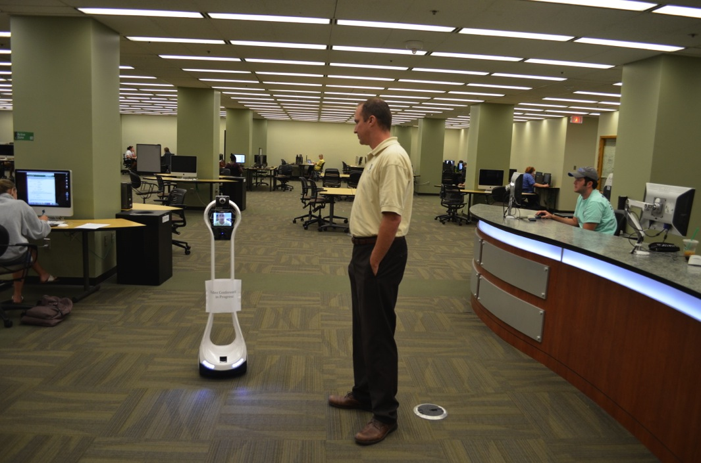
Library Computer Lab

Slide 26
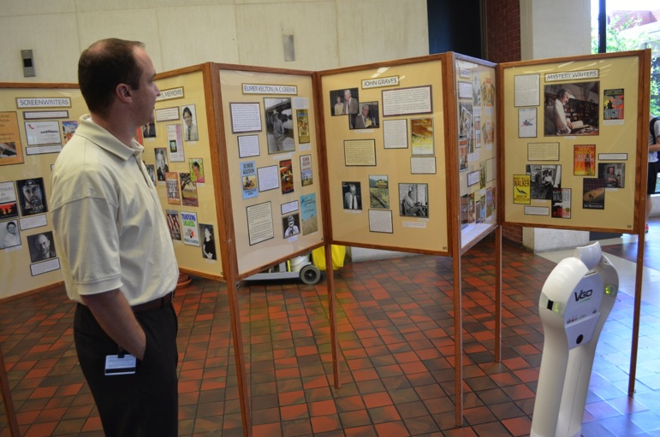
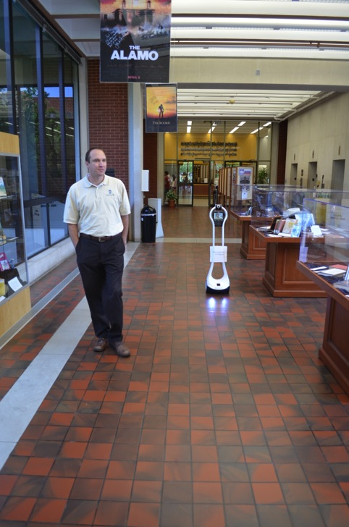
Texas Writers Exhibit

Slide 27
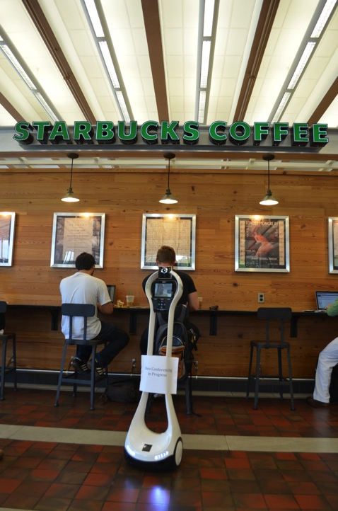
Visiting Baylor Library Starbucks

Slide 28
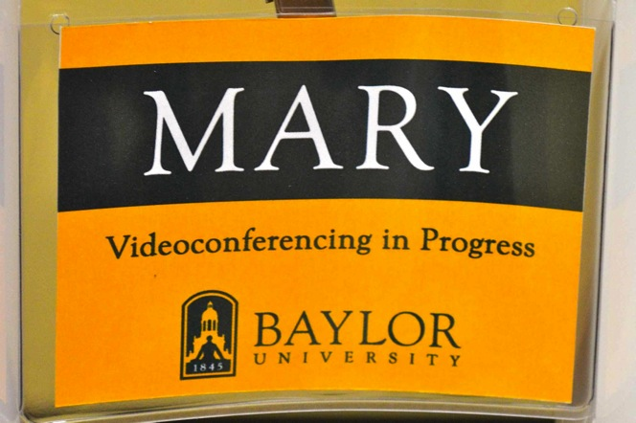
Policy Issues
Baylor Office of General Counsel required disclaimer sign
Recording events – Additional Issues
TETN handles media releases for students

Slide 29
Testing & Findings
Remote PC at China Spring ISD-5th Grade
Network connection at school was simple.
  One firewall issue
Projected laptop image
Audio echo in the classroom
Webcam face tracking
Students were very engaged
User interface and student driving

Slide 30
BUS 1301:
Business, the Economy, and World Affairs
Baylor University
Tour of
Sturdisteel Factory,
Hewitt, TX

Slide 31
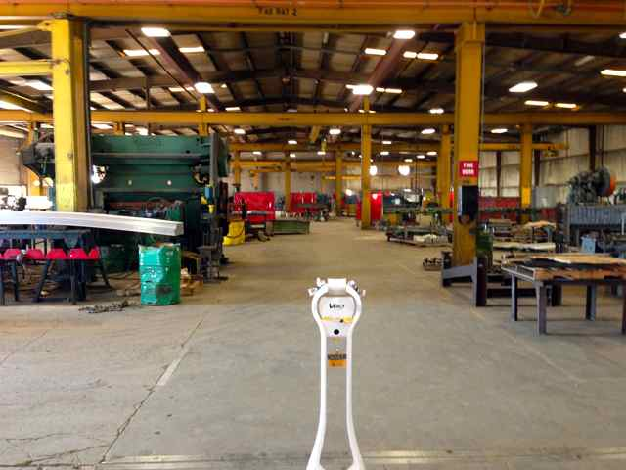
Dr. Blaine McCormick’s
Classroom Factory Tour

Slide 32
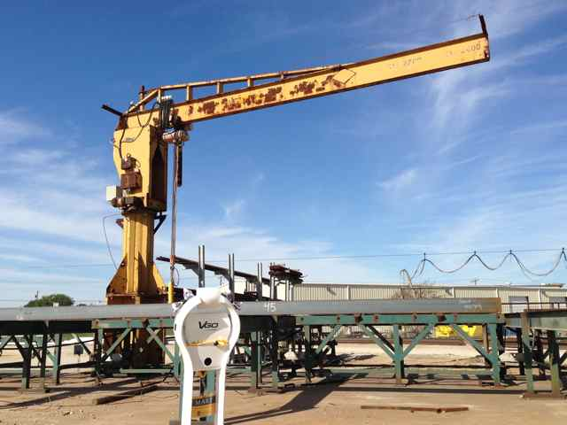
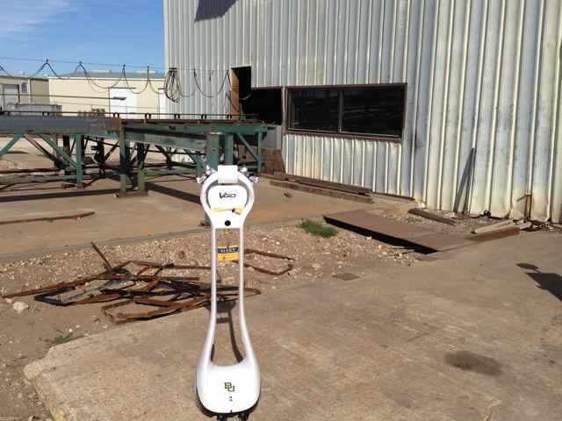
Steel Entering Factory

Slide 33
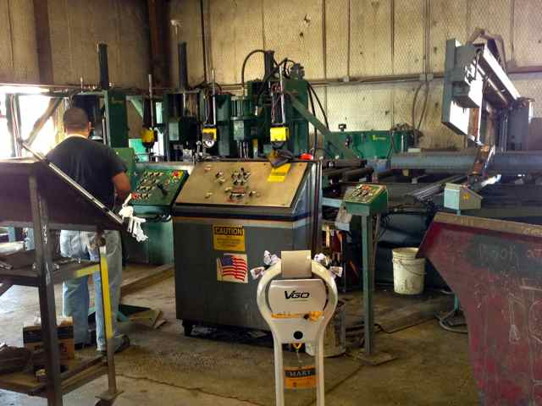
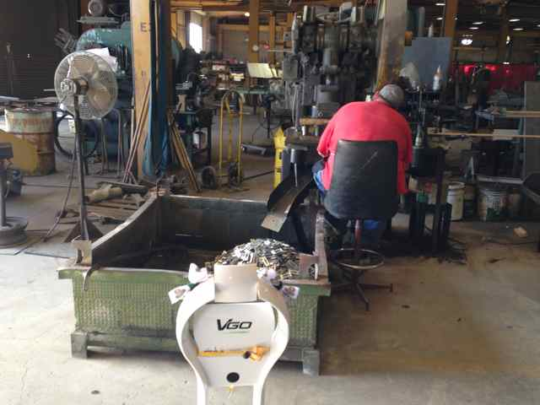
Factory Machines

Slide 34
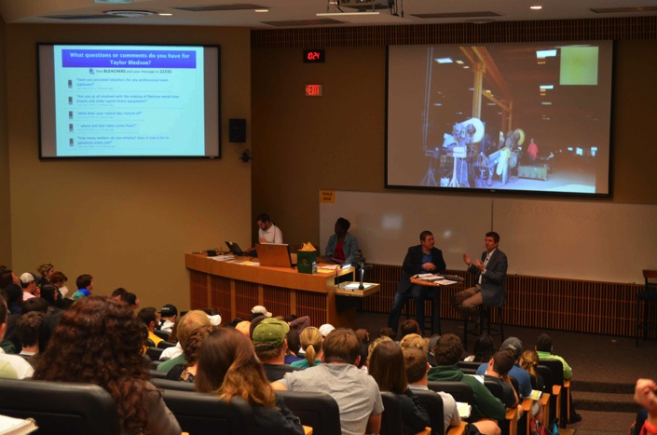
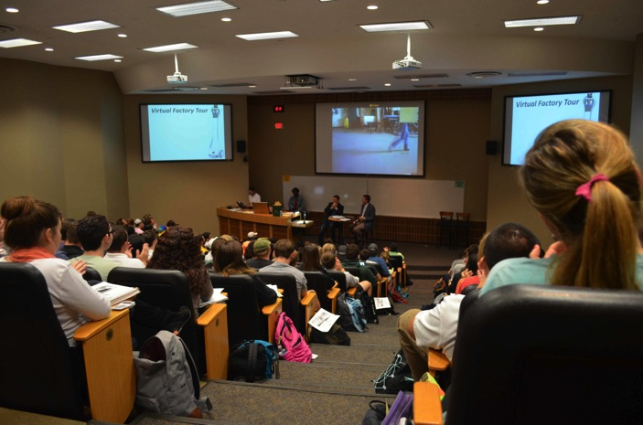
In The Classroom-BUS 1301

Slide 35
Testing & Findings
Dr. McCormick’s BUS 1301 Class
Used 4G LTE Cellular Network at Hewitt Factory
  A couple of dead spots in factory caused minor response delays
  Factory tour started outside
  Due to factory noise, communication was difficult, so tour guide was in classroom
Robot camera image projected in the classroom
Students were engaged and interested
Dr. McCormick was pleased with the outcome and is planning to use the robot for another tour next semester

Slide 36
Woodgate Intermediate School
Midway ISD, Waco, TX
Tour of
“Race for the White House” Exhibit at Poage Legislative Library,
Baylor University

Slide 37
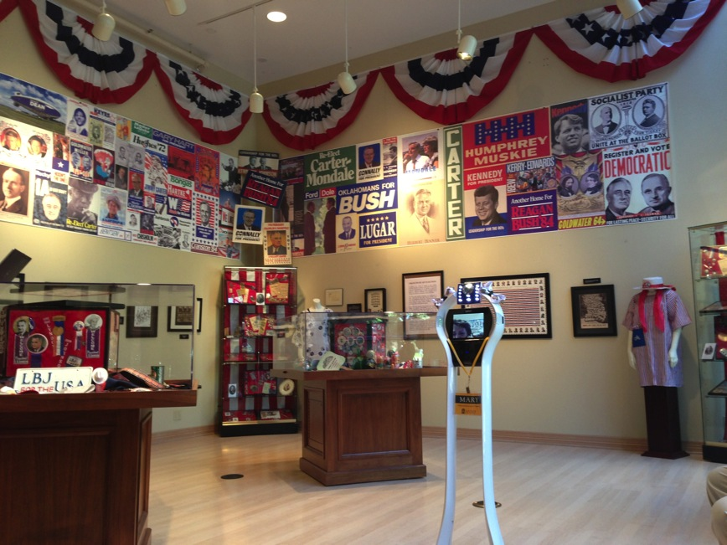
Woodgate Intermediate Tour
“Race for the White House” Exhibit

Slide 38
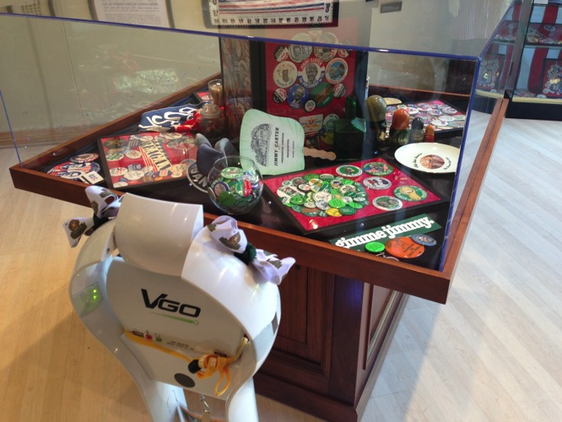
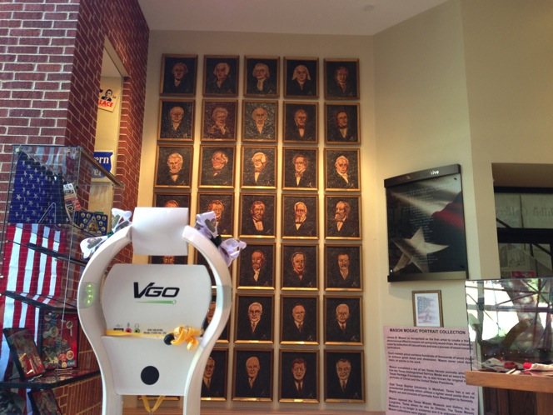
The Exhibit

Slide 39
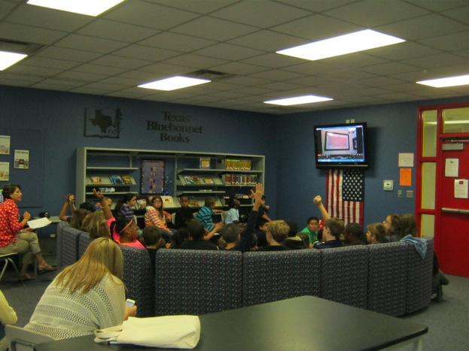
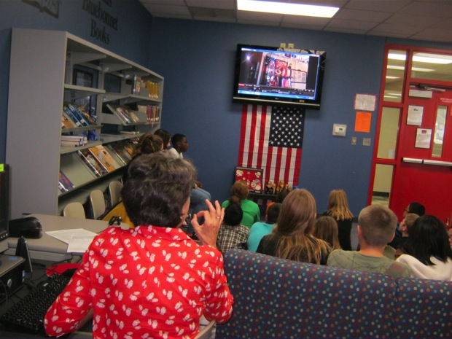
In The Classroom-
Woodgate Intermediate Social Studies

Slide 40
Testing & Findings
Woodgate Intermediate Social Studies
Six 5th & 6th grade classes-Librarian, Mrs. Hair gave tour
Used 4G LTE Cellular Network at Baylor Exhibit
  Baylor wireless coverage was somewhat limited, plus traffic
  Connections in 5 of the 6 classes were flawless
Tour guide ran robot and talked about exhibit from school
Robot camera image projected to large screen TV in library
Students were excited
Future tours planned

Slide 41
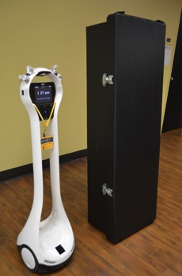
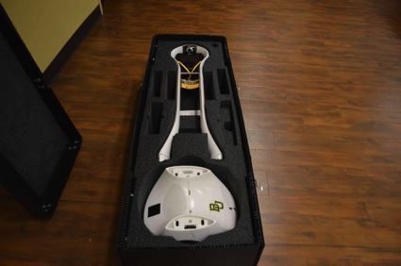
VGo Travels
Conferences
Waco Educational Alliance Summit
Internet2
LEARN
NETnet
EDUCAUSE
VGo Travel Case
Custom made case by Pelican
Case and VGo weigh less than 50 lbs

Slide 42
Questions?
For more information on
VGo Specs & Features:
http://bit.ly/YwfcEj

Slide 43
Tim Logan
Associate Vice President,
Electronic Library
Baylor University
www.baylor.edu/lib/el
Tim_Logan@baylor.edu
254.710.6665
Nils Holgersson
Academic Consultant
Video Conferencing,
Electronic Library
Baylor University
www.baylor.edu/lib/el/
Nils_Holgersson@baylor.edu
254.710.1738
Pattie Orr
Vice President for IT & Dean of Libraries,
Baylor University
www.baylor.edu/itslib
Pattie_Orr@baylor.edu
254.710.3200
featuring Conner Krey as Mary

Slide 44
End of presentation

