Slide 1
Multi-Campus Service Delivery Strategy: Creating Clarity In The Delivery of Information Technology

Slide 2
Multi-Campus Service Delivery Strategy: Creating Clarity In The Delivery of Information Technology
Darrel Huish
Vice Chancellor
Minnesota State Colleges and Universities
Kenneth Janz
Chief Information Officer
Winona State University
Chris McCoy
Chief Information Officer
Metropolitan State University
Ken Ries
Chief Information Officer
Pine Technical College
Andrea Kodner-Wenzel
System Director of Enterprise Systems
Minnesota State Colleges and Universities
Thursday, November 8, 2012, 8:00am, Meeting Room 404
EDUCAUSE 2012– Denver Colorado

Slide 3
Overview of Presentation
Minnesota State Colleges and Universities
Issues Facing the System Office and Campuses
Service Delivery Strategy
Supporting Steps
Initial Projects
Benefits and Outcomes
Discussion

Slide 4
Locations
The Minnesota State Colleges and Universities System has:
31 Institutions
54 Campuses
47 Communities

Slide 5
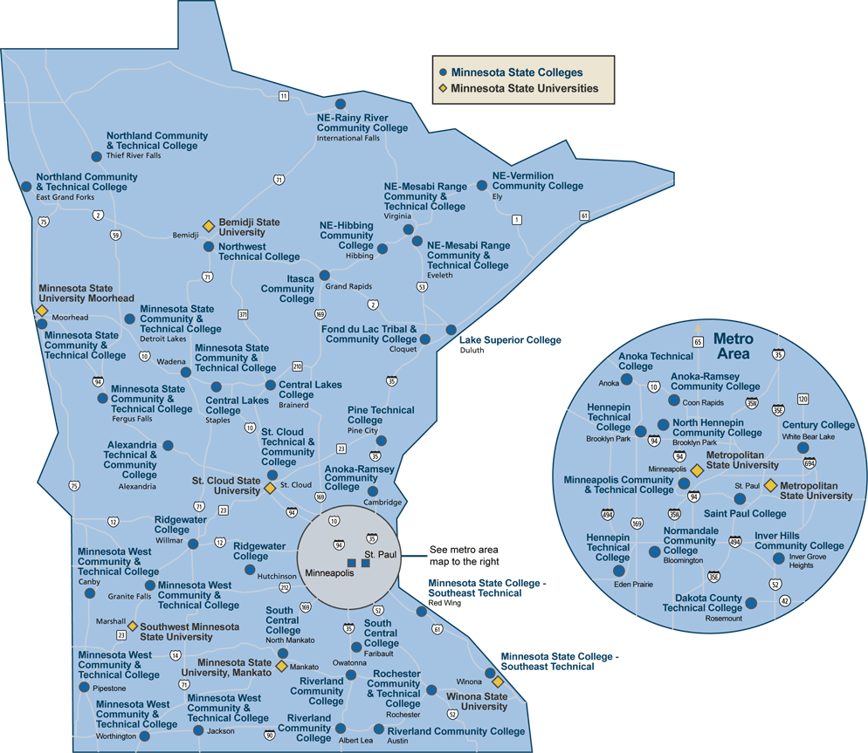

Slide 6
Students
Serve 430,000 students in credit and noncredit courses.
Produce 34,700 graduates each year.
Educate 63 percent of the state’s undergraduates.

Slide 7
Faculty and Staff
Employ more than 19,300 full-time and part-time faculty and staff

Slide 8
Issues Facing the System Office and Campus CIOs

Slide 9
Struggling to Find Balance
Campus
Autonomy
System Office
Efficiency

Slide 10
No Trust
Campus CIOs
System Office

Slide 11
No Service Inventory
Inventory of
Services

Slide 12
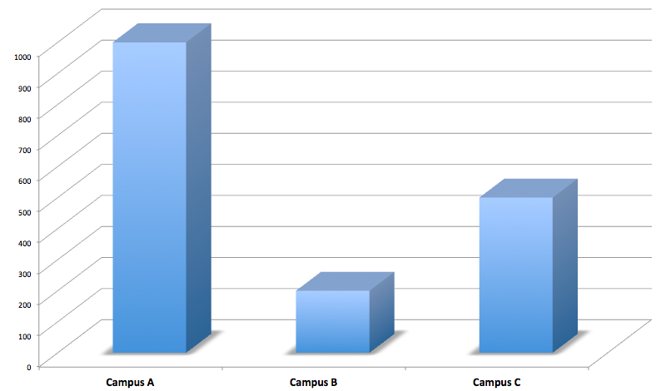
No Consistency
$
$
$

Slide 13
No Roadmap

Slide 14
Service Delivery Strategy

Slide 15
Creation of a Workgroup

Slide 16
Application Inventory Survey
“As – Is” Model

Slide 17
Shared Vision - Future State
Near-Term Service Collaboration Projects
“To – Be” Model
SDS Strategy
& Roadmap

Slide 18
How to Create A Shared Vision?
Vision
Goals
Supporting Steps *
Projects and Charters *
Principles, Assumptions, and Constraints
Vision Statements

Slide 19
Develop Supporting Steps
Ex: Life cycle management
Develop common service catalog
Clarify governance model
Expand data gathering
Roadmaps
Notes:
Delete “Ex: Life cycle management”
Move beyond a shared vision of a future state to a roadmap for turning that vision into reality

Slide 20
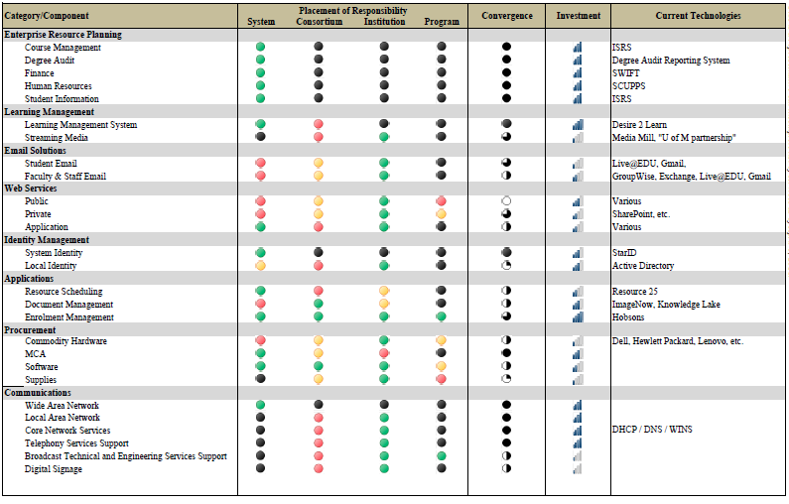
Supporting Step – Common Service Catalog
… pertinent data on enterprise services, services shared between institutions and individual campus services.
Notes:
Inventory of services becomes a common service catalog which promotes shared services
Increase transparency
Catalyst for new conversations
Example: Identify areas for future collaboration

Slide 21
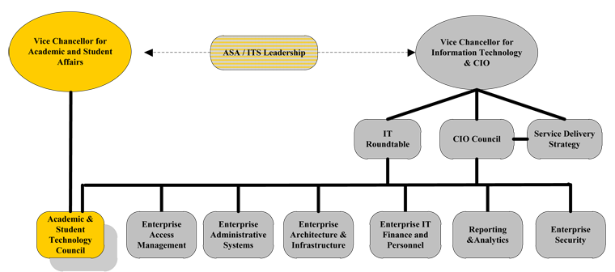
Supporting Step – Clarify Governance Model
Notes:
Leverage existing structures (e.g. governance model)
Clarify where the service delivery strategy fits into existing governance model
Temporary or permanent?

Slide 22
Supporting Step – Expand Data Gathering
Initial on-line survey
3rd party-led deep dives
CIO quarterly discussions
Bi-weekly conference call
Workgroups
Document sharing
Notes:
Delete first bullet point (Initial on-line survey)
Build trust through collaboration and shared experiences

Slide 23
Supporting Step - Roadmaps
Why Roadmaps?
Help us understand:
New services
Campus ↔ enterprise services
Discontinuing services

Slide 24
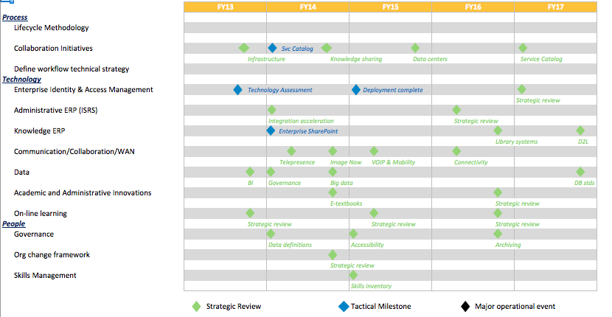
Development of SDS Roadmap

Slide 25
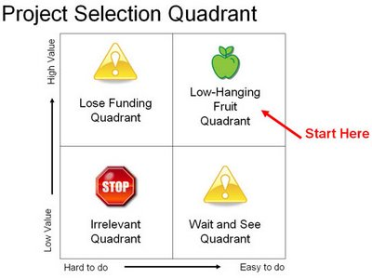
Step 6: Select Projects
Efficiency / Cost Reduction
Improved Service
Alignment with the System’s Strategic Framework
Time to implement
Feasibility
Cost

Slide 26
Projects and Charters
Near-Term
Opportunistic
Visionary
Easy to identify
Quick to implement
High impact
Close to home
Lingering work
Long-term impact
Longer lead time
Partners
Deeper thought
Greater impact
Higher risk
Increased coordination

Slide 27
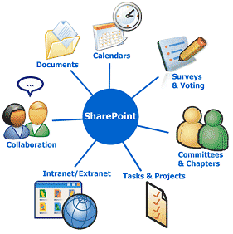
Phase I : Near-Term Projects
Enterprise Active Directory
Enterprise SharePoint
Event Management System

Slide 28
Phase II : Next Iteration of Projects
Enterprise Identity and Access Management Acceleration
ERP Integration Acceleration
Analytics Initiative
Shared Computing – Data Center Services Consolidation

Slide 29
Benefits
An environment that encourages …
EVERYONE to participate in seeking new IT services or policies to support current and emerging business strategies.

Slide 30
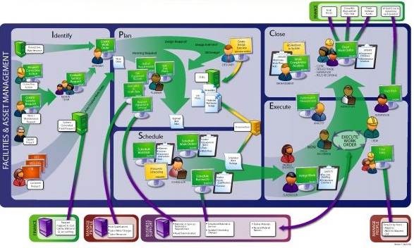
Benefits
Enterprise-wide services mapped to the business processes or strategies they support

Slide 31
Benefits
Everyone operating from …
of experimental, emerging, established, and obsolete information technologies.
a documented and well-understood roadmap …

Slide 32
Benefits
Stakeholders will receive value …
because IT services are planned, focused, aligned and cost effective.

Slide 33
Discussion

