Slide 1


  Learning Analytics - Bridging the Gap between Theory and Practice
What Grassroots Projects Reveal about Learning Analytics in Dutch Higher Education
John Doove, SURF educause Annual meeting, nov 8, 2012

Slide 2
Outline
Some context
Explorative program on Learning Analytics - process
Projects
Now what?

Slide 3


Some Context
CALIFORNIA, USA
THE NETHERLANDS
VS
420,000 km²
37,000,000
40
size
42,000 km²
16,600,000
60
citizens
universities

Slide 4
SURF: ICT innovation by and for higher education and research
Mission
SURF’s mission is: To improve the quality of higher education and research through ICT-driven innovation.
By collaborating within SURF, higher education institutions can achieve innovations that go beyond the interests and possibilities of the individual institutions.
http://www.surf.nl
Notes:
Some similarities to Educause.

Slide 5
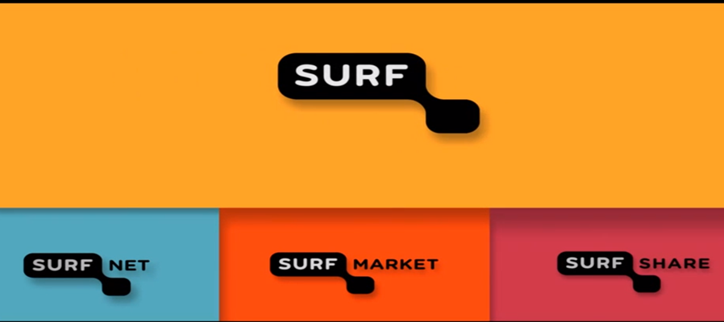
SURF
Within the parent organisation, SURF, the emphasis is on administrative coordination and initiating ICT-driven innovation.
http://www.surf.nl

Slide 6

EXPLORE AND EVALUATE
FACILITATE AND PARTICIPATE
IN NETWORKS
BUILD KNOWLEDGE AND
SHARE INFORMATION
PROFESSIONAL
DEVELOPMENT
EXPERIMENT, DEVELOP
AND ENCOURAGE USE
PROVIDE TECHNICAL
PRECONDITIONS
http://www.slideshare.net/ChristienBok/surf-educause-2011
Notes:
Within the parent organisation, SURF, the emphasis is on coordination and initiating ICT-driven innovation.

Slide 7

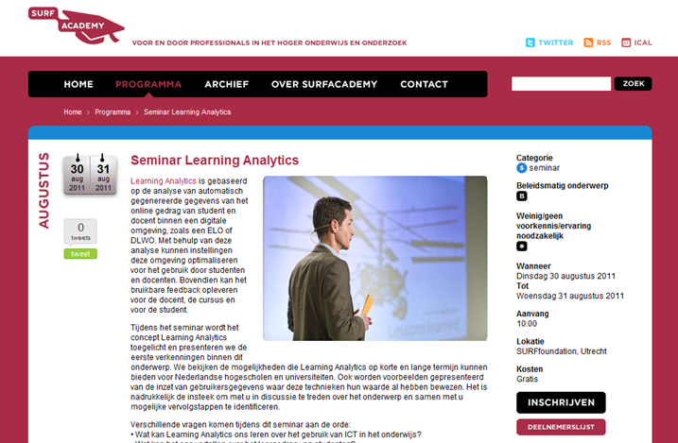


EXPLORE .AND EVALUATE
Notes:
Why SURF?
Nationwide perspective, easy way to share knowledge
International network
Why now?
Increase of online education
Exponential increase of data (of learners)
Data analysis expertise grwoing fast
Political pressure for Return on Investment in Higher ed. and measureability of the quality of education.

Slide 8
Learning Analytics
“the measurement, collection, analysis and reporting of data about learners and their contexts, for purposes of understanding and optimizing learning and the environments in which it occurs.”, SoLAR, 1st LAK, 2011.
Source: https://tekri.athabascau.ca/analytics/
Notes:
Pretty broad definition.

Slide 9
Learning Analytics - Cycle
Learner
Data
Metrics
Interventions
Source: http://dougclow.org/2011/02/28/the-learning-analytics-cycle/

Slide 10

Learner
Learner
Privacy
& Ethics

Slide 11

Data
Data
Availability/Quality/
Usability

Slide 12
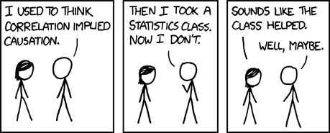
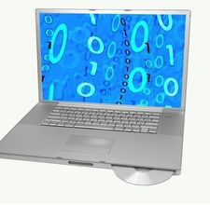

Metrics
Metrics

Slide 13

Interventions
Interventions

Slide 14
Now what? (1)
Find out if it appeals to our (broader) community?
Bring together the relevant different fields of Expertise
Facilitate the transfer of Knowledge between Theory (dataming, educational/pedagogical expertise, legal experts) and Practice (teachers, students and support staff)
Identify the possibilities and risks involved in Learning Analytics
What can be done? What can’t be done (yet)? And what is holding us back in what we want to do?
Notes:
That’s a lot to ask for with the small budget we had.

Slide 15
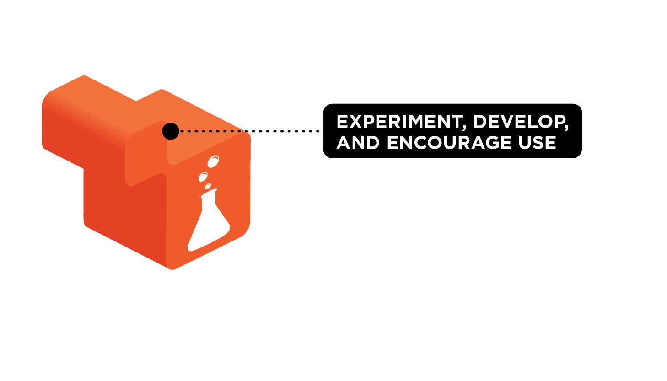
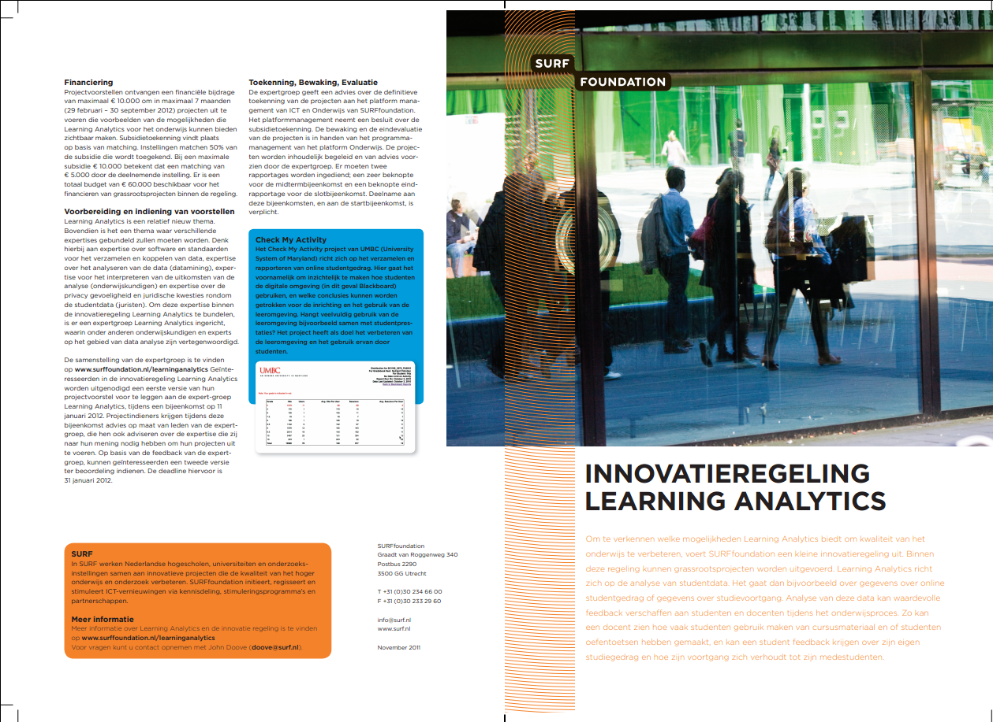

Slide 16
Characteristics
Experimental, Explorative
Short period of time (7 months, March – October 2012), little funding (average project $20.000, funding max $14.000)
Failing was an option! as long as it was done responsibly and fully documented ☺
Lessons Learned are key, share them

Slide 17
Expert group
Prof. Dr. Wil van der Aalst
Dr. Hendrik Drachsler
Prof. Dr. Erik Duval
Prof. Dr. Paul Kirschner
Prof. dr. Ton de Jong
Notes:
Independent group of professionals with different relevant expertise. Added value, they exchanged ideas.

Slide 18
Process of Selection
15 projects submitted
Feedback meeting. For all proposals.
  Advice from experts
  Learned from reflecting and discussing their proposal
  Learned from others/other proposals
  First steps of a community in the making
All proposals got better,
Some of which were not funded, started anyway
7 Projects recieved funding
Notes:
@from each other: example -> Universities can be big. Two departments found out they shared a mutual interest

Slide 19
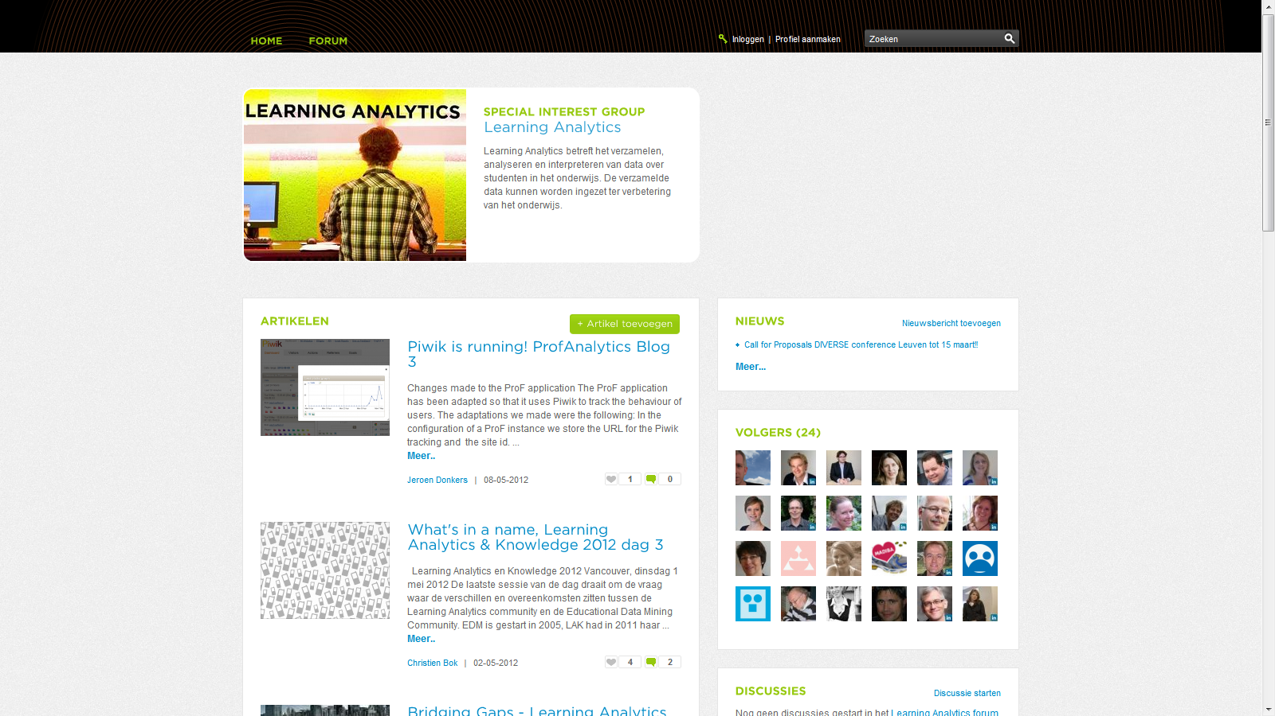
Process during the Projects
Regular meetings (kick off, midterm, final)
Blogs as a means of reporting progress but also to exchange knowledge and involve the community

Slide 20
Projects: a variety of analytics
A diverse bunch
  Different data sets
  Different target groups
  Different goals
Some set out from a research perspective others from a practical issue they wanted to address related to learning analytics.
All: brought together experts that hadn’t frequently worked together before

Slide 21

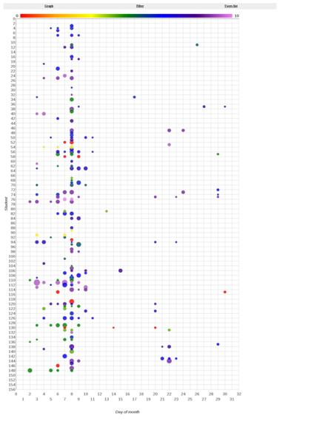
User Needs
Free University of Amsterdam and the University of Amsterdam
Data: Use of Learning objects (e.g. short instructional videos)
Target Group: students/teachers
Aims: gain insight in the use of
Learning objects,
&
Identify the need and thoughts of
students and teachers with regard
to learning analytics

Slide 22

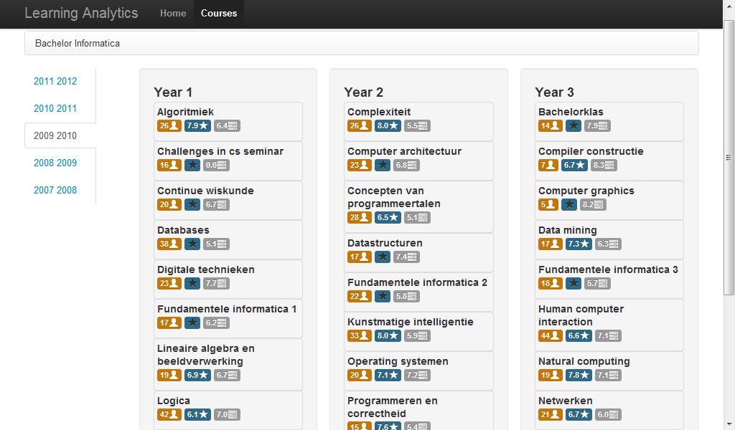
Vak voor Vak (Course by Course)
Leiden University
Data: Course evaluations (content, teacher, length etc.) by students and student performance data
Target Group: Educational Managers
Aim: Provide Insight in performance indicators and quality measures through a dashboard view

Slide 23

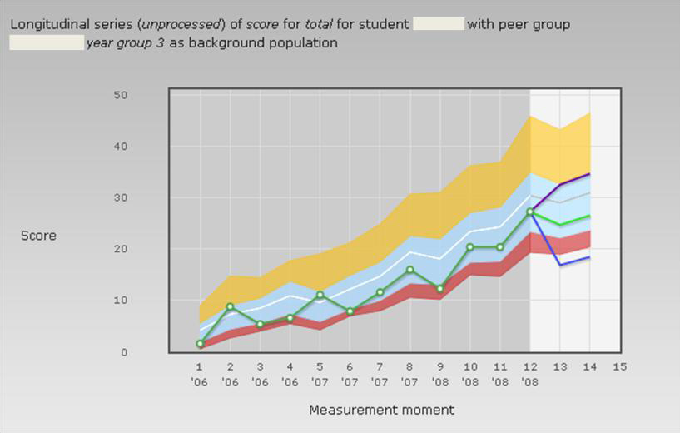
ProF analytics
Maastricht University
Data: Progress test data and feedback data
Target group: Teachers and ProF system developers
Aim: learn what user data tells us about how students use the system
Notes:
Now remember, these are projects to get things going. The time and money available didn’t allow them to go through the whole LA cycle, but start the discussion, bring together expertise. Please don’t compare these projects to the impressive examples as shown by us by Purdue (SIGNALS) and John Fritzes activities at UMBC.

Slide 24

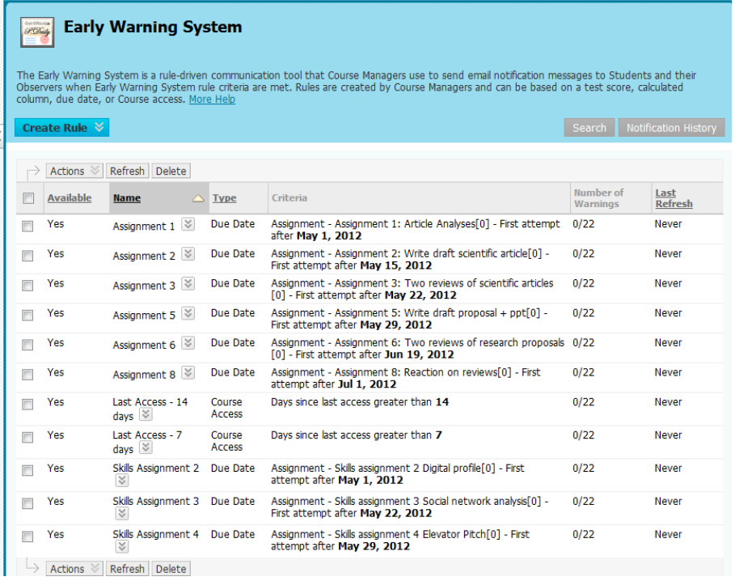
MAIS (Measure, Analyse, Inform, Steer)
Delft University of Technology
Data: As gathered by EWS (Bb)
Target group: teachers
Aim: Investigate whether (or when) to put a tool to use that practically everyone already bought… but doesn’t use.

Slide 25
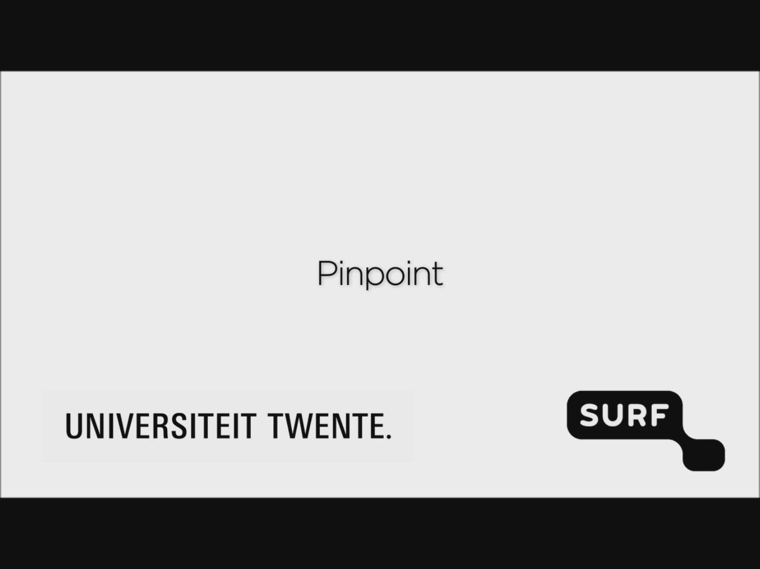
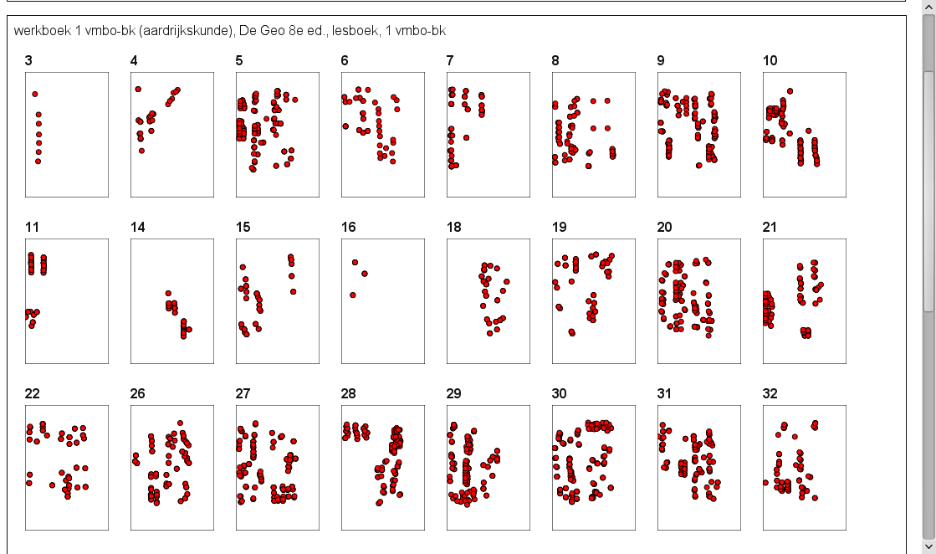
Pinpoint
Twente University
Data: student notes in textbooks (textmining)
Target groups: Teachers and application developers
Aim: See how textmining notes can help teachers
Notes:
USP Qualitative

Slide 26

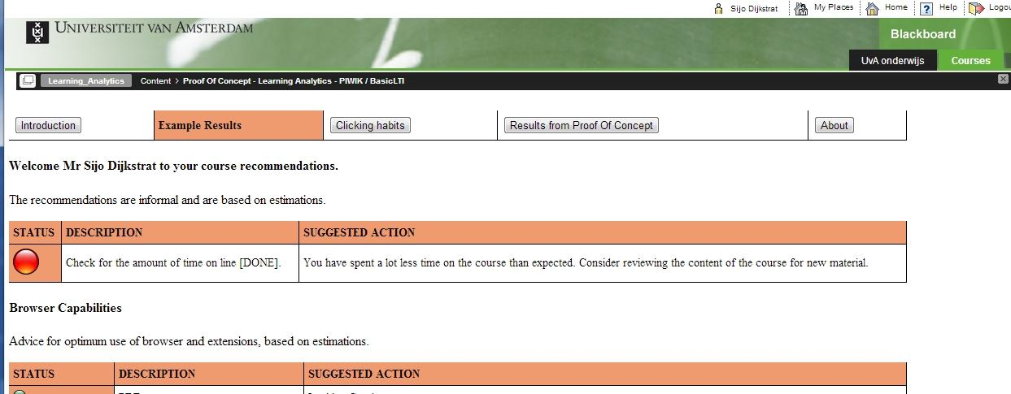
UvAnalytics
University of Amsterdam
Data: moments and frequency of downloads of course materials in the Learning Management System (Bb)
Target group: students
Aim: purposes of giving feedback and increasing awareness on study behevior

Slide 27

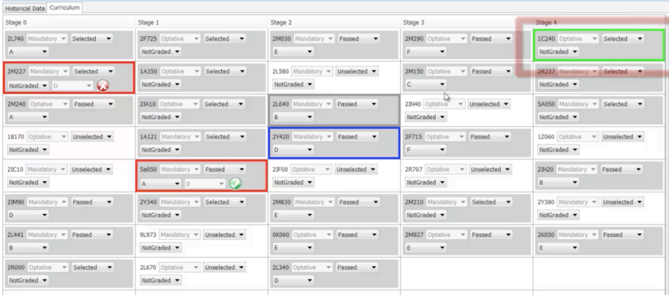
Curriculum Mining
Eindhoven University
Data: Learning paths and student performance
Target group: Students (educational managers)
Aim: Give feedback and recommendations on learning paths to students

Slide 28
Lessons Learned
There’s a lot of enthusiasm for the possibilities of learning analytics
Start with defining a goal (question to be adressed) not the data or method
Several projects were obviously too optimistic about the usability of the data
There’s no clarity on the legal constraints
Hard to separate learning analytics from other forms of analytics in education (shared datasets, shared expertise, shared issues…)
Transparency!
Notes:
@1 the projects have identified questions that they would want to see answered by learning analytics
@3Very much in line wit the recent ECAR report that has been mentioned in several sessions.

Slide 29
Network Meeting
What: Meeting of experts that reflect on learning analytics beyond the projects
When: On the day of the final presentations of the project results
Who: Project leaders, Expert group, Relevant other experts
Why (1): to analyze what the projects have taught us and recommend further steps
Why (2): Good step towards an actively involved community of experts

Slide 30
Recommendations
Good practices and Guidelines
For data management, quality control
Use of and maturity of tools
Privacy and Ethics
Special Interest Group on (Learning) Analytics
Collaboration between research focused groups and the educational work floor -> Match the needs and expertise within but also across institutions.

Slide 31
Now what ? (2)
Report on Explorative program to SURF board
Take with us what this Educause Conference teaches us
International exchange of knowledge/collaboration
More substantial program
was recommended…
Notes:
Present the results to our board, consisting of Boardmembers of Higher Ed instutions,… next week.
Also taking into account what this Educuase Conference is telling us.

Slide 32

John Doove
doove@surf.nl
www.surf.nl
Thanks for your attention!

