Slide 1
November 8, 2012

Slide 2
Disruptive Innovation: Current Trends & Future Directions
Marsha C. Lovett, Carnegie Mellon University
James G. Mazoué, Wayne State University
Adrian Sannier, Pearson
Robert Seidman, Southern New Hampshire University
November 8, 2012

Slide 3
Disruptive Innovation: Current Trends & Future Directions
Marsha C. Lovett
Director, Eberly Center for Teaching Excellence
Carnegie Mellon University
November 8, 2012

Slide 4
16,000

Slide 5
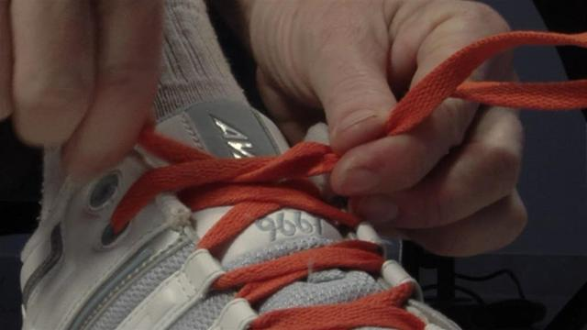
16,000

Slide 6
Like tying shoes…
Relevant research can inform and guide innovation in teaching
But change is hard, so
Support is needed to promote effective use of new teaching methods

Slide 7
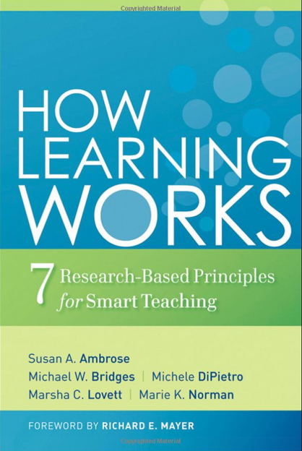
Research to guide innovative teaching
Goal-directed practice
Appropriate level of challenge
Targeted feedback

Slide 8
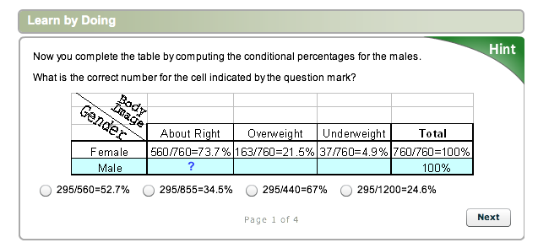
Research to guide innovative teaching
Online course in introductory statistics built within the Open Learning Initiative platform

Slide 9
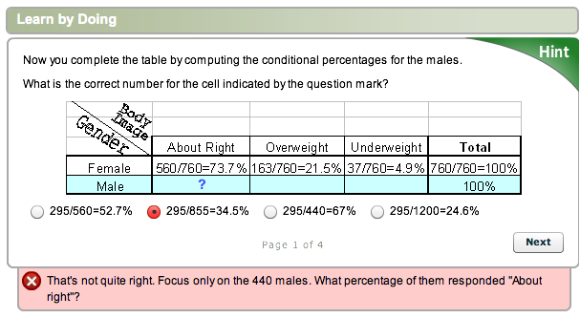
Research to guide innovative teaching
Online course in introductory statistics built within the Open Learning Initiative platform

Slide 10
Research to guide innovative teaching
When students take this course in hybrid mode, can they learn the same material as they would in a traditional course in shorter time and still show equal or better learning?
Lovett, Meyer, & Thille (2008) www-jime.open.ac.uk/

Slide 11
Research to guide innovative teaching
Typical “reformed” introductory course
15 weeks
4 classes/week
3% learning gain

Slide 12
Research to guide innovative teaching
Adaptive/accelerated hybrid course
8 weeks
2 classes/week
18% learning gain

Slide 13
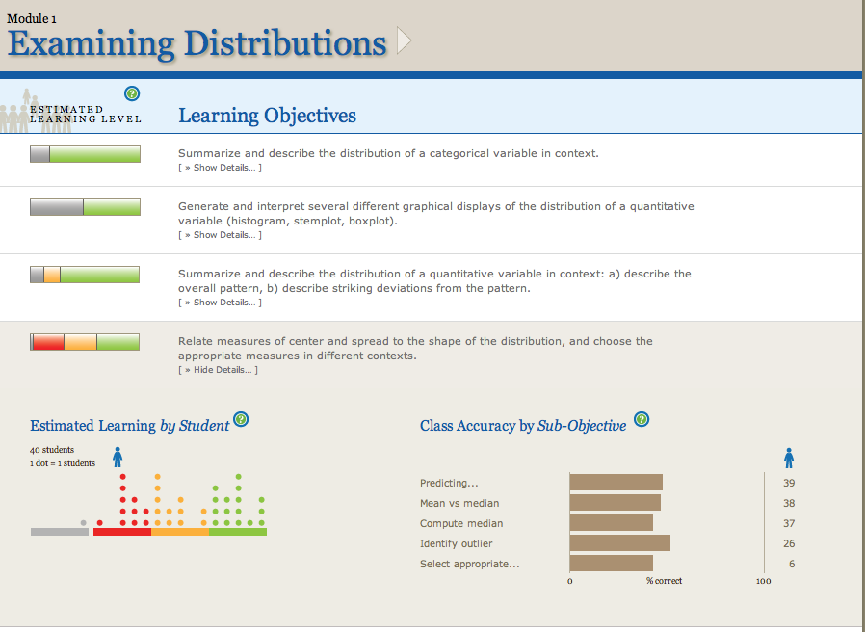
Support to promote use of new methods
The Learning Dashboard: an analytics system that estimates students’ learning skill by skill
Support for instructors, students, & designers

Slide 14
Learning Dashboard’s Key Ingredients
Cognitive/Learning Theory: learning is skill specific
If you’re not paying attention to the skills students need to learn, you’re missing something fundamental
State-of-the-Art Statistical Models
With modern statistical methods, we can build – and draw meaning from – a realistic model of the data

Slide 15
Deep insights into student learning
When students interact with online learning systems, they produce a rich data stream
Most learning analytic systems barely tap this potential:
Track what students do
Record which questions students get right or wrong
Summarize student performance
The Learning Dashboard gets more out of the data:
Reveals what students did/not learn
Quantifies how well students have learned each skill
Identifies consequential patterns in students’ learning behaviors
Measures effectiveness of instructional and design choices

Slide 16
Concluding Remarks
With the Learning Dashboard in a hybrid, online course, students learn at 2X speed
Feedback-rich teaching and learning
Focus on formative assessment
Data analysis aimed at “actionable” results
Self-directed learning is a key skill for students

Slide 17
Disruptive Innovation: Current Trends & Future Directions
Adrian Sannier
Senior Vice President of Product
Pearson
November 8, 2012

Slide 22
Improvement in Post Secondary Education will require converting teaching from a ‘solo sport’ to a community based research activity
Herbert Simon
Nobel Laureate

Slide 23
Changing the Production
Function In Higher Education
Candace Thille
Director
Open Learning Initiative
Carnegie Mellon University

Slide 24
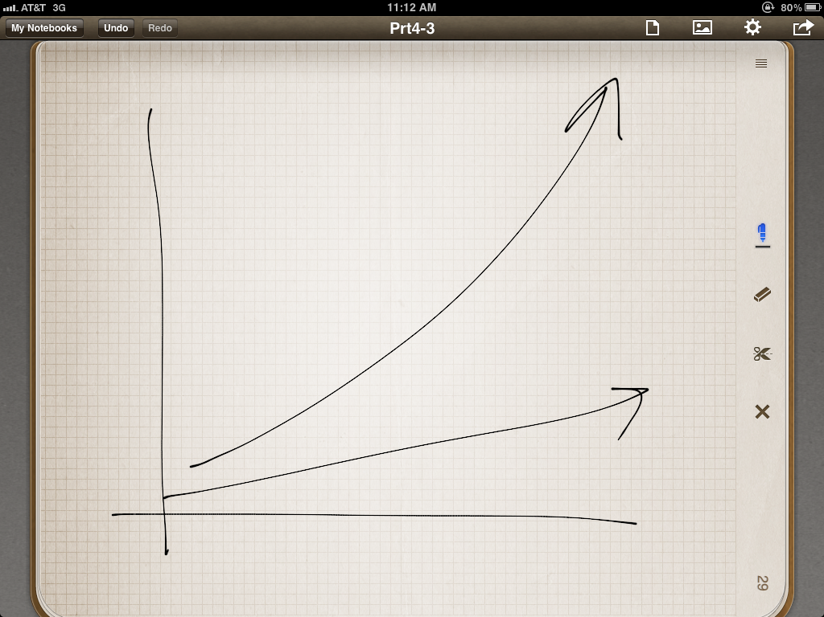

Slide 25
It's easier to change the course of history than to change a history course....
Johnny McMoy
College Dean
Wallace State

Slide 26
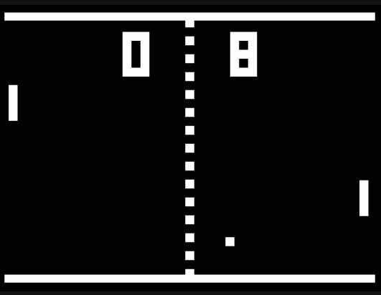

Slide 29
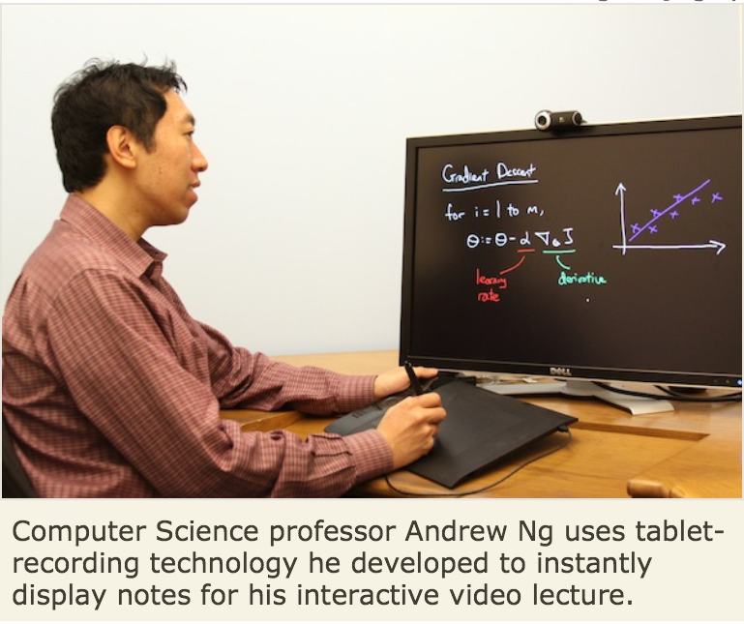

Slide 32
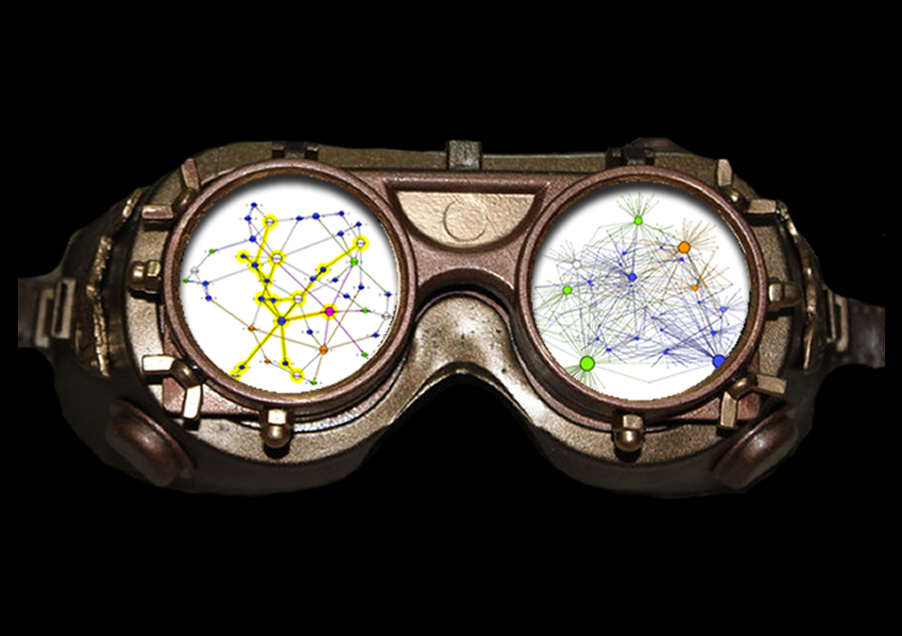

Slide 33
Redesign

Slide 34
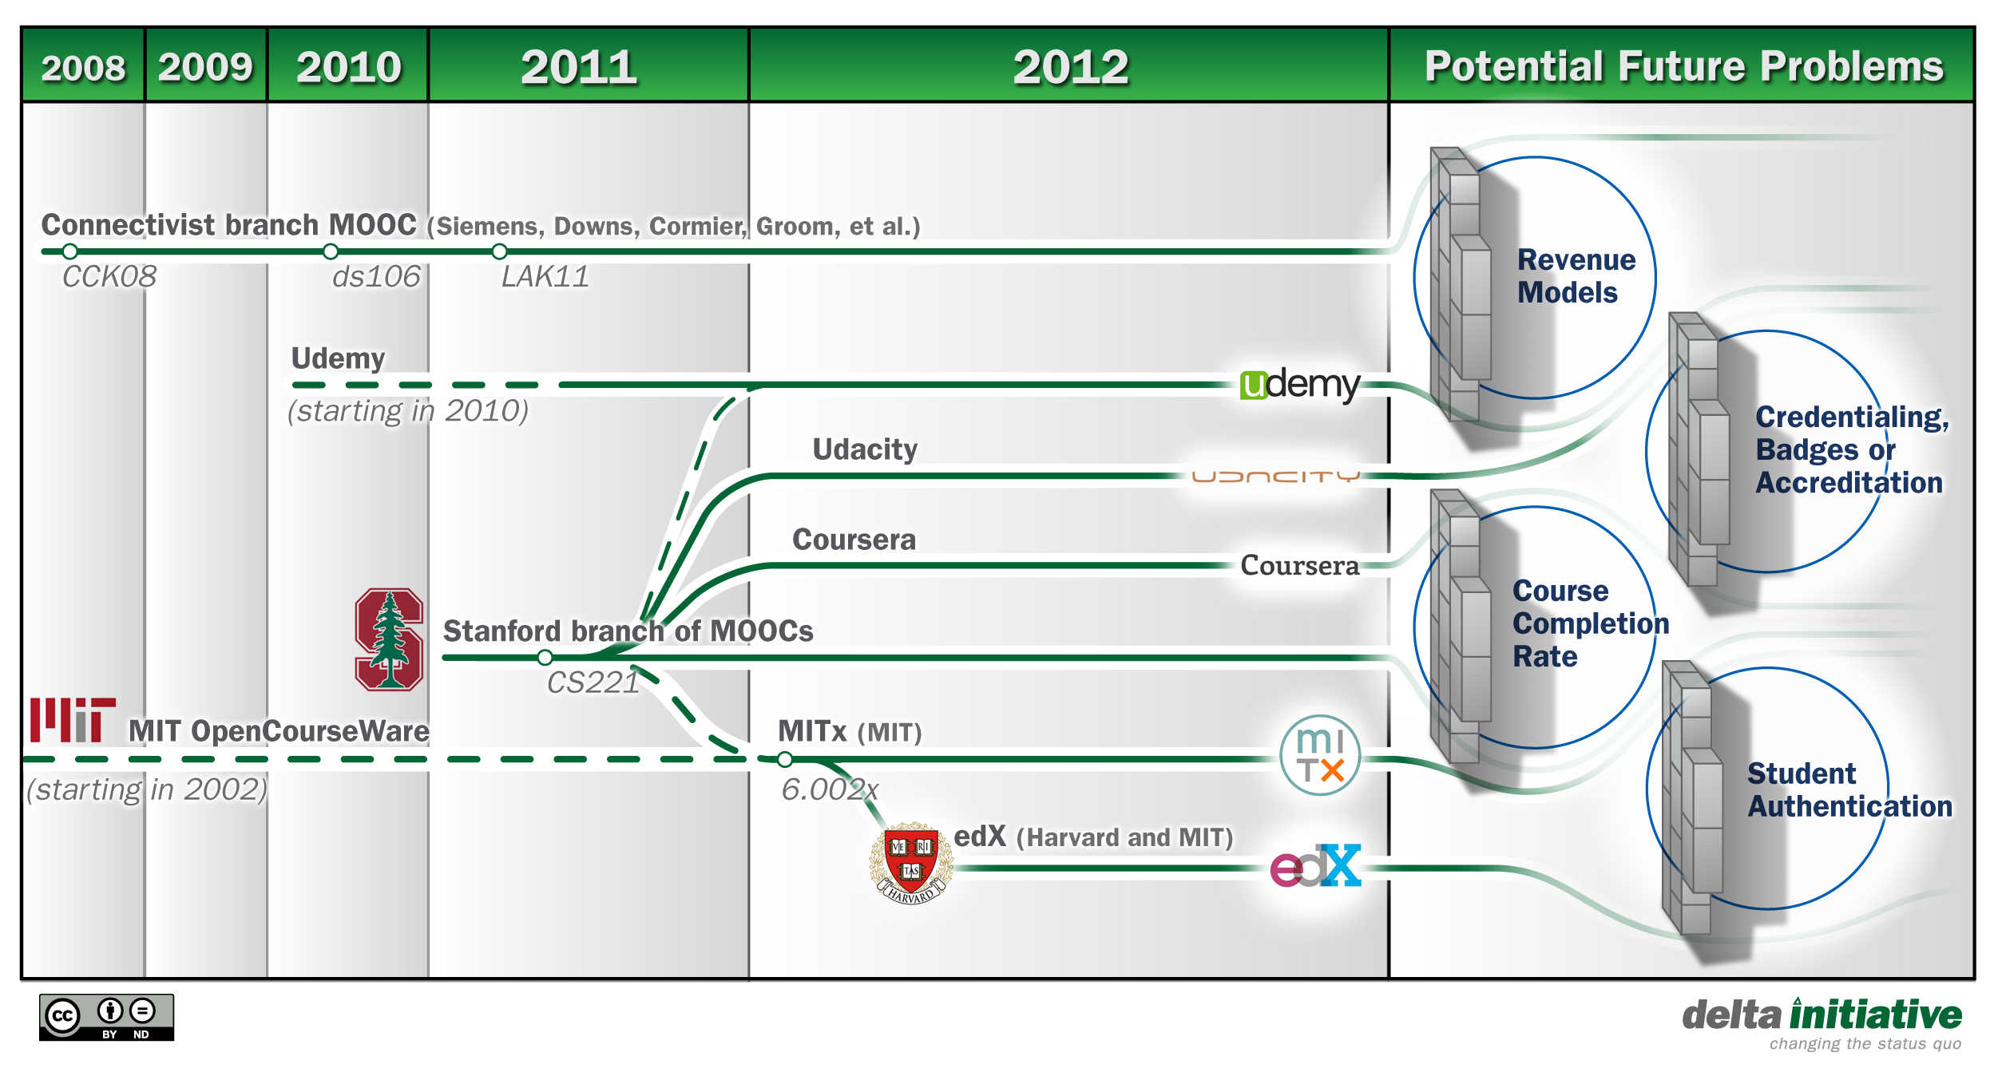

Slide 35
Disruptive Innovation: Current Trends & Future Directions
Robert Seidman
Professor, Computer Information Technology
Southern New Hampshire University
November 8, 2012

Slide 36
Southern New Hampshire University
Three-Year Degree Integrated Programs
College for America

Slide 37
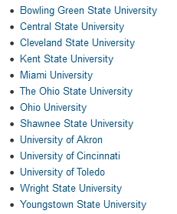
Three-Year Degree Programs
Ohio public colleges and universities required by law to make three-year degrees available for 10% of their majors by October 15, 2012.
60% by June 2014

Slide 38
Three-Year Degree Models
Prior-Learning | Accelerated (Compressed) | Integrated Competency-based
Students transfer in AP courses CLEP out of courses Three years of tuition No curricular changes needed 120 credits | 36 months additional courses in semesters – summers – intersessions – weekends – online Charged 3 or 4 years tuition No curricular changes needed 120 credits | No summer school, intersessions, or online classes required Time is variable & learning is constant Competency & outcomes-based 120 credits in only 6 semesters

Slide 39
Transforming 4-Year into 3-Year
Core components of Integrated 3-Year Programs
Seat-time is eliminated as primary measure of student learning & educational delivery
Competency-based curriculum focuses on measurable learning outcomes
4-Yr courses are reworked into Integrated 3-Yr modules
Notes:
SNHU’s Three-year degree land-based program eschews seat time for competency mastery. It views learning as a constant and time as the variable. Students complete their 120 credit course of study in six semesters with no summer school, intersession or online courses needed. Approximately 30 credits are earned outside of the traditional seat time model. Research shows that the learning outcomes of this Integrated three-year competency-based model are at least as good as the traditional four-year model. Students score on a par with or above their four-year counterparts on nationally normed major tests and fully participate in extra-curricular activities, including NCAA athletics.

Slide 40
Identifying & Measuring Competencies
Competencies are the hallmark of 3-Year Integrated programs
Learning experiences produce measurable outcomes to align with competencies
Alignment accomplished through master course-level Academic Plans
Formative & Summative competency assessments throughout
Notes:
Competencies & learning experiences → measurable learning outcomes: Must align with competencies.

Slide 41
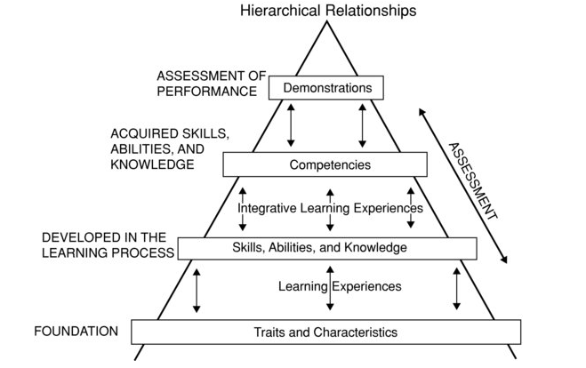
Competency
The skills, abilities, and knowledge that are functionally related to attaining a performance goal
Notes:
Defining and Assessing Learning: Exploring Competency-Based Initiatives: Report of the National Postsecondary Education Cooperative Working Group on Competency Based Initiatives in Postsecondary Education 2002 http://nces.ed.gov/pubs2002/2002159.pdf
Traits and Characteristics are the foundation for learning, the innate make-up of
individuals on which further experiences can be built. Differences in traits and
characteristics help explain why people pursue different learning experiences and
acquire different levels and kinds of knowledge and skills.
• Skills, Abilities, and Knowledge are developed through learning experiences,
broadly defined to include school, work, participation in community affairs, etc.
(although the Competency-Based Initiatives project is focusing on formally
organized postsecondary education learning processes).
• Competencies are the result of integrative learning experiences in which skills,
abilities, and knowledge interact to form bundles that have currency in relation to the
task for which they are assembled.
• Demonstrations are the results of applying competencies. It is at this level that
performance can be assessed.

Slide 42
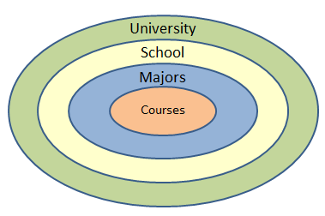
Program-level & Course-level Competencies
Notes:
The three-year program is based upon competencies, which consist of knowledge and skills. Together, these competencies define what a college-educated person should know and be able to do. Employers are happy because they are assured that graduates from competency-based programs have earned a high-quality education. Students are well prepared to go on to graduate school, and many do.

Slide 43
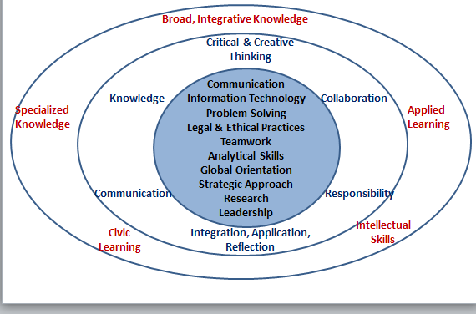
Southern NH University School of Business Competencies/SNHU Goals/Lumina DQP
Notes:
The retention and graduation statistics are quite remarkable with an overall first-to-second-year retention rate of 87 percent, in contrast to a 71 percent national rate for four-year students. The overall on-time SNHU three-year-graduation rate is 79 percent compared to a national on-time four-year-graduation rate of 39 percent. The program is in its 15th year. It saves students 25% of their college costs and saves institutional almost that much in course delivery costs.
Reference Bradley, M., Seidman, R., & Painchaud, S. (2012). Saving Higher Education: The Integrated, Competency-Based Three-Year Bachelor's Degree Program. San Francisco: Wiley.

Slide 44
Notes:
This is the result. Year One. Similar for other years.
Overview of modules, connecting themes, week-long integrating experiences.
SNHU School of Business is moving to all 3Yr Integrated degree majors. Total of three in 2013. More to follow.

Slide 45
Ensure Competency Alignment Module Academic Planning Documents
Notes:
Alignment is key. Interdisciplinary pedagogy and content is encouraged.
A side benefit of reworking of the traditional four year curriculum into a competency and assessment-based Integrated three-year model is that faculty rethinks everything that they have been doing – including the artificial division of disciplines and content, and their pedagogical approaches to teaching and learning.

Slide 46
@SOUTHERN NEW HAMPSHIRE UNIVERSITY
Notes:
A pilot project begins in January 2013 supported by a $1M Next Generation Learning Challenges grant. This is an online A.A. in General Studies degree that is self-paced, self-directed and competency-based. Plans for a future B.A.

Slide 47
College for America - Big Picture
Notes:
The goal is to offer higher education opportunities to those who are underserved. The program is intentionally designed to support student persistence toward completion. The A.A. degree program is low cost: $5,000. Because study is self-paced there are no conventional faculty roles in the actual instruction.
Each student enters into an Individualized Mastery Plan with a ‘coach’ who serves in an advisory role. There are no set courses in the traditional sense. Students choose the order and speed with which they progress through their program of competency mastery. Taken together, the competencies map into traditional for-credit courses offered by SNHU. Assessment is carried out by trained graders using expert-designed analytic rubrics. Student artifacts are collected in an e-portfolio system.

Slide 48
Mastery Triad
Foundational Skills
Personal and Social Skills
Content Knowledge

Slide 49
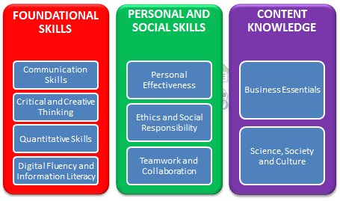
Competency Clusters

Slide 50
Conceptual Framework for A.A. Degree in General Studies

Slide 52
College for America - 5:30pm today Four Seasons Ballroom
Robert Seidman r.seidman@snhu.edu http://bit.ly/DrRHSeidman
Notes:
The new degree program is approved by SNHU’s regional accrediting body, New England Association of Schools and Colleges.
More on College for America at 4:30pm today in Four Seasons Ballroom.
Reference PRWeb (2012, June 21). Southern New Hampshire University Awarded Next Generation Learning Challenges Grant. Yahoo! News. Retrieved from http://news.yahoo.com/southern-hampshire-university-awarded-next-generation-learning-challenges-040143222.html

Slide 53
Disruptive Innovation: Current Trends & Future Directions
James G. Mazoué
Director, Online Programs
Wayne State University
November 8, 2012

Slide 54
Drivers of Change
Disruptive Decentralization
Christensen et al
Digital disintermediation
Learning Sciences
OLI, adaptive/individualized learning, ITS, cognitive courseware
Competency-based Education
WGU, verifiable learning outcomes, DQP

Slide 55
An Educational Reformation
Handcrafted
Intuitive Teaching
Seat-Time
Fee-based Credits
Scarcity
Campus-Centric
Location-bound
Precision-Built
Science of Education
Competency-based
Fee-based Credentials
Unlimited Scalability
Network- Mediated
Place-Independent

Slide 56
Post-Industrial Model Convergence: Learning Science + Online Networks
Learning Sciences → ‘Course’ Exemplars
Optimally Designed Curricula
Competency-Based
Customized Learning & Unlimited Scalability
Precision-Built Online Degrees/Credentialing
→ Disaggregation: Land-Based Services
Learning Optimized + Competency-Based + Location Independent + Cost Effective
Institutional Brand Differentiation?

Slide 57
jmazoue@wayne.edu
Mazoué, J. G. (2012). The deconstructed campus. Journal of Computing in Higher Education, 24 (2), 74-95.

Slide 58
Questions?

