Slide 1
Scalable Solutions for Implementing Accessible Technology in Postsecondary Institutions
EDUCAUSE 2012
Denver CO
November 8, 2012
Notes:
The California State University

Slide 2
Introductions
Gerard L. Hanley, Ph.D., Senior Director, Academic Technology Services
Cheryl Pruitt, M.S., Director, Accessible Technology Initiative
Lorraine M. Frost, M.A., PMP, Interim Vice President and Chief Information Officer Information Resources and Technology, CSU, San Bernardino
Carol K. Gonzales, Ph.D., CISA, Director, I&IT Support, Accessible Technology Coordinator, CSU Pomona

Slide 3
Agenda
CSU Accessible Technology Initiative (ATI) Leadership Overview
CSU Strategies and Implementation Process
Campus Perspectives
CSU Pomona
CSU San Bernardino
Open Discussion/Hands-On Activity

Slide 4
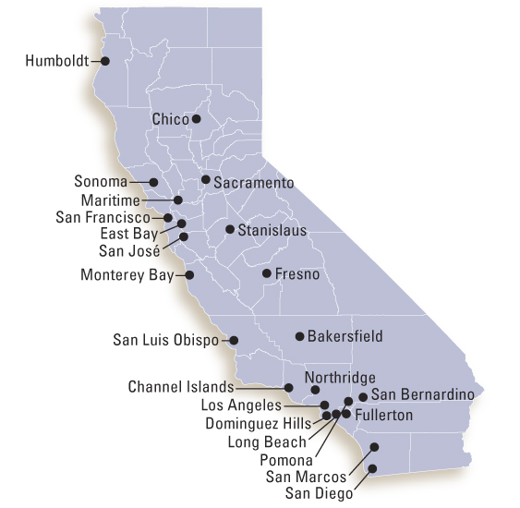
Context: about the CSU
California State University (CSU)
Largest public baccalaureate degree-granting institution in the United States
23 campuses; >400,000 students; ~80% undergraduate
More than 25% of students receive Pell grants
About 11,800 students with disabilities registered with our campus disability services offices

Slide 5
From Where I sit: CSU System Principles
Management by Fear vs. Management by Love
Capabilities Maturing Strategy
Integration into Academic Technology Services
Stand Firm on Your Institution’s Mission, Bring Passion to Your Institution’s Vision
We are here to educate all students successfully – period.
Choose Strategic Priorities That Really Matter
CSU’s Affordable Learning Solutions and Digital Textbooks
Notes:
Being afraid of the negative consequences for doing something wrong is needed and important for a society to function. But fear can also lead people to deny and avoid problems they need to solve. One might say that love begins with the unconditional acceptance of the true state of a person and your hope and actions will help develop that person to become a better person, through the loving relationship. That is, love helps mature the capabilities of the person so they reach their optimal state.
In the CSU, we have communicated the consequences of breaking the accessibility related laws and thanks to groups such as NFB, people are afraid of the consequences of breaking the laws. But if we only managed by fear, people would deny and try to hide the accessibility barriers they are facing.
Three years ago, we made some significant changes to the CSU Accessible Technology Initiative to move add management by Love to our strategy
Originally ATI was set up in a “policy” department and the policing of campus accessibility was the focus. Gerry choose to bring the ATI into the Academic Technology Services organization. Consequently, ATI shifted to a service department with its goal of improving the capabilities of all campuses to better service the accessibility needs of all their students. Also, all academic technology projects now had an accessibility element to the project. We institutionalized accessibility.
Being part of Academic Technology Services enable ATI to be connected to the broader mission of the university and in the CSU, the core principle of it’s mission is access to an excellent education for all students. The passion Gerry brings to accessible academic technology reinforces the importance of everyone adding accessibility to their planning and decision processes.
In 2006, Gerry launched the Digital Marketplace Project. Early on in the project, they focused on three (3) principles, “Choice, Affordability, and Accessibility”. In brief, the goal of the project is to provide faculty and students greater choices of high quality and affordable digital course materials that are accessible to all students and faculty. The accessibility principle guided the design of our vendors’ technologies and accessibility requirements became part of our business requirements. Once we decided that Digital Textbook Rentals was a high priority initiative (last fall), accessibility requirements were added to the contractual agreement with Cengage, Follett,and CourseSmart.

Slide 6
Executive Leadership & Support
In 2004, CSU Chancellor Reed signed an Executive Order affirming the CSU’s commitment to ensuring equal access for persons with disabilities.
Recognized that accessibility was an institution-wide responsibility that must be managed by all campus units—not just disability services programs.
Outlined responsibilities of stakeholder groups and required an Executive Sponsor to coordinate campus ATI activities
2006 – 2007, CSU funded Accessible Technology Initiative (ATI) and hired staff at the Chancellor’s Office to support the campus ATI implementation.

Slide 7
Implementation Policies
Policies are updated to meet the needs of the CSU Stakeholders
2006 – 2010: Campus implementation policy specified three priority areas Web Accessibility, Accessible Procurement, and Accessible Instructional Materials, goals, rigid compliance deadlines for all three areas, and narrative reporting by campuses.
2010-2012: Collaborative policy development involving campus stakeholder groups resulted in a new policy focused on business process improvement, goals supported by a set of success indicators measured by status levels, base campus implementation on priorities, and we standardized reporting on goals and success indicators from campuses
2013- On: Revise 2010 policy, added implementation strategies to support campus implementation, articulated year-long cycle of planning, working the plan systemwide and campus, and reporting on progress.

Slide 8
CSU Strategies
Accessible Technology Initiative
Policy
Capacity/ Target High Impact Areas
Procurement
Collaborate with vendors
Assessment
Connect
Notes:
As Gerry mentioned we have several implementation strategies
1) Establish a clear institutional policy.
2) Build sufficient capacity to support your implementation. Start by Targeting essential, high-impact areas
3) Use the procurement process to drive improvements for better product accessibility support.
4) Work collaboratively with vendors to improve product accessibility.
5)Measure progress over time.
7) Get connected with others. There are many postsecondary institutions and government agencies across the country actively engaged in accessible technology initiatives. strongly consider attending conferences to learn what strategies other institutions are using and to establish relationships/partnerships that will reduce redundant efforts and save costs.

Slide 9
Empowering People: Knowing what we need to do
The ATI Goals and Success Indicators articulate the processes, practices, and procedures that need to be in place for the sustainable removal of accessibility barriers.
Collectively there are 22 Goals and 142 Success Indicators spread across three priority areas Web, Procurement, and Instructional Materials
They were developed through our shared governance process that included diverse groups of CSU stakeholders coming together to share their accessibility expertise and knowledge
Progress is measured by a set of status levels
We have limited resources so we base our implementation efforts on a prioritization framework that considers impact, probability, risk, and capacity.
Notes:
In addition to our strategies we empower our CSU people by stating what needs to be done to integrate accessibility into our institutional processes

Slide 10
Goal and Success Indicators
Web Accessibility Evaluation Process Area
Goal 1.0 Identify and repair or replace inaccessible websites, web applications, and digital content.
Success Indicator | Status Level
1.1 Assigned responsibility for the evaluation process to a body (person(s) or business entity). | Established
1.2 Inventoried all campus websites and web applications | Established
1.3 Established a process to perform regularly scheduled accessibility audits using established criteria to identify websites that need remediation. | Defined
Notes:
Here is an example of one of our Goals and a few of success indicators that support the goal and status levels that measure progress.
The success indicators describe what needs to be done. Our campuses decide how they will do it.

Slide 11
Measuring Progress – Status Levels
Status Levels | Description for Procedures | Description for Documentation | Description for Resources
Not Started | No action has been taken yet. | No documentation has yet been generated. | No resources have yet been allocated.
Initiated | The campus has an ad hoc or developing practice. Procedures, if in place, are generally ad hoc. | Documentation is generally absent. | Resources have been tentatively identified but not yet allocated.
Defined | The campus has a common practice. Procedures, if in place, are consistent but informal. | Documentation, if present, is in working draft. | Resources have been firmly identified but not yet allocated.
Established | The campus has a standard practice. Procedures are consistent and formal. | Documentation is complete and fully reflects the standard practice. | Resources have been both identified and allocated.
Managed | The campus has a mature practice. Procedures are also in place to track and capture success indicators (milestones and measures of success). | Documentation is complete and fully reflects the standard practice. | Resources have been both identified and allocated.
Optimized | The campus has a mature practice. In addition, procedures are in place to conduct regular administrative reviews of success indicators to gauge effectiveness and implement improvements. | Documentation is continually revised to reflect the managed practice. Periodic administrative review of documentation is conducted. | Resources have been both identified and allocated. Periodic administrative review of resource allocations is conducted
Notes:
Status levels range from Not Started to Optimizing and they are measured by a description of the maturity of the procedure, the level of documentation, a whether or not resources have been allocated. For example, on the last slide we had a success indicator that is at the status level of defined. Establishing a regularly scheduled audit process – in this case defined may mean that Sally in the IT department has been designated to do audit scans every 6 months but the task is not part of her regular job description. So to move this success indicator to Established the tasks would need to part of her job description which would require more complete documentation and resource allocation.

Slide 12
Implementing the Framework - Campus
CSU Framework
Strategies/Goals & Success Indicators
Continuous Process Improvement with Strong Executive Support
Make a Campus Plan
Do a Self- Assessment
Work the Campus Plan
Notes:
We implement our framework by using our strategies, applying continuous process improvement guided by our goals and success indicators. There is strong Executive support which is one of keys to success. Each year our campuses follow the implementation cycle
Planning – Each campus establishes a plan based on priorities such as impact and capacity to guide their work on Success Indicators
Working the Plan - the ATI System team organizes projects to address specific high impact Success Indicators. These projects are collaborative efforts across our campuses that produce deliverables that can be adopted and adapted by individual campus’. Each campus works on their own projects and adopts systemwide deliverables as needed.
Measuring Progress - ATI Annual Reports that cover all the goals and success Indictors measured by status level are submitted by each campus. Systemwide Aggregate reports are compiled from the individual campus reports.
We are concluding the third year of measuring systemwide progress. We have seen improvement each year and we have been able to determine where campuses are experiencing difficulties.

Slide 13
Building Capacity
Systemwide contract that provides cost effective timely video captioning services
Systemwide contract for a Web Accessibility Evaluation tool including standardized accessibility requirements and extensive training and support so campuses will able to use the tool to its full capacity.
CSU Accessible Technology Network CSU ATN - leverages accessibility expertise across the system. Campus personnel at a variety of campuses contract with the Network to provide services and produce deliverables that can be shared throughout the system. The CSU ATN is starting to work collaboratively across campuses to provide accessible product documentation review, product accessibility testing, and collaboration with vendors to improve the accessibility of products. These services will reduce redundancy of effort and deliver cost savings to the system.
Notes:
Our annual reporting has also helped us identify areas where systemwide projects can help campuses build capacity. Some examples of these projects are

Slide 14
Campus Executive View: CSU San Bernardino
Establish Clear Institutional Policy
Executive Order 926 and Academic Affairs Coded Memorandums
Presidential appointments
Lorraine Frost, VP/CIO, co-executive sponsor for ATI
Frank Rincon, VP Student Affairs, co-executive sponsor for ATI
Early campus work on accessibility resulted from Office of Civil Rights findings
Multi-million dollar and multi-year effort to remediate physical barriers
Developed a strong web accessibility policy
Established CAAB – Campus Accessibility Advisory Board
Established ATI Steering Committee
CSU Executive Sponsor Steering Committee
Notes:
Mandated deadlines were overwhelming to the campus
Scope was so large that the initiative initially floundered
Establishing guiding principles and goals with success factors made attainment of accessibility objective more manageable
ESSC allows for discussion of best practices, impact of CO policy on campus infrastructure, establishment of collaborations across campuses – Higher Ed is heavy into shared governance

Slide 15
CSU San Bernardino
Building Capacity
Identified faculty cohorts – courses attended by students with disabilities and large lecture classes
Established training on web accessibility development
http://acm.csusb.edu/webaccessibility/default.html
Evaluated new web applications for compliance prior to release
Developed procurement guidelines which included exemption process
Refined working relationship between academic departments and services to students with disabilities
Slowly changing campus culture to THINK accessibility first
Notes:
Initial discussion of universal design was rejected by faculty, since then the conversation was reframed and more readily accepted

Slide 16
CSU San Bernardino
Collaboration with vendors
Work closely with vendors of web applications to increase web accessibility compliance. Increased vendor awareness of requirements.
Developed accessible media player since market did not provide
Incorporated media player into iTunesU deployment, ensured that all media was captioned on iTunesU
Continue education of vendors on need for accessible products
Each renewal period revisit vendor roadmap toward accessibility
Notes:
Scholarship Manager was eager – some vendors were non-responsive

Slide 17
CSU San Bernardino
Measure Progress
Annual reporting on compliance of administrative websites per policy
With new WCAG 2.0 guidelines, retooling training
Refocus evaluations on continuous improvement rather than annual reviews
ATI Annual reports assists campus in heightening awareness and establishing priorities
Executive sponsor meets with 3 subcommittees to discuss progress and future directions and creation of campus plan.
Campus Prioritization Framework developed for Web, challenging for Instructional Materials and Procurement
Annual budget requests include assessment of ATI shortfalls and prioritization of needs

Slide 18
CSU San Bernardino
Get Connected
Outreach to fellow campuses for best practices
Accessibility Events
Accessibility Awareness Day
Universal Design in Action Day
Access Fair prior to Access Day (inspirational speaker)
Creation of Accessibility website
http://accessibility.csusb.edu/
Developed Mobile Device Accessibility Guidelines
http://acm.csusb.edu/webaccessibility/mobileDeviceAccessibility.htm

Slide 19
Cal Poly Pomona
Responsibilities & Plans - Rules, consistency & enforcement
Internal: ATI Procurement Review Team, CIO, Procurement Department,
External: Chancellor’s Office, fellow campuses
Use existing processes – follow the money
Technical and security review teams
Procurement cycle including contract amendments, requisition forms, communications & training
Interesting Bedfellows – vendors (really!)
Training vs. education vs. operationalizing

Slide 20
Cal Poly Pomona
Measure Progress –
Acknowledge what you are doing and what you are not doing
Definable measures, goals, and indicators.
Not Started, Initiated, Defined, Managed, Optimized
Get Connected
ATI Steering Committee
CSU ATI Communities
Use existing relationships & seek new ones
Capitalize on the ideas and tools used by others

Slide 21
Cal Poly Pomona
Build Capacity
Participant with the CSU Accessible Technology Network as Product Documentation Review Coordinator.
Compiling best practices.
Developing a common set of practices, guidelines and templates.
Conducting/Coordinating VPAT and product reviews – starting with for widely-used and high risk products used in the CSU.

Slide 22
Example - Getting started with Web Accessibility
Identify Current Capacity
Who is responsible? Assign responsibility. Who will do these things? Is it part of someone’s job description?
Where are the current functions, departments & information to this goal? Web development, existing web sites (in-house & contract)?
Evaluating and measuring status.
Make a plan for improvement.
Build capacity, get connected, etc.
Measure Progress – re-evaluate & measure status

Slide 23
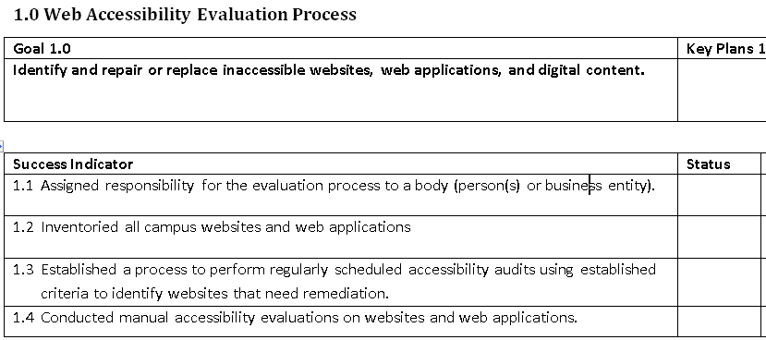
Web Accessibility – Self Assessment

Slide 24
Measuring Progress – Status Levels
Status Levels | Description for Procedures | Description for Documentation | Description for Resources
Not Started | No action has been taken yet. | No documentation has yet been generated. | No resources have yet been allocated.
Initiated | The campus has an ad hoc or developing practice. Procedures, if in place, are generally ad hoc. | Documentation is generally absent. | Resources have been tentatively identified but not yet allocated.
Defined | The campus has a common practice. Procedures, if in place, are consistent but informal. | Documentation, if present, is in working draft. | Resources have been firmly identified but not yet allocated.
Established | The campus has a standard practice. Procedures are consistent and formal. | Documentation is complete and fully reflects the standard practice. | Resources have been both identified and allocated.
Managed | The campus has a mature practice. Procedures are also in place to track and capture success indicators (milestones and measures of success). | Documentation is complete and fully reflects the standard practice. | Resources have been both identified and allocated.
Optimized | The campus has a mature practice. In addition, procedures are in place to conduct regular administrative reviews of success indicators to gauge effectiveness and implement improvements. | Documentation is continually revised to reflect the managed practice. Periodic administrative review of documentation is conducted. | Resources have been both identified and allocated. Periodic administrative review of resource allocations is conducted
Notes:
Status levels range from Not Started to Optimizing and they are measured by a description of the maturity of the procedure, the level of documentation, a whether or not resources have been allocated. For example, on the last slide we had a success indicator that is at the status level of defined. Establishing a regularly scheduled audit process – in this case defined may mean that Sally in the IT department has been designated to do audit scans every 6 months but the task is not part of her regular job description. So to move this success indicator to Established the tasks would need to part of her job description which would require more complete documentation and resource allocation.

Slide 25
Planning for Improvement
For each goal/indicator
Evaluate priority (impact, probability, capacity)
Identify related tasks for improvement
Set metrics & milestones
Assign responsibility for each task

Slide 26
Questions?

