Slide 1
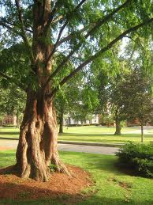
Grow Your Own: Creating a Leadership Garden
EDUCAUSE
November 8, 2012
Tufts University
Dawn Irish, Director Communications and Organizational Effectiveness
Mary Viola, Program Director, Tufts Gordon Institute

Slide 2
Introductions
Next Steps for You

Slide 3
Who is Tufts University?
Who is Tufts University?
Our Conundrum
Tufts Gordon Institute
Obstacles to Success
Next Steps for You
Who is Tufts University?
Our Conundrum
Tufts Gordon Institute
Obstacles to Success
Next Steps for You
Next Steps for You

Slide 4
Who is Tufts University?
8 schools across 3 Massachusetts campuses
European campus located in Talloires, France
5117 undergraduate students
5,588 graduate students
1,315 Faculty
3,195 staff
6 libraries
Who is Tufts University?
Our Conundrum
Tufts Gordon Institute
Obstacles to Success
Next Steps for You

Slide 5
Our Conundrum
Seasoned leaders reaching the end of their careers with no internal candidates qualified to assume their roles
A shortage of qualified external candidates
Motivated and talented new hires without the skills and experience to lead
Extremely limited financial resources
Complex, decentralized support structure that inhibited our ability to work collaboratively across organizational units
Lack of shared goals across the University
Aggressive plans for innovation and expansion of technology services
A general lack of staff leadership skills
Who is Tufts University?
Our Conundrum
Tufts Gordon Institute
Obstacles to Success
Next Steps for You

Slide 6
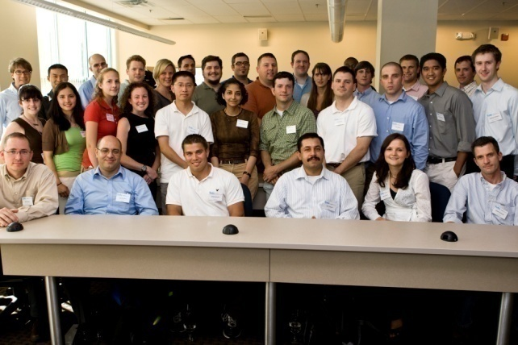
Tufts Gordon Institute
Transforming
Technical Professionals into Leaders
Who is Tufts University?
Our Conundrum
Tufts Gordon Institute
Obstacles to Success
Next Steps for You

Slide 7
Tufts Gordon Institute
“Tell me and I will forget. Show me and I may remember.
Involve me and I will understand.”
-Chinese Proverb
Who is Tufts University?
Our Conundrum
Tufts Gordon Institute
Obstacles to Success
Next Steps for You
“U.S. businesses spent $171.5 billion on learning and development in 2010, the most recent year for which data is available, according to the American Society for Training and Development.”
“Getting these programs to work, though is tricky. Management experts say it is all well and good to send employees to classes, but to get the lessons to stick, employees need to apply them to their daily work lives.”
Excerpts from the Wall Street Journal article, “Google’s Algorithms For Talent”
July 5, 2012.
Notes:
Focus on busienss accument and leadership..

Slide 8
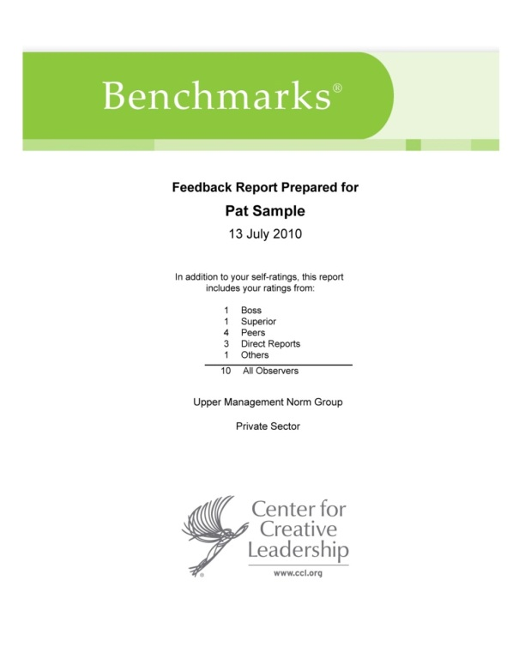
Tufts Gordon Institute
Classroom instruction customized to the needs of Tufts’ technology professionals
17 three hour classes over 6 months
Lectures, case studies, role plays, participant presentations
2 modules/3 instructors
“Learning to Lead”
“Conflict Management”
Individual coaching with 360 degree feedback
Team Project
Who is Tufts University?
Our Conundrum
Tufts Gordon Institute
Obstacles to Success
Next Steps for You

Slide 9
Tufts Gordon Institute
The Project
Participants identified chronic issues in IT organization
Self selected teams of 2-6 participants
Applied classroom concepts to achieve learning and results
Accountability built in: CIO and Sr. Managers attended final presentations
Who is Tufts University?
Our Conundrum
Tufts Gordon Institute
Obstacles to Success
Next Steps for You

Slide 10
Tufts Gordon Institute
Milestone 1 Results
Who is Tufts University?
Our Conundrum
Tufts Gordon Institute
Obstacles to Success
Next Steps for You
Notes:
Stress ambiguity during intitial phasese
But the fact that all of sr it mgt and some school deans were going to be at the final presentation really gave the teams motivation to perform.

Slide 11
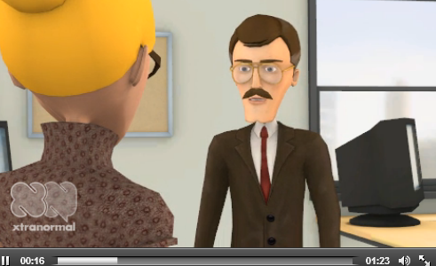
Tufts Gordon Institute
“Think left and think right and think low and think high. Oh, the thinks you can think up if only you try.”
– Dr. Seuss
Who is Tufts University?
Our Conundrum
Tufts Gordon Institute
Obstacles to Success
Next Steps for You
Part I: http://www.xtranormal.com/watch/12715013/legends-of-the-fail-part-1
Part II: http://www.xtranormal.com/watch/12745765/ledgends-of-the-fail-part-20?page=1
Notes:
Transition point: And so we had customized classroom instruction, we had 360 feedback and we had a project…but there was not doubt a ‘secret sauce’ that tied it all together…

Slide 12
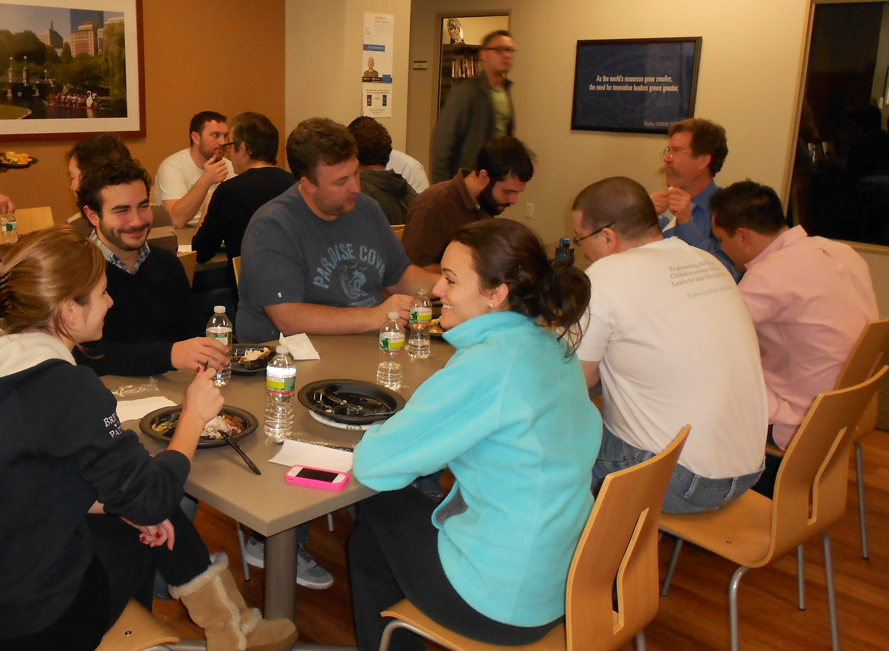
The secret sauce ?
Creativity in Action
Who is Tufts University?
Our Conundrum
Tufts Gordon Institute
Obstacles to Success
Next Steps for You

Slide 13
“A sense of humor is part of the art of leadership, of getting along with people, of getting things done.” -Dwight D. Eisenhower
Who is Tufts University?
Our Conundrum
Tufts Gordon Institute
Obstacles to Success
Next Steps for You

Slide 14
Questions?
Who is Tufts University?
Our Conundrum
Tufts Gordon Institute
Obstacles to Success
Next Steps for You

Slide 15
Next Steps for YOU
Who is Tufts University?
Our Conundrum
Tufts Gordon Institute
Obstacles to Success
Next Steps for You
How might you apply this at home?
What is your compelling case?
What barriers might you encounter
and how can the Tufts case help you
overcome them?

Slide 16
Next Steps for You
Dawn Irish
Director Communications and Organizational Effectiveness
University Information Technology
Tufts University
dawn.irish@tufts.edu
617-627-6258
Mary Viola
Program Director, Tufts Gordon Institute
mary.viola@tufts.edu
617-627-4622
Who is Tufts University?
Our Conundrum
Tufts Gordon Institute
Obstacles to Success
Next Steps for You
THANK YOU!

