Slide 1
Effective Online Assessment: Scalable Success Strategies
Denise Lowe, EdD
Instructional Design Team Lead
EDUCAUSE Annual Conference 2012
November 6 – 9, 2012
Center for Distributed Learning

Slide 2
Copyright Notice
This presentation leaves copyright of the content to the presenter. Unless otherwise noted in the materials, uploaded content carries the Creative Commons Attribution-NonCommercial-ShareAlike license, which grants usage to the general public with the stipulated criteria.

Slide 3
Objectives
Underlying issues
Assessment alternatives & test design
Pedagogy for LMS tool options
Notes:
Identify two underlying issues related to creating authentic online learning assessments.
Identify assessment alternatives and test item design strategies that elicit critical thinking.
Review the options available within the LMS online assessment tool to reinforce learning.

Slide 4
Underlying Issues
Objective 1

Slide 5
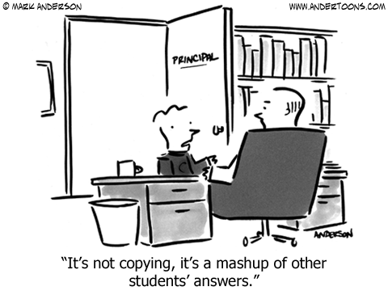
Reprinted with permission.
“Do you expect technology to compensate for a lack of ethics?”
Charles Dzuiban, PhD, RITE, UCF

Slide 6
Issue #1: Student Integrity
Cheating is being redefined
“Helping”

Slide 7
25%

Slide 8
Top 5 Ways Students Cheat with Technology Ford, C. (2009) Academics, Special Report: http://www.higheredmorning.com/category/special-report
Notes:
26% store info on their phone and look at it while taking a test
25% send text messages to friends, asking for answers
17% take pictures [or screen shots] of a test – and then send it to their friends
20% use their phones to search for answers on the Internet
48% warn friends about a pop quiz with a phone call or text message

Slide 9
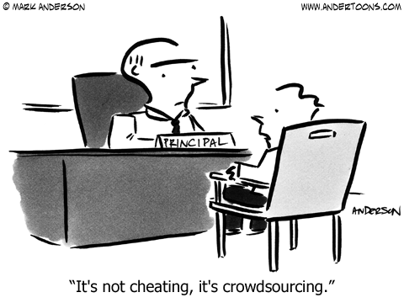
No magic here
All educational modalities
Closed book?
Reprinted with permission.

Slide 10
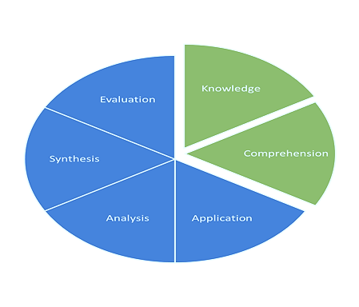
Issue #2: Faculty Methodology
Bloom’s Taxonomy

Slide 11
Traditional
Alternative
Notes:
Traditional methods of assessment may not be enough in a globally connected world
Using only exams, quizzes, and tests as a gauge of learning
Use of exams and quizzes that use knowledge recall or comprehension only

Slide 12
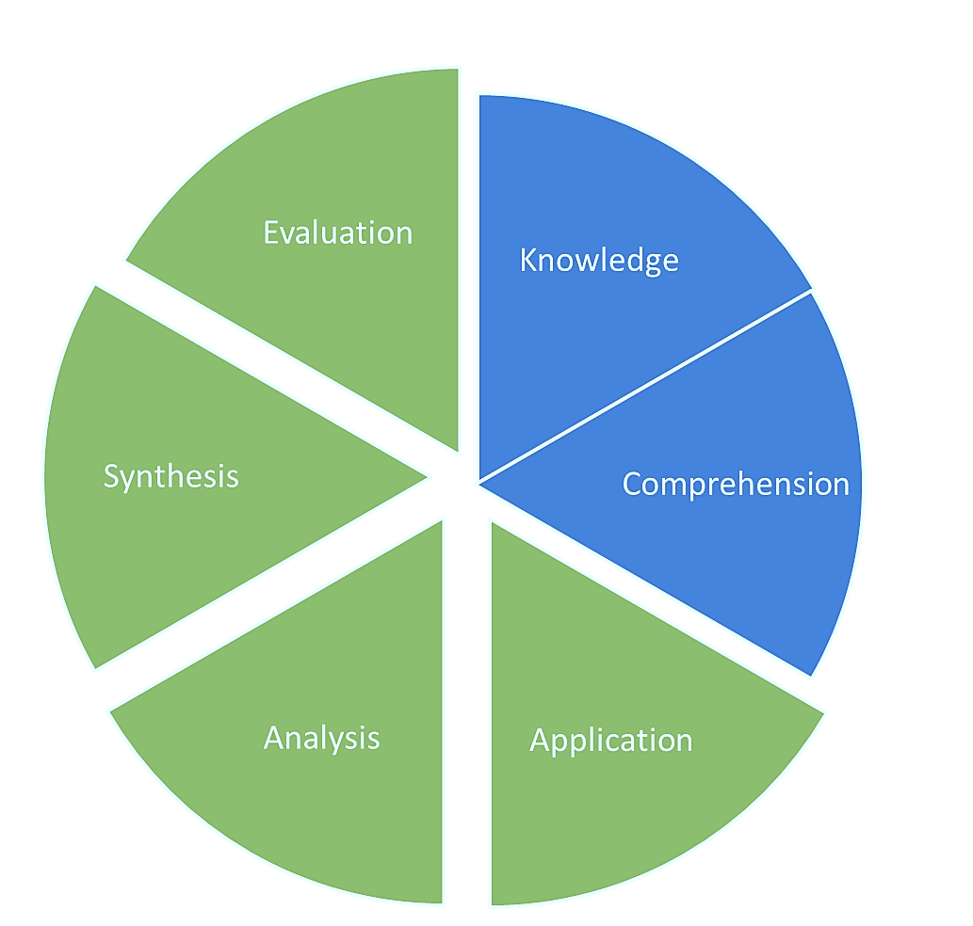
Problem-based constructivist practices
Relevant
Critical thinking
Notes:
Problem-based constructivist practices
Real world examples
Critical thinking

Slide 13
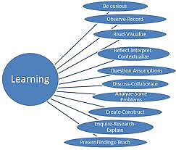
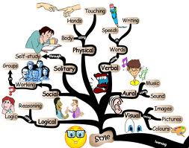
Learning, not control
Learning is the goal
Notes:
Focus must be on student learning - not student control
Learning, not the grade, is the goal

Slide 14
Authentic Assessment
Objective 2, Part 1

Slide 15
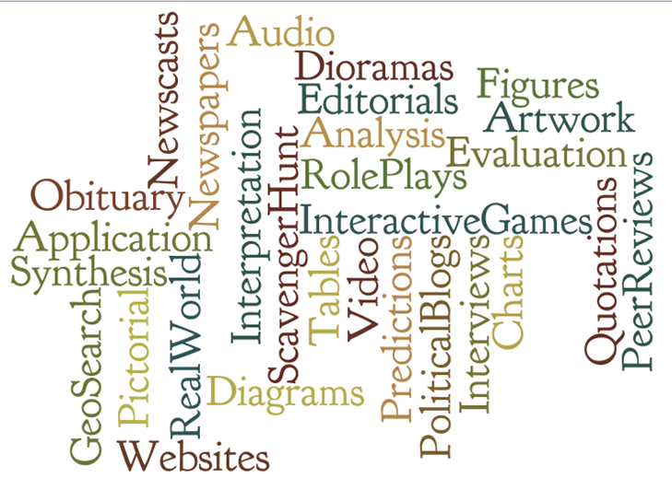
KEY: Use exams in conjunction with other assessment strategies
Notes:
KEY: Use exams in conjunction with other assessment strategies

Slide 16
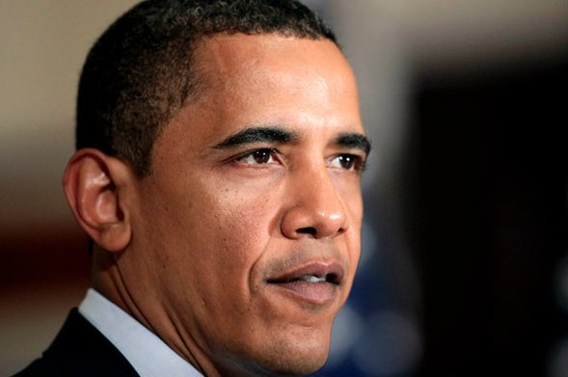
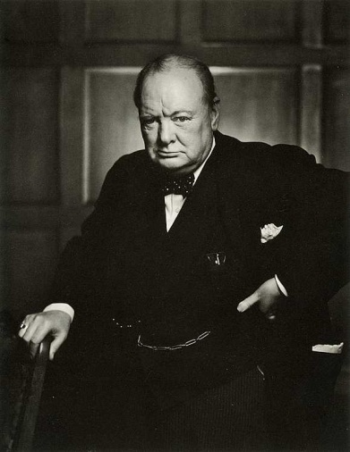
Interpretation
Quotes applied to different eras, economies, countries, etc.
October 7, 2008
"...I think it [health care] should be a right for every
American. In a country as wealthy as ours…”
March 2, 1943 "National compulsory insurance for all classes for all purposes from the cradle to the grave."
Notes:
Interpretation of quotations, written passages, charts, figures, tables

Slide 17
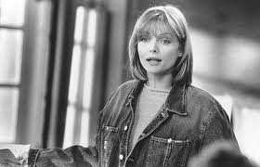
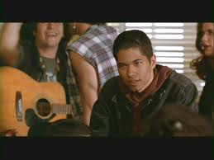
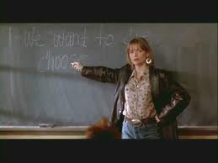
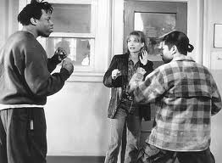
Different messages in time and modality with similar meanings
Dylan/Dylan contest
Notes:
Dylan Thomas vs. Bob Dylan
Writer vs. Musician
Movie: Dangerous Minds –

Slide 18
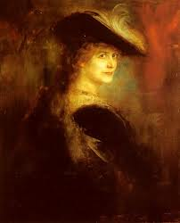
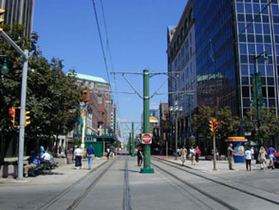
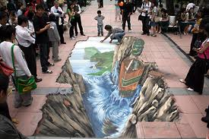
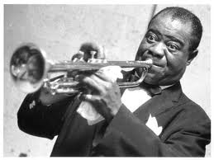
Pictorials and Audio
Using photographs, drawings, schematics, artwork, or musical clips
Notes:
Identifying urban planning concepts using architectural styles from city photographs
Comparing the genres of famous artists through specific art or musical works
Creating a new genre through opposing or complementary forces

Slide 19
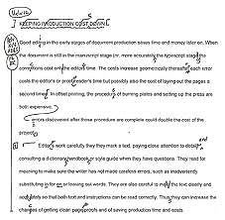
Using “hot spots” to edit a technical document
Notes:
Technical Writing, Grammar & Composition, Journalism

Slide 20
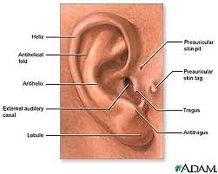
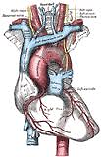
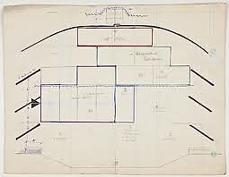
Simulations, Role Play, Learning Games
Medicine
Theatre
Notes:
Medicine: Labeling anatomical parts; identifying disease symptomology and diagnoses
Theatre: Identifying appropriate stage lighting or placement of stage effects or furniture

Slide 21
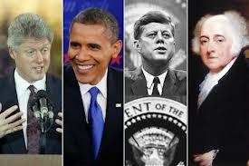
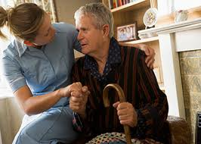
Social Work Political Science
Notes:
Social Work – prepare for an upcoming clinical home visit using a detailed simulation of home studies
Political Science – manage political campaigns past/present: Abe Lincoln as he competes with Rudy Giuliani in the presidential elections of 2008

Slide 22
Collaboration
Use problem-based learning as a group project with a specific challenge to address
What do we know?
What do we need to know?
Where will we get this information?
What challenges do we face?

Slide 23
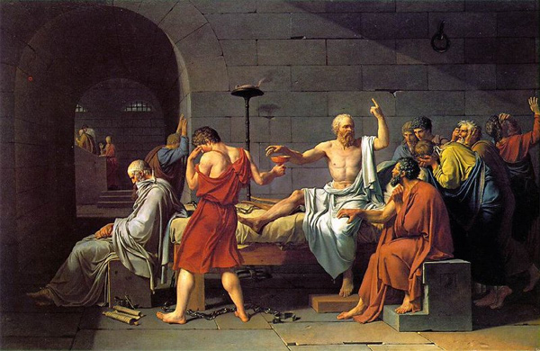
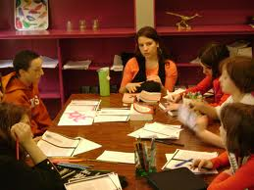
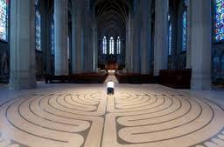
Socratic Dialogue
Small group discussions
Buzz groups
Case discussions
Debate
Jigsaw groups
Mock trials
Notes:
Small group discussions led by instructor
Buzz groups - 2 people; short period of time
Case discussions – real or simulated events
Debate teams – position defense
Jigsaw groups –smaller groups discuss specific issue elements and teach to larger group
Mock trials – role assumptions

Slide 24
Cognitive Load & Test Item Construction
Objective 2, Part 2

Slide 25
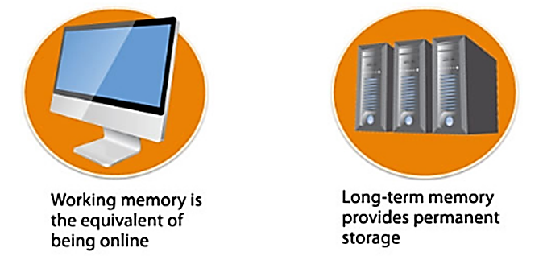
Cognitive Load
http://theelearningcoach.com/learning/what-is-cognitive-load/
Amount of brain power needed for understanding a concept
Higher complexity = higher level of brain power needed

Slide 26
Types of Cognitive Load
http://theelearningcoach.com/learning/what-is-cognitive-load/
Notes:
Extraneous CL – minimize unless the point of the exercise is to teach the skills of identifying extraneous information.

Slide 27
Magic #7
Novel information
Highly complex
Interface and delivery

Slide 28
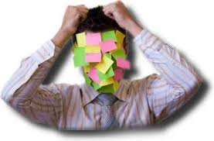
Overload?
Notes:
Cognitive Overload
Poor comprehension
Obstructs learning

Slide 29
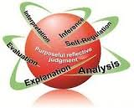
Impact?
Higher Complexity
Less Items Needed
Notes:
Use multiple choice quizzes as weekly reviews of content
Use PBL exams for larger-scale grades.

Slide 30
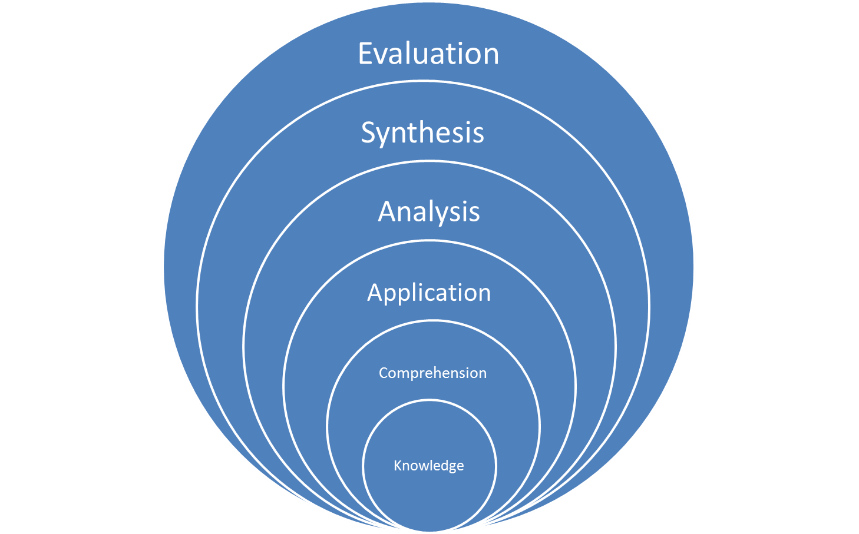
Test Item Construction
Notes:
Focus on application, rather than memorization
Create questions that emphasize higher levels of Bloom’s taxonomy
Knowledge
Comprehension
Application
Analysis
Synthesis
Evaluation

Slide 31
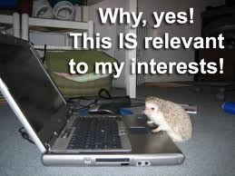
Test Item Construction
Critical Thinking Relevant
Transfer of Knowledge
Skill development
Patterns & themes
Extrapolation
Notes:
Emphasize critical thinking
Goes beyond just the facts
Use of real world situations when possible
Makes learning authentic & relevant
Aim is to promote transfer of knowledge
Skill development
Recognition & interpretation of patterns & themes
Extrapolation applied to other events

Slide 32
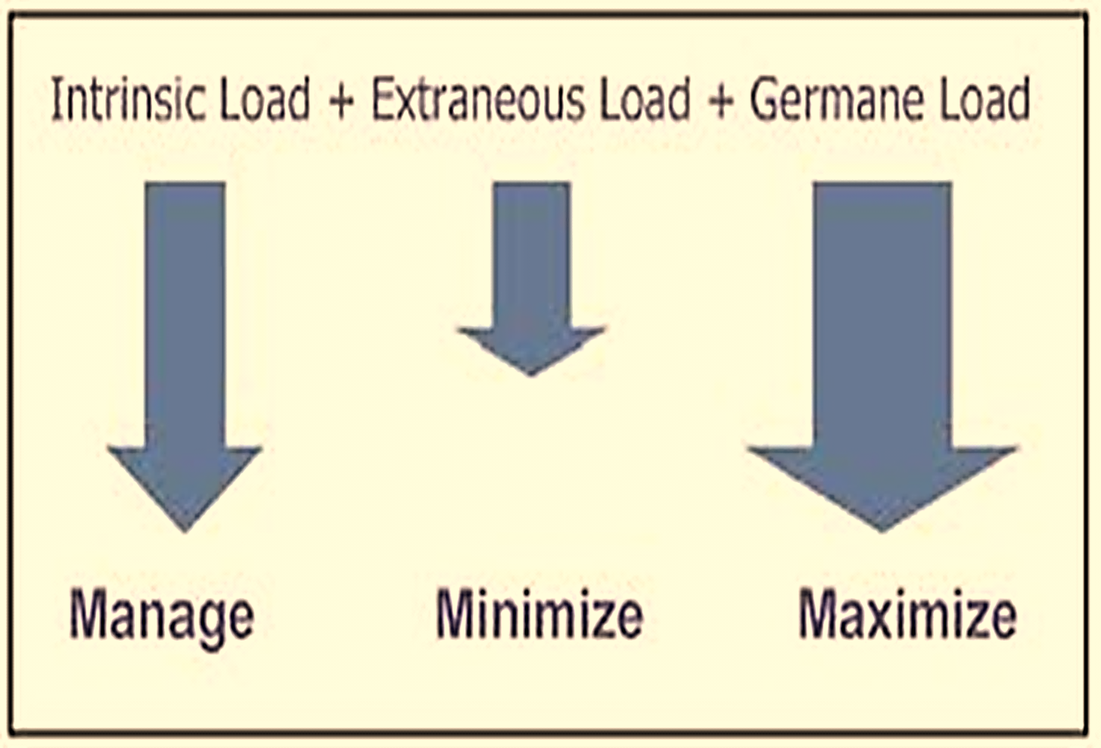
Notes:
Our job as instructors is to manage the intrinsic cognitive load so that students can learn without being overwhelmed.

Slide 33
Anatomy of Test Item
Keep it simple:
Only include relevant information in the question stem
Add common words to stem instead of in each alternative

Slide 34
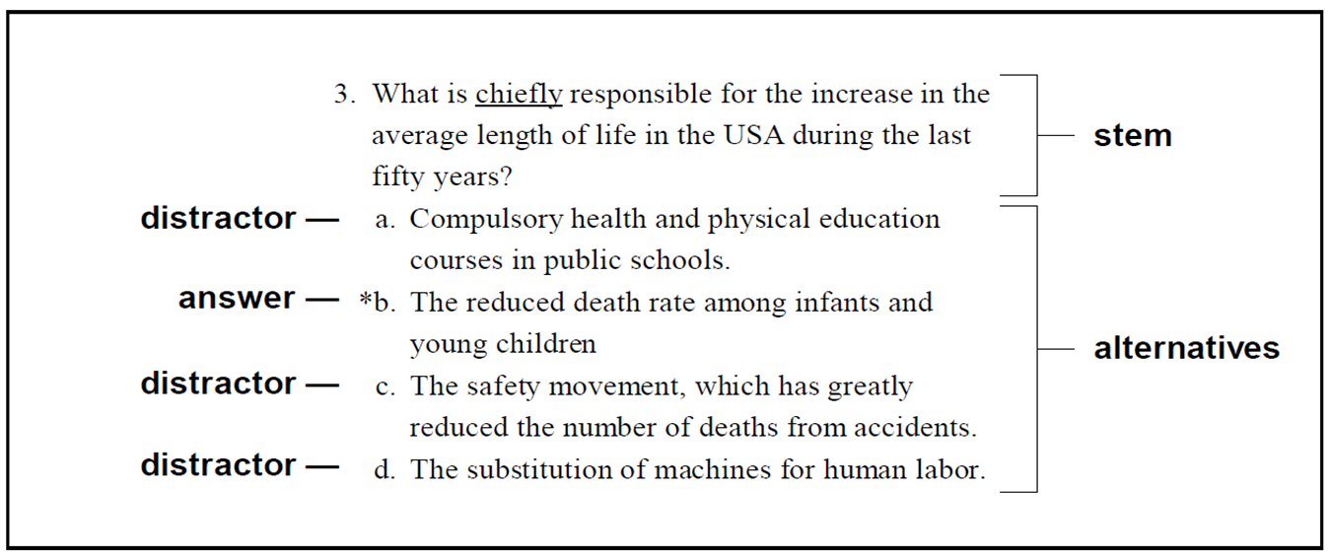
Anatomy of Test Item
Limit the use of:
Negatives (e.g., Not, Except)
Distractors (All or None of the Above)
Put alternatives in a logical order
Include the same number of alternatives for each item

Slide 35
True/False: #1
Test Objective: Identify how the issue of slavery impacted the Civil War and American society at that time.
One of the causes of the Civil War were differences concerning the elimination of slavery.
This is simple recall of information, yes/no answer.

Slide 36
Test Objective: Identify how the issue of slavery impacted the Civil War and American society at that time.
Improved
The type of individual that would support abolitionism would likely be a rural farmer or capitalist.
This requires an understanding of the concept of abolitionism and its impact on the lives & livelihood of societal members.

Slide 37
Multiple Choice #1
When differentiating between a supervisor and a leader, it is best to remember that a leader:
Is a person who has commanding authority or influence
Is at the forefront of a movement
Is tending toward a definite result
All of the above*
Requires knowledge recall, no concept understanding

Slide 38
Improved
As the overseer of a major retail department store, Jennifer received a directive to increase departmental profits. She implements a change in procedures, but this has never been tried before. The leadership trait she is mostly demonstrating is:
a. Commanding authority or influence
b. Using existing policies to address an issue
c. Taking initiative by setting a new precedent*
d. Discussing the concerns of superiors with her staff
Requires differentiation of traits and knowledge application

Slide 39
Multiple Choice #2
As discussed in the lecture notes, the three power bases are:
Knowledge, educational, and textbook
Positional, personal, and knowledge*
Educational, experiential, and practical
Requires knowledge recall only, no concept relationships

Slide 40
Improved
Jack works for IBM as a computer programmer. He is known for his multi-colored hair styles, casual dress, and body piercings. Jack is a talented programmer who works well with his peers. Jack’s style is expressed through which power base?
Knowledge
Personal*
Positional
Educational
Requires knowledge application and concept understanding

Slide 41
Multiple Choice #3
Being proactive as a leader, as defined by Covey, is to:
Take responsibility for the course of our lives*
Prioritize
Creatively cooperate with others
All of the above
Requires knowledge recall, no understanding of the individual concepts

Slide 42
Improved
Sandy has experienced conflict with a co-worker for some time. She has complained of her situation to her peers. After learning about Covey’s 7 Habits, she decides on a proactive approach - taking responsibility for her actions. Which of the following actions best reflects that position?
Speaks directly with her co-worker to resolve the issue*
Blames her co-worker for creating the conflict
Signs up for a team project with her co-worker
Files a complaint against her co-worker with their supervisor
Requires knowledge application, concept relationship

Slide 43
Multiple Choice #4
Ribosomes are important for:
a) the nucleus
b) DNA
c) Cellulose
d) Protein synthesis*
Knowledge recall - Must know what ribosomes are.

Slide 44
Improved
Suppose you thoroughly and adequately examined a particular type of cell, using the transmission electronic microscope, and discovered that it completely lacked ribosomes. You would then conclude that this cell also lacked:
a) A nucleus
b) DNA
c) Cellulose
d) Protein synthesis*
Knowledge application - Must know the relationship between ribosomes and cells.

Slide 45
Multiple Choice #5
Which of the following is a category in the taxonomy of the cognitive domain?
Reasoning ability
Critical thinking
Rote learning
All of the above
None of the above*
Only asks for simple identification of a category; contains “all of the above” and “none of the above” as option choices, which should be avoided, if possible. (recall)

Slide 46
Improved
What is the most complex level in the taxonomy of the cognitive domain?
Knowledge
Synthesis
Evaluation*
Analysis
Comprehension
This item asks for differentiation between levels. (comprehension)

Slide 47
LMS Assessment Tool Options
Objective 3

Slide 48
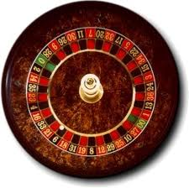
LMS Assessment Tool
Encourages individual work & study habits
Assessment alternatives (i.e., Test A or Test B)
Assessment questions presented in random order
Use of question sets, categories, levels of difficulty
Student groupings (specific tests available to specific students)
Randomization

Slide 49
LMS Assessment Tool
Review or “must know”?
Restricted or unlimited time to complete assessment once begun
Availability to students – how long is assessment open?
Display questions one at a time or all at once?
Note: # of MC answer alternatives information processing time (CL)
Assessment time limits

Slide 50
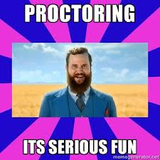
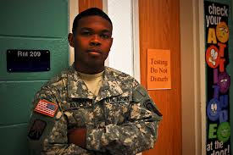
LMS Assessment Tool
Rules for assessment completion
Proctoring
Notes:
Rules for assessment completion
Length of contact with materials
Complete when launched first time – need to know
Save and come back to it later – study & review
Proctoring
Sensitive materials, critical knowledge
Assessment alternatives should be considered
Need to consider geographical constraints

Slide 51
Wrap-up
Resources and Contact Information

Slide 52
Resources Available
Faculty Seminars in Online Teaching
http://teach.ucf.edu/2010/12/14/effective-online-assessment-scalable-success-strategies/
Socratic Dialogue
http://www.ion.uillinois.edu/resources/otai/Socratic.asp
Teaching Online Pedagogical Repository
http://topr.online.ucf.edu/index.php/Main_Page
Center for Distributed Learning

Slide 53
Questions, Comments, Feedback
Dr. Denise Lowe
Instructional Design Team Lead
University of Central Florida
Denise.lowe@ucf.edu
407-823-4272
online.ucf.edu

