Slide 1





Women in Technology: Strategies and Best Practices to Attract Young Women into IT Programs and Careers
An Executive Panel Session
Thursday, November 8th

Slide 2
Welcome & Introductions
Sue B. Workman, Associate Vice President, Client Services & Support, Indiana University
Sharon Pitt, Executive Director for Instructional Technology, George Mason University
Margaret M. Burnett, Professor of Computer Science, Oregon State University, ACM Distinguished Speaker
Regina Kunkle, Vice President, State, Local and Higher Education, NetApp

Slide 3
Sue Workman, AVP Client Services and Support, Indiana University
Higher-ed IT Leader
AVP at IU – an awesome team
Currently run an organization of ~250 people.
Serve on the VP Cabinet
Blended business and education.
HOW I GOT HERE:
High school liked so I majored in Math and minored in Comp Technology. Only female.
Sys Admin paid more than teaching
Worked in private industry, HP, for 8 years.
Became a mom
Moved into Bloomington to raise family. Work at IU, hospital, or mall.
Why I LOVE IT
Something new almost every minute
Love working with people, using technology.
Challenges me and keeps me innovative.
Allows me to have my fingers in everything.
RECOMMEND:
Find your place – programming, support, training, R&D, administration.
Take risks, you can apologize later.
Find jobs that allow you to have other titles – like partner, mom, daughter, friend, aunt.
NETWORK!
LIFE IS GOOD – DO WHAT YOU LIKE and LIKE WHAT YOU DO

Slide 4
Sharon Pitt, Executive Director, Information Technology, George Mason
Higher Education IT Leader
ED at GMU – 66 FT staff and bevy of student staff
Serve on VP cabinet and other institutional committees
Network with IT leaders in HE, government and industry
HOW I GOT HERE:
College – started as math major; ended up with Economics Degree
Bridges
College – Master of Architecture; lots of technology use
Decision: IT or Architecture/Engineering?
Followed my heart
Why I LOVE IT
Uses my strengths: futurist, learning, organizing, managing people/tasks
Making a difference; fulfilling
Challenging
Love technology, education and improving/making structures and stuff
Flexible
RECOMMEND:
Follow your passion
Deeply learn about your interests/your field
Volunteer – extend your knowledge and your network
Find a coach or mentor

Slide 5
Margaret Burnett, Oregon State University Co-Chair NCWIT AA
CS Professor
Mentor & teach students
HCI+SE Research:
gender differences & software tools
Co-chair NCWIT AA
HOW I GOT HERE:
High school: liked math
➔ College: math major, CS minor
➔ Private industry: 1st woman ever hired into management at Proctor & Gamble Ivorydate (13k employees)
Started several small businesses
➔ Instructor Univ. Kansas
➔ PhD CS
➔ Faculty position
➔ Started working one-on-one with a few undergrads (mostly women)
➔ Became active in NCWIT
Why I LOVE IT
Variety
Set my own priorities (mostly)
Work with the best people in the world
Make a difference to state of CS
Make a difference to my students
RECOMMEND:
If you’re underconfident, just make sure it works for you
Do something tiny. It can change someone’s life:
If someone helps you, pass it on
“The moment that stood out for me: Dr. Burnett … said that she would be interested in working with me in the future.”

Slide 6

The Distinguished Speakers Program
is made possible by
For additional information, please visit http://dsp.acm.org/

Slide 7
Regina Kunkle, VP Sales, NetApp
SALES LEADER
VP in a Fortune 500 Company
Currently run an $200M organization of 100 people dedicated to selling and servicing Higher Education and State and local governments
Travel all over the country meeting CIOs and others at colleges and universities
HOW I GOT HERE:
High school liked Math but not so much in College
Tried Computer Science
Started as a Sales Engineer
Moved into sales quickly – where the money is!
Why I LOVE IT
Sales is positive, meet lots of people
When you “win” a deal – it is exhilarating
Traveled all over the world
Now, in management, coach people, teach them, make them better at what they do. Satisfying.
RECOMMEND:
Follow your passion. IT is where the jobs are, make your passion around IT.
Learn all things Microsoft. NO KIDDING
NETWORK – find jobs by networking
Passion is contagious, be passionate about what you do.

Slide 8
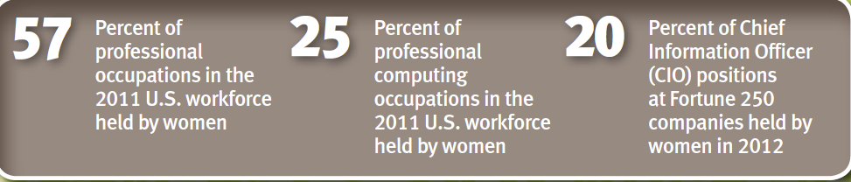
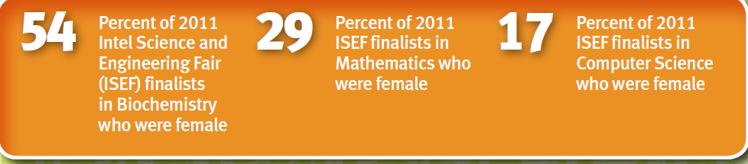
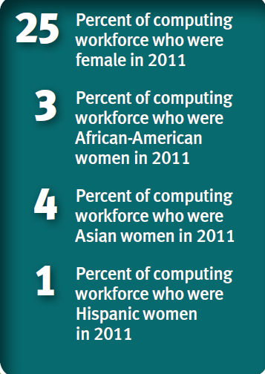
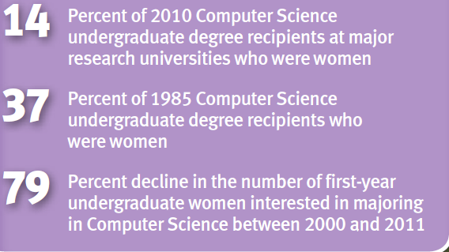
WIT – The Challenge
NCWIT, By the Numbers , 2012

Slide 9
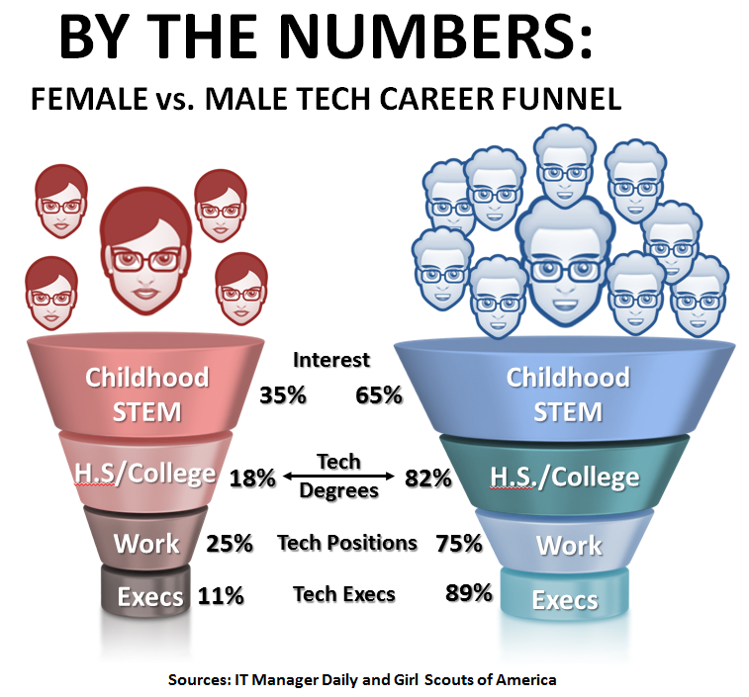
The Pipeline
Forbes article “Here's the Real Reason There Are Not More Women in Technology”
  http://www.forbes.com/sites/markfidelman/2012/06/05/heres-the-real-reason-there-are-not-more-women-in-technology/2/

Slide 10
Careers in High Tech
We are NOT ALL PROGRAMMERS
Sales
Woman are great here, empathy is strong. “Take care” of customers.
Learning Value Proposition is different than being overly technical. Sell the value.
Inside sales great start
Marketing
High Tech marketing – not much different except the market you are trying to reach
Planning Events
Graphics/Web design
Writing Press Releases, Success Stories.
Higher Education
CIOs, and staff
Engineering
Problem solving – working groups/program management/
QA testing/Build future products
Soft skills communicate vs deep technical
Passionate - end goal solve customer problem
Pre-sales Engineering
Go Green
Support:
Maximum Flexibility
Empathy/take care of customer
Trouble shooting problems
Customer facing and the broker of getting the right person
Getting parts and such to the right places.

Slide 11
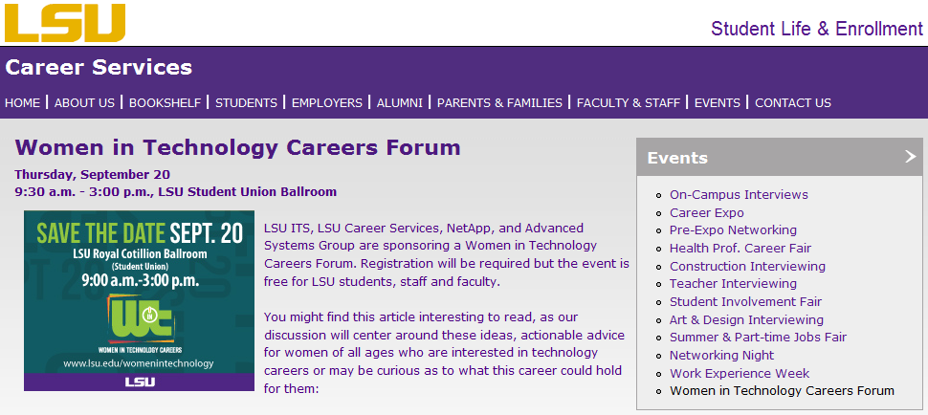
WIT Campus Events & Outreach

Slide 12
Audience Poll Question
What WIT outreach or programs have you seen be most effective ?

Slide 13


Slide 14
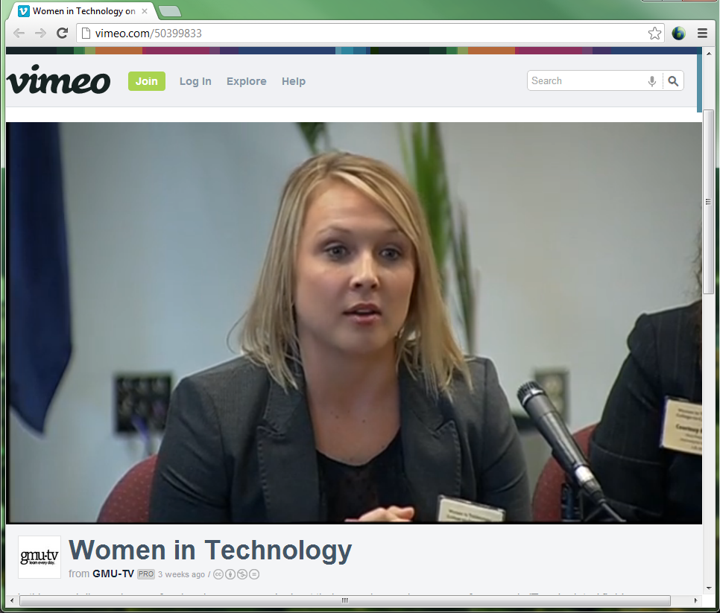
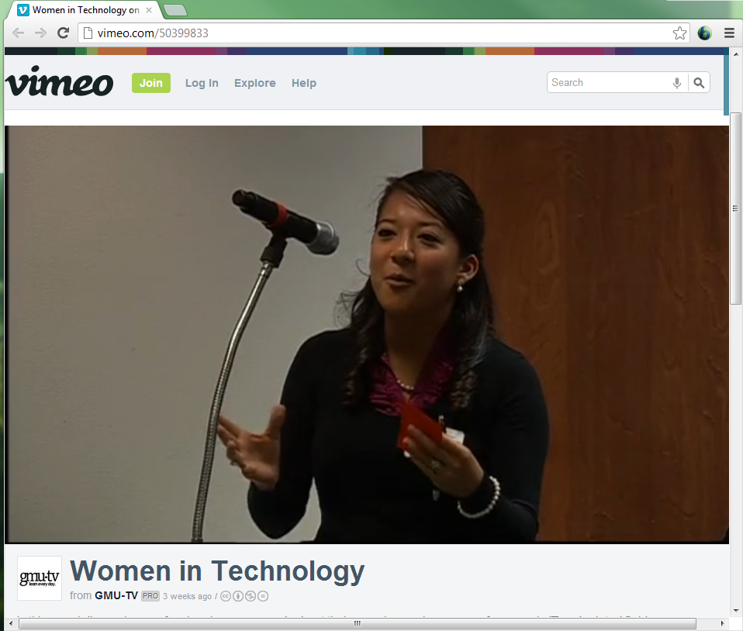

Slide 15
STEM & WIT in School of Engineering
AIT Departmental priority
NSF “Aspirations” Awards
  Recognition for HS girls aspiring CS students
Microsoft’s “DigiGirlz”
  Middle school girl outreach for EE/CS
NSF “Student and Technology in Academia”
  STARS undergraduate mentoring
  Middle & HS outreach and promotion

Slide 16
Audience Poll Question
How did you / can you make WIT a priority at your institution?

Slide 17


Slide 18
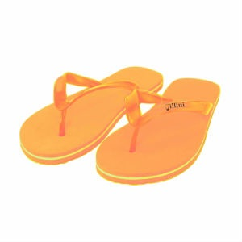


Slide 19
Best Practices
Think like the age of your audience – even colors matter.
Create a project plan, budget, communication plan, and timeline.
Make use of radio, tv, newspaper, flyers, posters, banners, sidewalk chalk, web, email, e-zines, digital signage, social networking.
Market early and often to the target audience focusing on how best to reach that audience rather than just general call outs. Identify classes/clubs where your target audience is likely to be in mass and ask the professors/presidents to help get the word out.

Slide 20
Best Practices
Choose the date for your event based on campus calendar
Line up a powerful role model to speak plus a panel of several successful women in technology of various age ranges and technology interests.
Make sure you are taking your target audience into consideration in every step of the planning and communication
Provide food, fun, and networking opportunities at your event.
Require registration even if the event is offered free, allowing walk-ins who show up without registering.

Slide 21
What else is happening at IU?
Center for Excellence WIT (STEM)
UITS Sponsored WIT
Informatics Dean Honored
Various other programs

Slide 22
Audience Poll Question
IT is HOT right now – Cloud, Mobile, Big Data, Security, & i-everything – how can we convey the breadth of opportunities to our women students?

Slide 23


Resources for Best Practices from NCWIT
An In-a-box is a “kit”.
  See resources
  to download this (free).
Notes:
Moving ahead: How to do it.
NCWIT has resources to help.
Who am I?
Margaret Burnett
CS Professor
Co-Chair NCWIT’s Academic Alliance
Co-Author of “REU in a Box”
This In-a-box supports:
Hands-on.
One-on-one research experience.

Slide 24
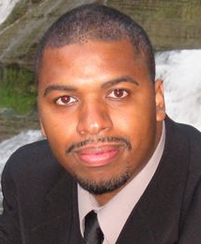
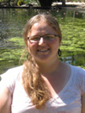
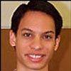
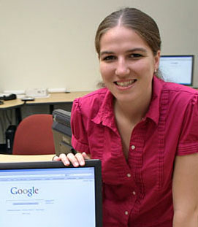
“My research experience is the reason I’m here today.”
Notes:
JJ Cadiz, researcher and product visioning, Microsoft
Jen Davidson, PhD student, Oregon State
Kyle Rector, PhD student, Univ. Washington
Hakim Weatherspoon, Asst. Prof. Cornell
Margaret is speaking

Slide 25




More Boxes: Mentoring & Supervising

Slide 26




More Resources
Free at NCWIT.org

Slide 27
Audience Poll Question
What resources or support are available to deploy a WIT initiative at my institution?

Slide 28
THANK YOU !!
http://www.ncwit.org/programs-campaigns/pacesetters
November 8th, 2012

