Slide 1
Ready, Set, Go: Measuring Organizational Readiness in Higher Education
November 8, 2012
#E12_SESS132

Slide 2
Your Presenters
Dr. Linda Shatzer
Jim Russell, M. Pub. A.

Slide 3
Overview
This session will identify methods CUNY has employed for measuring organizational readiness as well how such measurements can be used to reach critical decisions regarding resource allocation and go-lives.

Slide 4
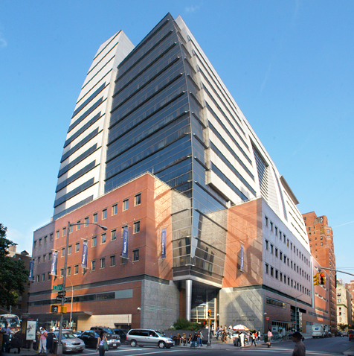
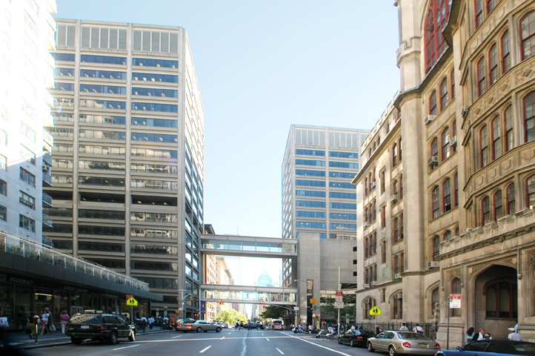

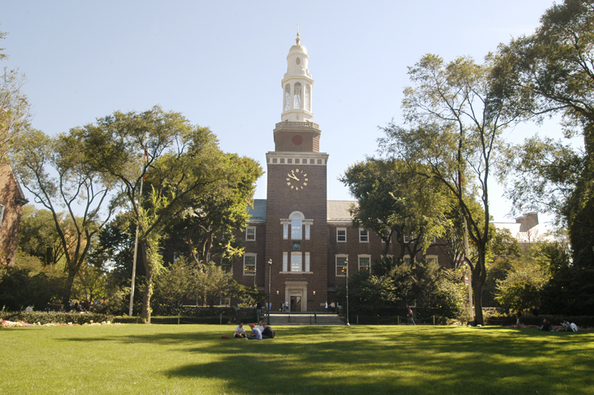
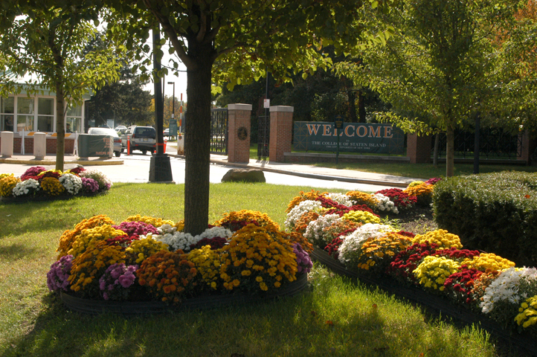
Header Divider

Slide 5
City University of New York
CUNY is the largest urban public university in the United States:
  24 Institutions
  >271,000 degree-seeking students
  >270,000 continuing education students
  >7,000 full-time faculty
  >10,000 part-time faculty
  >36,000 employees
  1,400 academic programs
  200+ associate and baccalaureate degree majors
  100+ graduate degree programs
  280+ buildings on 23 million square feet of space
  641+ acres

Slide 6
Change is a process, not an event
Change is the process of reducing commitment to the way things are and increasing commitment to the way things will be
Pain: Moving away from the Status Quo
Remedy: Shared vision of a Desired State
Current
State
Transition
State
Future
State
Pain Prerequisites Remedy
Lewin’s Force Field Model of Change

Slide 7
Stages of Change Commitment
Internalization
Institutionalization
Degree of Support for Change
Adoption
Installation
Commitment Phase
Commitment Threshold
Positive Perception
Understanding
Acceptance Phase
Awareness
Disposition Threshold
Contact
Preparation Phase
Time
Source: Managing at the Speed of Change, Derryl Conner, ODR Inc.

Slide 8
Three Paths to Change Commitment
I’ll master it, help make it better and improve the student experience.
Commitment Phase
I’ll do it but I’ll try to find a way around it.
Adopt
I’ll do it but nothing more.
Acceptance Phase
Accept
Degree of Support for Change
Preparation Phase
Prepare
Time
Source: Adapted from Derryl Conner, ODR Inc.
Notes:
The more time they are engaged, the greater the adoptions. Engagement is a two way street.

Slide 9





Measuring Organizational Readiness

Slide 10

“The only man I know who behaves sensibly is my tailor; he takes my measurements anew each time he sees me. The rest go on with their old measurements and expect me to fit them.”
― George Bernard Shaw

Slide 11
Tools for Measuring Readiness
CUNY conducted a community survey in 2008, 2010 and 2012 to measure staff attitudes/reactions to CUNYfirst. Key Metrics were in leadership, communications and training
A Change Index focusing on qualitative and quantitative metrics provided indicators for a decision “to go” or “not to go” to launch and sequencing
Post-Implementation Focus Groups

Slide 12

COMMUNITY SURVEY

Slide 13
Input - Major Dimensions
Overall Agreement, Neutral, and Disagreement
*Note: Taken from CUNY campus community survey
Change from 2007, % Agree
+2
+10
+9

Slide 14
Customer Orientation
Team Tries to Satisfy
Change from 2007, % Agree
5b. In my work group, we try hard to satisfy our customers
+1
5a. In my work group, we have a good idea of how to satisfy our customers
0
7b. My colleagues and I often work as a team
+5

Slide 15
Leadership
Growing Majority are Positive
Change from 2007, % Agree
3h. I believe my immediate supervisor/manager has been (or will be) willing to allow me to take part in CUNYfirst planning and training activities.
n/a
3g. I believe my immediate supervisor/manager will commit the time and energy to make CUNYfirst succeed.
+9
3b. My Senior Campus Leadership is committed to the success of this project.
+13
3a. My Senior Campus Leadership is eager to move forward with CUNYfirst.
+11
3d. I am confident that my Senior Campus Leadership can guide us to success.
+7
3e. My Senior Campus Leadership understands the effects CUNYfirst will have on our organization.
+10
3c. My Senior Campus Leadership will remove any campus barriers which could cause project failure.
+7
3f. I have attended staff meetings or planning sessions about the CUNYfirst implementation in my work unit.
+16

Slide 16
Communication
Improved Understanding of Program
Change from 2007, % Agree
1a. I have a good understanding of what CUNYfirst is trying to achieve.
+10
1f. My information on CUNYfirst comes mostly from management or official sources, not from gossip or the informal “grapevine”.
+4
1e. I know whom to contact if I want more information about the CUNYfirst on my campus.
+8
1b. I have received information from my campus CUNYfirst team for my campus.
+8
1g. I have looked at the CUNYfirst website (http://first.cuny.edu).
+18

Slide 17
What readiness questions do you think we could answer?

Slide 18
Survey Results
What colleges will have the most challenge in adopting to change?
What is the action plans for leadership to address areas of weakness?
What else might be learned from the data?
Has the year over year comparison been positive, negative or stayed the same?

Slide 19

CHANGE READINESS INDEX

Slide 20
Stages of Change Commitment
Internalization
Institutionalization
Degree of Support for Change
Adoption
Installation
Commitment Phase
Commitment Threshold
Positive Perception
Understanding
Acceptance Phase
Awareness
Disposition Threshold
Contact
Preparation Phase
Time
Source: Managing at the Speed of Change, Derryl Conner, ODR Inc.

Slide 21
Change Readiness Index
CUNY needed a tactical assessment tool
  Measured critical readiness areas derived from Community Survey and Vanguard focus groups
  Developed meta questions and survey questions informed by initial wave (vanguard) experience
  Measured multiple levels of organization
  Quantitative, qualitative and staffing ratios included
Results shared first with campuses, later with project
By making it tactical, mitigations plans were easily suggested

Slide 22
CRI – Question Development
Competency/Success Category: Coordination
Meta Question: Does the BARFIT team meet regularly with each other?
Literal Question: Were all areas represented in the last three BARFIT meetings?
Question Target: Manager
Weighting: 20%

Slide 23
CRI – Quantitative Score
Answers assigned a value 1-5, weighting applied, item score calculated

Slide 24
CRI – Qualitative Score
Using observational scores, provide an aggregate score of:
Demeanor
Body Language
Word Choice
Environment
Etc.

Slide 25
CRI – Staffing Evaluation
Staff count in key service areas
Calculate Z Score across cohort of units (colleges)
Isolate student ratio score, faculty ratio score, staff ratio score and other key scores
Average ratio scores for student support and all staff support

Slide 26
CRI – Staffing Evaluation
FTE IT Office | 21
Staff to Student Ratio | 0.004728
Z Score (std deviations from mean) | 0.53
Staff to Staff Ratio | 0.064516
Z Score (std deviations from mean) | -0.29
Staff to Faculty Ratio | 0.134146
Z Score (std deviations from mean) | 0.66
Fall 2010 FTE Enrollment | 4,653
Number of Academic Depts | 10
Full Time Non Teaching 2008 | 341
Full Time Faculty 2008 | 164
Average Z Score for Student Support | 1.07
Average Z Score All Areas | 0.47

Slide 27
CRI – Dashboard

Slide 28
What readiness questions do you think we could answer?

Slide 29
CRI Results
Where do colleges lack resources?
In what areas have certain colleges or units failed to prepare for change?
Where is the greatest resistance to change with the college or unit?
Where is there confusion?
Overall, which college or unit is trailing and a candidate for deferral if necessary?

Slide 30

FOCUS GROUPS

Slide 31
Stages of Change Commitment
Internalization
Institutionalization
Degree of Support for Change
Adoption
Installation
Commitment Phase
Commitment Threshold
Positive Perception
Understanding
Acceptance Phase
Awareness
Disposition Threshold
Contact
Preparation Phase
Time
Source: Managing at the Speed of Change, Derryl Conner, ODR Inc.

Slide 32
Post Implementation Focus Groups
About 3 months after go-live
Analysis of the data by categories
Themes fell into similar categories as Change Readiness Index
Four Sessions Held at Each Unit (Faculty, Student, Staff, and Fin Aid Staff)
343 comments collected supplying 539 Category meta-tags
  Count includes all comments
Isolated issues that were escalated and resolved

Slide 33
Overview of Results
Category | Count
Training | 139
General Comments | 126
Business Ownership | 82
System Design | 66
Communication | 43
Performance | 27
Security | 21
Testing | 19
Data | 15
Leadership | 12

Slide 34
Overview of Results

Slide 35
Results by Group

Slide 36
What readiness questions do you think we could answer?

Slide 37
Focus Groups Results
Are there critical defects not being escalated?
How deep and broad has the adoption been?
Are there implications for future implementations based upon results?
Are there processes that can be improved to support future implementations?

Slide 38
Take Away: Measuring
Survey instruments can measure “the pulse” of a large organization’s strengths and weaknesses
A more focused tools, a change index, can be an effective intervention to foster change in targeted populations
Focus Groups can yield details regarding end user experience
Not all measurements yield actionable intervention

Slide 39
Questions?

Slide 40
This presentation and all most Educause 2012 presentations are available for download from the conference site.
Please also review this and other sessions.
Presentations from previous meetings are also available

Slide 41
Contacts
Dr. Linda Shatzer
  Manager, Change and Organizational Readiness
  linda.shatzer@mail.cuny.edu
Jim Russell
  Academic Integration Manager
  jim.russell@mail.cuny.edu

