Slide 1
Business Intelligence at the University of Arizona – a Case Study
Educause, Denver, CO
November 9, 2012
Presented by Hank Childers
Senior Director,
Enterprise Information & Analytics

Slide 2
ABSTRACT
The University of Arizona has made a significant investment in Business Intelligence over a 4-year period. This presentation covers objectives, budget, technology, team structure, delivered capabilities, working relationship with campus, approaches taken, issues encountered, quantitative and qualitative results, current initiatives, and ongoing challenges.
This presentation leaves copyright of the content to the presenter. Unless otherwise noted in the materials, uploaded content carries the Creative Commons Attribution-NonCommercial-ShareAlike license, which grants usage to the general public with the stipulated criteria.
2
Notes:
REMARKS—
Welcome to those in attendance, both face-to-face and online
Already seen abstract…I hope to live up to it…my goal is to offer our experience as a reference
Lots of stuff & I will try to move quickly to leave time for questions at the end
Presentation is available on the Educause website, including the speaker notes, and you are welcome to use it according to the Creative Commons terms
OK…let’s get going!
As you’ll see BI didn’t really get going during Year 1, so this is really closer to a 3-year period.
A very compressed time that allows us to see the arcs of the various stories with some clarity.

Slide 3
AGENDA
Background
Enterprise Information & Analytics Team
Architecture & Technology
Dashboard Examples from UAccess Analytics
Methods & Madness
Miscellaneous Metrics
Where We Are Today
Looking Back / Looking Forward
Questions?
3

Slide 4
BACKGROUND
4

Slide 5
U of A – Quick Facts
Founded in 1885
Arizona’s Land Grant University
Tucson, AZ
39,239 Students
20 Colleges, 19 Schools
12,053 Employees (FTE)
Research 1, Member – AAU
NCAA Division I, PAC 12 Conference
5

Slide 6
MOSAIC PROJECT OBJECTIVES
Starting in July, 2008 the UA set out to implement:
PeopleSoft HCM (HR/Payroll)
PeopleSoft Campus Solutions (Student Admin)
Kuali Financial System (Financials)
Kuali Coeus (Research Admin)
Budgeting System
Student Recruiting System
Business Intelligence Capability
3-5 year timeline
$80M - $90M budget
(http://www.mosaic.arizona.edu/)
6
Notes:
I was project director for this project, which we called Mosaic.
Offline questions about Mosaic welcome.
3 years for most of the major go-lives; 5 years for the overall budget, as mandated by our Board of Regents.
Budget was set at $80M + $10M contingency…current projection is ~$86M at end. Note we are 4 months into Year 5.
Several links to public websites included. Feel free to browse and make use. It’s nice to know when that happens, but not necessary.

Slide 7
BI OBJECTIVES
Need/Opportunity for Vastly Improved Business Intelligence
“But this forced change also presents an opportunity to rethink our approach for housing, accessing, and presenting information. This will incorporate newer web-based tools that facilitate direct access by managers and decision-makers, with greater use of graphics, and the ability to drill down into details.”
Enterprise Systems Replacement Proposal
February 17, 2008
(http://www.mosaic.arizona.edu/sites/default/files/Enterprise_Feb2008.pdf)
7
Notes:
Two important points:
This was a very high-level objective
Not driven by risk and compliance concerns, but pulled by opportunity

Slide 8
MOSAIC TIMELINE & BI EXPENSE
8
Notes:
Lot of info on this diagram.
Upper half shows the Mosaic main projects with their go live dates.
Lower half shows the corresponding BI efforts, measured here as dollars expended on personnel.
(Note fully burdened employee cost of $100K equates to 1 FTE…so Years 3 & 4 approx. 25 FTE.
Early Year 2 big HR go live.
Last half of Year 2 and first half of Year 3 series of Student go lives.
Early Year 4 big Financials go live.
(Research a “back office” go live in late Year 3, but BI portion visible to campus.)
Essentially a series of intense BI activities around HR, then Student, then Financials.
We tried very hard to have BI ready to go on each go live, but that proved impractical or impossible.
So BI tended to lag the go live…and BI expense graph reflects this.

Slide 9
ENTERPRISE INFORMATION & ANALYTICS TEAM
9

Slide 10
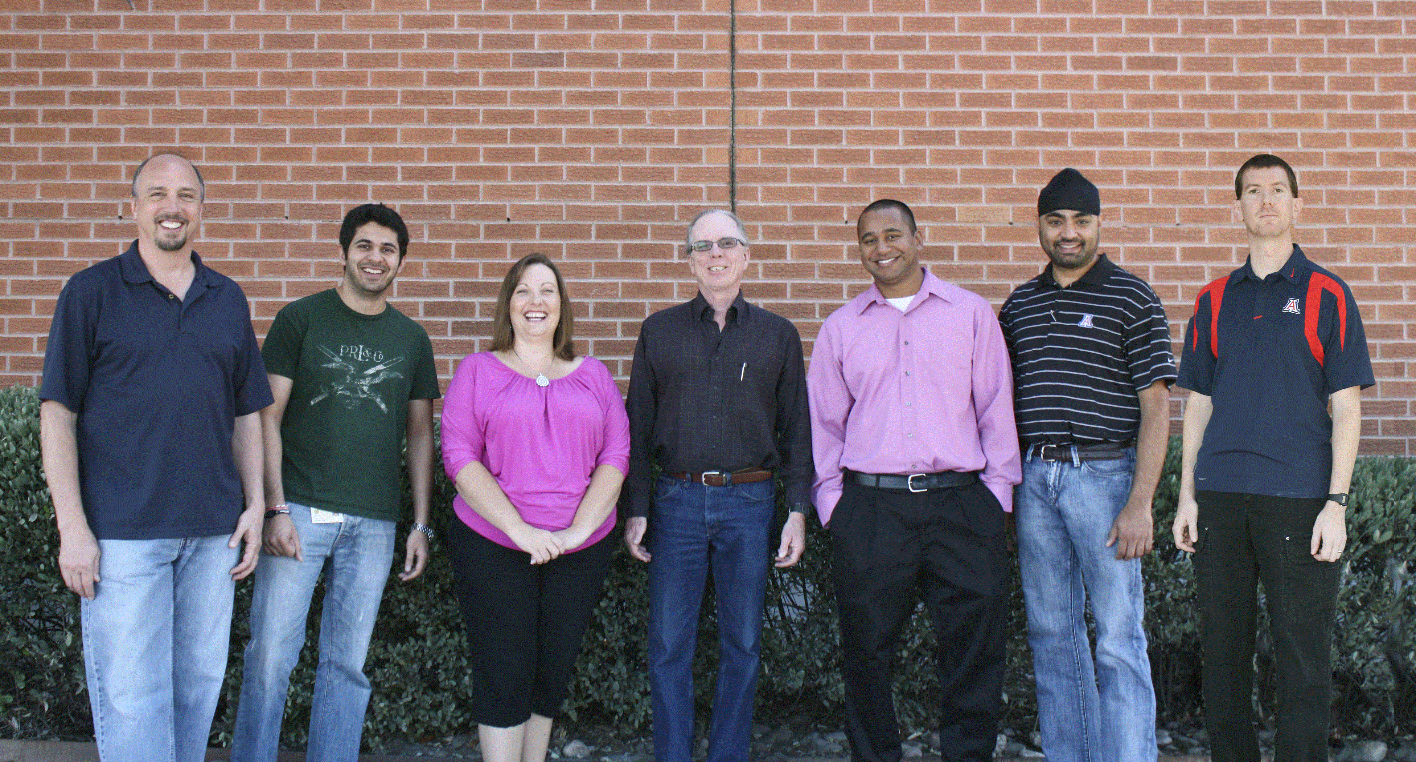
EIA LEADERSHIP TEAM
10
Notes:
Put a human face on things—EIA leadership team…
Interesting to see where people came from
Steve—Outreach, hired by Mosaic project as a professional trainer
Manav—ETL, hired by project
Rachel—part of legacy DW team, previously in IR
Hank—Mosaic project director…old guy in the middle
Dimuthu—from Chemistry Dept
Simran—from HR decision support
Doug—from Financial Services Tech Team
All but one some prior UA connection, either employee or student
Half had prior DW experience
All are smart, hard-working, imaginative, sometimes silly, determined

Slide 11
EIA MISSION
“We are Enterprise Information & Analytics.
“We construct and reconcile integrated information in order to provide open access to trusted data for campus consumption. We advocate the use of business intelligence in operational reporting and strategic decision support. We measure our success by our customers' successful use of and continued interest in our product.”
(http://www.eia.arizona.edu/)
11
Notes:
EIA conducted a facilitated planning process about 2 years ago.
Mission statement consciously expresses our values.

Slide 12
EIA PROVIDES REPORTING
Operational Reporting for Enterprise Systems
Management Reporting
Strategic Reporting
12
Notes:
While it varies for each Pillar, we can see that EIA provides probably 80% of the operational reporting for the UA.
PeopleSoft provides some transaction-based reporting capability—we make some use of PS/Query.
Kuali provides no reporting capability, so it’s all provided out of the BI environment.
Note that Space, which is shown here, is comparatively a very small system. BTW, we use Archibus.

Slide 13
RESPONSIBILITIES
Systems Administration for Repository, OBIEE, DataStage (but not Database)
ETL design & development
Analysis, design & development of subject areas, aka dimensional models
Design & development for central dashboards/reports
Support design & development of dashboards/reports by colleges/departments
Support connections w/departmental systems
13
Notes:
Some of these responsibilities are usual, but some perhaps not
Interesting to note boundaries between EIA and:
Tech Infrastructure team
Applications team
Colleges and departments

Slide 14
EIA REPORTING STRUCTURE
14
Notes:
EIA reports directly to the CIO, but it is not part of the IT organization.
IR reports to the Vice Provost for Academic Affairs.
EIA is consciously positioned to sit between the IT organization and the IR organization, closely related to both but separate.

Slide 15
EIA ORGANIZATIONAL CHART
15
Notes:
Technical component = Sys Admin & ETL teams
Analysis component = Business & Student & Research+ teams
Support component = Outreach
Heads of these 6 teams and I constitute the EIA Leadership team
Note that there are 3 jointly funded positions. We may see more of this.
Note some see this as messy, which it can be, but I see it as reflective of the collaboration.

Slide 16
ARCHITECTURE & TECHNOLOGY
16

Slide 17
BI ARCHITECTURE OVERVIEW
17
Notes:
Probably few surprises here…
We use IBM DataStage as our ETL tool. (Currently on Version 8.5, with last bit of 7.5 being converted.)
We “stage” the source systems by bringing “copies” of the transactional system tables in as the first step.
Then we transform, often in multiple steps, into the dimensional models.
We use OBIEE as the tool both for centrally produced dashboards and reports, and also for self-service.
We also provision access into the data warehouse by other systems, often departmental systems.
In all cases we “register” these usages, and provide specific views to allow us to manage them pretty tightly.
We try to counsel departments away from doing downloads, and instead to stay “behind the firewall.”
We try to be helpful in this regard to make this an easy choice.

Slide 18
TECHNOLOGY
18
All servers use RedHat Ent. Linux 5.8
Notes:
Offered here primarily for reference.
This is a pretty beefy setup.
We share the RAC with the transactional system databases.

Slide 19
DATA INTEGRATION
19
All servers use RedHat Ent. Linux 5.8
Notes:
Also offered primarily for reference, at least at the detail level.
At the overall level, we see that the warehouse plays a very important role from an integration standpoint.
It functions as a reference data hub.
The direct system to system interfaces are almost all transactional feeds.
When System A needs reference info from System B, it gets it thru the data warehouse.
Very very few cases where we permit System A to directly access the database in System B.

Slide 20
DASHBOARD EXAMPLES from UACCESS ANALYTICS
20

Slide 21
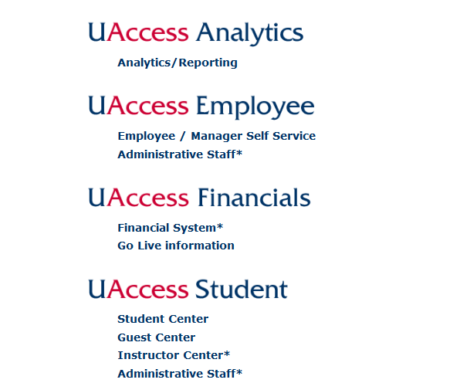
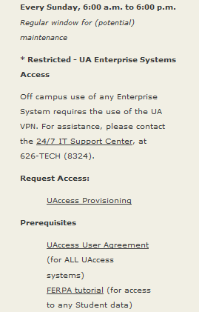
UACCESS LANDING PAGE
21

Slide 22
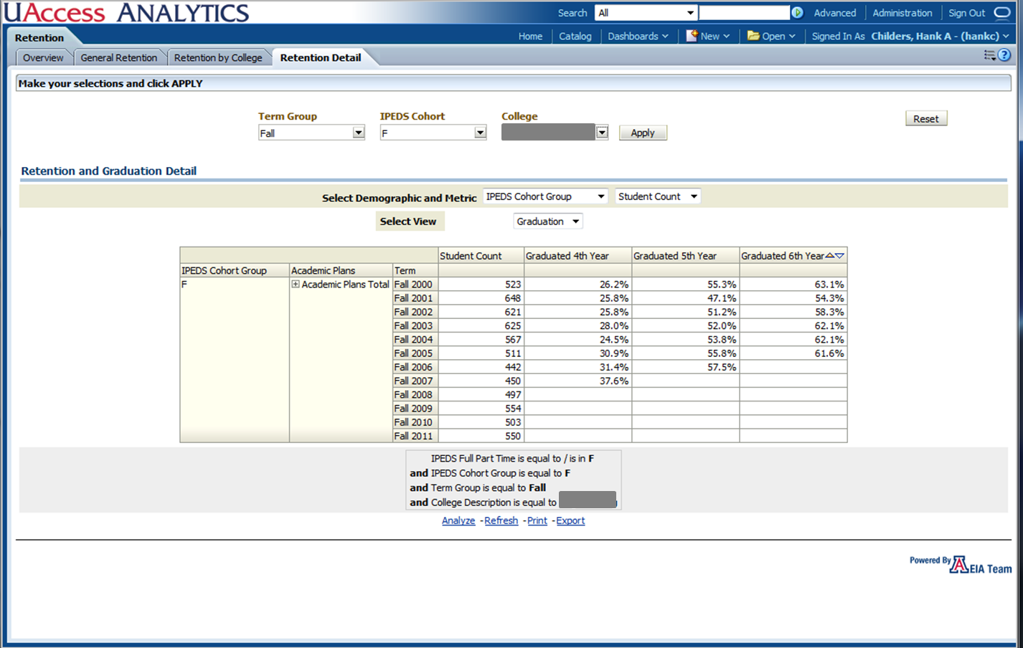
GRADUATION RATE
22
Notes:
This dashboard looks innocent enough on the surface.
But it supports analysis of student cohorts.
Exploits some new features in OBIEE, and allows users to organize and drill down to the student level.
It helps answer questions about the fate going forward of a given student cohort.
In the future, we will look backwards and be able to ask questions about where a given student cohort came from, to speak.
This was the #1 need as cited by the Deans.

Slide 23
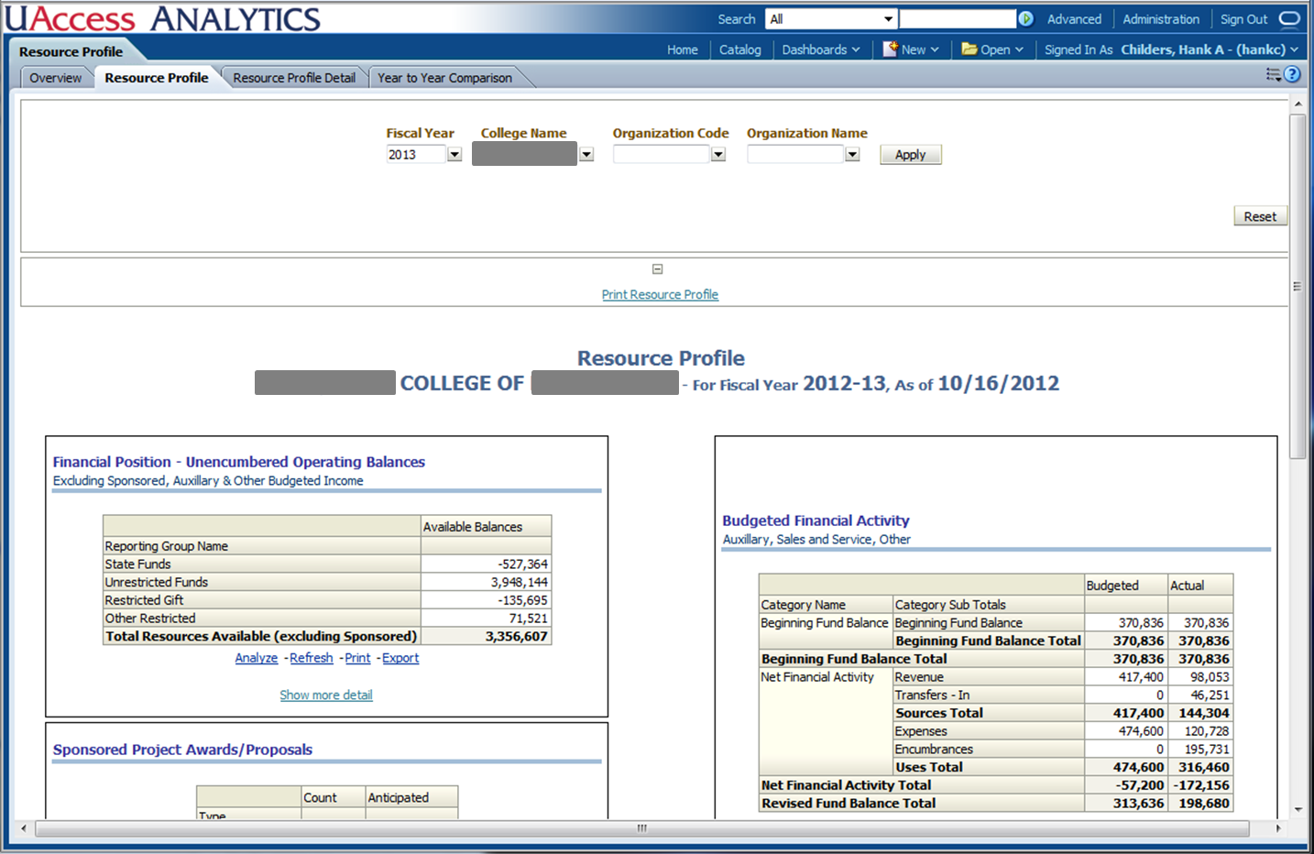
RESOURCE PROFILE 1
23
Notes:
Another new capability….
This dashboard links a number of different kinds of information for a snapshot look at any organizational unit to show the full set of resources available.
It links:
Financial
Budget
Employee
Research
Endowment

Slide 24
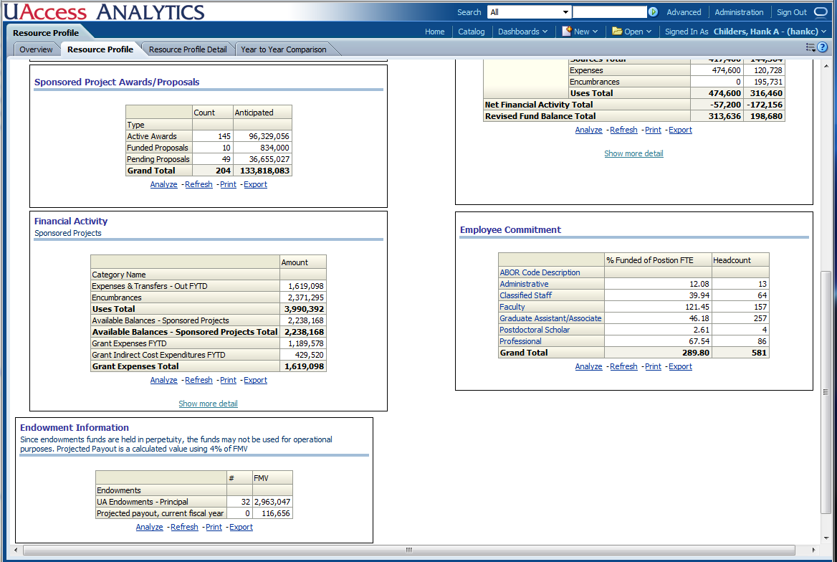
RESOURCE PROFILE 2
24
Notes:
Continuation of previous slide….

Slide 25
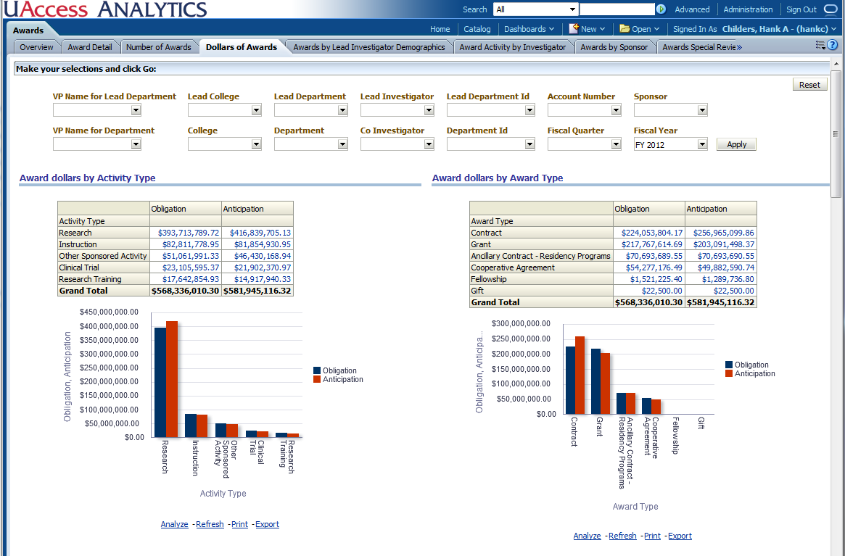
AWARD DOLLARS
25
Notes:
This dashboard, also a rich set of information brought together, but only showing the first slide.
It shows financial aspects of Research Awards.
We want/need to do more in terms of graphical display, and this dashboard is trying to get going in that direction.
By accident (I think) the auto-generated colors happen to be the UA colors.

Slide 26
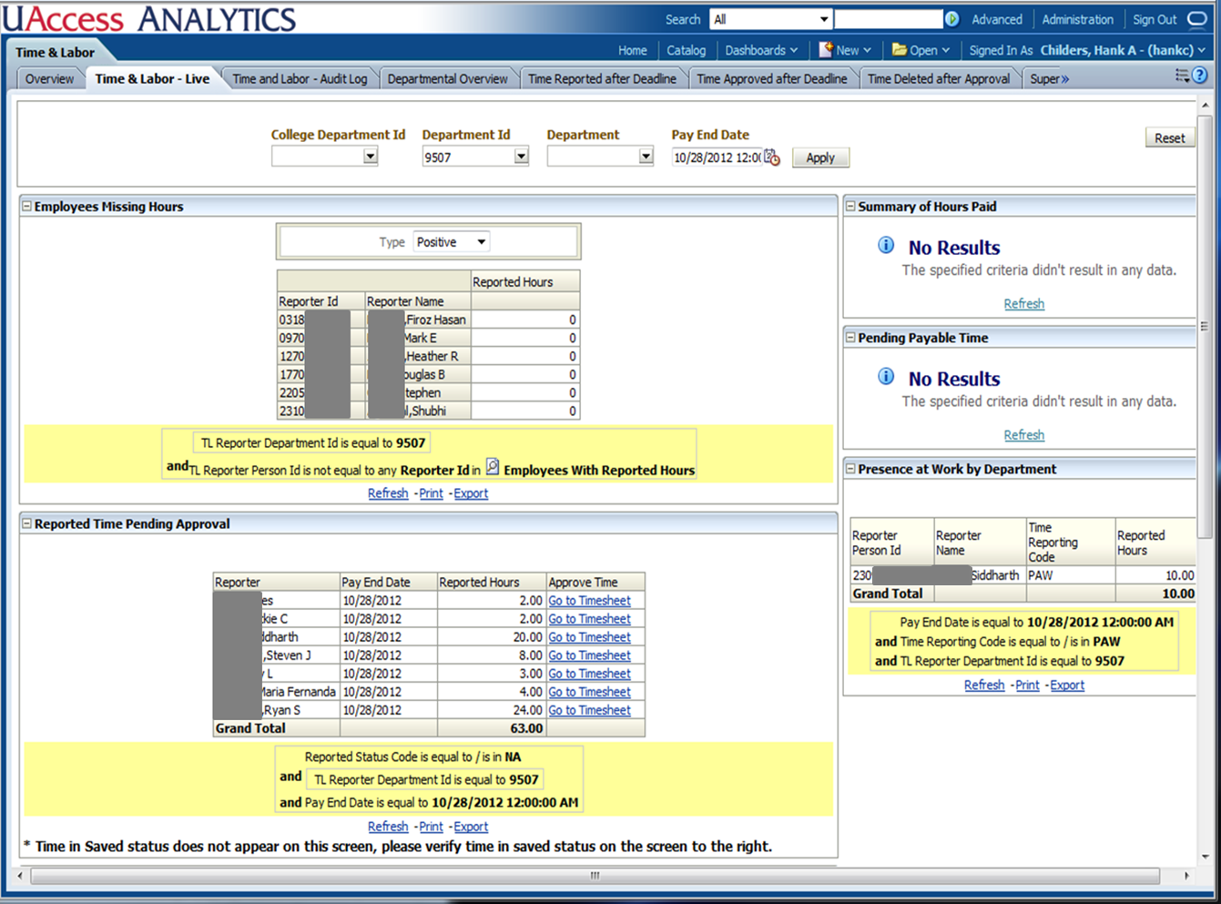
TIME & LABOR
26
Notes:
This is one of our oldest dashboards.
We don’t do it often, but this dashboard drills directly into the transaction system.
Its purpose is to help in the time approval process as part of the payroll cycle.
PeopleSoft is fairly rich in this regard, but this was added, and is a pretty popular dashboard.

Slide 27
METHODS & MADNESS
27

Slide 28
DASHBOARD DEVELOPMENT
Initially focused on operational reporting, then some management reporting, and later strategic reporting
Note that operational reporting delivered using dimensional models (sometimes quasi-dimensional)
HR & Student – used some delivered content, but evolved away
Financials – attempted a requirements-based approach
Research – essentially new capability…from scratch
Strategic
Management
Operational
28
Notes:
Operational = conducting the business (often day to day)
Management = overseeing the business (often monthly or annually)
Strategic = planning the business with an eye toward changine
These 3 layers form a rough continuum with a lot of gray in between
Found it useful in a few important cases to create quasi-dimensional models which are a hybrid of dimensional models and flattened reporting models, e.g., employee profile, student profile, etc.
HR & Student – used some delivered content, but evolved away
Started with some delivered ETL & dimensions
Delivered ETL did not handle deletes
Overall inexperienced team with a few veterans and consultant guidance at the outset on the functional side for HR
Financials – attempted a requirements-based approach
Specified 200+ reports based on analysis of 1000 previous system reports
Quickly moved to an iterative rapid turnaround approach
Spec’s did not represent broad campus needs, despite our efforts
Research – essentially new capability…from scratch
Iterative approach working closely with Sponsored Projects

Slide 29
DEVELOPMENT MUSINGS
Implemented subject area is the prize asset
Requirements/Specification-based approach not effective
“Build it & they will come” depends on experience/judgment
We don’t have dedicated data modelers
If subject area is in place, dashboards & reports can be developed and changed on the fly & we do this
Analysts are empowered to design & build in pilot (speculative) mode
Projects are best managed by something between “agile” and “iterative”
29
Notes:
Requirements/Specification-based approach not effective
- Spec’ed 200+ reports from previous system 1000+ reports
Built to spec and then immediately started changing pretty significantly
Subject areas did hold up well
Changes made using an iterative approach
We don’t have dedicated data modelers
Core project team = Analyst/PM + ETL specialist + SME (i.e., customer or proxy)
Dimensional model developed/owned jointly by Analyst & ETL specialist
If subject area is in place, dashboards & reports can be developed and changed on the fly & we do this
We apply rigorous change management to the dimensional model, but typically not to the dashboard/report
Analysts are empowered to design & build in pilot (speculative) mode
- Not so much “build it & they will come” as it is experimentation and demonstration

Slide 30
TRAINING, COMMUNICATIONS, SUPPORT
Workshop Training
Online Training
EIA Website
Analytics Community – Discussion forum with 800 subscribers
Super-Users – Cross campus group
Outreach support for colleges/departments
30
Notes:
Workshop Training
Typically 3.5 hours in length, with professional instructor (part of EIA team)
Beginning, Intermediate, and Advanced versions, in UA context
Delivered to 2300+ attendees to date
Online Training
Online versions of most of the above training, delivered via Oracle UPK
600 sessions by 100 users to date
EIA Website: http://eia.arizona.edu
Analytics Community – Discussion forum with 800 subscribers
Very active; 24-hour response rule, typically under an hour
Weekly news posting
Additional UA-created, process-specific documentation and videos
Super-Users
Cross-campus, designated experts at go-live, e.g., major upgrade
Outreach support for colleges/departments
College/Department presentations; onsite small group work sessions
Office hours

Slide 31
ACCESS AUTHORIZATION
Viewed as [Level of Access] X [Pillar]
Managed via workflow request & approval
Some limited exceptions to this structure
Note—no row-level security at this time
31
Notes:
“Low” targeted at individual users; summary level data; automatic provisioning
“Medium” targeted at those with an identified responsibility for functions and/or areas; detail level data; provisioning based on recommendation & approval
Note that Medium is both controlled (business need) and widespread (e.g., business manager)
“High” targeted at specific sensitive functions, e.g., Benefits Admin
Lack of row-level security implies & promotes transparency across the institution (you can see my data)
Also avoids what can be a very difficult-to-administer program

Slide 32
COMMON DATA
32
Notes:
Each of our pillar projects uses or even has its own copy of what might be called “master data” or “common data”.
This applied to:
EmplID (used for employees and students)
Account Number
Building Number
College/Division
Department
Etc.
Our goal with “common data” was that these items would have the same meaning and the same identifiers.
Note—this seems obvious, but required significant cross-unit attention to make it come true
Org hierarchy was especially challenging.
This chart shows how pillars can have different levels in their own hierarchies, but that they must conform at certain key levels:
Overall (maybe ‘campus’ in the future’)
College/Division
Official Org (aka department)
We have an initiative underway to move to even more of a “master data management” approach to this.

Slide 33
MISCELLANEOUS METRICS
33

Slide 34
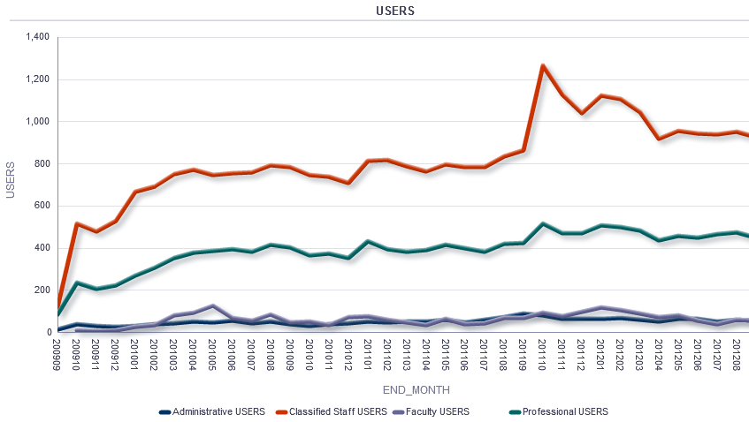
DISTINCT USERS by TYPE of USER
Financials Go Live
Student Go Lives
HR Go Live
34
Notes:
Graph covers 3-year period
Big jump at HR go-live
Increases over successive Student go-live
Big spike at Financials go live, then a tapering off
Attribute to curiosity and possibly confusion over what people now needed to do their job

Slide 35
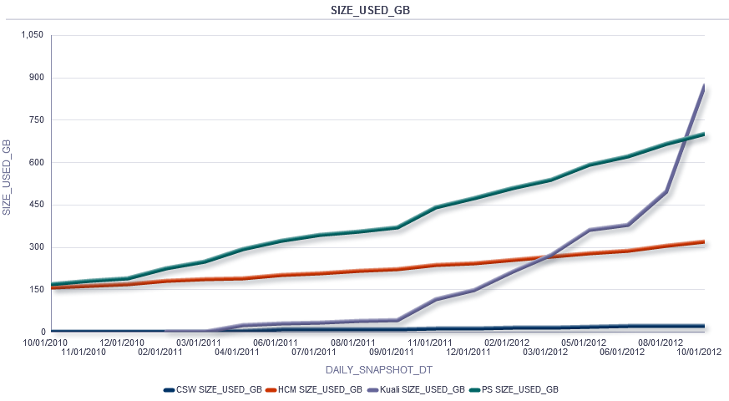
DB SPACE UTILIZATION by PILLAR
Financials Go Live
35
Notes:
Graph covers 2-year period
Steady and gradual growth for HR
Steady and more aggressive growth for Student
Explosive growth for Financials

Slide 36
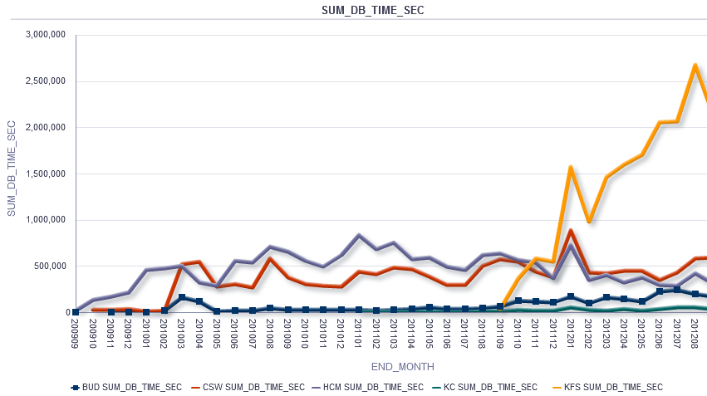
DB QUERY-SECONDS by PILLAR
Student Go Lives
Financials Go Live
HR Go Live
36
Notes:
Graph covers 3-year period
Really shows the load on the DB
Increases at HR and Student, then fairly steady and some decline (attribute to efficiency gains, both technical and people)
Dramatic increase with implementation of Financials
Note – Financials is currently ¾ of the load…so the go-live meant a quadrupling of the DB load

Slide 37
ADDITIONAL METRICS
600 distinct users per day
1500 distinct users per month (goal 2500)
20,000 queries per day (as measured by DBMS)
60 community posts per week
3000 tables in warehouse
Average query response
HR & Research: 4 seconds
Student & Financial: 13-14 seconds
Note: Timeout set at 3 minutes
Data Warehouse size: 2TB+
Top 10 Pages
Financial & Budget: 8
Business Manager Home Page: 2
37
Notes:
Richest offerings are Employee, Financials, & Student
EIA team also is an aggressive user
Topped 2000 users per month at one point when Financials went live…settled down at this point
Average query response
HR & Research: 4 seconds
Student & Financial: 13-14 seconds
Note: Timeout set at 3 minutes
We want to improve on these response times…expect to set a target, e.g., 90% within 10 seconds
Data Warehouse size: ~2GB
Top 10 Pages
Financial: 8
Business Manager Home Page: 2
Very operational in terms of volume, but that’s different than value

Slide 38
WHERE WE ARE TODAY
38

Slide 39
EVOLVING FOCUS
FTE
Projected Changes
Strategic +200%
Management +50%
Operational -40%
Reactive -40%
Basic -5%
39
Notes:
This is the year where we move out of mainly operational reporting into significant strategic reporting.
Management reporting is built on a foundation of operational reporting, and strategic reporting on top of that.

Slide 40
INITIATIVES
Additional data sources
- Internal
- External
Dean’s Dashboards
- Asked deans: “What do you need to know in order to run your college?”
Resource Profiles
Performance Metrics
Seat Projections
40
Notes:
Additional data sources
Internal, e.g., Space, Individual Student Degree Plans, Foundation, Alumni
External, e.g., NIH
Dean’s Dashboards
Asked deans: “What do you need to know in order to run your college?”
Top categories: information about Student Cohort (longitudinal), Financial Management, Enrollment, Faculty Activity, Graduate College, Research
Resource Profiles
Performance Metrics
Arizona Board of Regents mandated measures
UA-specific measures
Unit level
Seat Projections

Slide 41
CHALLENGES
Expectations and demand are very high
Transition from “operational” to “strategic”
What dashboards are already available?
What data is available and what does it mean?
Performance…strain due to growth
Budget – UA under great budget pressure
Market – BI skills are greatly in demand
Common data, esp. Organizational Hierarchy
41
Notes:
Transition from “operational” to “strategic”
Reactive vs. Proactive
Leadership, methodology, partnership
What dashboards are already available?
Need more effective “catalog”
What data is available and what does it mean?
Need to invest more in “metadata”…currently rely on examples & support
Performance…strain due to growth
ETL: ETL server upgrade, targeted ETL redesign
Query: DB tuning, targeted model redesign
Budget – UA under great budget pressure
Market – BI skills are greatly in demand
Common data, esp. Organizational Hierarchy
Moving towards Master Data Management approach

Slide 42
GOVERNANCE
UA-Wide Executive
Cross-Pillar, e.g., Common Data
Pillar-Specific, e.g., Student
Data Stewards,
e.g., Financial Aid
42
Notes:
Data Stewards at Sub-Pillar level, e.g., Financial Aid, Payroll
Access Authorization
Data Quality
Governance bodies and/or advisory groups at the Pillar level, e.g., Student, Financial, etc.
Advice and priority management within Pillar
Cross-Pillar working group around Common Data
E.g., Organizational Hierarchy
Data administration function
Dean’s Dashboard (partnership with Provost’s Office & Institutional Research, along with Deans)
University-wide BI Governance (BIG) group being set up to replace Mosaic Executive Steering
Roadmap
Priorities & Scope
Policies & Issue Resolution

Slide 43
LOOKING BACK / LOOKING FORWARD
43

Slide 44
LOOKING BACK
Lot of ground in a short period of time
Underestimated effort and issues involved in delivering operational reporting within the BI framework
Mindful of the significant investment in BI (~$10M over 5 years)
Conscious emphasis on “soft side”
We are the face of data even as we are not the owners
44
Notes:
Lot of ground in a short period of time
Team maturity is significant and hard-won
Underestimated effort and issues involved in delivering operational reporting within the BI framework
Mindful of the significant investment in BI (~$10M over 5 years)
Conscious emphasis on “soft side”
Training, Communications, & Support for Users
Relationships with Customers
Partnership with other units, especially IR and IT
We are the face of data even as we are not the owners
Leadership role to play in data quality & data usage issues
We are not allowed to say “not my problem”

Slide 45
LOOKING FORWARD
Rise of data analyst/data scientist
Data Visualization
Predictive Analytics
Clinical Research Data
Capacity Challenge
45
Notes:
Rise of data analyst/data scientist
We need them (recognize, develop, or hire)
We need to support them
Data Visualization
Toolset
Skill
Predictive Analytics
Seat projections
Student success
Clinical Research Data
Early stages of pilot project to build de-identified clinical research database using electronic medical records data and genomic data
Capacity Challenge
Technical Infrastructure will need to expand
Collaborative approach with other campus units

Slide 46
QUESTIONS?
46

Slide 47
CONTACT INFORMATION
Hank Childers
Senior Director, Enterprise Information & Analytics
The University of Arizona
hankc@email.arizona.edu
520-626-6779
http://www.eia.arizona.edu/
47

