Slide 1


Scaling a Higher Education Enterprise
Electronic Content Management (ECM) System
Presented by Texas A&M University System
November 9, 2012

Slide 2
About the Texas A&M University System
Judith Lewis
One of the largest systems of higher education in the nation
In the statewide network
  11 universities
  Seven state agencies
  A comprehensive health science center
A&M System members
  Educate more than 120,000 students
  Reach another 22 million people through service each year
  Include more than 28,000 faculty and staff
  Has a physical presence in 250 of the state’s 254 counties
  In 2011, externally funded research expenditures exceeded $780 million to help drive the state’s economy

Slide 3

Texas A&M AgriLife
Bob Hensz
AgriLife’s Organizational Structure
  Vice Chancellor of Agriculture
  College of Agriculture and Life Sciences
  4 state agencies
  85 major units and 250 County Offices

Slide 4
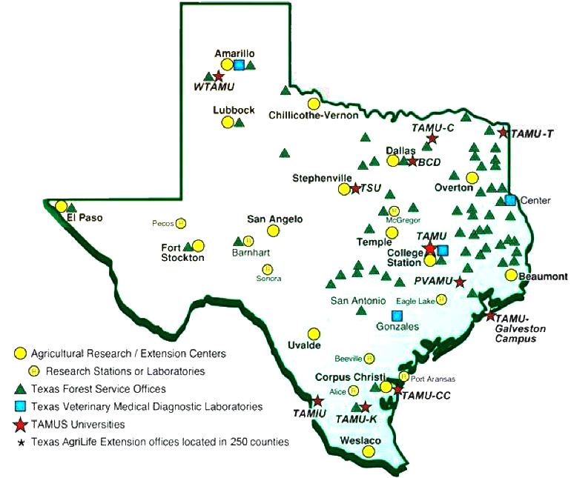
Texas A&M AgriLife Locations
Bob Hensz

Slide 5
Texas A&M AgriLife
Bob Hensz
RFP and Implementation
  RFP in 2005
  RFP Team included IT, Economist, College Department and Agency personnel,
  and Purchasing
  Selection matrix: cost a major factor
  Implementation used same team, and added some additional personnel for testing
  Phased Implementation
    Phase 1: basic installation, file structure and imaging
    Phase 2: automation from main frame
    Phase 3: workflow
Automation Examples
  Accounts Payable Data forms for purchase vouchers: printed, matches, and filed
  Payroll change forms: printed, overlay applied, metadata added, filed
    Purchase Orders, Printed, overlay applied, metadata added, placed in working folder
  Use of Inboxes: move a document from one unit to another instantly

Slide 6
Texas A&M AgriLife
Bob Hensz
ROI (as of December 2010)
  Overnight Mail: eliminated 58/week
  Copies: eliminated 23,335 copies per week, and eliminated copiers
  5-Drawer File Cabinets: eliminated 158, over 1000 sq. ft. of space
  Rotary File cabinets: 21, about 344 sq. ft.
  Positions eliminated: 2 budgeted & 4 student workers in accounts payable
  Automation: saved over 8000 man hours/year for filing
  Automation: also saved printing of over 200,000 pages per year
  Volume of documents: over 14 Million pages, stack 2800 ft. high
  weighing over 80,000 pounds

Slide 7

ECM as a Shared Service
Judith Lewis
History
  Campus Document Management Committee
Vision
  Making institutional information secure and useful
Goals
  Avoid software/hardware purchases at department level
  Reduce costs by eliminating redundant systems
  Enhance ability to share documents and workflows

Slide 8
Benefits of a Shared Service ECM
Judith Lewis
Notes:
Opportunity to leverage experience and skill sets
Access to wider pool of resources
Conventions and Best Practices – Agile: “Do it incrementally.”
Steering Committee
TAMU User Community of Practice
Professional Support and Training
Educational outreach (training, website, user groups, etc.)
System-wide collaboration
Document sharing
Facilitated workflow
Leveraging legacy systems
Shared experience
Contracts management
Promotion and Tenure process
Route within a department
Within a college
To the President
Board of Regents
And back

Slide 9
Coburn’s Qualitative Aspects of Scaling
Judith Lewis
Spread
  Conventional connotation of scaling (more units, more modules)
Depth
  Participative social interaction
Sustainability
  Underlying momentum taking hold
Shift
  Change in ownership
-- Coburn, C.E. (2003). Rethinking Scale: Moving beyond Numbers to Deep and Lasting Change.
Educational Researcher, 32(6), 3-12.

Slide 10
Vendor Maturity Model Approach
Judith Lewis
ECM Maturity Model
  Localize best practices
  Standardize across the institution
  Consolidate
  Cost benefits realized
  Continuous review for quality improvements
-- Laserfiche, (2010). ECM Agility for Higher Educations: Harnessing Technology to Achieve Institutional Efficiency and Responsiveness.

Slide 11
Leveraging an ECM Maturity Model Approach
Judith Lewis
Gartner’s ECM Maturity Model: Five Levels
-- Maturity Model for Enterprise Content Management, Gartner, 2011, ID # G00213197.

Slide 12
Gartner’s Six Factors Maturity Model Approach
Judith Lewis
  -- Maturity Model for Enterprise Content Management, Gartner, 2011, ID # G00213197.

Slide 13
Level 1: Initial
Judith Lewis
Level 1 facets:
  Each installation a silo
  Multiple contracts with the same vendor
  Multiple vendors for the same service
  Multiple systems
Looking to the next level:
  Create an ECM program
  Establish IT governance to bridge information gaps

Slide 14
Level 2: Opportunistic
Judith Lewis
Level 2 Facets:
  Use becomes part of business processes
  Opportunity to consolidate – Document Selection Committee (2009)
Looking to the next level:
  Itemize checklist of needed features and functions
  Consolidate vendors
  Choose ECM for strategic purposes
  Organize governance efforts into a steering committee

Slide 15
Level 3: Organized
Judith Lewis
Level 3 Facets: Selection of Laserfiche (2010)
  Shared Services Initiative (2010)
  Steering Committee and Project Manager (2011)
  ECM team has long-range plan; but, organization still has multiple products and repositories
Looking to the next level:
  Report ECM progress regularly to build support (branding/communication effort)
  Survey organizational metadata schemas/ requirements (training, education, collaboration)
  Work with colleagues to better align ECM and BPM by re-engineering processes (collaboration)

Slide 16
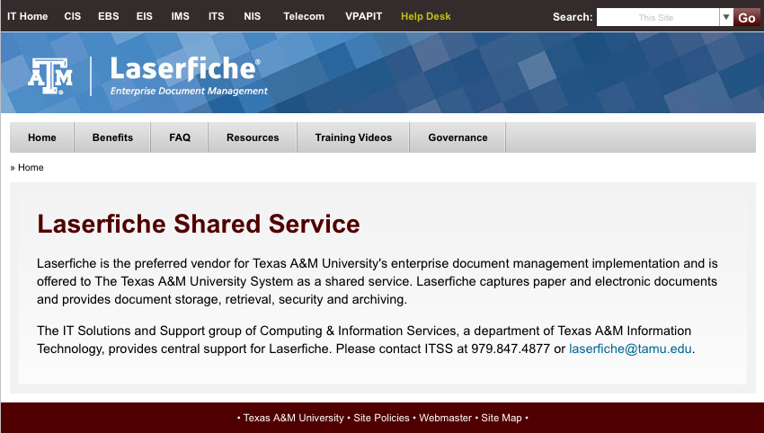
Shared Service
Judith Lewis

Slide 17
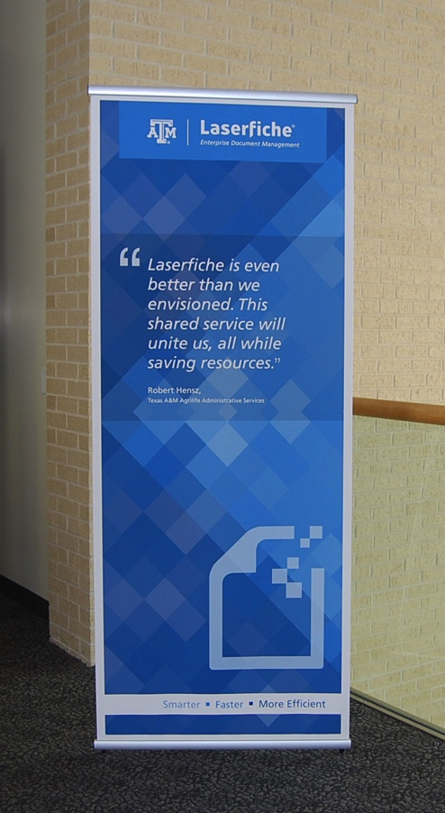
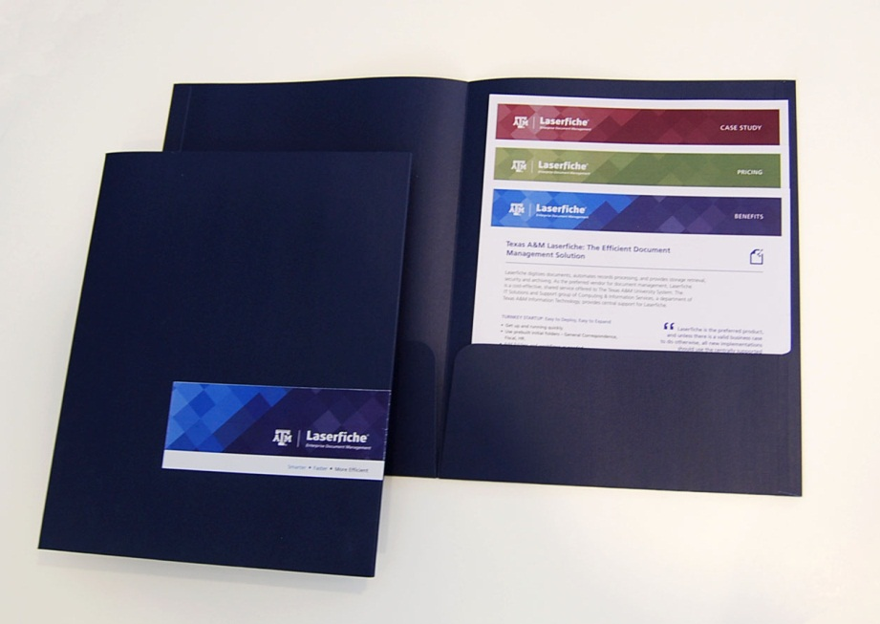
Branding for Texas A&M Laserfiche
Judith Lewis

Slide 18
Level 3: Organized
Judith Lewis
Level 3 Facets: Selection of Laserfiche (2010)
  Shared Services Initiative (2010)
  Steering Committee and Project Manager (2011)
  ECM team has long-range plan; but, organization still has multiple products and repositories
Looking to the next level:
  Report ECM progress regularly to build support (branding/communication effort)
  Survey organizational metadata schemas/ requirements (training, education, collaboration)
  Work with colleagues to better align ECM and BPM by re-engineering processes (collaboration)

Slide 19
Level 4: Enterprise
Judith Lewis
Level 4 Facets:
  Multi-server, Multi-User
  Metatagging is automated
  Better leverage of the Steering Committee for establish enterprise policies and practices
  ECM team consolidates overlapping projects
Looking to the next level:
  Goal of making the organization more agile: Look for ways to adopt new technologies and new sources of content

Slide 20
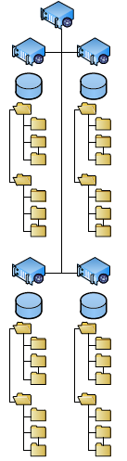
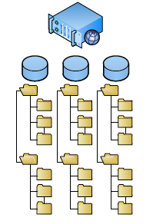
Enterprise Shared Service Model
Judith Lewis
Single Server to Multiple Servers
--Diagram provided courtesy of Laserfiche

Slide 21
Level 4: Enterprise
Judith Lewis
Level 4 Facets:
  Multi-server, Multi-User
  Metatagging is automated
  Better leverage of the Steering Committee for establish enterprise policies and practices
  ECM team consolidates overlapping projects
Looking to the next level:
  Goal of making the organization more agile: Look for ways to adopt new technologies and new sources of content

Slide 22
Level 5: Transformative
Judith Lewis
Level 5 Facets:
  The organization uses ECM to change the way it does business
  Leveraging exemplar processes (ex. Contracts)
How to remain at the transformative level:
  Turn business and vendor partnerships into collaborations for future vision and planning (Master contract)

Slide 23
Coburn’s Aspects of Scaling
Judith Lewis
Spread (More units, More modules)
  Single server to multiple server implementations
  Five-year plan to scale the shared service initiative
Depth (Participation)
  Engagement/support of the shared service
  Success of the agency is tied to the success of the shared service
Sustainability (Momentum taking hold)
  Document Imaging Selection Committee decision
  Executive support
  CIS shared service focus on branding, training, collaboration, maturity model
  Steering Committee involvement
  User Community of Practice (in development)
Shift (Change in Ownership)
  Localized successes lead to shared adoption
  Spontaneous collaboration
-- Coburn, C.E. (2003).

Slide 24
Q & A:
Judith Lewis
Contact Information:
Texas A&M Information Technology
Computing and Information Services
Laserfiche Enterprise Shared Service
Judith H. Lewis, MS, PMP
Project Manager
laserfiche@tamu.edu
&
Bob Hensz, SPHR
Risk & Compliance Manager
Internal Management Review & Records Officer
Texas A&M AgriLife Risk & Compliance

