Slide 1
UMD Mobile Language Learning Group
Mobile Apps Initiative
©2008 Regents of the University of Minnesota. All rights reserved.

Slide 2
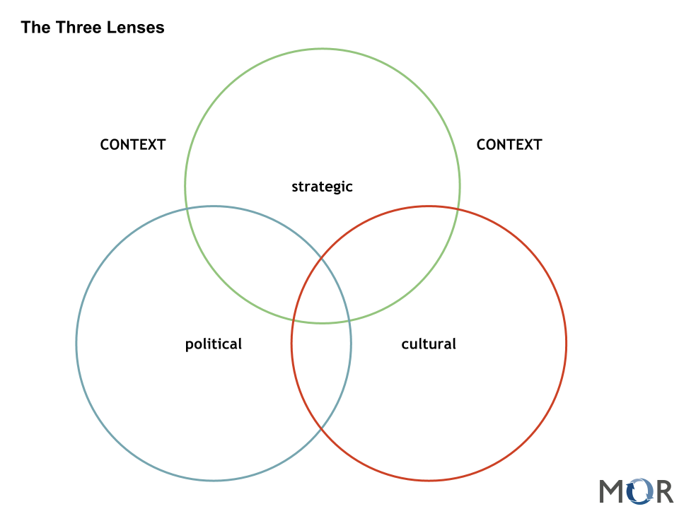
The World of Tri-focals
©2008 Regents of the University of Minnesota. All rights reserved.

Slide 3
The Beginnings of our initiative
Incorporating technology into foreign language and culture classrooms (FLL)
Tradition of technology in Foreign Languages Classroom
mobile devices: iPad, smart phones,laptops, e-readers
©2008 Regents of the University of Minnesota. All rights reserved.

Slide 4
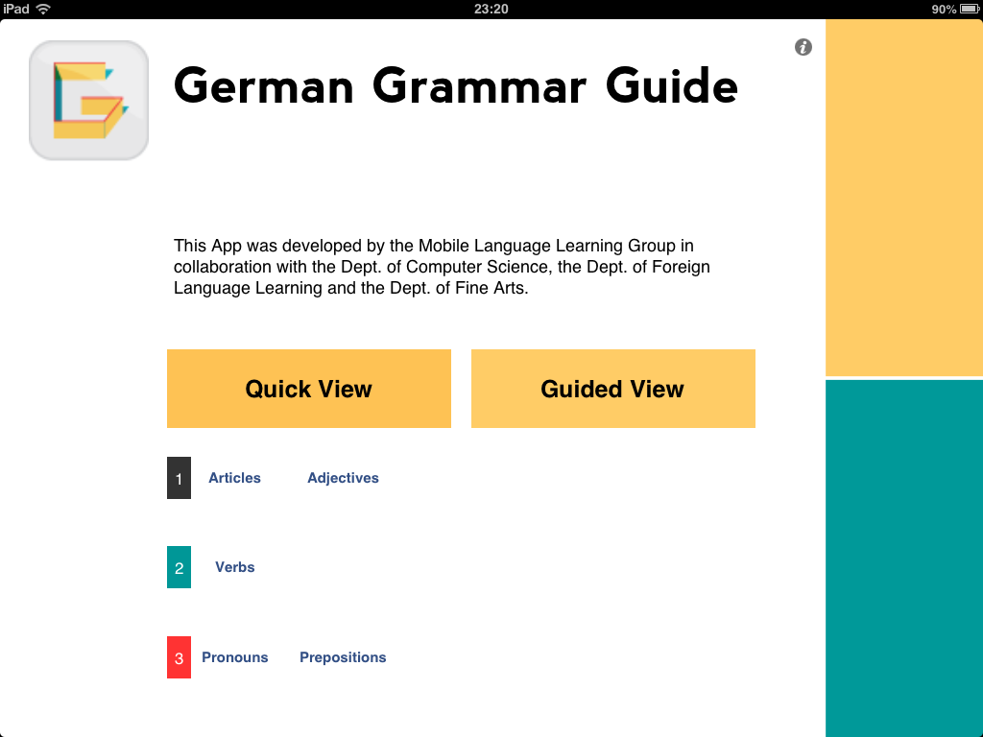
The German Grammar App
©2008 Regents of the University of Minnesota. All rights reserved.

Slide 5
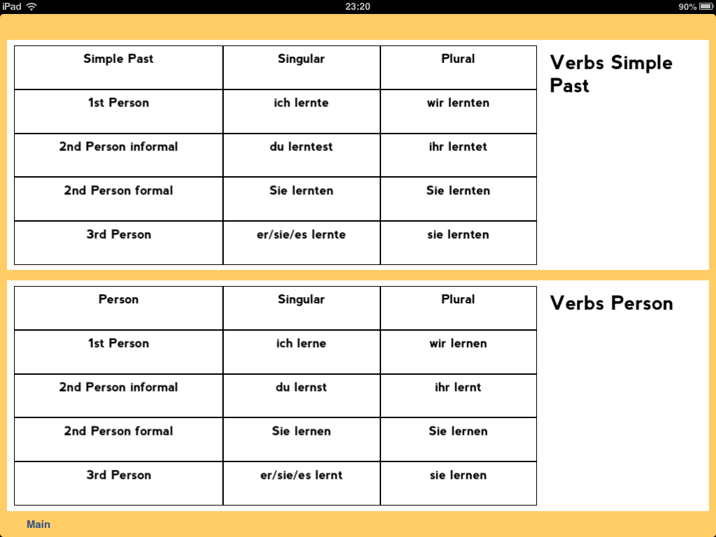
The German Grammar App
©2008 Regents of the University of Minnesota. All rights reserved.

Slide 6
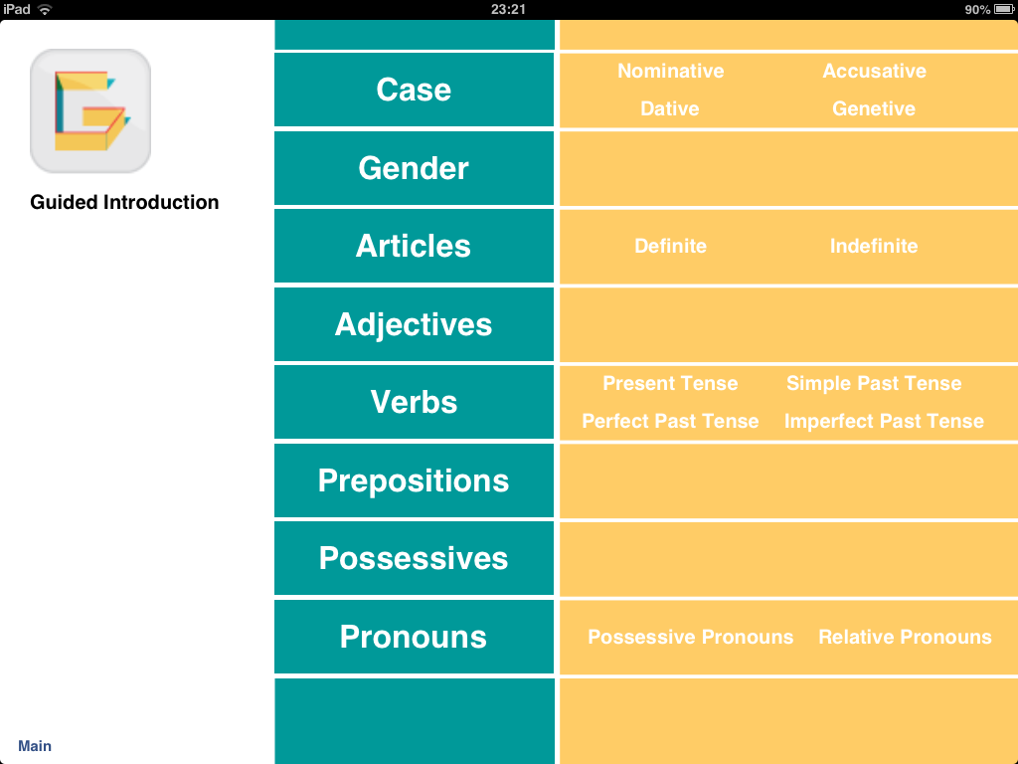
The German Grammar App
©2008 Regents of the University of Minnesota. All rights reserved.

Slide 7
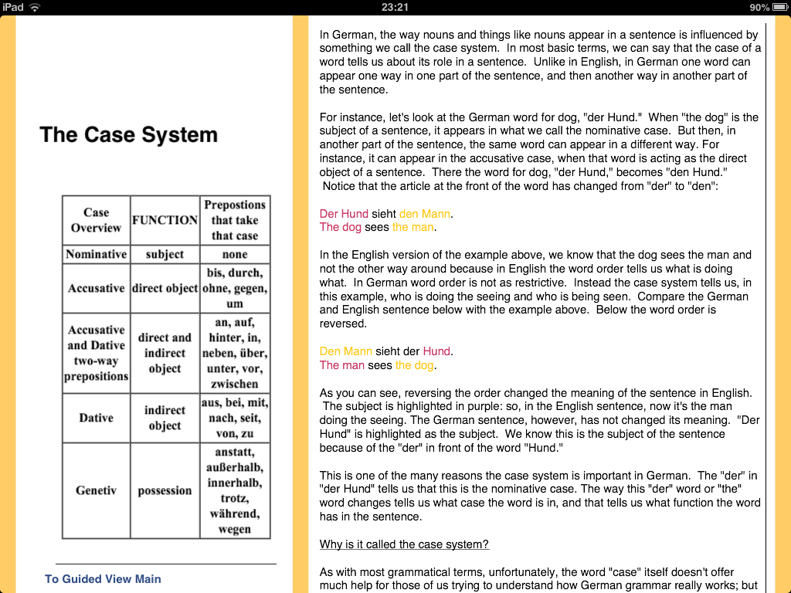
The German Grammar App
©2008 Regents of the University of Minnesota. All rights reserved.

Slide 8
A little context
In 2007, hybrid courses are a novelty
In 2009, instructors were granted the right to determine the delivery mode for their own instruction
In 2010, the arrival of mobile technology
©2008 Regents of the University of Minnesota. All rights reserved.

Slide 9
iPad Project #1
15 iPads were shared across three languages in spring 2010 courses
Issues: connectivity, unfamiliarity
Student feedback:
  (+) portability, quietness, intuitiveness, cool factor
  (-) virtual keyboard, class-time distraction, not a creation device
©2008 Regents of the University of Minnesota. All rights reserved.
Notes:
Spring 2010-Fall 2011

Slide 10
How the iPad was used in class
Story boarding:
  Doodle Buddy, MindMap HD,
Film editing/streaming:
  iMovie, Airvideo
Google Apps:
  books, forms (for student surveys), gmail
various other language specific apps:
  dictionaries, translators, lessons
©2008 Regents of the University of Minnesota. All rights reserved.

Slide 11
iPad Project #2
30 iPad 2s and a syncing/charging cart (caveat emptor)
  better vga connection
  new creative uses with camera
Corporate account for purchasing apps
Used in German, French and Spanish
  language, cinema, literature
  Skype, Dragon Dictation, iMovie, etc.
A shift toward creation
©2008 Regents of the University of Minnesota. All rights reserved.

Slide 12
iPad Project #2
Issues:
classroom deployment
wifi access points: number and location
continued funding
assessing outcomes
©2008 Regents of the University of Minnesota. All rights reserved.

Slide 13
iPad Project #3
A suite of FLL Apps to address our needs
  German Grammer App
  Study Abroad App
  Interactive Textbook App
  Pronunciation App
advantages
  UROP collaborative between colleges
Grants from across the UM system
©2008 Regents of the University of Minnesota. All rights reserved.

Slide 14
iPad Project #3
Issues:
mass purchase and installation of apps
mobility
costs
reluctant colleagues
©2008 Regents of the University of Minnesota. All rights reserved.

Slide 15
Recap of our story
I
growth of technology in FLL
broadened sense of collaboration: SFA, SCSE, CLA
student involvement: UROP
sharing our story beyond the University
©2008 Regents of the University of Minnesota. All rights reserved.

Slide 16
Overview:
German Grammar Guide App
French Pronunciation App
French Textbook App
Study Abroad App
©2008 Regents of the University of Minnesota. All rights reserved.

Slide 17
The Process
making the switch from user to creator
realizing the potential in collaborating across colleges
multidimensional learning, students learning new things on their own, faculty learning from students, faculty learning from faculty, etc.
©2008 Regents of the University of Minnesota. All rights reserved.

Slide 18
The Process…
The point:
making apps may seem complicated to
faculty or students, but for each part in the
process there’s someone, often a student,
on your campus with the skill set you
need, the enthusiasm, and some great
new ideas that you haven’t thought of yet.
©2008 Regents of the University of Minnesota. All rights reserved.

Slide 19
Our Focus: Mobile Language Learning…
Bringing the most wonderful aspects of tablet devices to solve problems for language learners and create new opportunities in foreign language curriculum development
Looking closer at the intersection of language pedagogy and the new capabilities introduced by mobile devices
©2008 Regents of the University of Minnesota. All rights reserved.

Slide 20
Pre-discussion prep:
At the end of this section, we would like to ask you to imagine how a new app, that doesn't exist yet, might help one of your faculty members solve a problem, get past a sticking point in the semester, or bring more enthusiasm to some part of some class. Is there some way a mobile device could alleviate that problem or create new chances for students to learn more, differently, more effectively, have more fun, etc...? Draw the app, and later we’ll ask you to explain what you have in mind.
©2008 Regents of the University of Minnesota. All rights reserved.

Slide 21
The German Grammar Guide:
German Grammar is complicated, and print version of the grammar table had just gone out-of-print…
Some faculty sat down, start drawing story boards, outlining how a German Grammar app might work on a mobile device.
New potential, new opportunities…
©2008 Regents of the University of Minnesota. All rights reserved.

Slide 22
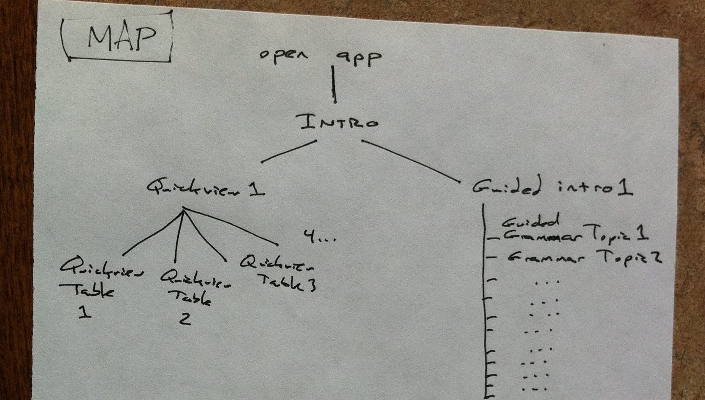
German Grammar Guide App:
Notes:
Fear factor, students learn faster when they’re not scared.

Slide 23
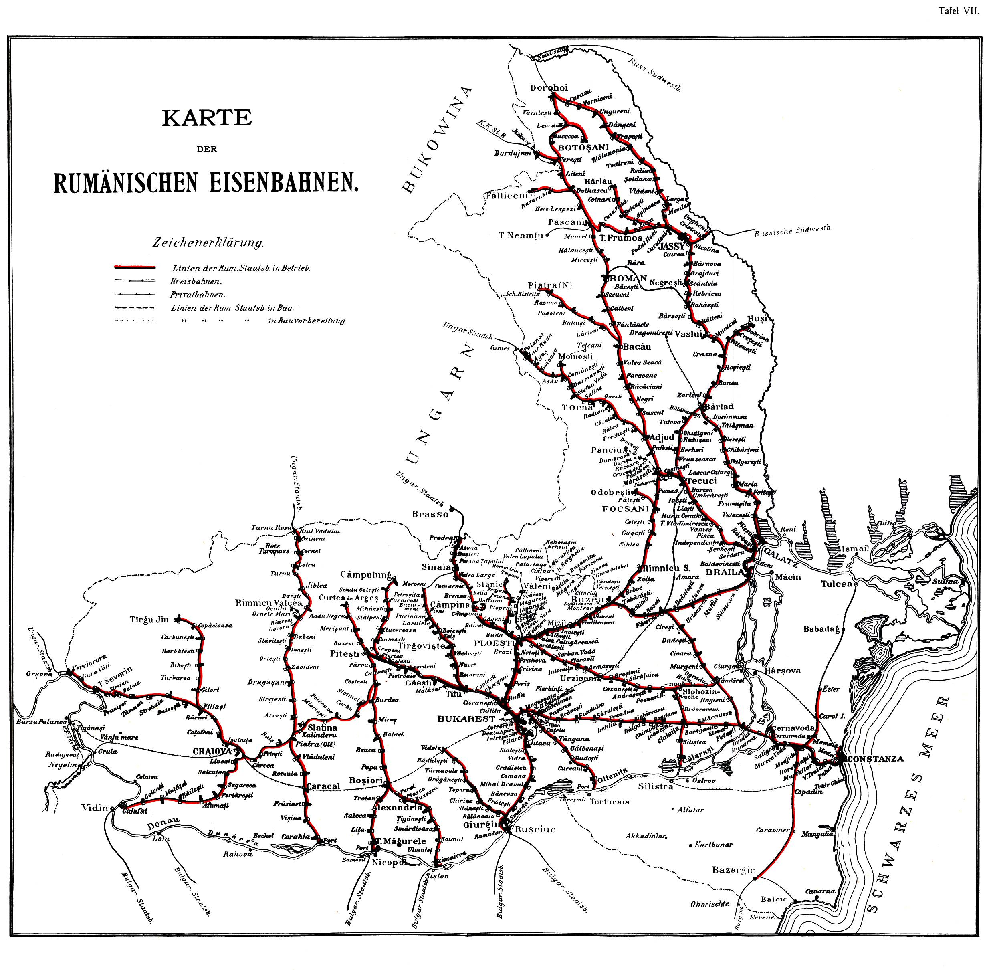
German Grammar is complex:
©2008 Regents of the University of Minnesota. All rights reserved.
Notes:
Visual approximation of the complexity of declension patterns for unpreceded adjectives

Slide 24
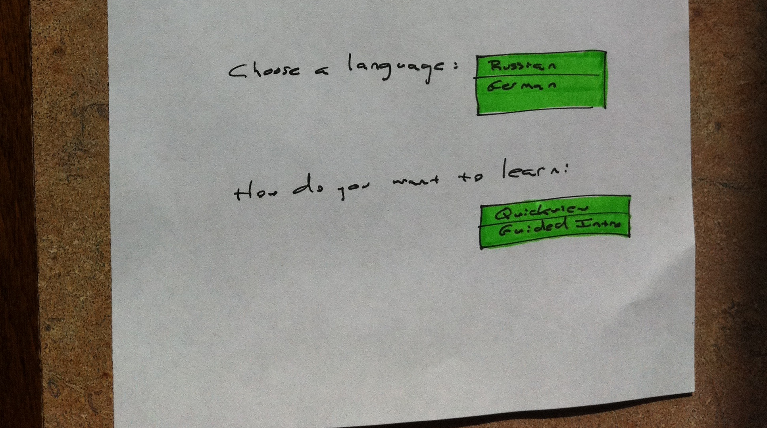
Dynamic presentation:
©2008 Regents of the University of Minnesota. All rights reserved.

Slide 25
The right pace…
Giving teachers and learners opportunities to work with complex grammatical issues at their own pace. Instead of data throttling, grammar throttling...
©2008 Regents of the University of Minnesota. All rights reserved.

Slide 26
The German Grammar App
[Switch to iPad display]
©2008 Regents of the University of Minnesota. All rights reserved.

Slide 27
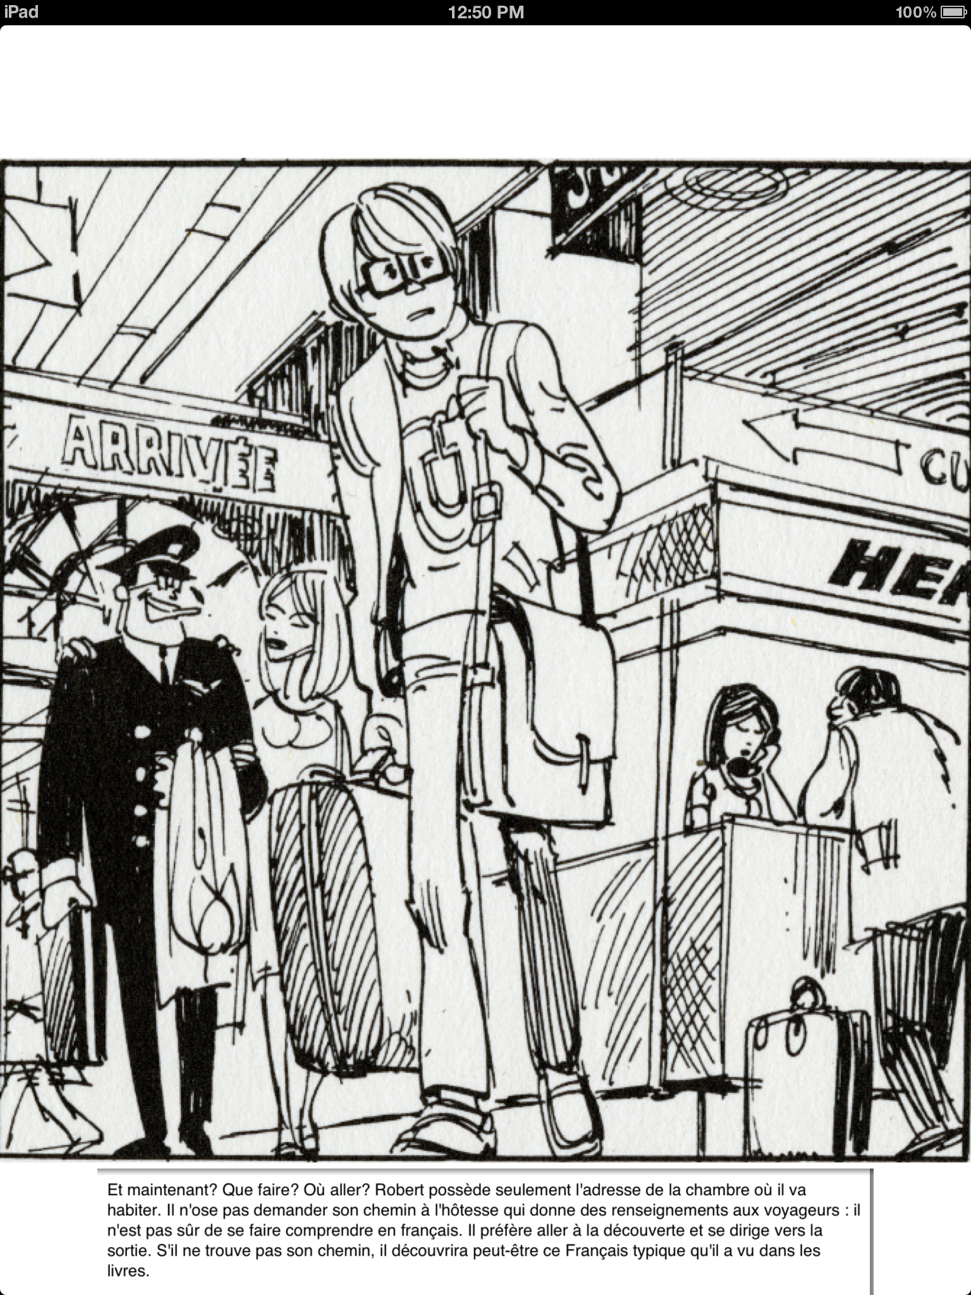
Interactive Textbook App
Comic book account
embedded vocabulary
“read it myself – read to me” functionality
embedded translator/dictionary
©2008 Regents of the University of Minnesota. All rights reserved.
Notes:
Thanks to an Apple buy-back program, this year we were able to swap out the initial first generation iPads for iPad 3s at a reduced price.

Slide 28
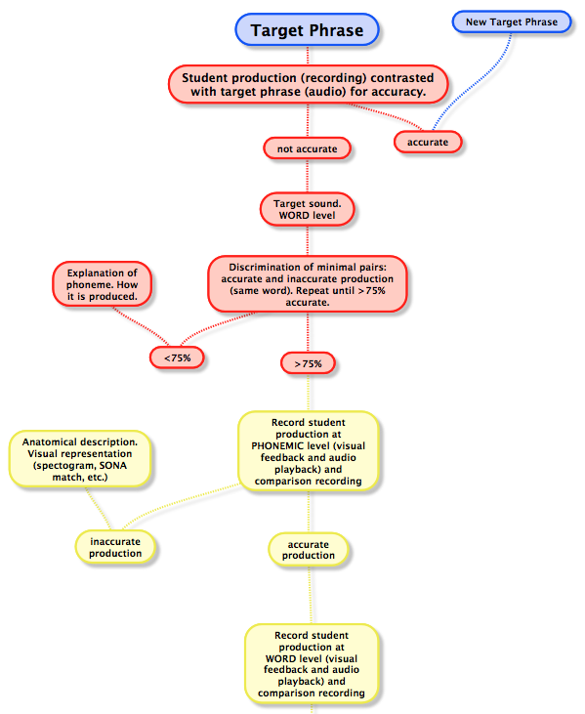
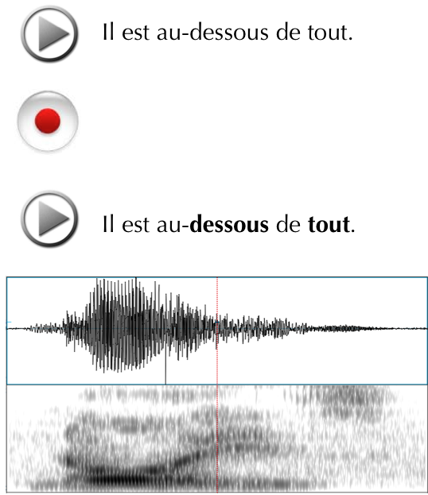


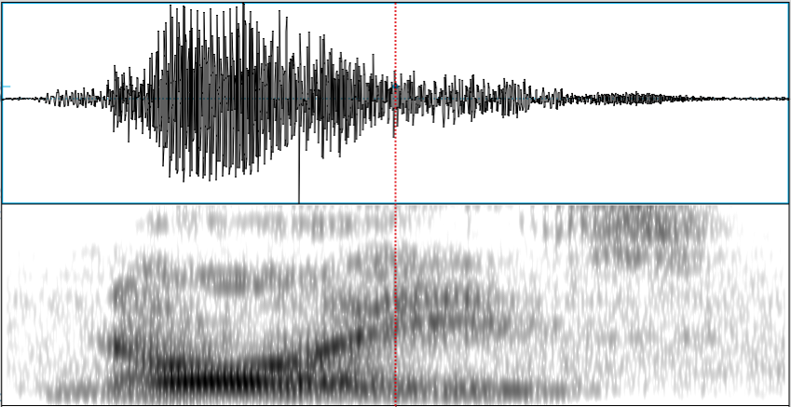
Interactive Textbook App
Il est au-dessous de tout.
©2008 Regents of the University of Minnesota. All rights reserved.
Notes:
speech visualization
student UROPs for speech lab

Slide 29
The Study Abroad App
Embracing mobility in a new way, providing orientation for the newcomer in a foreign city
This is a big idea, and a big project, but also a familiar idea, drawing on location specific services, but this time for study abroad...
Nonetheless, there are some key differences with big potential: level appropriate content, a community of newcomers creating their own map of a foreign city
©2008 Regents of the University of Minnesota. All rights reserved.

Slide 30
The Study Abroad App…
Linguistic and cultural orientation on mobile devices presents such a promising field…
Bringing together a wide variety of functions that enhance language learning and support the process of acquiring intercultural awareness
This is a clearly a field in which mobile digital technology can excel and innovate
©2008 Regents of the University of Minnesota. All rights reserved.

Slide 31
The Study Abroad App
Once again, faculty sat down and started sketching out their thoughts on how a mobile study abroad app might look…
©2008 Regents of the University of Minnesota. All rights reserved.

Slide 32
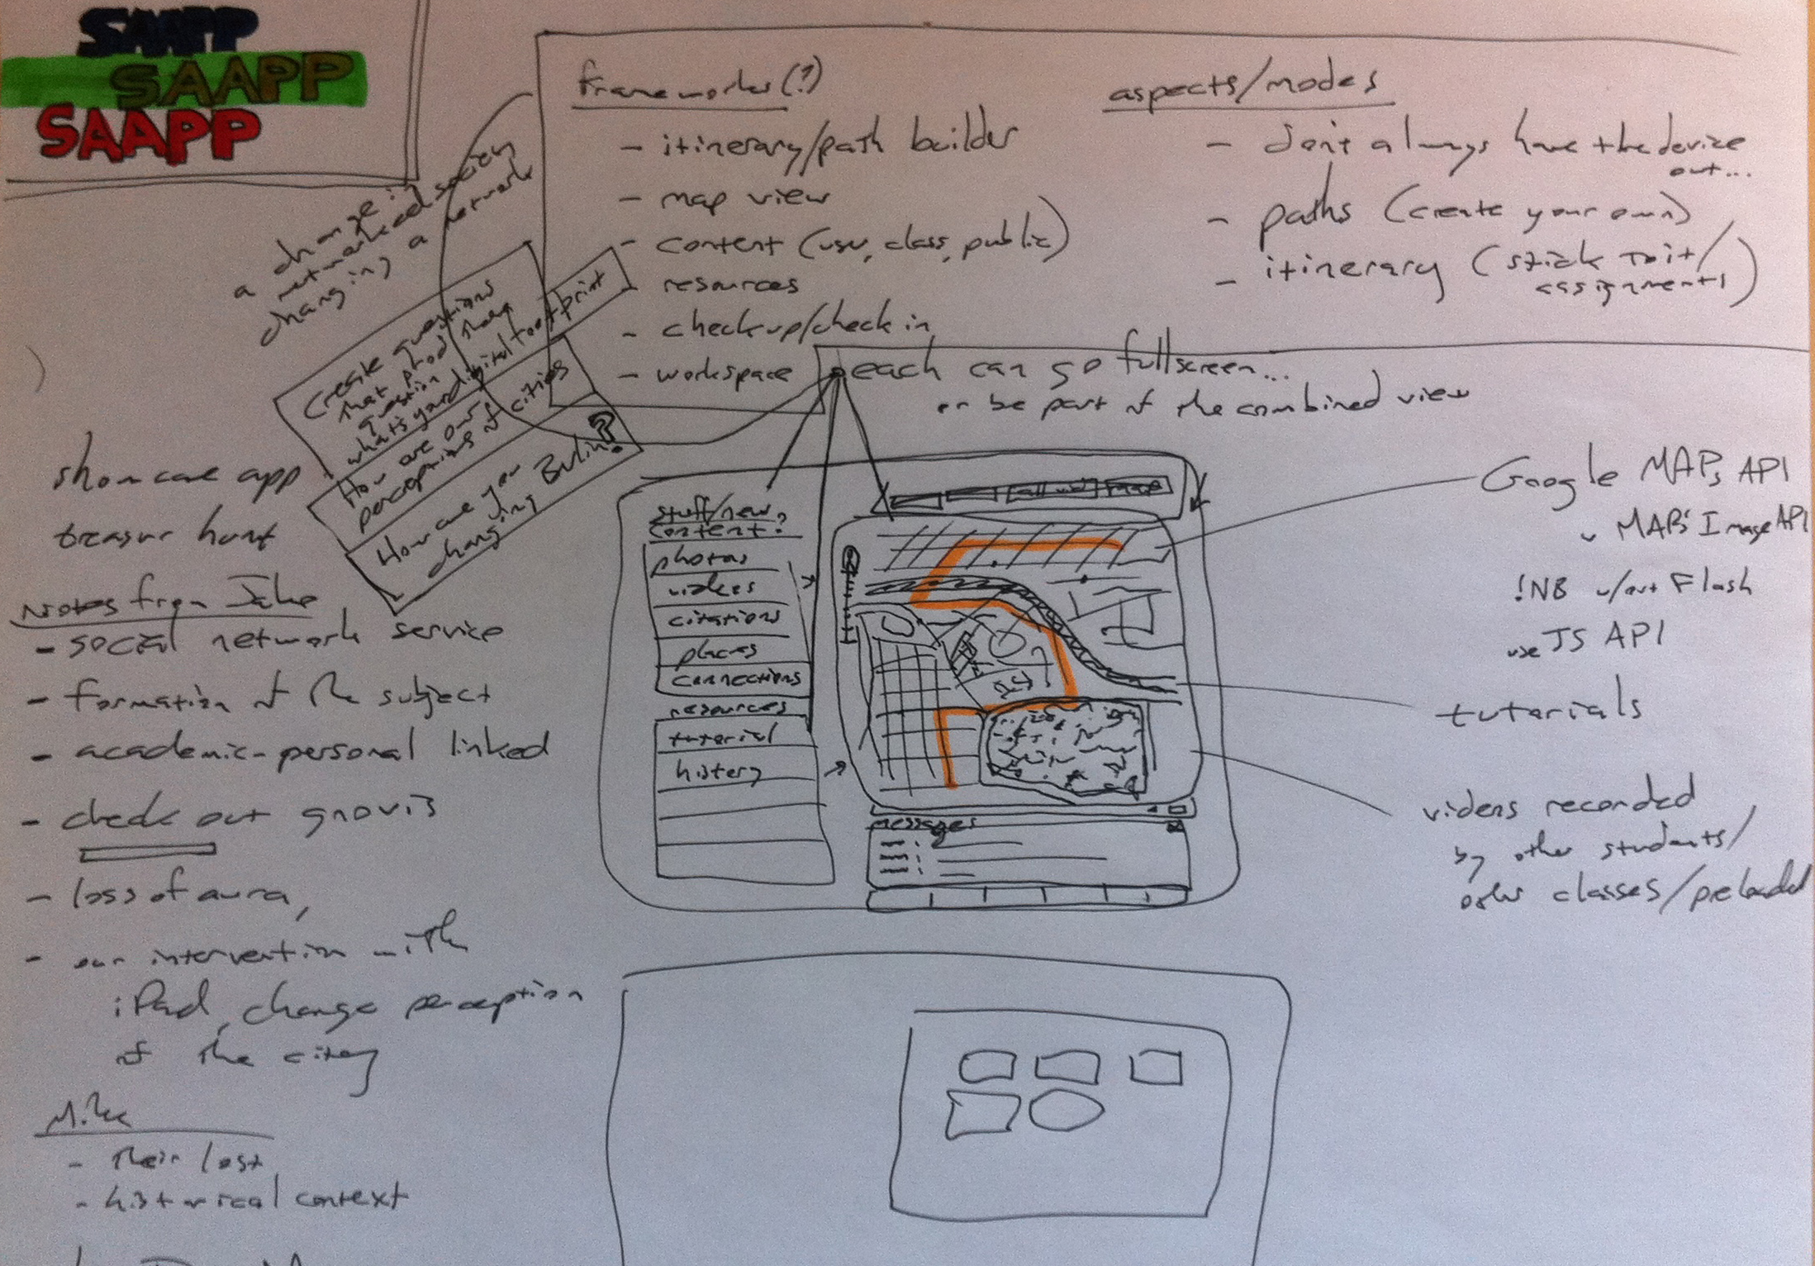
The Study Abroad App
©2008 Regents of the University of Minnesota. All rights reserved.

Slide 33
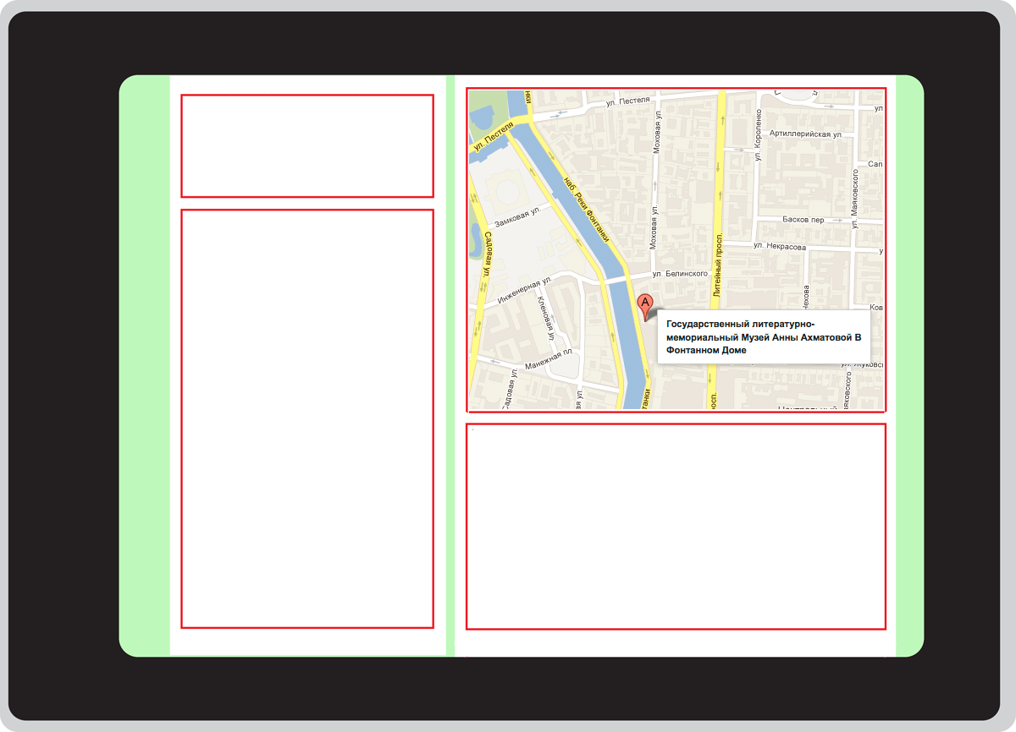
The Study Abroad App
©2008 Regents of the University of Minnesota. All rights reserved.

Slide 34
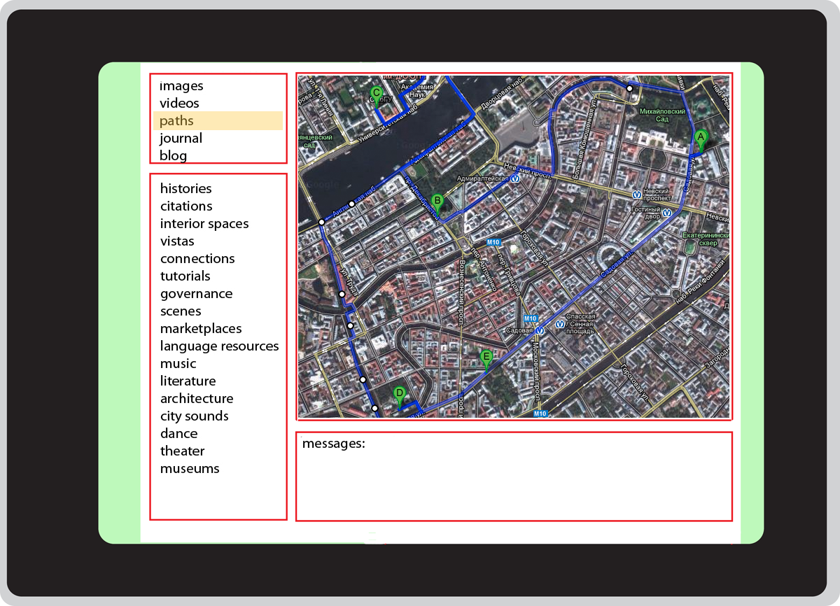
The Study Abroad App
©2008 Regents of the University of Minnesota. All rights reserved.

Slide 35
The Study Abroad App
Then we began working together with Graphics Arts…
Exploring functionality from multiple perspectives, possible gestures, styles, and paths through the app
Graphics Arts began suggesting different possible ideas for map APIs to CS
©2008 Regents of the University of Minnesota. All rights reserved.

Slide 36
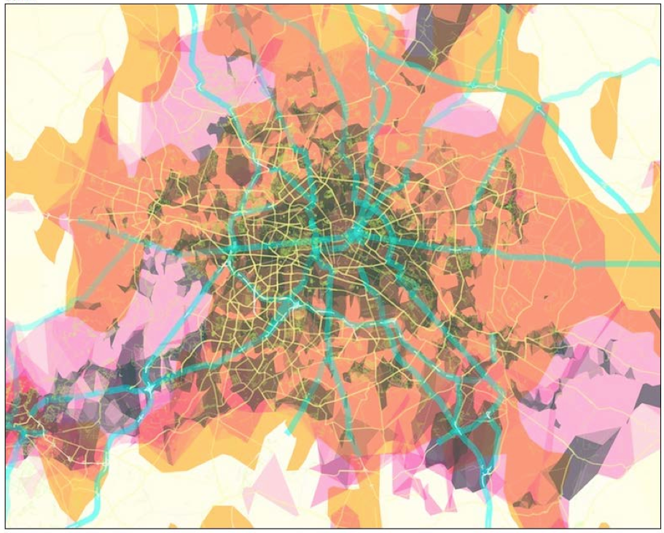
The Study Abroad App
©2008 Regents of the University of Minnesota. All rights reserved.

Slide 37
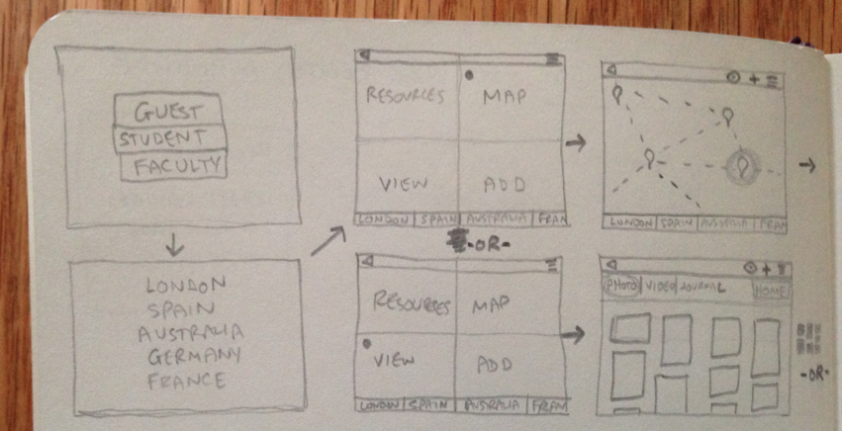
The Study Abroad App
©2008 Regents of the University of Minnesota. All rights reserved.

Slide 38
The Study Abroad App
Meanwhile UROP students in CS and UROP students in German and Russian are working on the basic functions of the app and the content for the resources…
©2008 Regents of the University of Minnesota. All rights reserved.

Slide 39
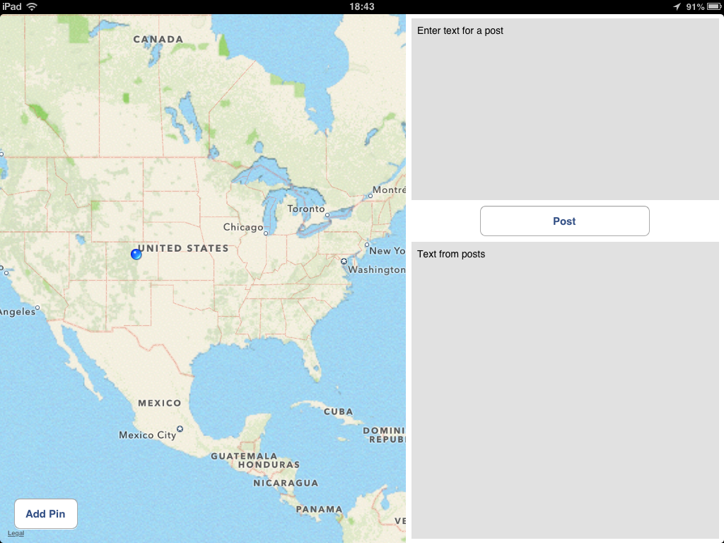
The Study Abroad App
©2008 Regents of the University of Minnesota. All rights reserved.

Slide 40
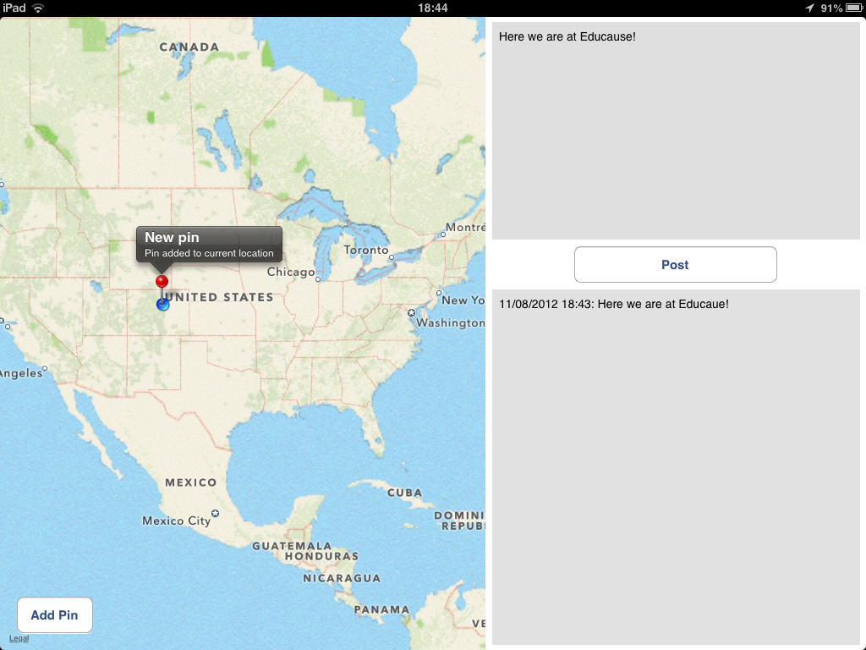
The Study Abroad App
©2008 Regents of the University of Minnesota. All rights reserved.

Slide 41

The Study Abroad App
©2008 Regents of the University of Minnesota. All rights reserved.

Slide 42
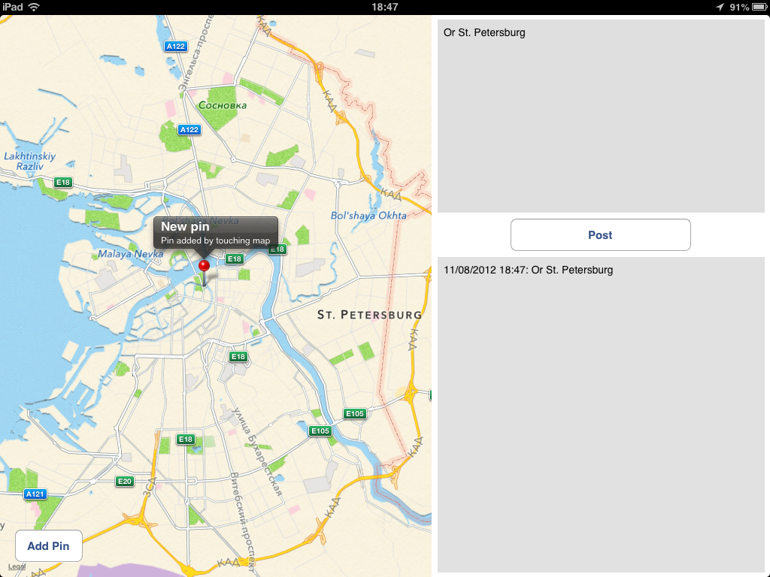
The Study Abroad App
©2008 Regents of the University of Minnesota. All rights reserved.

Slide 43
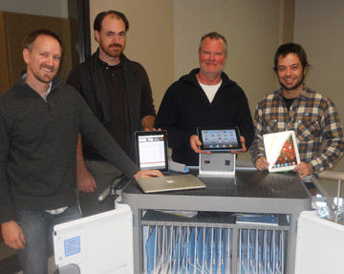
Funding
Student Tech Funds (CLA)
Strategic Grant (UMD)
OIT Grant (UMN)
©2008 Regents of the University of Minnesota. All rights reserved.
Notes:
Initially fifteen iPads were financed through a CLA technology fund grant. We worked with the Dean’s office, and IT to identify and secure these funds. Ultimately, a committee with student reps had to agree to this use of their funds since it represents a pool of money generated from student fees. They approved us unanimously.
“The goal of CLA in using student-generated technology dollars is to enhance the students’ learning experience, encourage integration of current technology as tools for effective teaching, and introduce students to the most current technology used in their respective fields.”

Slide 44
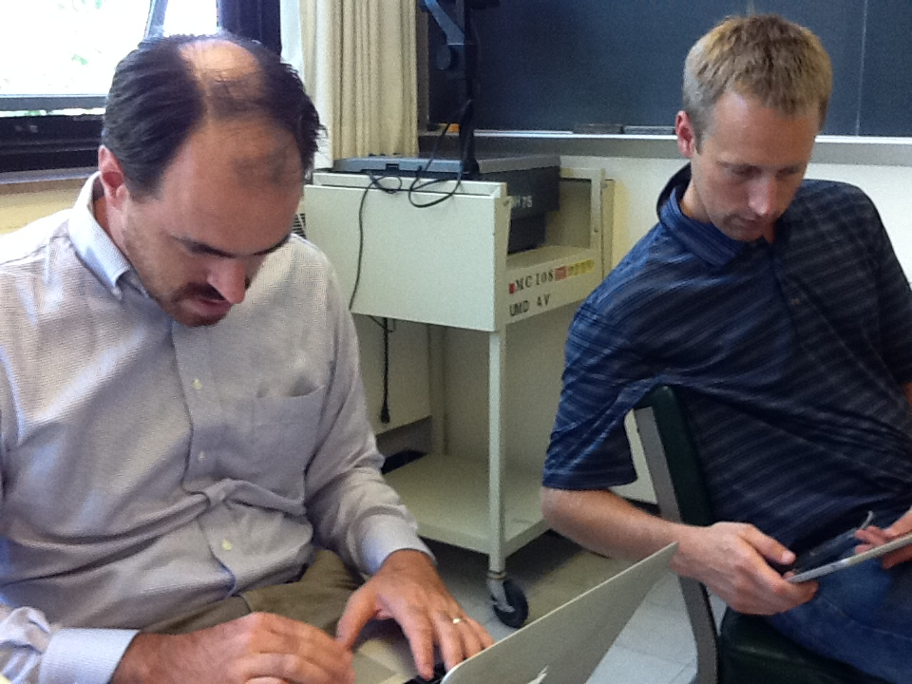
Now what?
continued app refinement
cross-platform development
exploration of new apps
identification of new funding sources
©2008 Regents of the University of Minnesota. All rights reserved.
Notes:
Where are we going from here?
How have you funded technology initiatives on your campus?
Certain issues have started to arise at this point:
Licensing issues
Publishing issues
Privacy
Security

