Slide 1
Implementing Kuali Financial System at a Small institution
Spencer Golden, Haverford College

Slide 2
Agenda
Haverford College
The Mandate
Why Kuali Financial System ?
Implementation Approach
Project Timing and Results
Recommendations for Smaller Institutions

Slide 3


Haverford College
Leading Liberal Arts College
Founded on Quaker Values
One of the Oldest Honor Codes
Profile
  Student Body of 1,200
  150 Faculty
  500 Staff Members
  24 Total IT Staff
  $3.8MM IT Budget

Slide 4
The Mandate
Thirty-year old legacy administrative systems
Financial “module” no longer meets accounting needs, user desires, or audit requirements
Chart of Accounts as old and fragile as the system
Board Mandate – Replace by start of FY13

Slide 5

“…university leaders desperately need
To transform how colleges do business,”
Jeff Selingo, June 25, 2012

Slide 6

“Slowly, as Student Debt Rises,
Colleges Confront Costs,” Andrew
Martin, May 14

Slide 7
The Small School “Project Management Square”
Scope
Scope
Collaboration
The traditional three
legged stool is informed by the need and opportunity
for collaboration
Time
$$$
Time
$$$

Slide 8

How Might an Institution React?
Choose Robust, Accessible Financial System
Continue internal trend toward adopting open source products
Leverage open source to provide high value solution with low TCO
Leverage board mandate and presidential leadership to acquire necessary startup funds and institutional buy-in
Control scope to enable 9 month implementation

Slide 9
Robust Tier 1 Commercial vs.
Inexpensive but Limited Commercial vs.
Robust Evolving Community Source
Solution: Look to the Future
Cost, Functionality, Collaboration

Slide 10





Why Kuali ?
Selection Process
  Performed thorough evaluation by joint functional/technical team
  Considered both vended and open source solutions
  Considered collaboration with local sister school
  Unanimous consensus on Kuali
Selected Kuali
  Belief in Open Source applications
  Robust functionality
  Lower costs of ownership
  Community possibilities and support
  Better control of environment
☑
☒
☒
☒
☒

Slide 11

Implementation Approach
Haverford College KFS Project Objective
  Implement New Chart of Accounts, KFS General Ledger and Purchasing/Accounts Payable in 9 months.
  Deliver a project budget of under $900k
Getting the Project Started:
  Worked with Kuali Foundation to identify KCAs
  RFP process to select appropriate Partner
  Worked with Partner (NMP) to finalize appropriate internal project team and determine required training
  Chartered Project and began implementation

Slide 12

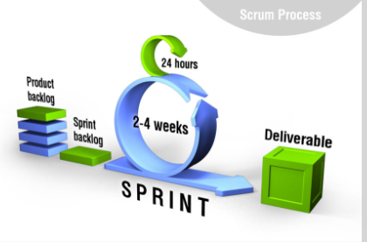
Implementation Approach
Project Methodology:
  We used Agile/Scrum implementation methodology
  Concentrated on completing functionality that builds on itself, not project phases that build on each other.
    COA->GL/FP->PUR/AP not Design->Build->Test
  Do the things that add the most value first
  Collaborative teaming between staff and consultants

Slide 13
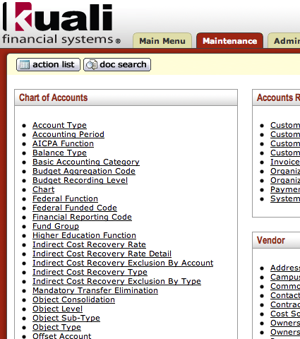
Implementation Approach
Configuration Approach:
  Keep it simple
    Start with the end in mind
    One chart
    Keep Organization structure simple
    Build business processes to match software best practices
    Configure only what you need
    Don’t go wild with Workflow
    Communicate with campus offices, faculty, and staff (about all of the above )
Notes:
Start with the end in mind is good…if I could do it all over, I would have spent time in some version of KFS testing out forms before we started planning.

Slide 14

Implementation Approach
Conversion Approach:
  Convert summary and current data (one year only). Do historical reporting in legacy system
  Scrub the Vendor File. Only convert good data
  Establish conversion procedures and process as soon as you can
  Convert as you go
  Do not reinvent the wheel:
    Leverage community tools wherever possible
ADMIN

Slide 15

Implementation Approach
Modifications Approach
  Stay Vanilla
  Change Processes, Not Software
    Our processes needed change anyway
  Leverage the community.
    Borrow ideas from those who came before.
  Handful of modifications
    Keep simple
    Use mods created by others if possible
    Build outside of base code
Notes:
What about the PCDO modification? Or is that more of a case for staying vanilla?

Slide 16


Implementation Approach
Reporting Approach:
  Robust Business Intelligence Initiative Planned
  Use open source stopgap solution in interim
    JasperSoft
  Identify and Recreate Financial and Operating Reports that are actually used
  Leveraged reporting views not a data warehouse
    Once established simple to maintain
    Real-time data

Slide 17

Implementation Approach
Training Approach:
  Leveraged Oracle’s UPK Training / Documentation Tool
    Built out custom tutorials for every user transaction
    Designed model of tutorials coupled with training
  Developed Training Classes for different user classes
    Business Office Superusers
    Fiscal Officers and Administrative Assistants
    Faculty and Senior Administration
    General Users
  Scheduled Two Training Phases
    At Go-Live
    At start of Fall Semester

Slide 18
KFS Project Timing – Summary
Board Mandate – Fall 2010
KFS selected July 2011 – unanimous choice
Project Kickoff in September 2011
Project Planning Phase Completed Nov. 23, 2011
Training for all users in June, 2012
Project Go-Live July, 2012 – On Time, On Budget
Currently Evaluating Follow-on Phases

Slide 19
Recommendations for Smaller Institutions
Start with Institutional Buy-In
Keep Scope Manageable
  Phased modules as appropriate
Partner with Knowledgeable AND Flexible Firm
Change Processes not Software
  Leverage best practices in software
Keep it Simple
  Organization Structure
  Workflow
  Functionality

Slide 20
Recommendations for Smaller Institutions
Don’t Reinvent the Wheel
  Leverage the Kuali Community
Communicate Well in Advance
  Especially Changes to who does what
Don’t Give Reporting Short Shift
Train in Focused Bursts

Slide 21
Thank You !

