Slide 1
IT Support Analytics = Better Decisions
Sponsored by: bmcsoftware
Presented by: Cathy O’Bryan, Director of Client Support @ Indiana University
Notes:
Introductions
Participate through chat.
Couple of surveys
When done:
You will be able find the data that leads to real information that can inform your operational (day to day) and strategic decision (quickly). Make better business decisions from your tools.
In this session, we will share how at IU we use a Dashboard tool (homegrown) that sources data from our enterprise tools (bmc software (footprints… other name?) to enable fact-based decisions. Smart decision allow us to align resources efficiently and enable strategic goals to become reality.
Use ITSM tools, ACD’s, software downloads, self-help Knowledge Base to make real informed decisions without drowning in data.
Invite you to participate through chat.
Thank Sponsors & Educause
We hope when done that you:
Need to use the data and tools that are available on our campuses to make better business decisions
In this session we will share how at IU we’ve developed a dashboard tool to enable fact-based decision making. Smart decisions align IT resources efficiently to enable strategic goals.
Use Service Management solutions to make informed decisions BOTH:
Operationally & Strategically

Slide 2
Do you have access to information that answers “What’s Happening?” when the campus community is clamoring for help? When you need it, do you have the answer? (Check the one that fits your situation best.)
Just the right information immediately.
Lots of data (noise), but little value immediately.
You have to ask several people to “get that for you”.
You wait for the weekly, daily or monthly report.
You guess until the you can find the answers.
Comments? __________________________

Slide 3
Notes:
The Origin of the Dashboard:
Tell the KMS birth story……
Do MORE with less, do more with less…….
How to add value while reducing costs
Self-service portal
Self-help
Be ready, be flexible, know your environment, see patterns before they impact support
Operational Value:
Aligning resources for Fall Rush 2012
First time both campuses
First time shorter move-in
Get Connected All, Passphrase Expiration, and Bears?
Strategic Value:
Inter-institutional Support
How do you package, price and define Support Center Service for an institution external to IU?
What metrics define the service?
Inform the estimate?
Can be flexed during negotiation?
Need to be measured as service matures?

Slide 4
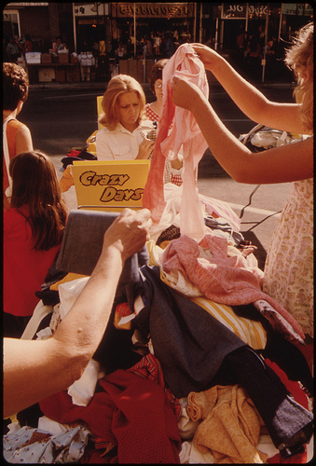
Data Must be Readily Available
One-Stop Shop
Department Store
Well-stocked
with Current Data
Not a flea market
Can you find what you need
when you need it in a useful
format?
Notes:
Readily Available
easy to access (one-stop shop with a diverse set of perspectives)
real time
not just noise: SC/HD’s tons of noise; you can drown
(too much may be worse than too little)
Not a flea market. A contact center of any kind or even just a set of metrics from the Semester start up can drown you in noise.
You don’t want junk, but how to sort through and find what you really need?
VP has a question
VP contacts AVP
AVP contacts Director
Director contacts Manager
Manager figures gets some staff member to write a report to get the info
Staff member stays all night trying to get the data
Staff member contacts Manager
Manager contacts Director
Director Contacts AVP
AVP contacts VP
VP forgot why they wanted to know…

Slide 5
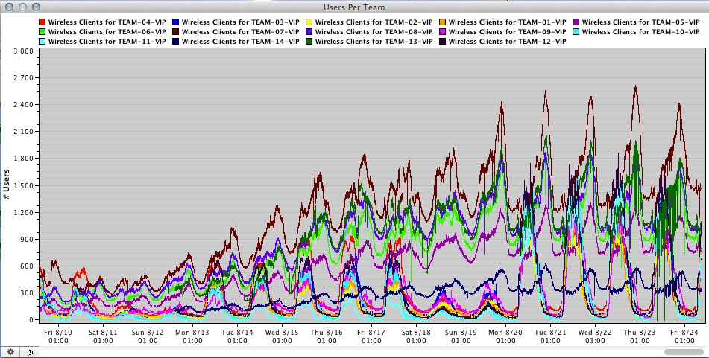
Colorful, but……. ?
Notes:
Lots of data, TB’s of it to be exact.
Real image from SS ‘12
Tell you anything?
Grateful Dead tie died T-Shirt
Not much, a bit of trending.
Folks are well-intended and they know their piece of the pie in great detail. However, when making decision as SS’12 chair and making sure to align resources rapidly across two weeks, you need to see the whole picture. Not just pretty rainbows of color.
You need to get to the gold. You need to rapidly move from the abstract to the specific.

Slide 6
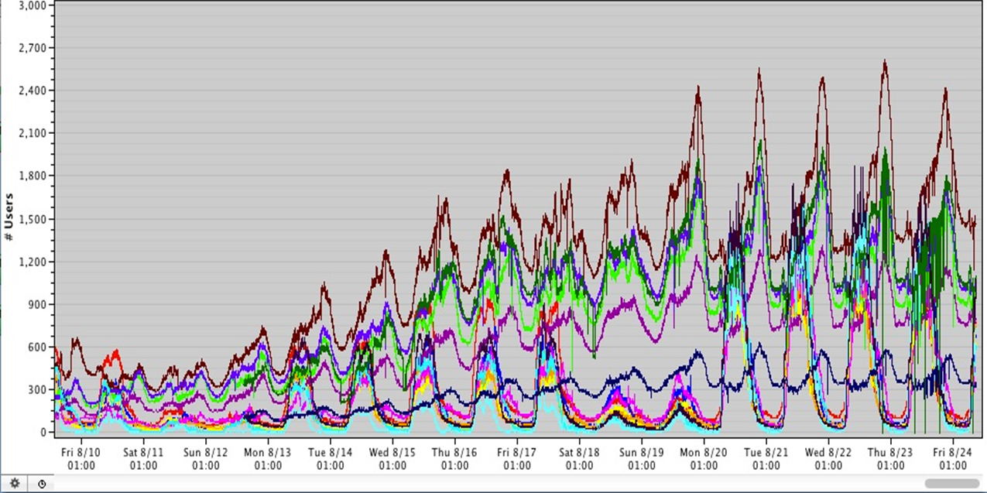
Real Value is in Clarity

Slide 7
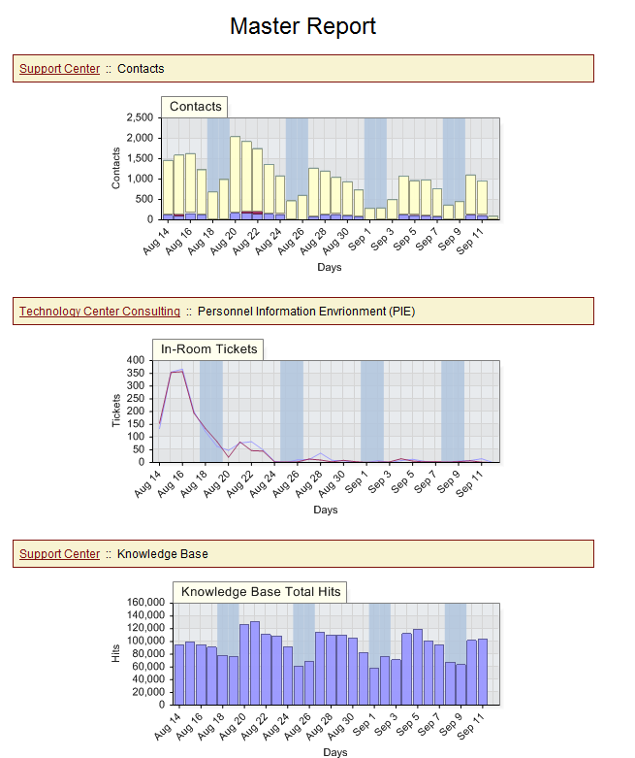
One-Stop Shop
Broad set of data from a variety of sources.
A department store with choices to inform your decision.
Notes:
Master Report in IU Support Dashboard
What should be there from a Client Support Service perspective?
Support Center
TCC
Kbase
Support Systems & Licensing: IUware
Support System & Licensing: IUware Online
What is the over-arching data set from each of the perspectives?
SC – Contacts
TCC: - Tickets/Consults
Kbase: Hits
IUWare: Online Download Attempts
Here’s my bias: I hate shopping. Get in, get out. I know what I want. But even if I don’t want, I want to find it fast.
I don’t want to shop the whole mall at each individual stores.
You do need context. Be able to ask questions. Cross reference the data points to verify. Is your assumption correct?
Stay on the balcony but climb down when it is important to do so. Have the ladder to your data ready, mobile and safe (easy to access).

Slide 8
Isolate One Set of Data

Slide 9
Other Support Data Options

Slide 10
Where is the Demand?

Slide 11
What Do You See?

Slide 13
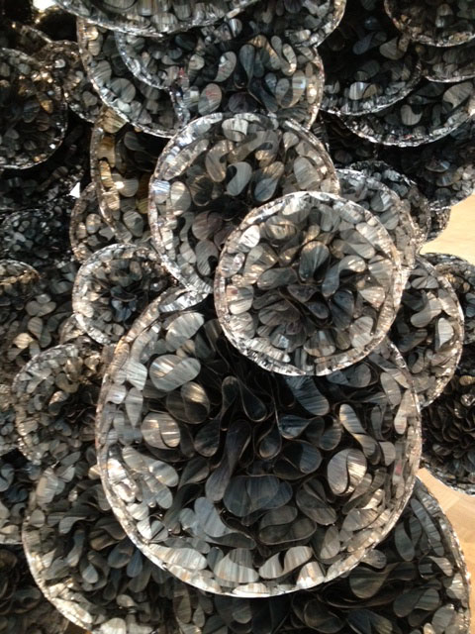

Slide 14
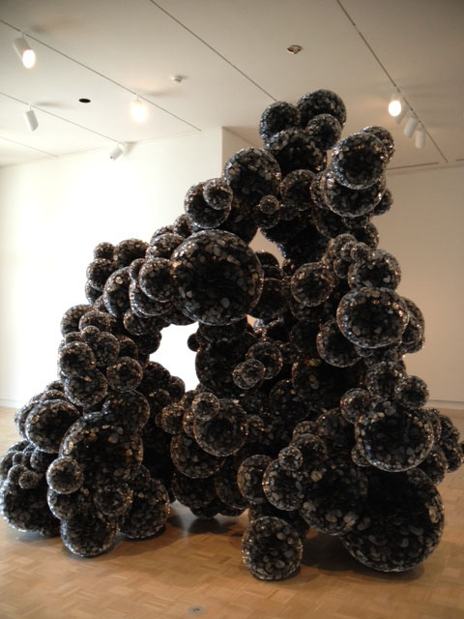

Slide 15
Depends on Your Focal Point!
And sometimes we still aren’t sure what it is………
Notes:
Sometimes granularity adds context and produces information. S
Sometimes stepping back and making sure that you are viewing the big picture enables you to see the whole structure and how it fits together,…..
Eyes play tricks and so does data. Context, granularity, source, timing, quantity, but you need it.
And well, sometimes you still wonder!
You have the right questions to ask. You know who to inform.

Slide 16
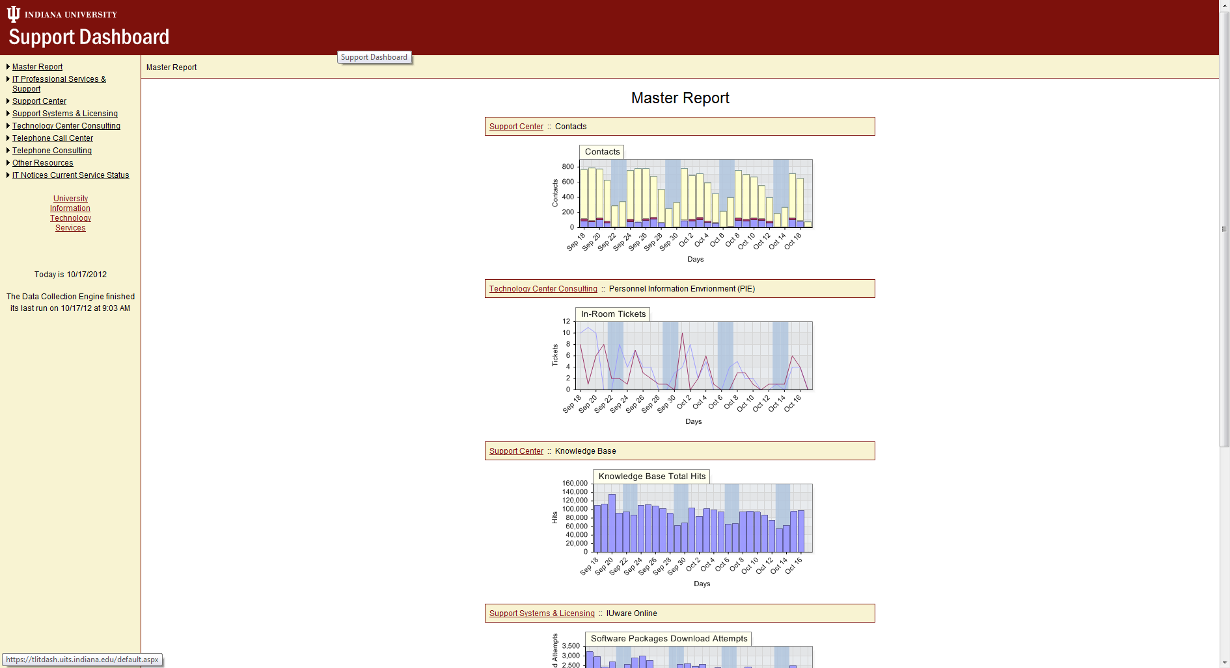
http://screencast.com/t/dRAyDlySoI
Having data that can provide both a summative overview and depth when needed is crucial.
Notes:
Does the data have the right degree of granularity for your question?
One size does NOT fit all.
Tailoring must be available
Story: Perhaps you need to know what hours during the day during fall rush to add staff hours to the Support Center?
Or
Are you more concerned with a more granular question? What documents are most used, needed and valuable during fall rush? Which should be updated first?
Have all the data shots (from the closeup to far away), but start from far away on a dashboard. Have tools that inform actionable decisions.
Service and Support Analytics takes planning.

Slide 17
Not just data, but information is needed………

Slide 18
Information will explain the data… “What, where, when….?” = Knowledge

Slide 19
What was Impacted? When?

Slide 20
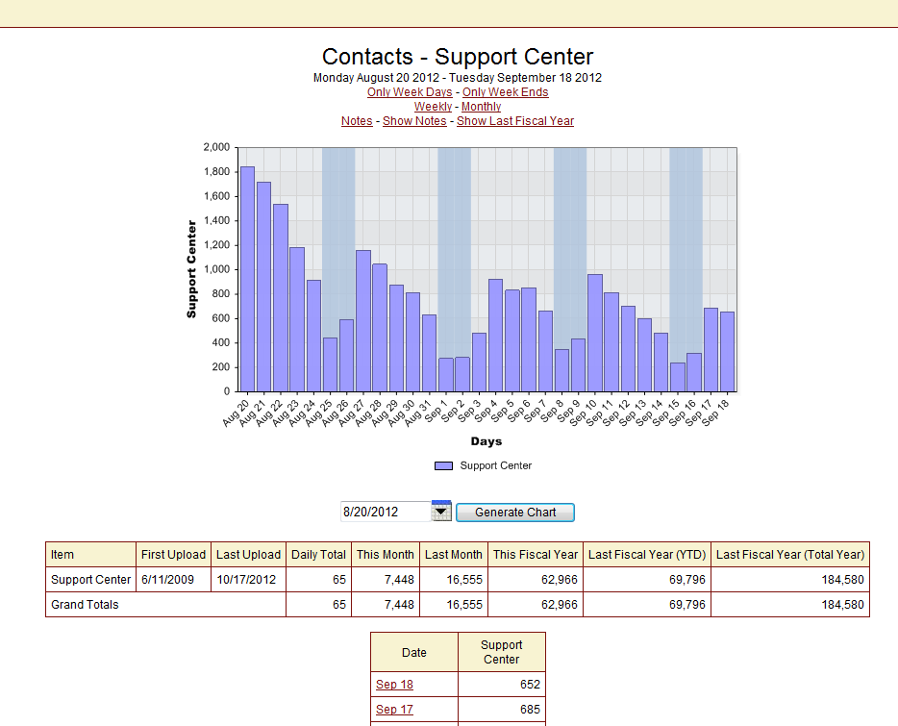
Information leads to Knowledge to Understanding to Wisdom

Slide 21
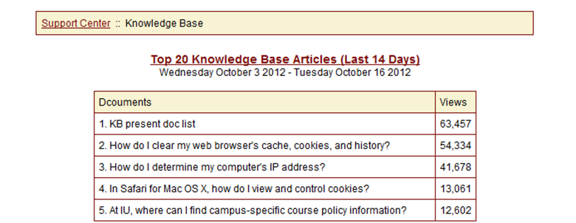
Get a Different Set of Related Data.

Slide 22
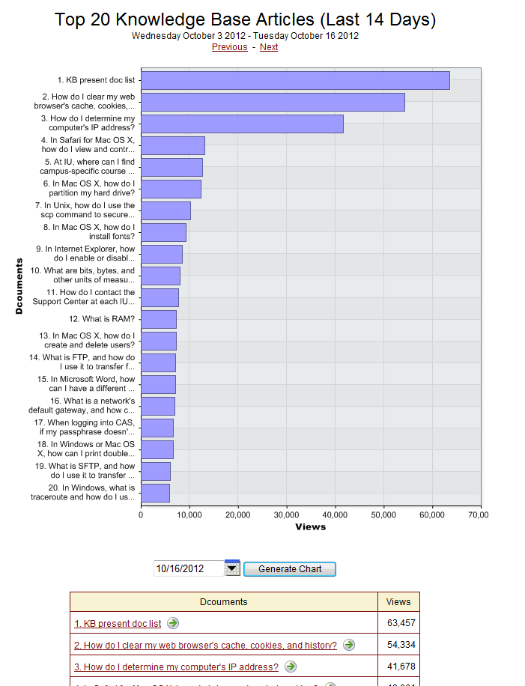
Historical Trends Can Help Prioritize My Resources.
Past is Often Prologue!

Slide 23
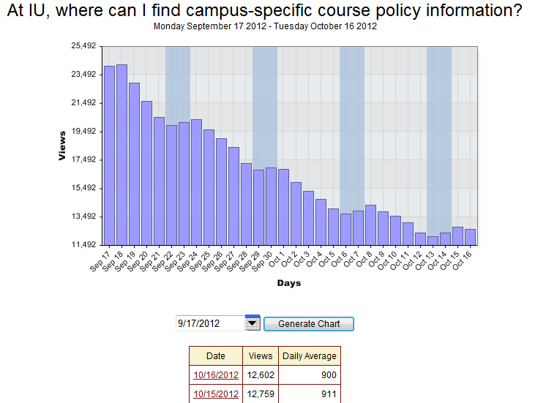

Slide 24
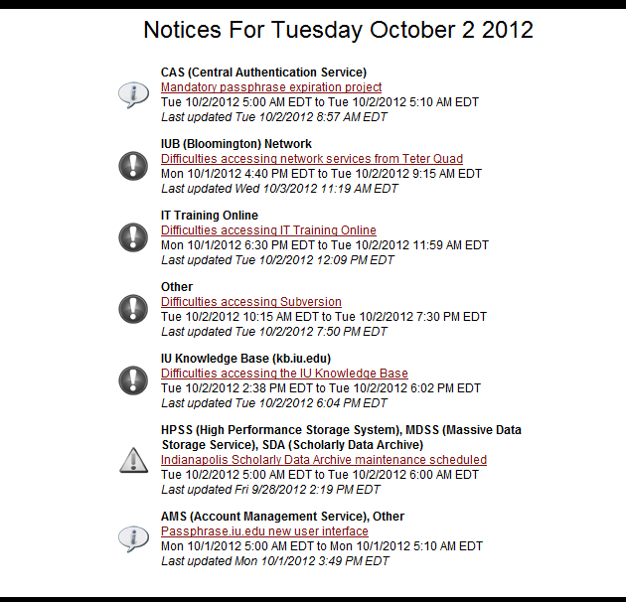

Slide 25
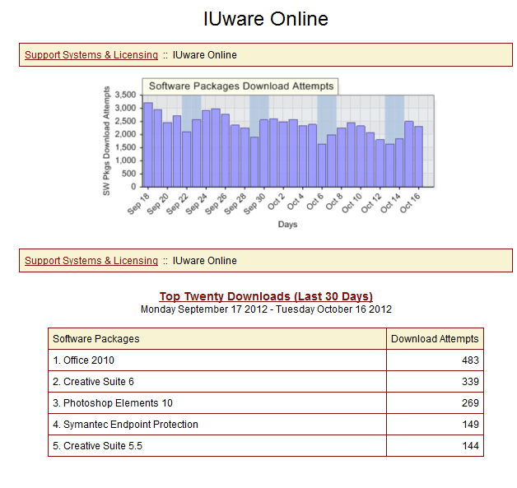
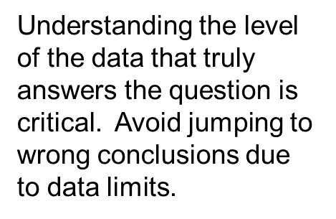

Slide 26
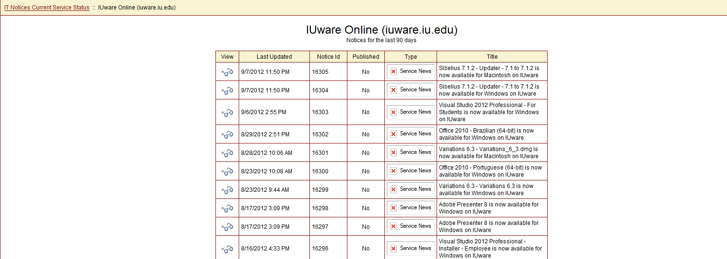
Your closet must be stocked with INFORMATION
Context creates understanding & value.
Must be flexible: able to mix & match!
Does it inform other data points?
Or does it clash with rest of the data closet?
Notes:
It is not data, it is information
it has context
Context can answer related questions
Point to new questions, inquiry or decisive action
it has granularity
This enables leaders to drill down, get more than a bird’s eye view when needed.
You have enough information to make a decision or to ask informed questions of the sources. In red because INFORMATION is crucial. It is not just data. (not just IU)

Slide 27
Be Picky About Data Selection
Accurate and current
Historical context:
Significant data sample
Trend and Pattern
recognition
Granular where you need it
Notes:
Be able to drill down.
More value in little nuggets: not big shiny object; Which nuggets? Can’t get them all?
Over 7 years of data across 12 different data sets.
Where do you start?
What part will inform you?
O
Collect data
Manage the data
Understand when something is changing
Don’t fix it if it isn’t broken
Make sure it is really changing and not just a blip
Statistical Process Control in Manufacturing (SPC)
perations happen quickly.

Slide 28
Support Center Summary
First Week of Semester | 2011 | 2012 | % change
Phone | 4287 | 4152 | 97%
FootPrints (Contact Tickets) | 5204 | 5356 | 103%
TOTALS | 9491 | 9508 | 100%
Not much new information here? Why?
Notes:
Make predictions.
Test the predictions.
Can’t Script all the question in advance.
Engage the brain
Tools don’t make you smarter, be involved, in the context as a way that supports the institution. To make the ultimate best decision.

Slide 29
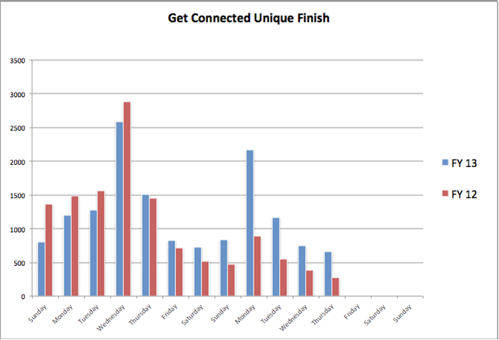
Get Connected Metrics
Since Aug 7th, of the systems running GC, 57% were Windows & 43% were Macs.
Notes:
GC story this year.
30% last year for only 10K students
Now 70K students going to run. How?
Improve
Watch numbers, need more

Slide 30
Get Connected Support Center Contacts
 | Sun | Mon | Tues | Wed | Thur | Fri | Sat
First week 2011 | 93 | 57 | 43 | 18 | 18 | 13 | 7
First week 2012 | 121 | 194 | 92 | 50 | 55 | 27 | 10
Running totals | 93 | 150 | 193 | 211 | 229 | 242 | 249
 | 121 | 315 | 407 | 457 | 512 | 539 | 549
Daily % change | 130% | 340% | 214% | 278% | 306% | 208% | 143%
Running % change | 130% | 210% | 211% | 217% | 224% | 223% | 220%
Notes:
Week before relatively quiet
Into the first week. Huge numbers.
Likely to impact Walk-in from last year’s numbers.
Watch walk-in locations at Indy and Bloomington

Slide 31
Support Center: Walk-In Contacts
Location |  | Sun | Mon | Tues | Wed | Thur | Fri | Sat
Walkin-IMU | First week 2011 |  | 33 | 23 | 8 | 3 | 4
 | First week 2012 |  | 32 | 35 | 21 | 24 | 4
 | Running totals |  | 33 | 56 | 64 | 67 | 71 | 71
 |  |  | 32 | 67 | 88 | 112 | 116
 | Daily % change |  | 97% | 152% | 263% | 800% | 100%
 | Running % change |  | 97% | 120% | 138% | 167% | 163%
Walkin-IC | First week 2011 | 219 | 341 | 278 | 298 | 212 | 138 | 50
 | First week 2012 | 204 | 353 | 276 | 273 | 203 | 162 | 34
 | Running totals | 219 | 560 | 838 | 1136 | 1348 | 1486 | 1536
 |  | 204 | 557 | 833 | 1106 | 1309 | 1471 | 1505
 | Daily % change | 93% | 104% | 99% | 92% | 96% | 117% | 68%
 | Running % change | 93% | 99% | 99% | 97% | 97% | 99% | 98%
Walkin-IUPUI | First week 2011 | 5 | 99 | 67 | 66 | 63 | 22 | 2
 | First week 2012 | 7 | 139 | 147 | 109 | 88 | 43 | 9
 | Running totals | 5 | 104 | 171 | 237 | 300 | 322 | 324
 |  | 7 | 146 | 293 | 402 | 490 | 533 | 542
 | Daily % change | 140% | 140% | 219% | 165% | 140% | 195% | 450%
 | Running % change | 140% | 140% | 171% | 170% | 163% | 166% | 167%

Slide 32
Avoid Being just a Data Warehouse
Too Much Data is Almost as Useless as None.
Throw away the Noise in the Data Pool
Remove the Obstacles to Data Access
Cross Reference Data for Improved Acuity
Be Able to Flexibly Hone In on the Key Points
It Takes Planning!
Notes:
We’ve all been there to a big box warehouse with the promise of great pricing (if not service) and after wandering for what seems like days we leave with little or nothing of value and confusion.
You can get 100’s of metrics from an ACD and form a ticketing system. Within a Knowledge Management or any system, you can pour over the logs for the number of downloads, clicks, anomalies, etc.
In this vast sea of data, what is needed, useful, measurable, valuable?
Decide in advance what you might need to know that will shape and guide the future.
When planning for a dashboard think first about the strategic questions that your mission demands that you address. That should determine what you need to address more granular operational decisions as well.
A IU, EP (IU Strategic Plan for IT 2009) has several Action Items that drive Client Support. Let’s look at one:
IU should continue to pioneer and provision effective means of user support through advanced tools for self-service and connection to IU experts to help faculty, staff and students effectively use IT. …
How used is the Kbase, which documents, how can it be improved? When should specific pieces of content be updated. The KB costs $.07 per page. It has 15K active pages.
We pay attention to what we measure. But that’s backwards, you should measure what you WANT/NEED to pay attention to. Planning
Data moves fast! Can you see the forest for the trees? Who is raiding the bird feeder? What is the teradactal that is feeding. Remember to introduce before I click.

Slide 34
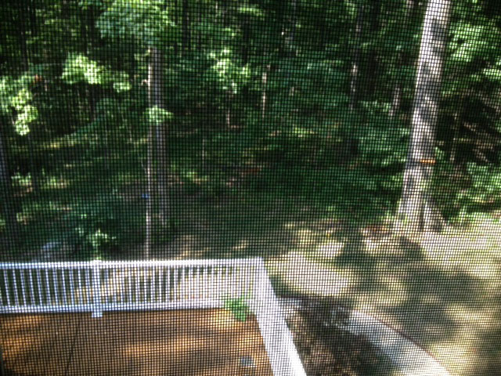

Slide 35
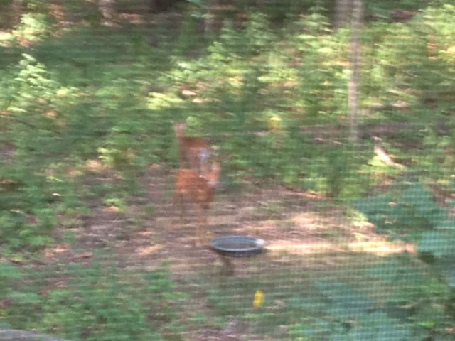

Slide 36
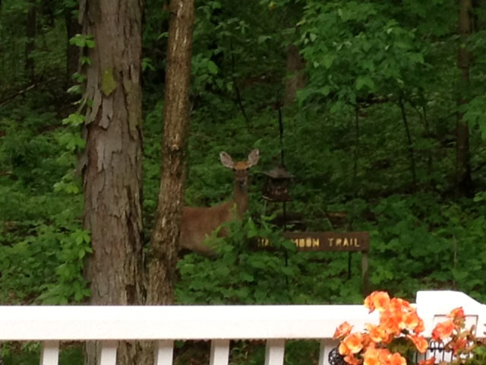
Notes:
OK, so you may not have got the full picture as there were two twin fawns prior to this shot, but you now know that a whole flock of giant birds do NOT come by every night and raid the bird feeder. ☺
You’ve positioned the camera, quit shooting the picture through the screen and snuck outside. You’ve got enough data to know its deer. The twins got away. It’s OK, you’ve got enough data.
So within our usage of the Dashboard on Faculty Consulting engagement. And perhaps some of you have been down this road. Tickets! Oh my! It’s a relationship, a consultation, a long, creative process. Tickets are too time consuming! Or Tickets don’t capture the full event. Agreed, but having just a quick record of something happening, with who, in what department and perhaps (dare I?) what type of request informs the organization:
1. Type of instructional support needed.
2. Obstacles that should be considered for elimination on tools.
3. Most popular tools, features, pedagogical uses by discpline?
etc.
Get what you need. Perfect is so highly over rated. So the twins got away, you can prove what ate the feed.

Slide 37
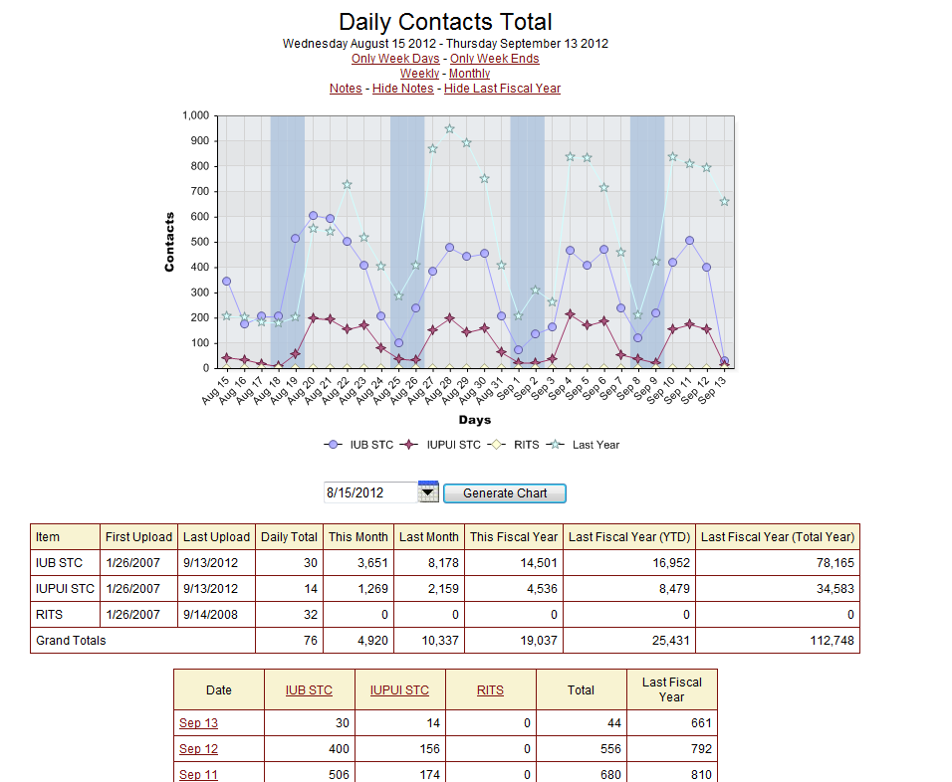
Catch Your Data Before It’s Gone!
Technology Center Consulting
Notes:
Academic data difficult
Where, when, who STC support, what campus as compared ot last year
Analytics are important but should not be a burden to service.
They should walk that balance between improving service and not over-shadowing it.

Slide 38
Find the Data Where It Hides!
Notes:
What type of response time? Service? Where (location of walk-in) is staff needed? What expertise? What time of day? What day?
Sometimes the data hides.

Slide 39
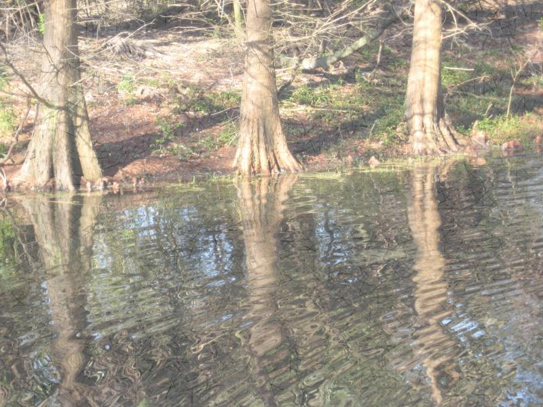
Leveraging IU Support to Other Institutions
How Do You Package Your Service for Extension to Other Institutions?
How Do You Blueprint and Cost Your Services?
How Do You Estimate Another Institutions’ Support Volume/Needs?
What Do You Do if They Have No Data to Share?
Notes:
Recently IU and Ivy Tech Community Colleges began an innovative partnership within the state of IN to better leverage the existing support, infrastructure, licensing and administration at IU across both institutions.
As a result of negotiations, Ivy Tech’s Board has signed a two-year contract to outsource Ivy Tech Technical Support to IU.
Preparing for this ground-breaking service offering was difficult. Ivy Tech had little or no data to share. Not from a ticketing system, an outage system nor an ACD. How to best estimate other than guess?
What is the average number of contacts per student?
What are the number of systems at IU relative to the number of systems that need support Ivy Tech?
What’s your wiggle space in the cost range? What would it mean to reduce hours? Increase call abandonment? Increase wait time? Reduce number of systems? Add Chat? Add IT Notice System? How do you know all this while negotiating?
How do you insure as a non-profit that you make no money, provide best value to all the users across both institutions while safe-guarding the taxpayer dollars?
How Do you Package, Cost and Extend Your Services?
How Do You Estimate Another Institution’s Call Volume?
What If They Have No Data to Share?

Slide 40
Data Driven Decision Making @ IU
Selecting the Meaningful Real Time and Historical Data from FootPrints ticketing system, ACD, and other sources
Automated in a Dashboard
Analyzed as Needed; When Needed
Result: Informed Decisions Aligned with Strategic and Operational Goals
Notes:
My other thought is you could incorporate a story at the end of your Educause presentation on Slide 21 “Data Driven Decision Making @ IU” – how did/ will the data you collected during Semester Start-Up impact the way you handle semester start-ups in the future?
Story of Ivy tech and IU. Couldn’t have done it without our data, information, combined with What if Vision?

Slide 41
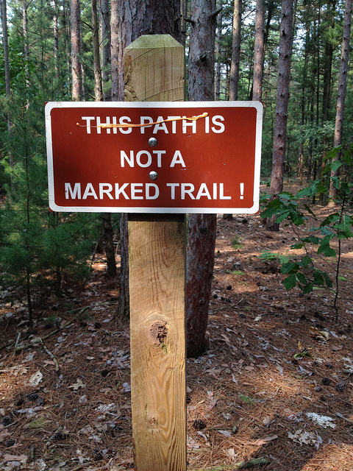
Questions?
Cathy O’Bryan
caobryan@iu.edu
812.856.3527
Notes:
The path m
Evaluation.
Path may be unmarked, but you can bring a map and compass (capture the right coordinates)! Your service blueprint.
You might just see this!

Slide 42
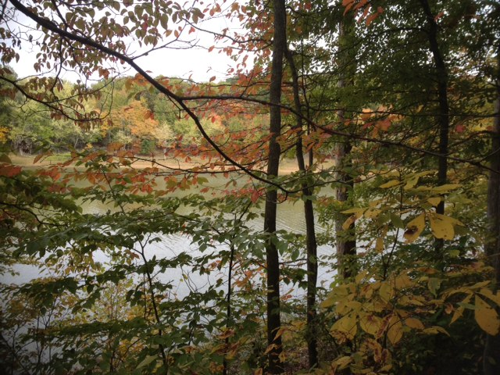
Notes:
7.5
Want to know that…..
You might just get an overlook view!

