Slide 1
The 2012 Study of Analytics in Higher Education Jacqueline Bichsel, Ph.D. Senior Research Analyst, ECAR

Slide 2
Analytics: EDUCAUSE Initiative for 2012
Year of Data Analytics (YODA)
Focus of Game Changers (Diana Oblinger)
Many publications, including reports, research bulletins, and case studies: http://www.educause.edu/library/analytics
Major ECAR study: http://www.educause.edu/library/resources/2012-ecar-study-analytics-higher-education

Slide 3
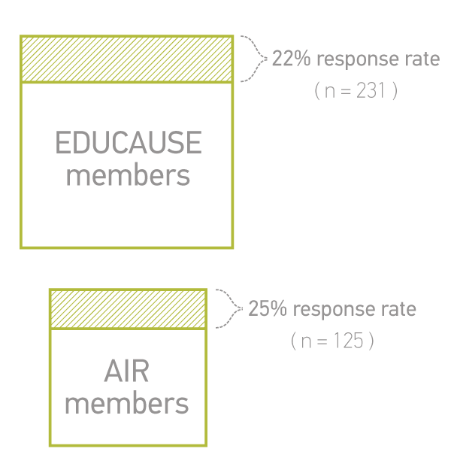
ECAR Analytics Study Methodology
Two surveys
Seven focus groups
IT and IR professionals from around the country

Slide 4
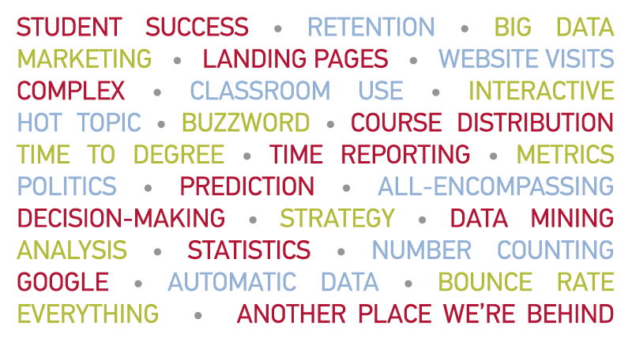
When I Hear Analytics, I Think of…

Slide 5
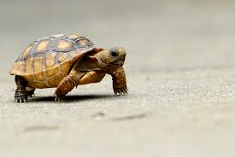

Slide 6
Defining Analytics
Analytics is the use of data, statistical analysis, and explanatory and predictive models to gain insights and act on complex issues. (EDUCAUSE)

Slide 7
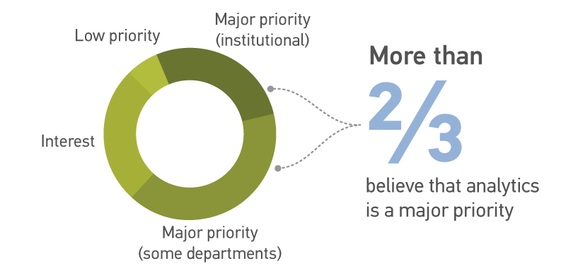
Analytics Is a Priority

Slide 8
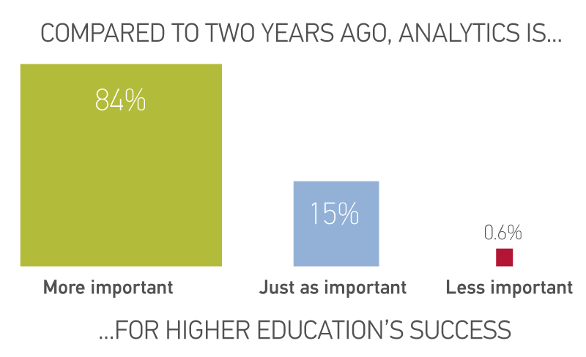
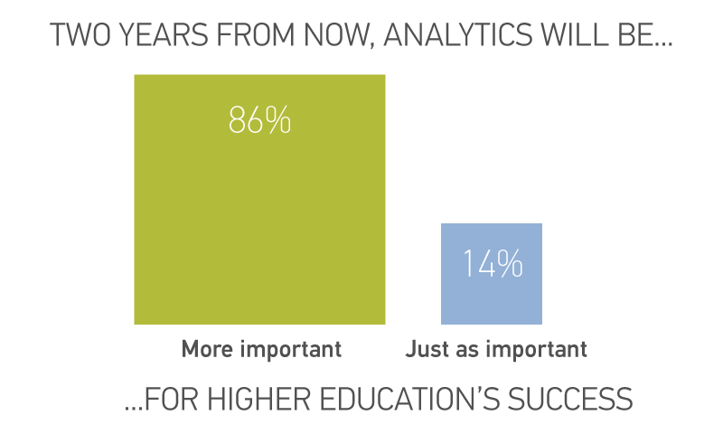
Analytics Is a Priority

Slide 9
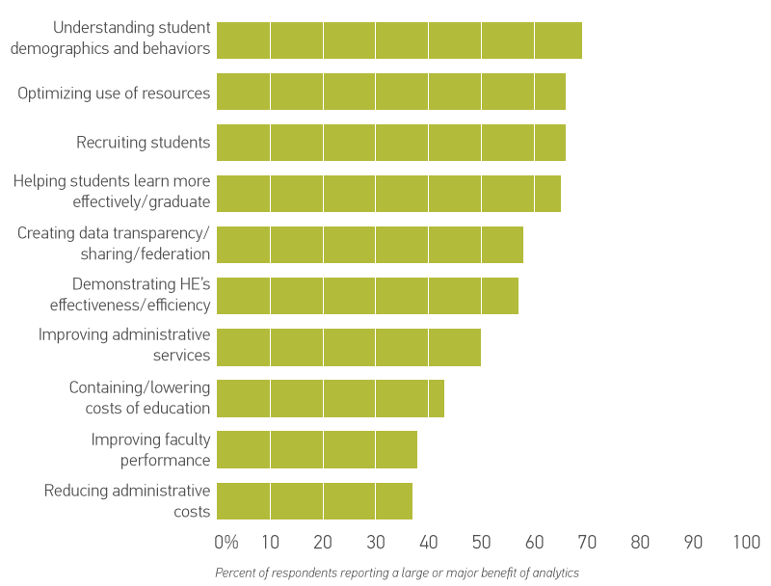
Benefits of Analytics

Slide 10
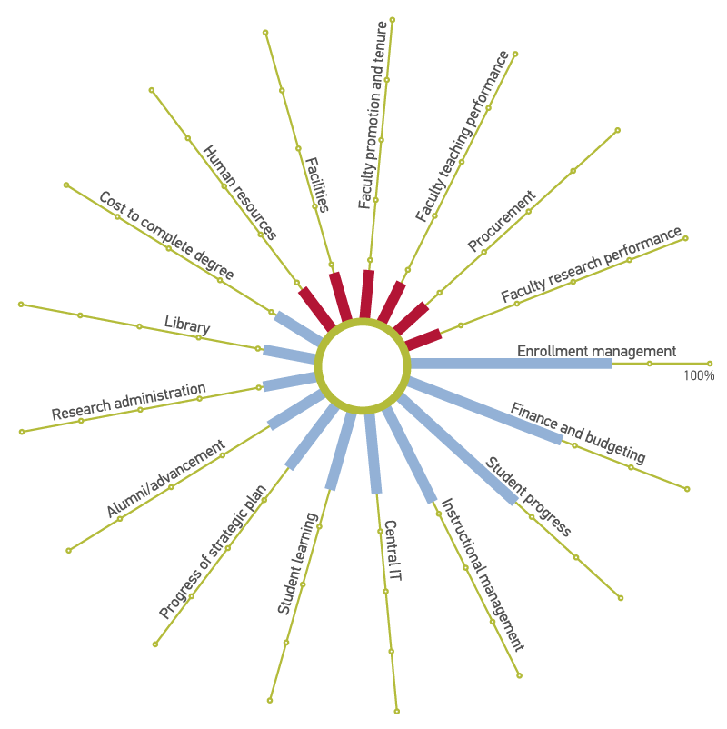
But Analytics Use Is Lagging
…particularly in areas of administrative and faculty activities

Slide 11
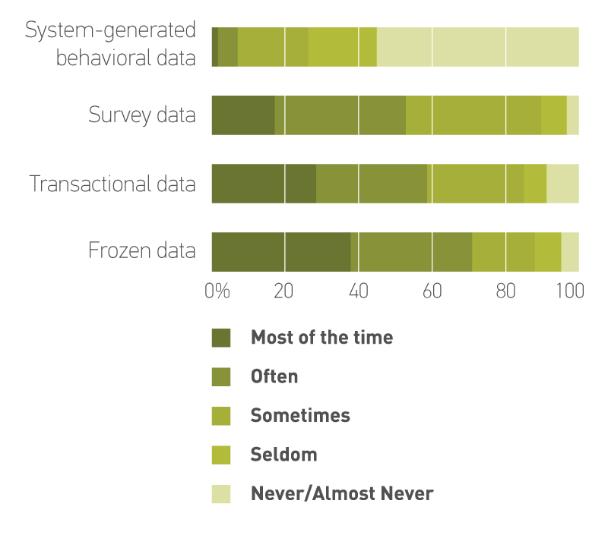
Still, Predominant Use of Static Data

Slide 12
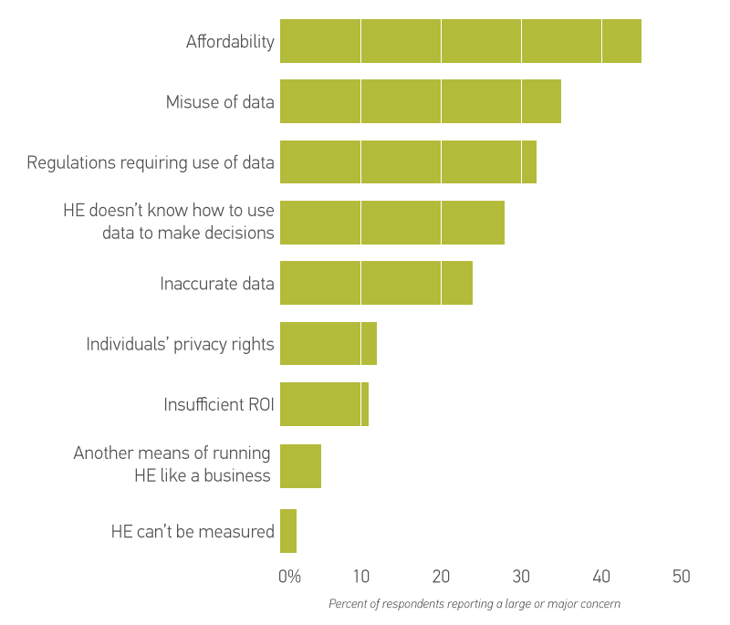
Concerns About Analytics

Slide 13
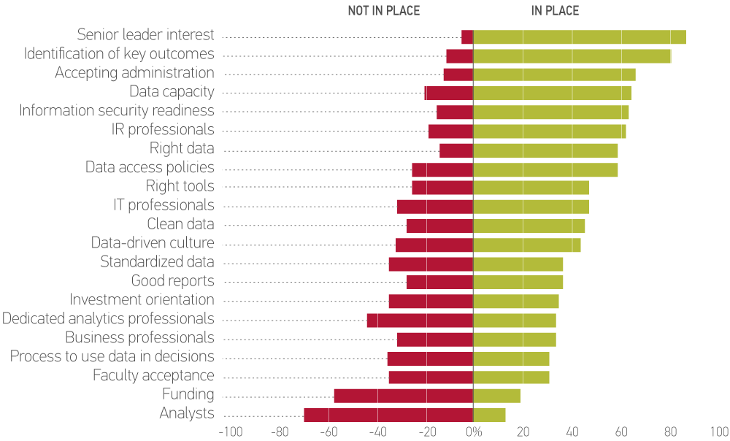
What Is In Place for Analytics

Slide 14
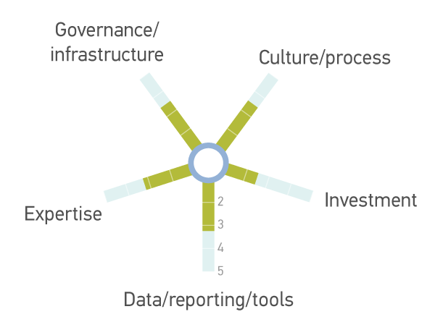
Higher Education’s Progress

Slide 15
Recommendations
Map out strategy and planning.
Questions drive analytics, not data or tools.
Develop an important win.
Show value of using data to drive decisions.
Invest in people over tools.
Don’t wait for perfection.
Encourage partnerships and communication.

Slide 16
Recommendations
Plan for infrastructure that supports analytics across the institution.
All important: data accessibility
Plan for IT support.
Training, resources, tools
Benchmark to provide context.

Slide 17
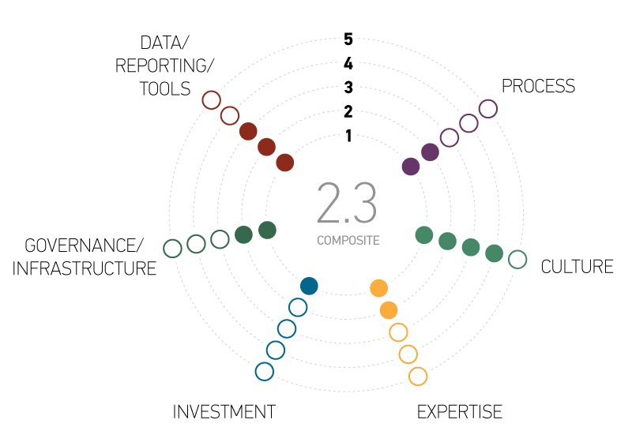
ECAR Analytics Maturity Index

Slide 18
ECAR Analytics Maturity Index
Publicly available through ECAR site: http://www.educause.edu/library/resources/2012-ecar-study-analytics-higher-education

Slide 19
THANK YOU
Gates Foundation
Association for Institutional Research (AIR)
Subject matter experts: Jerry Grochow, Joel Hartman, Vernon Smith, & John Campbell.
Susan Grajek, Pam Arroway, Eden Dahlstrom, & Greg Dobbin (EDUCAUSE in-house expert feedback and reviews).
Tyson Anderson (graphics).

