Slide 1
Four Reasons You Should Never Buy BI/Analytic Solutions
Cameron Evans, MBA
Chief Technology Officer
Microsoft Education
#MSFTEDU13

Slide 2
You likely already own the foundation for BI and Analytics
Reason #1

Slide 3
The World of Data is Changing
10x increase every five years
Data explosion
Consumerization of IT
4.3 connected devices per adult
85% from new data types
27%
using social media input
“By 2015, organizations integrating high-value, diverse, new information types and sources into a coherent information management infrastructure will outperform their industry peers financially by more than 20%.”
– Gartner, Regina Casonato et al., “Information Management in the 21st Century”
Notes:
There has never been a more exciting time with respect to the world of data. We are seeing the convergence of a number of significant trends that are fundamental transforming the industry.
More types, shapes and sizes than ever before…Where does it come from? 1) Transactional growth in your business. 2) New data sources – image files, sensors driven 3) Moving business online – entirely new channels, with different pace at which the business needs to operate. entirely new scale and scope of the kinds of data we are trying to gain insights from
The way users are consuming and collaborating on data is changing and it’s setting new expectations, we are all carrying around devices with powerful computational capabilities, and we want to use them with data. And new tech like social networking is teaching people how to collaborate more effectively around information and ideas… Users expectations have changed and they want to be able to do more for themselves, from any device……
Gartner asserts that “By 2015 businesses that build a modern information management system will outperform their peers financially by 20 percent.” McKinsey agrees, confirming that organizations that use data and business analytics to drive decision making are more productive and deliver higher return on equity than those who don’t.

Slide 4
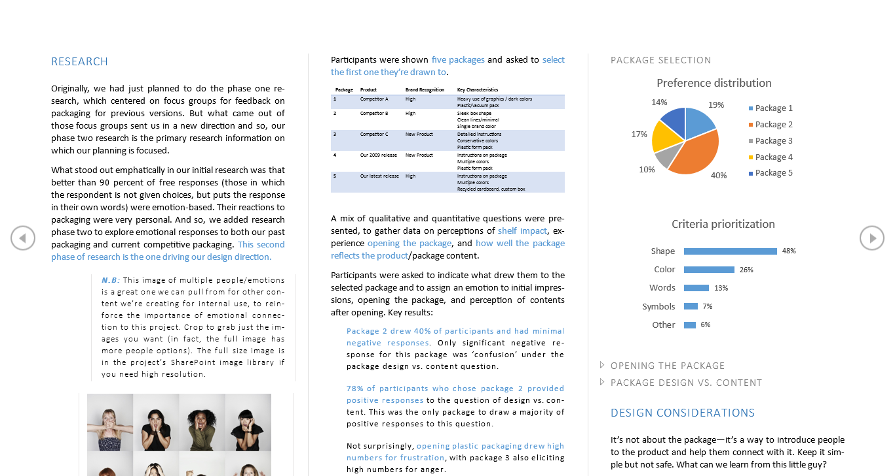
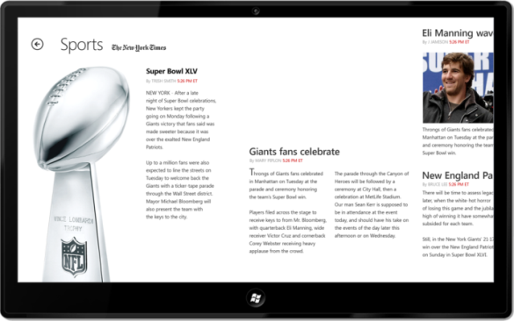
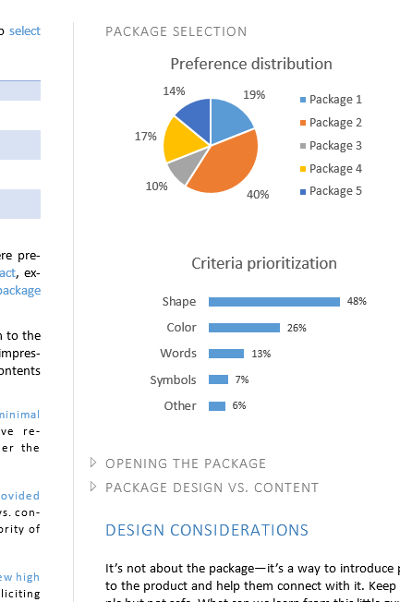
Microsoft’s productivity vision
Hybrid
On Premises
Online
Best experience across devices
Cloud on your terms
Messaging
Voice & Video
Content
Management
Enterprise
Social
Data
& Analytics
Integrated best-of-breed solutions
Notes:
Microsoft has a vision for the new office place and for productivity, which evolves with these new user expectations in mind. It’s about delivering the best experience to users across any device and it’s about enabling new turn-key productivity solutions through the cloud, that are designed to seamlessly integrate as a single integrated, best-of-breed cloud solution. This includes messaging, voice & video, content management, enterprise social, and the investments that we are making in Data & Analytics, otherwise know as Self-Service BI.

Slide 5
Microsoft Power BI for Office 365 Self-service BI with the familiarity of Office and the power of the cloud
Insights in Excel 1 Billion Office Users
Collaborate in Office 365 1 in 4 enterprise customers on Office 365
Discover
Analyze
Visualize
Share
Find
Mobile
Q&A
Scalable | Manageable | Trusted
Notes:
What is Power BI?
Power BI for Office 365, a self-service business intelligence (BI) solution delivered through Excel and Office 365 which provides information workers with data analysis and visualization capabilities to identify deeper business insights either on-premise or within a trusted cloud environment. With Power BI for Office 365, customers can connect to data in the cloud or extend their existing on premise data sources and systems to quickly build and deploy self-service BI solutions hosted in Microsoft’s enterprise cloud.
Power BI for Office 365 enables customers to do more with their data:
- Analyze and present insights from data in compelling visual formats either on premises or in the cloud from Excel.
- Share reports and data sets online with data that is always kept up to date.
- Ask questions of your data using natural language search and get immediate answers through interactive tables, charts and graphs.
- Access and stay connected to data and reports from your mobile devices wherever you are.
Power BI addresses several fundamental business needs:
Enable self-service BI solutions for everyday business users with the ease of use and familiarity of a tool they already use – Excel. Excel is the most widely-used analytical tool by information workers.
Enable collaboration, connectivity, scale and governance by offering BI in the cloud through Office 365. Users can easily share their data and analysis with colleagues and access reports wherever they go – on their desktop at work, over the Web at home, and on their mobile device. Manage important data for the team and track usage to see who’s accessing the data and what data sets are most often used.
Enable organizations to extend their existing investments for on-premise data warehouses and operational systems as well as cloud-based data sources and Hadoop clusters to create secure and easy-to-use self-service BI solutions that can also monitor employee access and usage.
Customers can sign up to preview Power BI for Office 365 at www.office.com/powerbi.

Slide 6
Everyone needs BI for institutional effectiveness
Reason #2

Slide 7
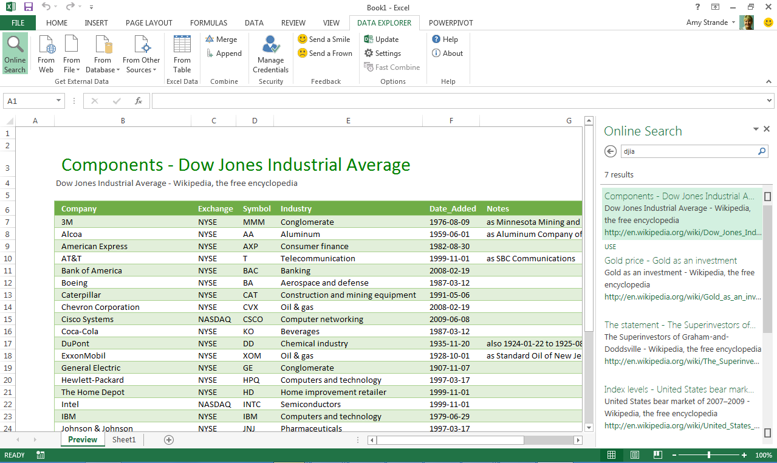
Powerful Self-Service BI with Excel 2013
Discover & Combine
Search and access internal & external data
Clean, transform, and shape data
Merge and combine data from multiple sources
Power Query – formerly project “Data Explorer”
Analyze & Model
Lightning fast analytics with in-memory technology
Model relationships, custom measures, hierarchies, and KPI’s
Visualize & Explore
Bring your data to life with interactive visualization
Explore data in new ways to discover hidden insights
Notes:
Think of this as self-service ETL
Explorer: Data Explorer provides a familiar and intuitive experience for finding and connect to data from within Excel. Easily combine and transform data so that it can be analyzed and visualized for deeper insight. Power Query supports a wide variety of data sources including relational, structured and semi-structured, OData, from the Web, Hadoop, as well as Data Search capabilities that provide users with a search experience for data, returning relevant data sets from across the enterprise and from external sources.

Slide 8
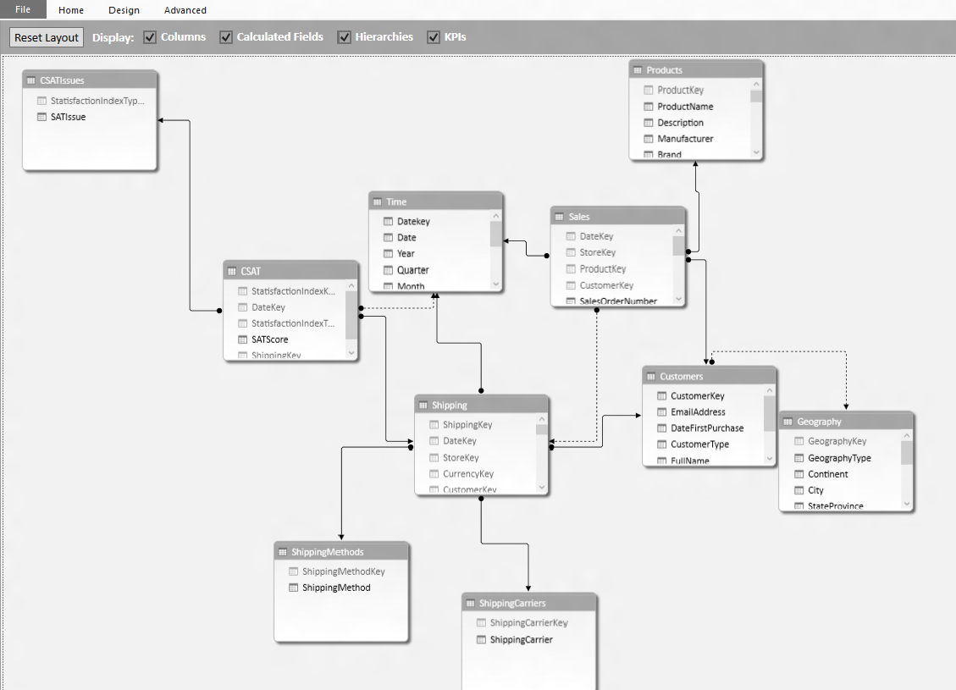
Powerful Self-Service BI with Excel 2013
Discover & Combine
Search and find internal & external data
Clean, transform, and shape data
Merge and combine data from multiple sources
Power Pivot
Analyze & Model
Lightning fast analytics with in-memory technology
Model relationships, custom measures, hierarchies, and KPI’s
Visualize & Explore
Bring your data to life with interactive visualization
Explore data in new ways to discover hidden insights
Notes:
In market for a while and gaining traction. What is it? We’ve taken an enterprise grade in-memory database engine and we’ve built it into Excel. Then we build an intuitive, user friendly modeling interface on top of it, so that users can build relationships, create custom measures, hierarchies and KPI’s in the familiar environment of Excel. To do this we introduced DAX, which is an excel like formula language.
Power Pivot: Power Pivot brings the power of in-memory database technology and flexible modeling to Excel. Create powerful analytical models in a familiar and flexible environment for fast manipulation and processing of large data sets. Define relationships, create custom measures, hierarchies and KPIs.

Slide 9
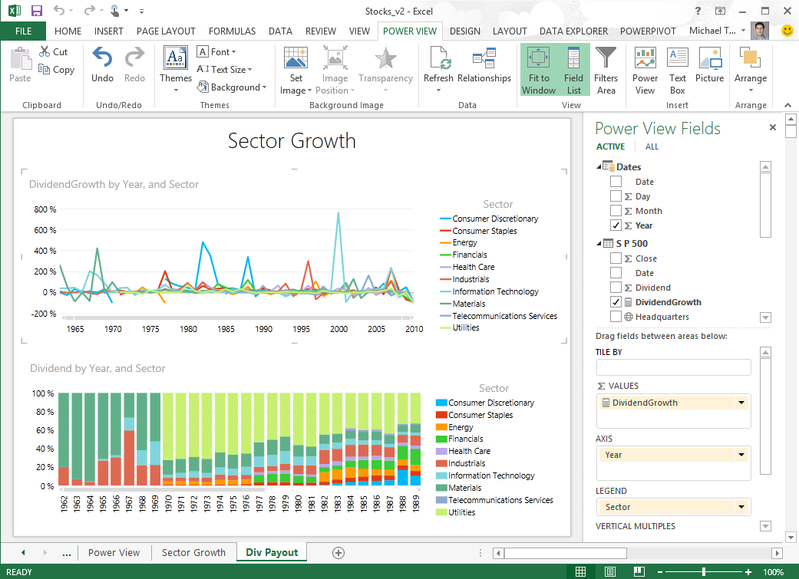
Powerful Self-Service BI with Excel 2013
Discover & Combine
Search and find internal & external data
Clean, transform, and shape data
Merge and combine data from multiple sources
Power View
Analyze & Model
Lightning fast analytics with xVelocity in-memory technology
Model relationships, custom measures, hierarchies, and KPI’s
Visualize & Explore
Bring your data to life with interactive visualization
Explore data in new ways to uncover hidden insights
Notes:
Power View: Discover and share new insights through interactive data exploration and visualization experiences with Power View in Excel. Power View lets you compile data, charts, and graphs into a single view to bring your data to life.

Slide 10
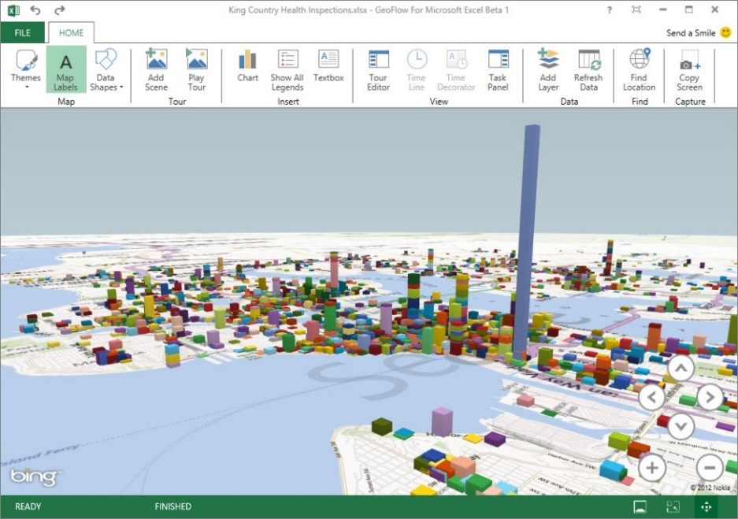
Powerful Self-Service BI with Excel 2013
Discover & Combine
Search and find internal & external data
Clean, transform, and shape data
Merge and combine data from multiple sources
Power Map – formerly project “Geoflow”
Analyze & Model
Lightning fast analytics with xVelocity in-memory technology
Model relationships, custom measures, hierarchies, and KPI’s
Visualize & Explore
Bring your data to life with interactive visualization
Explore data in new ways to discover hidden insights
Notes:
Power Map: Power Map is a 3D data visualization tool for Excel that provides a powerful method for people to look at information in new ways enabling discoveries in data that might never be seen in traditional 2D tables and charts. “GeoFlow" combines 3D visual exploration with the ability to make direct comparisons of values and identify outliers by seeing data displayed in 2D charts at the same time. "GeoFlow" is the best way to visualize geographic data in Excel 2013 workbooks, with new 3D columns or heat maps. Then play the visualizations over time and share insights captured within your organization through interactive tours.

Slide 11
Demo – Self-Service BI in Excel

Slide 12
Shared insight is the intersection of innovation
Reason #3

Slide 13
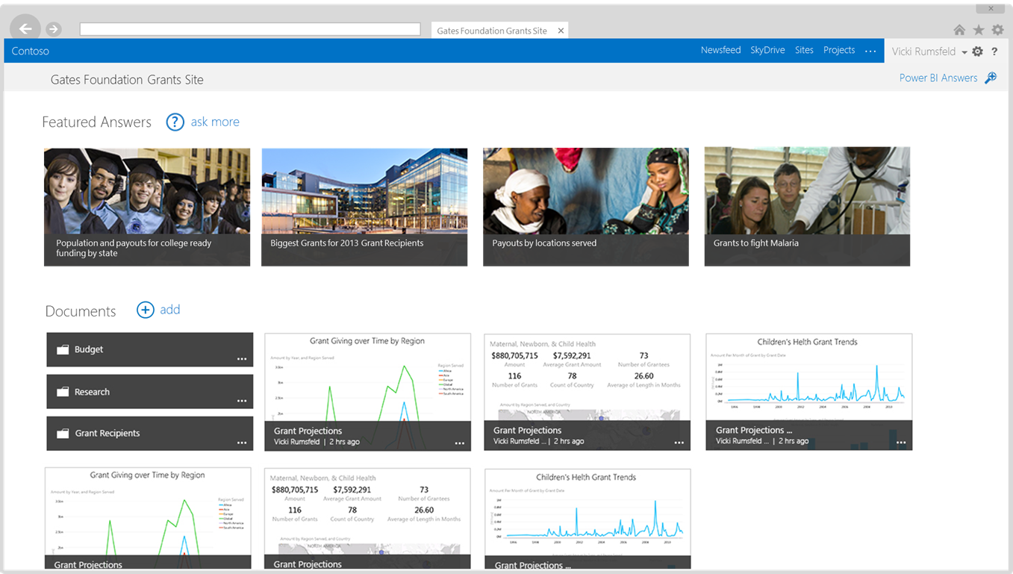
Collaborate and Stay Connected with Office 365
Share Data & Insights
Easily setup powerful BI sites
Share live reports with data refresh from on-prem sources
Manage and share data sets and monitor usage
Power BI Site in Office 365
Ask Questions & Get Answers
Ask questions in the natural language speech bubble
Get back answers as the system generates data visualizations
Q&A
Mobile Access
View Power View reports on any device with HTML5 support
Discover and explore all your favorite reports with the mobile BI app
Notes:
BI Sites: Quickly create collaborative BI optimized workspaces in Office 365 to share BI worksheets with colleagues, collaborate over insights and results, and quickly find the data you’re looking for quickly. BI Sites make it easier to find report, refresh data,
Get answers quickly with natural language query

Slide 14
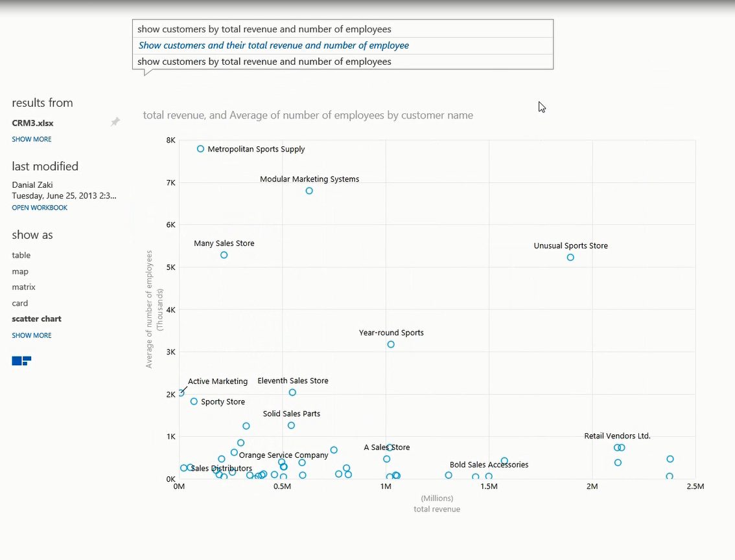
Collaborate and Stay Connected with Office 365
Share Data & Insights
Easily setup powerful BI sites
Share live reports with data refresh from on-prem sources
Manage and share data sets and monitor usage
Q&A – natural language query
Ask Questions & Get Answers
Ask questions in the natural language speech bubble
Get back answers as the system generates data visualizations
Q&A
Mobile Access
View Power View reports on any device with HTML5 support
Discover and explore all your favorite reports with the mobile BI app
Notes:
Data Stewardship: Manage and share your own data views and definitions with others, certify that the data is correct, and gain valuable insights on who and how the data is being used.

Slide 15
Collaborate and Stay Connected with Office 365
Share Data & Insights
Easily setup powerful BI sites
Share live reports with data refresh from on-prem sources
Manage and share data sets and monitor usage
HTML5 & Mobile BI app
Ask Questions & Get Answers
Ask questions in the natural language speech bubble
Get back answers as the system generates data visualizations
Q&A
Mobile Access
View Power View reports on any device with HTML5 support
Discover and explore all your favorite reports with the mobile BI app
Notes:
Mobile BI: Enable users to stay connected to live reports through the browser with HTML5 or through a mobile BI app designed for their device, providing touch optimized live mobile access to critical business information and reports stored in Office 365. HTML 5 support enables interactive browser based report access from any device. In addition, the BI mobile app provides an optimized experience for your device, enabling you to view all your favorite reports in integrated mobile experience, wherever and whenever they need it. Mobile access to reports will be supported by the BI offering for O365 due to preview later this year.
The mobile app offer a consumption experience for the reports that you save to Office 365.
Features of the mobile app include:
Discover – Find published Excel and Power View content. Navigate and find documents. Save favorites.
Present – Show and interact with content. View content, keep context. Sort, highlight, filter, play axis. Zoom, pan, swipe.
Share – Collaborate with others by taking a snapshot and sending an email.

Slide 16
Demo – Power BI for Office 365

Slide 17
You need insight beyond the institutional walls
Reason #4

Slide 18
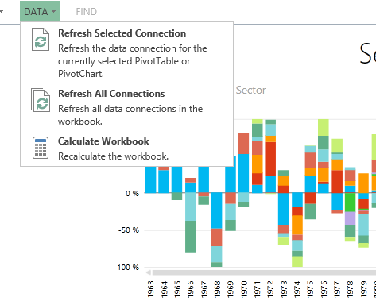
Extend with Hybrid Cloud Solutions
On-Premise Data Access
Enable manual or scheduled data refresh for reports in Office 365 to on-premise sources
Data Management Gateway
Enterprise Data Search
Enable ease of discovery with data search across on premise data
Data Usage & Telemetry
Monitor data usage across your organization to optimize system investments
Notes:
New capabilities that allow you to extend your existing systems into this user experience:
We introduce a new Data Management Gateway, which allows you to build connections to on premise data sources so that reports that are published to BI Sites in Office 365 can refresh the data either on demand or scheduled so that users are looking at the latest view of the data.
We’re providing an enterprise data search engine. This is the same engine that we have available publically and we’re using to index the worlds data with sources such as from Wikipedia and Data.gov, as well as with partners such as Dunn & Bradstreet. We’re providing a private version of this to the enterprise so that you can index your own data sources and sets so that users …
Also, we’re builting into this search engine a number of useful different diagnostic tools so that you can see which users are accessing the data and which data sources they’re using, giving you more information to decide which data sources are sitting idle and can be decommissioned.

Slide 19
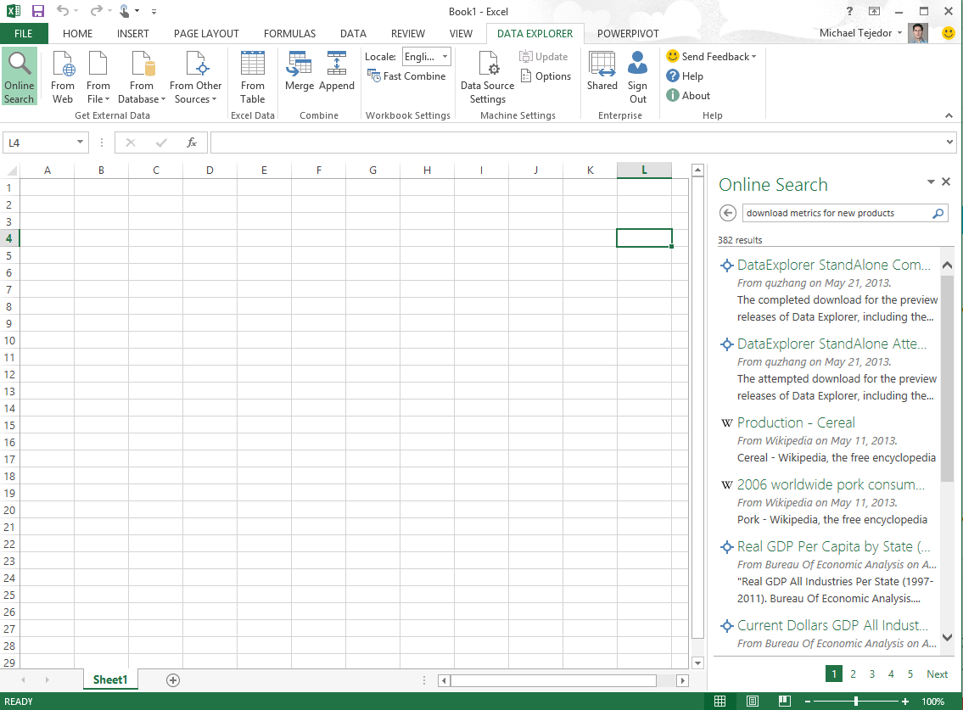
Extend with Hybrid Cloud Solutions
On-Premise Data Access
Enable manual or scheduled data refresh for reports in Office 365 to on-premise sources
Data Catalogue
Enterprise Data Search
Enable ease of discovery with data search across on premise data
Data Usage & Telemetry
Monitor data usage across your organization to optimize system investments
Notes:
New capabilities that allow you to extend your existing systems into this user experience:
We introduce a new Data Management Gateway, which allows you to build connections to on premise data sources so that reports that are published to BI Sites in Office 365 can refresh the data either on demand or scheduled so that users are looking at the latest view of the data.
We’re providing an enterprise data search engine. This is the same engine that we have available publically and we’re using to index the worlds data with sources such as from Wikipedia and Data.gov, as well as with partners such as Dunn & Bradstreet. We’re providing a private version of this to the enterprise so that you can index your own data sources and sets so that users …
Also, we’re builting into this search engine a number of useful different diagnostic tools so that you can see which users are accessing the data and which data sources they’re using, giving you more information to decide which data sources are sitting idle and can be decommissioned.

Slide 20
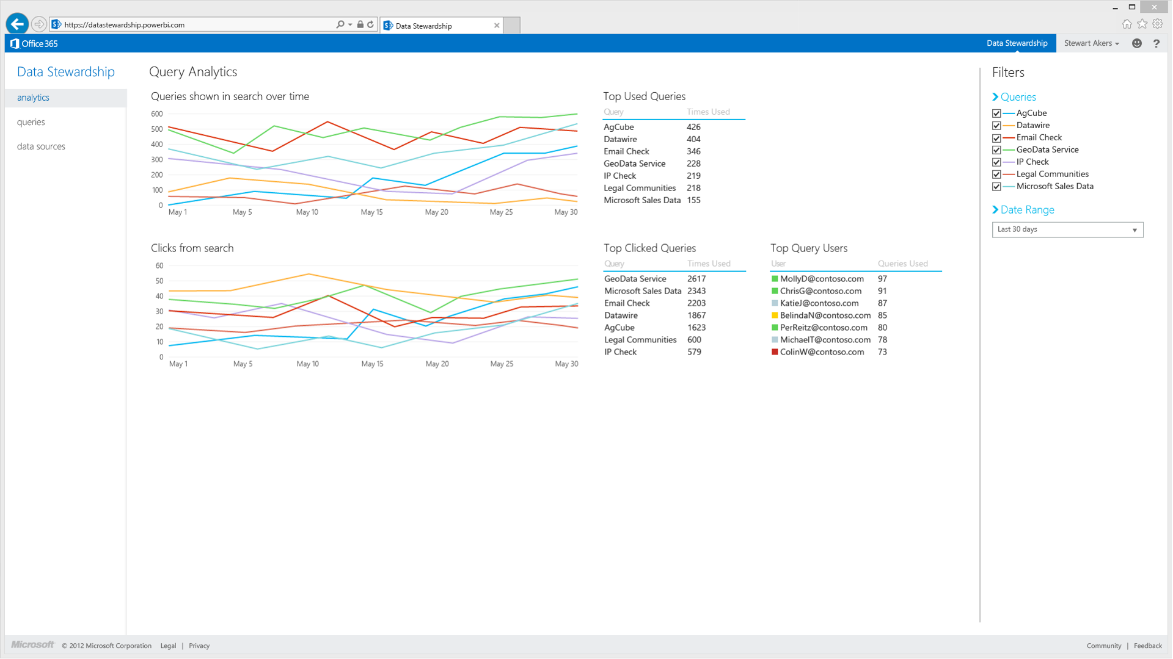
Extend with Hybrid Cloud Solutions
On-Premise Data Access
Enable manual or scheduled data refresh for reports in Office 365 to on-premise sources
Data Catalogue
Enterprise Data Search
Enable ease of discovery with data search across on premise data
Data Usage & Telemetry
Monitor data usage across your organization to optimize system investments
Notes:
New capabilities that allow you to extend your existing systems into this user experience:
We introduce a new Data Management Gateway, which allows you to build connections to on premise data sources so that reports that are published to BI Sites in Office 365 can refresh the data either on demand or scheduled so that users are looking at the latest view of the data.
We’re providing an enterprise data search engine. This is the same engine that we have available publically and we’re using to index the worlds data with sources such as from Wikipedia and Data.gov, as well as with partners such as Dunn & Bradstreet. We’re providing a private version of this to the enterprise so that you can index your own data sources and sets so that users …
Also, we’re builting into this search engine a number of useful different diagnostic tools so that you can see which users are accessing the data and which data sources they’re using, giving you more information to decide which data sources are sitting idle and can be decommissioned.

Slide 21
Microsoft Power BI for Office 365
Insights in Excel
Collaborate in Office 365
Discover
Search, access, and transform public and internal data sources with Power Query
Share
Share data views and workbooks refreshable from on-premises and cloud based data sources, with Power BI Sites
Analyze
Easy data modeling and lightning fast in-memory analytics with Power Pivot
Find
Ask questions and get immediate answers with natural language query
Q&A
Visualize
Bold new interactive data visualizations with Power View and Power Map
Mobile
Mobile access through HTML5 and touch optimized apps for Windows 8, RT and iOS tablets
Scalable | Manageable | Trusted
Notes:
What’s in Power BI for Office 365? Let me walk through the new features which include a number of new capabilities within Excel 2013 and Office 365.
Powerful Self-Service BI in Excel 2013: We are taking our most powerful business intelligence solutions and building them directly into Excel. These solutions package the data discovery, analysis and visualization process into one self-service BI solution, which is essential for business users who are looking to get bigger returns on their data. Features include:
For data search and discovery, we’re introducing Power Query, formerly Project codename “Data Explorer.” We’ve created a data search engine so customers can query data from within their business and from external data sources on the Web, all within Excel. We’re working with partners to provide a private version of this search engine so businesses can customize the engine and index the data sources they commonly access. Power Query also cleans and merges data sets from multiple sources, enabling IT and BI users to focus on data insights rather than data management.
For analyzing and modeling data we will continue to offer Power Pivot. Power Pivot enables customers to create flexible models within Excel that can process large data sets very quickly using SQL Server’s in-memory database. Customers can customize the model as needed all within Excel – no extra coding needed.
For visualizing and exploring data we introduced Power View and Power Map, formerly Project codename “Geoflow.”
Using Power View, customers can manipulate data and compile it into charts, graphs, and other visual means. Great for presentations and reports.
Power Map is a 3D data visualization tool for mapping, exploring and interacting with geographic and temporal data. Customers can visually plot up to a million rows of data in 3D on Bing Maps, view data in a geographic space, and share findings through screenshot slides and cinematic, guided video tours.
Collaborate and stay connected with Office 365: While all of these tools enable great self-service BI, asking business users to work within a BI silo significantly decreases the potential value of their data to the entire organization. That’s why we’ve made all of these Excel capabilities available in the cloud in Office 365, so customers can share and access their BI models across the desktop, Web and devices, all in a trusted, managed environment.
To share insights and help customers get answers quickly, we’ve created BI Sites. Within their organization’s trusted environment, BI users can quickly create workspaces in Office 365 to share worksheets with colleagues, collaborate over insights and results, and quickly find data and reports. A couple key features:
We’ve incorporated a natural language query engine that IT can customize to help their users search for specific datasets quickly and easily.
We’ve created a Data Management Gateway, which allows IT to build connections to internal data sources so reports that are published to BI Sites in Office 365 will refresh either on-demand or on a scheduled basis, ensuring that users are always looking at the latest view of their data.
To better manage data, Power BI for Office 365 empowers a business’s IT organization to help its users become their own data stewards. This means that users can grant access to their BI Sites and published models based on their colleague’s credentials. In addition, we’re introducing a number of useful different diagnostic tools so IT can see which data sources are commonly accessed and which are sitting idle and can be decommissioned.
To enable users to stay connected to their data wherever they are, we’ve created a connected BI experience. BI users can access and receive live updates on their reports through their browser with HTML5 or through a mobile application designed for their device.
Enable organizations to extend their existing investments for their on premise data warehouses and operational systems as well as cloud based data sources and Hadoop clusters to create powerful, trusted and easy to use self-service BI solutions that can also monitor employee data access and usage.
Microsoft is uniquely positioned to deliver this solution, which we believe outpaces the rest of the market, in two ways.
Connected Platform: While some vendors offer self-service BI and visualization tools, we are the only vendor that delivers a complete data platform of connected technologies from relational data warehouses like SQL Server to big data stores like HDInsight to end user productivity tools like Office, to enable rapid insights from any data (structured or unstructured), in the tools that they know and love. Power BI for Office 365 brings together the best of Windows Azure and Office 365 bringing Big Data to a billion users..
BI & IT Management Together: Power BI for Office 365 is the industry’s first BI solution that brings self-service BI and essential IT management tools into one service. This allows businesses to leverage internal and external data in a safe environment, increasing collaboration around data insights.

Slide 22
Designed for IW’s and IT
Easy to use - Self-Service BI capabilities delivered through the familiar Excel environment.
Easy to get started – turn-key solution delivered through a trusted service in Office 365.
Faster time to solution - reduces deployment complexity and project time.
Extend existing systems – cloud based services that extend your existing on-premises systems.

Slide 23
Join the Preview
Register at PowerBI.com

