Slide 1
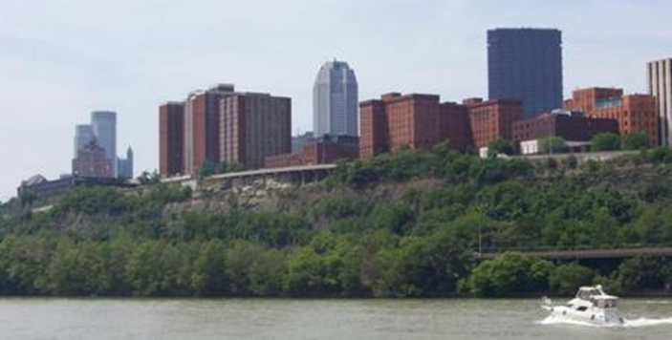
From Wired to BYOD to Distance Learning:
Lessons Learned in Making Technology Investments
Sheryl Reinhard
Director of IT Infrastructure
Computing and Technology Services

Slide 2
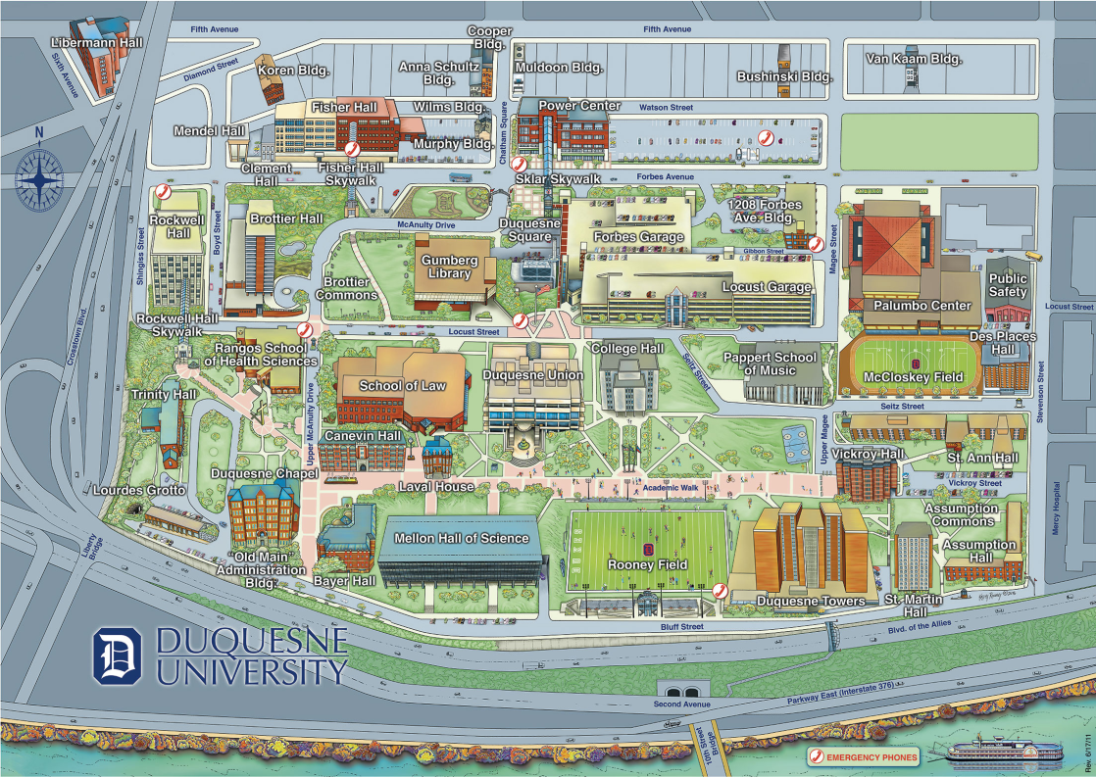
Duquesne was founded on Oct. 1, 1878 as a Catholic College by the Congregation of the Holy Spirit
50 Acre Campus, 7 residence halls, 45 buildings
Enrollment: 10,011 students
5,751 undergraduate
3,620 graduate
6,40 law
3,500 students live on campus,
85% of freshmen and sophomores
14:1 Student-to-Faculty ratio
480 full-time and 511 part-time faculty
10 schools of study

Slide 3
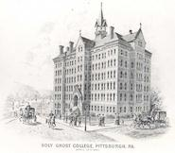
The Duquesne University mission is to serve God by serving students
Academic community dedicated to excellence in education
Spiritan Identity
Open to Diversity
Service to the Church, the nation and the world
Core Values
Ethics
Service to the community
Environmental Stewardship

Slide 4
Top 10 IT issues in Higher Education, Educause 2013
Leverage the Wireless and Device explosion across
Improve the student outcomes through leverage of Technology
Develop a University wide cloud strategy
Develop a Organisational model that accommodates the changing environment, and facilitates openness & agility
Support information security that aligns with infrastructural openness needed by BYOD
Build a strategic funding model
Develop a sustainable online learning strategy
Support BYOD and Consumerization universally
Transform the business practices with IT
Increase use of Analytics to support critical outcomes

Slide 5
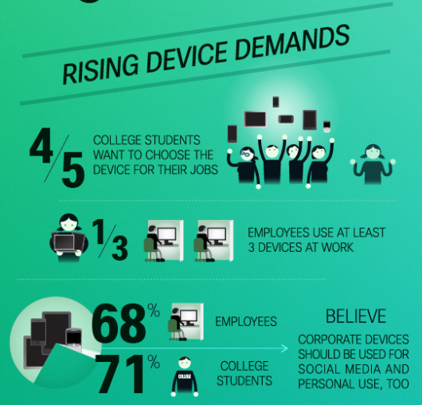
Our Challenges
Funding
Our Students are living a connected life when they arrive
BYOD
Smartphones, tablets
Students demand that services such as Facebook, text, YouTube, etc. are always available
Mobility and Access
Services
Self-service and Automation
Guest Access
Security
Notes:
First and foremost, our challenge has been funding and sustainability. As the demand for technology grows exponentially, our funding does not follow suit. College students are addicted to technology. 38 % of college students say the cannot go more than 10 minutes without using a digital device.

Slide 6
Our Challenges
Data Center Limitations
Limitations of existing infrastructure to facilitate the use of voice, video and data
Need for better control, visibility and security for both managed and non-managed endpoints, guest access and role-based access
Communication and Collaboration
Centrex
Video Conferencing
Email/Calendar/Productivity Tools
Other Universities/Researchers
Social Media
Cloud/Hosted Services/SaaS
Distance Education and eLearning

Slide 7
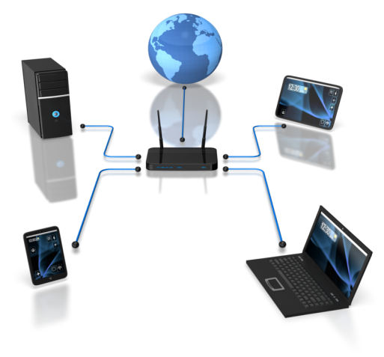
FROM WIRED
Ability to access Campus Life with multiple devices
Quick and simple deployment of new approved applications
Quality delivery of applications which are multimedia content reach (ex. Video, Collaboration)
Ability to Teach/Study anywhere and be always connected (mobility)
CONVERGED
NETWORKING
Increase bandwidth at the network access and core
High WLAN density, capacity and coverage
Enhanced context aware QoS
Unified network access control (LAN and WLAN): Guest Access, same policies, etc
Augment network security
Quick and quality delivery of new applications
Management & SLA

Slide 8
BYOD
Replace WLAN enabled Laptop carts or 1st Gen WLAN
Controller based, 802.11n, 802.11ac… Access Points, Policy Enabled Firewalls
Add Network Access Control
Device aware profiles, Automatic Remediation, Support User Network Profiles
Train Certified Staff on pedagogical changes in a connected classroom, campus environment.
Create segmented SSIDs to automate controls.
BEST PRACTICES
Secure
Wireless domain member devices only
802.1x device authentication
Same log-on experience as wired domain devices
Guest
Filtered Internet access only
Captive portal authentication
AD guest ID required
No device to device visibility
SSDZ (Student - Staff Device Zone)
Pre-configured for auto connection to stage 1
Stage 1 access same services as Guest access
Stage 2 full access to core resources (printers, file servers, etc) after successful HIC check
Presenter
Authenticated raw Internet access extended to any AP upon specific request

Slide 9
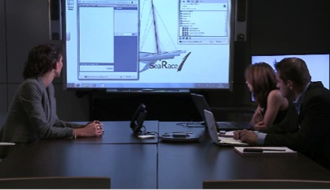
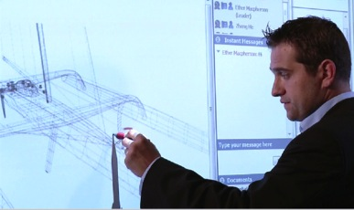
DISTANCE LEARNING
The internet is the new frontier for higher education
Supports our mission
Expands our recruiting pool
Maintain a competitive edge
No physical limitations of classrooms, parking, traffic, course schedules, etc.
Distance Education will continue to drive the demand for video
How do we maintain our identity and preserve our brand in the virtual world?

Slide 10
Recommended Areas of Focus
Attribute | Connectivity | Teaching & Learning | Communications | Data Security
1. Network Refresh (backbone / capacity)
2. Wireless Access (extend coverage)
3. Remote Access (same access regardless of location)
4. Telephony Requirements (replace aging Centrex system)
5. Mobile Device Support (guidelines; provision phones; leverage size)
6. Enterprise Communications (reachable and able to reach others)
7. Video Conferencing (flip the classroom; remote sites)
Current technology is meeting the need
Some need for improvement
Significant need – negative impact on the faculty, staff, and/or students

Slide 11
Gap Analysis Summary
State of the Market
Last Generation
Leading Edge
Obsolete
Emerging Technology
Current State |  | Future State
Partial wireless coverage |  | Complete campus coverage
Centrex |  | OmniPCX Enterprise
Ad hoc cell phone usage |  | Corporate mobile device policy
Paper /web directories |  | Enterprise Communications (fixed & mobile)
Ad hoc Skype usage |  | Enterprise grade video collaboration
No wireless print capability |  | Print from anywhere to anywhere
Mix of MS Outlook and MeetingMaker |  | Commodity productivity tools
Notes:
The Gap Analysis was a great tool for us to demonstrate the current state of technology and the results of where our stakeholders feel we should be.

Slide 12
Technology Roadmap
Remote Access
Video Conf
Network Refresh
Wireless LAN
Enterprise Communications
Telephony Upgrade
Mobile Device Support
As seen in the roadmap above, the projects are aligned from left to right and the complexity and impact to ITM and operations are represented by the 3 swim-lanes.
Low impact projects are projects can be delivered with minimal impact to business operations and resources and have very little impact to resource utilization in ITM.
Medium impact projects have much more involvement from operations and ITM will require focused resources for the projects successful implementation.
High impact projects require organizational change as well has a significant time and resource investment from both operations and ITM. The projects require a high degree of involvement but yield a highly functional result that will drive longer-term financial reward to the business.

Slide 13
Where we are today
CONVERGED
COMPLETE
OPTIMIZED
Refresh of the back-end infrastructure is 100% complete
Wired and wireless network refresh completion with the new data center.
The design and deployment of the new POE switches has positioned us for the VOIP deployment and the replacement of all Centrex lines.
Faculty and staff have moved to Microsoft Cloud for email/calendar
SafeNAC solution across the campus has provided security for BYOD (with User Profiles)
Student have AD accounts with the completion of the LDAP/ISW/AD project.
We then leverage AD to for authentication and role-based access using the SafeNAC solution, firewalls and VPN computer LAB access, firewall secure access, VPN and printing .
The OmniPCX Enterprise communication system pilot was successful. Now preparing the deployment of campus wide IP Telephony and UC offerings
LifeSize Video Conferencing pilot implemented to support the Pharmacy remote classroom program
Same team deployed SafeNAC (BYOD), moving the datacenter , and starting the migration to the new IPT/UC solution

Slide 14
Interactive
Campus
Signage
Part of the Welcome Center project
An interactive information experience across the campus, using Digital displays and “BYOD” device
Alerts / Notification / Contextual information
Queue Management (Admissions, Interviews , Visitor center etc)
Video Concierge & Real Time communications
Kiosk, Way Finding and many other tools

Slide 15
Where we are heading …
Strategic vision built on a foundation of understanding, communication and innovation
Commitment to collaborate on a Duquesne University Center for Connected Education
Continue the Conversation
Changing the experience.
Notes:
This transformation requires the network infrastructure to properly support three fundamental areas: Devices, Applications and Mobility.
Let’s look at each of these aspects in more detail…

Slide 16
Alcatel Lucent’s Educause Demos Come experience the Universal University Campus
SOLUTION
Unified Access
Seamless BYOD over Wired and Wireless
The definition of the Bring your own “Campus”
Consistent user policies & profiles
Broad portfolio of products across Wired & Wireless
Interactive Digital Signage
An interactive information experience across the campus, using Digital displays and “your” device
Safe Campus
Emergency Notification and Alerts across the Interactive campus (Digital Displays & “Your” device)
Leading-edge IP Video Surveillance (with A+)
The Visual Campus
Integrating Video into Campus life (OpenTouch Video Store)
Visual Collaboration for Teachers and Students

Slide 17
...Continue the conversation
Sheryl Reinhard
Director of IT Infrastructure
Duquesne University
reinhard@duq.edu
Neal Tilley
Snr Director, Business Development , Education Markets
Alcatel –Lucent Enterprise
Neal.tilley@alcatel-lucent.com
+14079923864
Changing the experience.

