Slide 1
KnowU – Where Social Meets Learning SM
October 16, 2013
Presented by:
Dr. Dennis Trinkle, Provost/CAO
Kevin Hesler, VP – Information Services
Jason Stele, Director - EdTech

Slide 2

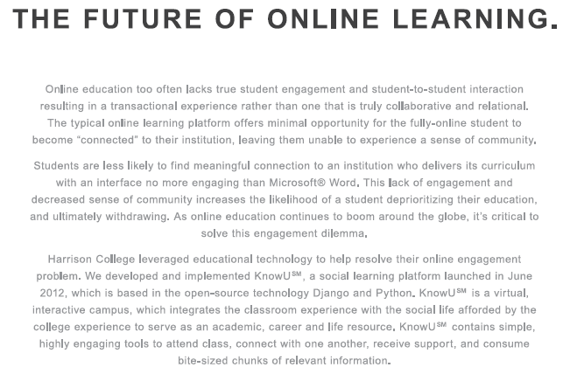

Slide 3
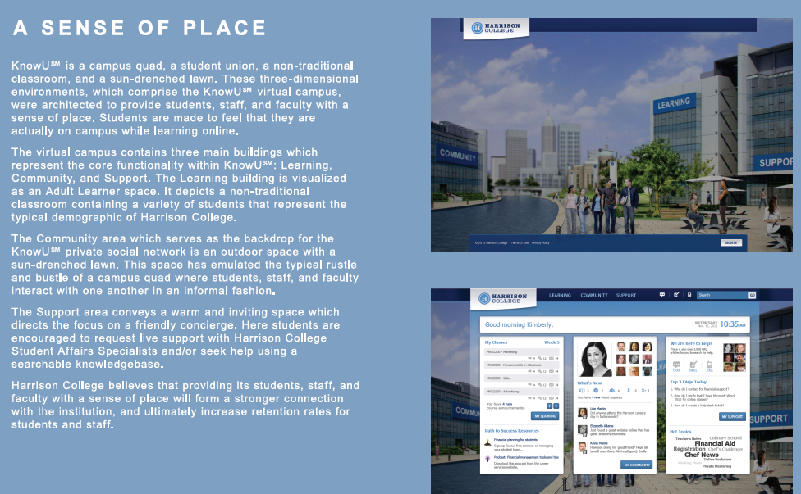

Slide 4
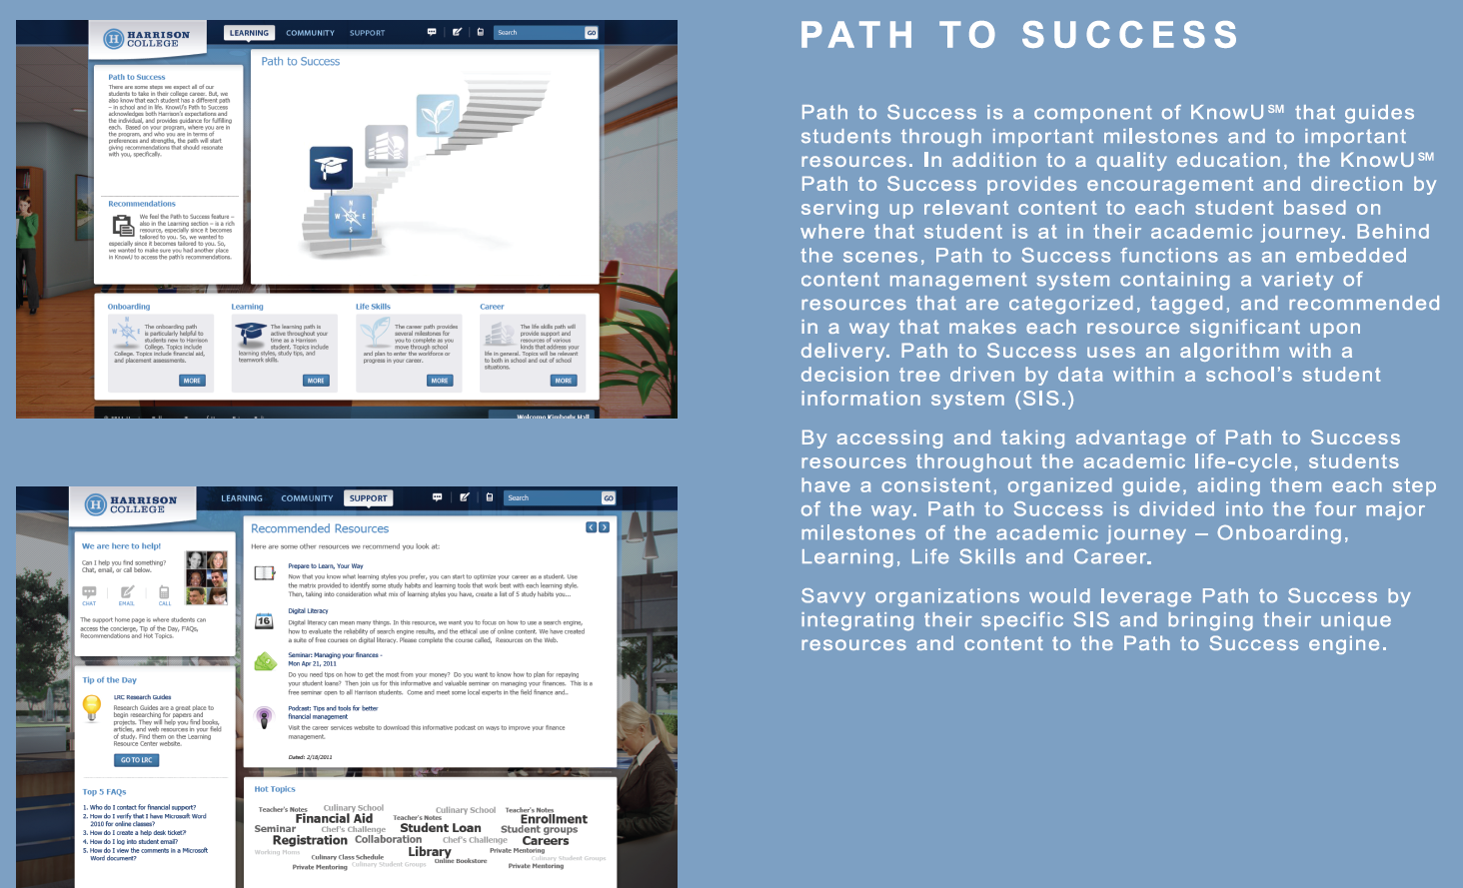

Slide 5
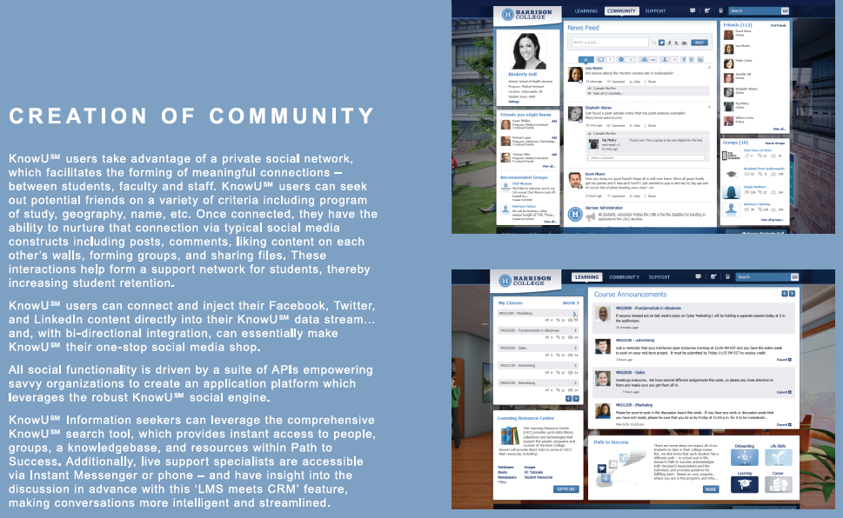

Slide 6
