Slide 1
From Question to Action: Creating In-House Surveys as a part of Data-Driven Decision Making
David Consiglio, Gentry Lankewicz Holbert, Jeffrey L. Overholtzer, Maureen H. Scoones

Slide 2
The survey design process

Slide 3
Survey design process
stages
Stage 1: Mission statement
Stage 2: Planning
Stage 3: Instrument development, Recruiting plan
Stage 4: Data collection
Stage 5: Data analysis and reporting

Slide 4
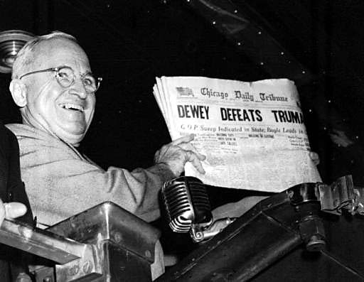
Alf Landon, 33rd President of the United States
Thomas dewey, 35rd President of the United States

Slide 5
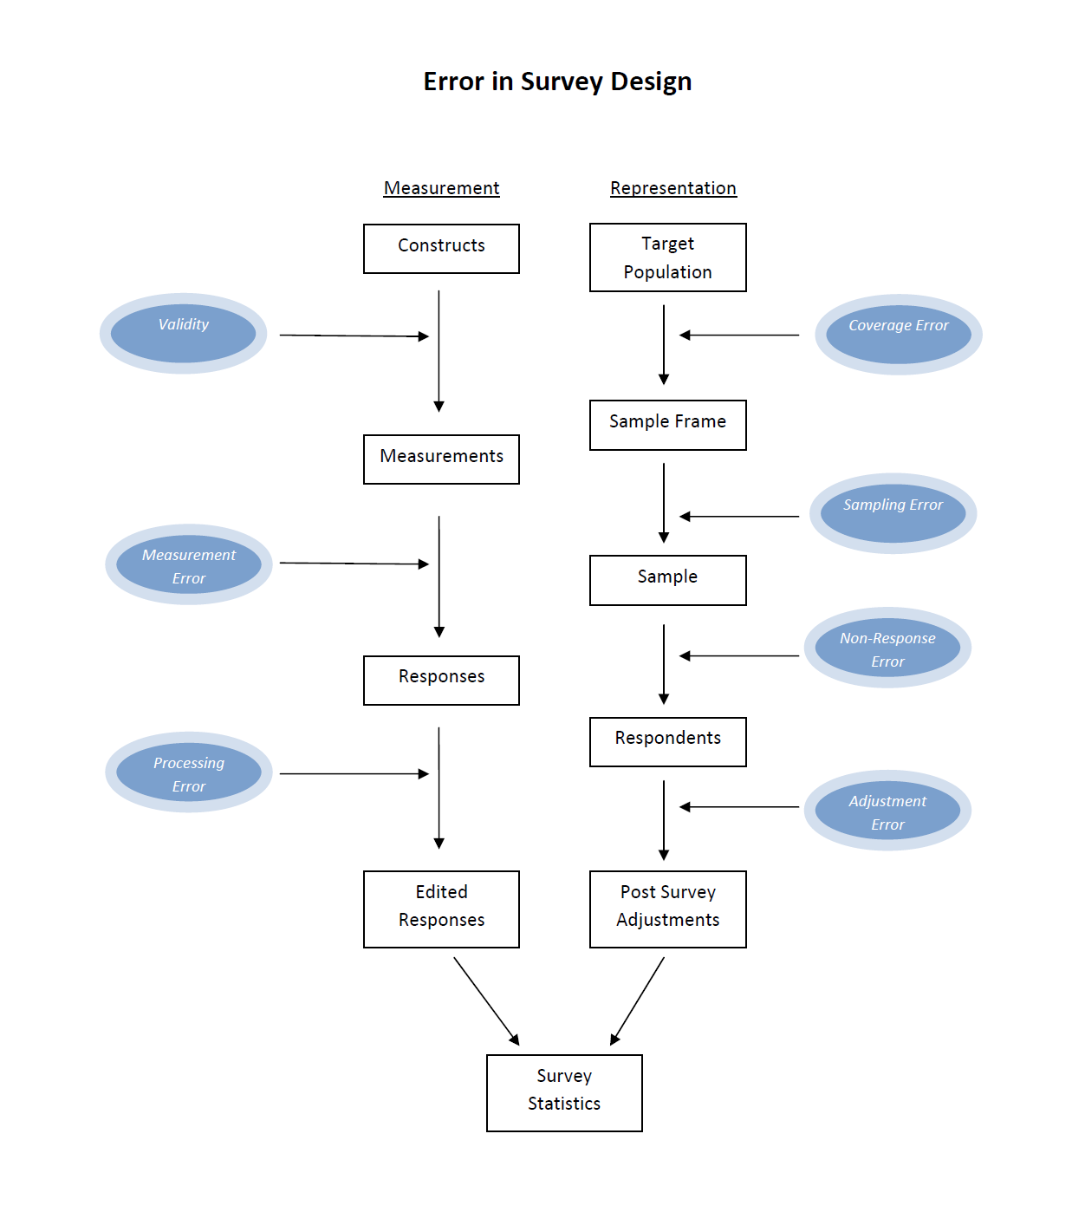

Slide 6
Survey design process: stage 1
Mission statement
Why do the research?
What are the goals?
What actions may result from it?
Write a mission statement and refer to it throughout the process

Slide 7
Survey design process: stage 2
Planning: Measurement
Define the primary constructs
Once primary constructs are defined, determine the elements that compose the constructs
Consider related elements of interest (e.g., demographics)
Develop a data analysis plan

Slide 8
Survey design process: stage 2
Planning: Representation
Define the intended populations – be specific
Develop a sample frame - a plan for determining how to reach the population
Develop a sampling plan
Determine the mode for data collection (i.e., Web, paper, in-person interviews, telephone)

Slide 9
Survey design process: stage 2
Planning: IRB
Determine if research falls under the purview of the IRB
Begin IRB process early
Decide if survey will be confidential or anonymous

Slide 10
Survey design process: stage 3
Instrument development: Consult with experts
Experts of survey design and sampling
Topic experts: service providers
Topic experts: service consumers
Look to existing and well tested survey instruments

Slide 11
Survey design process: stage 3
Instrument development: draft questions
Review to detect common flaws

Slide 12
SEM01F : Question Writing
Tips for creating effective surveys

Slide 13
1. Write answer choices that are mutually exclusive and exhaustive.
Don’t
do
What is your age?
18-25
25-35
35-45
45-55
55-65
What is your age?
17 or younger
18-24
25-34
35-44
45-54
55-64
65 or older

Slide 14
2. Write questions that ask about the choices given.
Don’t
Do
How happy are you with your mobile phone service?
Not satisfied
Somewhat satisfied
Satisfied
Very satisfied
How satisfied are you with your mobile phone service?
Not satisfied
Somewhat satisfied
Satisfied
Very satisfied

Slide 15
3. Avoid leading the respondents to one side of the choice scale.
Don’t
Do
How important to you is fuel efficiency when buying a new car?
Unimportant
Somewhat unimportant
Somewhat important
Important
How unimportant or important to you is fuel efficiency when buying a new car?
Unimportant
Somewhat unimportant
Somewhat important
Important

Slide 16
4. Have the choice order in the question match the order of the choices given.
Don’t
Do
How dissatisfied or satisfied are you with your mobile phone service?
Very satisfied
Satisfied
Somewhat satisfied
Somewhat dissatisfied
Dissatisfied
Very dissatisfied
How satisfied or dissatisfied are you with your mobile phone service?
Very satisfied
Satisfied
Somewhat satisfied
Somewhat dissatisfied
Dissatisfied
Very dissatisfied

Slide 17
5. Ask questions that avoid terms which could be defined differently by respondents.
Don’t
do
How often do you use Moodle?
Rarely
Sometimes
Often
All the time
How many times did you use Moodle in the last seven days?
None
1 – 3 times
4 – 7 times
8 or more times

Slide 18
6. Do not ask respondents to recall far into the past. (Telescoping)
Don’t
do
How many vacations have you taken over the last ten years?
How many vacations have you taken in the last 12 months?

Slide 19
7. Avoid using acronyms, insider language, and jargon
Don’t
do
Do you believe the DMCA is a necessary law?
Do you believe it should be considered a crime to circumvent security measures on digital media such as DVDs and digital music files?

Slide 20
8. Use simple language wherever possible.
Don’t
do
“If at any time since you started working at the University have you had a reason to request relief from your duties (e.g., course release, unpaid leave, use of sick time, reduction of committee work) in order to care for children, partners, parents or attend to your own health but chose NOT to request relief, please indicate how much the following reasons contributed to your decision NOT to request relief from some of your duties. If you did request relief, please answer Question 7 and 8 (instead of Question 6). If you had no such occasion to request relief, please go on to Question 9."
This example should be broken out into a series of questions and use skip logic.

Slide 21
9. Ask questions instead of making statements.
Don’t
do
Age:
What is your age?

Slide 22
10. Avoid negative values in the choices you offer unless the question demands it.
Don’t
do
On a scale of -5 to 5, how would you rate the success of your academic career, where -5=far below expectations, and 5=far above expectations?
On a scale of 0 to 10, how would you rate the success of your academic career, where 0=far below expectations, and 10=far above expectations?

Slide 23
11. Avoid asking about two things in one question. (Double jeopardy)
Don’t
do
How satisfied are you with the Help Desk hours & the responsiveness of the staff?
Not satisfied
Somewhat satisfied
Satisfied
Very satisfied
How satisfied are you with the Help Desk hours of operation?
Not satisfied
Somewhat satisfied
Satisfied
Very satisfied
How responsive is the Help Desk staff?
Not responsive
Somewhat responsive
Responsive
Very responsive

Slide 24
12. Instead of asking respondents to rank items, create a matrix question asking them to assess the attribute of interest for each item.
Don’t
do
How would you rank the following flavors of ice cream?
Vanilla
Chocolate
Strawberry
Coffee
How much do you like the following flavors of ice cream, using a scale of 1 to 5 where 1 = Not at all, and 5 = A great deal?
1 2 3 4 5
Vanilla 0 0 0 0 0
Chocolate 0 0 0 0 0
Strawberry 0 0 0 0 0
Coffee 0 0 0 0 0

Slide 25
13. Do not use Agree/Disagree questions. Instead, directly ask respondents to measure what it is you want to assess.
Don’t
do
Do you agree, disagree, or have no opinion about the following statement? In general, the economy is heading in the right direction.
Agree
Disagree
No opinion
In general, do you think the economy is heading in the right direction, wrong direction, or do you have no opinion?
Right direction
Wrong direction
No opinion

Slide 26
14. Avoid using language in a question that makes a person with an affirmative opinion have to choose a negative response to express that opinion. (Double negative)
Don’t
do
Do you think public schools should prohibit religious student clubs?
Yes
No
No opinion
Do you think public schools should allow or prohibit religious student clubs?
Allow religious student clubs
Prohibit religious student clubs
No opinion

Slide 27
15. Avoid using "Check all that apply" questions when there is a long list of items. Instead ask respondents to evaluate each item individually. (Primacy effect)
Don’t
do
Which of the following technology items do you own? Please check all that apply.
Desktop computer
Laptop computer
Tablet
MP3 player
Game system
Do you own the following technology items?
Yes No
Desktop computer 0 0
Laptop computer 0 0
Tablet 0 0
MP3 player 0 0
Game system 0 0

Slide 28
16. If you include negative options among the possible answers, have an equal number of positive and negative options.
Don’t
do
Overall, how satisfied are you with technology services at the University?
Dissatisfied
Somewhat satisfied
Satisfied
Very satisfied
Overall, how satisfied or dissatisfied are you with technology services at the University?
Satisfied
Somewhat satisfied
Somewhat dissatisfied
Dissatisfied

Slide 29
Survey design process: stage 3
Instrument development: focus group testing
Five to twelve individuals for each major population to be surveyed
Two staff members: one to facilitate focus group, one to take notes
Participants should complete the survey
Ask how they interpreted each question and each item individually
Ask if they were able to answer each question

Slide 30
Survey design process: stage 3
Instrument development: Rewrite questionnaire
Take into account feedback from focus group testing
Re-test if necessary
Build in all survey mechanics (e.g. skip logic)
Define all values and variable names

Slide 31
Survey design process: stage 3
Recruiting plan: messaging
How many messages will be sent
Who will be the sender of the messages
When will messages be sent
Draft message content

Slide 32
Tips for maximizing response rates

Slide 33
Maximizing response rates
Survey construction
Incentives
Messaging

Slide 34
Maximizing response rates: survey construction
Make survey as short as possible while still collecting the data you need.
If the survey is long, break it up across many pages.
Make survey easy to take.
Use matrix questions when several questions have the same scale.
Keep question wording simple.
Begin survey with the most general and easy questions to answer.
Save demographic questions for the end of the survey.
Make the “story of the survey” easy to follow.
Keep the open survey period relatively short, in most cases two weeks is more than enough time.

Slide 35
Maximizing response rates: Incentives
Minimally effective:
Chance to win gift certificate or common item (e.g., iPod)
Effective:
Chance to win something highly desirable and difficult to obtain (e.g., student gets first choice for selecting housing)
Very effective:
Payment, even at small amounts, to all participants

Slide 36
Maximizing response rates: Messaging
Preliminary notification
Send preliminary notification from a trusted authority.
Do not include link to the survey.
Announce the survey is coming and state why it is important to the institution.

Slide 37
Maximizing response rates: Messaging
Ineffective message example
From: HDSurvey
From email address: HDSurvey@worston.edu
Subject: Help Desk Survey!
Dear community member,
Here’s your chance to win a $50 gift certificate to the Worston Book Store! Worston Help Desk is conducting a survey of the campus community and we would like your feedback. One of the respondents will receive a $50 gift certificate to the Worston Book Store.
Responses from this survey will help the leadership at Worston College to assess the current resources and practices of the Worston Help Desk. The data collected from this survey will help us identify areas where we are doing well and areas where we need to improve. We are reaching out to faculty, staff and students for this feedback. Here's your chance to tell us about your experiences. The results of this survey are very important to us as we work to improve our services.
We estimate the survey will take 5 minutes to complete. This is a confidential survey. You are under no obligation to complete and you may stop at any time.
{Link}
Thank you for participating in this survey.
Sincerely,
The Worston College Help Desk
Worston College

Slide 38
Maximizing response rates: Messaging
effective message example
From: Roger Smith
From email address: RSmith@worston.edu
Subject: Worston Computing Help Desk
Hi John,
I am Roger Smith, the director of Worston's help desk. I want to improve the services we provide to the students here at Worston College. I am reaching out to a select group of the students to find out how we are doing and what we can do to make things better for all of our students. You are one of the students I am hoping will give us this input. The information you provide will help me to improve things for you and students like you. Below is a link to a short survey which should take about five minutes to complete.
{Link}
This is a confidential survey. You are under no obligation to complete and you may stop at any time.
Please let me know if you have any questions or would like more information.
Thank you,
Roger
_____
Roger Smith
Director of Help Desk Services, Worston College
(555) 555-1882
1600 E. Campus Dr.
Worston College
Worston, DE 19800

Slide 39
Maximizing response rates: Messaging
Initial invitation
Write the message as if it is a personal communication from one person to one person.
Send the messages from one individual using the email address of an individual.
Personalize the invitations: e.g., “Dear John,” or “Hi John,”
Use singular personal pronouns: Write “I” instead of“We” whenever possible.
Tell them why survey is important to them, not why it is important to you or the institution.

Slide 40
Maximizing response rates: Messaging
Initial invitation
Tell them why their participation is important.
Use samples from populations if populations are large enough, then inform the selected individuals that they are among a selected group of individuals.
Make invitations short.
Save IRB language for the survey itself, if permissible by your IRB.
Use language that is as informal as permitted for the population.

Slide 41
Maximizing response rates: Messaging
Initial invitation
Never include the word “survey” in the subject line of the messages.
Do not reveal the close date of the survey until the final reminder notice.
Choose subject lines that are generic sounding but interesting to potential respondents.
Message should contain no other link then the one that takes them to the survey.
Do not be overly concerned with grammar.

Slide 42
Maximizing response rates: Messaging
Reminder notices
Follow all the rules of the Initial Invitation.
Use several reminder notifications scheduled evenly throughout the open survey period.
Reminder notices can be less formal and should refer to the previous messages.
Use the subject heading for the Initial Invitation with the addition of “Re:” in front of it.

Slide 43
Survey design process: stage 4
Data collection: dress rehearsal
Check that all messages clear spam filters
Message formatting is correct
Links work properly
Final review of the survey instruments

Slide 44
Survey design process: stage 4
Data collection: survey launch
Check that data is being collected properly
Respond quickly to any reports of problems with the survey
Send reminder notices as scheduled
Close survey as scheduled

Slide 45
Survey design process: stage
Data analysis and reporting
Clean data
Analysis data as guided by analysis plan
Report results

Slide 46
Additional Survey writing Resources
Converse, Jean M. and Stanley Presser. 1986. Survey Questions: Handcrafting the Standardized Questionnaire. Newbury Park: Sage Publications.
Fielding, Nigel, Raymond M. Lee and Grant Blank. 2008. The SAGE Handbook of Online Research Methods. Sage Publications.
Fowler, Floyd J. 2009. Survey Research Methods. San Francisco: Sage Publications.
Grooves, Robert M., Floyd J. Fowler, Jr., Mick P. Couper, James M. Lepkowski, Eleanor Singer, and Roger Tourangeau. 2009. Survey Methodology. Hoboken: John Wiley & Sons, Inc. (More advanced resource)
Tourangeau, Roger, Frederick G. Conrad, Mick P. Couper. 2013. The Science of Web Surveys. Oxford University Press.
Qualtrics’ Introduction to Survey Writing
http://www.qualtrics.com/university/researchsuite/research-resources/survey-basics/introduction-to-survey-research/

