Slide 1
Ensuring Quality in
Online and Blended Programs
October 15th, 2013
Dylan Barth and Tanya Joosten
Learning Technology Center, LTC@uwm.edu
University of Wisconsin - Milwaukee
Notes:
With the increase in the diffusion of blended and online programming across higher educational institutions, stakeholders are looking for ways to ensure the quality of the student experience. Quality of blended programs can be ensured through faculty and instructional development and training, faculty and instructor evidence of competence and recognition for excellence, constructive evaluation and feedback on blended and online course design and delivery, and community-building opportunities among instructors and staff. Blended learning is becoming a prominent mode of programming and delivery in education. It is swiftly emerging and transforming higher education to better meet the needs of our students providing them with more effective learning experiences. This movement is leading to a renovation in the way courses are taught and programs support their students. Instructional and faculty development provides the core foundation to institutional programming in providing a framework for implementing blended and online learning pedagogy in the classroom. This student-centered, active learning pedagogy has the potential to alter the traditional classroom by enhancing course effectiveness through increased interactivity leading to superior student outcomes.
A recent study reported that "Respondents ... anticipated that the number of students taking online courses will grow by 22.8% and that those taking blended courses will grow even more over the next 2 years" (Picciano, Seamen, Shea, & Swan, 2012, p. 128). As the demand for blended learning opportunities increases, so does the need for development of instructors to teach and design blended courses and mechanisms to ensure the quality of courses and programs. The University of Wisconsin - Milwaukee (UWM) has been providing instructional development and blended learning opportunities to students for over a decade. Since 2001, UWM has developed 8 blended degree programs. In the fall of 2012, UWM offered approximately 100 blended courses and enrolled 7,655 students (26%) in at least one blended course. The average age of a blended undergraduate student is 24, 23% are students of color, and 64% are from the Milwaukee metro area. UWM (2012) defines blended courses as "â¦courses where 20% or more of the traditional face-to-face classroom time is replaced by online assignments and activities. Students spend less time in the classroom and more time working and interacting online, providing greater flexibility regarding when and where coursework can be completed" (para 1). UWM continues to see growth, as the nation does, and continues to provide opportunities for students to best meet their needs.
UWM's Learning Technology Center has several measures in place for ensuring quality in blended learning on campus, including:
1. UWM's Faculty Development Program for Blended Teaching
The Learning Technology Center at UWM offers a program for blended teaching providing instructional development earning an international reputation in the field. The program guides the pedagogical design to move more didactic activities online while keeping tasks that require a richer media due to equivocality and uncertainty in the face-to-face (f2f) environment. This increases the capacity for mastery of content and of deeper learning outcomes. The program is delivered in a blended format with multiple face-to-face meetings and integrated online activities. The blended format allows instructors to experience blended learning and provides the facilitators the opportunity to model good pedagogical practices in the blended learning environment. The program includes presentations by experienced blended instructors, online and face-to-face discussions and group work, creation of course materials, and peer and facilitator feedback. As part of the program, participants begin to develop their blended courses, leaving with the draft of a syllabus, a redesign plan, a learning module, and an assessment plan (Aycock, Mangrich, Joosten, Russell, & Bergtrom, 2008). The model is currently shared through the faculty development program and is being used by hundreds of faculty, teaching academic staff, and teaching assistants across many disciplines, course levels, and course sizes, illustrating its ability to scale on UWM's campus and on other college campuses.
2. Certificate Program for Online and Blended Teaching
The Certificate Program requires the delivery of an online or a blended credit course at UWM; provision of a brief (2-3 pages) letter of reflection on how the instructor's pedagogy has changed; and a course evaluation by the LTC staff or by a certified mentor/evaluator through a peer evaluation checklist. In addition to the Certificate Program, the Learning Technology Center offers ongoing evaluations of blended courses.
3. The Online and Blended Teaching Users Group
The Online and Blended Teaching Users Group meets monthly to discuss challenges, exchange ideas, and share best practices for teaching online, blended, and tech-enhanced courses. Each meeting typically features open discussions as well as brief presentations by experienced UWM instructors and opportunities for networking with other teachers on campus.
Format of the Workshop
This workshop will consist of a series of group activities (5-6 participants per group) that require individuals to brainstorm potential strategies and considerations for implementation requiring that they collectively use their expertise and experiences to develop 1) criteria, knowledge and skills, needed to teach online and blended 2) methods of facilitating and delivering a faculty and instructional development program that would build these knowledge and skills 3) an evaluation instrument that would include the criteria outline in #1 4) a scalable process to implement such an evaluation 5) methods to illustrate instructor competence to others and in their tenure review, and 6) mechanisms that will provide support and community to all those involved in blended and online programming. After each group completes their activity, they will report out their group products to the larger group in order to share and gather feedback. After each activity, the UWM team will share their own considerations and examples in ensuring quality in these areas. These group activities will be documented (text, images, video) through collaborative web spaces and social media to be shared with those beyond the conference session as an open education resource on ensuring quality in blended and online courses.

Slide 2
Overview
Introduction to UWM Online
Breakout activity, questions to ensure quality
UWM’s processes to ensure quality
Conclusions
Notes:
Schedule
Agenda
8:30 - 9:00 Welcome to session
Intro presentation of UWMLTC, stats of blended and online at UWM, history of blended at UWM (Tanya)
Introduction of LTC folks (Dylan, Nicole, Gerry, Matt, Bara?, Megan?, Tanya)
9:00 - 9:15 Introduction to Activity (Dylan)
9:15 - 10:00 Break out (Answer 3 questions in groups)
10:00-10:30 Break
10:30-11:00 Question 1 Report out, LTC summary of UWM faculty incentives and awareness efforts (last 5 minutes) (Tanya)
11:00-11:30 Question 2 Report out, LTC summary of UWM faculty development and support efforts (last 5 minutes) (Dylan)
11:30-12:00 Question 3 Report out, LTC summary of UWM evaluation efforts (last 5 minutes) (Nicole)

Slide 3
Introductions

Slide 4
University of Wisconsin –Milwaukee
Learning Technology Center (LTC)
Dylan Barth, djbarth@uwm.edu
Tanya Joosten, tjoosten@uwm.edu
LTC.uwm.edu | LTC@uwm.edu | @UWMLTC

Slide 5
About us

Slide 6
What we do?
Faculty development programs and pedagogical consultation
Technology training and support
Evaluation and research
The LTC provides faculty development and pedagogical consultation, technology training and support, and evaluation and research of an array of course delivery modes, including tech enhanced, blended, and online.
Blended
Online
Flex
MOOCs
Self-paced
Traditional
Tech Enhanced

Slide 7
Delivery modes
Tech Enhanced
Blended
Online
Traditional
Flex
MOOCs
Self-paced
Pedagogical considerations
Content
Text
Discussions
Groups
Assessment
Written and oral examination
Video
Audio
Interactivity
Feedback
Discursive
Portfolio
Images
For each delivery mode, there are pedagogical considerations to be made with regard to content delivery, interactivity, and assessment.
The UWMLTC faculty development program and pedagogical consultations with our team guide instructors in making decisions about these considerations.

Slide 8
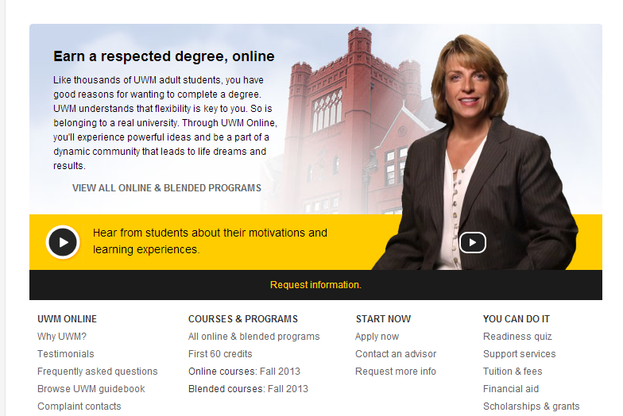
About
UWM Online

Slide 9
What is blended and online for UWM?

Slide 10
Blended 1
21 - 50%
Online with
commensurate
reduction
in seat time
Blended 2
51 - 80%
Online with
commensurate
reduction
in seat time
Blended 3
81 - 99%
Online with
commensurate
reduction
in seat time
Web-enhanced
0 - 20%
Blended
21 - 99%
Online100%
Notes:
Blended course definition:
An Institutional Definition
Tanya can discuss UWM -
From an institutional perspective, there are several ways to define blended courses; the example given is that of University of Wisconsin – Milwaukee, though it is not dissimilar to that of other campuses. The definition relies on an assessment of the impact of blended pedagogical strategies.
Up to a certain point, about 20% of seat time placed online, the effect of blended learning is roughly equivalent to that of Web enhancement. This isn’t necessarily a bad thing: we often recommend to faculty that they start in the 0-20% range until they feel more comfortable assigning and assessing online work
Between 20-50%, a course requires significant redesign work if it is to be taught successfully. The reduction of a third of the face time of a course, for instance, means that the instructor must find new learning activities and new forms of assessment, as well as different ways to deliver course content.
Beyond 50%, the online work begins to dominate the pedagogical design of the course, and the instructor must explicitly work with considerable care to resolve the three key issues of blended learning: “closing the loop,” “course-and-a-half,” and “hearing voices.”
Finally, when a course reaches 80% or more online, a question becomes increasingly acute: why is this course not being delivered fully online? What is the rationale for having face-to-face meetings at all? Often, there is such a rationale, but it becomes urgent to identify that rationale at this stage of course redesign.

Slide 11
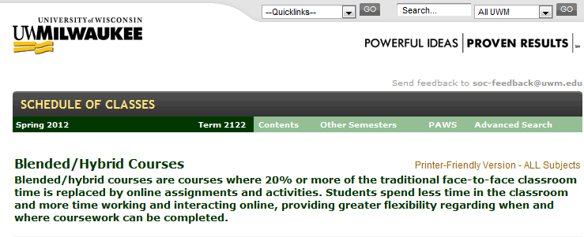
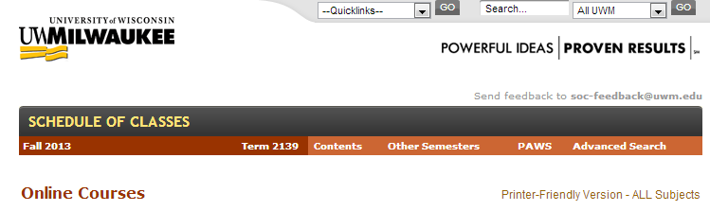


Slide 12
What are we doing today?

Slide 13
edu13.wikispaces.com

Slide 14
1. How do you foster faculty awareness and interest in online and blended teaching? How do you motivate faculty to design effective online and blended courses that include pedagogical or technological innovation? What incentives are in place for course redesign?
Notes:
It is critical that institution leadership support the effort – at all levels. The effort must be part of the strategic agenda, adequate resources allocated or a revenue stream identified, messaging that consistently re-enforces the commitment. Without that support engaging the larger academic community will be challenging and once engaged, resources to follow-through with support may disappear in the absence of administrative commitment.

Slide 15
2. What makes for an effective online and blended learning model? What opportunities should be available to help instructors learn effective practices in design and delivery of online and blended courses? What experiences should be provided to faculty to effectively teach online and blended courses? How can you develop a community of online and blended practitioners on campus?

Slide 16
3. How will instructors know when they are providing quality online and blended courses? How will faculty, programs, or the campus know whether the course was a good course? What tools or services could be provided for evaluating the effectiveness of online and blended courses? How will quality be communicated to the larger campus (e.g., students, faculty, administration, etc.)?

Slide 17
How does UWM ensure quality?

Slide 18
1. How do you foster faculty awareness and interest in online and blended teaching? How do you motivate faculty to design effective online and blended courses that include pedagogical or technological innovation? What incentives are in place for course redesign?
Notes:
It is critical that institution leadership support the effort – at all levels. The effort must be part of the strategic agenda, adequate resources allocated or a revenue stream identified, messaging that consistently re-enforces the commitment. Without that support engaging the larger academic community will be challenging and once engaged, resources to follow-through with support may disappear in the absence of administrative commitment.

Slide 19
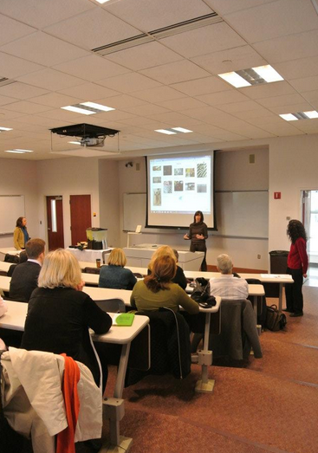

Slide 20
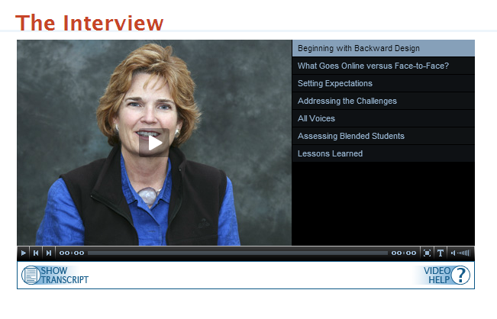

Slide 21


Slide 22


Slide 23
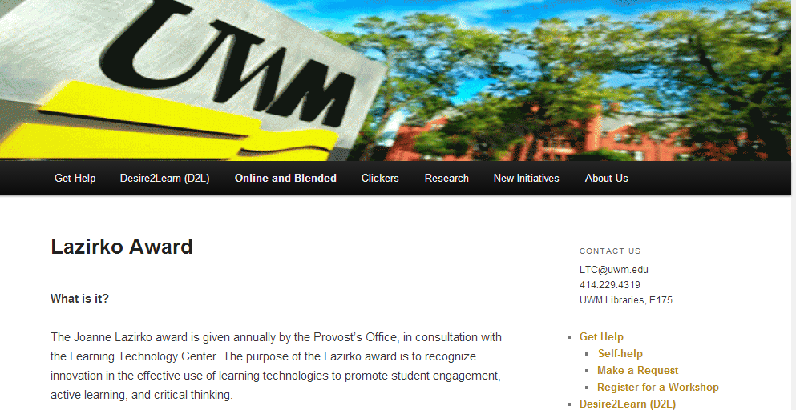

Slide 24

The Information Technology Policy Committee encourages divisions and individual departments to ensure that their tenure, promotion, and merit processes value innovative forms of publication, research, and teaching
Notes:
Encouraging Faculty Engagement with Innovative Research and Teaching
Endorsed by the Information Technology Policy Committee, May 13, 2011
New technological developments are transforming the practice of research, teaching, and administration around the University, and the ways in which we fulfill our mission in the discovery and dissemination of knowledge. Working to lead, rather than lag, in our adoption of new approaches and techniques will benefit the quality of our work, the reputation of our institution, and our ability to recruit the finest faculty, staff, and students.
The Digital Future working groups convened by the Provost seek to assist UWM faculty, students, and staff in making use of recent innovations in research, teaching, and administration. The forward-looking aspects of their work should also help the University to respond with agility to future technological developments.
The Information Technology Policy Committee encourages divisions and individual departments to ensure that their tenure, promotion, and merit processes value innovative forms of publication, research, and teaching, such as:
• open-access, online, and other novel forms of research publication
• research sharing with colleagues, students, and the public via blogging and other online tools
• telematic and virtual-world participation in conferences and other research and scholarly activities
• creation of and participation in interdisciplinary research working groups
• the development of novel digital tools for teaching and learning, including integration of social media in the classroom and mobile e-learning tools
• participation in professional development activities targeted towards the development of new online and blended courses, and the optimization of existing courses for online delivery
The ITPC encourages divisional committees and departments to view such activities as meaningful contributions to the overall balance of research, teaching, and service performed by faculty. The committee urges the University as a whole to look for opportunities to incentivize faculty and staff professional development leading to innovative engagement with technology and its use in research, teaching, learning, and administration.

Slide 25
2. What makes for an effective online and blended learning model? What opportunities should be available to help instructors learn effective practices in design and delivery of online and blended courses? What experiences should be provided to faculty to effectively teach online and blended courses? How can you develop a community of online and blended practitioners on campus?

Slide 26
UW-Milwaukee
Faculty Development Program:
Purpose | Format | Outcomes
Notes:
Welcome to the second presentation in our train-the-trainer series. In this presentation we will examine the purpose, format, and outcomes of our faculty blended course redesign development program.

Slide 27
Overall purpose or goals
Design, develop, teach, and advocate for blended courses
A practical approach
  Get started
  Redesign course
  Develop course material
  Acquire teaching skills
Notes:
The purpose of our faculty development program is to support and encourage faculty who wish to redesign their courses for blended learning. We have adopted a practical rather than a theoretical approach – although our notion of “practice” is supported by current theory – because we know that faculty are busy, and that they are more interested in what works than in abstractions.
A practical approach to blended course redesign identifies how to get started, how to redesign a course for blended teaching and learning, how to develop blended course material, and how to acquire the teaching skills needed for a blended course.
We assume that faculty are already experienced teachers from a traditional face-to-face perspective, and that their principal task is to learn how to redeploy their skills in a somewhat different context.

Slide 28
Program format
Taught in a blended format and in multiple formats during the academic year
Face-to-face meetings and online assignments
  Model good blended practices
  Experience blended course as a student
  Effective teaching model
Experienced blended teachers are program facilitators
Notes:
The faculty development program that we offer is taught itself in a blended mode, since we take seriously the adage that the best way to learn how to teach a blended course is to take one. We offer the faculty development program multiple times during the year, once during each UWM semester (Fall and Spring) and once during the summer.
The program comprises both face-to-face and online learning activities, in which our goal is to model good blended teaching practices, to encourage participants to experience blended learning as their students will, and to demonstrate that blended learning is an effective teaching model. To this end, we ensure that all of the presenters in our faculty development program are themselves experienced blended instructors, since that ensures that the presenters speak not only from theory, but also from lengthy experience as practitioners of blended learning.

Slide 29
Program Structure
F2F 1
3 hrs
Online 1
F2F 2
3 hrs
Showcase
3 hrs
Online 2
F2F 3
3 hrs
Post-Program

Slide 30
Program activities
Presentation, demonstration, small-group activities, facilitator feedback, peer feedback, online discussion, consultation
Emphasis on faculty “active learning”
  Discussing
  Questioning
  Developing
Notes:
Program activities are varied, and as such exemplify what has already been discussed as the multiplicity of “voices” accompanying blended course redesign. The program offers presentations, demonstrations of blended courses by their instructors, breakouts in small group format, feedback offered by program facilitators as well as by the peer participants, and individual consultation where needed to acknowledge the needs of individual disciplines or special approaches to instruction. Emphasis is always placed primarily on faculty as active learners in the process of their own course redesign process: faculty discuss their concerns both online and face-to-face, they ask questions to which both facilitators and the peer community provide response, and faculty develop actual components of their blended courses as they proceed through the program.

Slide 31
Main Program Outcomes
Start of a redesigned course
New teaching skills and knowledge
Re-examine both face-to-face and online component
Faculty know what to expect
Faculty get their questions answered
Notes:
Six main outcomes are highlighted as central to the faculty development program.
First, faculty start with concrete development of both broad-perspective elements of their new course, such as a course redesign plan and a syllabus, and the development of more specific features of the course such as learning modules. This is especially appropriate in disciplines or areas where “learning modules” are not typically the unit of course redesign, thus requiring faculty to re-examine their conceptual basis for instruction from the bottom up.
Second, faculty must acquire new teaching skills and knowledge appropriate to a blended learning frame, such as how to facilitate a peer learning community both face-to-face and online, and how to assess student learning in a manner that is quite distinct from the usual “three exams and a term paper” of a traditional face-to-face course. In the latter context, it is important to note that faculty are often committed to the use of summative assessments such as exams and term papers without ever having questioned previously their efficacy. The prospect of a blended course redesign thus holds out the possibility of a paradigm shift from modes of instruction that once seemed satisfactory to a model of teaching and learning that problematizes everything that has once been taken for granted. This is a source of considerable skepticism and anxiety for faculty who have been teaching for many years in a more traditional manner, often unreflectively.

Slide 32
Course Redesign
Course Content
Ten questions
Online vs. F2F - Integration
Designing learning modules
Decision rubric for content choices
Learning objects
Course Evaluation
Online Learning Community
Progressive/summative
Before, during, and after
Self evaluation
Peer evaluation
Student evaluation
Transitioning to blended teaching
Synchronous/asynchronous
Establishing voice
Discussion forums
Small groups
Course Management
Helping Your Students
Assessment Plan
Staying organized
Managing workload
Avoiding course and a half
Rubrics
CATs
Templates
Traditional formats
Managing expectations
Time management
Technology support
Notes:
This diagram reviews on a single screen all of the program features that have been described above. It is scarcely comprehensive, however, as we offer the program we discover changes and additions that are required. An example that provides case in point is the development of alternative modes of blended learning that focus on large enrollment courses. This has been a recent area of examination for which we have now produced a special module.

Slide 33
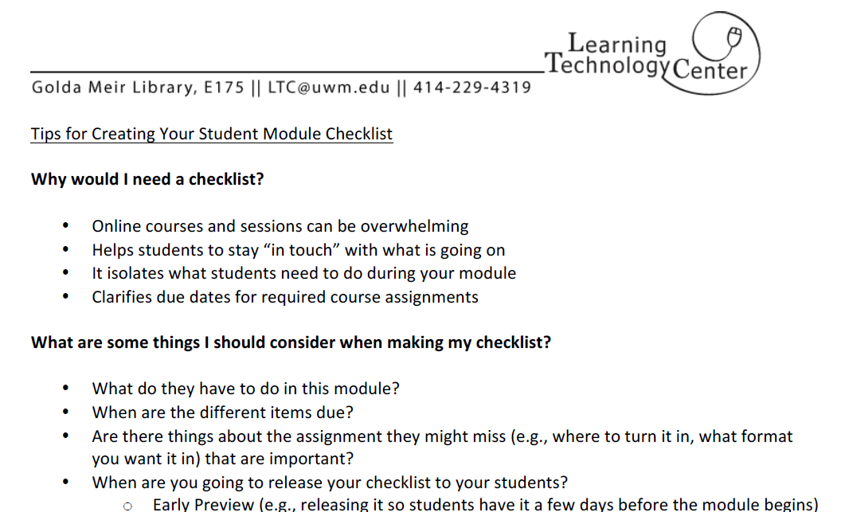
Pedagogical meets technical

Slide 34
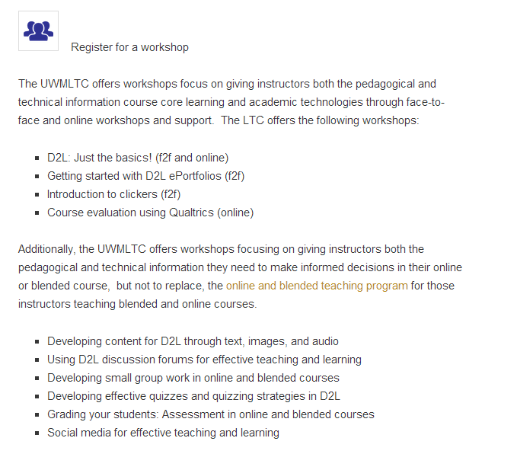
Specialized workshops

Slide 35
Online and Blended
Teaching Group (OBTG)
User-driven, monthly meetings for sharing questions, concerns, and resources
Demonstrations, presentations, discussions
Online community of instructors

Slide 36
3. How will instructors know when they are providing quality online and blended courses? How will faculty, programs, or the campus know whether the course was a good course? What tools or services could be provided for evaluating the effectiveness of online and blended courses? How will quality be communicated to the larger campus (e.g., students, faculty, administration, etc.)?

Slide 37
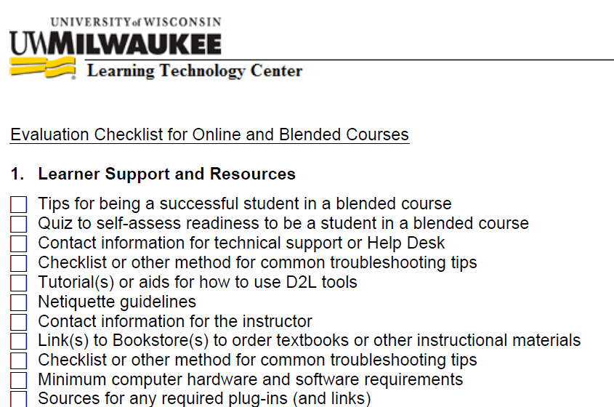
Faculty Development Resources
Notes:
Nicole—faculty are given resources on our website and by consultation to ensure quality when planning their blended course. We offer planning materials (e.g., checklists, handbooks), faculty development program for transforming courses into the blended format, and certification.
Tanya – I can discuss the idea of lifecycle of evaluation and the evaluation checklist development and use

Slide 38
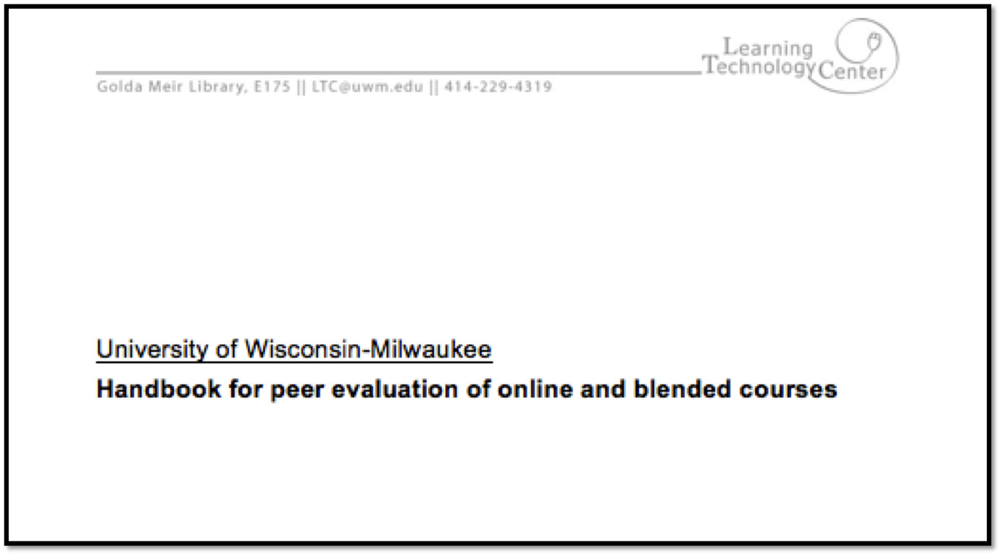
Peer Evaluation Handbook
Notes:
Nicole: A course evaluation is not a judgment; it is a recognition and an acknowledgement of work in progress. The purposes of peer course evaluation are to highlight the positive qualities of an instructor’s design, and to offer suggestions for future improvement. This evaluation can be used before the course has run (e.g., to evaluate design) and/or after to reflect on the course. Used for peer evaluation by department colleague, LTC, or self.
Step 1: Exploring the course overview materials
Step 2: Addressing the key parameters of evaluation (I. Learner support and resources; II. Organization of course materials; III. Instructional design and delivery; IV. Effective use of the online environment ; V. Assessment of student learning and course evaluation; VI. Comments and suggestions not included above)
Step 3: Evaluating the key parameters of online/blended course design
Sample formats and timelines
Tanya - Again, I can explain how it came into development, if time

Slide 40
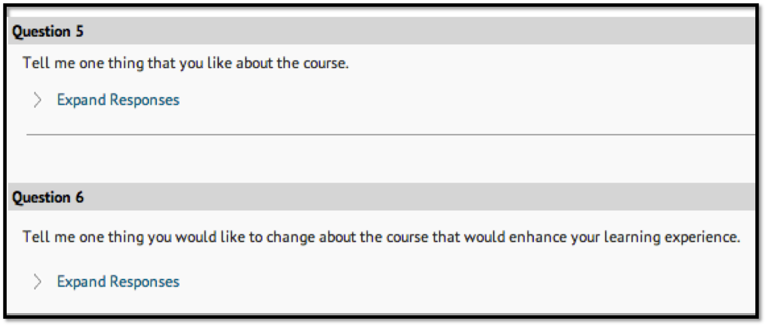
Student Evaluation Data
Enter slides
Notes:
Nicole—using student evaluation data to ensure course quality. Students have firsthand knowledge of the course that was provided and often have taken other blended courses. Two ways of gathering student perceptions regarding the course is through mid-semester feedback (as pictured) and at the end of the semester.
Tanya - I can talk about using CATs as a way to guage course improvements needed

Slide 41
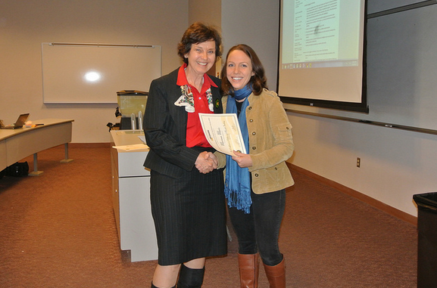
Certification Program
Notes:
Nicole—The certificate programs allows us to transform the culture of our campus to promote online and blended learning, to emphasize the importance of quality teaching and sound pedagogy, and to create a community of online teachers. Components: successful completion of OBTP, delivery of a blended course at UWM, peer course evaluation by LTC staff and/or peer mentor/evaluator, 2-3 page reflection on how the instructor’s pedagogy has changed, and “paying it forward” (e.g., guidance on the listserv, syllabus added to resource repository). Over 70 faculty and instructors have been awarded the certificate represented in the Colleges of Letters and Science, Peck School of the Arts, School of Education, College of Nursing, School of Information Studies, Lubar School of Business, and College of Health Sciences
Tanya – I can discuss how the certificate program came to be and philosophical debates around its development

Slide 42
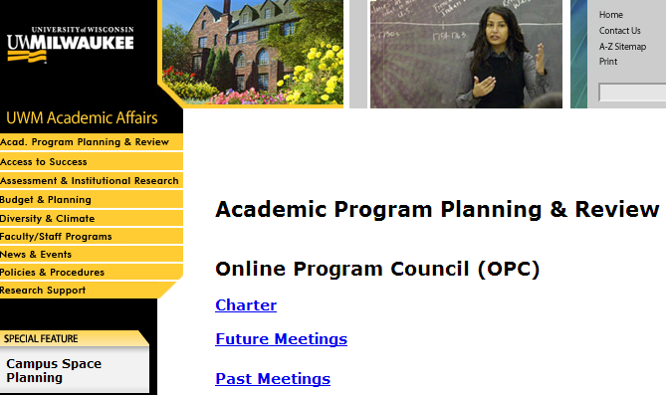
Communicating Quality

Slide 43
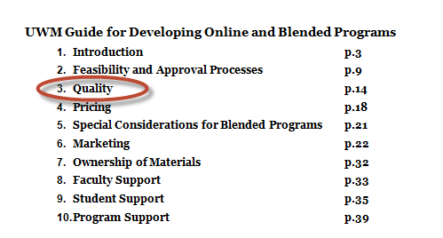

Slide 44
Check out some resources: edu13.wikispaces.com

