Slide 1
Improving Transparency, Relationships, and IT Decision Making
Through a Campus-Wide Governance and Strategic Planning Process
Jane Livingston, Faith Brown, and Susan West
Notes:
So, submitting a proposal for educause seems like a long time ago.
Back in January when we put our proposal together, all three of us had different roles.
I was the Director for Governance, Strategy and eServices. Now I lead an enterprise system group. I have been at Yale for the past (almost) 8 years. Before Yale I worked in IT at Vassar College in a variety of different roles
But, back when we submitted our proposal in January, I was lucky enough to get to lead a team that contained these two remarkable colleagues:
Faith Brown leads the portfolio planning and management processes for Yale as well as the annual and ongoing strategic planning activities; large parts of this are deeply involved with our governance model we’ll describe today. Faith has managed IT for 23 years at Yale. She holds an MS in Management with a focus on Information Systems, and a BA in Computer Science. She is also a Project Management Professional, and has completed Six Sigma Black Belt training.
Susan is Associate Director of Strategic Communications in the Office of the CIO for Information Technology Services (ITS) at Yale University. At Yale, her work focuses on supporting ITS and the Office of the CIO in a variety of initiatives including cross-campus strategic and organizational communications, diversity and recruitment initiatives, and strategies for customer satisfaction
Footnote. We had originally intended to talk also about our SP process, but realized that was too much information for one session. We’d be happy to answer any questions about that process offline.

Slide 2
Session Overview
Collect your questions
Yale’s story
Lessons learned
Break Out Session
Wrap up

Slide 3
What questions do you hope to have answered today?

Slide 4
Total Headcounts
Undergraduate & Graduate Students | 11,906
Faculty | 4,000
Staff | 9,000
IT Headcounts
FTEs in central ITS | 420
FTEs in distributed IT | 300+
Notes:
So here is some basic demographic information about Yale, which is something I always find helpful when I go to talks
Want to give you a sense of where we have been and how our governance program at Yale has grown.
In 2009, I took a newly created position to define governance and strategy for Yale IT.
About 2 months later our former CIO announced his retirement and my boss, the deputy CIO, hit the road too
So began a 8 month research project for me where I created some foundational information and began to socialize governance for IT and beginning to prepare our IT staff for what we meant.
What is governance anyway??

Slide 5
Governance and Collaboration
IT Governance specifies the decision rights and accountability framework to encourage desirable behavior in the use of IT
(Weill, P., Woodham, R., 2002)
Collaboration is working together to achieve a goal. a deep, collective, determination to reach an identical objective
(Wikipedia May 29, 2012)
Notes:
May 2011, Len Peters came as our new CIO and I was delighted to learn that he had strong feelings about governance and a clear idea of how to get started.
Over the first year, we did a lot of organizational learning
We did VOC activities
We did satisfaction surveys
We had one major reorganization
We rolled out ITIL and a new service management tool
We rolled out new governance processes
In short, we tried to change the culture of our IT organization

Slide 6
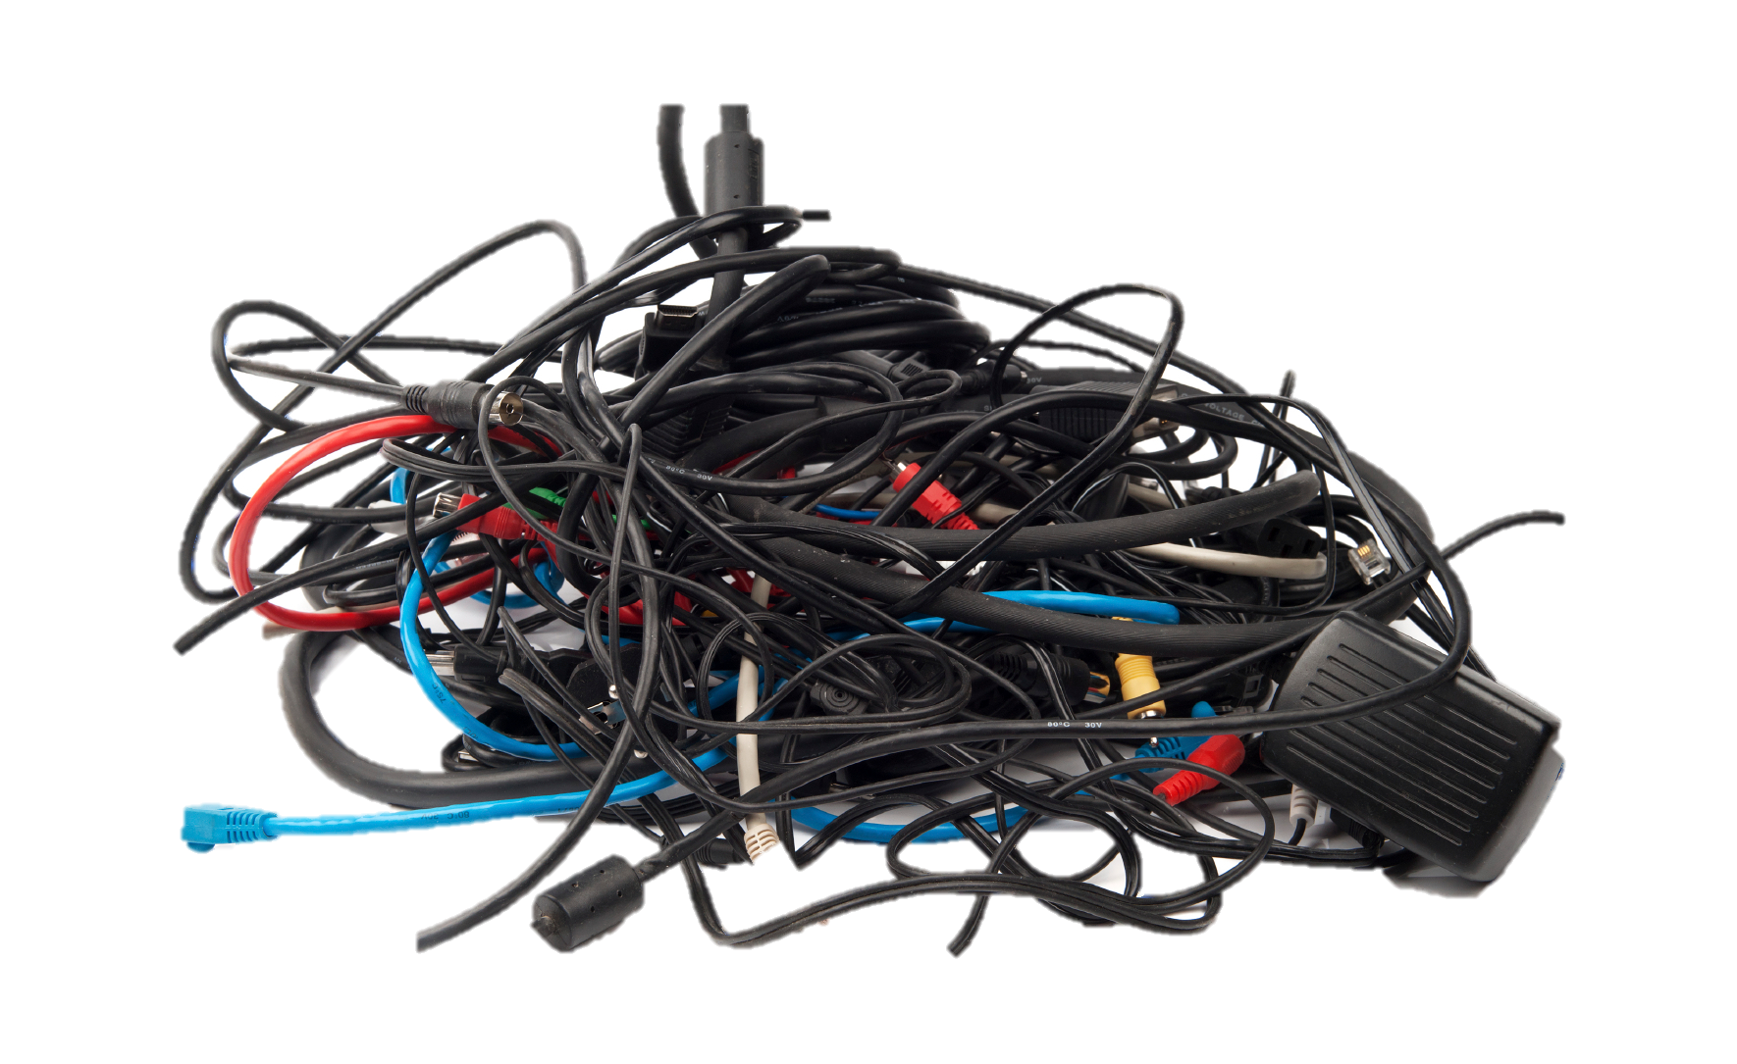
Where we’ve been. . .
_{Lack of clarity}
Missing framework for communication
_{Opaque decision} _{making}
Notes:
Feedback pointed to several pain points
Lack of clarity
We learned that there was a lot of confusion about what IT does – what services we provide and to whom
Within the IT organization there were groups with overlapping missions of organizations, all of whom had responsibility for technology directions, and at times these groups were setting off in directions that were sometimes not integrated or coordinated
Missing frameworks for communication
We had no framework to enable collecting feedback and incorporating the feedback into our solutions We also had no framework for communicating decisions
Opaque decision making
IT decisions were guided by the voice of the VIP in the room
No clarity around who is responsible for what decisions
No transparency to prioritization process

Slide 7
The Vision for IT Decision Making
Institute a clear framework that enables IT collaboration across Yale
Continuously improve IT decision-making through client feedback and metrics
Make decisions in a transparent fashion and communicate them effectively
Notes:
We are now instituting a framework that clarifies to the community who will be involved with making decisions about various services and how to collaborate in the process.
This framework allows us to continuously improve our decisions based on two way collaboration, broad communication and metrics – both on service delivery and community satisfaction.
We are also communicating the framework as well as publishing all the decisions that are being made.

Slide 8
Where are we headed?
Cohesive vision and a strategy to advance us to that vision
Transparency in:
Decision rights and responsibilities
Prioritization
Accountability for delivering
Notes:
What other things have we been doing?
Communication (Newsletters specific to faculty, staff, and students, social media, re-vamped Monday Morning News, and IT Professionals Intranet)
Partner Forum
Yale Technology Surveys
Feedback on Strategic Planning Drafts

Slide 9
Yale ITS Governance Committees
University Officers and Deans
Strategy
IT Advisory Board
CIO and Directs
ITS Advisory Committee (ITSAC)
Advising
Advising
Planned
Technology Initiatives Committee (TIC)
Business Systems
Institutional Technologies
Teaching and Learning
Clinical Research Technologies
ITS Information Security & Policy
Research Technologies
Portfolio Management
Operating Committees (TOC & ROC)
Technology Architecture Committee (TAC)
Existing
Service Board
Service Management
Change Advisory Board
Notes:
(hit the positive result of getting people involved)- everyone understands how complex the decision making is – how many needs are out there – how your needs relate to the other needs – gets everyone on the same page -
We developed a structure that integrates strategy, portfolio operations, and service management. The strategy groups – highlignted in blue define the overall strategy for IT services and projects and ensure that IT is aligned with overall University strategy and that we are working on the highest value activities. The portfolio operations committees, highlighted in yellow, oversee the implementation of the set of projects selected by the strategic committees. They insure that the projects are executed in a way that ensures that the community is adequately engaged, that funds are effectively being used to achieve the desired outcomes, that solutions are aligned with the university’s technology architecture and long term roadmap and that we are prepared to effectively provide ongoing service for the new or modified service that is being implemented. The Service Management committees ensure that the services we provide on an ongoing basis are secure, reliable, available, and cost effective.
I will describe at a high level the functions of the committees within our emerging governance model.
Beginning with the strategic committees (in blue). The University Officers and Deans ultimately approve the three year IT strategy as well as the annual portfolio of projects. The recommendations are developed with the input of the other strategic committees. We have two advisory boards that provide input to the CIO and his directs. The IT Advisory Board will be comprised of IT leaders from industry who will have relevant expertise about IT trends and opportunities. The ITS Advisory Committee is comprised of Faculty and Faculty Administrators and will advise on IT policy and decisions. The Technology Initiatives Committee is comprised of high level leaders from the various campus communities, and are tasked with prioiritizing and selecting the portfolio of projects that will be funded in a particular year. They review the proposals that are submitted by the special interest committees. The special interest committees review that needs of their stakeholders and provide feedback on services and recommend projects that will meet their evolving needs. They also develop strategic roadmaps to lay out the three year vision for IT strategy that will meet their needs.
The execution of the project portfolio is managed by the portfolio operating committees. The technology operating committee and the Ready-to-Serve operating committee oversees the portfolio budget and ensures that the projects are effectively delivering the projects within the allocated budgets. The Technology Architecture Committee establishes the architectural standards for the University and ensures that the projects are executing in alignment with those standards.
Within a particular community there may be multiple program committees to address the needs of specific consituent groups. For example within the area of administrative technologies, we have separate programs for Facilities, Public Safety, Business Systems, Academic Administration. These program groups are accountable for delivering the approved programs on budget.
Service board helps us build and maintain our service catalog and is focused on the end to end life cycle of a service.
Application teams – manage the services and applications
CAB – ensures the integrety of the production environments by putting process around the introduction of

Slide 10
Leadership and commitment are essential
Governance should be right-sized
Bring the right people together at the right time
Align decision making to services
Commit resources to support management of these activities
Notes:
In all IT organizations in higher education, community engagement, collaboration and satisfaction are key to success.
Understanding the voice of the customer in higher education can be complex, as roles and responsibilities for technology components exist in multiple areas of the university.
Pulling together the right people for the right conversations is key to strategic planning and decision-making.
In the past two years at Yale University, we have worked with faculty, staff, students, university leaders, technology leaders, and operational managers to develop a governance structure that effectively executes decision-making around capital projects and operational initiatives.
Leadership and commitment are essential
Governance should be right-sized
Bringing the right people together at the right time.
Align services to decision making

Slide 11
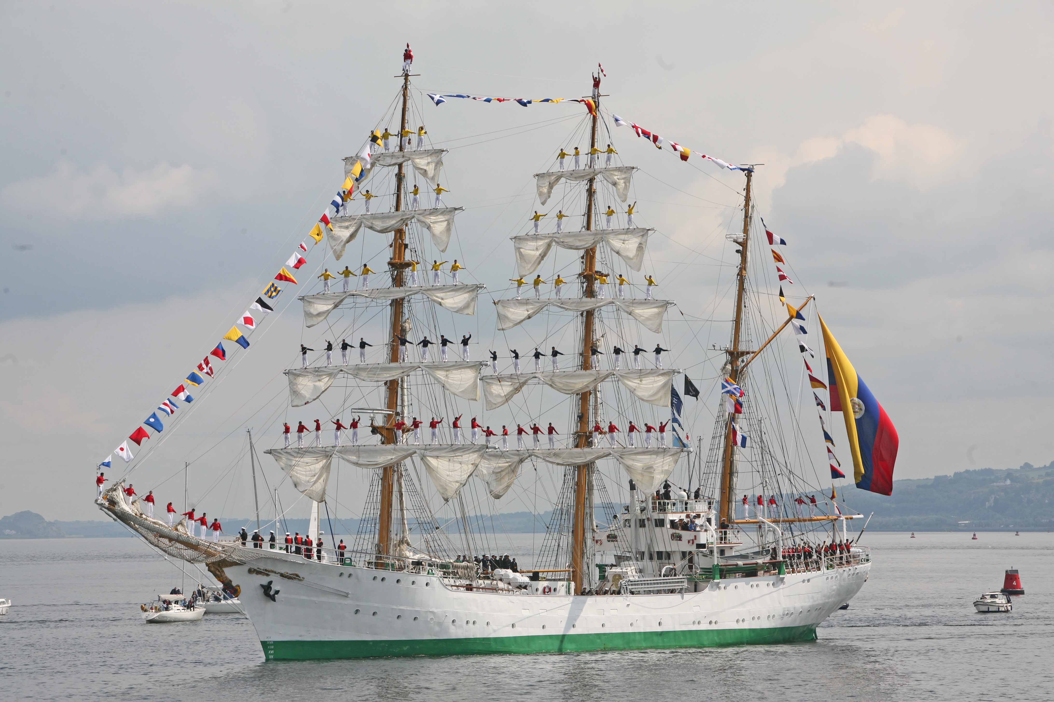
Notes:
It takes a lot of people to support these activities. There are actually 70 different people on this ship.

Slide 12
Break Out Session
Split up into right-sized groups
Research institutions
Master’s institutions
Liberal arts colleges
Community colleges
Etc

Slide 13
Break Out Questions
How would you engage leadership in your institution to ensure support?
What governance functions would be most helpful in your institution?
What barriers prevent you from governance?
Notes:
Leadership and commitment are essential
Governance should be right-sized
Bringing the right people together at the right time.
Align services to decision making

Slide 14
Helpful Links
Link to Yale University’s Governance page: http://its.yale.edu/about/collaboration-and-governance
Link to Yale University’s IT Strategic Plannning page: http://its.yale.edu/about/strategic-planning

Slide 15
Thank you Please fill out an evaluation
Jane Livingston
Associate CIO, Campus Community Technologies
jane.livingston@yale.edu
Faith Brown
Director, Strategy & Portfolio Management, Office of the CIO
faith.brown@yale.edu
Susan West
Associate Director, Strategic Communications, Office of the CIO
susan.west@yale.edu

