Slide 2
Visual Notes and Vivid Memories
The Digital Tablet as a Travel Companion
welcome

Slide 3
Visual Notes and Vivid Memories
Kyle Parker
Senior Software Engineer for Developing Technologies
Information Technology Services
Ball State University

Slide 4
Visual Notes and Vivid Memories
Kyle Parker
Senior Software Engineer for Developing Technologies
Information Technology Services
Ball State University
Lohren Ray Deeg
Assistant Professor of Urban Planning
(Undergraduate) First Year Coordinator
College of Architecture and Planning Ball State University

Slide 5
Topics for today
Creating and building a compelling and relevant mobile app for the classroom
agenda

Slide 6
Topics for today
Creating and building a compelling and relevant mobile app for the classroom
Utilizing mobile devices as learning tools
agenda

Slide 7
Topics for today
Creating and building a compelling and relevant mobile app for the classroom
Utilizing mobile devices as learning tools
Exploring new technologies and their impact
agenda

Slide 8
We encourage and ask you to think about your own use of apps and mobile devices at your respective universities
After our slides, we will begin a group discussion and spend some time actually using Traveler on this array of devices
agenda

Slide 9
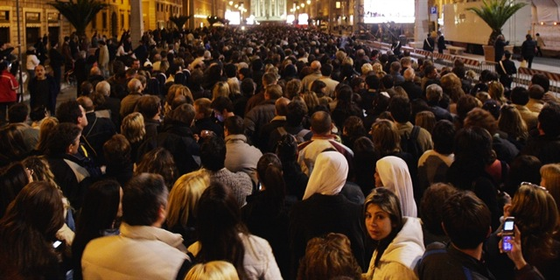
Funeral parade of Pope John Paul II
2005
Source: MSNBC

Slide 10
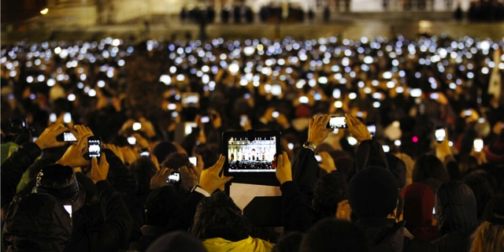
Funeral parade of Pope John Paul II
2005
Introduction of Pope Francis I
2013
Source: MSNBC

Slide 11
This is about an app

Slide 12
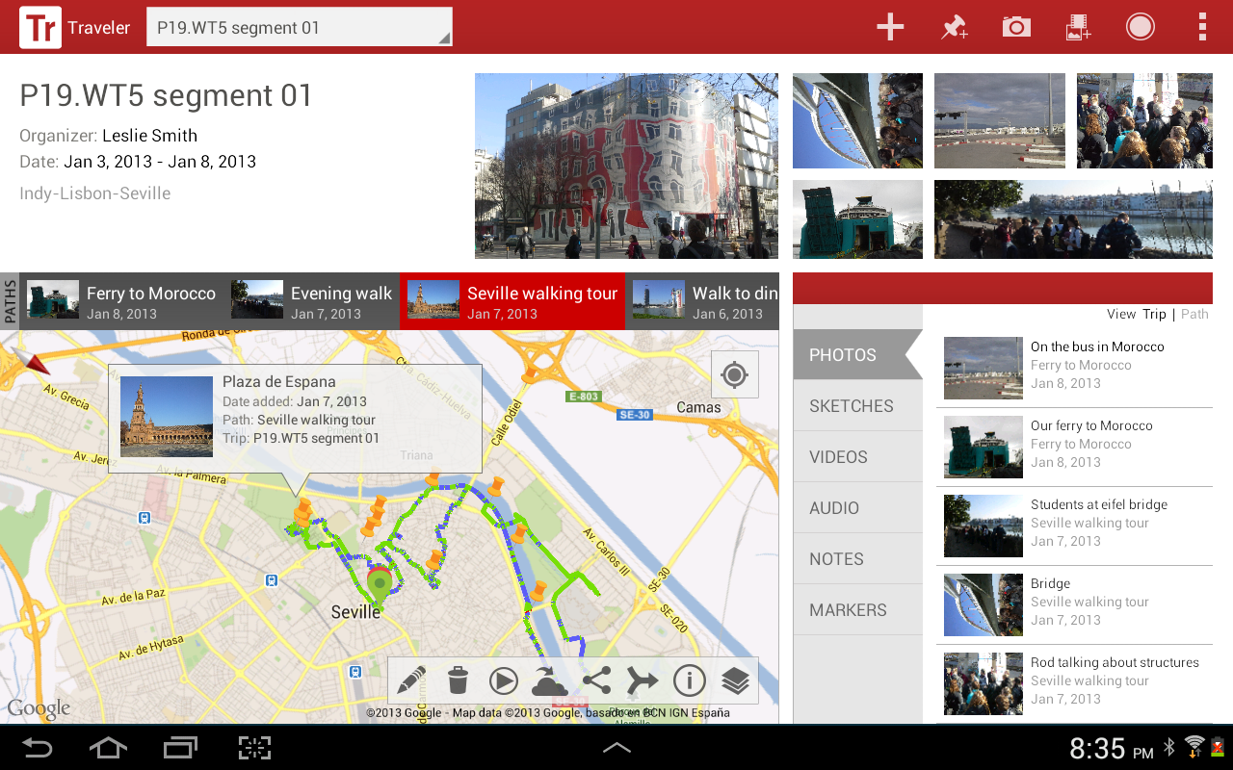

Slide 13
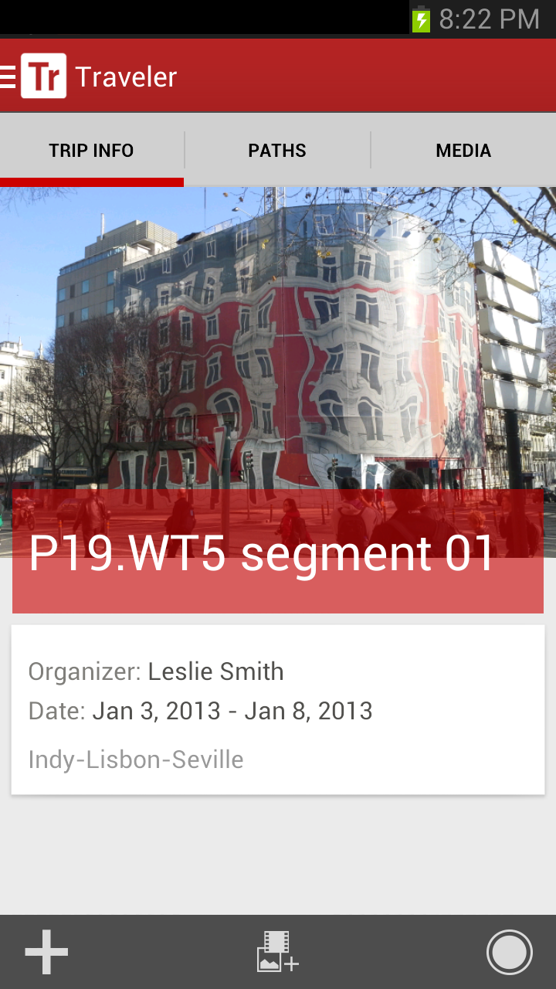
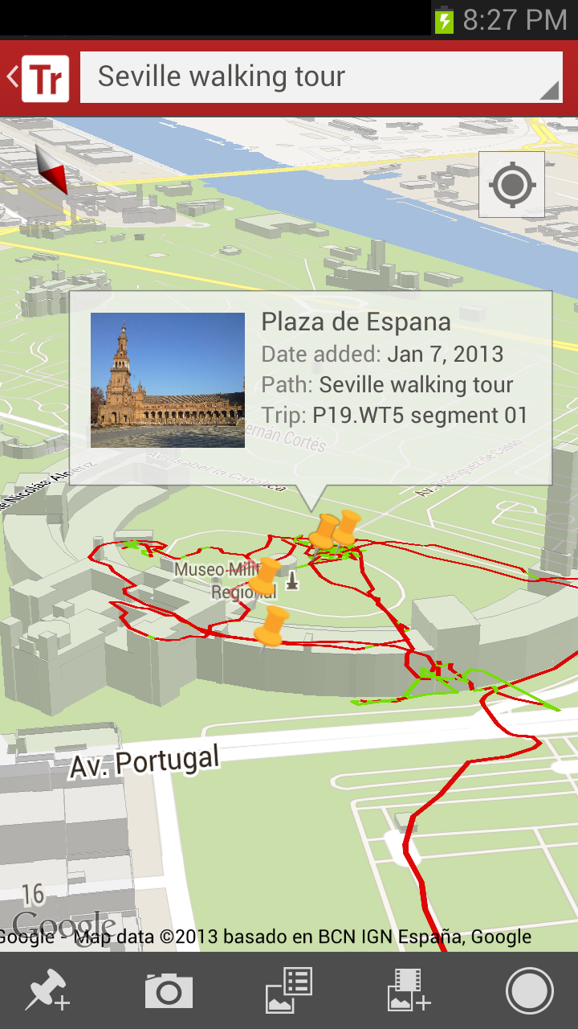

Slide 14
This is about creating relevant academic apps for mobile devices

Slide 15
This is about confronting students with a mission to think critically, assess, and develop a set of self directed learning outcomes

Slide 16
What we DID

Slide 17
?
Two field studies with two different groups of students in the College of Architecture and Planning

Slide 18
?
Two field studies with two different groups of students in the College of Architecture and Planning
Group 1: 18 first year CAP students on a four-day trip to Chicago

Slide 19
?
Two field studies with two different groups of students in the College of Architecture and Planning
Group 1: 18 first year CAP students on a four-day trip to Chicago
Group 2: 24 upper class students on an immersive 15 week trip to over 30 countries

Slide 20
?
Two field studies with two different groups of students in the College of Architecture and Planning
Group 1: 18 first year CAP students on a four-day trip to Chicago
Group 2: 24 upper class students on an immersive 15 week trip to over 30 countries
Students were given an Android tablet with on-board stylus for drawing and sketching

Slide 21
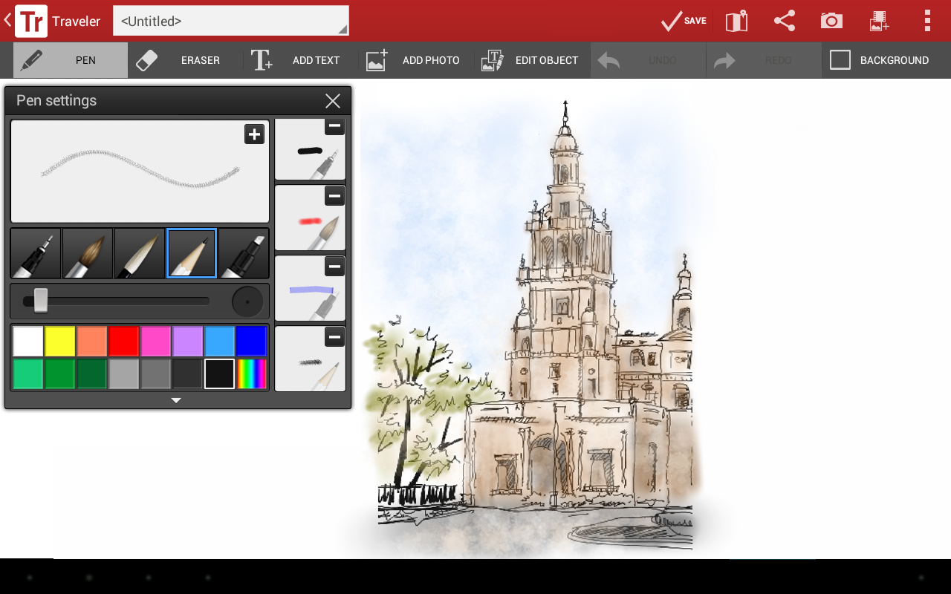

Slide 22
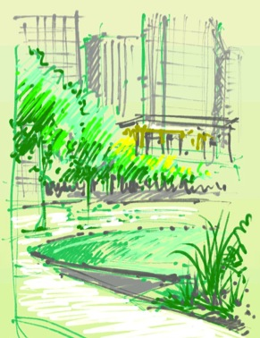
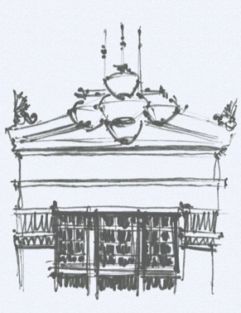
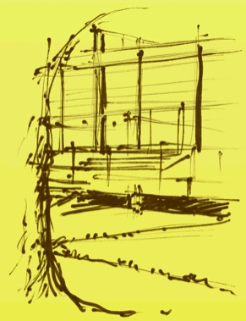
Park at Lakeshore East
Office of James Burnett
Chicago Public Library
Hammond Beeby & Babka
Crown Hall
Ludwig von Mies van der Rohe
Lohren Deeg

Slide 23
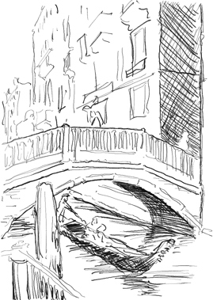
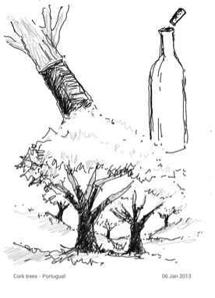
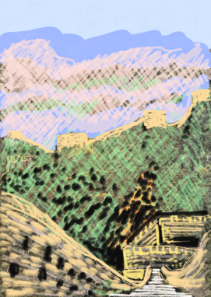
Venice, Italy
Cork Trees in Portugal
Great Wall of China
Les Smith

Slide 24
?
Two field studies with two different groups of students in the College of Architecture and Planning
Convey a sense of meaningful spatial and geographic awareness

Slide 25
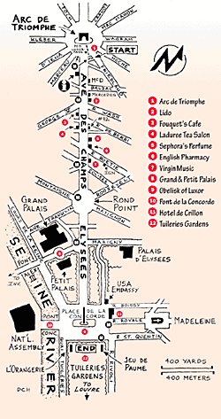
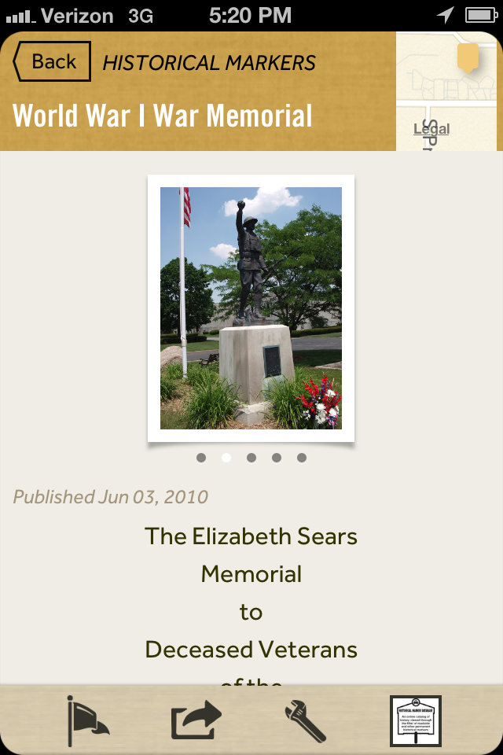
Rick Steves’s Europe Through the Back Door
Map My Run
Google Fieldtrip
Google Glass

Slide 26
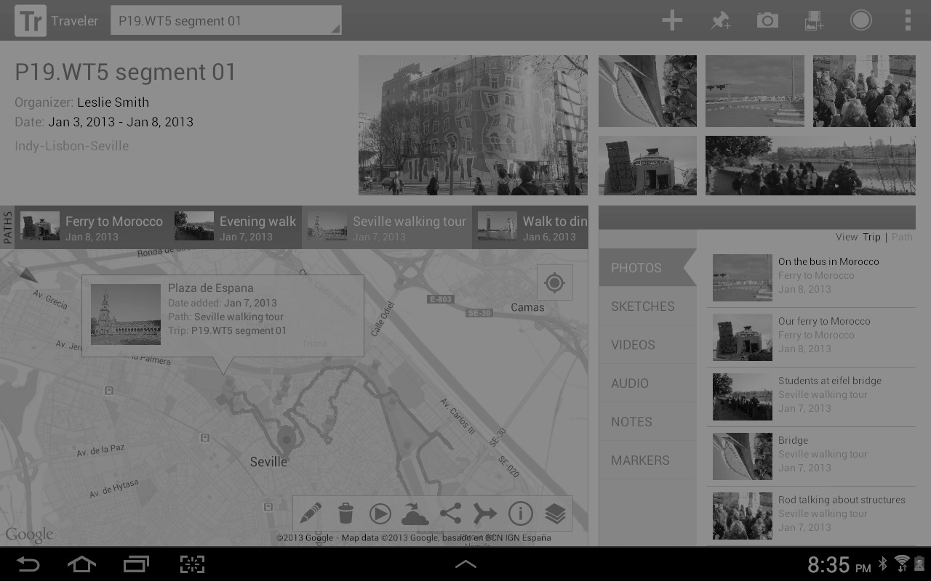

Slide 27
Integration with geospatial mapping

Slide 29
Record, save and share GPS referenced paths with a time stamp

Slide 30
?
Two field studies with two different groups of students in the College of Architecture and Planning
Convey a sense of meaningful spatial and geographic awareness
Provide a single device to bundle travel media

Slide 32
Media is stored in a gallery and later in a backup server

Slide 34
Media captured while traveling

Slide 35
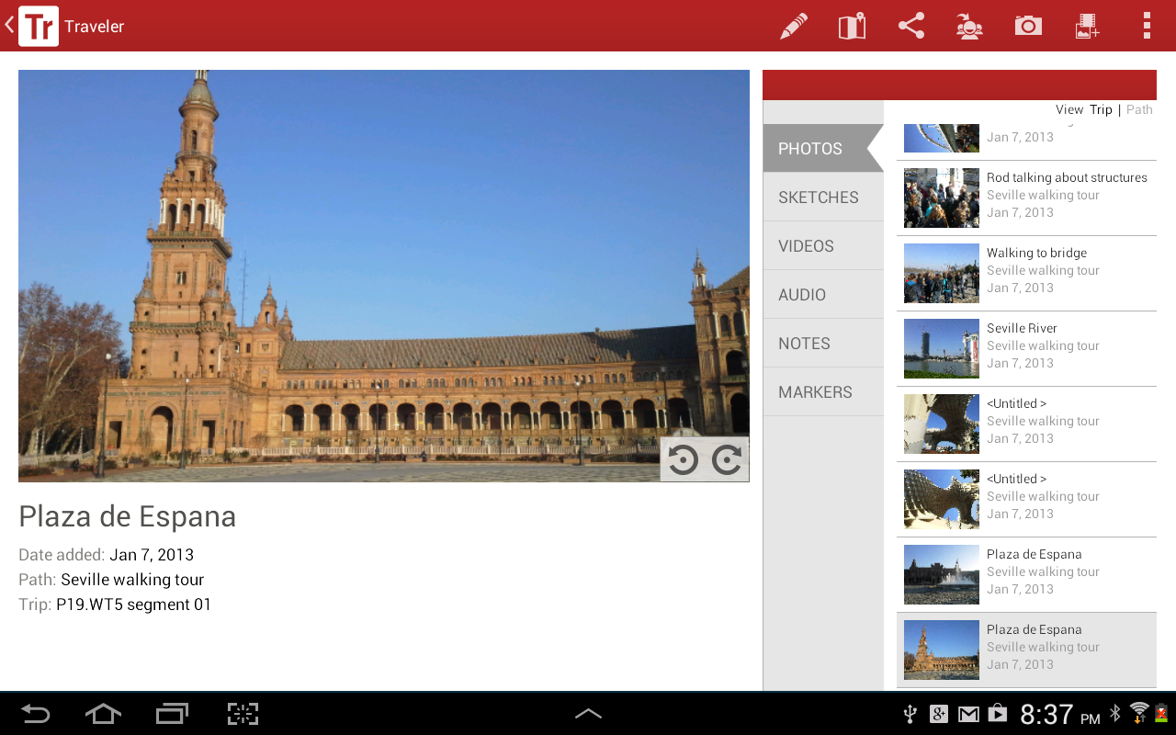
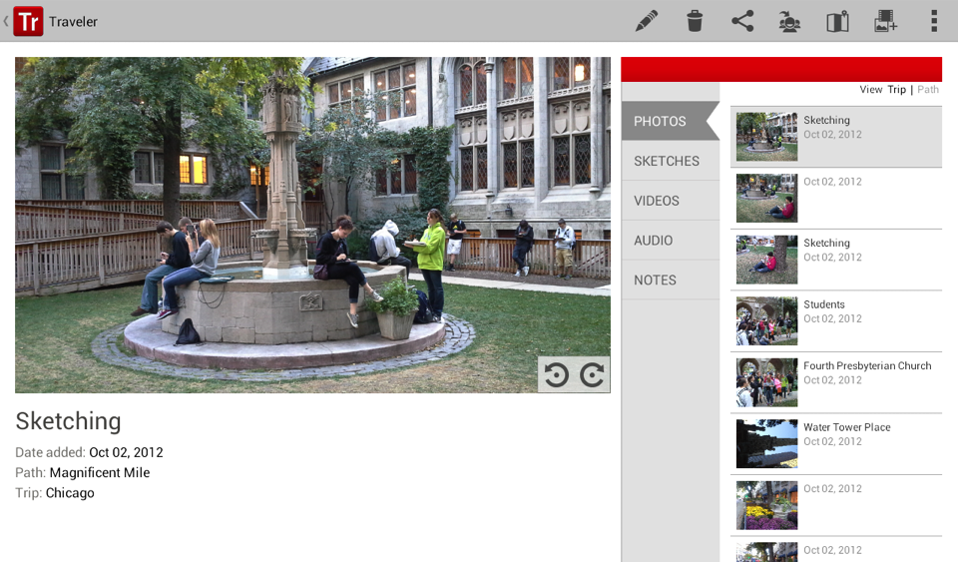

Slide 36
Add informational tags to media

Slide 37
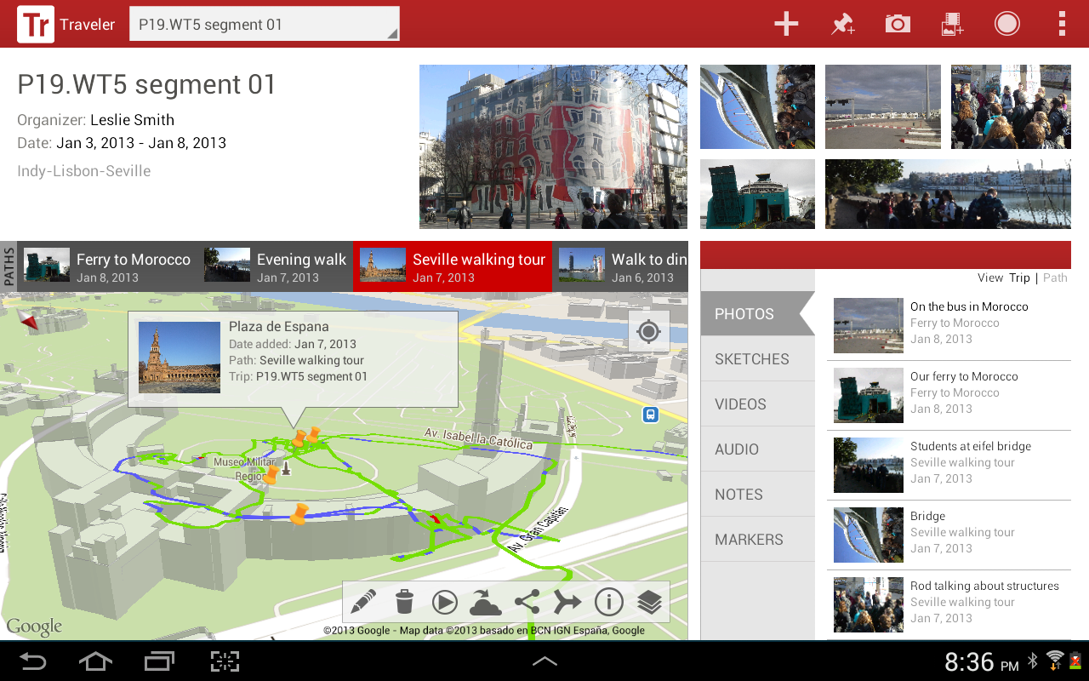

Slide 38
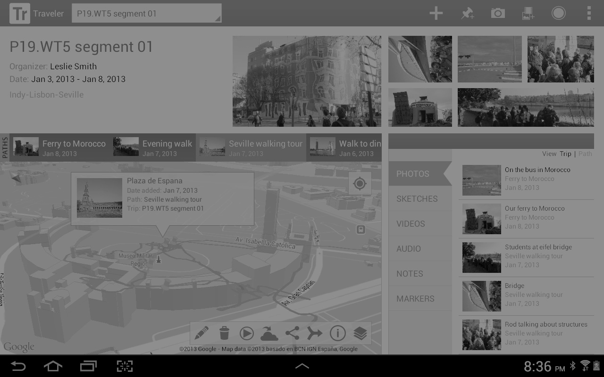
GPS markers locate the media recorded

Slide 39
?
Two field studies with two different groups of students in the College of Architecture and Planning
Convey a sense of meaningful spatial and geographic awareness
Provide a single device to bundle travel media
Utilize sharing, assessment, playback and archive opportunities

Slide 40
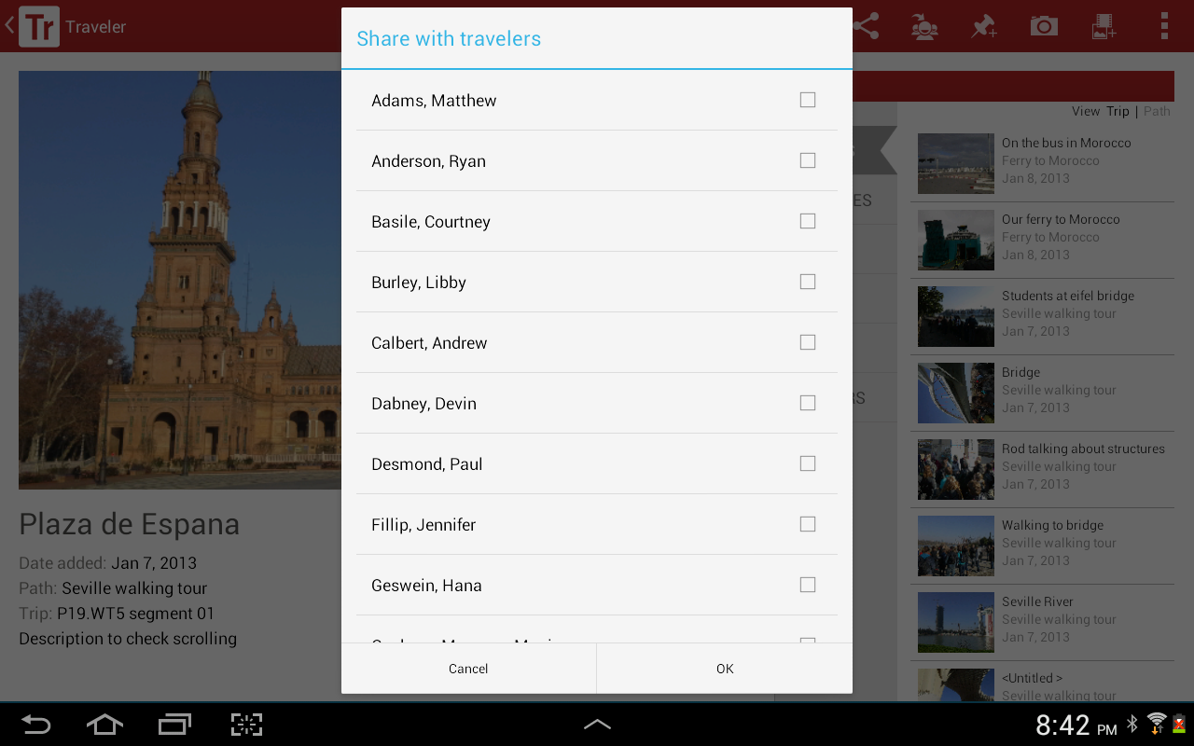

Slide 41
Share content with fellow travelers and social media

Slide 42
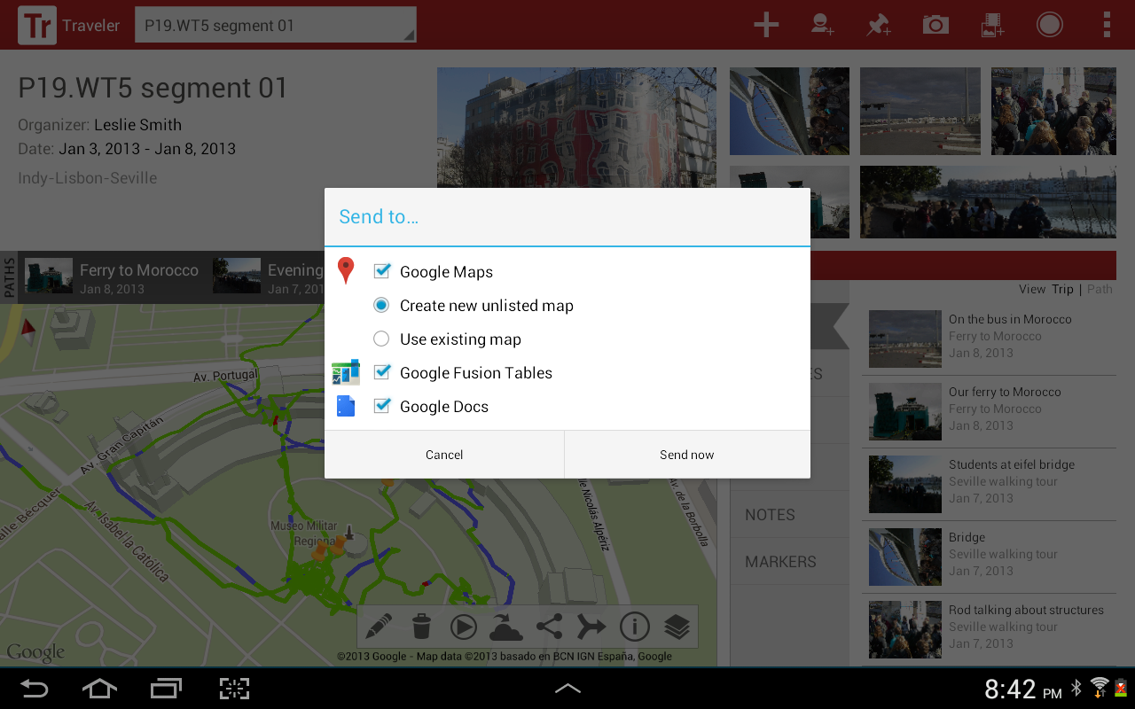

Slide 43
Integration with Google Maps and Google Earth

Slide 44
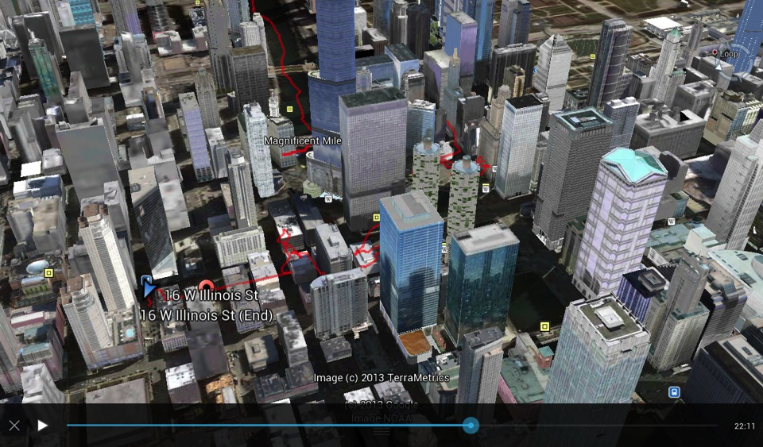

Slide 45
View paths in Google Maps or Google Earth

Slide 46
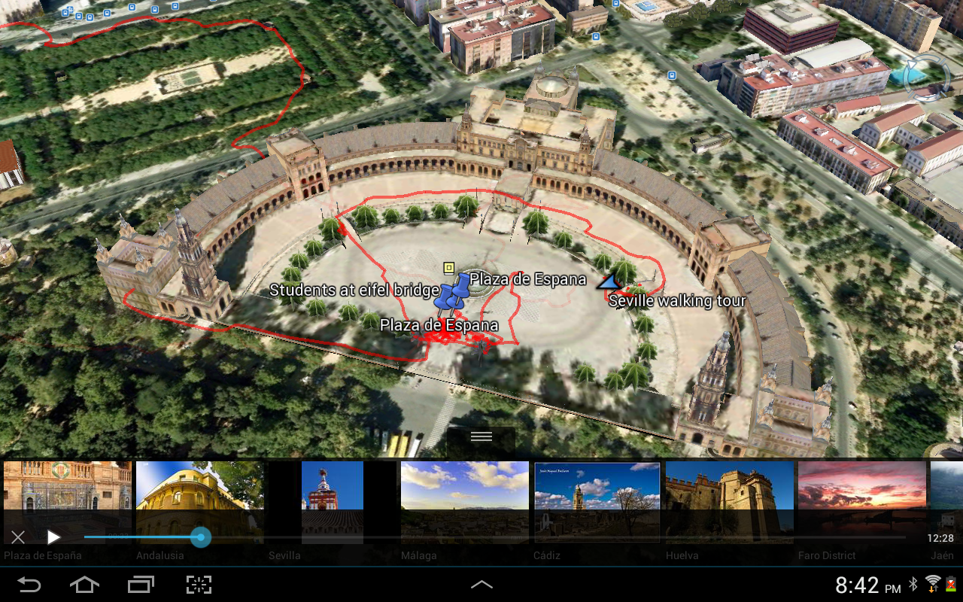

Slide 47
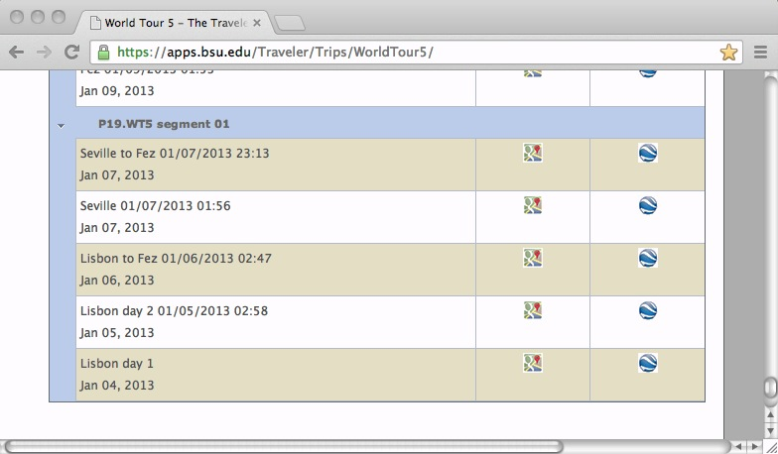

Slide 48
Share paths with family and friends via the web

Slide 49
What the STUDENTS RECORDED
Over 25,000 media assets from field studies

Slide 50
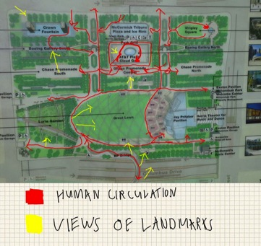
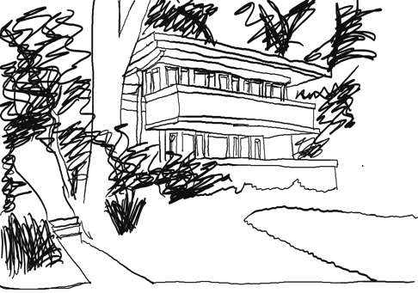
Millennium Park
Mrs. Thomas Gale House, F.L.Wright
Matt Arbore
Paige Story

Slide 51
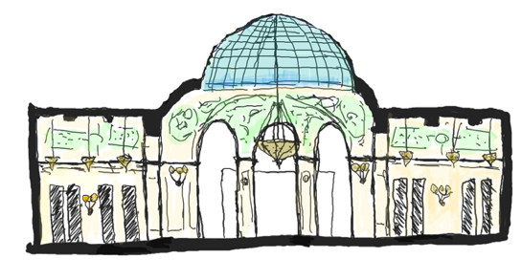
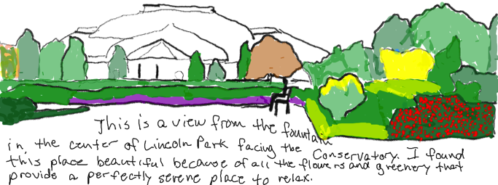
Chicago Cultural Center, Coolidge and Spencer
Logan Richmond
Lincoln Park,
F.L. Olmstead
Bryant Niehoff

Slide 52
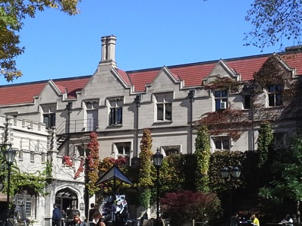
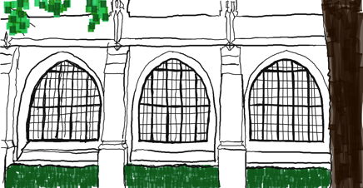
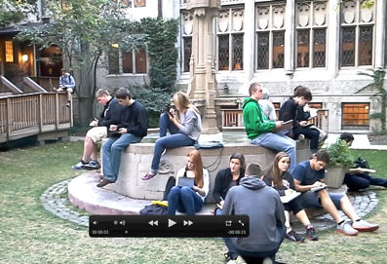
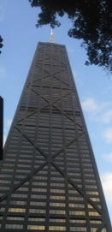
University of Chicago
Paige Story
Video clips of 4th Presbyterian and Hancock Tower
Charlie Rymer

Slide 53
Chicago Botanic Garden and Crown Hall
Taylor Sheppard

Slide 54
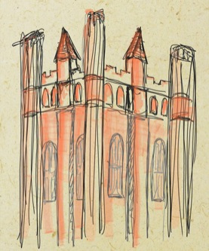
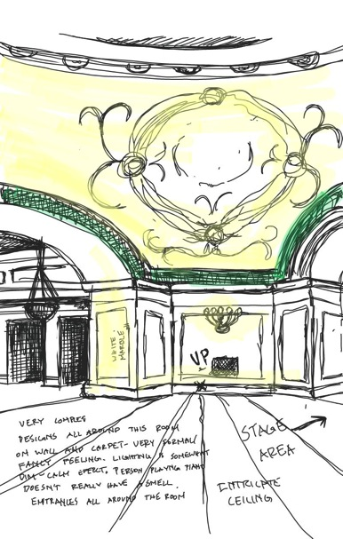
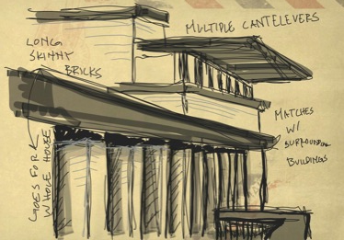
UC Campus, Robie House, Chicago Cultural Center
Craig Zehr

Slide 55
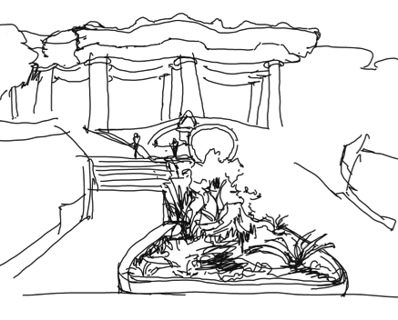
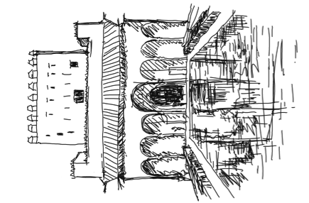
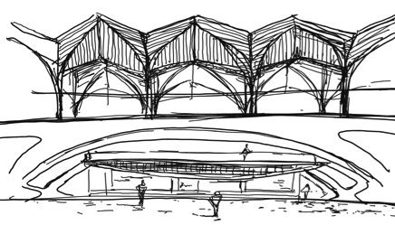
Alhambra, Parc Guell, Gare de Oriente
Lin Wang

Slide 56
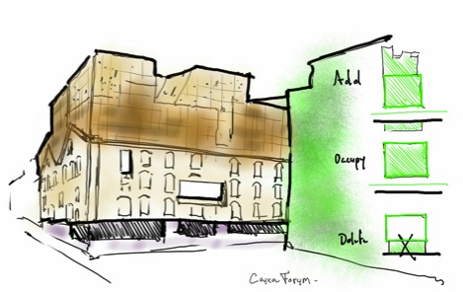
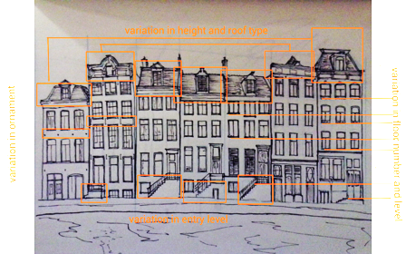
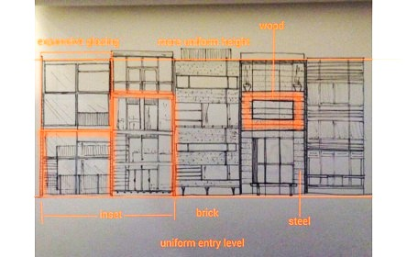
Brandenburg Gate, Caixa Forum, Facades
Ryan Anderson

Slide 57
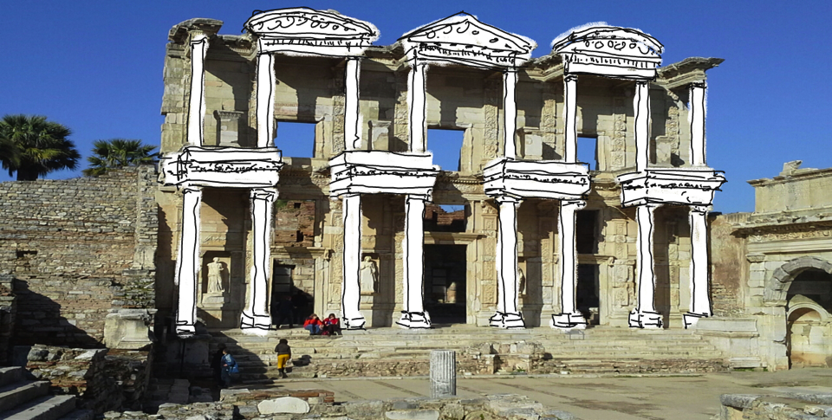
Library of Celcus, Ephesus Turkey
Andrew Calbert

Slide 58
What we LEARNED

Slide 59
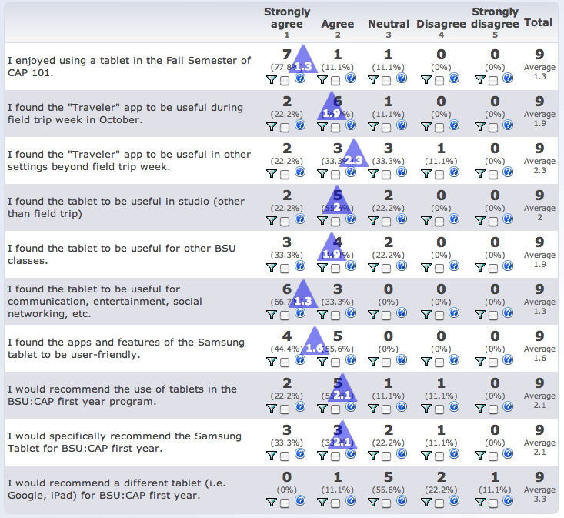

Slide 60
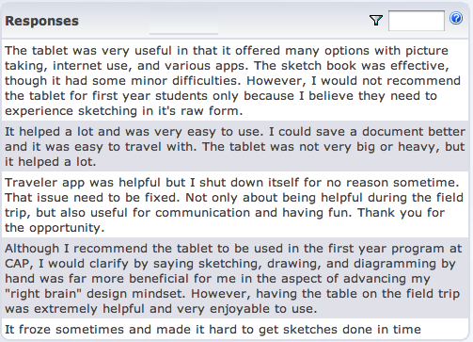

Slide 61
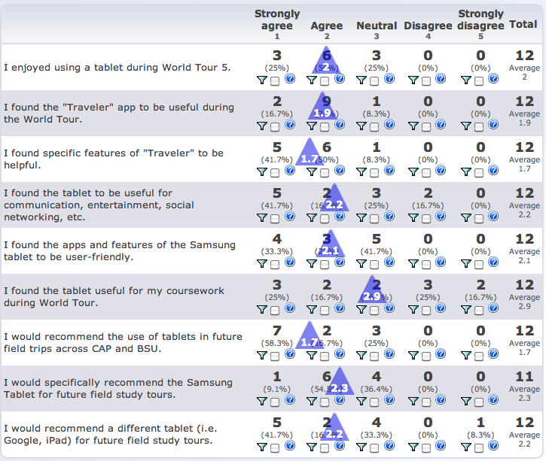

Slide 63
Students responded well to path recording, sharing, and social networking capabilities

Slide 64
Students responded well to path recording, sharing, and social networking capabilities
Some features of the app and tablet did not replace other cameras or sketchbooks / notebooks

Slide 65
Students responded well to path recording, sharing, and social networking capabilities
Some features of the app and tablet did not replace other cameras or sketchbooks / notebooks
App provided immediate, diverse, and extended learning methods as well as ‘take-away’ learning outcomes

Slide 66
Students responded well to path recording, sharing, and social networking capabilities
Some features of the app and tablet did not replace other cameras or sketchbooks / notebooks
App provided immediate, diverse, and extended learning methods as well as ‘take-away’ learning outcomes
App provided students with more comprehensive discoveries and conclusions throughout their study

Slide 67
Our RESPONSE

Slide 68
Incorporate feedback and features requested by the students into new versions of Traveler

Slide 69
Incorporate feedback and features requested by the students into new versions of Traveler
Google Places API to search for and locate nearby points of interests

Slide 70
Incorporate feedback and features requested by the students into new versions of Traveler
Google Places API to search for and locate nearby points of interests
Geofencing to remind you as you approach a location

Slide 71
Incorporate feedback and features requested by the students into new versions of Traveler
Google Places API to search for and locate nearby points of interests
Geofencing to remind you as you approach a location
Sharing the experience with family and friends on the web

Slide 72
What is NEXT

Slide 73
TRAVELER + GLASS

Slide 74
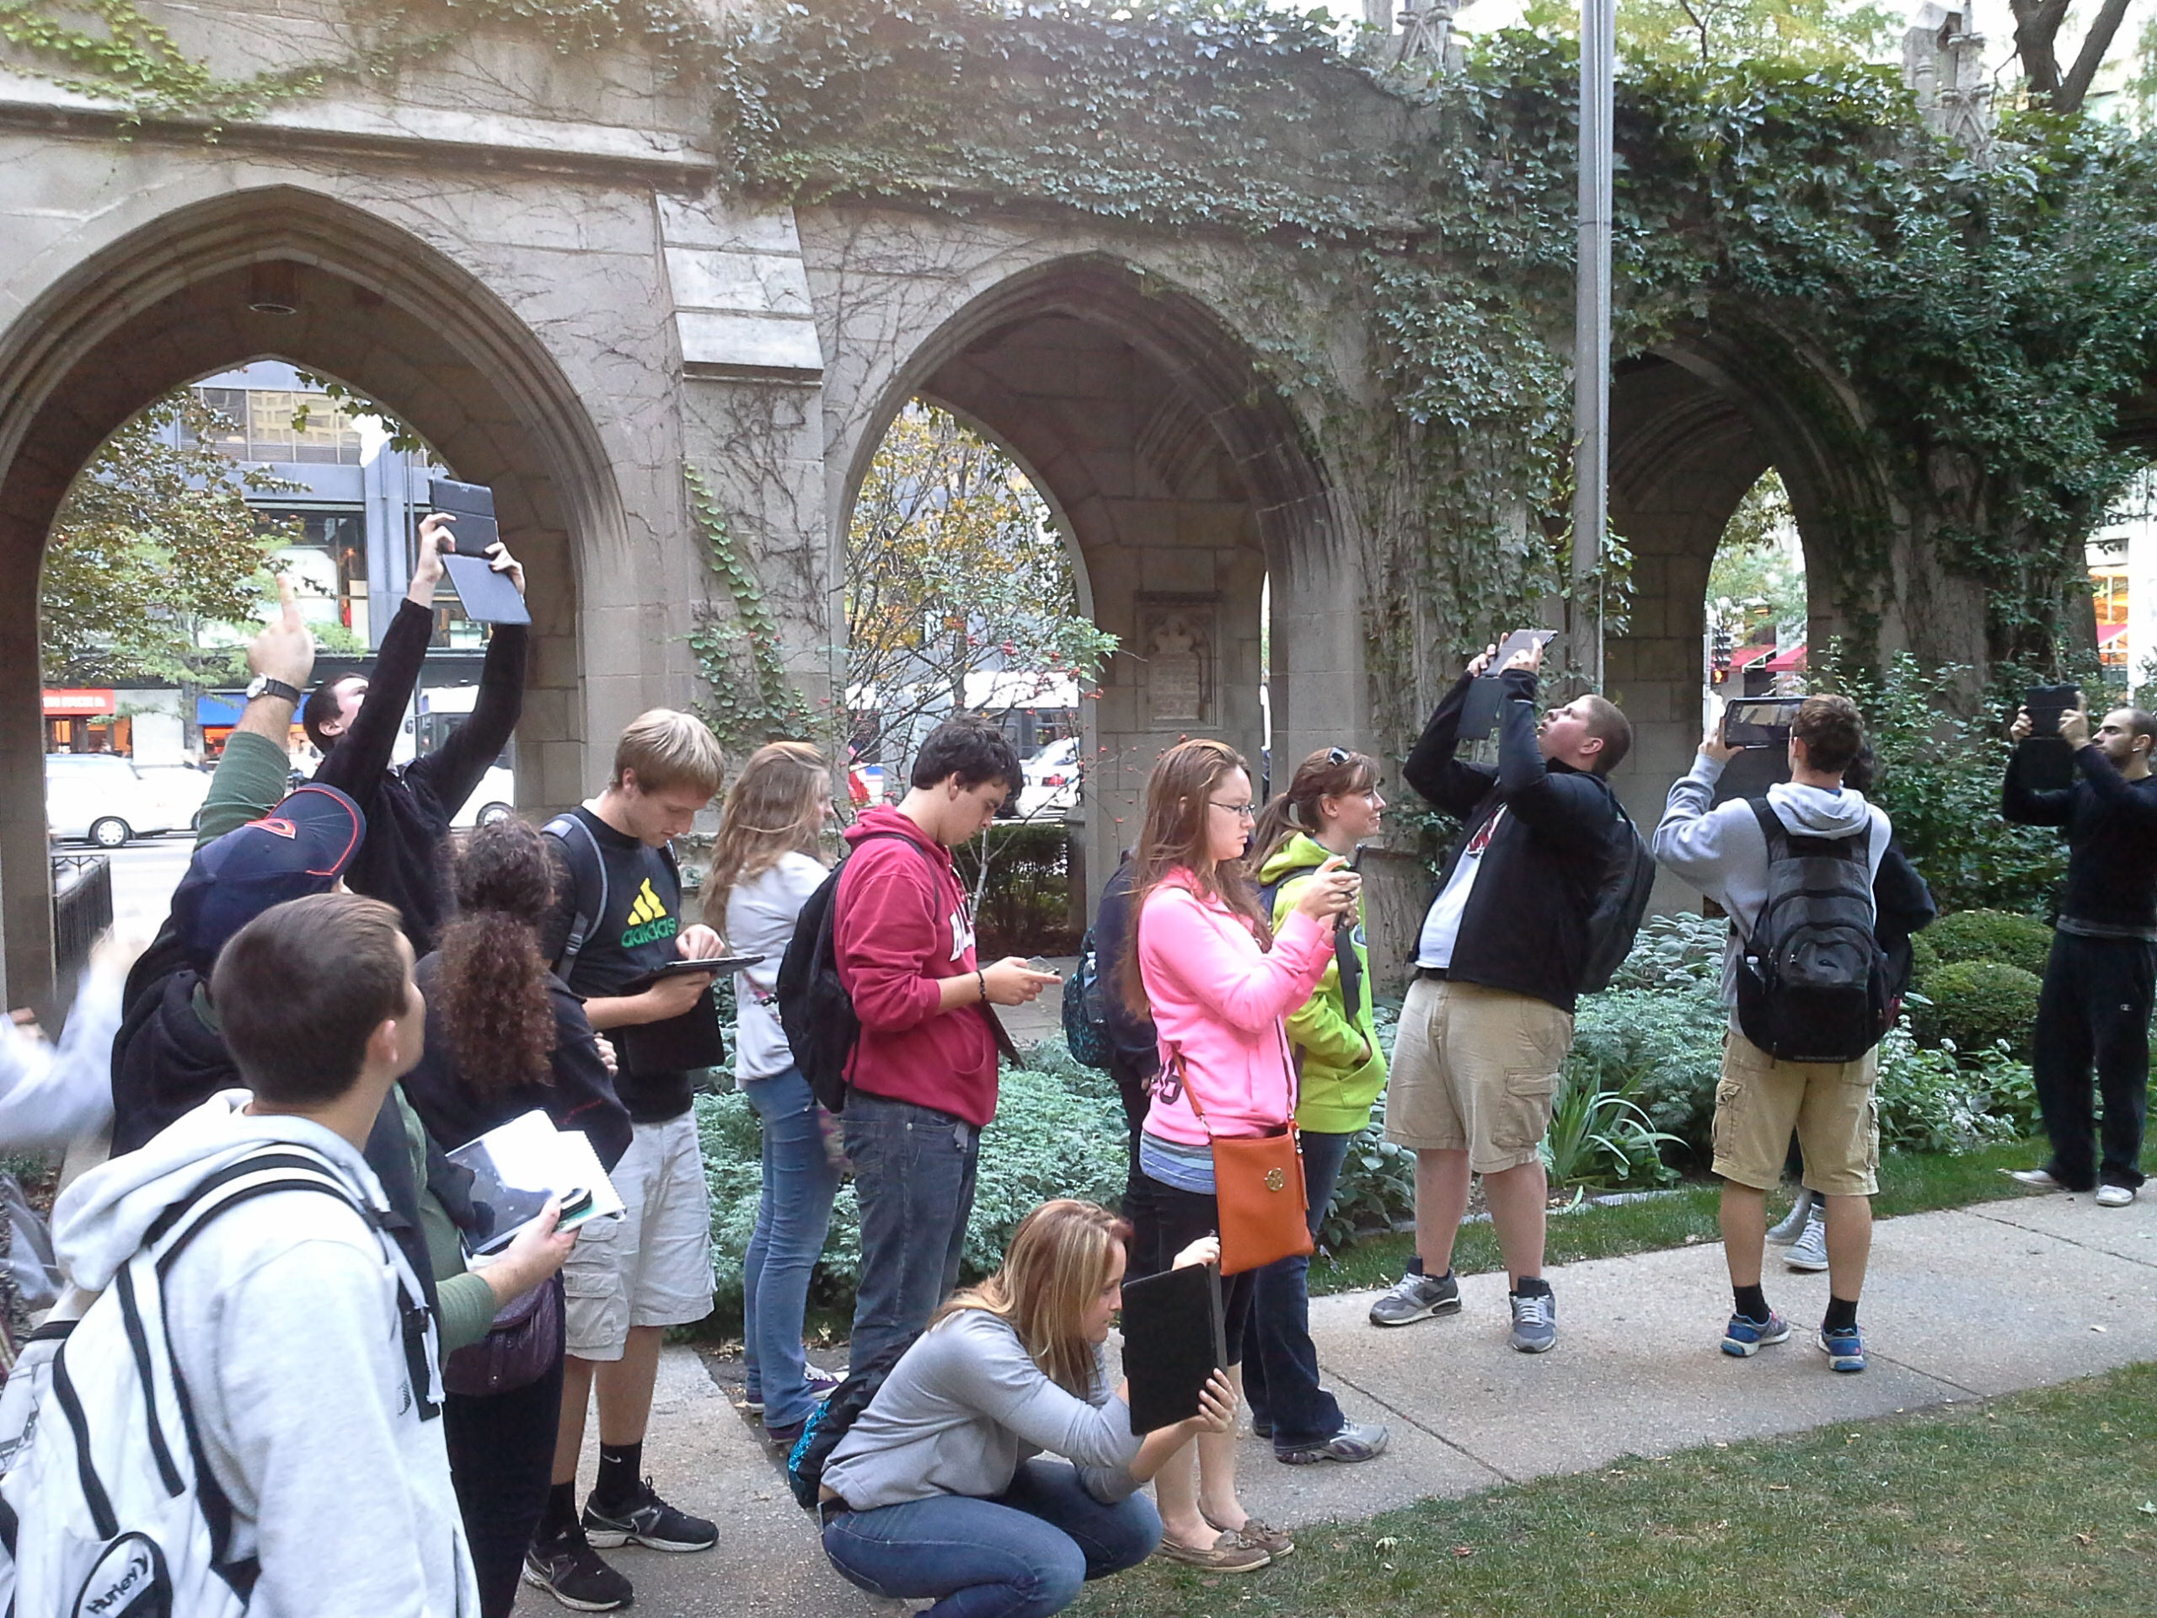
Traditional technology simply gets in the way and creates a barrier to the world around us

Slide 75
Traditional technology simply gets in the way and creates a barrier to the world around us
Our goal is to focus on voice and a simple tap of the finger, using a device that is always facing the action

Slide 76
DEMO TIME!
#throughglass

Slide 77
#throughglass

Slide 78
#throughglass

Slide 79
#throughglass

Slide 80
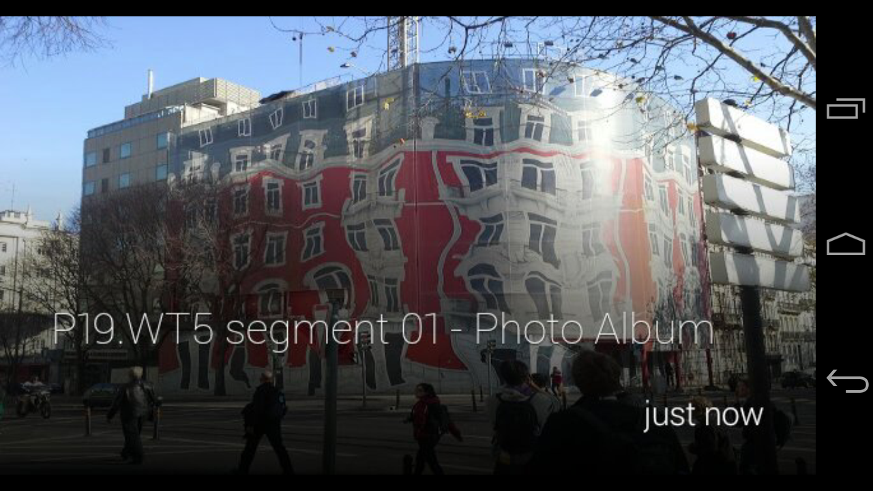
#throughglass

Slide 81
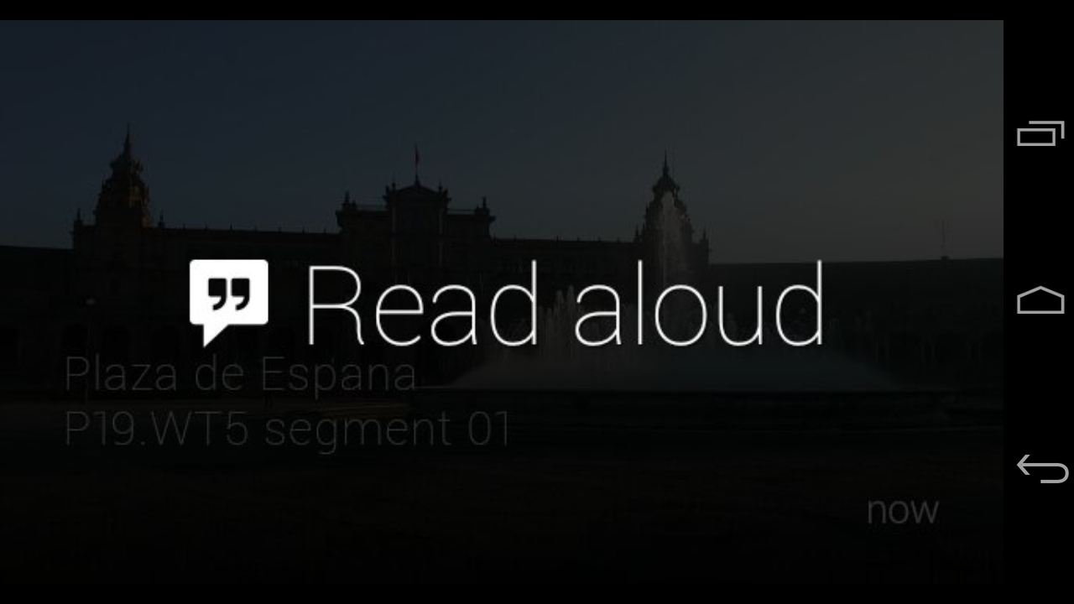
#throughglass

Slide 82
#throughglass

Slide 83
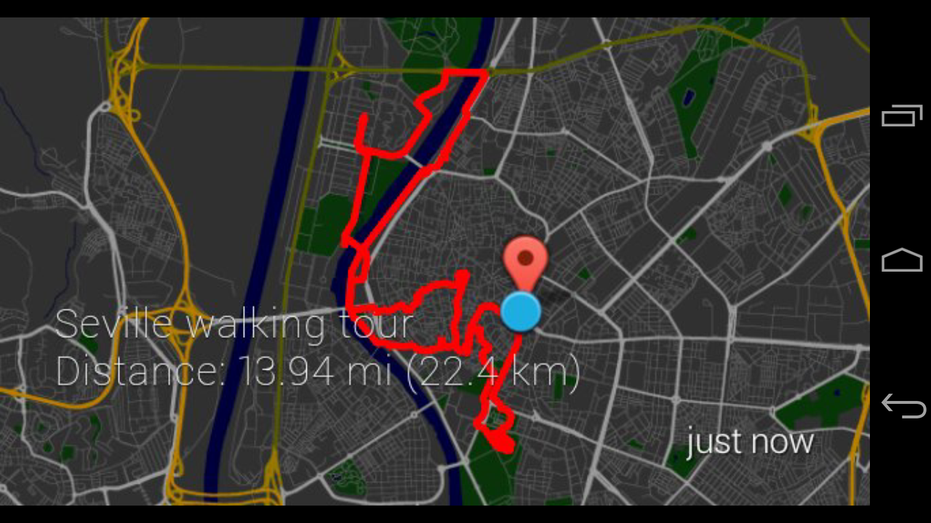
#throughglass

Slide 84
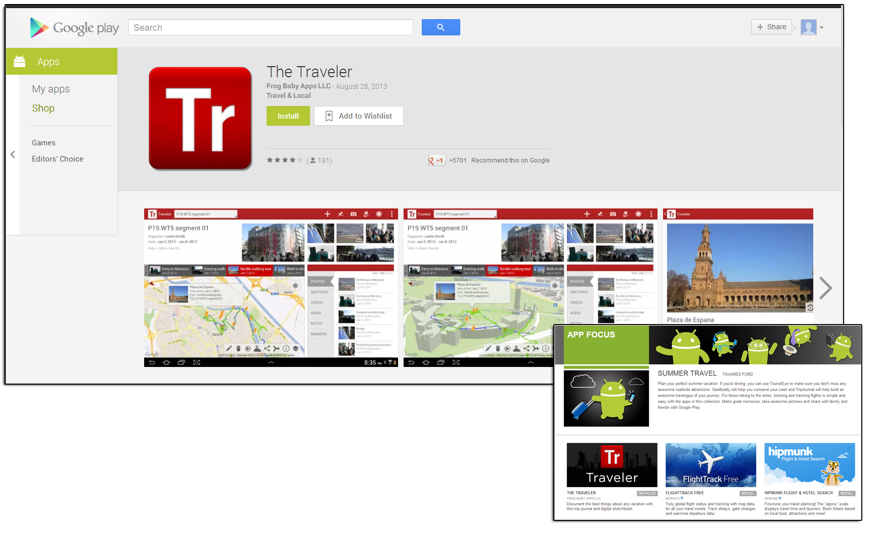

Slide 85
Find us on
FACEBOOK or GOOGLE+
Look for THE TRAVELER

Slide 86
DISCUSSION TIME

Slide 87
How are you using mobile in the classroom at your university?
What apps – either custom developed or purchased – are you using?
What are students’ expectations for mobile in the classroom?
What apps are your students using for academic purposes?

