Slide 1
New Developments in Central Directory Service and Account Provisioning Dan Menicucci (dan@pitt.edu) Enterprise Architect - University of Pittsburgh

Slide 2
Who are we?
Founded in 1787
One of the oldest universities in the U.S.
Five campuses (Pittsburgh,
Bradford, Greensburg,
Johnstown and Titusville)
Notes:
Figures taken from 2009 University Fact Book

Slide 3
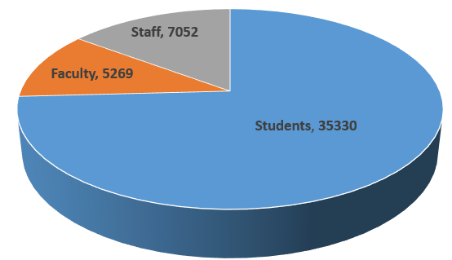
Students, Faculty, and Staff at Pitt
All campuses
Notes:
Figures taken from 2013 University Fact Book
52,953 Applicants
89,298 Accounts
8,527 Groups

Slide 4
Central Directory Service
Everything from our system’s of record down
Identity Registry
Provisioning Engine
Authentication Services
Other identity services

Slide 5
History 2000
Built an identity registry on top of an Oracle DB
Implemented Novell DirXML1.0
Provisioning for users in e-Directory, Active Directory, OpenLDAP and a Kerberos 4 Realm
Provisioning for IMAP, AFS, and Unix Time Sharing
Built a custom user account portal

Slide 6
Later Enhancements
Spam and Virus Filtering
Enterprise Active Directory
Exchange
Groups
Emergency Notification
Guest Wireless
Password Enhancements
Box
Office 365

Slide 7
Challenges
System built in an NT/Novell era
Limits on group membership sizes
Difficulty managing multi-valued attributes
Stable, but aging

Slide 8
Current Focus
Upgrade the hardware and software of the registry
Replace provisioning engine with a new solution
Remove redundant authentication directories
Standardize non-Windows authentication
Multifactor Authentication

Slide 9
Account Provisioning
Implemented Microsoft Forefront Identity Manager 2010 R2
More supportable solution
Easier integration
Solves scalability issues in previous architecture
Notes:
52,953 Applicants
89,298 Accounts
8,527 Groups

Slide 10
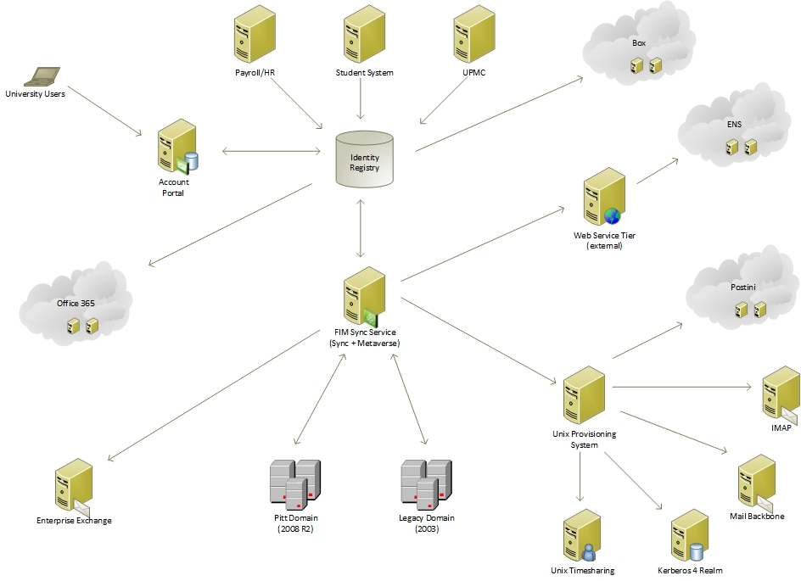
Notes:
52,953 Applicants
89,298 Accounts
8,527 Groups

Slide 11
Remove Redundancies
Two Enterprise AD environments, Novell eDirectory, Kerberos 4 realm and two open LDAP systems.
~40 remaining departmental authentication systems
Move to a single domain Active Directory forest (Pitt)

Slide 12
Standardize Non-Windows Auth
Site license for Centrify Direct Control
Authenticate and apply policy from Active Directory
Replace Kerberos 4 Realm
Replace NIS+
Replace Open Directory

Slide 13
Multifactor Authentication
Implemented multiple solutions
Certificate Based Authenticators from Safenet
OTP from Deepnet Security
Rolled out to Central IT Now
Focus on applications in future, including the addition of customers

Slide 14
Looking Ahead
Extend Role Based Account Provisioning
Authentication Assurance
True Web SSO
Bring Your Own Credentials

Slide 15
Thank you for attending
Dan Menicucci
Enterprise Architect
dan@pitt.edu

