Slide 2
The Transformational Journey to a Modern Learning Environment: A Triangulation of Perspectives
Melaine C. Kenyon, Eugene J. Harvey, Mark McBride

Slide 3
Planning From A/V and IT
Melaine C. Kenyon alibrarian

Slide 4
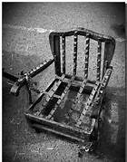
It all started with a chair…

Slide 5
Classroom and Modern Mobile Chair

Slide 6
Classroom and Modern Mobile Chair

Slide 7
Visit to University of Florida

Slide 8
University of Florida classroom

Slide 9
University of Florida classroom

Slide 10
University of Florida classroom

Slide 11
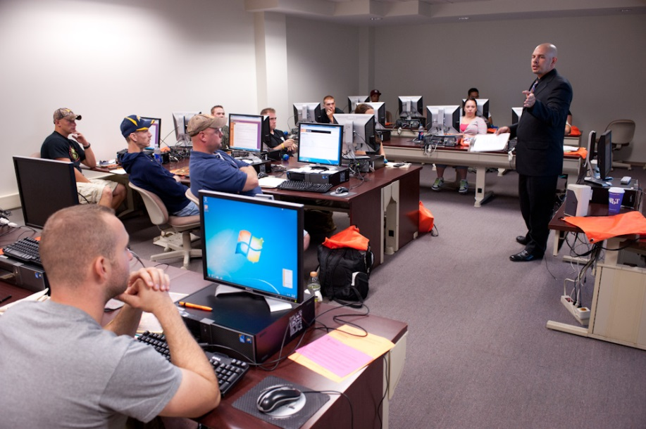

Slide 12
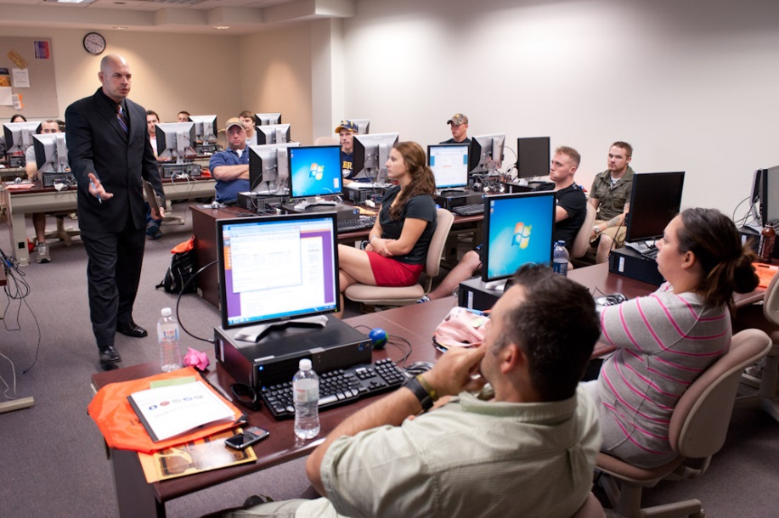

Slide 13
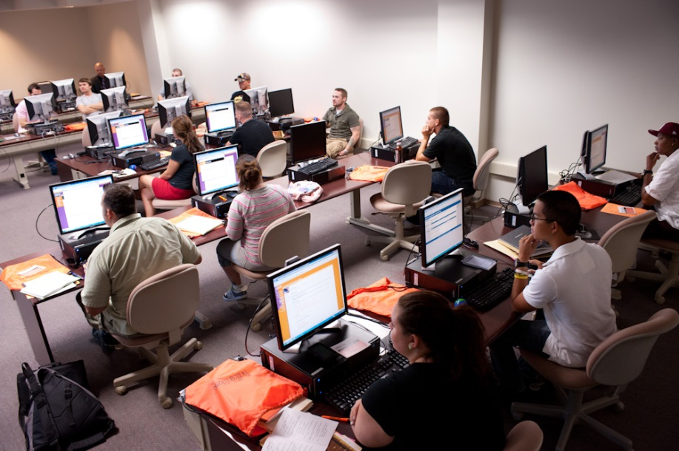

Slide 14
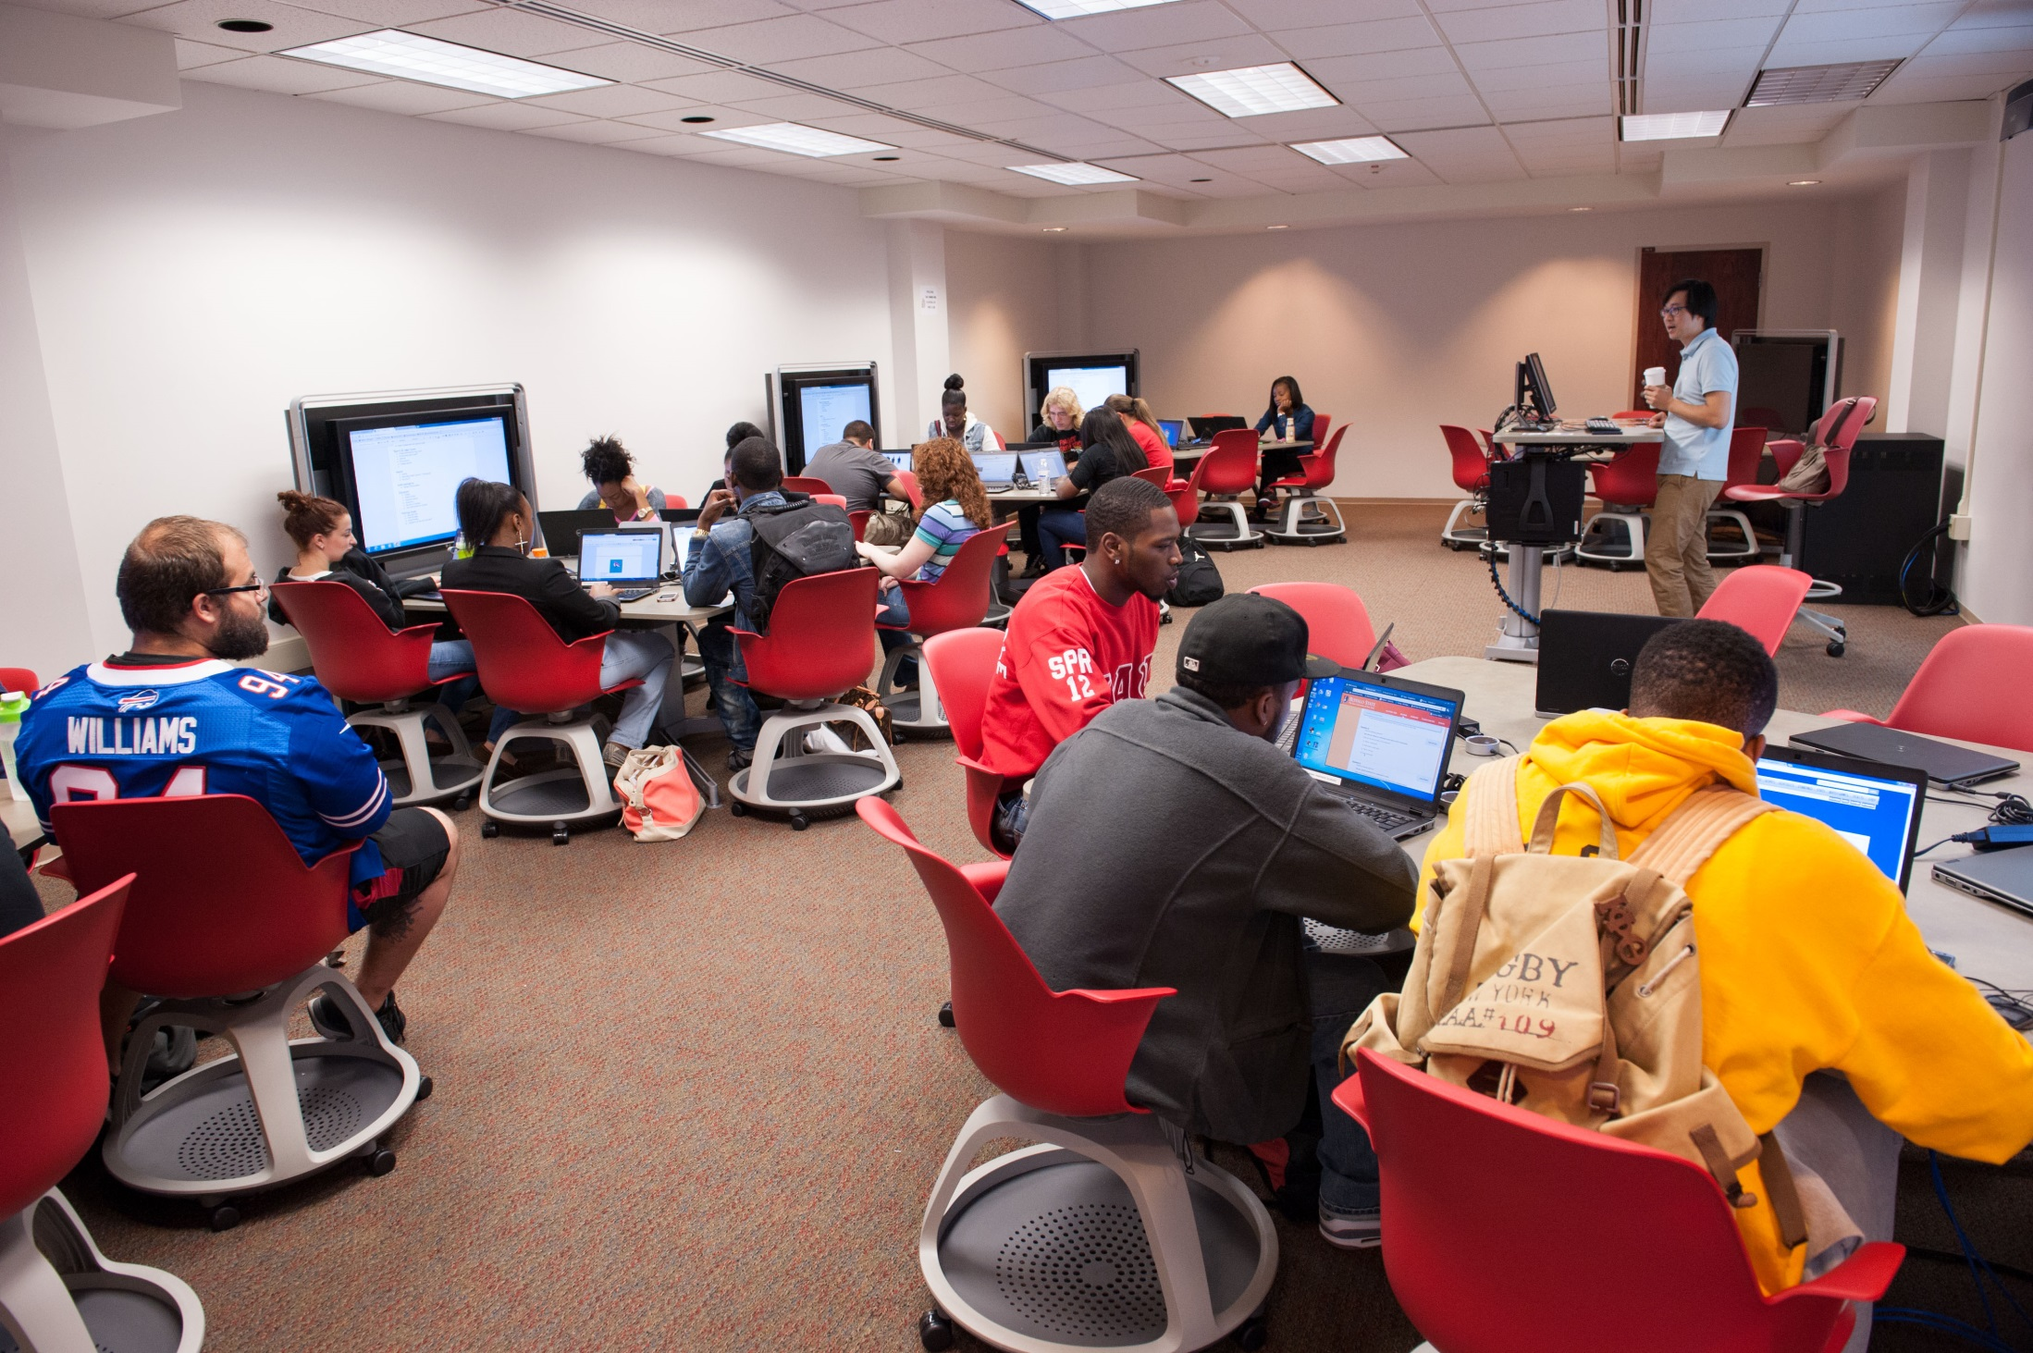

Slide 15
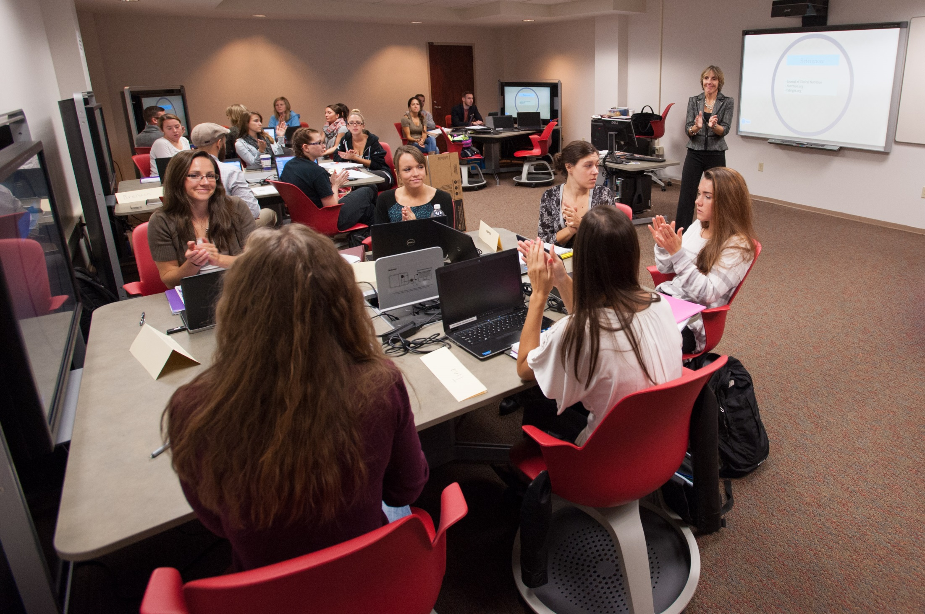
Notes:
Same space now seats 36.

Slide 16
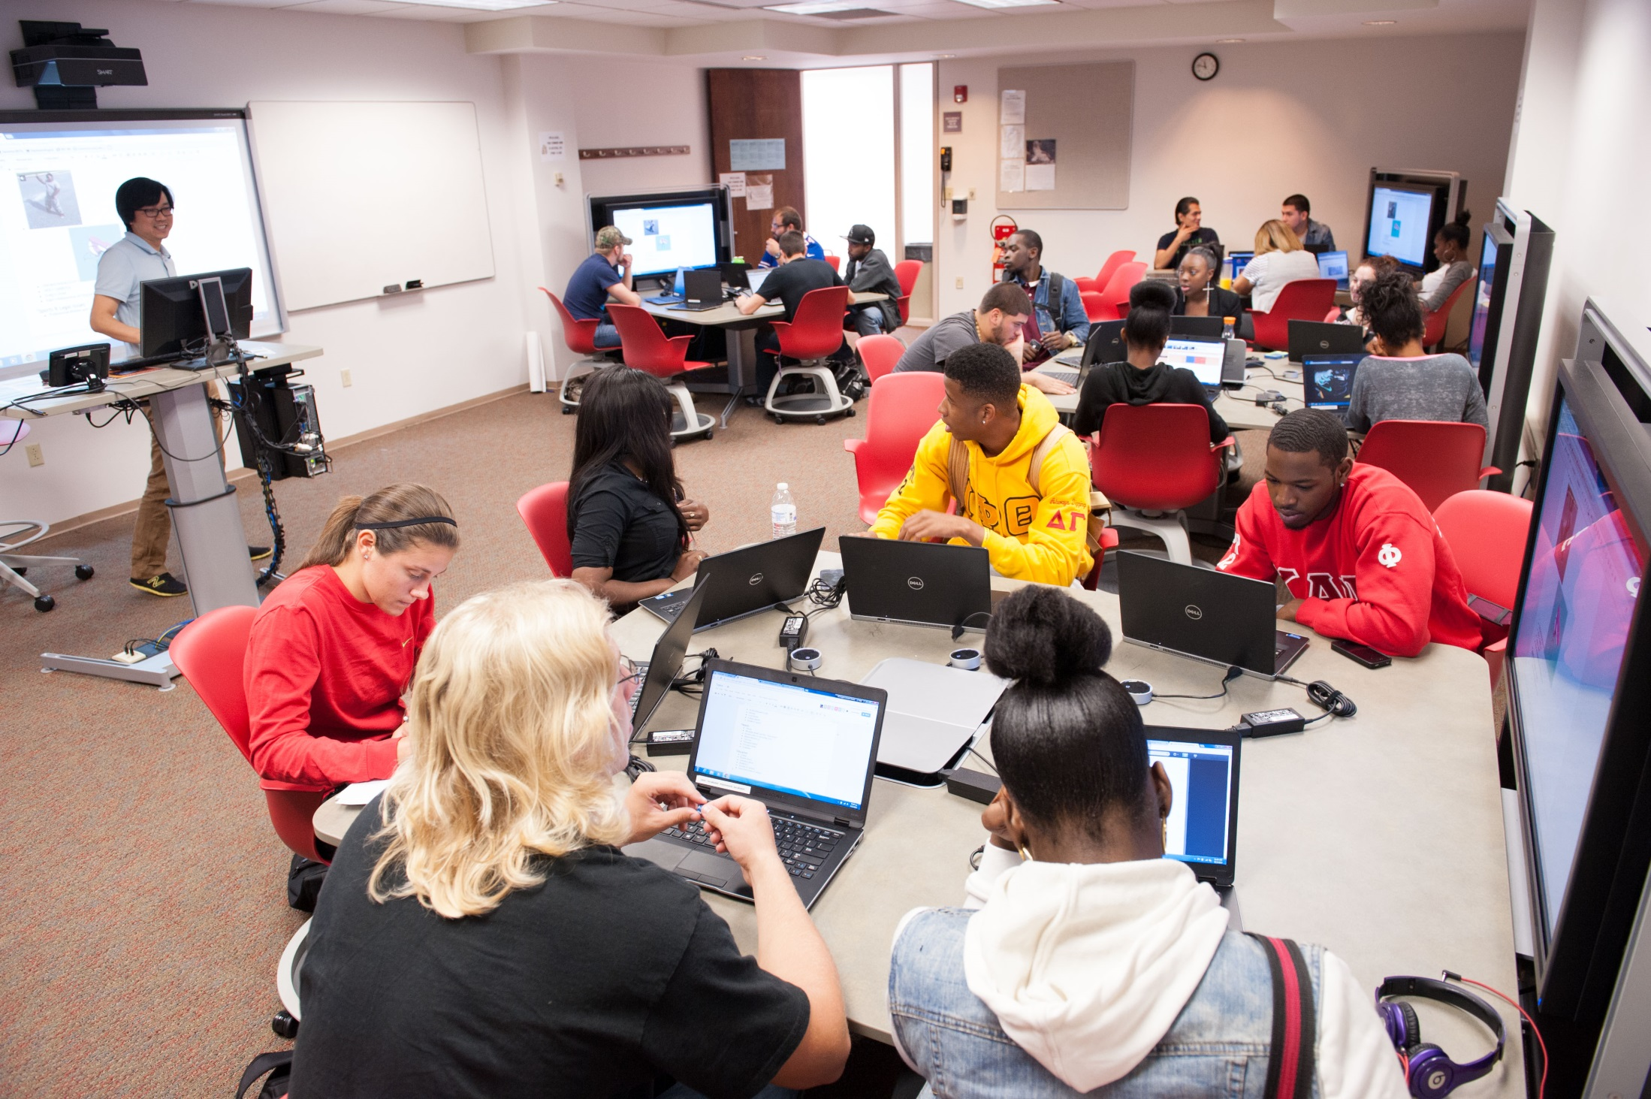

Slide 17
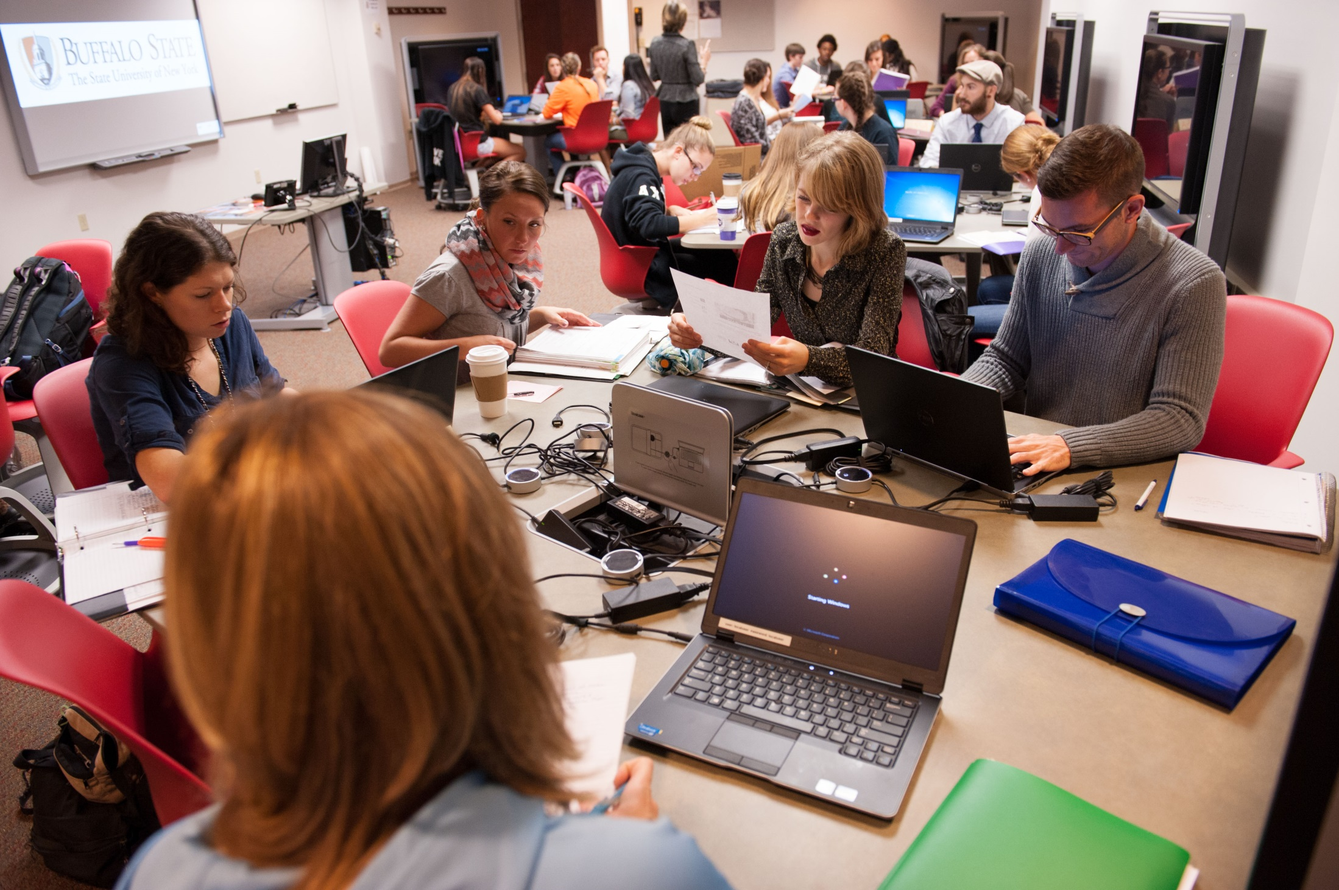

Slide 18
From Steelcase technical overview
Notes:
Technical overview of the steelcase media scape table with puck technology – link on end slide

Slide 19
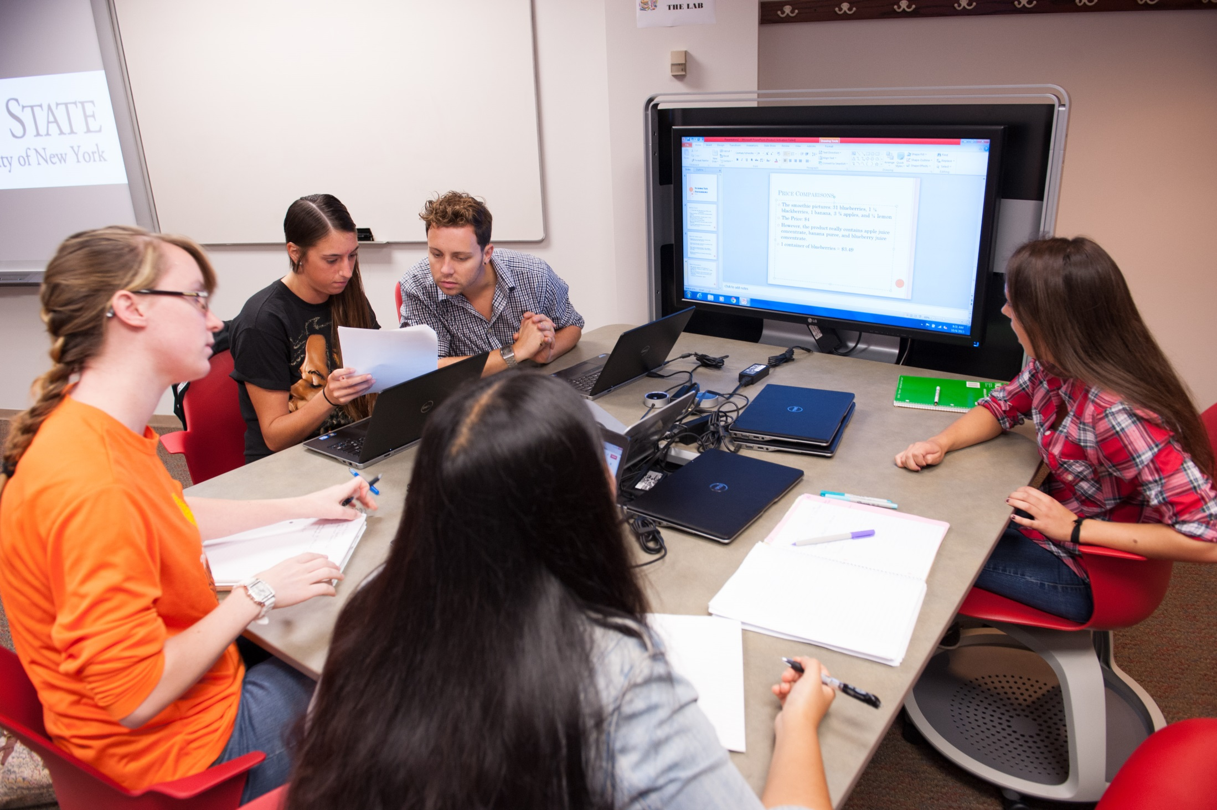

Slide 20
Triangulation
Triangulation of content is easily visible from anywhere in the classroom.
Our three modes labeled:
Teach
Present
Collaborate
These modes facilitate collaboration and teamwork for large and small groups.

Slide 21
How does it work?
Interactive technology built into media tables
Each table had own control system – each table can stand alone
Using client supplied A/V technology, can send input from table to any output so able to program modes

Slide 22
From Steelcase technical overview
Notes:
Included in technical overview

Slide 23
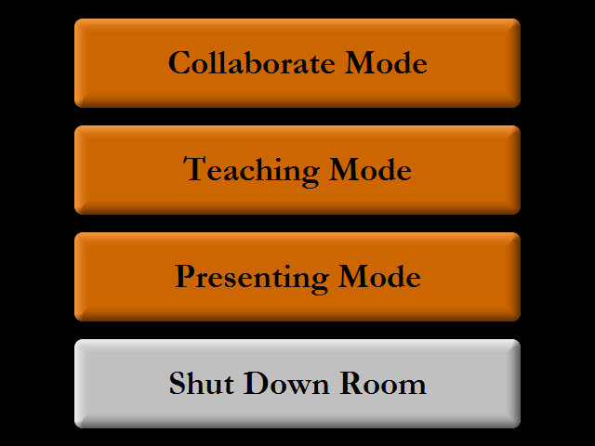

Slide 24
How does this work?
Notes:
Each table – each Media:scape table – had its own control system, the system that controls power of the table, audio and video. There is an Altinex control system under the table, above the pillar, all pucks plug into that box. Output from audio and video from each of those switchers goes into a Crestron digital media transmitter. That signal is transmitted from each table goes into a digital media router

Slide 25
Notes:
Example of Collaborate mode – - students work together – laptops display from puck input to monitor. teacher can select a table to display input from that table

Slide 26
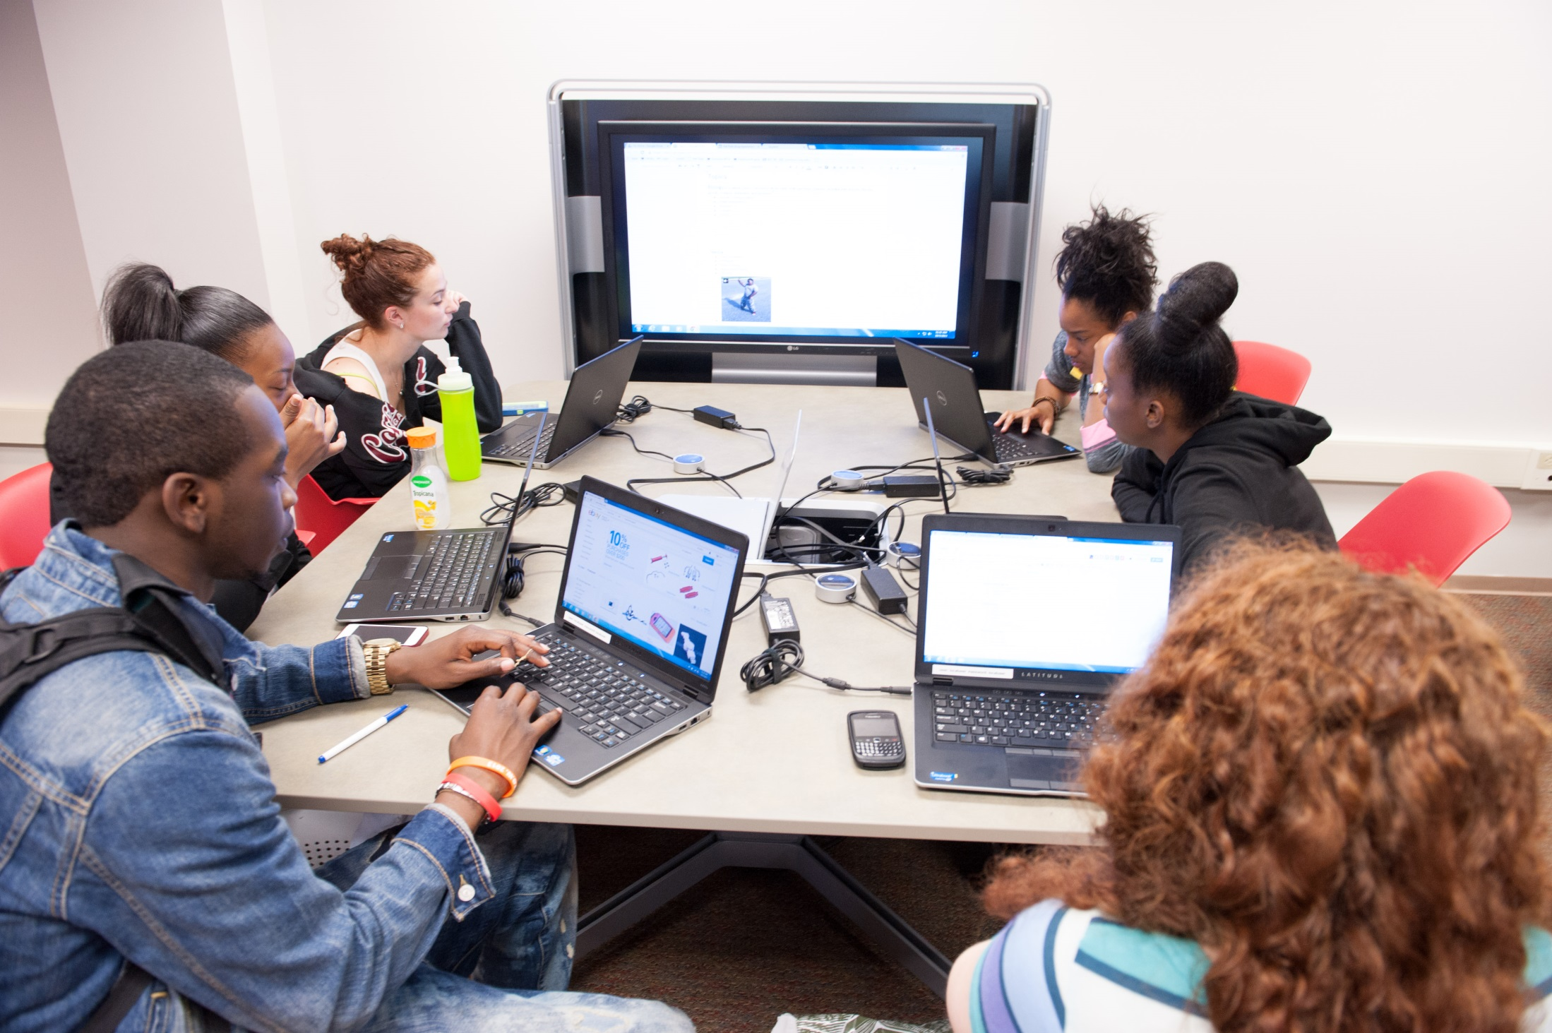

Slide 27
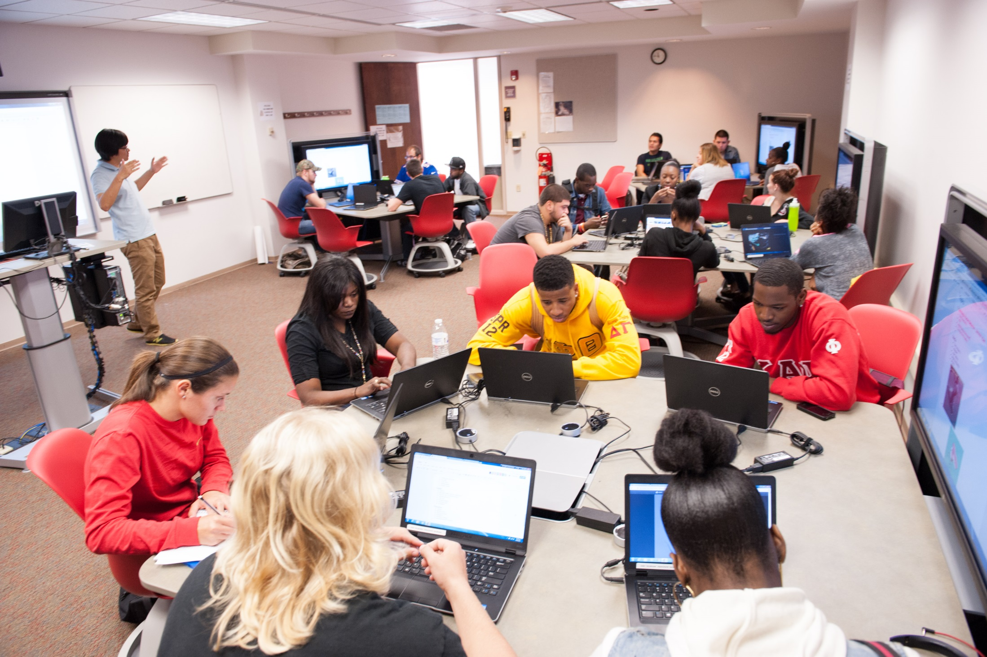
Notes:
Teaching mode – pucks are locked, only teacher input displays – laptop or resident PC. Presenting mode - teacher can select a table to display input from that table to entire room.

Slide 28
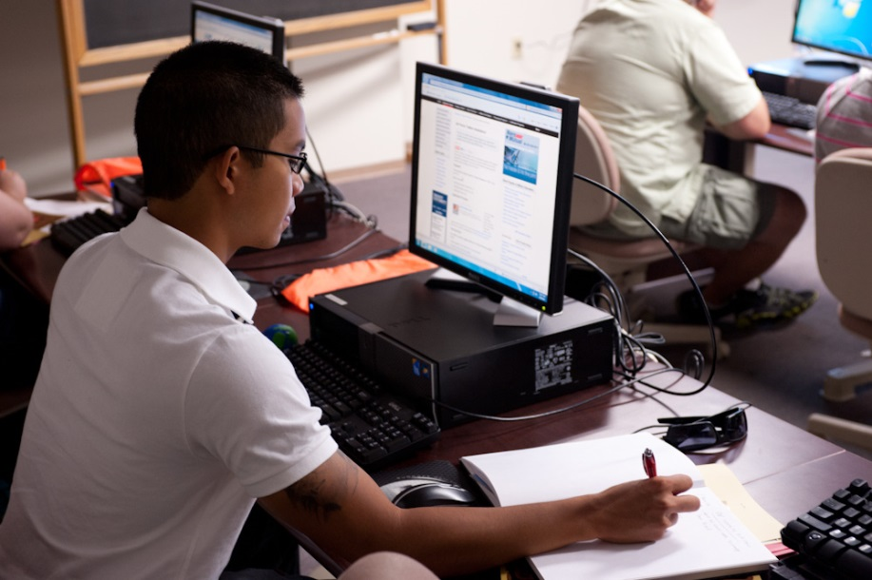

Slide 29
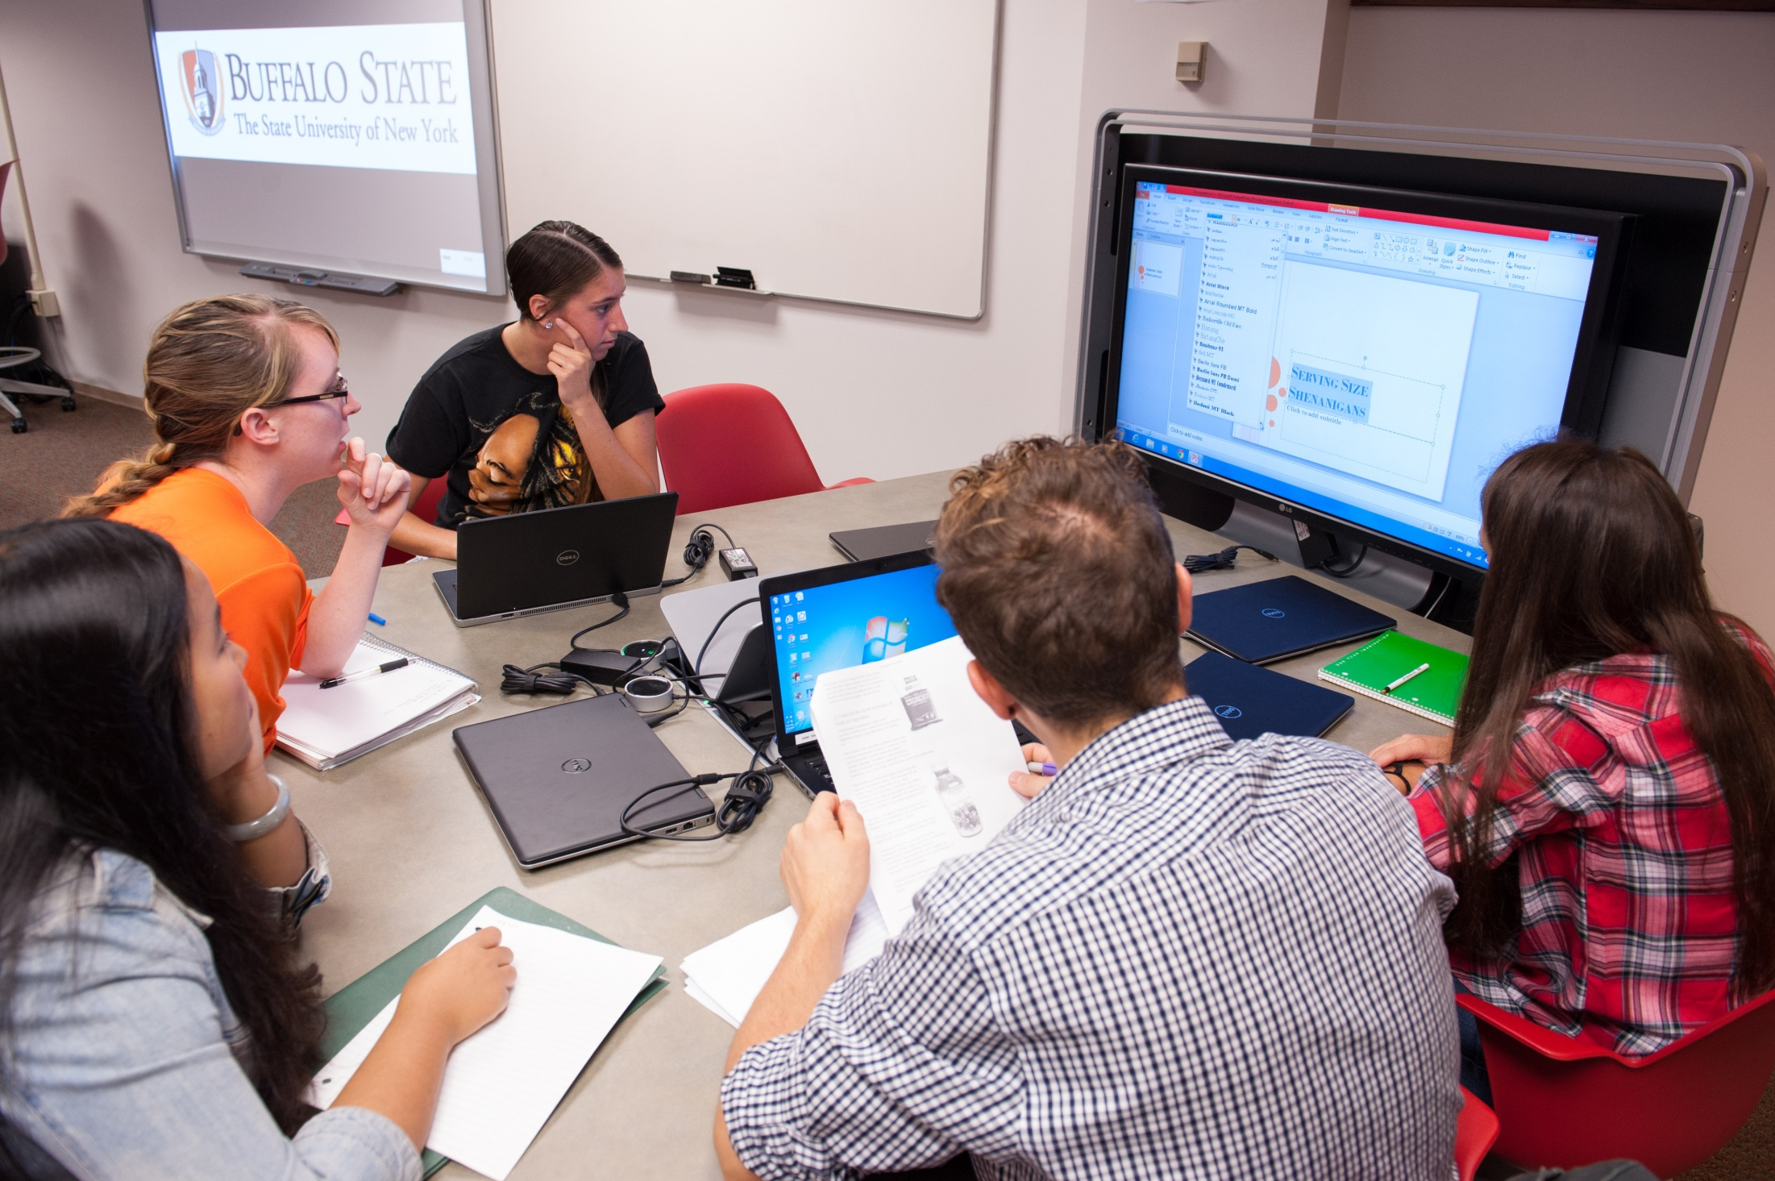

Slide 30
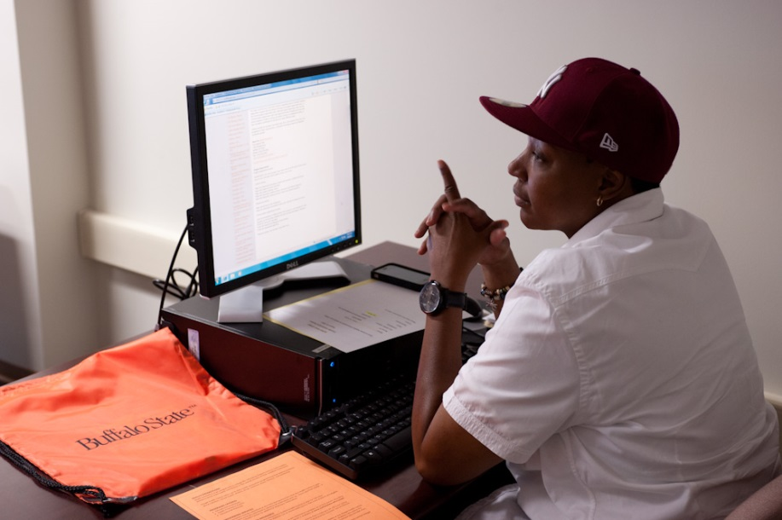

Slide 31
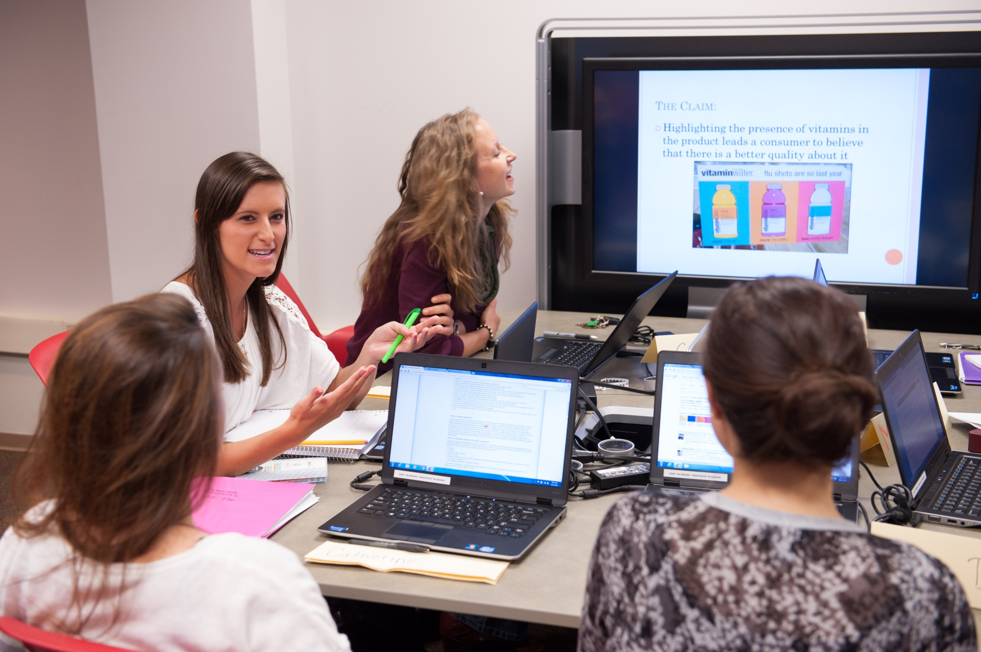

Slide 32
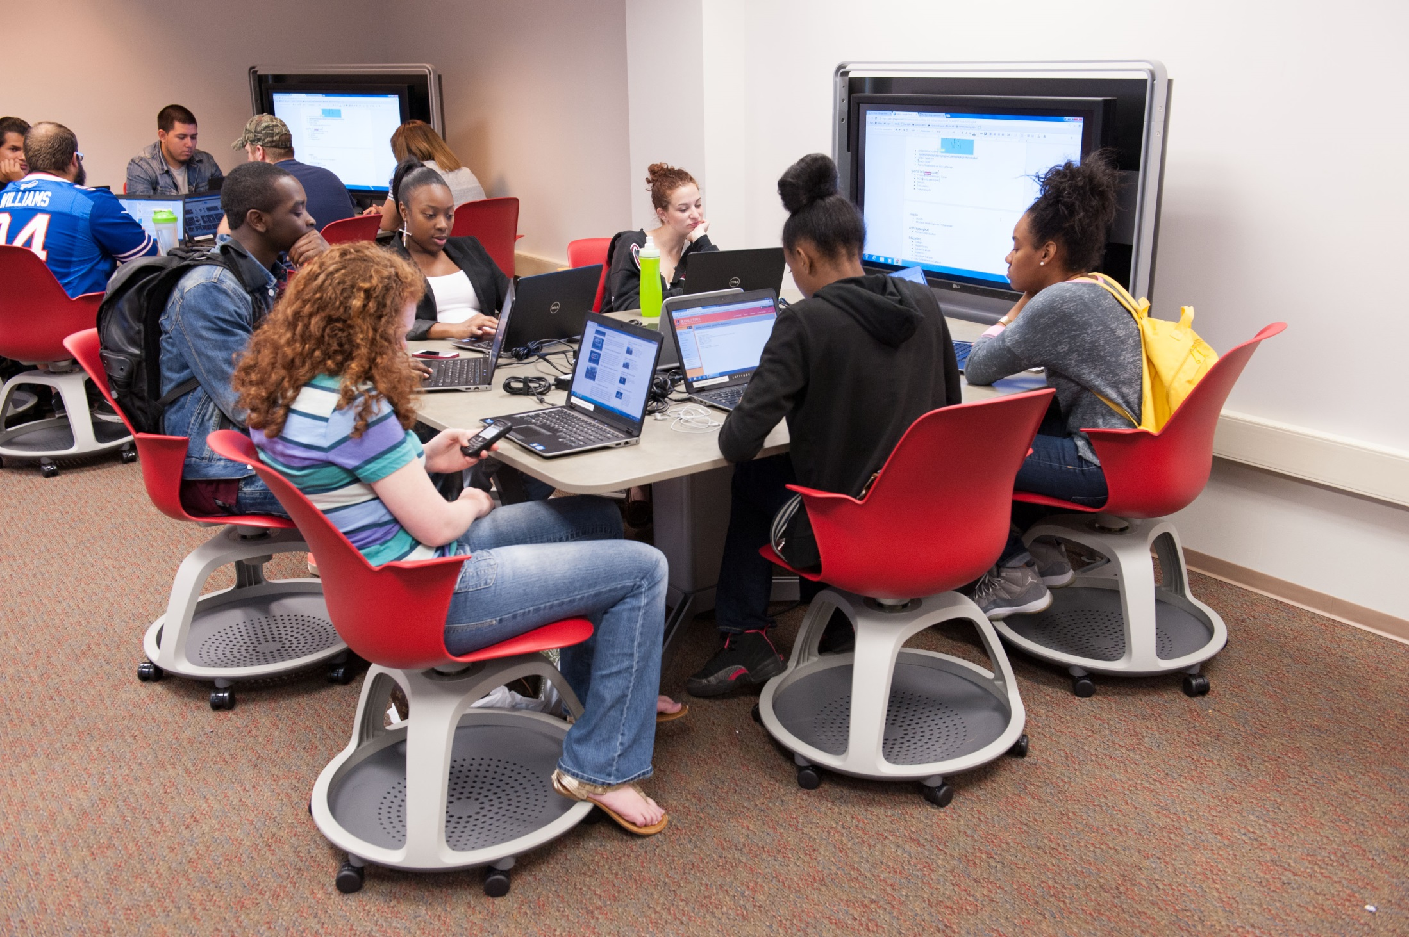

Slide 33
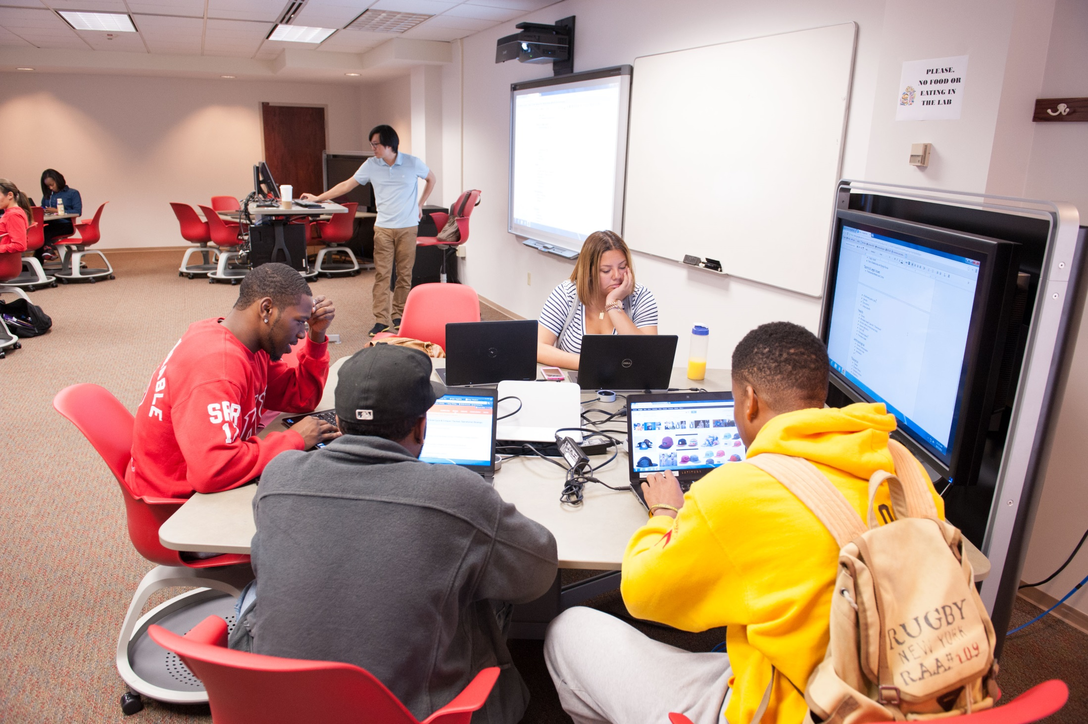

Slide 34
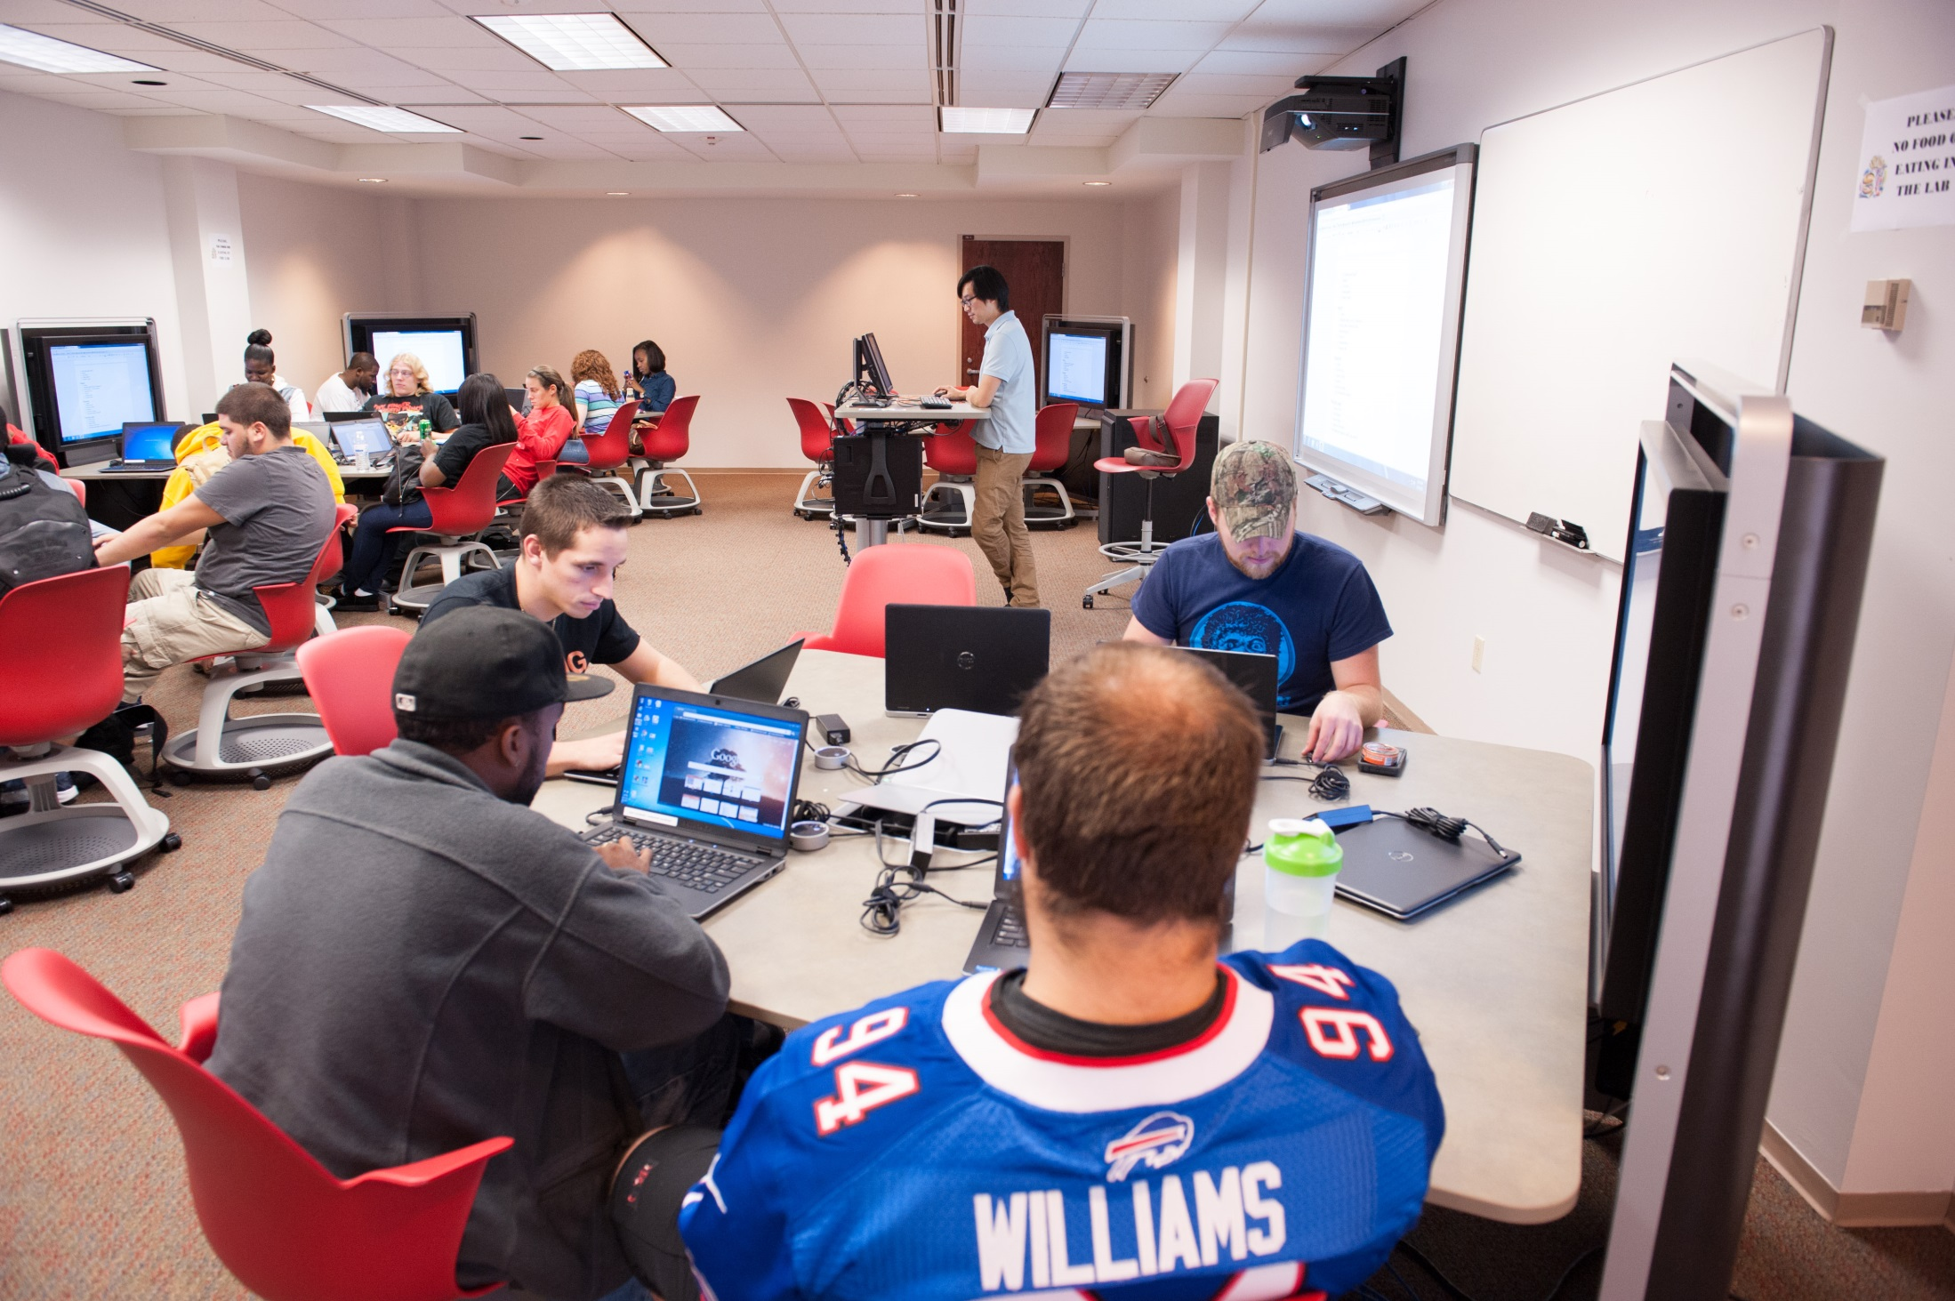

Slide 35
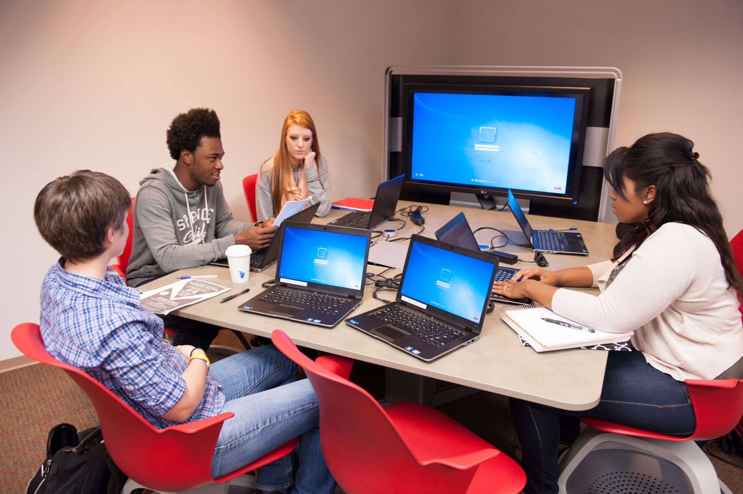

Slide 36
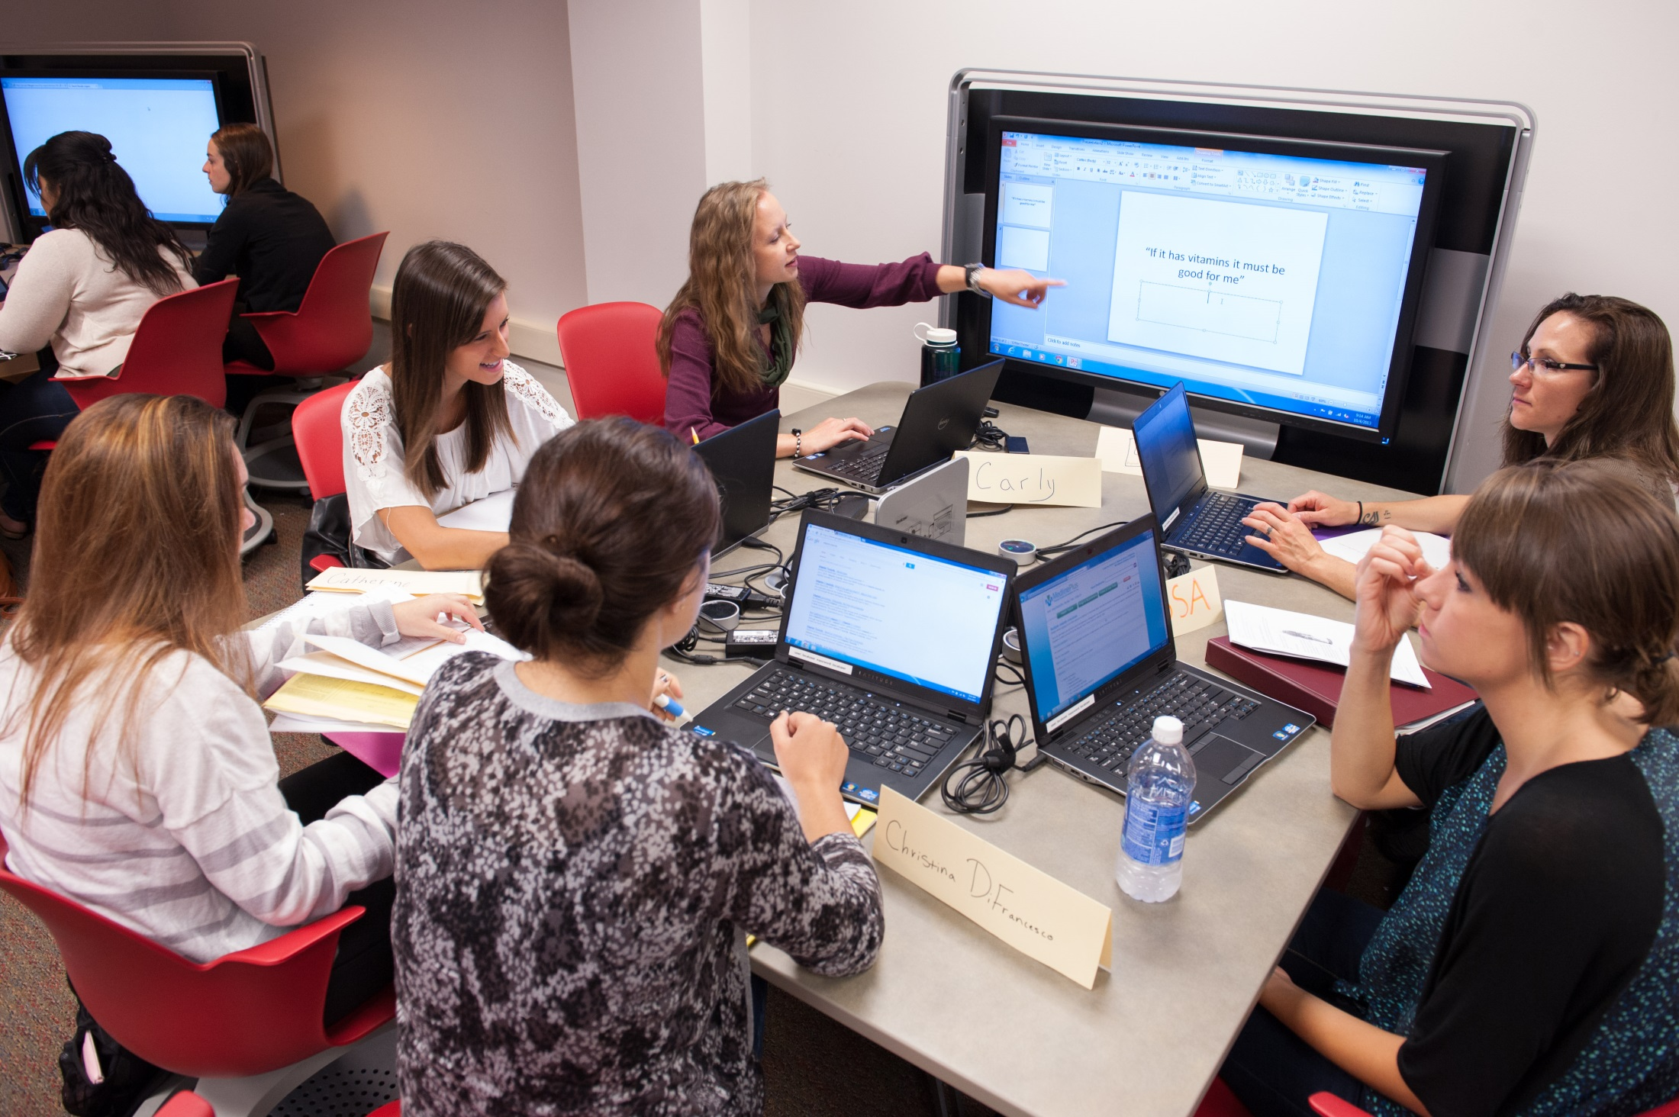

Slide 37
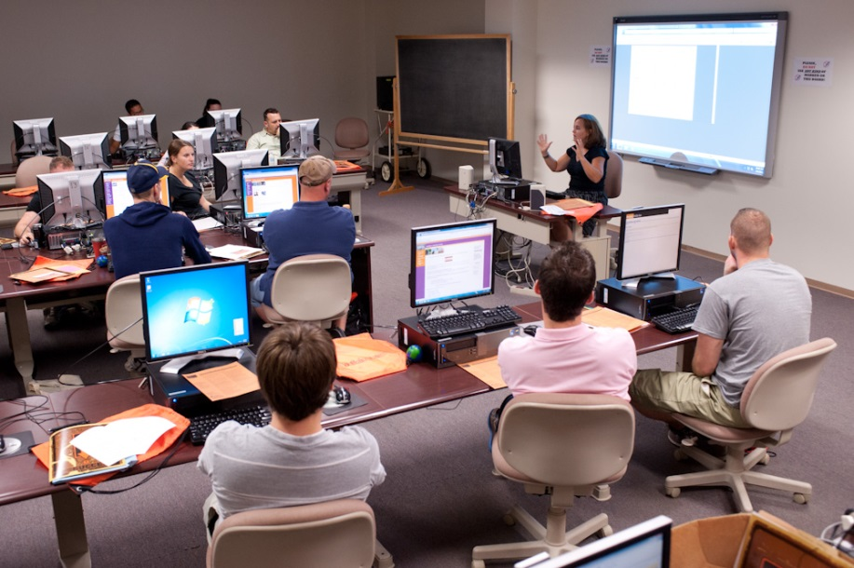
Notes:
Chalkboard! Smart board in here was new…went from this…transformation…

Slide 38
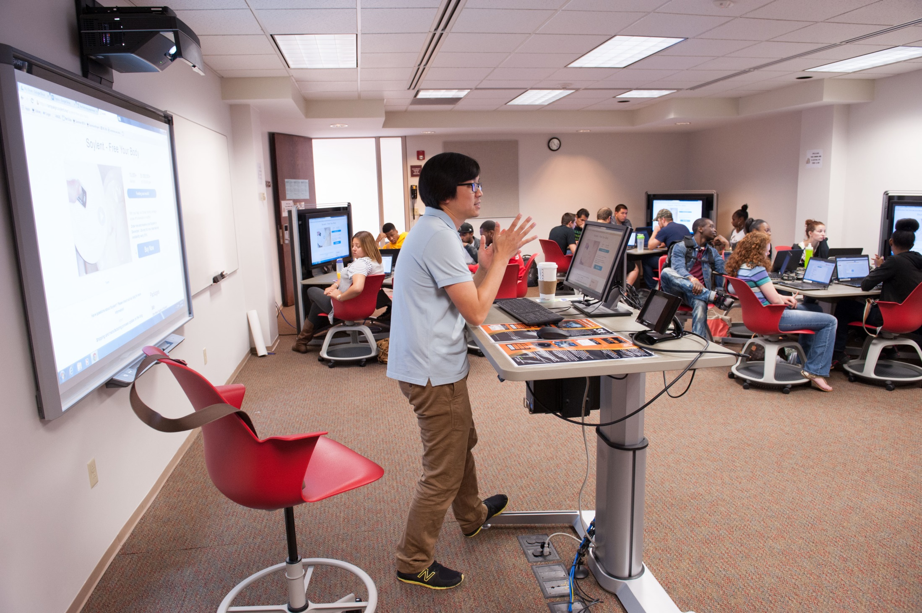
Notes:
To this…

Slide 39
Resources
Media:scape LearnLab Technical Overview
http://www.steelcase.com/en/products/category/educational/learnlab/documents/ms_learn-lab_technical_overview_fn.pdf

