Slide 1
IPAS Status Colorado State University
Pat Burns, VP for IT & Dean of Libraries
Wed., Oct. 16, 2013; 10:30-11:20 AM
EDUCAUSE Meeting

Slide 2
Outline
“I keep six honest-serving men (they taught me all I knew); Their names are What and Why and When and How and Where and Who.”
R. Kipling

Slide 3
Why?

Slide 4
Via IPAS Grant, Improve Student Success
Learning
Persistence
Retention
Completion
Lower the Cost of Degree

Slide 5
WhAT?

Slide 6
Our IPAS Systems
Be
____________
Beacon
u.direct®
+
u.achieve®

Slide 7
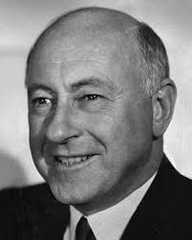
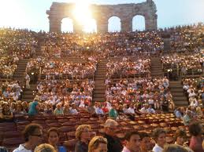
Our IPAS Team
Assoc. VP for
Student Affairs
VP for IT
OnlinePlus
Registrar
Mobile
Committee
Provost’s
Office
Academic
Computing
Cecile B. DeMille
Administrative
Computing
Fin. Aid
Students
Center for
Advising &
Student
Achievement
Institute for
Teaching &
Learning

Slide 8
WhO?

Slide 9
Target: All Students Incl. Distance
Be
____________
Beacon
u.direct®
+
u.achieve®
Advising, planning
Academic support
Support teams
Co-curricular involvements
Homework
Grades
Chats
Threaded discussions

Slide 10
HOW?

Slide 11
Integrated Planning & Advising Systems

Slide 12
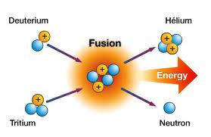
Integration: Data Fusion
u.direct®
+
u.achieve®
Be
____________
Beacon

Slide 13
Integrated Planning & Advising Systems

Slide 14
Student Planning
Enroll in major
Courses needed and completed in major
Plan out course enrollments until graduation
u.direct®
+
u.achieve®

Slide 15
University Planning
Number of course sections to offer
Sizes of course sections to offer
Schedule of course sections to offer
u.Direct®

Slide 16
Integrated Planning & Advising Systems

Slide 17
Advising
Curricular
Course
Social
Courses
Behaviors
Grades

Slide 18
360º – Advising/Interventions
IPAS
Advisor

Slide 19
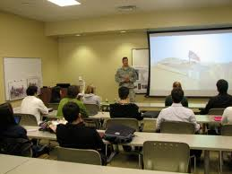
3,500 sections x
38 students/section x
15 weeks/semester x
5 activities/wk-student x
9.3 semesters/student =
93 million activities

Slide 20
Regression: Calculus 1 Predictor
S(HS_GPA, HS_rank, ACT_m, IB_courses, AP_Calc, G, Pell, F, M, A, C, N)
S = Success = Calc 1 grade = [A, B, C, D, F, W] = [4, 3, 2, 1, 0, 1]
HS_GPA = high school GPA [0-4.5]
HS_Rank = high school rank (%)
ACT_m = ACT math score [0-38]
IB_courses = IB course count [0,30]
AP_Calc = AP Calculus exam score [0,5]
Gender = Gender [M, F]
Pell = Pell recipient status [0,1]
F = First-generation status [0,1]
M = Minority status [0,1]
A = Application type (new or transfer) [N,T]
C = Concurrent enrollment in PH141 and/or CHEM111 [0, 1, 2]
N = number of students in high school class [0,…]

Slide 21
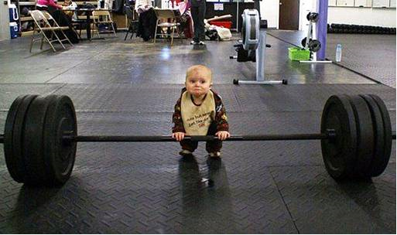
Big Analytics @ an Unprecedented Scale
Us
Big Data

Slide 22
Huge Regression
Cray XT6m

Slide 23
Make Work as Easy as Possible
“So much of what we call management consists of making it difficult for people to work.” - - Peter Drucker, Management Theorist

Slide 24
WhEN?

Slide 25
Status: Our IPAS Systems
Be
____________
Beacon
u.achieve®
Sept. 2, 2013
Feb. 2014
Nov 15, 2013
Sept. 28, 2013

Slide 26
How will we measure success?

Slide 27
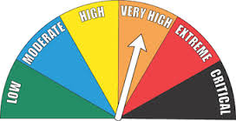
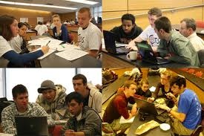
Two Types of Measures
Quantitative – move the needle on
Persistence
Retention
Completion
Qualitative – feedback from
Students
Stakeholders

Slide 28
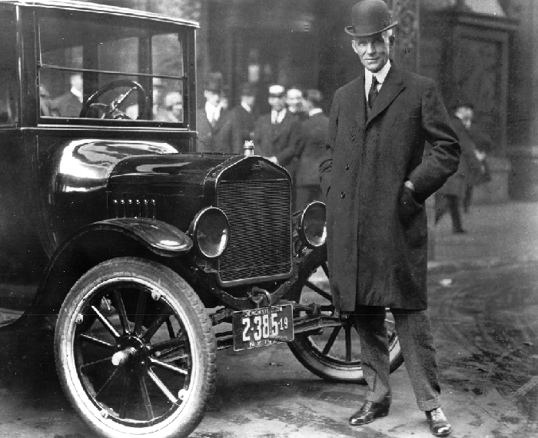
“If I had asked people what they wanted, they would have said faster horses.”
- Henry Ford

Slide 29
Finis
Move in any direction, as long as it’s somewhat positive!!!

